Slide 1
Addressing the System-on-a-Chip Interconnect Woes Through Communication-Based Design
Veronica Eyo
Sharvari Joshi
Notes:
Most embedded systems use the system on chip technology, which is the ability to place multiple function systems on a single silicon chip and integrating all components to improve functionality, performance and quality. The aim of this paper is to show that communications between components is as important as the computations that these components perform.

Slide 2
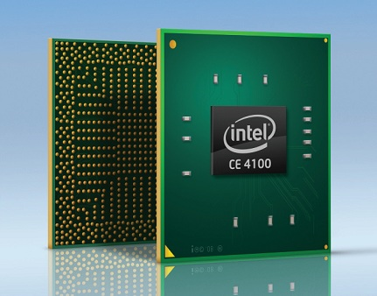
System on chip
Notes:
An atom ce4100 media processor designed for use in dvd players and HD media players.

Slide 3
Overview
Transition from Ad hoc System On Chip design to Platform based design
Partitioning the communication design into layers using the “network on chip” approach
Notes:
The overview of this paper is to describe tools and methodologies that help integrated circuit designers in the transition of adhoc soc to platform based design. Partitioning the system maximize reuse and provides the programmer with an abstraction of the underlying communication framework.

Slide 4
Platform based Design
Designed based on standards
A two stage process
More features are added on the platform
Essential elements of platform based design
Computation
Communication
The platform-based design addresses orthogonalization of concerns
Notes:
Orthogonalization guarantees that when a component is modified, the technical effect due to this modification should not create side effects for other components in the system.

Slide 5
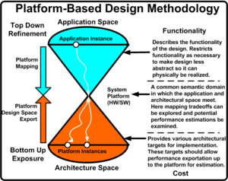
Platform based design

Slide 6
Challenges
Predictability
Wiring delay
Power dissipation
Diverse interconnect architectures
Notes:
The aim of circuit designers changing the design methodology from adhoc to platform design, is to try to find solutions to the challenges posed by ad hoc soc.
Predictability: it’s the ability of a system to give an expected performance within a time frame. This becomes a critical issue in soc design because the long wires connecting the components will create gate delay and propagation delay.
Wiring delay: explained above
Power dissipation: from our previous lectures we know that lots of wires leads to power consumption by the components in the system including clocks.
Diverse interconnect architectures; sharing a lot of resouses like buses , meshes etc becomes a challenge when the interconnect archiecture is complex.

Slide 7
The layered stack approach
describes protocol functions that operate on data units at different levels of abstraction
decomposition of the design problem into a set of simpler, tractable problems
simplifies the synthesis and validation tasks.
Notes:
Suitable for addressing on chip communication design hitches and is used to solve the challenges posed by adhoc soc. Siimilar to the osi model that describes protocols in networking, layering is used to……………………

Slide 8
Network on chip methodology
Brings networking methods to on chip communication
Can accommodate multiple asynchronous clocking
Brings notable improvements over conventional bus systems
Not an easy task, and may result in incorrect protocol
implementation
Notes:
Noc is a complex process!

Slide 9
Processor unit
cache
Router and control logic
Memory unit
Control unit
Notes:
The network-on-chip (NoC) design just shows the system on chip architecture for each slide. The functions of each unit has been explained by my collegue.

Slide 10
OSI Model Vs layer Stack Model
Application: exports functions defined at lower layers
Presentation: Converts different bytes ordering to the same format
Session: Synchronization system components
Transport: packets segmentation
Network: Data routing and congestion control
Datalink: Mac protocol, Time Division Multiplex Access
Physical: Bus width, signal voltages, timing, pulse shape
Notes:
Communication-based design uses the stack model as a tool to guide the decomposition of the design problem. The layered approach of OSI Model is a useful method for structuring and organizing a protocol at an early stage of the design process. This diagram just shows the on chip examples given for each layer of the OSI model.

Slide 11
Example: The Pleiades platform
Collection of satellites such as ALUs, memories, FPGAs
Satellites are analogous to a set of Ips in SOC
The computation at each satellite is arbitrary because each is wrapped in an inter-satellite communication interface.
This interface is actually the physical layer in the NOC framework
Notes:
An example of the NOC . It just shows how noc layers of abstraction are used in existing designs. Each link in its architecture is error free so it doesn’t need a datalink layer. Its energy consumption is predictable.
Its in the network layer that this architecture is novel. A network connection is set up at a reconfigurable time and is rewired everytime the new task is overlaid on the configurable fabric.

Slide 12
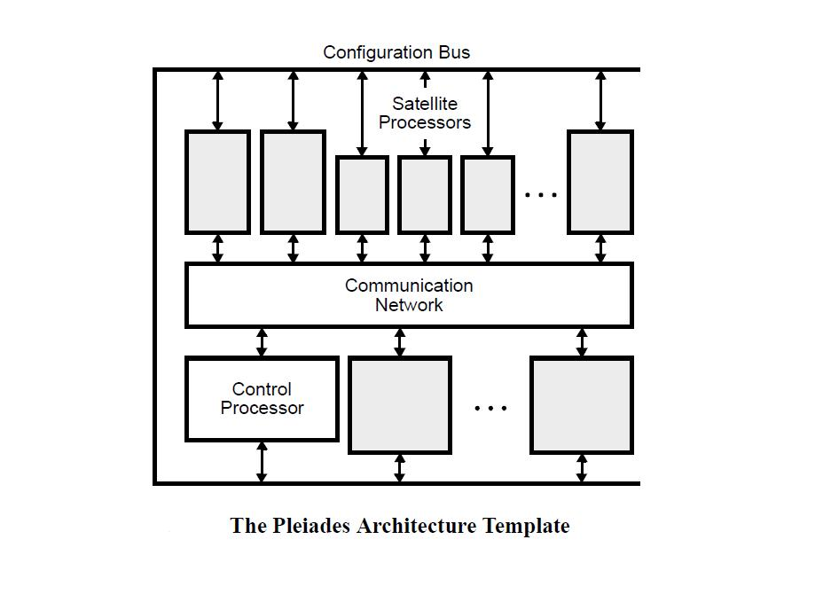
Notes:
The architecture template consists of a control processor, a general-purpose microprocessor core, surrounded by a heterogeneous array of autonomous, special-purpose satellite processors. All processors in the system communicate over a reconfigurable communication network
that can be configured to create the required communication patterns. All computation and communication activities are coordinated via a distributed data-driven control mechanism.

Slide 13
The Metropolis Methodology
Describes the blocks that perform computations
Layers of the protocols only encapsulate the original computation cores without changing their internal structure.
Constraints such as power, number of errors, delay are propagated (e.g. through budgeting) at each design step
Notes:
Behaviour adaptation; for 2 behavioural objects to communicate, there must be an agreement on semantics and syntax. Like 2 processes that are connected. An objectmaps signals from one domain to another must be put between them.
Encapsulaton:merging the object with the process.
Channel selection, a physical channel such as wires, bus or network. Each channel is defined by a set of ppties such as error rate, bandwidth n a set of interfaces that their processes can access.
Channel adaptation; then the designer must select a model of computation that defines the firing rules. It is necessary to introduce adapters like encoding n retranmission functions if the channel is error prone n unreliable.
Optimization is just simply merging the adapters with the communication process.

Slide 14
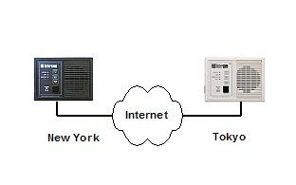
A metropolis example: Intercom
segmentation
MAC and TDMA
Refinement
Notes:
Intercom mobile terminal that supports voice communication over wireless lans.
The goal of this design is to allow embedded processor, custom logic and memory to communicate on the chip.
In the 1st adaptation step, a block performing segmentation and reassembly of data is introduced
Then a mac adapter is also introduced to arbitrate the access to the shared medium
Refinement is finally put at each reciever to determine the destination of the packet

Slide 15
Conclusion
Network on chip approach will lead to dramatic changes in how system on chips will be constructed in the next decade.

Slide 16
References
W. J Dally, B. Towles, Route packets, not wires:
on-chip interconnection network, DAC, 2001,
pp. 684– 689.
A. Sangiovanni-Vincentelli, Addressing the System-on-a-Chip Interconnect Woes
Through Communication-Based Design, DAC 2001, pp. 667 –672.
J. Xu, W. Wolf, Wave Pipelining for Application-Specific Network-on-Chip,
International Conference on Compilers, Architecture, and Synthesis
for Embedded Systems, 2002

Slide 17
Thank you!

