Slide 1
Towards a Self-Reconfigurable Embedded Processor Architecture
Shady O. Agwa, Hany H. Ahmad, Awad I. Saleh
Wen-qian Wu
EEL 6935

Slide 2
Contents
1
Background Introduction
2
Self-reconfigurable Architecture
3
Xtensa Acceleration Technique
4
Runtime Profiling
5
Experiment and result
6
Conclusion

Slide 3
Traditional Processor
Embedded processors with fixed architecture have
disadvantages:
Not reusable
Not flexible enough to match the specific needs of different application domains
Acceleration technique is adding fixed hardware units:
e.g. JPEG encoder/decoder
However, insufficient or useless for other applications;
hardware overhead: area, power

Slide 4
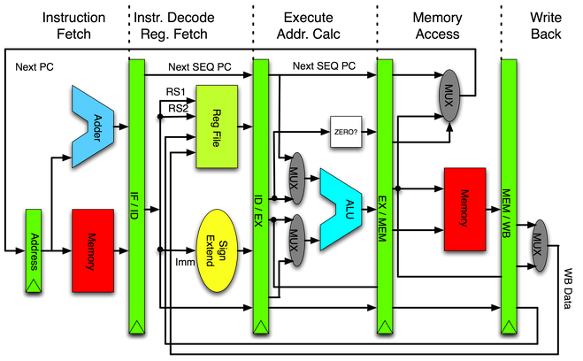
Self-reconfigurable architecture
Self-reconfigurable architecture
The architecture is extended from simple RISC core by adding new acceleration units built on a reconfigurable fabric
The execution units can be reconfigured or replaced at runtime
Simple RISC processor core

Slide 5
Self-reconfigurable architecture
ADDI R1, #E1
ST R2, [R1]
AVARAGE R3, R4, R5
…
…
…
Alternative exe unit
ADDI R1, #E1
ST R2, [R1]
AVARAGE R3, R4
General overview of the processor architecture
Notes:
Since traditional processors have been extremely difficult and time consuming to design and modify; and since our main objective at this stage is to study the characteristics of different profiling and acceleration techniques; we decided to use Tensilica’s Technology Tools

Slide 6
Tensilica Tools
Tensilica
Tensilica is an IP core company based in Silicon Valley.
Tensilica is best known for its Xtensa tool-generated microprocessor
cores that are particularly configurable and able to be extended.
Tensilica also offers a Diamond product line of less configurable processor and software IP for audio and video encoding and decoding.
Xtensa LX2 processor core
Highly efficient, small, low-power base 32-bit modern architecture
Extend processor with application-specific instructions, execution units, and register files
Unlimited I/O bandwidth with designer-defined FIFO, GPIO, and Lookup interfaces
Automated fine-grained clock gating for ultra-low power
Designer-selectable 5- or 7-stage pipeline depth
Automatic synthesis of processor configurations and extensions with XPRES™ Compiler
Local memories configurable up to 4MB with the option for parity or ECC
Modelessly intermix 24-bit base ISA instructions with 16-bit narrow instructions and VLIW instructions
Notes:
搭积木：build with blocks

Slide 7
Tensilica Tool
Xtensa LX2 core
Notes:
The Xtensa LX2 architecture starts with base ISA features. SOC developers can configure the Xtensa LX2 processor from menus of predefined options and add functional units of their own design to optimize algorithm performance, achieving designs equivalent to hand-coded custom logic blocks in a fraction of the time.

Slide 8
Tensilica Tools
Two essential unique features:
Configurability
designer is offered a menu of checkbox and drop-down menu options.
For example, the designer can choose to have execution units such as a 16x16 multiplier, a floating-point unit, a barrel shifter, etc.
Extensibility
enables the designer to add multi-cycle execution units, registers, register files, FIFO interfaces, general purpose IO (GPIO) pins, single-instruction multiple-data functional units, or even make the basic RISC pipeline into a multi-issue VLIW (very long instruction word) processor.
Notes:
Tensilica is an IP core company based in Silicon Valley. Tensilica is best known for its Xtensa tool-generated microprocessor cores that are particularly configurable and able to be extended. Tensilica also offers a Diamond product line of less configurable processor and software IP for audio and video encoding and decoding.
搭积木：build with blocks

Slide 9
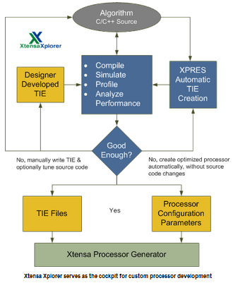
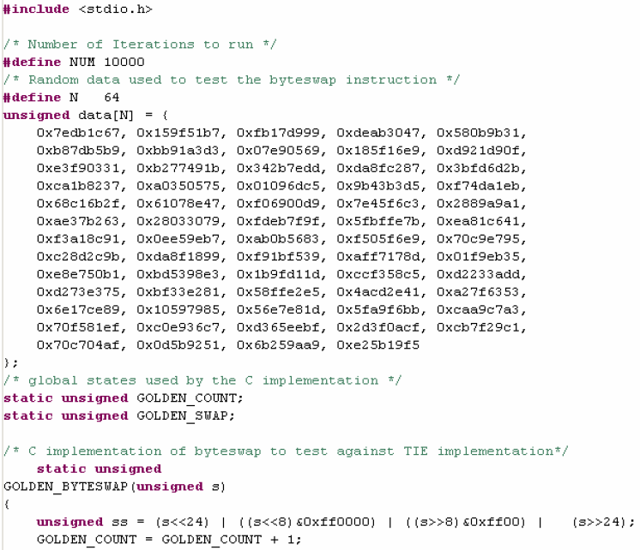
Tensilica Tools
Xtensa design flow
Why acceleration from designer-defined extension ?

Slide 10
Xtensa Acceleration Techniques
Fusion
Consider a simple example:
The above C code adds two short data items and shifts the sum right by 1 bit in each loop iteration.
Two base instructions are required for each computation
These two operations can be fused into a single TIE instructions described as TIE language:
operation AVERAGE {out AR res, in AR input0, in AR input1} {} {
wire [16:0] tmp = input0 [15:0] + input1 [15:0];
assign res = tmp [16:1];
}
C or C++ program uses the new AVERAGE instruction as follows:
Assembly code can also directly use the AVERAGE instruction. The entire software tool chain recognizes AVERAGE as a valid instruction for processors built using this TIE extension.

Slide 11
Xtensa Acceleration Techniques
SIMD
SIMD instructions perform multiple loop iterations simultaneously by performing parallel computations on different data sets during the execution of one instruction.
Consider a case where a TIE instruction computes four AVERAGE operations in one instruction:
This new instruction, VAVERAGE, takes two 64-bit operands (each containing four 16-bit scalar quantities) from the VEC register file, computes four simultaneous averages, and saves the 64-bit vector result in a VEC register-file entry.
Notes:
the Xtensa processor generator automatically creates new load and store instructions to move 64-bit vectors between the VEC register file and memory.

Slide 12
Xtensa Acceleration Techniques
FLIX Instruction
Xtensa FLIX instructions are multi-operation instructions that allow a processor to perform multiple, simultaneous, independent operations by encoding the multiple operations into a wide instruction word (similar to VLIW).
FLIX instructions are either 32 or 64 bits wide, to provide enough instruction-word bits to fully describe the multiple independent operations.
Consider again the AVERAGE example. Using base instructions, the inner loop contains the ADD and SRAI instructions to perform the actual computation. Two L16I load instructions and one S16I store instruction move the data as needed and three ADDI instructions update the address pointers used by the loads and stores.
A 64-bit FLIX instruction format with one operation slot for the load and store instructions, one slot for the computation instructions, and one slot for address-update instructions can greatly accelerate this code as follows:
Generated assembly code for the loop:
Notes:
1. The first declaration creates a 64-bit instruction and defines an instruction format with three operation slots.
2. The last three lines of code list base ISA instructions that are to be available in each slot defined for this FLIX configuration.
3. A computation that requires eight cycles per iteration on a base Xtensa processor now requires just three cycles per iteration, which is nearly a 3x performance increase.

Slide 13
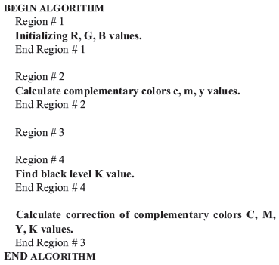
Benchmark
RGB to CMYK Conversion
This benchmark provides opportunities for full-fury
benchmark optimization.
used for digital image processing in color printers and
other digital imaging products.
This is a very expensive routine that can be repeated many times for the same number of input pixels, and its processing time is almost linearly proportional to the number of input pixels
Notes:
CMYK: Cyan, magenta, yellow, and key (black).

Slide 14
Prepared Acceleration Units
General | Special
Load 128-bit | Region1 (RGB_init)
Store 128-bit | Region2 (CMY_calc)
Load 32-bit | Region3 (Correction)
Store 32-bit | --
TIE HARDWARE

Slide 15
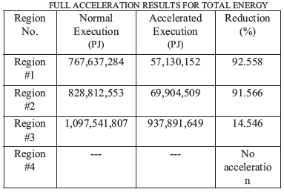
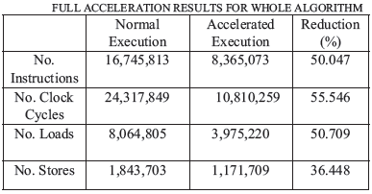
Test result

Slide 16
Profiling
Run-time profiling importance
It provides the processor with the necessary flexibility to determine, at runtime, which regions of the running algorithm need to be accelerated and which regions do not.
Without runtime profiling there would be no means to use the hardware acceleration units judiciously
Two profiling techniques
Preparation mode profiling
A “preparation run” precedes normal execution. In preparation mode, the processor starts profiling the algorithm to identify critical regions that need acceleration.
The processor will then generate the required acceleration units and switch to normal execution.
Pessimistic runtime profiling

Slide 17
Pessimistic runtime profiling – cont.
Pessimistic runtime profiling
The processor will start at “full throttle” and consider all blocks of instructions to be critical regions that need to be accelerated.
This fully accelerated run will be done only once and runtime profiling will provide the processor with sufficient data to identify the real critical regions that truly need acceleration.
In the next phase of execution, all unnecessary acceleration units will be removed, and profiling will continue collecting data about the new critical regions during the full execution life time of the algorithm.
If the processor is pessimistic, it will not have to wait for results and decisions from the preparation phase, leading to execution-time and often power savings.

Slide 18
Runtime Profiling Result
5 cases in the runtime profiling test:
 | # clock cycles | # Instructions
Case 1 (normal execution without acceleration) | 121,579,398 | 83,723,913
Case 2 (fully accelerated execution without runtime profiling) | 54,041,448 | 41,820,213
Case 3 (Accelerated execution with preparation mode profiling) | 94,495,104 | 69,422,774
Case 4 (Accelerated execution with pessimistic runtime profiling) | 65,034,008 | 49,068,578
Case 5 (Accelerated execution with pessimistic runtime profiling, with a change in threshold values to take into the consideration of the additional area cost) | 69,949,063 | 52,754,908

Slide 19
Acceleration Techniques
In Case # 3, only a modest execution time reduction was achieved. This can be attributed to the fact that the preparation phase represents an overhead that is not effectively compensated for by the acceleration used in the following execution phase.
Pessimistic Runtime Profiling (Case # 4) achieves a significant execution time reduction of just over 46% which is twice that of Case # 3. This is a result of employing all the acceleration units in the first phase so that profiling data can be obtained and the associated decisions to remove unnecessary acceleration units can be made faster.
Case # 5 also uses Pessimistic Runtime Profiling but attempts to strike the balance between the performance gain in terms of speedup and the penalty inflicted in terms of the extra area consumed. Noting that acceleration of Region # 3 is area consuming yet its speed gain is comparatively low, we set the threshold for this region to be accelerated only in cases with greater than 320x240 input pixels.

Slide 20
Conclusion
combining coarse grained acceleration with runtime profiling is a valid approach to achieve significant speedups at moderate area expense.
able to avoid the “slow startup” associated with preparation mode profiling by making the processor act pessimistically in the first execution phase by turning on all the acceleration units.
Runtime profiling can be done by a completely separate hardware unit to avoid increasing the number of instructions executed by the normal execution units of the processor (undergoing).
Building and evaluating the reconfiguration unit (next major step)

Slide 22
Reference
[1] Hamid Noori, Kazuaki Murakami, and Koji Inoue “An Adaptive Dynamic Extensible Processor,” in Conf. Rec. 2005 IEICE General Conference, CPSY2005-29(2005-12).
[2] Lars Bauer, Muhammad shafique, Dirk Teufel and Jorg Henkel, “A Self-Adaptive Extensible Embedded Processor,” in Conf. Rec. 2007 IEEE Int. Conf. SASO '07. First International Conference, pp. 344-350.
[3] MIPS Architecture, http://en.wikipedia.org/wiki/MIPS_architecture.
[4] Tensilica Tools, Tensilica Inc: http://www.tensilica.com/.
[5] Xia, Chen and Zhang, Qi, “H.264 Decoder Tensilica Configurable Embedded Processor Implementation”, December 19, 2008. Web document found at: http://www.ee.hawaii.edu/~xrzhou/ee693e/slides/final_project.pdf.
[6] EEMBC Software Benchmark Data Book, http://www.eembc.org/.
[7] Steven Leibson, Tensilica Inc, “Customizable Processors and Processor Customization,” in Processor Design: System-on-Chip Computing for ASICs and FPGAs, J.Nurmi (ed.), ©2007 Springer. Ch. 8, pp. 149-175.

