Slide 1
Presented by:
Mohamad Hammam Alsafrjalani
System Level Hardware/Software Partitioning
Based on Simulated Annealing and Tabu Search
UFL ECE Dept.

Slide 2
Outline
15 minutes break
Introduction of the challenge
Overview of heuristics
Implementation and modification
Comparison of the two approaches
Conclusion

Slide 3
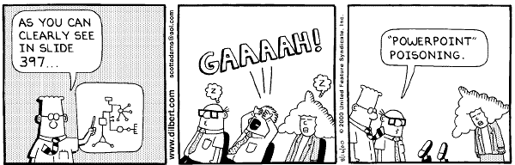
Introduction
Our goal is not to

Slide 4
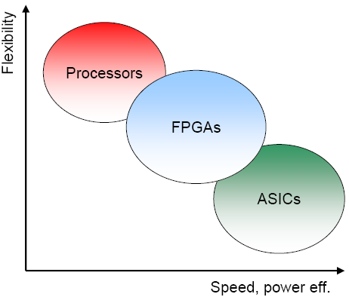
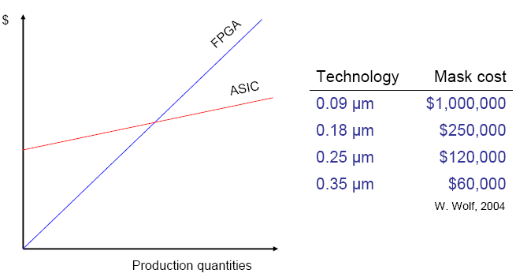
Introduction
Many embedded systems have strong requirements concerning the expected performance
  Solution—1: application specific systems such as
    Application specific integrated circuits (ASIC)
    Application specific instruction processor (ASIP)
    Problem: very expensive
  Solution—2: FPGA’s
    Problem: still is not the optimal solution
      FPGA for I/O operations?

Slide 5
Today’s challenge
  Solution—3: hybrid systems (SW/HW)
    Ex: Super computing: CPU controls multiple FPGA platforms
    Ex: Embedded systems: Software radios
    Problem: huge exploration space, long time to market (SW/HW developed separately), less reliability
  The challenge:
    How can we partition the system into HW & SW regions to gain the best speedup at minimum overhead
    Areas of challenge (what factors into your cost function)
      Area, power, $$, and code overhead
      Minimize communication between HW/SW domains
      Increase parallelism

Slide 6
Hw-sw partitioning co-design challenges
System specification and modeling
Co-simulation
Partitioning
Synthesizing
Verification
Performance and cost estimation

Slide 7

Partitioning
Determining which module to run on sw/hw
Has crucial impact on system performance
  Matrix multiply can take 1 cycle in hw*
Critical cost factor
  Silicon, sw/hw-dev & engineering costs
  Power and energy costs
But, as mentioned, huge exploration area

Slide 8
Partitioning –Challenges
Granularity
Evaluation
Alternative region implementations
Implementation models
Exploration

Slide 9
Granularity
How big/small is each area
Coarse grained:
  Simple partitioning, less inter-partition communication, more accurate estimation
Fine grained:
  More complex, more communication, harder to estimate
  Provides a better solution

Slide 10
Coarse Grained
Example
  Main (){
    Function 1
      Function 1-a
      Function 1-b
      Function 1-c
    Function 2
      Function 1-a
      Function 1-b
      Function 1-c
  …
  }
HW
SW

Slide 11
Fine Grained
Example
  Main (){
    Function 1
      Function 1-a
      Function 1-b
      Function 1-c
    Function 2
      Function 1-a
      Function 1-b
      Function 1-c
  …
  }
HW
SW
HW
HW
SW
HW

Slide 12
Evaluation, Alternative Region Implementations & models
Evaluation: : How good is a given partition
  Based on the cost function
    Power consumption, heat dissipation, speedup, etc
Alternative Region Implementation
  There could be more than one way to implement a given region in sw or hw.
    Colum vs. row major ordering in loops
Implementation models
  How do we implement our system
    Execution, trace, communication

Slide 13
Exploration–very big area to explore
If a problem has a polynomial solution in the form of O(n), O(n2), O(n3), etc. Then it is a (P) problem
If the solution can’t be determined, then its called (NP) problem (nondeterministic polynomial time); doesn’t mean not-polynomial
HW/SW partitioning is an NP problem

Slide 14
Exploration—example
How huge is huge?
Example:
  How many possible ways are their to realize 45 functional units in hw or sw?

Slide 15
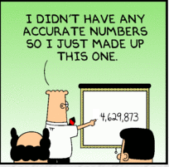
Partitioning
Actually 35x10^12

Slide 16
Practical approach
Do we implement all possibilities to evaluate performance?
  No
Do we accept a random partition?
  No
Then?
  We use heuristics to get close to a good enough partition

Slide 17
Possible Heuristics
The most common ones are those based on neighborhood search
  Hill climbing
  Simulated annealing
  Tabu search

Slide 18
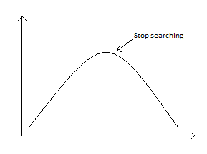
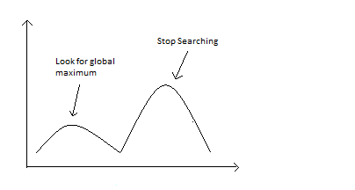
Possible Heuristics
Use a heuristic to find a possible good solution
  Hill climbing
  Simulated Annealing
  Tabu Search
Very similar to SA but more complicated algorithm
  Keep searching until
  next value < current value
  If next < current, keep trying, for some limit
(+)Very fast, (-) stuck at local peaks
(+) Can find near optimal solution, (-) takes longer, very sensitive to initial state

Slide 19
Simulated Annealing (SA)
Name inspiration: from annealing in metallurgy
  Searching for a better state than the current state
Very common, why?
  Can be quickly implemented
  Widely applicable to many different problems
Disadvantage
  Takes a long execution time
  Amount of experiments needed to tune the algorithm

Slide 20
SA – Basic Algorithm
Starts with an initial ‘best state’
Selects neighboring solution randomly
Accept an improved solution
  Replace initial ‘best’ state with this ‘better’
Accepts a worse solution with a certain probability that depends on the deterioration of the cost function and on a control parameter called temperature
  Repeat until probability (temperature) is very small (cold)

Slide 21
SA – Improved Algorithm
Solution space (hw-sw areas/modules/functions)
Two ways:
  Simple move
    Move one node from one domain into another
  Improved move
    Move the node and its direct neighboring at the same time
    Reduces the spectrum of visited solutions
Moves are repeated (another neighboring solution) if it violates constraints

Slide 22
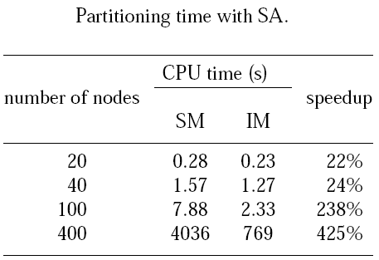
SM vs. IM – Experimental Results
Exploration with improved moves reaches the optimal partitioning faster
Table summarizes simple and improved moves times and speed up of IM to SM

Slide 23
Questions?

Slide 24
Tabu Search (TS)
Name Inspiration: from a ‘taboo’/prohibited list
Uphill moves are not purely random
Saves searching history
  Maintains a search list called Tabu list
  Doesn’t repeat explored areas and their evaluations
  Provides a better diversity of solutions

Slide 25
TS – Memories
Short term memory, contains a tabu list of information relative to the most recent history of the search. It is used in order to avoid cycling that could occur if a certain move returns to a recently visited solution.
Long term memory, stores information on the global evolution of the algorithm.
Long and short memory lists are used for Diversification. Diversification meant to improve exploration of the solution space by broadening the spectrum of visited solutions.

Slide 26
TS – Algorithm
1-Define an initial solution
2-If stopping condition is not met
  Identify neighboring set N(s)
  Identify Tabu set T(s)
  Identify Aspirant set A(s)
  Choose the best in N(s): N(s,k) = {N(s) - T(s,k)}+A(s,k)
  Memorize s’ if it improves the previous best known solution
  s := s’.
  k := k+1
3-END

Slide 27
TS – Diversification
Improve the searching strategies by:
  Node moves are ordered according to a penalized cost function which favors the transfer of nodes that have spent a long time in their current partition
  A move is considered tabu if the frequency of occurrences of the node in its current partition is smaller than a certain threshold
  If the system is frozen a new search can be started from an initial configuration which is different from those encountered previously

Slide 28
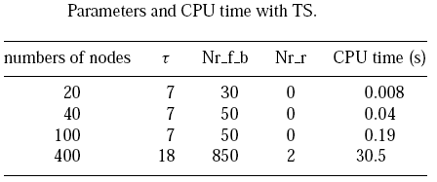
TS –Experimental Results
The minimal values needed for an optimal partitioning of all graphs of the respective dimension and the resulted CPU times. The times have been computed as the average of the partitioning time for all graphs of the given dimension.
Restarting tours were necessary only for the 400 nodes graphs.
Tao: Tabu Tenure
Nr_f_b: Number of iterations without improvement of the solution after which the system is considered frozen
Nr_r: Number of restarts with a new initial configuration

Slide 29
SA vs. TS
1) Near-optimal partitioning can be produced both by the SA and TS based algorithm
2) SA is based on a random exploration of the neighborhood while TS is completely deterministic
The deterministic nature of TS makes experimental tuning of the algorithm less laborious than for SA
3) SA strategy for a particular problem is relatively easy and can be performed without a deep study of domain specific aspects. Although, specific improvements can result in large gains of performance.
Development of a TS algorithm is more complex and has to consider particular aspects of the given problem.
* Bases on the paper

Slide 30
SA vs TS
4) TS performance are superior to those in SA (on average more than 20 times faster)
5) TS based hardware/software partitioning approach has yet been reported, while SA continues to be one of the most popular approaches for automatic partitioning.
* Bases on the paper

Slide 31
Conclusion
Embedded systems has strong requirements of performance
  Those can be realized in ASIC’s, ASIP’s, FPGA, Hybrid, etc
Hybrid Systems impose a new challenge: HW/SW co-design aspects (co-simulation, partitioning, etc)
Partitioning has its own challenges: (Granularity, evaluation, alternative region implementation, models, and exploration)
Exploration is remedied by heuristics such as SA & TS
TS & SA each has its own advantages and disadvantages

Slide 32

Questions?

Slide 33
References
Mastrolilli M., Tabu Seach, Dalle Molle Institute for Artificial Intelligence
  http://www.idsia.ch/~monaldo/tabusearch.html
Kimmo Järvinen, DI., FPGA’s Helsinki University of Technology http://www.automationit.hut.fi/file.php?id=787
Stitt, G., HW/SW paritioning, University of Florida
http://www.gstitt.ece.ufl.edu/
ELES, KUCHCINSKI, PENG, DOBOLI, System Level Hardware/Software Partitioning Based on Simulated Annealing and Tabu Search

