Slide 1
Comparing Three Heuristic Search Methods for Functional Partitioning in Hardware-Software Codesign
Theerayod Wiangtong, Peter Y. K. Cheung and Wayne Luk
Presented by: Wei Zang
Mar.17, 2010

Slide 2
Outline
Introduction of HW/SW partitioning
Heuristic Search Methods
Genetic algorithm
Simulated annealing
Tabu search
Processing time – System cost
Experiment results
Conclusions

Slide 3
Outline
Introduction of HW/SW partitioning
Heuristic Search Methods
Genetic algorithm
Simulated annealing
Tabu search
Processing time – System cost
Experiment results
Conclusions

Slide 4
Introduction of HW/SW partitioning
Common case
Implement performance critical code in FPGA
Implement everything else on microprocessors
Definition
Given an application, hw/sw partitioning maps each region of the application onto hardware (custom circuits) or software (microprocessors) under design constraints
Possible Goals
Meet design constraints (performance, power, size, cost, etc.)
Maximize performance
Minimize power for a given performance constraint
Exploration searches partition space for a optimal partition
NP complete/NP hard(Reconfigurable hardware) problem
Heuristic method to generate near-optimal solution

Slide 5
Outline
Introduction of HW/SW partitioning
Heuristic Search Methods
Genetic algorithm
Simulated annealing
Tabu search
Processing time – System cost
Experiment results
Conclusions

Slide 6
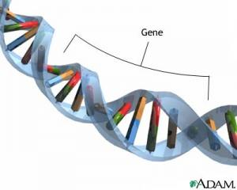
Genetic Algorithm
Based on Darwinian natural evaluation and selection. Solve optimization problems (Video)
Four main operations:
Evaluation
Use fitness function
Selection
Select the parents to breed a new generation
Features in parents represented by chromosome, made by genes. Each capture a desirable features
Crossover
Randomly divide each parents chronmosome into two sets of geanes and then mix them – help to transmit good features into next generation
Mutation
Occasionally modify a gene
To avoid being trapped in local minima

Slide 7
Begin
The number of genes in a chromosome of each individual is equal to the number of tasks or functional blocks
A gene is encoded as “0” if the task is implemented in software; “1” if it is mapped to hardware
Get input parameters:
pop size, # generations
Initialize population
Evaluation
Cal cost fun and fitness fun
Selection
Crossover
Mutation
Reach # of desired generations
End

Slide 8
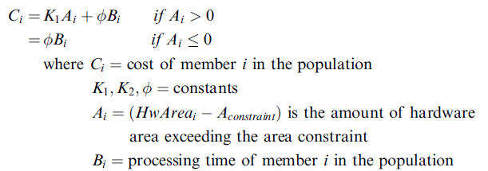
Fitness function
Define the cost of the number:
Fitness
Crossover
Two surviving parents generate two children to maintain population size
Mutation
Randomly flipping individual bits in the child chromosome with a small probability value(less than 0.01)

Slide 9
Simulated Annealing
Search feasible solutions in optimization problems (video)
Can avoid being trapped in local minima
Hill-climbing algorithm always choose the best solution in the neighborhood, miss better solution further away
SA accepts an inferior solution in the neighborhood according to an acceptance probability function
Annealing process
The acceptance probability function is set high at the beginning
Gradually reduced to zero
Cooling schedule
Predefined threshold, a solution is arrived
Too fast, algorithm stop early at some local minimum
Too slow, algorithm jump more or less randomly for a long time before settling to a solution

Slide 10
Begin
Cooling schedule
Neighborhood search: randomly changing one state bit in the solution (and obey the area constraint)
Cost is a direct function of processing time
Acceptance probability for a more costly neighboring solution:
Loop terminate when
New temperature reaches Tstop
No improvement over the last 500 iterations.
Get input parameters:
Tstart, Tstop, area constraint
Initialized solution (Snow)
Generate a neighboring solution (Sneigh) randomly
Compare diff of cost function
Dcost = cost(Sneigh)–cost(Snow)
q= random(0,1)
Dcost < 0?
q<exp
(-Dcost/T)?
Snow=Sneigh
Update temp use cooling schedule
Meet terminating condition?
End

Slide 11
Outline
Introduction of HW/SW partitioning
Heuristic Search Methods
Genetic algorithm
Simulated annealing
Tabu search
Processing time – System cost
Experiment results
Conclusions

Slide 12
Reference architecture
Shared memory
Software processor
Hardware ASIC/FPGA
shbus
swbus
hwbus
Timing model
Communication time
Execution time on HW/SW
Configuration time if reconfigurable HW
Only consider ASIC or FPGA without reconfiguration (all hardware tasks are bounded to on-chip hardware)
Execution on SW & HW
SW processor can execute only one task at a time
HW can execute multiple tasks concurrently;
HW and SW can work in parallel
Transmit data between tasks can only use read or write shared or local memory
Memory acts like a medium; Prevent loss of data while waiting
Bus conflicts -> waiting time
SW tasks have higher priority in using shared bus since hardware is generally faster
One has the minimum use of bus is allocated first
Local
memory
Shared memory

Slide 13
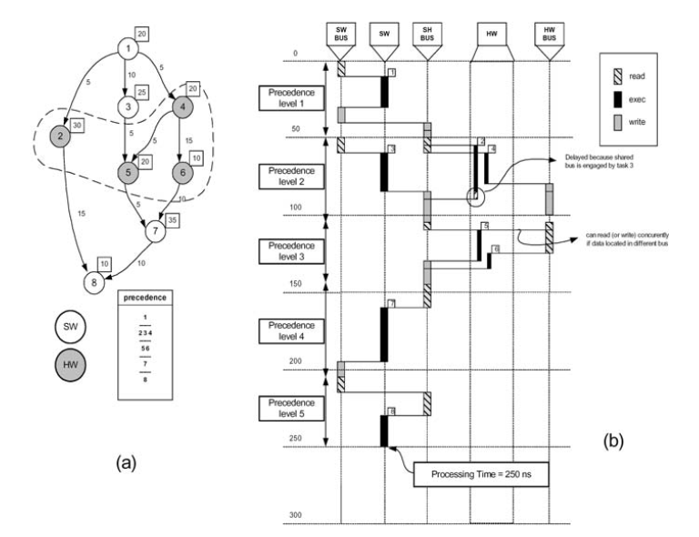
Example
Processing time: Sum the worst-case time at each precedence level

Slide 14
Outline
Introduction of HW/SW partitioning
Heuristic Search Methods
Genetic algorithm
Simulated annealing
Tabu search
Processing time – System cost
Experiment results
Conclusions

Slide 15
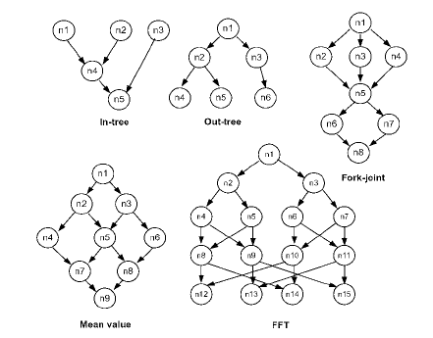
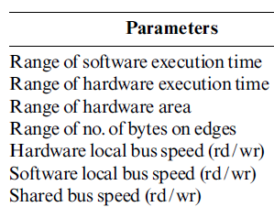
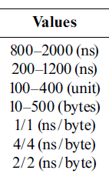
Experimental setting
Input parameters for each algorithm are carefully selected by several pre-simulations to get the most promising value
Test on randomly generated task graphs with a uniform distribution and commonly encountered structures
Parameters used

Slide 16
Experimental results
TS provide the shortest processing time and the lowest search time
SA is better than GA in most cases

Slide 17
Outline
Introduction of HW/SW partitioning
Heuristic Search Methods
Genetic algorithm
Simulated annealing
Tabu search
Processing time – System cost
Experiment results
Conclusions

Slide 18
Conclusions
Combines HW/SW partitioning and scheduling to minimize processing time
Compare three popular optimization algorithms
Genetic algorithm – demands more memory to stoe information of large number of solutions
Simulated annealing – better than GA in most cases; more memory efficient
Tabu search – provides higher quality results in shorter time than both GA and SA; more memory efficient
Future work
Now only use simulated inputs in task graphs
Need to be verified on real hardware-software systems by using realistic benchmarks

