Slide 1
HW/SW Co-Design
Mingwei Liu
Varun Mathur

Slide 2
A System Architecture Exploration on the Configurable HW/SW Co-design for H.264 Video Decoder
Guo-An Jian, Jui-Chin Chu, Ting-Yu Huang, Tao-Cheng Chang, and Jiun-In Guo
Department of Computer Science and Information Engineering, National Chung Cheng University, Chia-Yi, Taiwan, R.O.C.

Slide 3
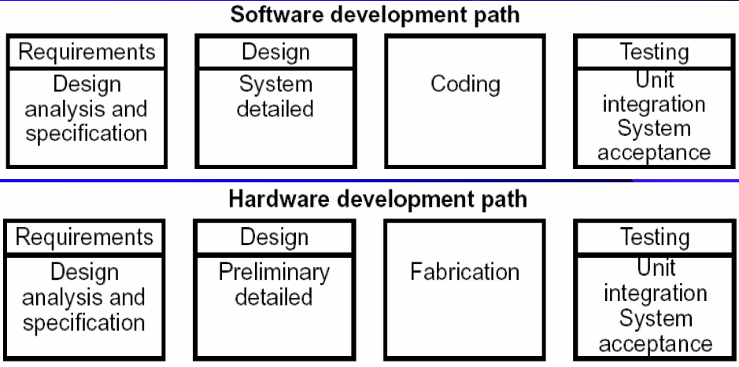
Model of design in old days

Slide 4
Facing Problems
Partitions based on old experience
Cannot verify the whole system
Incompatible at the boundary of HW and SW
Lack of mature design process
Hard to estimate the time to market

Slide 5
Contemporary way

Slide 6
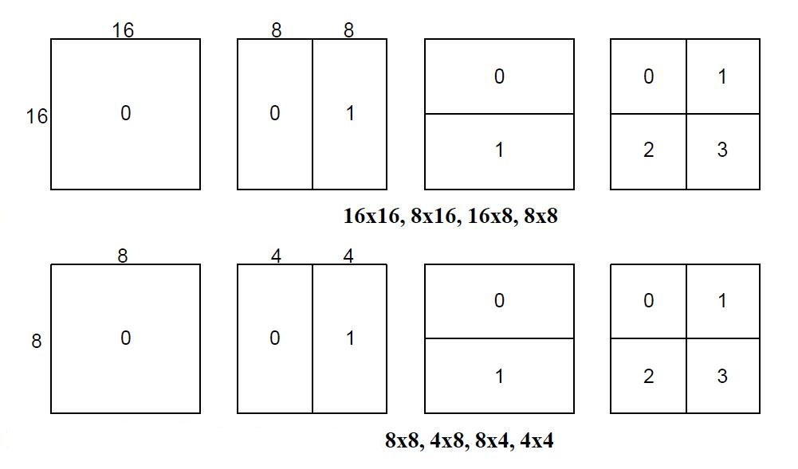
H.264 Encoding and Decoding
Slice: an independent encoding unit
Macroblock: each slice contains several marcoblocks
Blocks: one macroblock can be divided into several blocks

Slide 7
Process of H.264 encoding and decoding
IPPPPPPPPP

Slide 8
Two Old Solutions and One New
ASIC (Application Specific Integrated Circuit): limited by inflexible hardware structure
Processor-based: Lack of computation power and cannot achieve real time requirement
DEM (Data Exchange Mechanism) controller: focus on the exploration of memory access requirement for different software/hardware partitions in an application-specific processor architecture.
It is more flexible than ASIC solution and more efficient than the processor-based solution for H.264 video decoder.

Slide 9
DEM Controller
serves as the bridge between the software (tasks executed in processors) and the hardware accelerators.
DEM controller is the only one master in the architecture and the other hardware accelerators are all slaves.
users can add or delete hardware accelerators easily since there is no data dependency among hardware accelerators.

Slide 10
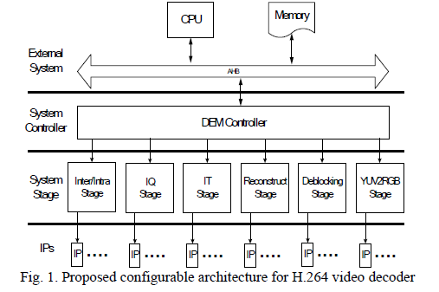
DEM Controller
Parallel processing will be carried out because each stage of the macroblock can execute its computation concurrently with the stages of other macroblocks.

Slide 11
Outline of the paper
Explore the memory access bandwidth requirement, in order to minimize memory bandwidth cost.
Explore different software/hardware partitions adopting a DEM (Data Exchange Mechanism) controller to fit the best tradeoff between performance and cost when realizing H.264 video decoder.

Slide 12
Intra Prediction

Slide 13
Intra Prediction
In the first solution, we get all the reference data from the external memory.
In the second solution, we get all the reference data from the internal memory
In the third solution, we get the reference data of the left macroblock from the internal memory and get the upper reference data from the external memory

Slide 14
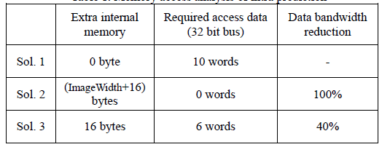
Intra Prediction
solution 3 is a better method among them under the consideration
between cost and performance.

Slide 15
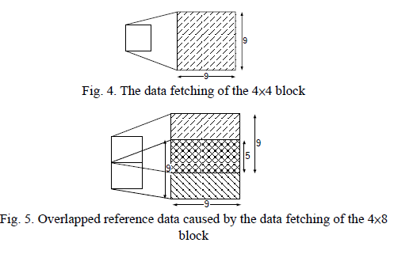
Inter Prediction
16×16, 16×8, 8×16, 8×8, 8×4, 4×8, 4×4
21×21, 21×13, 13×21, 13×13, 13×9, 9×13, 9×9

Slide 16
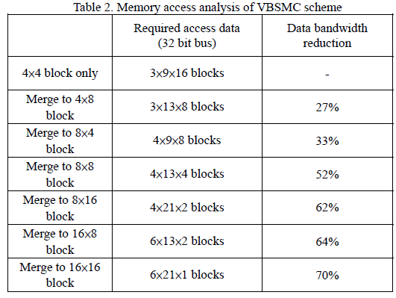
Inter Prediction

Slide 17
Deblocking Filter
1st solution all the reference data from the
external memory
2nd solution all the reference data from the
internal memory
3rd solution get the reference data of the left
macroblock from the internal memory and get the reference data of the upper macroblock from the external memory

Slide 18
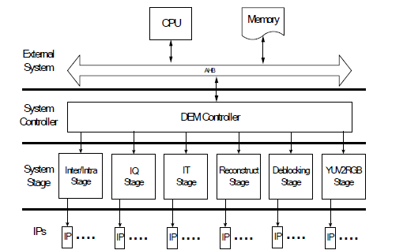
Configurable Architecture for H.264 Video Decoder

Slide 19
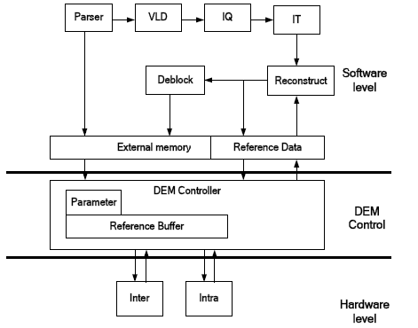
Partition 1
According to the complexity profiling of H.264 decoder, we refer the intra prediction and inter prediction to the hardware part since they occupy the most part of computation.

Slide 20
Partition 2
Based on partition 1, we add the second most part of computation, i.e. deblocking, into the hardware part in partition 2.
The most important issue of partition 2 is the data exchange between the external memory and the internal memory.

Slide 21
Partition 3
In partition 3, we consider about the memory access of Deblock IP so that we move Deblocking to the software part andadded IQ and IT into the hardware part.

Slide 22
Partition 4
In partition 4, we add most components into the hardware part except VLD.
This partition has the most hardware accelerators and the maximal size of the internal memory.

Slide 23
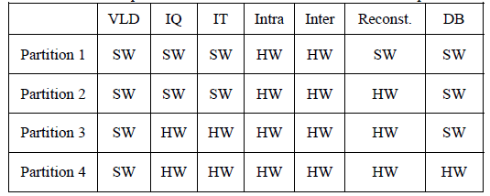
Summary

Slide 24
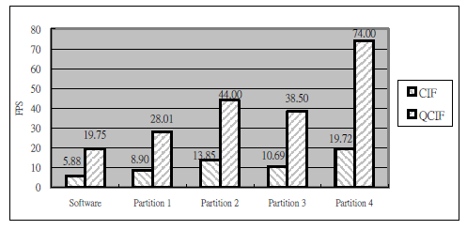
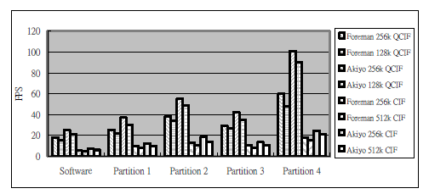
CONCLUSION
In this paper, we explore memory access bandwidth and different software/hardware partitions for H.264 video decoder and propose a configurable architecture adopting the DEM (Data Exchange Mechanism) controller. The proposed architecture can achieve more than three times acceleration in performance.

Slide 25
Hardware/software architecture of an algorithm for vision-based real-time vehicle detection in dark environments
Nicolas Alt, Christopher Claus, Walter Stechele Technische Universitat Munchen, Munchen, Germany

Slide 26
Why Hardware/Software Codesign ?
Software is flexible but slow.
Hardware is fast but inflexible.
Therefore a combined approach offers the advantages of both.

Slide 27
Their work at a glance :
A vision-based algorithm for detection of cars using taillight pairs and license plate illumination is proposed and its hw/sw implementation is presented.
Instead of using expensive sensors such as RADAR, grayscale images taken by a low cost on-board camera are used for detection.
With this architecture it possible to process the incoming video stream at 25fps and detect cars in real time on an embedded system.

Slide 28
Hardware/Software Partitioning :
Algorithm
Pixel level operations
High level application code
Pixel level operations are highly parallel and computation intensive so mapped onto hardware.
High level application code is implemented fully programmable on an embedded CPU core.

Slide 29
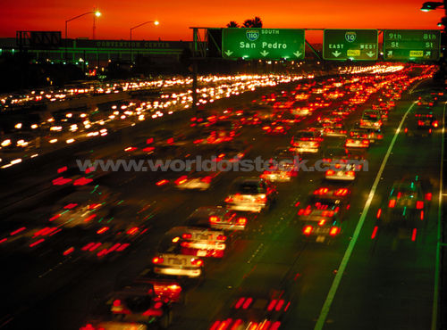
Disclaimer :
The system is designed specifically for tunnels or night time driving on roads with separated lanes for each direction, like freeways.

Slide 30
Some useful terms :
Spotlight : They are local, bright regions in an image that are ideally round and surrounded by relatively dark pixels.
Thresholding : It is an important method for image segmentation in which pixels with similar brightness levels are grouped together.

Slide 31
Hardware part :
Image sequence Camera
Spotlight Engine + Thresholding
Labeling Engine
Standard Video Camera
Sensitive to visible light
Recording grayscale images@25fps
These two processes extract all the spotlights from the image and produce a binary image.
Searches the binary image for regions of connected white pixels.
Creates a label for each region.
Provides the list of labels to the software.

Slide 32
Spotlight Engine + Thresholding
Labeling Engine
List of Labels

Slide 33
Spotlight Engine :
It scans the image and filters out the spotlights.
Input – grayscale image, Output – Binary bitmap(Black&White)
Previous algorithms use just Thresholding to do this.
Drawback – it does not consider the shape and size of the bright objects and therefore cannot distinguish taillights from lane markers, reflecting traffic signs or bright tunnel exit.
Proposed algorithm overcomes that by applying a simple shape filter.

Slide 34
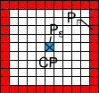
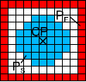
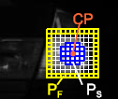
Masks :
For Cp to be a spotlight pixel :
Notes:
1. Talk about masks, Cp is the pixel under question, what does the equation say, then how by using masks we can distinguish between taillights and other bright objects like lane markers etc, what happens when sizes of Ps and Pf are changed

Slide 35
Labeling Engine :
Input – Binary bitmap, Output – List of labels, one label for every spotlight.
It searches for regions of connected 1-pixels.
It gives a single label to every group of connected 1-pixels.
All 1-pixels not connected to each other should have a different label.
All 0-pixels are ignored. They form the background.
Then it provides this list of labels to the software. The information it provides includes :
Bounding rectangle
Position in the image
Total brightness
Number of pixels (size)

Slide 36
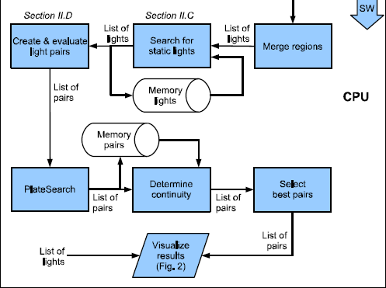
Software portion :

Slide 37
Determining Static lights :
This tries to filter out lights which do not move relative to the road like:
Tunnel lighting
Lit road signs
Reflections
They track motion vectors using light tracking to determine static lights.
Assumption : Vanishing point remains stationary. Holds for straight roads in a tunnel.

Slide 38
Finding light pairs to characterize as taillights :
All possible combinations of lights are formed(^{N}C₂).
Combinations in which the lights are too far apart in the y direction are removed (less than 2N remained in all cases).
Then for each potential combination several properties are tested :
Distance of lights in the y direction
Distance of lights in the x direction
Ratio of brightness
Existence of additional light between the pair
License plate visibility
Temporal continuity

Slide 39
System Implementation :
System was implemented on an ML310 evaluation board with a Xilinx Virtex-II pro FPGA.
The FPGA also has 2 embedded 300MHz PowerPC CPU cores.
A kernel driver was developed to provide access to Spotlight and Labelling Engines.
The hardware resources required by the Spotlight and Labelling Engines were as follows :

Slide 40
Experimental results :
It was crucial for the presented system to work in real time.
25fps = 40ms for the processing of every frame.
At 100 MHz the following results were obtained :

Slide 41
Detection statistics of the Taillight Engine
Results produced by the system when it was fed 20sec long unpreprocessed video sequences recorded during different instances of tunnel driving.
Certainty is a number assigned based on temporal continuity of the taillights.

Slide 42
Limitations and Future work:
10% of the vehicles were not detected because of an activated indicator.
Vehicles with solely one taillight, like motorbikes cannot be detected.
Cannot detect non-moving cars right now.
Changes in the environment such as curved or hilly roads might break some assumptions.
Urban traffic needs to be considered to make it more robust.
Need to be enhanced to work for daylight driving.
Finally the system should be ported to a real car to demonstrate its actual real time benefits.

Slide 43
Questions?

