Slide 1
Icap Controller for high-reliable internal scrubbing
Quinn Martin
Steven Fingulin

Slide 2
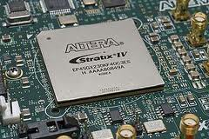
Motivation
Field-programmable gate arrays (FPGAs) perform well in space
Low non-recurring engineering (NRE) costs compared to application-specific IC (ASIC)
Good performance per watt compared to microprocessor
Reconfigurability
However, they are susceptible to radiation effects
Generally more susceptible than ASIC
Can cause unpredictable behavior or system failure
Therefore, want develop efficient ways to improve reliability of FPGA-based systems in space

Slide 3
Radiation Effects on Electronics
Single event effects – trapped protons and heavy ions in space/upper atmosphere can affect electronic operation when they encounter device
Single event latchup (SEL) – Event that causes a certain overcurrent condition that can permanently damage device
Single even upset (SEU) – Event that results in the change of a flip-flop value
Single event transient (SET) – Event that results in a pulse through the circuit. If latched, becomes an SEU.
Single event functional interrupt (SEFI) –
Event that results in interruption of basic
device function. Usually requires a full
reset to repair.

Slide 4
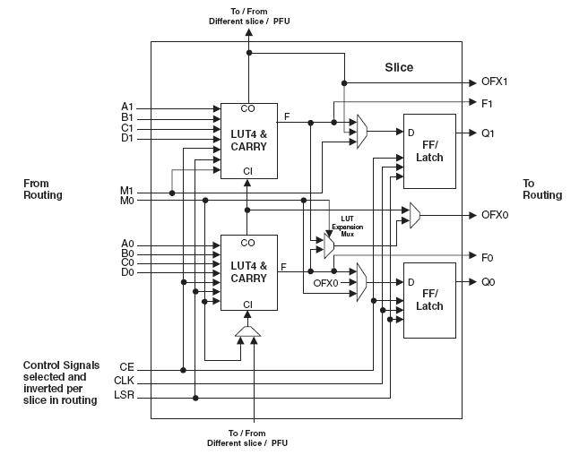
Field-Programmable Gate Arrays
Reconfigurable field-programmable gate arrays (FPGAs) provide a fabric that can be used to implement arbitrary digital logic
Configuration (logic and routing information) is stored in SRAM cells
SRAM is highly susceptible to SEUs
Some radiation-hardened FPGAs are available, but cost up to 100x more than equivalent commercial off-the-shelf (COTS) part

Slide 5
Configuration Memory Scrubbing
Scrubbing corrects SEUs in configuration memory
Takes advantage of reconfigurability of FPGA to repair upsets quickly after the occur
Uses redundant configuration data
Scrubbing can not correct user flip-flop values or SETs
Must use other fault-tolerant techniques like triple-modular redundancy (TMR) or algorithm-based fault tolerance (ABFT)
Two main scrubbing strategies
Blind scrubbing: Write over all configuration memory periodically or continuously with a “golden copy” stored externally
Readback scrubbing: Read the configuration memory and only correct when upset detected
Detection commonly done using Cyclic Redundancy Check (CRC) or Hamming error correction code

Slide 6
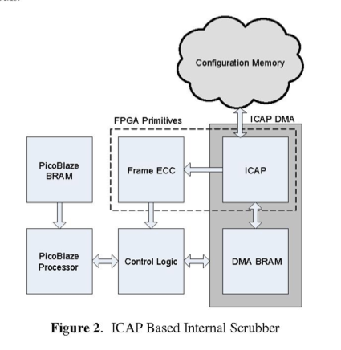
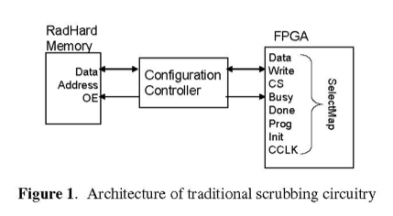
Internal vs. External Implementation
External scrubbing
Traditional method of scrubbing the FPGA uses an external, usually radiation-hardened, microcontroller or one-time-programmable (OTP) FPGA
Internal scrubbing
Takes advantage of internal configuration access port (ICAP) to implement the scrubbing controller in the FPGA fabric

Slide 7
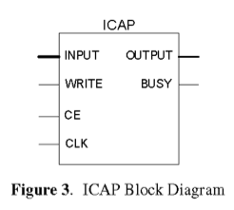
Internal Configuration Access Port (ICAP)
Internal Configuration Access Port (ICAP) provides direct access to FPGA configuration data from user logic designs
Built into Virtex-II and above FPGAs from Xilinx
Can be used to partially reconfigure the device
Uses the SelectMAP interface
A parallel interface to the configuration logic
Gives access to special device registers
Allows addressing of individual configuration
frames (sets of 41 32-byte words) for read or
write

Slide 8
FRAME_ECC Primitive
Fixed logic primitive built into Virtex-4 and above
Works in conjunction with 12-bit single error correction, double error detection (SECDED) Hamming code stored in the frame during configuration
Calculates error syndrome on frame data that is read back through ICAP
Readback and repair must be done in user logic

Slide 9
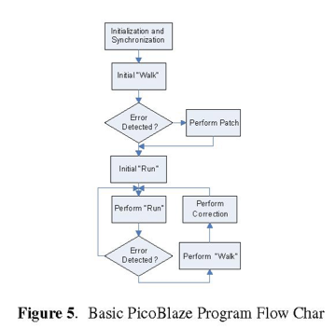
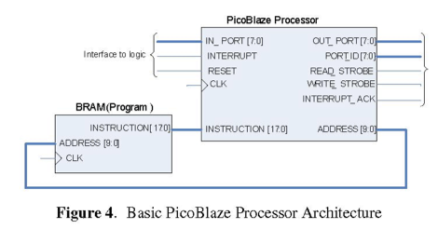
PicoBlaze Processor
A small 8-bit processor
Fetches instructions and data from a small block RAM (BRAM) on the FPGA
Used in this system to handle control of the scrubber (Figure 5)
Performs “run” scan until it detects an error
Then performs “walk” to correct the error

Slide 10
High Reliability Scrubber
Internal ICAP scrubber is susceptible to SEUs
Upset could jeopardize device configuration
Two methods to make scrubber more reliable
Triple Modular Redundancy (TMR)
BRAM scrubbing

Slide 11
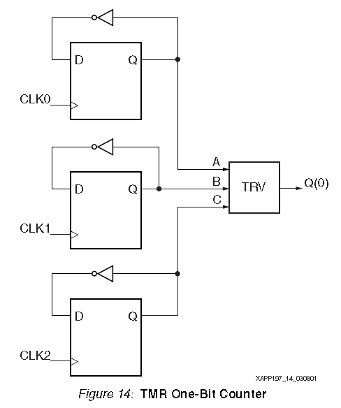
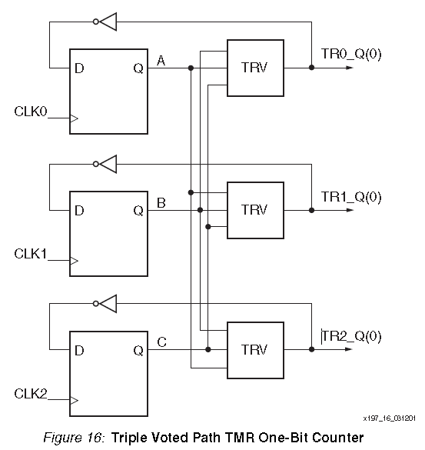
Triple Modular Redundancy (TMR)
Triplicate each component and use voting to verify correct operation
Two of the three modules would need to be corrupt to give incorrect output
Feedback TMR
Uses voters on the feedback loops within the circuit
Reduces number of single points of failure
BL-TMR tools used to apply TMR
ICAP, Frame ECC, PicoBlaze program BRAM not triplicated due to resources

Slide 12
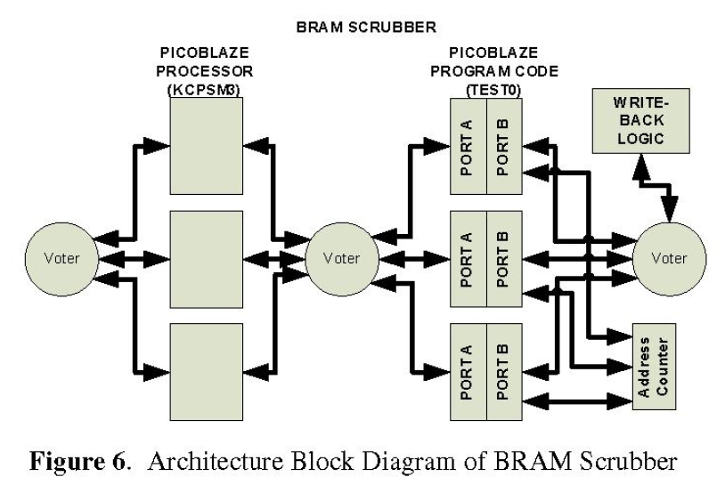
Block Memory Scrubbing
BRAM contents change during operation so BRAMs cannot be scrubbed with “golden” copy
Three types of BRAMs in design
PicoBlaze processor’s stack, scrath pad, store, and register memory
DMA BRAM
PicoBlaze program BRAM
BRAM scrubber algorithm
Data at address AddrB is read from each of three BRAMs using second data port
Data is voted on then sent as dataIn back to each BRAM
If an error is found, then WEB (write enable) is set
Address is incremented, repeat

Slide 13
Radiation Test
Goals
Demonstrate a working scrubber in an environment where upsets are present
Determine amount of reliability provided by TMR and memory scrubbing
Identify ways of improving reliability and on-line functionality of the circuit
Avnet Virtex-4 LX-25 evaluation board
Aluminum shield protects components other than FPGA
UART cable connects host PC to PicoBlaze processor for status information
Two designs used
First design used internal scrubber circuit, but no TMR
Second design did make use of TMR
TMR design did not triplicate clock or UART

Slide 14
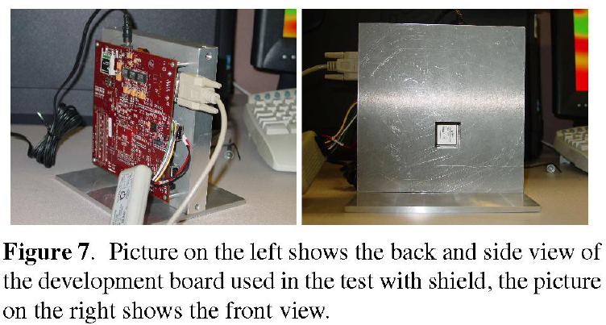
Radiation Test
The test program consisted of:
PicoBlaze detecting and correcting errors
UART communication
Read/Write configuration registers
Transmit BRAM data to host computer
One inch aluminum shield protects all of the board except FPGA
Proton beam set to 63 MeV

Slide 15
Results
Average of 24.75 Multiple Bit Upsets (MBUs) per failure for design two (TMR protected)
Average of 10.68 MBUs per failure for design one (no TMR)
1.7% of all upsets were MBUs
Types of failures:
Program crash
Invalid response from UART
Repeat FAR (Frame Address Register) and/or syndrome values/sets of values
Failure during reconfiguration
Errors present at end of test
45.45% of tests on TMR design failed
74.19% of tests on design without TMR failed

Slide 16
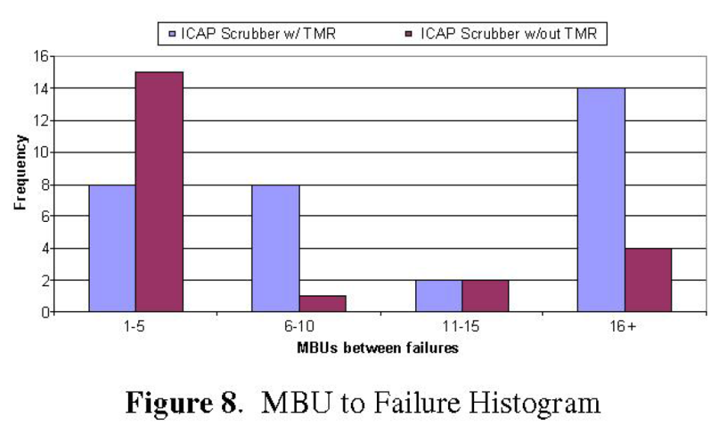
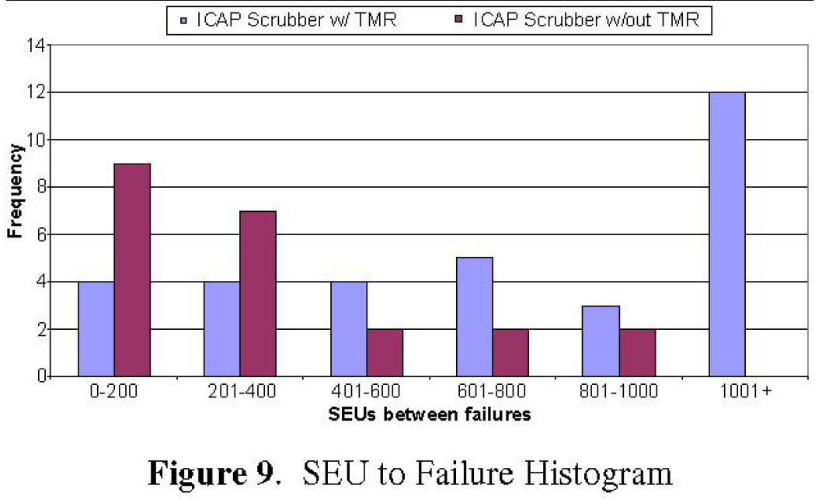
Results and Conclusions
TMR design was 3.6x less likely to fail than unmitigated design
TMR design also tolerated more MBUs
Single points of failure introduced at UART and communication points
Able to detect, but not fix MBUs
Future work will reduce amount of single points of failure and attempt to correct multiple bits within a frame

