Slide 1
HOME AUTOMATION NETWORKS
Oliver Pankiewicz
EEL 6935
Embedded Systems
10-25-11

Slide 2
Outline
My Background
Applications
Home Automation Protocols:
Insteon
Z-Wave
ZigBee
X10
Wi-Fi
Network Layers
Comparisons

Slide 3
My Background
Oliver Pankiewicz
Electrical engineer
Live in Orlando
Work at Kennedy Space Center since 2003
NASA contractor
Ground support equipment design
Interests in home automation

Slide 4
Papers
Wireless Home Automation Networks: A Survey of Architectures and Technologies
Research and Design of Smart Home System Based on ZigBee Technology
Home Area Network Technology Assessment for Demand Response in Smart Grid Environment
Other Sources:
Z-Wave Node Type Overview and Network Installation Guide
Insteon Compared

Slide 5
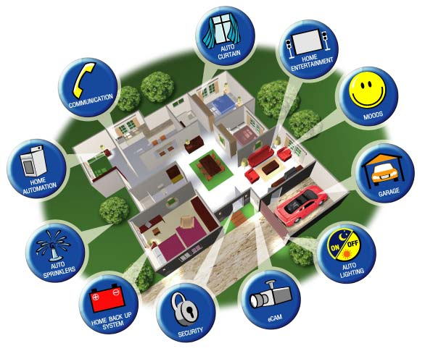
Home Automation Applications
Light Control
Security
HVAC
Smart Grid
Sensors
Door Locks
Windows
Power Outlets
Home Theater
Scenarios

Slide 6
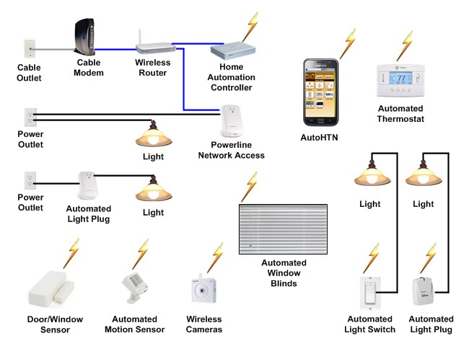
Home Automation Diagram

Slide 7
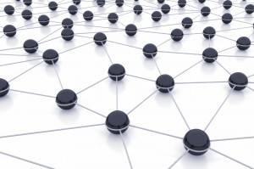
Mesh Networking
Ad-Hoc network
Independent devices
Self-routing
Healing properties
Increased reliability

Slide 8
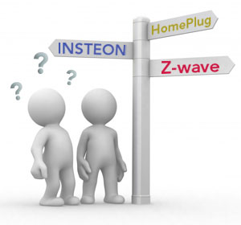
Home Automation Protocols
ZigBee
Z-Wave
Insteon
HomePlug
X10
Wavenis
6LoWPAN
WiFi

Slide 9
Insteon
Dual mesh network
Powerlines
RF
Advantage of using home’s existing powerline infrastructure
Powerline phase issue
ISM frequency at 904 MHz
RF issues:
Interference from other wireless devices
Interference from walls and objects

Slide 10
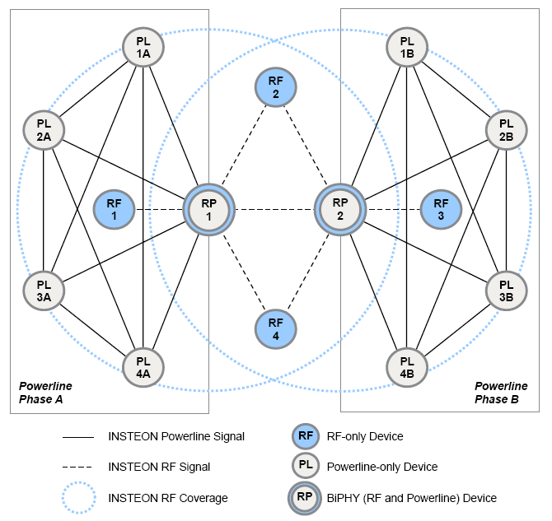
Insteon Network

Slide 11
Insteon Details
Peer-to-peer network
No master controller
Simulcast transmission method
Any device can be a sender, receiver, or repeater
Max 3 hops, 4 total transmissions.
Sends RF signals and through powerline
No collision avoidance

Slide 12
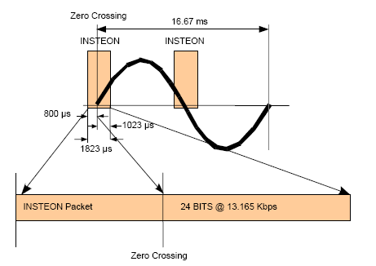
Insteon Signals
24 bit packet
Sent at zero crossing
13 kbps
Uses rolling codes for encryption
Standard message = 120 raw bits
Extended message = 264 raw bits
RF uses FSK
Powerline uses BPSK

Slide 13
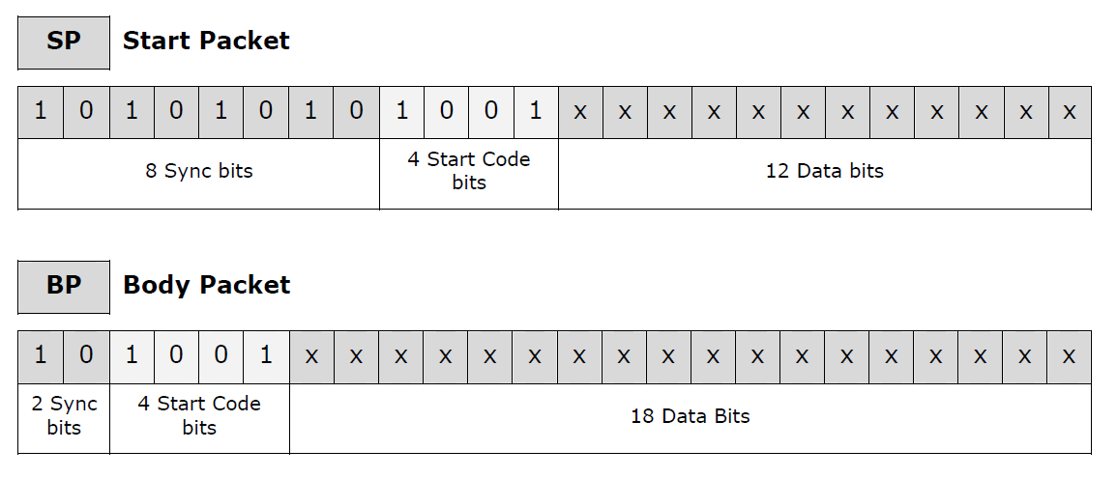
Insteon Powerline Packets

Slide 14
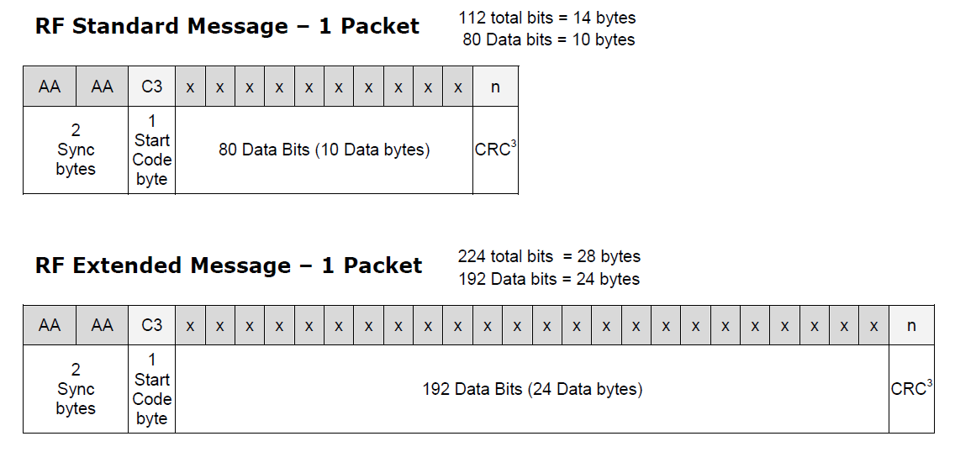
Insteon RF Packets

Slide 15
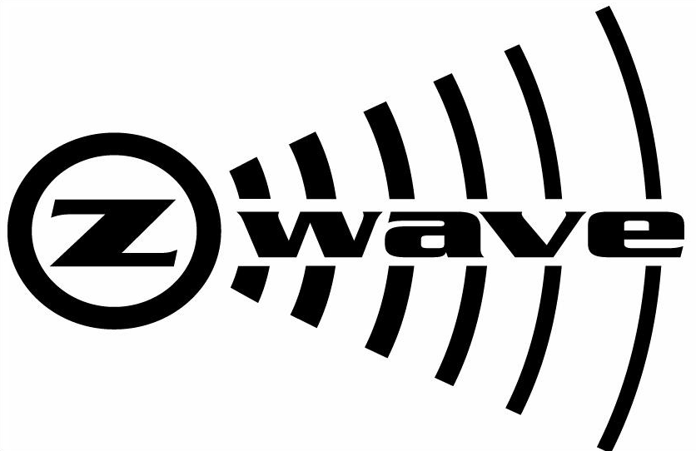
Z-Wave
Z-Wave Alliance
9.6 to 200 kbps
908 MHz in U.S.
868 MHz in Europe
New 2.4 GHz
90’ to 300’ range
232 nodes max
Master and slave architecture
Uses mesh networking
BPSK
Collision Avoidance
Random back off times

Slide 16
Z-Wave Devise Types
Controllers:
Host routing tables for mesh network
Used to calculate best route for a signal to get to a slave
Routes retransmitted by slave nodes
Only one primary controller
Can include/exclude devices
Manage allocation of Node Ids
Secondary controllers get copies of routing tables
Slave Devices
Do not compute routing tables
Can store routing tables
Act as a repeater

Slide 17
Z-Wave Routing Example

Slide 18
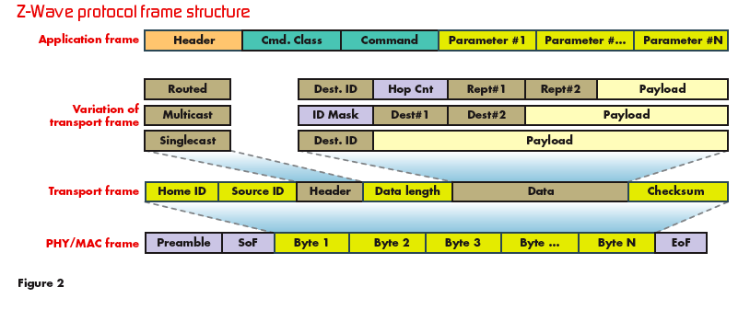
Z-Wave Packets

Slide 19
ZigBee
ZigBee Alliance
Based on IEEE 802.15.4
Design goals:
Wireless networks
Low data rates
Self organizing mesh networks
Low power
Released in 2005

Slide 20
ZigBee Details
IEEE 802.15.4
915 MHz and 2.4 GHz in U.S.
868 MHz and 2.4 GHz in Europe
Supports up to 64,000 nodes
Mesh networking
128 Bytes packet size
20/40/250 kbps data rate
10 to 100 meter range
Uses CSMA/CA
128 bit encryption keys

Slide 21
ZigBee Device Types
ZigBee Coordinators
Controller
Discovers other devices
Stores security information
One per network
ZigBee Router
Can pass data from other devices
ZigBee End Device
Low capabilities
Can’t relay data

Slide 22
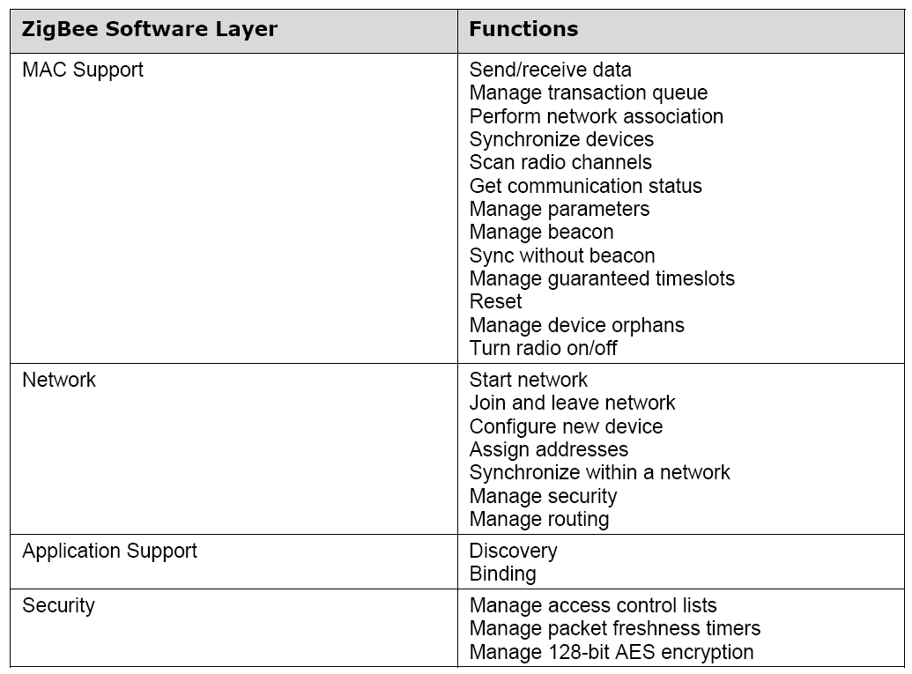
ZigBee Software Layer

Slide 23
ZigBee Packet
PHY Packet Fields
Preamble (32 bits) – synchronization
Start of Packet Delimiter (8 bits)
PHY Header (8 bits) – PSDU length
PSDU (0 to 1016 bits) – Data field
Start of
Packet
Delimiter
PHY
Header
PHY Service
Data Unit (PSDU)
Preamble
6 Octets
0-127 Octets

Slide 24
X10 Details
Powerline networking
Designed in the 1970’s
Max 256 devices
16 Command codes
60 bps
No acknowledgments
No security

Slide 25
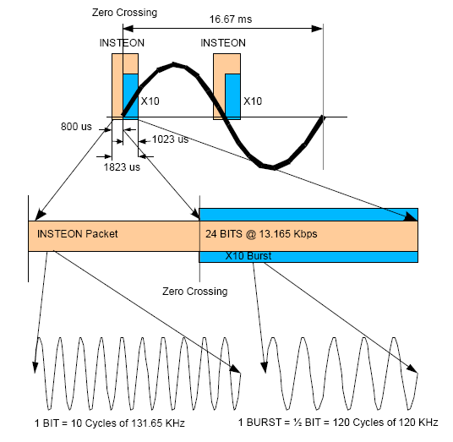
X10 Signals
Insteon compatible with X10
Manchester coding
Insteon starts 800us before X10
Zero crossing
60 bps

Slide 26
X10 Packet
Start Code (4-bit)
House Code (8-bit)
Key Code (10-bit)

Slide 27
6LoWPAN
IPv6 over Low power Wireless Personal Area Network
Use existing internet network infrastructure
IPv6 packets on top of IEEE 802.15.4 network
Issues:
IPv6 not designed for sensor networks
1280 byte IPv6 packets
127 byte IEEE 802.15.4 frames
40 byte IPv6 header

Slide 28
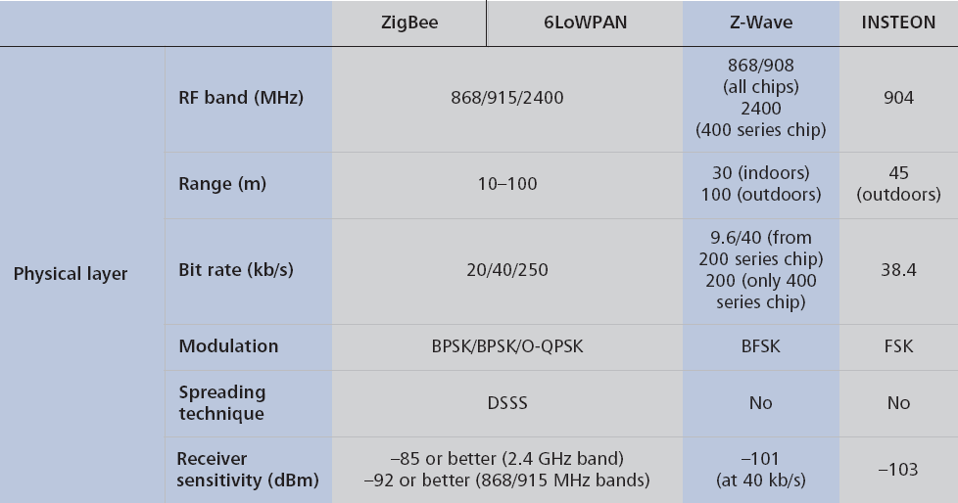
Physical Layer Comparison

Slide 29
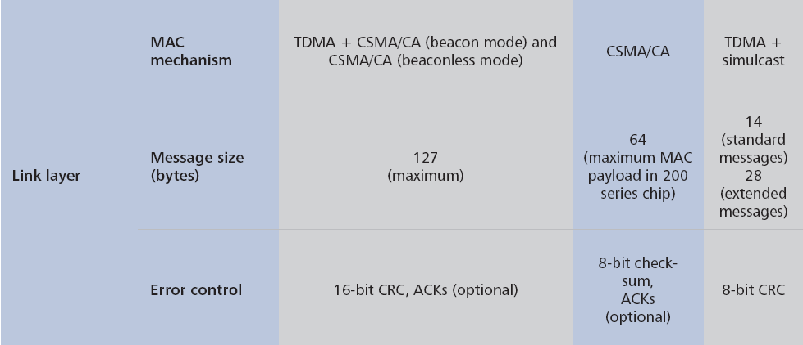
Link Layer Comparison

Slide 30
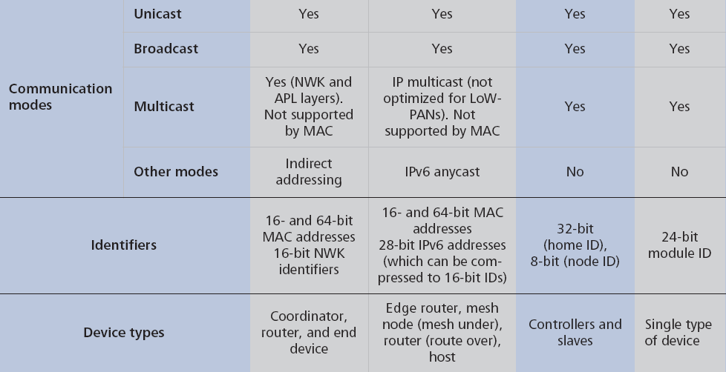
Communication Comparison

Slide 31
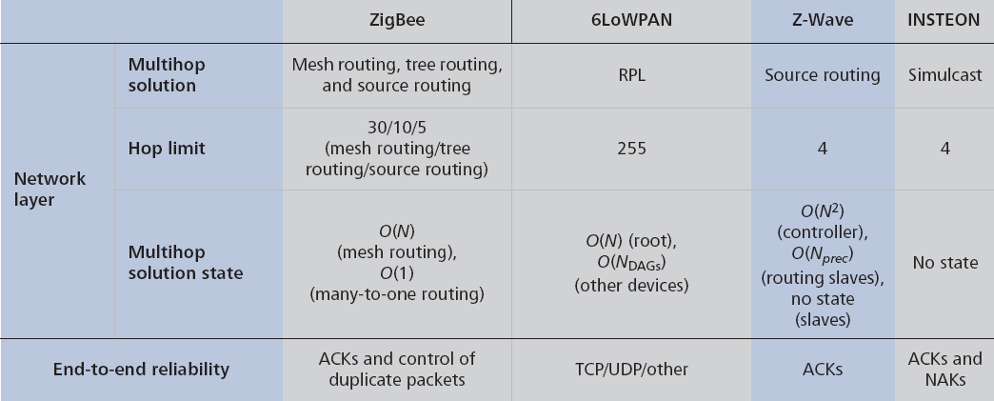
Network Layer Comparison

Slide 32
Application Layer Comparison

Slide 33
Questions?
Please post any questions on Sakai
Notes:
Nembus Home Automation aims to bring home automation to the masses and capture a significant portion of the multi-billion dollar industry. Nembus will accomplish its goals by focusing on the comprehensive customer experience through:
Creating easy-to-use apps for smartphones, media boxes, and HDTVs.
Building a social network where customers connect with home automation installers, find home automation products, and get questions answered.
Designing a home automation-focused media box with easy-to-setup hardware.
Creating an HTN professional certification program that trains electricians how to install and wire home automation hardware.
Nembus Home Automation is seeking $500,000 to complete product development. The majority of the funding will be used for salaries, hardware prototyping, and research and development. The $500,000 will support Nembus until month thirteen when Nembus’ products are ready for production.

