Slide 1
SPACE BASED WIRELESS PICO-SATELLITE SENSOR NETWORKS
Oliver Pankiewicz
EEL 6935
Embedded Systems
11-15-11

Slide 2
Agenda
Satellite Background Information
Algorithm Goals and Assumptions
Deployments
Decision making algorithm
Simulation
Simulation Results

Slide 3
Paper
Distributed Adaptability and Mobility in Space Based Wireless Pico-Satellite Sensor Networks
Wei Li, Tughrul Arslan, Ahmed O. El-Rayis, Nakul Haridas, Ahmet T. Erdogan, E. Yang, School of Electronic and Information Engineering, Xi’an Jiaotong University, China, School of Engineering and Electronics, University of Edinburgh, Edinburgh EH9 3JL, United Kingdom
Presented at NASA/ESA Conference on Adaptive Hardware and Systems in 2008

Slide 4
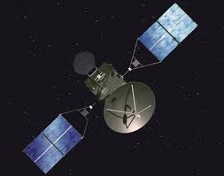
Background - Satellites
Use of Satellites:
Telecommunications
Navigation
Weather
Remote Sensors
Space Based Wireless Satellite Sensor Networks (SBWSSN)
Pico-satellites
Similar to Wireless Networks
Low power
Short transmission distance
Multi-hop

Slide 5
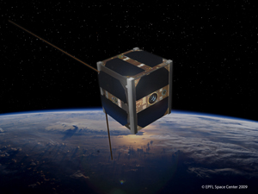
Background – Pico-Satellites
Cheaper
Increased reliability
Increased security
Features:
Mobile
Self-organized
Adaptable to target formation
Can locate and tract
Utilize mobility to increase communications ability

Slide 6
Goal and Assumptions
Goal:
To design a decision making method for satellite nodes to adaptively handle the mobility of SBWSSN deployment.
Assumptions:
All nodes share information
Uniform in functionality and ability
Measure distance using wireless communications
Nodes can access information such as:
Remaining energy
Total moving distance
Communication leads

Slide 7
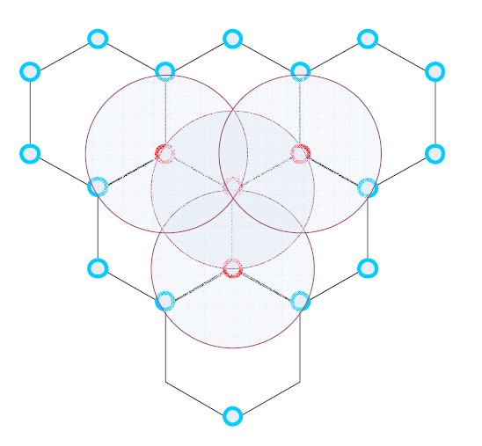
Full Coverage Deployment
Rc = Wireless communications range
Rs = Sensing range
Hexagonal formation
If Rc > Rs, d = Rs
If Rc < Rs, d = Rc

Slide 8
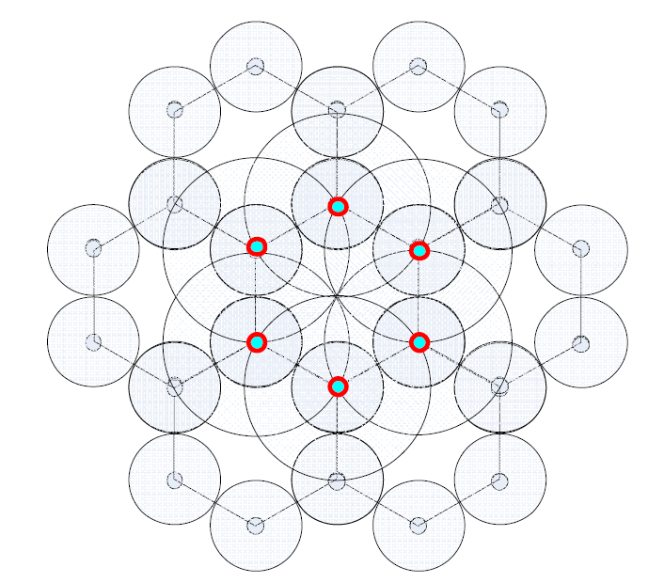
Partial Coverage Deployment
Rc = Wireless communications range
Rs = Sensing range
Hexagonal formation
If Rc > 2Rs
Leads to gap in coverage
If Rc/2 < Rs
Leads to no communication
gap
If Rc/2 = Rs
Is most efficient choice

Slide 9
Virtual Force Algorithm
Utilize position information of each node.
Deploys nodes adaptively in distributed manner.
Keeps nodes at distance equal to Rs and less than Rc.
Disadvantages:
Vibration during converging to final deployment formation.
Costs more convergence time.
With out boundary or virtual boundary, the algorithm has stochastic behavior.

Slide 10
Algorithm
Distributive
Adaptable
Uses portion of Virtual Force algorithm

Slide 11
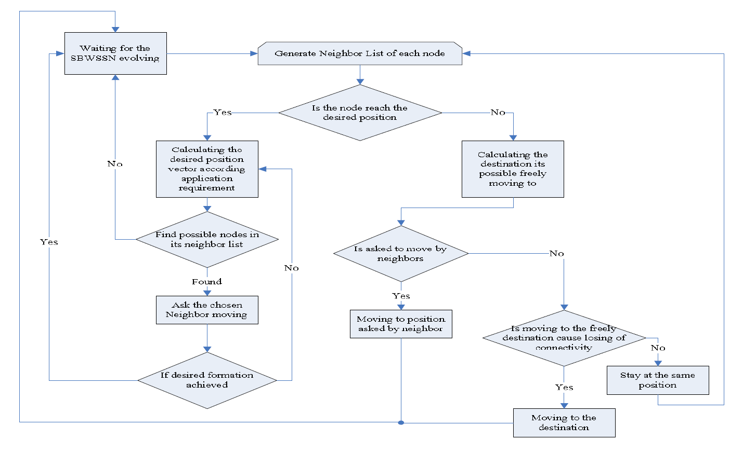
Decision Flow Chart

Slide 12
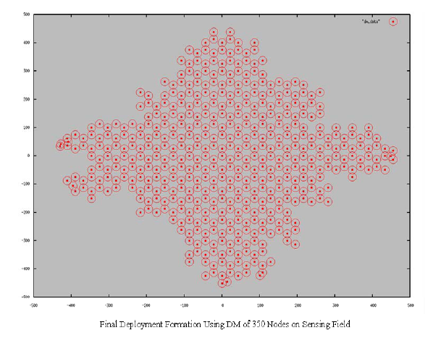
Simulation
Simulates:
Decision making algorithm
Virtual Force
Start with all satellites in 20m x 20m area
Stop when 95% find correct position
Goal is to conserve fuel and limit time.

Slide 13
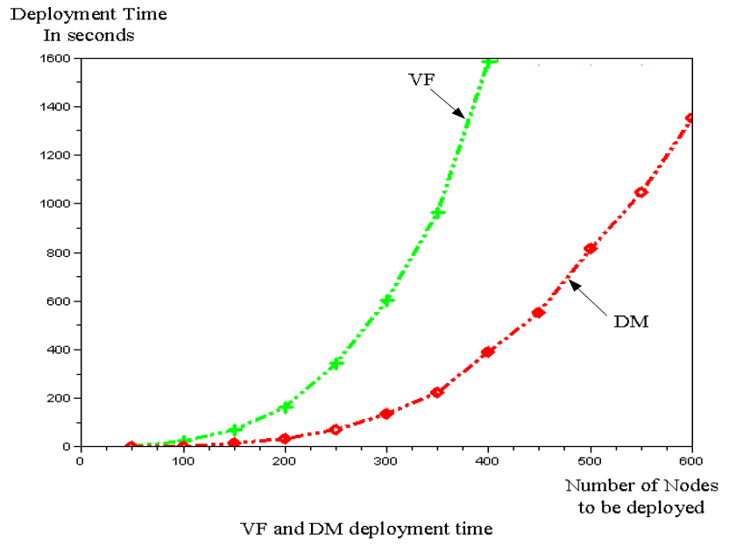
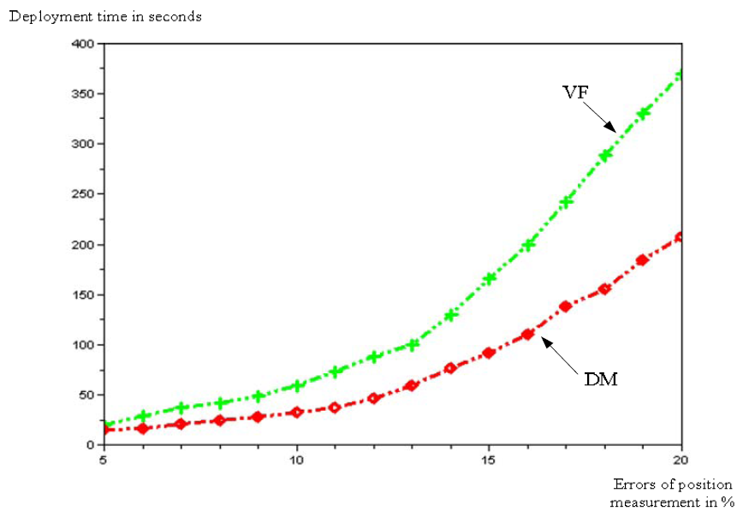
Simulation Results
Number of Nodes Deployed
Errors in Position Measurement

Slide 14
Paper Limitations
Only compare their VF and DM algorithms
2-D only
Does not go into detail of how Rs and Rc is used in their algorithm
Doesn't go into details on how the Wi equation works in the decision tree
Simulation results

Slide 15
Conclusion
Decision Making Algorithm
Designed for Space Based Wireless Satellite Sensor Networks
Optimize in energy and distribution
Improvement over Virtual Force

Slide 16
Questions?
Please post any questions on Sakai
Notes:
Nembus Home Automation aims to bring home automation to the masses and capture a significant portion of the multi-billion dollar industry. Nembus will accomplish its goals by focusing on the comprehensive customer experience through:
Creating easy-to-use apps for smartphones, media boxes, and HDTVs.
Building a social network where customers connect with home automation installers, find home automation products, and get questions answered.
Designing a home automation-focused media box with easy-to-setup hardware.
Creating an HTN professional certification program that trains electricians how to install and wire home automation hardware.
Nembus Home Automation is seeking $500,000 to complete product development. The majority of the funding will be used for salaries, hardware prototyping, and research and development. The $500,000 will support Nembus until month thirteen when Nembus’ products are ready for production.

