Slide 1
ROBTIC : On chip I-cache design for low power embedded systems
Varun Mathur
Mingwei Liu

Slide 2
I-cache and address tag
Instruction cache has
Large chip area
High access frequency=>switching power
Example:
Direct mapped I-cache
1024 entries (=>1024 one way sets)
32 bit data per entry (=>four 8 bit instructions per entry)
32 bit PC address
So,
10 bit index
2 bit block offset
Therefore, 32-(10+2) = 20 bit tag
Cache area taken by tag = (20/(20+1+32)) = 37.7%
Larger the cache tag => more area and power consumption.

Slide 3
Previous work
a filter cache or L0-cache
tag comparison before data fetch
buffer the address of the previously hit cache line (non-branch or un-taken)
use a couple of the least significant bits of the tag for comparison
Reduced One-Bit Tag Instruction Cache (ROBTIC)

Slide 4
Their work is directed at:
Application programs have a lot of loops.
Loops have high temporal and spatial locality.
Exploit this locality to reduce tag size.

Slide 5
Standard cache size for ROBTIC:
Wide range of benchmarks surveyed.
Apps most time within certain loop blocks.
90% of loops have < 30 instructions.
ROBTIC’s standard capacity = 32 inst
Enough to capture most of temporal and spatial locality.

Slide 6
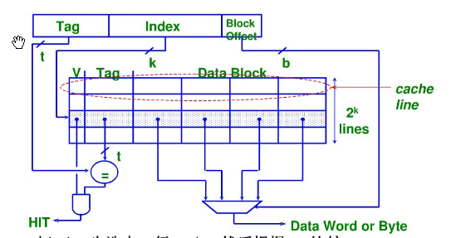
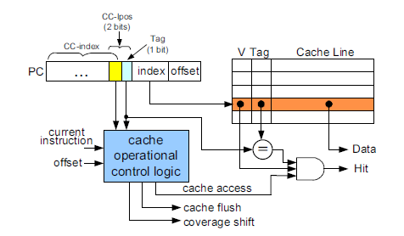
ROBTIC Archetecture

Slide 7
Cache tag size v/s cache memory coverage
Tag : identifies which memory location stored at particular cache location
Cache memory coverage : cache mappable address space of main memory.

Slide 8
Features of ROBTIC:
Direct mapped
Each cache entry contains :
Cache line (data)
1 bit tag
Valid bit
Cache size extensively reduced
Due to 1 bit tag, cache operational control unit reqd.
Performance retained.
Reduced size + maintained performance=>reduced power consumption

Slide 9
Cache tag size v/s cache memory coverage
FULL TAG = FULL MEMORY COVERAGE

Slide 10
Cache tag size v/s cache memory coverage
Reduced TAG = PARTIAL MEMORY COVERAGE
Only segments of memory mapped at a time.
Mappable regions distinguished by CC-index.

Slide 11
Ideal scenario

Slide 12
Reality : Ping-Pong effect
Consider the case of block B2.

Slide 13
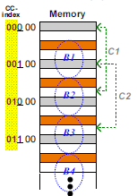
Overlapped Dynamic Cache Coverage Control
Dynamically shift cache coverage in overlapping manner.
Some of the previously mapped addresses survive.
Again consider the case of Block B2.

Slide 14
Cache operation control flow:
Three states:
Cache coverage shift
Shift when PC moves out of current coverage.
Invalidate
Always shift by cache size.
Cache flush
If Jump or Branch offset > cache size
Normal cache access

Slide 15
Cache coverage shift and shift detection
Method 1 : Range gauge
Disadvantages
2 registers (full tag size)
2 comparators (full tag size)
Neutralizes savings from 1 bit tag.

Slide 16
Method 2 : with gray encoding
Only need to differentiate between 3 regions.
Least two significant bits of tag sufficient.
Called local cache coverage position (CC-lpos).
Range checking will not work.
2 bit CC-lpos (p₁p₀) -> gray code value (g₁g₀)
Adjacent coverage regions differentiated by a bit in (g₁g₀) called common value bit (CVB).
Its value is called common value(CV).
CVB and its CV uniquely identify 4 consecutive regions.

Slide 17
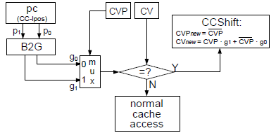
For current cache coverage :
CVP = ~(g1 xor g0) = ~p0
CV = g0 = p1 xor p0
Hardware cost : does not increase with tag size, one 2 bit reg, one 2 bit B2G conv, one 2x1 mux and 1 bit comp.

Slide 18
Experimental Results:
Results of Cache Coverage Shift implementation

Slide 19
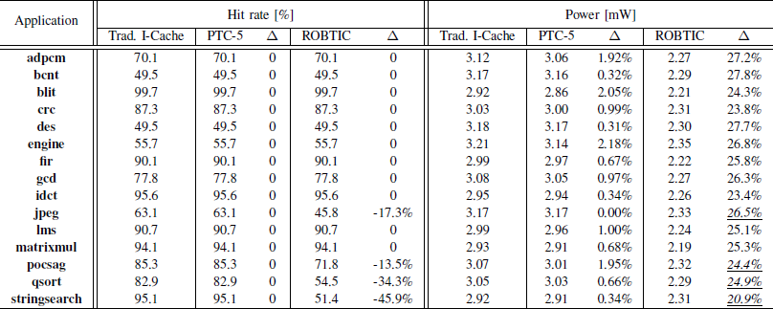
Experimental Results:
Comparison of ROBTIC with PTC-5

Slide 20
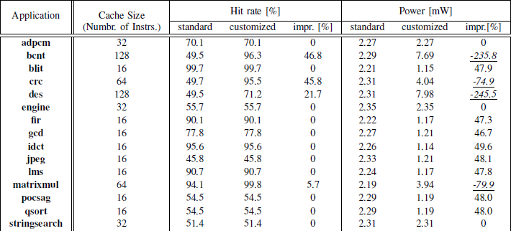
Experimental Results:
Comparison of standard & custom ROBTIC designs

Slide 21
Limitations and future work:
On a jump instruction, the cache is flushed irrespective of the offset.
For future work, they want to investigate multi-way associative structure in ROBTIC.

