Slide 1
Run-time reconfiguration for automatic hardware/software partitioning
Tom Davidson, Karel Bruneel, Dirk Stroobandt
Ghent University, Belgium
Presenting: Steven Fingulin, Quinn Martin

Slide 2
Run-time Reconfiguration
FPGAs store configuration data in SRAMs
Allows configuration to be changed during run-time
Can change functionality quickly without needing to restart
Parameterisable configurations
FPGA configuration where bits are expressed as Boolean functions rather than Boolean values
Allows for one configuration to represent several designs
Previous reconfiguration techniques required all possible configurations externally

Slide 3
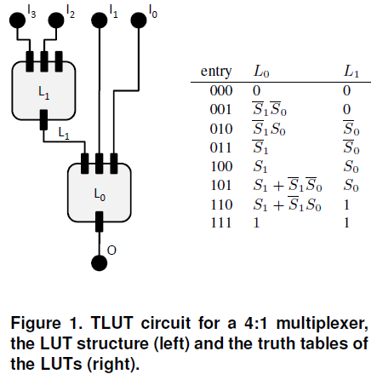
TMAP Tool Flow
TMAP tool flow is a modification of traditional FPGA mappers
Inputs are either parameters (change slowly) or regular signals (change frequently)
TMAP generates parameterisable configuration based on the design
For different parameter values, a new configuration must be generated
User specifies which signals are parameters by annotating VHDL
After generating a new configuration, the FPGA can be reconfigured
Only values in truth tables (LUTs) can be reconfigured
Prevents need to place and route entire design
This overhead of generating new configurations and applying them is application dependent
Usually on the order of milliseconds

Slide 4
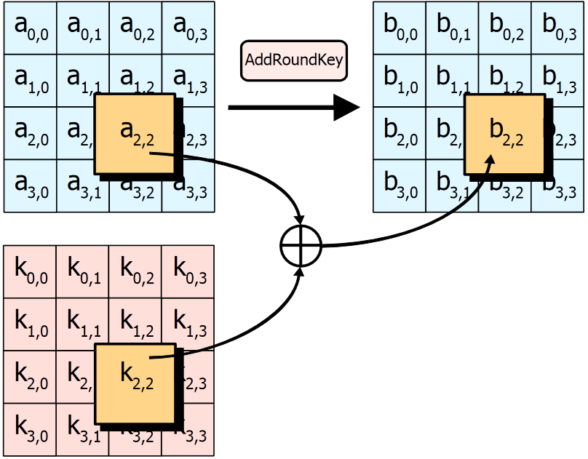
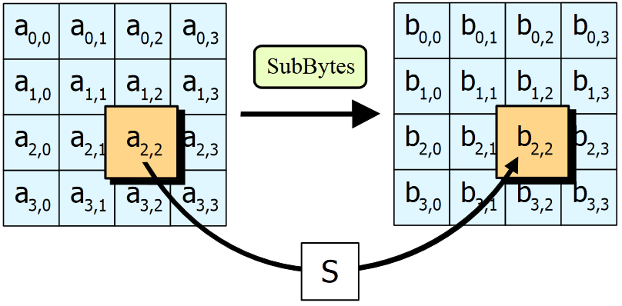
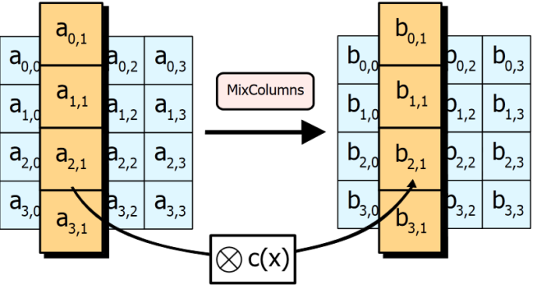
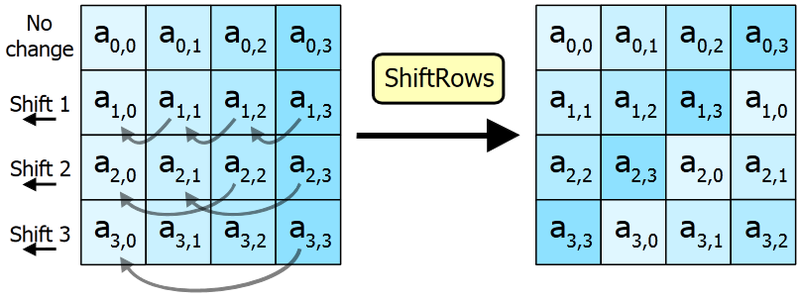
Advanced Encryption Standard (AES)
AES specifies how to encode 128-bits of data using a specific key-value
Data Encoding
128-bits split to 16 bytes
Each byte is assigned a location in 4x4 state matrix
Byte transformation are performed in rounds according to current RoundKey
SubBytes
ShiftRows
AddRoundKey
MixColumns
RoundKey changes every round

Slide 5
AES Continued
Key Expansion
Used to generate keys for each round of the algorithm
Input Key is used for first round
Three operations
Rcon(i) – constant value dependent upon i
SubWord() – applies Rijndael S-box transformation
RotWord() – Cyclic rotate word 8 bits left
Full explanation is beyond scope of this presentation

Slide 6
Automatic Hardware/Software Partitioning
Most research is focused on system level and algorithm aspects of HW/SW partitioning
Goal of TMAP tool flow is to optimize hardware design and automatically partition HW and SW components
Frequently changing inputs lead to static segments of configuration and coded in hardware
Parameter inputs change more slowly and can be computed by software
Configuration manager (CM) such as PowerPC processor will compute values to complete FPGA configuration

Slide 7
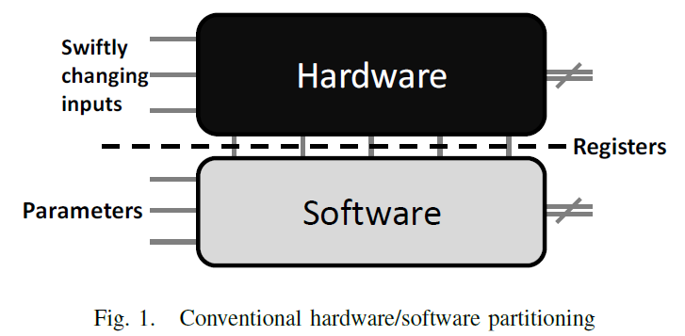
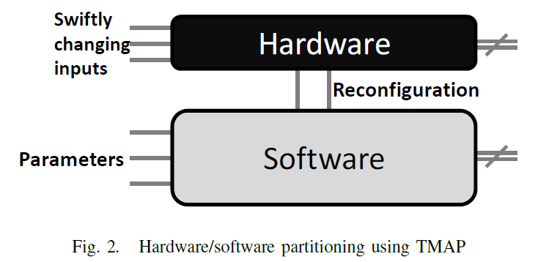
Hardware/Software Boundary
Conventional HW/SW partitioning
Does not use Run-time reconfiguration
Hardware must be general for different parameter values
All operations dependent upon Parameters are computed in SW
Software writes values to registers for HW to read
Run-time reconfiguration
Can alter configuration memory (LUT values) rather than write to registers
Hardware circuit can be more specialized and faster

Slide 8
An Example: k_AES
Manually partitioning AES would naturally lead to encoding in HW and key generation in SW
Authors write implementation: k_AES
Pipelined chain of 10 rounds that implements encoding
Combinatorial 10 k_rounds that perform key expansion
128-bits of encoded data output each clock cycle
Design is not optimized for simplicity
TMAP tool flow applied to design
Key for encoding is selected as parameter

Slide 9
Results for k_AES
For k_AES, there is a fairly large area gain (20.3%)
k_AES algorithm is fairly easy to parition
Converted key input (parameter-dependent) part to software
Also must consider reconfiguration penalties
Several milliseconds to load new FPGA configuration
Memory to store bit files
Manual partitioning showed .7% gain over TMAP
Minimal effort to partition this application manually
Motivation to see if other less clearly partitioned applications see performance gains

Slide 10
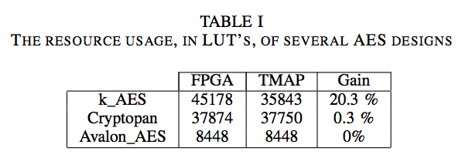
Comparison to other implementations
k_AES algorithm also compared to open-source cores
Crytopan
More sequential than k_AES (state machine)
Same throughput (128 bits/cycle)
Less resource usage before HW/SW paritioning because already hardware optimized
Smaller gains because less parallelizable
Avalon_AES
Even more sequential than Cryptopan
However, 10x lower throughput
Hard to compare designs because they are both Pareto optimal
TMAP gains are small
because of low levels of
parallellism

Slide 11
Other Applications
From k_AES, we see that real gains can be achieved with TMAP
TMAP is fast and automatic, works well for algorithms with clear partitioning
Nearly as good as manual partitioning
Not every app has a clear hardware software boundary
Will explore the effect of using TMAP on some of these cases
Two case studies
Triple DES Encryption
Quadratic

Slide 12
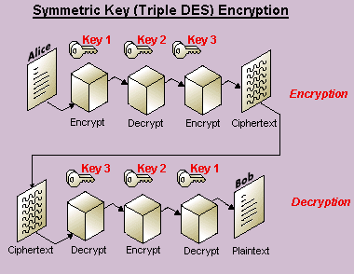
Triple DES
Basic symmetric key encryption/decryption scheme using Data Encryption Standard (DES)
Encrypts with key 1, decrypts with key 2, then encrypts with key 3
Extra steps add layers of additional security
TMAP able to improve area usage by 28.7% over hardware-only implementation
From 3584 to 2552 LUTs
Main design effort in finding
parameters

Slide 13
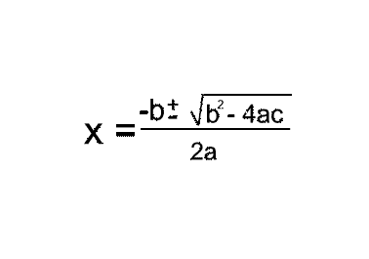
Quadratic
Quadratic polynomial solver
Solves an equation of the form ax²+bx+c
Easily parameterizable
Coefficients are parameters
Therefore easy to partition using TMAP
Not easily partitioned manually
Unclear how coefficients map to partitioning with design-space exploration
TMAP sees area gain of of 21.9%
Partly due to run-time reconfiguration advantage

Slide 14
General Guidelines
Parameter selection the most important choice for TMAP
Other than parameters, tool flow is fully automatic
Implementation choices greatly affect partitionability
k_AES saw large gains, but not Cryptonpan or Avalon_AES
Since parameter-dependent parts are optimized in hardware by design-space exploration, they should be as parallel as possible
Often in conflict with traditional hardware-optimized designs that are largely parameter independent

Slide 15
Conclusions/Thoughts
TMAP tool flow successful at automatic hardware/software partitioning
Can reduce FPGA resource utilization by 20%
Highly dependent on parameter and implementation choices
Still needs an expert user
Reconfiguration time penalty should be explored more thoroughly
No specifics on FPGA/microprocessor platform used for implementation
Maximum frequency consideration could offset gains

Slide 16
Questions?

