Slide 1
A Generalized Framework for System-Wide Energy Saving in Hard Real-Time Embedded Systems
Gang Zeng, Hiroyuki Tomiyama, Hiroki Takada
Graduate School of Information Science, Nagoya University
Tohru Ishihara
System LSI Research Center, Kyushu University
Presenters: Quinn Martin, Steven Fingulin

Slide 2
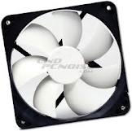
Introduction
Power and energy consumption a major concern in embedded systems
Battery lifetime
Cooling costs
Reliability
Three main approaches for energy savings
Dynamic Hardware Resource Configuration (DHRC)
Dynamic Voltage Frequency Scaling (DVFS)
Dynamic Power Management (DPM)
Real-time systems in particular have a good chance of benefitting from these techniques
Typically have “slack” as a consequence of deadlines

Slide 3
Dynamic Hardware Resource Configuration (DHRC)
Attempts to dynamically tune processor resources in order to be more efficient, thus saving power
Adaptive branch predictor
Selective cache way (associativity)
Performance is heavily application-dependent
A technique may be effective for some applications but not for others
An application with random branch behavior would not benefit from a dynamic branch predictor, and may actually suffer

Slide 4
Dynamic Voltage Frequency Scaling (DVFS)
Lowers voltage and frequency to save power
Dynamic power for CMOS is P = ACV²F
Proportional to frequency and square of voltage
Easy to predict effect on power consumption
Embedded processors often have several voltage and/or frequency levels
Can use digitally-controlled oscillators and dividers to provide different clocks to different part of the chip
Generally has similar effectiveness on different applications

Slide 5
Dynamic Power Management (DPM)
Transfers a device in idle state to a low power or “sleep” mode
Applies not only to the microprocessor/microcontroller, but also to external peripherals (e.g. memories)
Challenging to balance power savings with performance degradation incurred from transferring to and from low power mod
Often takes time and energy to sleep and wake
Must decide which of potentially several low power modes to use

Slide 6
Motivation/DEPS
Since each of these technologies contributes to power savings, why not combine them?
Evaluating the effectiveness of such a scheme has been difficult, especially for hard real-time systems
Energy savings in the processor does not necessarily indicate energy savings in the system
Must consider the entire system when evaluating power

Slide 7
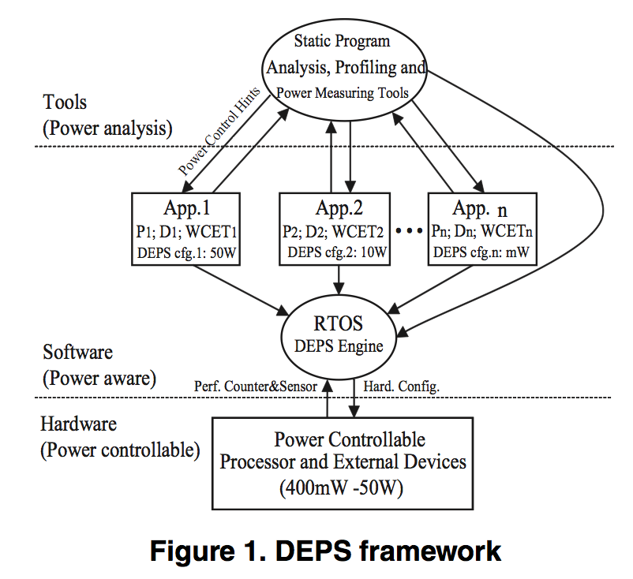
DEPS Framework
Three Layers
Power-controllable hardware
Power-aware software
Power analysis tools
Implemented in the scheduler of the real-time OS
Software-centric approach to power optimization offers greater flexibility than traditional hardware-centric approach

Slide 8
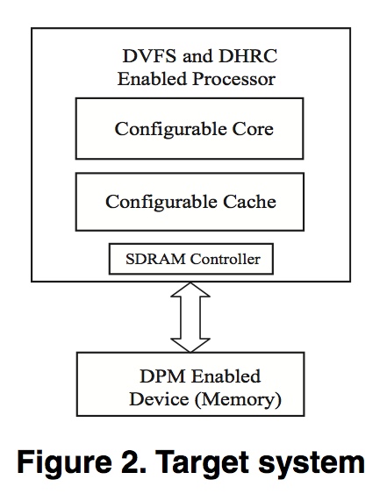
System Model
Includes a processor
Configurable core and cache for DHRC
Capable of DVFS
Also includes a memory
Demonstrates system aspect of framework
Capable of DPM

Slide 9
Problem Formulation (1)
Consider n periodic real-time tasks Γ = {τ₁, τ₂, ..., τ_{n}}
Each task τ_{i} has a period P_{i} and m_{i} effective DEPS configurations denoted C_{i1}, C_{i2}, …, C_{im}.
Each configuration C_{ij} has an associated energy-time relation that can be represented by (T_{ij}, E_{ij}).
T_{ij} is the worst-case execution time (WCET)
E_{ij} is the energy consumption
A hyperperiod = LCM(P₁, P₂, …, P_{n})
Essentially the fundamental period of all tasks
The problem is finding the optimal DEPS configuration for each task such that energy usage over a hyperperiod is minimized

Slide 10
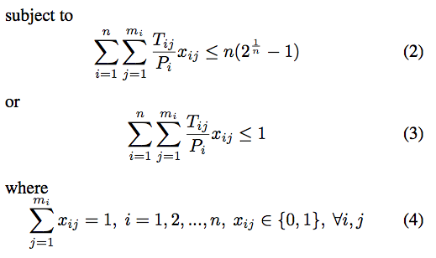
Problem Formulation (2)
In English: Minimize energy of all the tasks over a hyperperiod (1) subject to either Rate Monotonic (2) or Earliest Deadline First (3) scheduling
Selecting the optimal configuration is NP-hard – was solved using linear programming

Slide 11
Static Scheme Implementation
Find the set of effective DEPS configurations (those with lowest power for their execution time)
Find the energy time relations for these configurations
Solve the optimization problem described previously using linear programming or similar method
Store the derived optimal configurations into a configuration table
The OS scheduler uses the table to load the best configuration for the currently scheduled task
Off-line
On-line

Slide 12
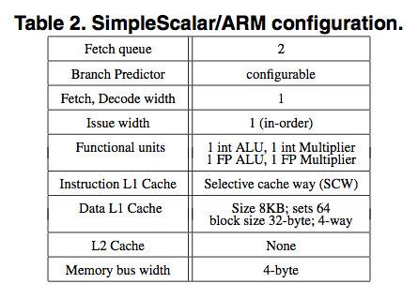
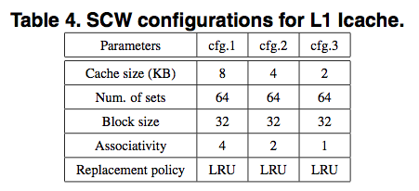
Case Study/Simulation Setup
Energy savings possible highly dependent on employed technologies
Simulation case study performed using a SimpleScalar/ARM-based power analyzer, Sim-Panalyzer

Slide 13
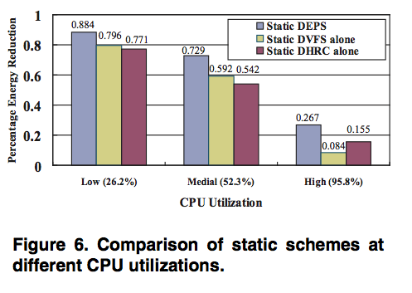
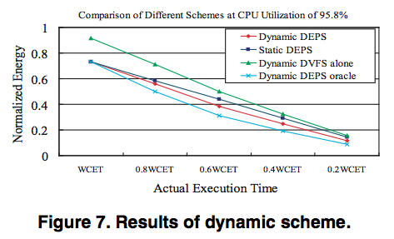
Simulation of Static Scheme
Ran two benchmarks on the simulation setup – g3fax and V42
As expected, DEPS can save much power when CPU utilization is low
Static DEPS is more effective than DVFS or DHRC alone by about 14%, and dynamic DEPS is more effective than static

Slide 14
Conclusions/Comments
DEPS is a useful framework for improving performance of embedded hard real-time systems
Future work will apply DEPS to use on a multiprocessor
Dynamic DEPS and the DPM memory aspect of the static DEPS system was explored in the paper but not covered due to time
Since performance is so application dependent, comparison against a larger set of benchmarks would have added validity to the work
“System” element of the framework is weak – only one off-chip component is included

Slide 15
Questions?
Please post on the discussion topic on Sakai. Thanks!

