Slide 1
Topic 2: Communications (Short Lecture)
Jorge J. Gómez

Slide 2
The Flooding Time Synchronization Protocol
Miklós Maróti, Branislav Kusy, Gyula Simon, Ákos Lédeczi Institute for Software Integrated Systems, Vanderbilt University Proceedings of the 2nd international conference on Embedded networked sensor systems (SenSys '04)

Slide 3
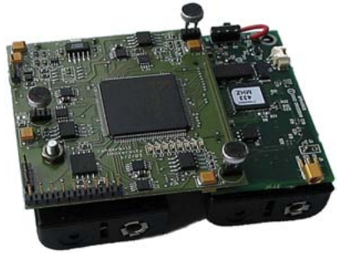
Introduction
Typical sensor network applications need time synchronization
Doesn’t need to be as heavy as distributed computing world
Better precision leads to better, more consistent, sensing
Examples
Target tracking
Surveillance
Battlefield monitoring
Counter-sniper systems
Target platform is Mica2
7.37 MHz processor
4kB RAM, 128kB flash
433 MHz radio (38.4 kbps, 500 ft range)
TinyOS operating system
Allows application developers to override OS operations like scheduling and radio communication

Slide 4
Approaches to Time Synchronization
Network Time Protocol (NTP)
Most widely adopted protocol
Used primarily in data centers
Accuracy in order of milliseconds
In DSNs, non-determinism of wireless communications add substantial imprecision
Popular DSN time protocols
Reference Broadcast Synchronization (RBS)
A reference message is broadcast, nodes timestamp the receipt
Nodes exchange time-stamp of reference message in order to sync
Large message overhead for communicating local time-stamps
Timing-sync Protocol for Sensor Networks (TPSN)
Builds a spanning tree of the network topology
Pairwise message exchange on edges, always syncing to root node
Does not handle clock drift and topology changes
The proposed protocol: FTSP
Uses less messages than TPSN
Handles clock drift between synchronization periods

Slide 5
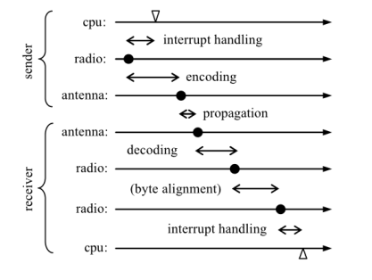
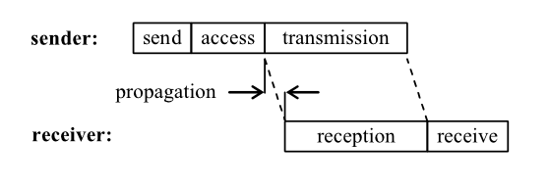
Uncertainties in Radio Message Delivery
Non-deterministic delays in wireless communications limit the precision of any time protocol
Sources of uncertainty can be classified as
Send time– time to assemble a message and issue the request to the MAC layer
Access time– delay of waiting for the medium to become free
Transmission time– time it takes to send the message
Propagation time– time it takes a bit to arrive at the receiver
Reception time– same as transmission time but at receiver

Slide 6
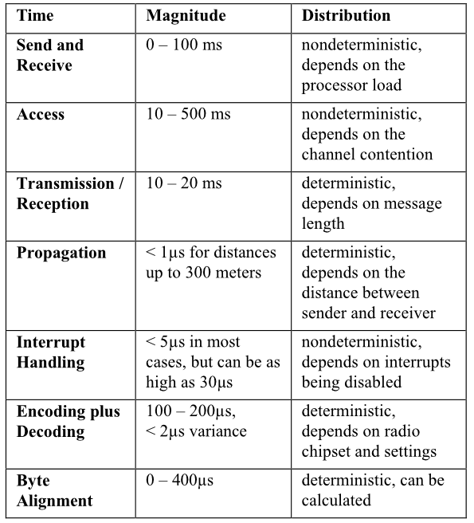
Uncertainties cont.
Sources of uncertainty cont.
Interrupt handling time– delay from radio issuing an interrupt and the CPU responding
Encoding time– time taken to transform bit stream to wireless pattern
Decoding time– time taken to transform wireless pattern to bit stream
Byte alignment time– time required to align sender’s bit stream at the receiver
Table outlines magnitudes and distributions
We see that send/receive and access time are biggest issues

Slide 7
Flooding Time Synchronization Protocol
Intro
Assume each node has local clock
Can have drift due to crystal’s timing errors
Nodes can communicate over wireless link to some neighbors
Unreliable but error corrected
FTSP synchronizes one sender to multiple receivers
Single message MAC layer time-stamped at sender and receiver
Linear regression used to compensate for clock drift between sync periods
Time-stamping
Multiple time-stamps are generated as byte boundaries pass
Interrupt handling time–minimum of these stamps
Encoding/decoding time– average of the time stamps
Alignment time– calculated from transmission speed and byte offset
With 6 time stamps used to calculate single error corrected final time stamp
Errors on Mica set-up was 1.4μs (average), 4.2μs (max)

Slide 8
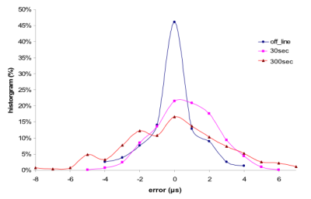
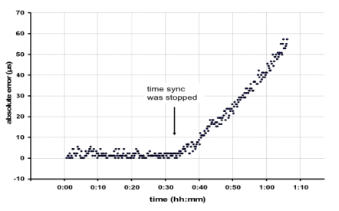
Clock Drift Management
Crystals in Mica can drift 40μs per second
If we wanted μs precision, sync period would have to be less than one second
Assume drift is linear provided short-ish sync period
Using linear regression of previous time offsets we can predict clock drift
Tested linear properties of drift in following experiment
Off-line linear regression of time stamps
Ideal case, not practical
Last 8 points used for on-line calculation
Re-sync period of 30s or 300s
Shorter period only marginally better
Requires re-sync (see →)

Slide 9
Multi-hop Time Synchronization
In practical DSNs network radius is larger than single radio’s range
Multiple nodes will need to broadcast reference times
FTSP’s solution
Root node is reference
A node is synchronized if enough sync periods have been gathered
Synchronized nodes can broadcast synchronization messages
Subtleties
Synchronization message format
Contains timestamp, root ID, and sequence number
Sequence number is set and incremented by root and used to handle redundant synchronization
Managing redundant information
Regression table needs 8 entries
New entry can only come from (rootID >= myRoot && seqNum > highestSeqNum)
Longer period of time contained in regression table leads to better regression results
Root election
Root is node with smallest ID in the network
Possibility of multiple roots in network but if message received with root ID lower than node ID, that node stops claiming to be root
Convergence
Choice of synchronization period is a tradeoff between power consumption, accuracy, and speed of convergence

Slide 10
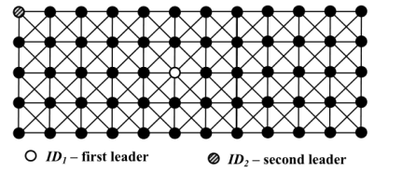
Experimental Set-up
Set-up
60 nodes with software implemented topology shown here
Topology meant to mimic multi-hop real-life network, but all nodes in experimental set-up need to be in range of metric gathering station
Root node (ID1) is in center, back up (ID2) is on edge
Parameters tuned to 30 second re-sync and 3 minute root declaration
Script for graph on next slide
A) All motes turned on at 0:04
B) At 1:00 root was turned off causing ID2 to become root eventually
C) For 15 minutes, starting at 2:00, nodes were reset randomly on a 30 second period
D) At 2:30 all odd node IDs were turned off
E) At 3:01 all odd nodes were turned back on
F) At 4:02 the experiment was ended

Slide 11
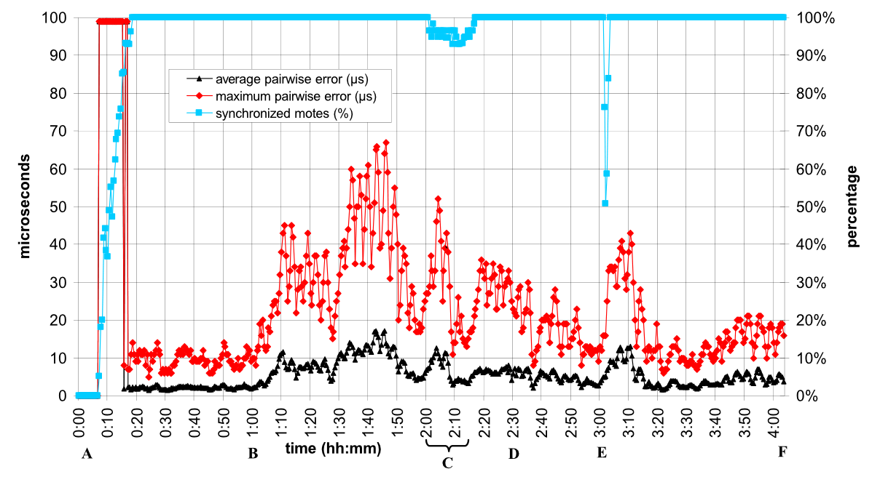
Results

Slide 12
Discussion and Comparison to Previous Approaches
When experiment starts, large percentage of nodes declare themselves root, no real sync
Eventually, system converges
Took 14 minutes (idealized result would have been 9-12 minutes)
During election of new root, error stays low
Nodes declare themselves new root but do not throw out their regression tables
This voting round only took 6 minutes
Errors under root ID2 were greater than under root ID1
First network is 60-mote, 6 max hop to root
Second network is 59-mote, 11 max hop to root
Average per-hop error only increased from 0.5μs to 1.6μs
TPSN and RBS algorithms were tested in a two-node experiment on identical hardware
16.9 and 29.1μs average errors compared to 3μs in FTSP case
Message overhead also much less than RBS, slightly less than TPSN

Slide 13
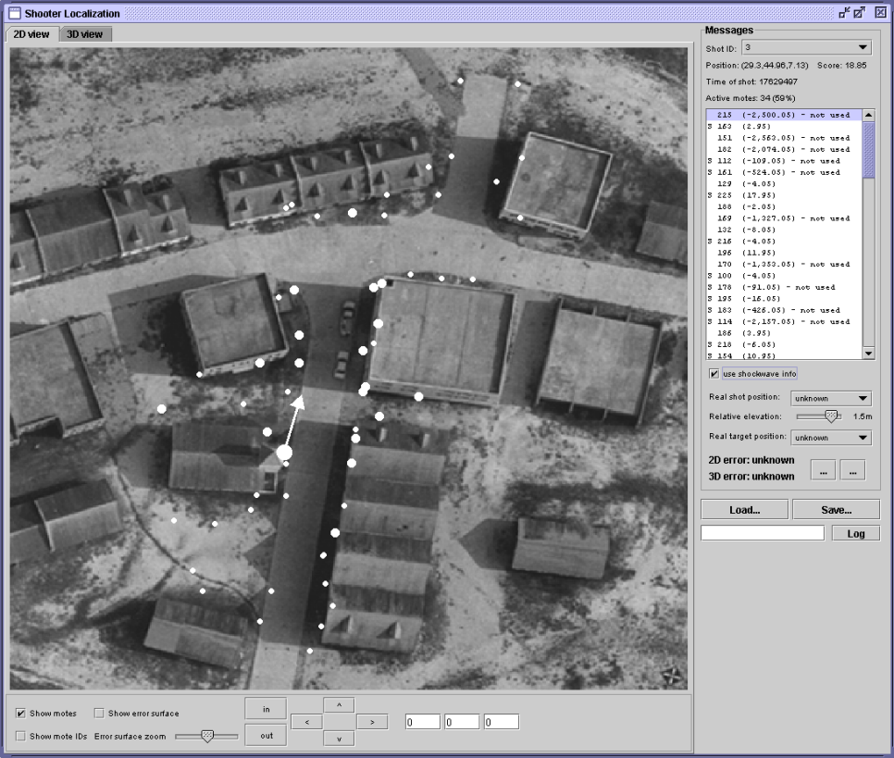
Applications and Conclusions
Used in real-world test experiment: Counter-sniper sensor network
60 motes with special FPGA-accelerated acoustical sensing algorithm
Repeated tests of 4-8 hours with fluctuations in humidity and temperature affecting clock drift
No FTSP metrics collected but application was successful and performance did not degrade over time
Further Improvements
Perform examination of scaling to thousands of nodes
Improve convergence by using two different broadcast periods (remember trickle?)

