Slide 1
Topic 3: Aero-space Applications (Short Lecture)
Jorge J. Gómez

Slide 2
A Distributed Routing Algorithm for Datagram Traffic in LEO Satellite Networks
Eylem Ekici, Ian F. Akyildiz, Michael D. Bender Georgia Institute of Technology and National Security Agency IEEE/ACM Transactions on Networking April 2001

Slide 3
Introduction
Satellite networks meet specialized communications needs of business, government, and individuals
Next-Generation Internet (NGI)
Rural, remote, and inaccessible areas
Flexible bandwidth on demand
Trivial to add new users
Satellite networking is very challenging
Satellites move causing changes in network topology
Distinction between logical and physical locations of satellites with respect to ground stations (destination)
Satellites move with respect to each other and with respect to their final, logical destination on the ground
This work extends existing datagram routing algorithms
Distributed algorithms to find minimum propagation delay paths
Off-line (pre-launch) calculations not required
No overhead because no topology information needs to be exchanged between satellites

Slide 4
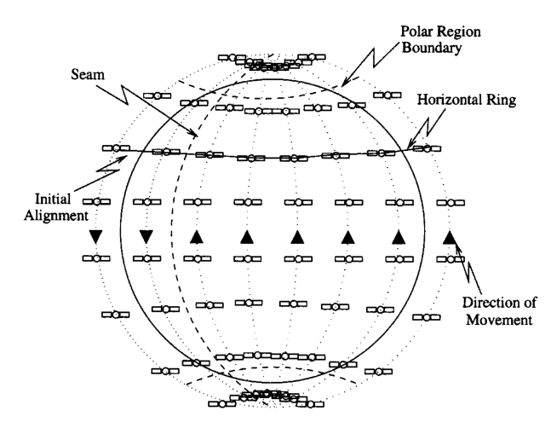
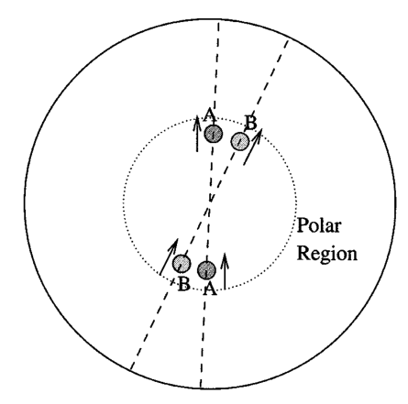
Satellite Network Architecture
Satellite Networks in LEO composed of
N – polar orbits (planes)
With M satellites per orbit
Inter-satellite distances
Constant within a plane (intra-plane links)
North-south routing
Length computation can be done off-line
Changes between planes (east-west routing)
Length varies but can be calculated easily
Inter-plane links are shorter the closer to the poles they get
Inter-plane links are shut down while crossing the poles because neighbors change locations
Routing is done with respect to logical locations
Logical location (base state) has one satellite associated with it at a time

Slide 5
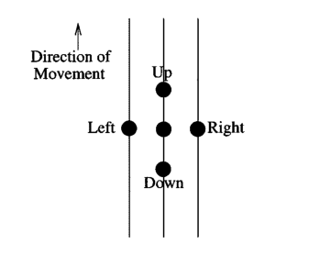
Satellite Network Architecture cont.
Definitions
Neighbors
Each satellite has two inter-plane neighbors (up, down) and two intra-plane neighbors (left, right)
Eastern and Western Hemispheres
The boundary where a satellite moving north has a neighbor to its west moving south (called seam) separates the logical east and west
Initial Alignment
When all satellites are over logical locations and all inter-plane links are parallel to the equator
Horizontal Ring
The satellites on the same latitude in initial alignment make up a horizontal ring
The horizontal rings closest to the polar regions are said to be at LATmin
Multi-hop path
Any source-destination satellite pair can be connected by a multi-hop path
Total propagation delay– the delay over a multi-hop path
Minimum propagation delay path– the multi-hop path that minimizes total propagation delay for a given source-destination pair

Slide 6
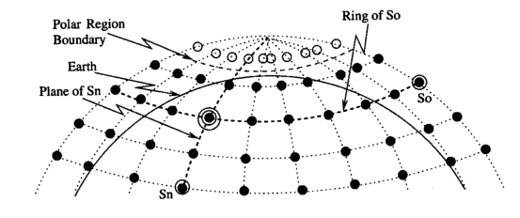
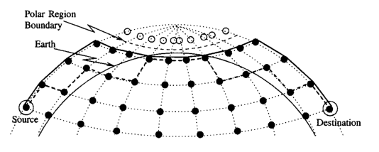
Datagram Routing Algorithm
Satellite network can be considered a spherical Manhattan Network
Special care taken with polar regions where only north-south links are active
Strict Manhattan Networking is sub-optimal
Inter-plane links further north are shorter and therefore have shorter inter-plane delays
Decision map created to decide whether to pass over pole to get to destination
Two equations presented which serve as decision metric for the north direction in LATmin horizontal ring
Logically, delay of going strictly horizontally is greater than going north twice and finishing the rotation in opposite hemisphere

Slide 7
Datagram Routing Algorithm cont.
First step: Direction Estimation
Assume all links have equal delay and position is over logical locations
Output of this step is two directions dv and dh with three possible values each {-1, 0, 1} for up/right, no change, or down/left
Simple look up table created for every destination
Second step: Direction Enhancement
Considers output of last step but relaxes assumption of equal delay links
Simple rules for enhancement
If in polar region, take dv as dh is unavailable
If in LATmin, prefer dh unless polar crossing is shorter (decision map)
Anywhere else, compute minimum delay based on simple equation set
Outputs preferred direction and secondary direction in case of congestion or faults
Third step: Congestion Avoidance
Take secondary direction if output buffer in preferred direction is larger than preset metric
Resulting path will still be minimum-hop but may not be minimum-delay

Slide 8
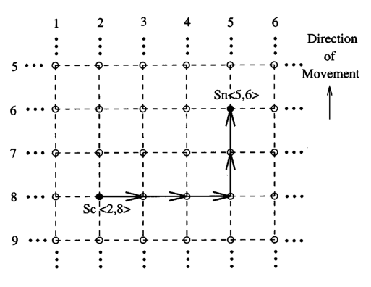
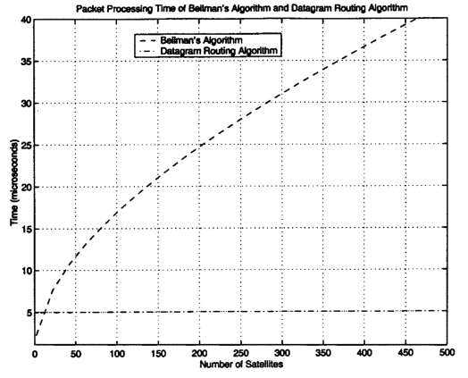
Datagram Routing Algorithm cont.
Fault-tolerance
If currently in polar region and north neighbor failed, send back
If satellite in primary direction failed, use secondary
If satellite in primary direction failed and no secondary direction identified send in a direction orthogonal to primary
Time and space complexity
Packet forwarding decision is O(1)
Connectivity and lookup tables are of size M²xN²

Slide 9
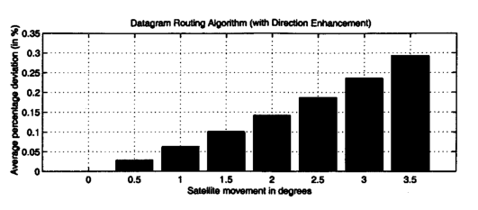
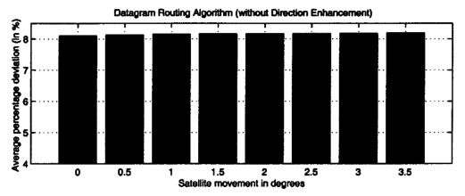
Performance
In all experiments constellation is 12 planes with 24 satellites per plane
Results based on all possible source-destination pairs
Comparisons based on Bellman’s algorithm O(N³) max O(N*log(N)) average
Path Optimality
Authors made assumption that all routing happens with satellites positioned over logical locations
Effect of deviating from that assumption is minimal
Max deviation from results of Bellman’s is 0.35% with direction enhancement stage turned on
Constantly 8% without direction enhancement
Enhancement phase is critical in the algorithm for minimum delay paths

Slide 10
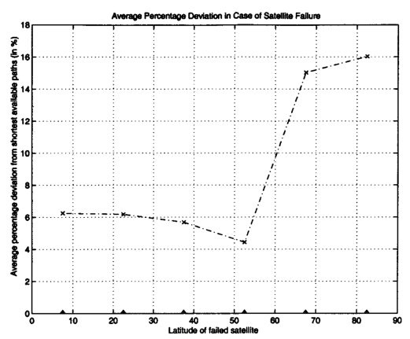
Performance cont.
Effect of satellite failures
Percent deviation from optimal studied versus latitude of failed satellite
Longitude of satellite follows the same pattern
Deviation falls from 6.25% to 4.4% while moving north from equator
Links get shorter
When the satellite is in LATmin the deviation increases to 15%, 16% for satellites in the polar region
Failures inside of next to polar region causes the packets to be sent back to satellites outside that region
Increases the difference in the propagation delay
The increases in this case are still minimal
Satellite failures are rare and typically short lived

Slide 11
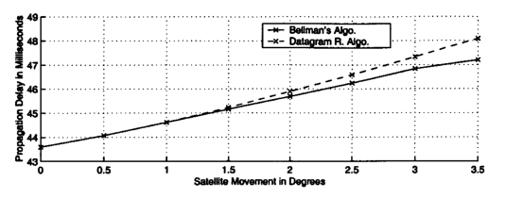
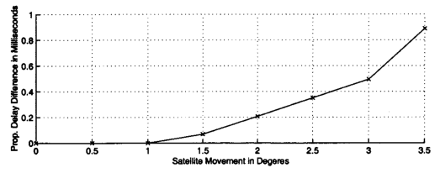
Performance cont.
Typical propagation delay values
Real-life scenario of packets travelling from continental North America (40N, 120W) to Central Europe (55N, 12E)
Satellite constellation is identical to the other experiments
All satellites ~1375 km above the surface
We start with initial alignment of the satellites and examine the change in propagation delay over each quarter of the movement period
Bellman’s algorithm yields values between 43.5 and 47.1 milliseconds one way, while this algorithm deviates from that by less than a millisecond at the worst case

Slide 12
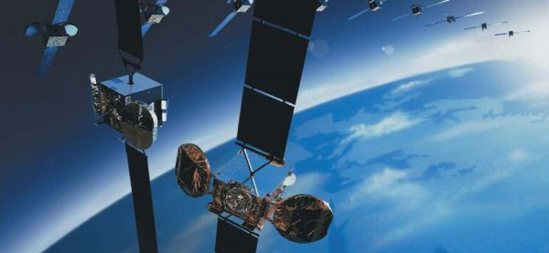
Conclusions
Introduced a datagram routing algorithm for LEO satellite networks
Algorithm is distributed
Routing decisions are made on a per packet basis
The generated paths are loop free and shown to be durable
Satellite movements have negligible effect on optimality
Protocol can route around failures with minimal performance degradation
Can avoid congested satellites using only local data
Viable routing algorithm for satellites providing Next Generation Internet

