Slide 1
A Real-time Non-intrusive FPGA-based Drowsiness Detection System
Salvatore Vitabile, Alessandra De Paola, Filippo Sorbello
Department of Biopathology and Medical Biotechnology and Forensics, University of Palermo, Italy
Journal of Ambient Intelligence and Humanized Computing
Published on March 30, 2011
Chien-Chih(Paul) Chao
Chih-Chiang(Michael) Chang
Instructor: Dr. Ann Gordon-Ross

Slide 2
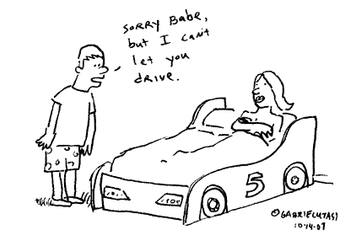
Overview
An embedded monitoring system to detect symptoms of driver’s drowsiness.

Slide 3
Agenda
Motivation
Related works
Drowsiness Monitoring System
Eye Regions Segmentation
Candidate Eye Regions Selection
Driver’s Eyes Detection
Drowsiness Level Computation
Experimental trials
Conclusion
Limitations & Future Work

Slide 4
Motivation
10-20% of all European traffic accidents are due to the diminished level of attention caused by fatigue.
In the trucking industry about 60% of vehicular accidents are related to driver hypo-vigilance. [1]
Automotive has gained several benefit from the Ambient Intelligent researches involving the development of sensors and hardware devices

Slide 5
Related works
The technique categories for preventing driver’s drowsiness [2]
Readiness-to-perform and fitness-for-duty technologies
Mathematical models of dynamics alertness
Vehicle-based performance technologies
The lateral position
Steering wheel movements
time-to-line crossing
Real-time technologies for monitoring driver’s status
Intrusive monitoring systems
Non-intrusive monitoring systems
Notes:
Assess the vigilance capacity of an operator before the work is performed

Slide 6
Related works
The most accurate techniques are based on physiological measures
Brain waves
Heart rate
Pulse rate
Causing annoyance due to require electrodes to be attached to the drivers

Slide 7
Drowsiness Monitoring System
A non-intrusive, real-time drowsiness detection system.
Using FPGA instead of ASIC of DSP
Re-programmability
Performance
Costs
IR camera
Low light conditions
‘‘Bright pupil’’ phenomenon to detect the eyes

Slide 8
Drowsiness Monitoring System
PERCLOS (Percentage of Eye Closure)
The driver eyes are closed more than 80% within a specified time interval is defined as drowsiness. [3]

Slide 9
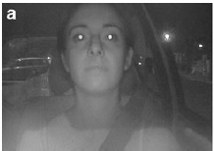
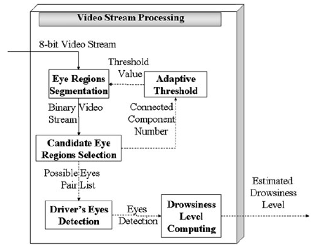
Eye Regions Segmentation
“Bright Pupil”
Threshold Operation
Clipping & Morphological Operation
Notes:
The first step comprises a process of segmentation of the frames from the video stream in order to isolate the regions that could correspond to the driver’s eyes.
***Adaptive Threshold***

Slide 10
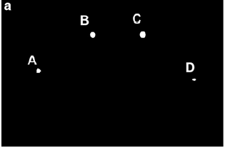
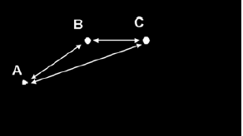
Candidate Eye Regions Selection
A list of blobs
Possible Eye Pairs
Quasi-circular shape:
Square Bounding Box
R
R = ½ a
a
Notes:
1) Accordingly to the face model described in Sect. 3, connected component pairs has been checked against the selected shape and geometric rules.
2) The shape test detects binary blobs satisfying size and shape constraints (driver’s eyes have a quasi-circular shape), while other bright components are discarded.
3) To detect if a blob has a quasi-circular shape the following heuristic tests were performed:
1)) the blob’s bounding box is almost similar to a square;
2)) the blob’s area (computed as the number of pixels) is similar to the area of an ideal circle with radius equal to the half of the mean among bounding-box dimensions;
**[4) check and validate inclination and distance between all possible connected components]** keep this

Slide 11
Driver’s Eyes Detection
Notes:
1) Accordingly to the face model described in Sect. 3, connected component pairs has been checked against the selected shape and geometric rules.
2) The shape test detects binary blobs satisfying size and shape constraints (driver’s eyes have a quasi-circular shape), while other bright components are discarded.
3) To detect if a blob has a quasi-circular shape the following heuristic tests were performed:
1)) the blob’s bounding box is almost similar to a square;
2)) the blob’s area (computed as the number of pixels) is similar to the area of an idxeal circle with radius equal to the half of the mean among bounding-box dimensions;
**[4) check and validate inclination and distance between all possible connected components]** keep this
driver’s eyes are marked as open when the number of occurrences of the predominant class exceeds half of the temporal window

Slide 12
Driver’s Eyes Detection
Frame 1
Frame 2
Frame 3
Frame 4
Coordinate
At t
[ (X1, Y1) , (X2, Y2) ]
t = 5
[ (X1, Y1) , (X2, Y2) ]
t = 4
[ (X1, Y1) , (X2, Y2) ]
t = 3
[ (X1, Y1) , (X2, Y2) ]
t = 2
[ (X1, Y1) , (X2, Y2) ]
t = 1
Class
Class 2
Class 1
Class 1
Class 1
Class 1
Class 1
Class 2
Class 3
Class 4
Class 5
Weight
4
3
0
0
0
0
1

Slide 13
Drowsiness Level Computation
PERCLOS
18 consecutive frames w/o eyes
(300 ms)
The alarm system is activated!
Notes:
1) Percentage of Eye Closure(PERCLOS)
PERCLOS measures the proportion of time that the pupils are at least 80% covered by the eyelids
2) PERCLOS value is directly related to the number of frames with no driver’s eye
3) However, experimental trials have suggested that a robust measure of the level of fatigue has to follow sudden changes by incorporating information about the past history of those levels. So, PERCLOS value is carried out by a weighted function including
the present value as well as the weighted past values.
4) the alarm system is activated either when the overall_PERCLOS <= 0.5 or driver’s eyes are undetected in 18 consecutive frames (300 ms)

Slide 14
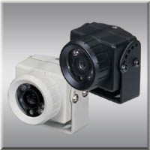
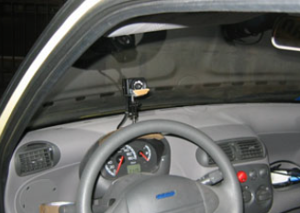
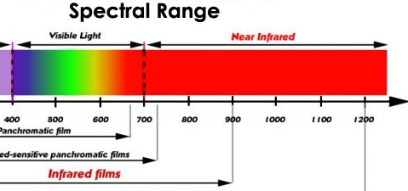
Experimental Devices
JSP DF-402 infrared-sensitive camera
Color camera in daytime
Infrared camera under low light cond.

Slide 15
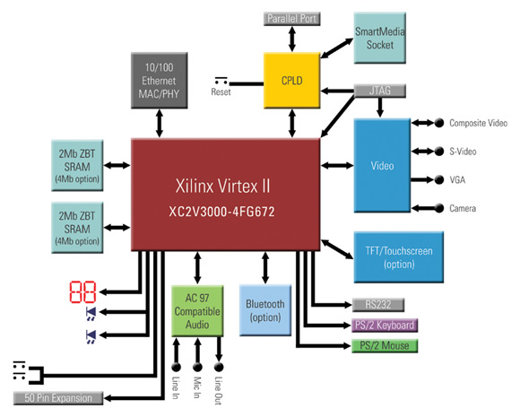
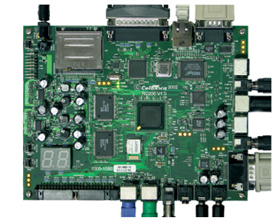
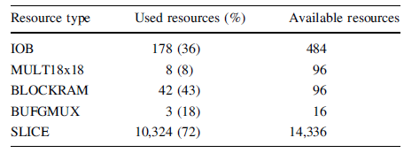
Experimental Devices
Celoxica RC203E
XilinX XC2V3000-4 Virtex II FPGA
Handel-C
PixelStreams Library
Notes:
The IOB row reports information about board input-output blocks
The MULT18X18 reports information about board combinational signed 18-bit 9 18-bit multipliers
BLOCKRAM row reports information about board SRAM memory
The BUFGMUX row reports information about board multiplexed global clock buffers
The SLICE row reports information about board logical cells contained in the Configurable Logic Block

Slide 16
Experimental Trials
In light controlled environment
Drive-Camera relative distance
Not affected by driver-camera relative distance
ID =1

Slide 17
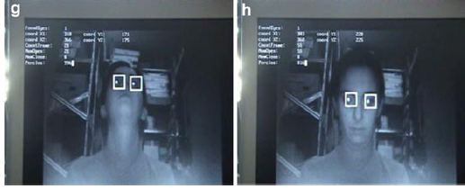
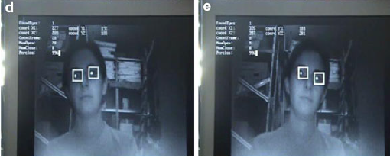
Experimental Trials (cont.)
Vertical and Horizontal of head movement
ID =2

Slide 18
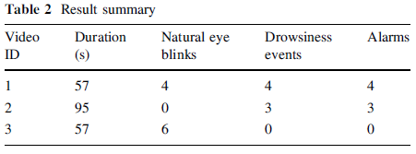
Experimental Trials Result
Real operation condition (External illumination not controlled)
ID =3

Slide 19
Conclusion
An algorithm to detect and track the driver’s eyes has been developed by exploiting bright pupils phenomenon
Good performance on rapid movements of driver’s head.
Performance not affected by driver-camera relative distance.
The drowsiness monitoring system can be used with low light conditions by using infrared camera

Slide 20
Limitations & Future Work
Faulty operations
the driver is wearing glasses
the driver’s IR-reflecting objects such as earring
Drowsiness usually happen during the evening/night hours
Light poles might be recognized as eye candidates due to the shape and size on screen

