Slide 1
Reconfigurable Hardware for High–Security/ High Performance Embedded Systems: The SAFES Perspective
Guy Gogniat, Jean Philippe Diguet ,Romain Vaslin,Tilman Wolf, Wayne Burleson, Lilian Bossuet
University of South Britanny, University of Massachusetts, Amherst, University of Bordeaux
IEEE TRANSACTIONS ON VERY LARGE SCALE INTEGRATION (VLSI) SYSTEMS, VOL. 16, NO. 2, FEBRUARY 2008
Deepika Ranade
Sharanna Chowdhury

Slide 2
Motivation
Security issues
Sophisticated attacks
User concerns
Confidentiality and privacy
Security

Slide 3
Related Work
Processor-based cryptography solutions
Computation is costly
Cryptography Co-processor
Not considered energy-efficiency
FPGA for security primitives
Not considered flexibility of primitives
Hardware Monitoring
Energy Monitoring
SAFES is the first approach to dynamically adapt security primitive

Slide 4
Hardware Attacks and Countermeasures
Hardware Attacks
Active
Irreversible ( Invasive)
Reversible ( Non Invasive)
Passive
Counter Measures
Symptom-free
Security-aware
Activity-aware
Agility
Robust
Classification of attacks against
embedded systems

Slide 5
Use of Reconfigurability
SOLUTION ??
Reconfigurable Hardware
- to deal with hardware security and performance
Properties:
Adaptability
Dynamic Property
Security
High
Performance

Slide 6
SAFES: Reconfigurable Architecture and Monitors
Battery
Secure Embedded System
Processor
Memory
Power
Monitor
Bus
Monitor
FPGA
I/O
Security Executive Processor
Security Primitive
Security Primitive
Security Primitive
Clock
Clock
Monitor
Primitive
Monitor
Channel
Monitor

Slide 7
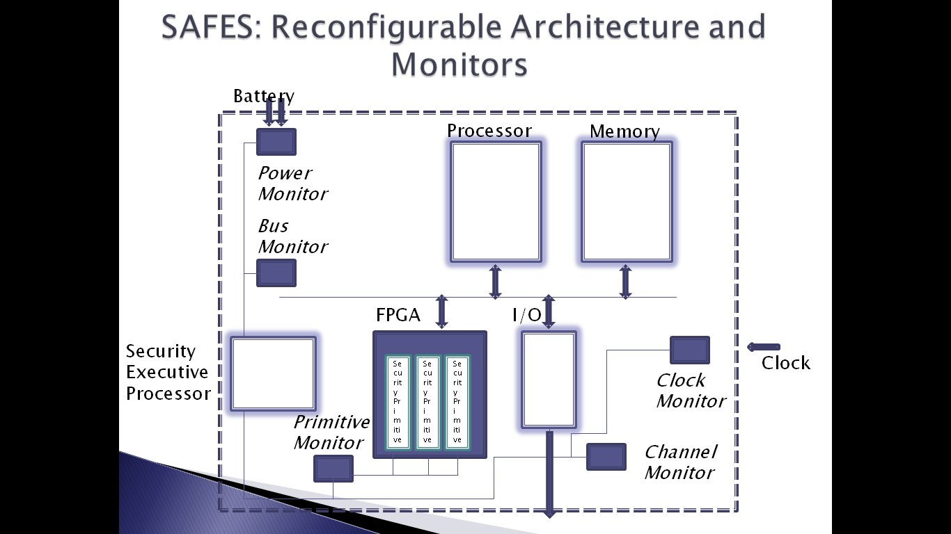
SAFES: Security Architecture for Embedded Systems
The Monitoring System
The Reconfigurable Architecture
Tracks specific data of system
Detects attacks
Characterizes normal activity
Monitors authenticated in the network
Levels of reaction:
reflex or global
Monitors linked by on-chip security network
controlled by the security executive processor (SEP)
FPGA which contains security primitives
Dynamically reconfigurable primitives
Security Primitive
Agile Hardware Accelerator
Performs security Algorithm
Goals:
speedup computation
provide flexibility
provide various tradeoffs

Slide 8
Security Primitive Architecture
1] The security primitive datapath
2] The security primitive controller (SPC)
SPC is connected to the datapath
~ for the reconfiguration of the datapath
SPC is connected to the system processor
~to define the configuration of the security primitive
3] The system security controller (SSC)
SSC is connected to the SPC
~ to monitor the primitive
~ to detect attacks against the primitive.
SSC is connected to all monitors of the system
~ to analyze the different parts of the system

Slide 9
SPC FSM
Security
Algorithm Parameters modification for security
Init
Checking of Algorithm Parameters done
Algorithm Parameters modification for performance
INITIALIZATION
SPC polls system state
Battery level
Comm. channel quality
Defines implementation feasible within the primitive
Provides info. to processor
Restart Security Primitive
Run
Config
Security Primitive Ready
Security Primitive Terminated
Stop

Slide 10
SPC FSM
Algorithm Parameters modification for security
Security
CONFIGURATION
After Processor selects algorithm parameters
SPC selects configuration data
Begins configuring datapath
Init
Algorithm Parameters modification for performance
Checking of Algorithm Parameters done
Restart Security Primitive
Run
Config
Security Primitive Ready
Security Primitive Terminated
Stop

Slide 11
SPC FSM
Security
Algorithm Parameters modification for security
Init
Algorithm Parameters modification for performance
Checking of Algorithm Parameters done
Restart Security Primitive
RUN
Security Primitive is ready to run
SPC checks system through SSC to define if primitive needs reconfiguration
Run
Config
Security Primitive Ready
Security Primitive Terminated
Stop

Slide 12
SPC FSM
Security
Algorithm Parameters modification for security
Init
Algorithm Parameters modification for performance
Checking of Algorithm Parameters done
IDLE/ STOP
Computation performed.
Security Primitive can be stopped (Idle)/ removed from Reconfigurable hardware(Stop)
Restart Security Primitive
Run
Config
Security Primitive Ready
Security Primitive Terminated
Idle/Stop

Slide 13
SPC FSM
SECURITY
Always active.
Driven by SSC to indicate requirement of reconfig.
Enforces activation of Config state
Security
Algorithm Parameters modification for security
Init
Algorithm Parameters modification for performance
Checking of Algorithm Parameters done
Restart Security Primitive
Run
Config
Security Primitive Ready
Security Primitive Terminated
Stop

Slide 14
Scenario 1: Attack
Irregular activity in primitive/ system
Hijack
Denial of service attack
Extraction of secret information attack
SSC indicates the configuration to SPC
Reconfigure Security primitive
Enhance fault tolerance of primitive
Stall I/O of primitive
Attack
SSC’s action

Slide 15
Scenario 2: Attack fended off
SPC defines new configuration
Power limitation
Evolving environment
Protected modes require more area, power
Kick in only when required
For best effort performance policy
Throughput Vs energy
Energy-efficient architecture with lower throughput
Battery low
Channel quality < threshold

Slide 16
Scenario 1revisited
Primitive/ System evolves
New configuration needs to be downloaded
Cause
Effect

Slide 17
Scenario 1revisited
Replace correct configuration
All trusted configurations replaced
Encrypt Bitstream
Download bitstream to system only after integrity check
Store all bitstreams in attack-proof memory
Attack
Solution

Slide 18
Case Study
Xilinx Virtex-II Pro device
Xilinx ISE, Xilinx Xpower
AES and RC6 algorithms
Memory
FPGA
Processor
Execution modes
Key/ data sizes
Architectural Modes
Algorithm parameters
Fault Detection/ Tolerance
Throughput, Area, Energy
Notes:
IPSec is flexible : allows negotiation of algorithm choices and configurations between communicating parties.
Algorithm parameters defined during main mode, quick mode security association steps.
Parameters are used to transmit data during secure data transfer step.

Slide 19
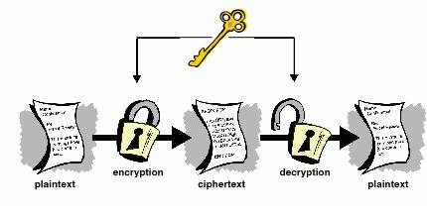
RC6
Performance analysis
2 steps
Offline exploration of architectures
Online select parameters
Application-wise bandwidth requirement
Adapt area, power

Slide 20
RC6 Step 1
# pipeline stages
Data (i) & key (j)
Data (i+1) & key (j+1)
# of key generators
insignificant area
Period for computation
Pipeline stages
1, 2, 4, 8
Key generators
1,2
If 2 KG
Parallel Encryption and Decrytion
If 1 KG
Alternate Encryption and Decrytion
Parameters
Architectures

Slide 21
RC6 Step 1
ID0-3: 1 KG
Depth of pipeline doubled
Throughput doubles
ID4-7: 2 KG
Parallel Computation
Double throughput w.r.t 1 KG
Results
Throughput Vs Area

Slide 22
RC6 Step 1
Pipe | Power (W) |  | Energy Efficiency (Gbit/J)
 | KG=1 | KG=2 | KG=1 | KG=1
1 | 1.6 | 2.4 | 0.08 | 0.09
2 | 3.4 | 6 | 0.07 | 0.09
4 | 5.1 | 7.1 | 0.1 | 0.15
8 | 8.1 | 9.8 | 0.13 | 0.18
Energy Efficiency = Throughput / energy
Parallel Computations provide better energy-efficiency
Results
Energy

Slide 23
RC6 Step 2
Performance analysis
2 steps
Offline exploration of architectures
Online parameters selection
Application-wise bandwidth requirement
Compare Required Throughput Vs Maximum Throughput with current parameters
Is reconfiguration needed?
Select slower/ faster configuration
Adapt area, power

Slide 24
AES
Feedback mode without security
Feedback mode + fault detection
Parity-based
Feedback mode + fault tolerant architecture
TMR technique

Slide 25
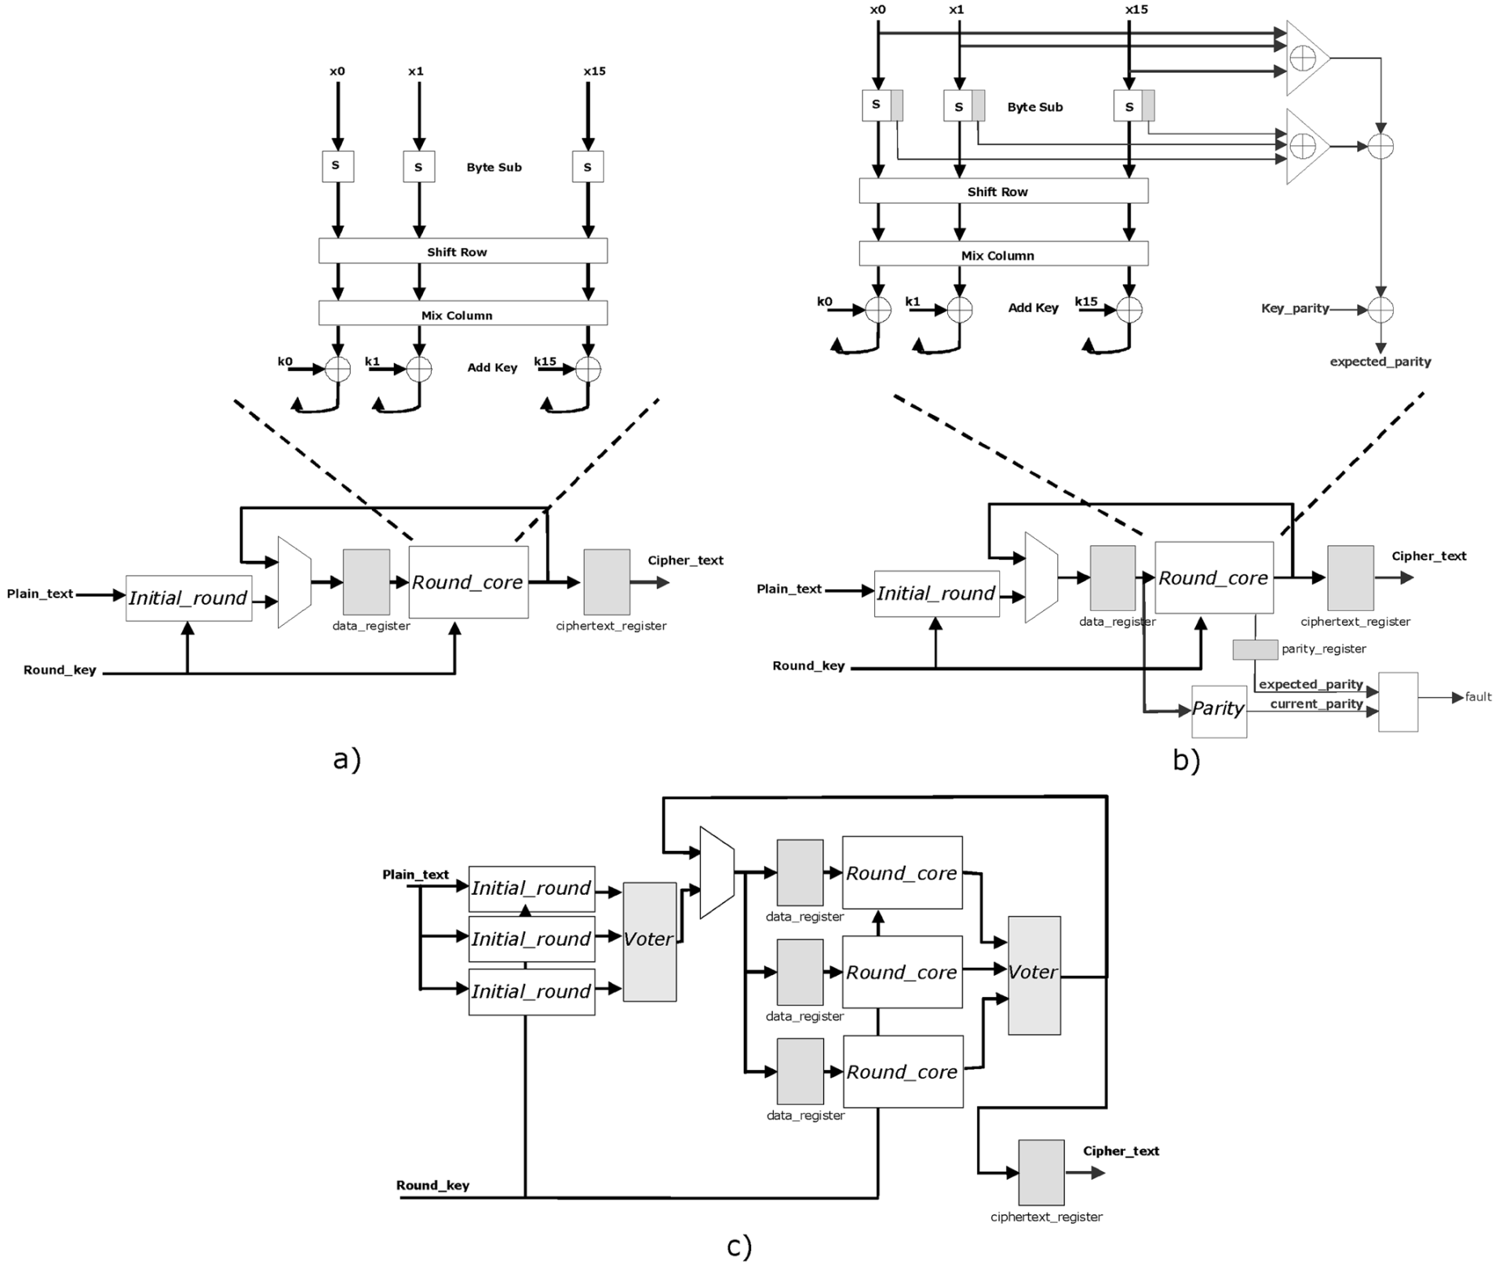

Slide 26
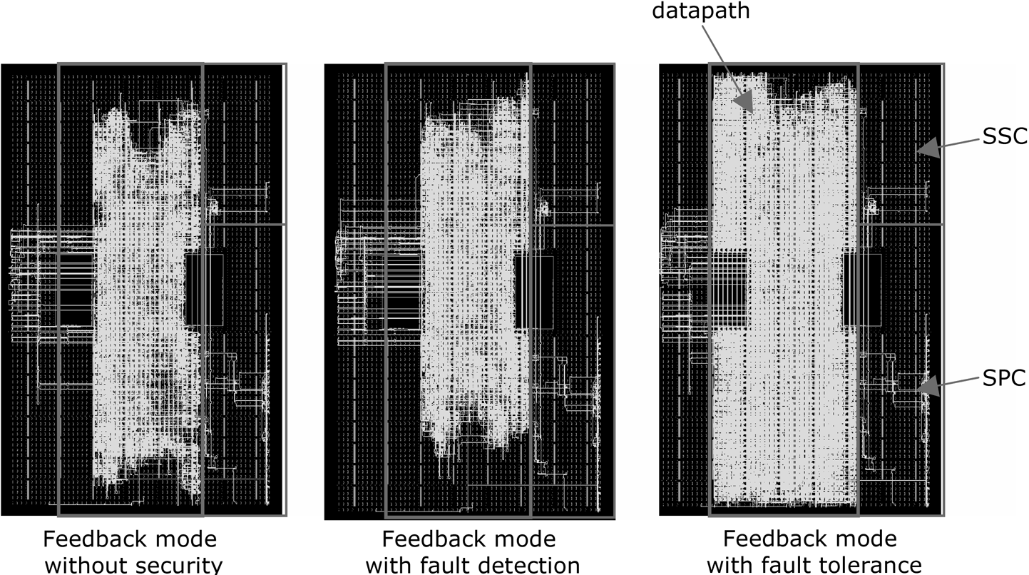

Slide 27
AES
Feedback mode
FB + fault detection
Only +2.1 % area, -2.7 % power
FB + fault tolerant architecture
High energy (GB/J), area overhead
Bus monitoring
Regular access to key memory address
Counter for non-key n key access

Slide 28
Conclusions
Reconfigurable hardware in Embedded Systems
Adaptability
Dynamic Reconfiguration
SAFES
Energy-efficient + Secure
Protection + Performance
Reconfigurable Security Primitives
Continuous monitoring to detect abnormal behaviour
Future work
Control flow monitor within Embedded Processor
Attack detection

