Slide 1
Cost-Efficient Memory Architecture Design of NAND Flash Memory Embedded Systems
Chanik Park, Jaeyu Seo, Dongyoung Seo, Shinhan Kim and Bumsoo Kim
Software Center, SAMSUNG Electronics, Co., Ltd.
Proceedings of the 21st International Conference on Computer Design
2003 IEEE
Deepika Ranade
Sharanna Chowdhury

Slide 2
Why is Memory Architecture Design so important?
COST
POWER
PERFORMANCE

Slide 3
Typical Memory Architecture of Embedded Systems
ROM
~bootstrapping
~code execution
~working memory
~permanent data
storage
RAM
Flash
Memory

Slide 4
Flash Memory
XIP
Execution of application directly from the Flash instead of downloading code into systems’ RAM before executing
FEATURES ~
Non-volatility
Reliability
Low power consumption
NAND
NOR
FLASH
~High density+low-cost data storage
~Not suited to XIP applications
(sequential access +long access latency)
~Code storage
~XIP applications
(high-speed random access)

Slide 5
Characteristics of various memory devices
Adv
Disadv
Performance
Power
Mobile SDRAM
NOR
Flash
Low power SRAM
Fast SRAM
NAND
Flash
Power
Storage capacity Erase/Write
Performance
Random Read Latency
Power
Cost
Random access speed
Power
Cost
Performance
Cost

Slide 6
NAND flash memory with XIP functionality
Cost reduces
data storage + code storage
Cost-efficient memory systems
reasonable performance + power consumption
Approach
exploit locality of code access pattern
devise cache controller for repeatedly accessed codes
use prefetching cache to hide memory latency of NAND access

Slide 7
Motivational Systems: Mobile Embedded Systems
Mobile systems
~data centric + multimedia oriented
apps
~Requires high
performance+ huge permanent storage
capacity
Performance not enough for 3G apps ~real-time multimedia apps
Increased no. of
Components
~ increased system cost
Best performance
~ slow boot process. SDRAM to holds OS + apps.
~power consumption of SDRAM=problem for battery-operated systems
Approach 1
NOR=code storage
SRAM=working memory
Used for low-end phones (Medium performance +cost)
Approach 2
NAND= meets storage capacity requirement
Approach 3
Eliminates NOR
Uses NAND for shadowing technique.

Slide 8
NAND XIP Architecture -Background
Block
Page 1
Main data (512 bytes)
Spare data
(16 Bytes)
Page 2
Page 32

Slide 9
Performance considerations for NAND XIP
1. Average memory access time
~ performance metric
~ comparable to other memories eg. NOR, SRAM, SDRAM
2. Worst case handling
~ /cache miss handling
~ practical problem for mobile systems (e.g. Cell phones)
-time-critical interrupt handling e.g. call processing.
-e.g. if interrupt during cache miss handling
->system can miss deadline / lose data or connection.
3. Bad block management
~ bad blocks-inherent in NAND
~ cause discontinuous memory space
->intolerable for code execution

Slide 10
Basic Implementation
Syst
em
Interface
Cache
(SRAM)
Fla
sh Interface
NAND
Boot Loader
Prefetch
Control Logic
NAND XIP controller

Slide 11
Basic Implementation cont.
Interface conversion
~ Connects I/O interface of NAND to memory bus
Cache mechanism
~ direct map cache + victim cache + optimization
for NAND flash
~ 1. victim cache(vc) accessed on main cache miss
2. if vc hit-data returned to CPU + sent to main cache;
replaced block in main cache moved to vc *
3. if vc miss -> NAND access;
data fills main cache;
replaced block moved to vc
Swap modified using system memory and PAT
The prefetching cache - hides memory latency
of NAND access.
SWAP !!

Slide 12
Intelligent Caching: Priority-based Caching
Basic implementation
application code (shows spatial + temporal localities)
systems code (complex functionality + large size +
interrupt driven control transfers among procedures)
Intelligent Caching
distinguish different cache behavior
between system & application codes adapt it to page-based NAND architecture

Slide 13
Code Page Priorities
Code pages
High Priority
Pages
Mid Priority
Pages
Low Priority Pages
PAT
*remaps pages in bad blocks to pages in
good blocks
*remaps requested pages to swapped pages in system memory
Categorized~
access cost
Priority ~
number of references to pages
criticality.
Page referenced frequently + time critical codes
should be cached
~to reduce access cost if
page is in NAND
e.g. OS-related code, real-time applications
normal application code
handled by normal caching policy
Sequential code (rarely executed)
e.g. initialization code

Slide 14
Caching Mechanism
Data bus
Address bus
Page address translation table
Control
Conflict!
Main cache
Victim
A
H
A
A
H
H
B
B
B
L
L
L
C
C
C
H
H
H
NAND
SRAM/ SDRAM

Slide 15
Usage of Spare Area
*Stores priority info (H or L)
*Stores auxiliary info
~ bad block identification
~error correction code
*Stores pre-fetching info
Page = main data + spare data
Main data (512 bytes)
Spare data
(16 Bytes)

Slide 16
Experimental Results1
~Compare miss ratio over various
configuration parameters
(associativity, replacement
policy, cache size)
~Cache size affects miss ratio most

Slide 17
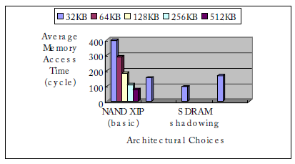
Experimental Results2
~Analyze optimal cache line size in NAND XIP cache
~Line size of 256-byte better
*in average memory
access time
*energy consumption

Slide 18
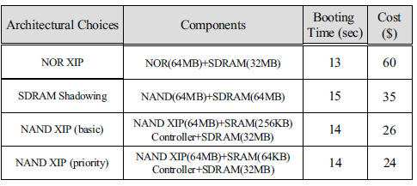
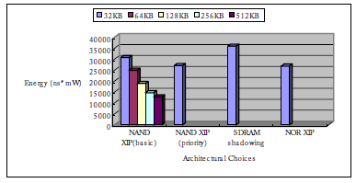
Experimental Results 3
~Overall performance
comparison among different memory architectures
1. NOR XIP architecture (NOR+SDRAM)
~fast boot time+ low power
~high cost.
2. SDRAM shadowing architecture (NAND + SDRAM)
~ high performance
~ long booting time
3. NAND XIP
~reasonable booting time
~good performance
~decent power
~ outstanding cost efficiency

Slide 19
Worst Case Handling
NAND XIP suffers from worst-case handling /cache miss handling
CPU utilization problem
Solution
~hold CPU till requested page arrives
~implemented using handshaking
~ miss penalty =35us is non-trivial
Time-critical interrupt loss as processor waits for memory’s response
Solution
~requires system-wide approach.
~OS handles cache miss as a page fault
~CPU supplies “abort” function to restart requested instruction after
cache miss handling

Slide 20
Conclusion
Extended NAND flash application to include code execution area
Demonstrated feasibility of proposed architecture in real-life mobile embedded environment
As future work, system-wide approach will be helpful to exploit NAND flash in embedded memory systems

Slide 21
Design of a NAND Flash Memory File System to Improve System Boot Time
Song-Hwa Park, Tae-Hoon Lee, Ki-Dong Chung
Pusan National University, Pusan, Korea
International Journal of Information Processing Systems, Vol.2, No.3, December 2006
Deepika Ranade
Sharanna Chowdhury

Slide 22
Motivation
Target Embedded systems
MP3 players, digital cameras, RFID readers
limited resources
instant start-up time
Flash memory pros
non-volatile,
fast access time
solid-state shock resistance
Flash memory Cons
Mounting time of Flash file system
Large fraction of system boot time
flash capacity
amount of stored data

Slide 23
Hardware constraints
write-once device
No direct overwriting
Initial state → other state
No reverse transition
Block erase operation
Even to change 1 bit of data
Granularity: Block erase Vs page write

Slide 24
YAFFS
ChunkID=0
~object header
~name, size, modified time
ChunkID !=0
~Chunk contains data
~ChunkID= position of chunk in the file
512-byte pages + 16-byte spare area
Chunk (==user area)of data
object header
file data
Spare area <-> chunk
chunkID
serialNumber
byteCount
objectID
ECC
Tree of File data locations

Slide 25
RFFS
flash memory capacity
amount of
stored data
Location Information Area (LIA)
General Area (GA)
managed separately

Slide 26
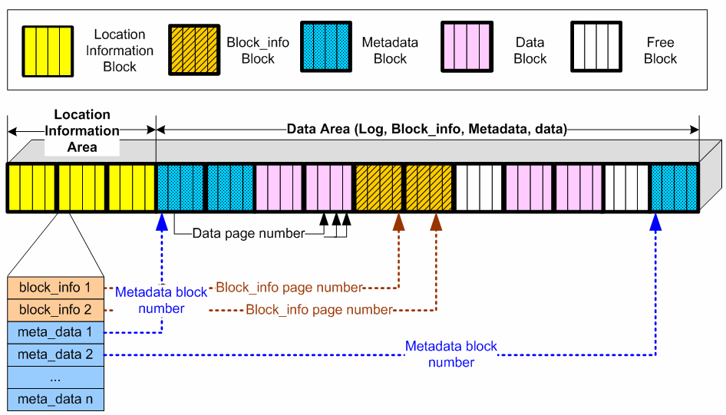
RFSS cont..
LIA
GA
Latest location information
Groups of blocks
Read into the main memory @ mounting
Loc_Info
LI data structure
block_info
Latest block information ptr
array of meta_data
Ptr to metadata sub-area
Stores all sub-areas
File Data
Metadata
Block_Info
Managed by Segment unit

Slide 27
RFSS (GA) cont..
Metadata
Block_info
Independent segments
For objects like files, directories, hard links, symbolic links
RFFS contains file locations in metadata
Block_Info data structures
# pages in use
block status
block type
Helps RFFS to decide
new block allocation
garbage collection
Can construct data structures in RAM by only scanning the metadata sub-area @mounting
@Unmounting
latest Block_Info written
to flash

Slide 28
Existing File Systems
Fast mounting solution
LFS Log-structured File System
JFFS2, YAFFS
updated data written to other space
Long mounting time
File systems have to scan entire flash memory
RFFS
stores Block_Info+ Block_Info addresses + metadata blocks
Further improvement
Reduce data scanned
Blocks used partly
Why write all Block_Info
wastes memory
delay mounting
Data scattered all over NAND Flash

Slide 29
Proposed File system
stores flash memory image
in-memory block status
Mounting procedure
reads flash memory image
construct block information in RAM
Reads only metadata blocks using block information
Unmounting procedure:
memory image written to fixed location
Molehill from the mountain ☺
Fast

Slide 30
NAND Flash File System Design
On-Flash Data Structures
Flash Image Area (FIA)
Block_Info
Data Area (DA)
Metadata
In-Memory Data Structures
Block_Status
UsedBlockNumber
Object structures
Abstraction of directories, files, hard links, symbolic links
And the Data, of course!!
~file data or data locations depending on the file size
~improves flash memory availability

Slide 31
Flash Image Area
latest flash memory info
Block_Info
block type
Block status
# pages in use
fixed size
round-robin
@unmounting
Block_Info of used blocks written in FIA
Invalidate pages with previous image

Slide 32
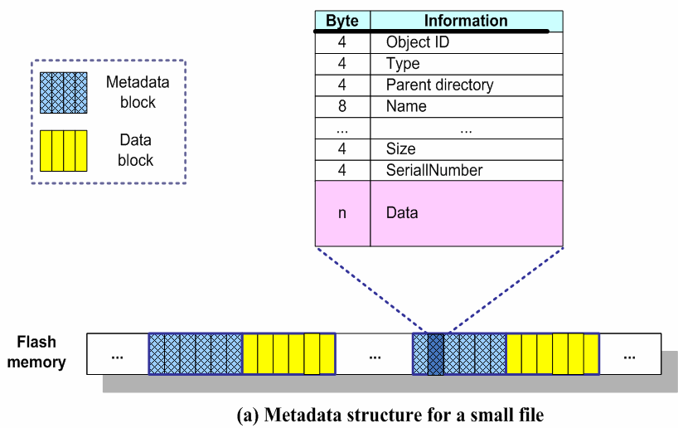
Data Area (1)
Content type
Metadata
File data
Block for metadata cant store file data
Small files
file size < 320 b
Better availability
1 page stores
Metadata
file data
Data inside
!!

Slide 33
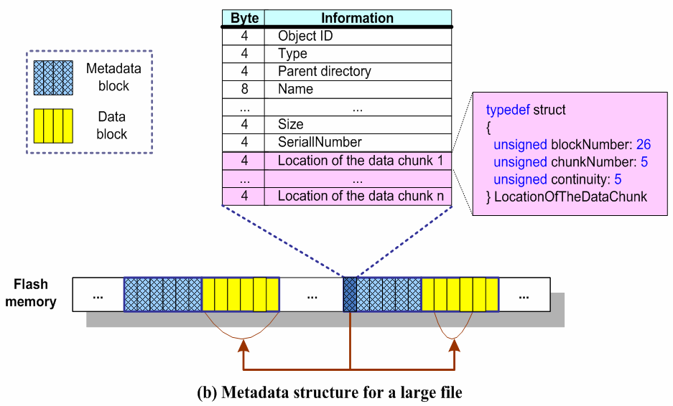
Data Area (2)
For large files
locations of data pages
Objects
Files
Directories
hard links
symbolic links
Only metadata scanned

Slide 34
In-Memory Data Structures (1)
Block_Status
Created using image
Data <-> Block_Info
Managed in array
Index <->block #
space allocation
garbage collection
UsedBlockNumber
Block # of allocated block

Slide 35
In-Memory Data Structures(2)
Object data structure
run-time support of operations on Objects
directories, files, hard links, symbolic links
Modifications reflected to Object on-the-fly
Created in RAM @mounting
by loading metadata
Name
Type
Metadata location
Data Locations
Tree structure
When file created
Tree reduces/ expands as per file size
Fast run-time support

Slide 36
Mounting Procedure
Initialize Block_Status array
Set Block_Status by loading Block_Info from FIA
Append block # to UsedBlockNumber array
Finishing loading all Block_Info
Block to read: last block # in UsedBlockNumber
Obtain its Block_Status, check Content
If metadata block, we read the block and construct an Object in RAM.

Slide 37
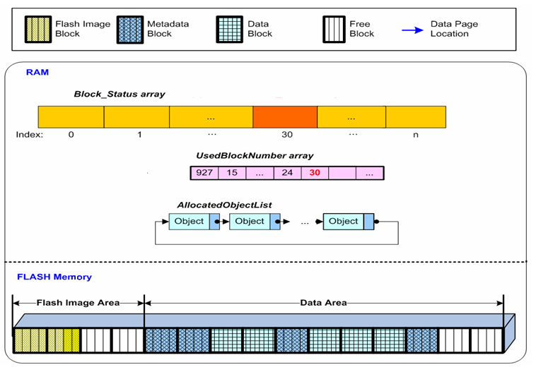
Mounting Procedure (2)
Initialize Block_status array
Insert Block#
Read Metadata blocks by using block status and construct Objects in RAM
Set Block_status by loading block info

Slide 38
Mounting Procedure (3)
YAFS/ RFFS
Proposed File System
Mark every newly written page with incremental serial#
@Scanning, may detect multiple data pages of one file with same ChunkID
Latest page=> with greatest serial number.
Read Metadata block according to allocated sequence
Latest data => recently read page
No need to read file data blocks
Metadata contains file data/ data locations.
Reduce mounting time
Improve system boot time.

Slide 39
Unmounting Procedure
RFFS
Proposed File System
Writes info. on locations
Writes all blocks Flash memory
Wastes flash memory space
Store info. required @mounting
Stores info. of used blocks
# used blocks
UsedBlockNumber
Block information
Block_Status
Amount of written data varies according to flash memory usage

Slide 40
Experimental Environment
Linux kernel 2.4
PXA255-Pro III board
NAND flash 60-MB
block size: 64 KB
chunk size: 512 bytes
Read 512 B at 15 us
Write 512 B at 200 us
Erase 20 KB at 2 ms
Test data
average file size 22KB
most files < 2KB.

Slide 41
Results (1)
Average mounting time comparing
increasing the flash memory usage from 10% to 80%
Best performance: proposed file system
no need to scan entire flash memory space
YAFFS shows poorest performance
it fully scans flash memory
.

Slide 42
Results(2)
Number of read spares and pages during mounting
RFFS , proposed file system read much smaller spares and pages than YAFFS at mounting time
Improvement over YAFFS
RFFS 65%~76%
Proposed file system 74%~87%.

Slide 43
Conclusion
Design of new NAND flash file system to support fast mounting
Flash Image Area
Data Area
During mounting
Flash memory image
metadata blocks
file data or data locations
does not need to read the data blocks
74%~87% improvement in mounting time over YAFFS
Fast

Slide 44
Future work
Efficient wear-leveling algorithm
Journaling mechanism
to provide file system consistency against sudden system faults

