Slide 1
High Performance Cache Replacement Using Re-Reference Interval Prediction (RRIP)
Aamer Jaleel, Kevin B. Theobald, Simon C. Steely Jr. , Joel Emer
Intel Corporation
The ACM IEEE International Symposium on Computer Architecture (ISCA) conference,
June 19–23, 2010, Saint-Malo, France.
Chien-Chih(Paul) Chao
Chih-Chiang(Michael) Chang
Instructor: Dr. Ann Gordon-Ross

Slide 2
Agenda
Motivation
Background
Least Recently Used (LRU) policy
Dynamic Insertion Policy (DIP)
Least Frequently Used(LFU) policy
Re-Reference Interval Prediction (RRIP)
Not Recently Used policy
Static RRIP
Dynamic RRIP
Experimental Methodology
Results and Analysis
Conclusion

Slide 3
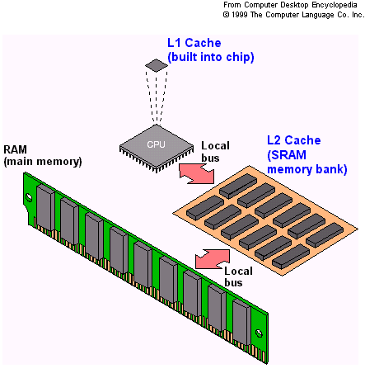
Cache Replacement Policies
Cache stores the frequently required data
Discard items to make room for the new ones when cache is full.
http://i.crn.com/enc/CACHEMEM.GIF
Notes:
Knowledge based on “Memory Hierarchy”
“The Librarian Example”
Cache memory stores the data items that are frequently required by the processor
When the cache is full, the algorithm must choose which items to discard to make room for the new ones

Slide 4
Motivation
Efficient last-level cache(LLC) utilization
Avoid long latency cache misses to main memory
Need a practical cache replacement policy that is not only thrash-resistant but scan-resistant
Notes:
LLC, also called as the L3 cache as we know

Slide 5
Background
LRU Replacement Policies
DIP (Improvement of LRU)
Cache Access Patterns
LRU/ LFU Hybrid replacement policy
Comparison of DIP and Hybrid(LRU/LFU)
Improving LLC performance by targeting cache blocks that are dead upon cache insertion
Notes:
Both industry and academia have produced an impressive amount of research work dedicated to improving the performance of replacement policies. While we cannot describe all replacement policies that exist in the literature,
summarize prior art that most closely relates to improving LLC performance by targeting cache blocks that are dead upon cache insertion.

Slide 6
LRU Replacement Policies
Least Recently Used(LRU)
LRU Chain: LRU / MRU
Re-Reference Interval Prediction (RRIP) chain
Good with high data locality
Bad performance when re-references only occur in the distant future.
Near-immediate
Distant
Notes:
It is a commonly used cache replacement policy
Re-Reference Interval Prediction (RRIP) chain that represents the order in which blocks are predicted to be re-referenced

Slide 7
Dynamic Insertion Policy(DIP)
Improves LRU replacement by dynamically changing the re-reference prediction
Both DIP and LRU are failed t0 make accurate predictions when mixed re-reference patterns occur
Scan: a burst of references to data whose re-reference interval is in the distant future
Notes:
improves LRU replacement in situations where the re-reference interval is in the distant future by dynamically changing the re-reference prediction from a near-immediate re-reference interval to a distant re-reference interval.
A scan is any sequence of one-time use requests

Slide 8
Cache Access Patterns
Recency-friendly Access Pattern
Thrashing Access Pattern
Streaming Access Pattern
Mixed Access Pattern

Slide 9
Cache Access Patterns (cont.)
Recency-friendly Access Pattern

Slide 10
Cache Access Patterns (cont.)
Thrashing Access Pattern

Slide 11
Cache Access Patterns (cont.)
Streaming Access Pattern

Slide 12
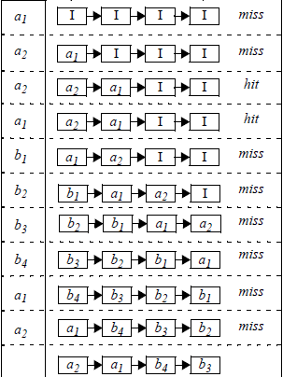
Cache Access Patterns (cont.)
Mixed Access Pattern

Slide 13
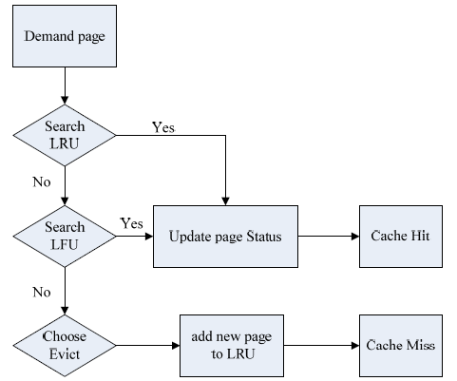
LRU / LFU Replacement Policy
Least Frequently Used(LFU)
frequently accessed : near-immediate future
infrequently accessed : distant future
Measured by counter
Features:
DIP: Thrash-resistant
LRU/LFU: Scan-resistant

Slide 14
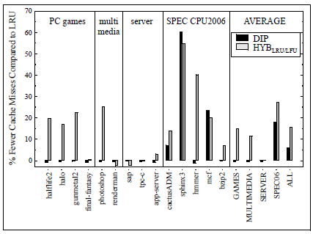
Comparison of DIP and Hybrid(LRU/LFU)

Slide 15
Re-Reference Intervall Prediction
Not Recently Used (NRC) replacement policy
Static RRIP
SRRIP with Hit priority
SRRIP with Frequency priority
Dynamic RRIP
Behavior for a Mixed Access Pattern
Experimental methodology and Results
Simulator
Benchmark

Slide 16
NRC replacement policy
Motivation
LRU cannot perform to mixed access patterns
Chained-based LRU is impractical for highly associative caches
The nru-bit
Value of ‘1’ implies was recently used and is predicted to be re-referenced in the near-immediate future
Value of ‘0’ implies was not recently used and is predicted to be re-referenced in the distant future

Slide 17
Static RRIP
Motivation
One bit of information is not enough
NRU cannot identify non-scan blocks in a mix access pattern
M-bit Re-Reference Prediction Values (RRPV)
2M possible RRPV eables intermediate re-reference intervals predicton
Hit Priority (HP)
Updates RRIP to be near-immediate on a hit
Prioritize replacement of blocks with no hits
Frequency Priority
Decrementing the RRPV register on cache hits
Prioritize replacement of blocks with infrequently re-ref

Slide 18
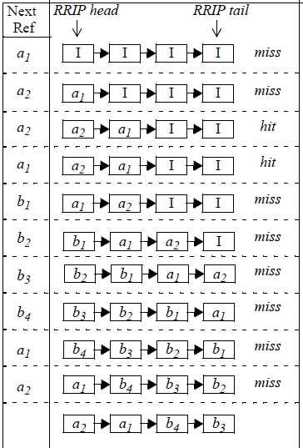
Behavior of LRU
Mixed Access Pattern
a1, a2, a2, a1, b1, b2, b3, b4, a1, a2
Cache Hit:
Move block to MRU
Cache Miss:
Replace LRU block
Move block to MUR

Slide 19
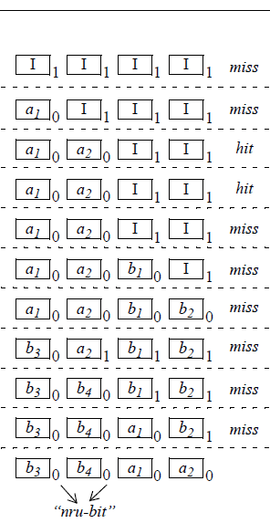
Behavior of NRC
Mixed Access Pattern
a1, a2, a2, a1, b1, b2, b3, b4, a1, a2
Cache Hit:
Set nru-bit of block to ‘0’
Cache Miss:
Search for first ‘1’ from left
If ‘1’ found go to step (5)
Set all nru-bits to ‘1’
Go to step (1)
Replace block and set nru-bit to ‘0’

Slide 20
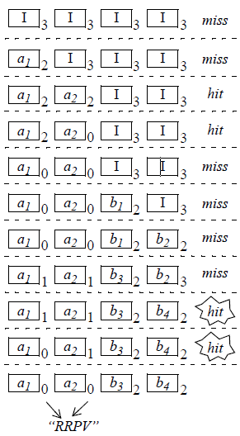
Behavior of 2-bit SRRIP with HP
Mixed Access Pattern
a1, a2, a2, a1, b1, b2, b3, b4, a1, a2
Cache Hit:
Set RRPV of block to ‘0’
Cache Miss:
Search for first ‘3’ from left
If ‘3’ found go to step (5)
Increment all RRPVs
Go to step (1)
Replace block and set RRPV to ‘2’

Slide 21
Dynamic RRIP
Motivation
SRRIP does not thrash-resistant
Bimodal RRIP (BRRIP)
Similar to Bimodal Insertion Policy of DIP
Insert majority of cache blocks with distant re-ref
Insert infrequently with a long re-ref interval
Set Dueling
Choose between scan-resistant SRRIP and thrash-resistant BRRIP by using two Set Dueling Mointors
Use a single policy selection counter

Slide 22
Experimental Methodology
Simulator
CMP$IM
4-way out-of-oreder
128-entry reorder buffer
3 level cache hierarchy
Benchmarks
5 workloads from SPEC CPU2006
9 “real world” workloads
PC Games
Multimedia
Server

Slide 23
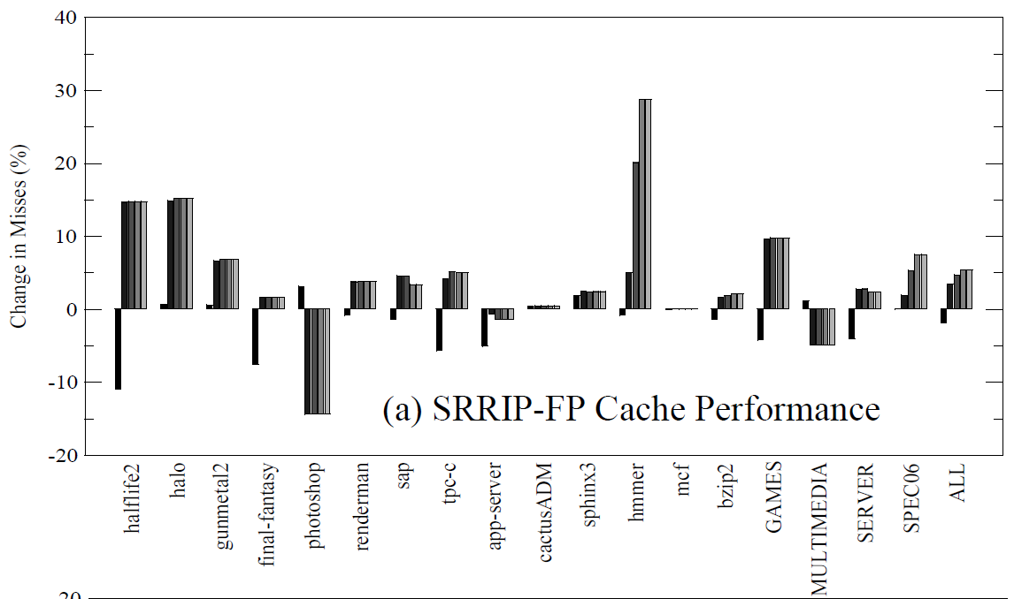
Results of SRRIP-FP
Reduces MPKI by 5-18%
Outpeform LRU by an average of 2.5%

Slide 24
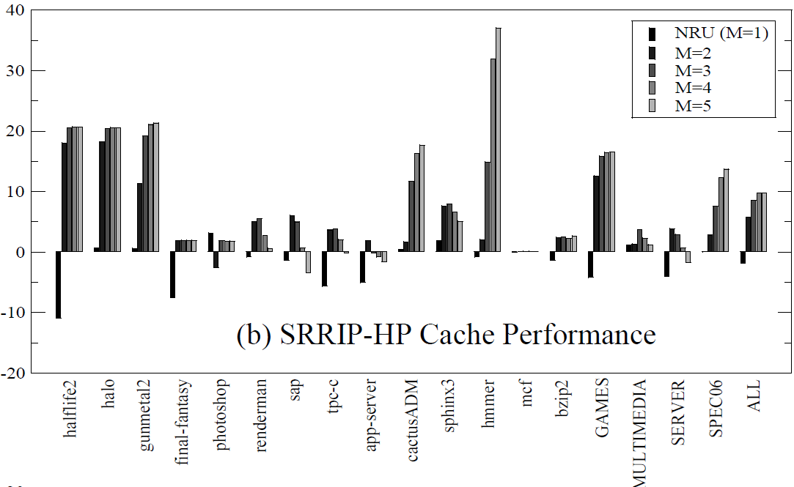
Results of SRRIP-HP
Reduces MPKI by 5-15%
Outpeform LRU by an average of 5%

Slide 25
SRRIP-HP Sensitivity to Cache size
SRRIP is insensitive when M>3
Wider RRPV retain blocks for longer periods
2-bit or 3-bit RRPV is sufficient to be scan-resistant

Slide 26
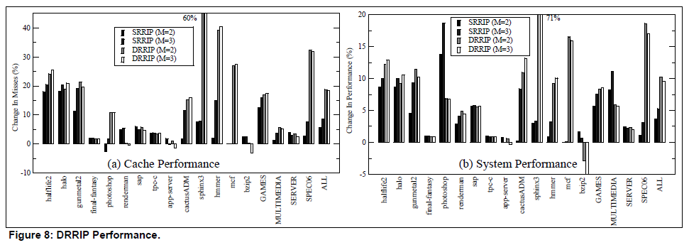
DRRIP Performance
Improve avg 5% above SRRIP

Slide 27
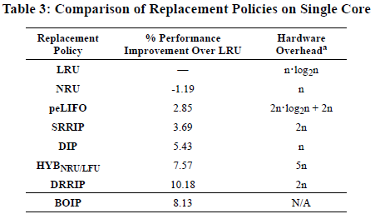
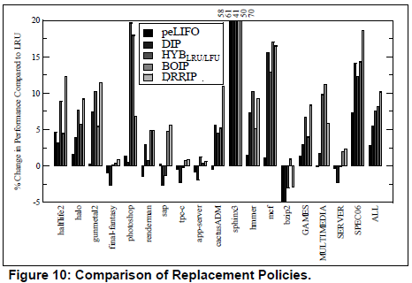
Comparing to Other Policies
Base on single-core processor with 16-way 2MB LLC
RRIP requires less hardware than LRU yet outperform LRU on average
RRIP requires 2.5X less hardware than HYB

Slide 28
Conclusion
RRIP predicts intermediate re-ref between near-immediate and distant re-ref interval
SRRIP needs only 2-bit for scan-resistant
DRRIP for both scan-resistant and thrash-resistant
SRRIP and DRRIP outperform LRU by an average of 4% and 10%

