Slide 1
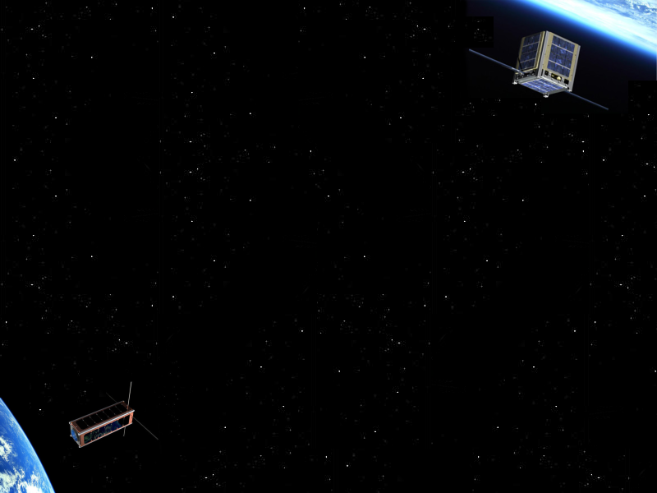
CubeSat Research
with Scott Arnold & Ryan Nuzzaci
Topic III (long) – Aerospace
Paper I – CubeSat Design for LEO-Based Earth Science Missions
Stephen Waydo, Daniel Henry, and Mark Campbell
Paper II – A CubeSat Design to Validate the Virtex-5 FPGA for Spaceborne Image Processing
Dmitriy L. Bekker, Kiril Dontchev, and many others…
Notes:
We will discuss two papers that describe embedded system designs in aerospace research
I’ll start out with a paper that describes a whole-system design for a cubesat in order to establish a framework for the rest of our papers that are more narrow

Slide 2
CubeSat Background
Origin
  Cal Poly and Stanford University developed the CubeSat standard in 1999
Philosophy
  Simplification of satellite infrastructure
  Encapsulation of launcher-payload interface
  Unification among payloads and launchers
Use
  Help universities perform space science and exploration
Notes:
The cubesat standard originated from Cal Poly and stanford in 1999 in order to establish a low cost design to help universities perform space science experiments relatively cheap and quick.
Standardizing allows for a cheaper implementation because manufacturers will adopt and build for the standard …
The launch cost is also reduced by standardizing the launching mechanism so that a custom launcher is not required for every satellite.
The development time is reduced because the satellite designer and the launch provider can now work independently which allows the researchers to utilize launch opportunities on short notice (rare / few and far between)

Slide 3
CubeSat Background (cont)
Design
  Categorized under ‘nano-satellite’
  Single unit (1u) dimensions of 10cm³ and a mass no greater than 1.0kg
  Can scale in length by multiples of 1u (2u, 3u)
Launcher
  Poly-PicoSatellite Orbital Deployer (P-POD)
  Can deploy any combination of CubeSats that fit in the standardized 3u volume

Slide 4
Motivation
Describe a CubeSat bus that supports two mission architectures based on two 1u CubeSat packages
  Mission I – Combined Plasma Impedance Probe/DC Probe (DC/PIP) system on two satellites connected via tether
  Mission II – GPS scintillation measurement system on two separate satellites
  Each architecture involves multiple CubeSats separated from each other to gather spatially and temporally distributed data
Notes:
Aligned architecture design to fit these requirements

Slide 5
Introduction
DC/PIP Experiment
  Variations in ionospheric plasma density can create large amplitude and phase fluctuations in radio waves passing through this region
  Modeling of the density is critical for scientists working in satellite communications
GPS Experiment
  Scintillation - The fluctuation in brightness of a radio source due to the scattering of radio waves by irregularities in the Earth's ionosphere
  Measuring this fluctuation from LEO to the GPS satellites (half-geosynchronous orbit) is important to understand its effects on GPS signal strength and interference
Notes:
GPS – signal strength
PIP/DC - variations

Slide 6
Mission Plan & Modes
Mission Plan
  Day 0 – P-POD deployment @ 300km (low for LEO)
  Day 1-10 – Passive attitude stabilization
  Day 11-30 – Data collection and downlink
  Day 31-44 – Mission margin, additional data collection
  Day 45 – De-orbit and EOL
Mission Modes
  Mode 1 – Deployment/power on
  Mode 2 – Stabilization
  Mode 3 – Magnetometer calibration
  Mode 4 – Data collection
  Mode 5 – Ground communication
  Mode 6 – Conserve power/recharge
  Mode 7 – Standby

Slide 7
Mission Objectives
DC/PIP
  Probes
    Plasma Impedance Probe – Measures plasma frequency
    DC Probe – Measures electric current in the plasma (serves as a backup for the PIP)
  Distributed ionospheric science places the requirement that simultaneous measurements must be spaced 3m-10m apart
  Orbit allows for 11min of downlink time which corresponds to at least 1MB of data/day

Slide 8
Mission Objectives
GPS Scintillation
  Two GPS antennas are mounted on opposite sides as a 2x2cm patch
  A separation of 100m+ is needed to measure large structures in the ionosphere. This distance also allows both CubeSats to downlink simultaneously, doubling the bandwidth of the DC/PIP experiment
  Orbit allows for 11m of downlink time which corresponds to at least 2MB of data/day

Slide 9
Systems Design
System Components (shared)
  Structure – Housing and mounting hardware
  Power System – Solar panels, batteries, charge control, conditioning, and supply
  Communication System – Transceiver and antenna
  Command/Data Handling (C&DH) – Computer (storage, control processing and interfacing)
  Magnetometer (3 axis) – Used to determine when the satellite is in the desired data-taking region
  Attitude Control System (ACS) – Viscous liquid vibration dampers used to implement the gravity gradient stabilization technique
Notes:
These components are the base components for all cubesat designs
Mag--ne--tometer is used in conjunction with the assumed attitude to estimate the satellite’s position

Slide 10
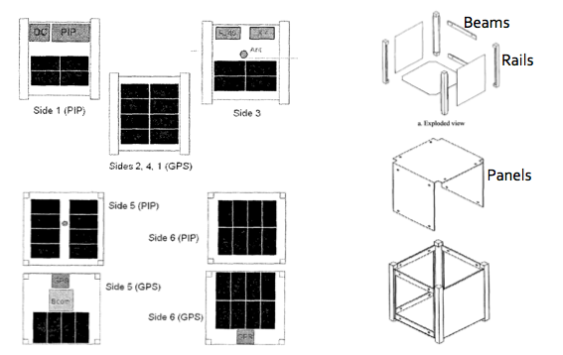
Systems Design – Structure

Slide 11
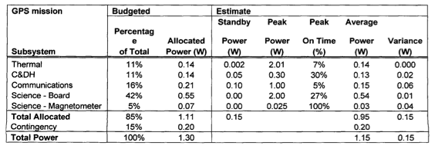
Systems Design – Power
Power components
  Solar panels – Triple junction 26.5% efficiency cells
  Battery – Lithium polymer, unknown capacity
  Conditioning – 5V @ 600mA

Slide 12
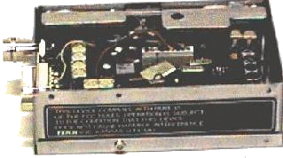
Systems Design – Communication
Communication components
  Transceiver – Modified Tekk KS 960
    Removed power regulation components
    Reduced transmission power
    Replaced all electrolytic caps
  Frequency – 437.49MHz
  Antenna – Single, steel half-wave dipole
  COTS amateur radio parts used since there are no regulatory constraints on those frequency bands and other universities have ground stations for these bands

Slide 13
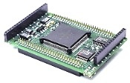
Systems Design – C&DH
C&DH components
  Processor – Tattletale 8v2
    256K RAM, 1MB SRAM
    8 ADCs @ 100KS/s
    RS232
  Error recovery – Upsets are addressed by monitoring the processor board’s current draw. If a current is seen outside the normal range, the power is cycled for a hard reset.
  Software – Simple control flow software layout with three basic functions
    Science
    Communications
    Fault response
Notes:
Can adjust clock of uP to regulate power use
Lots of individual ADCs for data acquisition
Fairly low cost

Slide 14
Systems Design – Attitude Control
DC/PIP
  Separation
    Two CubeSats are connected with a 10m aramid fiber tether, where the tension provides pitch and roll control
    Spring forces CubeSats apart during launch. Tether tensioner prevents bounce-back
  Orientation
    The PIP & DC sensors need to face undisturbed plasma, therefore, must be on the leading face of the CubeSat which must be maintained within 45° of the direction of travel
    Yaw is controlled by offsetting the CG towards the antenna side
Notes:
Plasma impedance probe
CG = center of gravity

Slide 15
Systems Design – Attitude Control
GPS
  Separation
    A 100m+ separation is needed, therefore, a tethered approach is not feasible
    Relies on the slow drift from the spring force during launch
  Orientation
    The GPS antenna must have a clear view of the GPS satellites orbiting far above LEO
    A deployable gravity-gradient boom is used to stabilize the pitch and roll
    Two GPS antenna (on opposite sides) are used eliminate the yaw orientation requirement

Slide 16
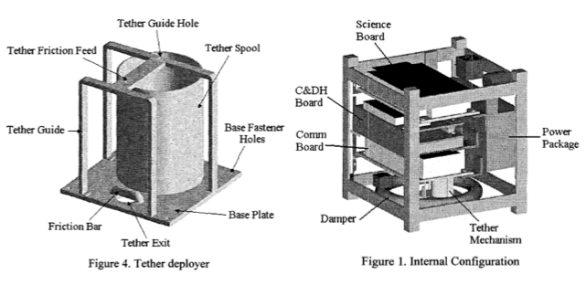
Systems Design – Overview

Slide 17
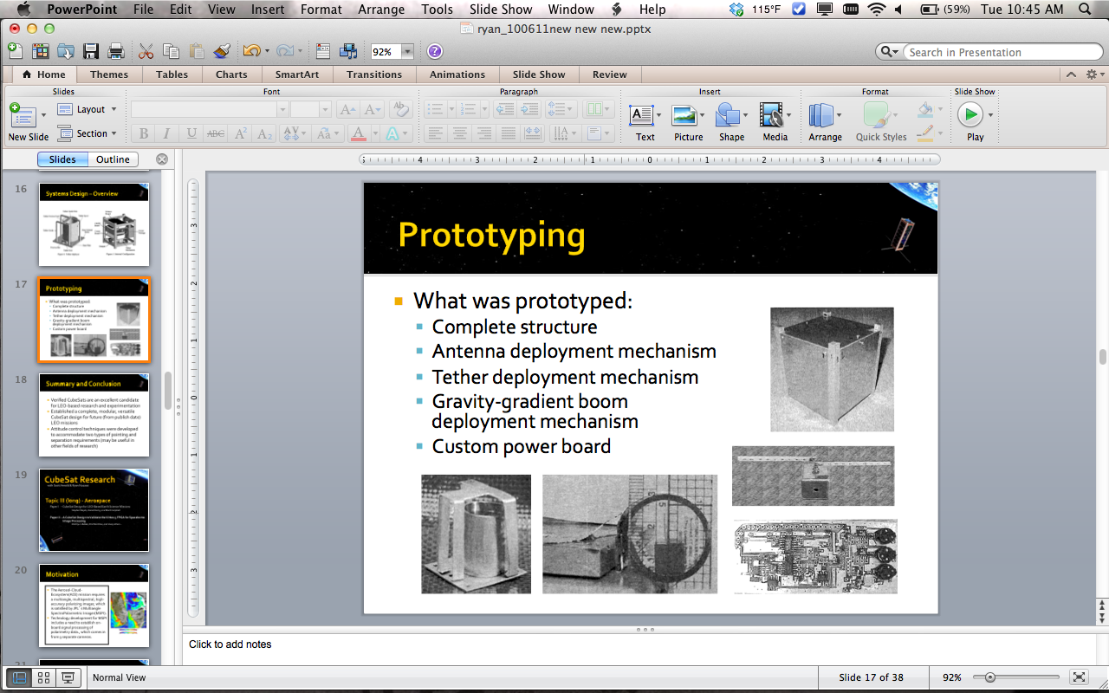
Prototyping
What was prototyped:
  Complete structure
  Antenna deployment mechanism
  Tether deployment mechanism
  Gravity-gradient boom deployment mechanism
  Custom power board

Slide 18
Summary and Conclusion
Verified CubeSats are an excellent candidate for LEO-based research and experimentation
Established a complete, modular, versatile CubeSat design for future (from publish date) LEO missions
Attitude control techniques were developed to accommodate two types of pointing and separation requirements (may be useful in other fields of research)

Slide 19
CubeSat Research
with Scott Arnold & Ryan Nuzzaci
Topic III (long) - Aerospace
Paper I – CubeSat Design for LEO-Based Earth Science Missions
Stephen Waydo, Daniel Henry, and Mark Campbell
Paper II – A CubeSat Design to Validate the Virtex-5 FPGA for Spaceborne Image Processing
Dmitriy L. Bekker, Kiril Dontchev, and many others…

Slide 20
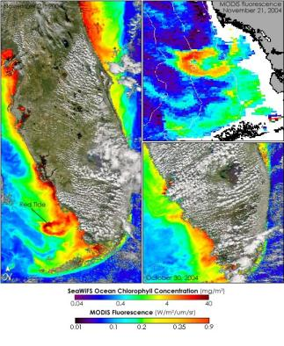
Motivation
The Aerosol-Cloud-Ecosystem(ACE) mission requires a multiangle, multispectral, high-accuracy polarizing imager, which is satisfied by JPL’s Multiangle SpectroPolarmetric Imager(MSPI).
Technology development for MSPI includes a need to establish on-board signal processing of polarimetry data., which comes in from 9 separate cameras.

Slide 21
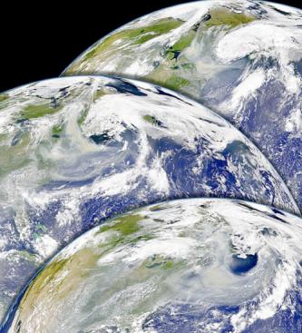
Motivation
The end goal is to reduce 95Mbytes/sec data over 16 channels for each of 9 cameras down to .45Mbytes/sec data stream.
Using a Virtex 5(V5) FPGA with a least-squares fitting algorithm on chip will potentially satisfy the MSPI needs

Slide 22
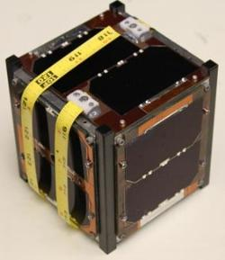

The M³ project
The Virtex-5 platform is not yet space-flight qualified
FPGAs are particularly vulnerable to SEU and SEFI errors due to cosmic radiation
  SEU – Single Event Upset(bit flips and configuration faults)
  SEFI – Single Event Fault Injection(transient errors)
The Validation using a V5 on a CubeSat will advance the development of the MSPI algorithm used on-board ACE

Slide 23
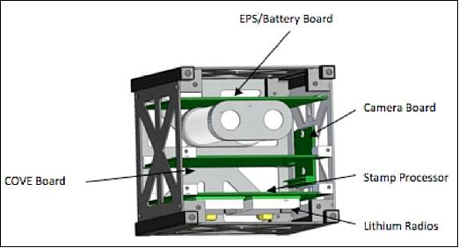
COVE payload board
Since the writing of the first paper the Virtex-5QV has been selected for payload over the original due to being more radiation hardened.
Virtex-5QV commonly referred to as SIRF for Single-event Immune Reconfigurable FPGA

Slide 24
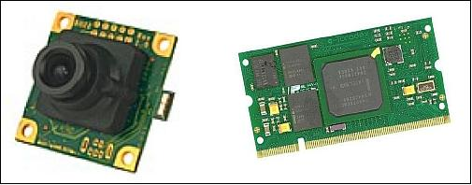
M³ Payloads
Primary function of the M³ is to obtain quality color images of the earth from low earth orbit(LEO) using a CMOS camera.
The Omni-vision 2 MegaPixel camera will take images and save them into a Taskit Stamp9G20 microprocessor.

Slide 25
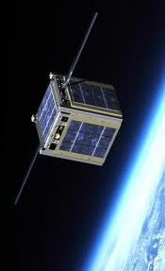
M³ Payload
The JPL payload called COVE(CubeSat On-board Validation Experiment)will then perform processing on-board.
The processed data and raw image data() will be down-linked and a separate on ground processing unit will re-process the downlinked raw image data and compare it to the pre-processed image.

Slide 26
Specifics of the M³
1U platform
Expected sun-synchronous orbit of500 to 800 KM at inclination of 98º
Command and Data Handling(C&DH) Atmega164p to control satellite subsystems
Communcation system consists of a 16.5 cm antennae at 430MHz and a reciever antennae of 45 cm at 140 MHz
Ann-Arbor base station
  5 minutes orbit for downlink
  10 minutes for uplink
Passive Magnetic Attitude Determination and control(ADCS)

Slide 27
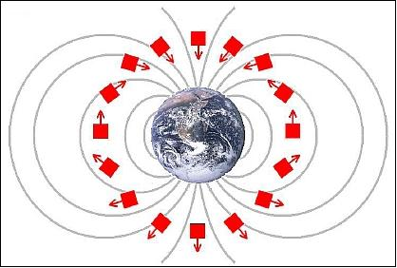
M³ ADCS
Passive Magnetic ADCS keeps in line with the earth’s magnetic field.
Typically accurate to about within 10 degrees

Slide 28
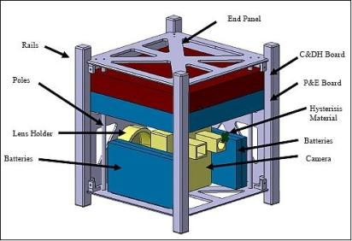
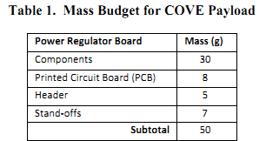
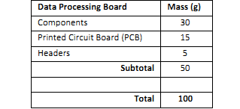
M³ Structures
Constructed of six iso-grid aluminum 7075 panels and 4 Aluminum 6061 hard anodized rails.
The construction met a safety qualification of 6 at worst case scenario, 1.5 is the goal.
87% of satellite taken up by subsystems
100 grams available for JPL payload

Slide 29
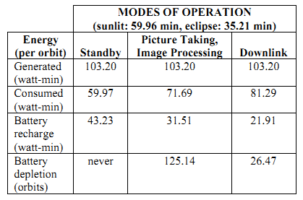
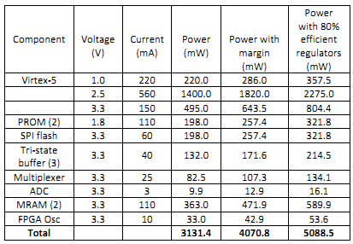
M³ EPS
Power budget assumes continual 1.73 Watts during orbit
3.7 V, 2.2 A-hr Lithium-ion battery
Three modes of operation were predicted
Update of paper more accurate estimates and modes

Slide 30
MSPI Algorithm Objectives
De-Multiplex data stream, using ancillary info from Photoelastic Modulator(PEM) and timestamps of the subframes to create a set of basis functions
Create the polarization measurement matrix B, comprised of the sampled basis, and calculate it’s psuedo-inverse(W)
Load the W operator into hardware and apply it to the sampled measurements using matrix multiplication, which retrieves the desired polarization.

Slide 31
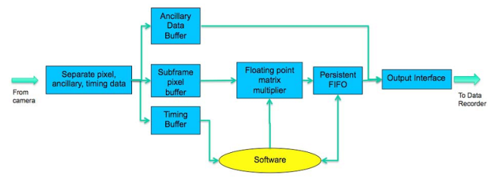
MSPI OBP Algorithm
This is not a compression algorithm
The data is oversampled in the MSPI algorithm
OBP is applying estimation and extraction

Slide 32
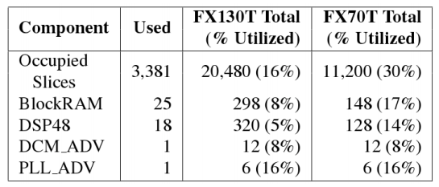
MSPI OBP Algorithm
For more details on this algorithm see, “Dual –Photoelastic Modulator-Based Polarimetric Imaging Concept for Aerosol Remote Sensing”
FPGA logic, BRAM, and DSP should be transferrable from a multitude of devices

Slide 33
MSPI OBP for M³
Slight modification based on 1U platform are made to the connecting glue logic between subcomponents
A subset of pixel data will be surrogate for timing info
Apply Polarimetric extraction to the remaining pixels
Because of static nature of camera vs. the continuous stream the timing we use the timing info generated from before to process the same image
Implementation on the V5 uses a power PC440 for software and it’s abundant logic resources for hardware implementation

Slide 34
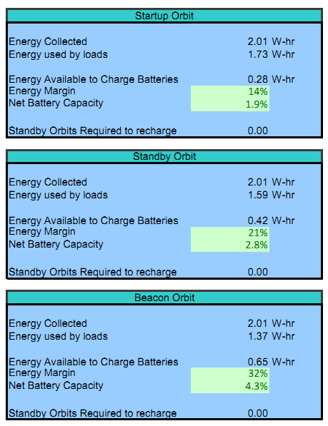
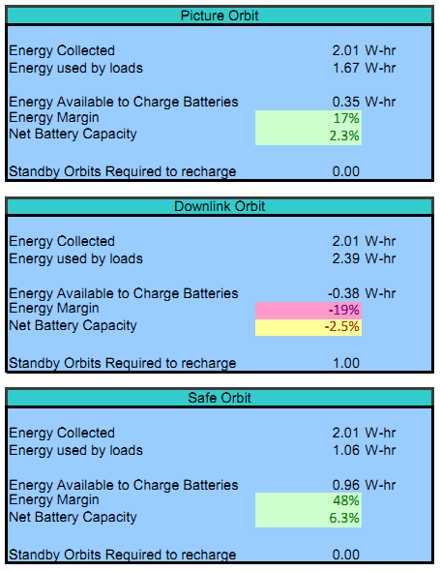
COVE operational modes
Preliminary estimates had the V5 power at 10 Watt maximum usage.
Prototype designs have now shown actual implementation to be much lower than anticipated
  4-6 Watts max for V-5QV
  Earlier Slide shows exact numbers
Because of this alternative operational modes were formed

Slide 35
COVE Nominal Operations
M³ recieves a message from ground station specifying time to take picture.
Remain in standby until scheduled time
At specified time take picture and send to FPGA or store image for later processing
Post-processing M³ enters downlink mode and transmits data at next pass of the Satellite
Both processed and pre-processed data are sent for verification of results

Slide 36
What’s next
The MSPI OBS payload experiment aboard M³ will be launched on Oct 28th, 2012.
The SIRF validation process will be expedited by this CubeSat
ACE mission will use the SIRF aboard it’s host satellite to process data pending results from the experiment

Slide 37
References other than paper
http://umcubed.org/
http://events.eoportal.org/presentations/10002279/10002568.html
“M-Cubed: University of Michigan Multipurpose MiniSatellite with Optical Imager Payload”
“The Prototype Development Phase of the CubeSat On-Board Processing Validation Experiment”

Slide 38

Any Questions

