Slide 1
Hiding cache miss penalty using priority based execution for embedded processors
Sanghyun Park, Aviral Shrivastava and Yunheung Paek
Varun Mathur
Mingwei Liu

Slide 2
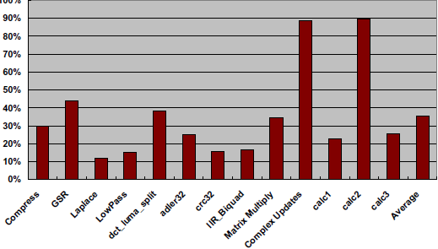
Motivation
Disparity between memory & processor speeds keeps increasing.
30-40% of instructions access memory.
Processor time wasted waiting for memory.

Slide 3
Solution
Multiple issue
Value prediction
Out of order execution
Speculative execution
Problem:
Only suited for high end processors
Significant power & area overhead
Most embedded processors:
Single issue
Non-speculative
Alternative mechanisms reqd to hide memory latency with minimal power & area overheads

Slide 4
Their technique at a glance
Compiler classifies instructions into high and low priority.
Processor executes high priority inst.
Execution of low priority inst postponed.
Low priority instructions are executed on a cache miss.
Hardware reqd:
Simple reg renaming mechanism
Buffer to keep state of low priority inst.

Slide 5
Priority of instructions
High priority instructions are reqd to continue :
Instruction fetch
Data transfers
Therefore, high priority instructions are:
Branches
Loads
Instructions feeding high priority instructions
All others are low priority.

Slide 6
Steps involved in determining priority
Mark loads & branches.
Mark instructions that generate source operands of marked instructions.
Mark conditional inst that marked inst are control dependant on.
Loop between step 2 and 3.
Marked instructions are high priority, rest low priority.

Slide 7
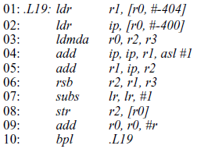
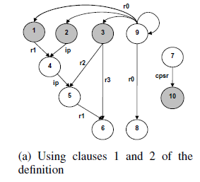
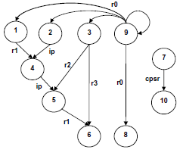
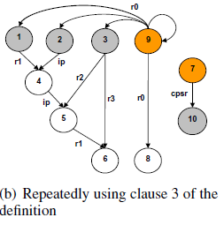
Example

Slide 8
Scope of their analysis
Considers only instructions in loops.
First execute all high P instructions of the loop.
Once done, execute pending low P instructions.
Cannot wait till another cache miss, since cache misses rare outside loops.
ISA enhancements :
1 bit priority info
Special flushLowPriority instruction

Slide 9
Execution model
Two execution modes:
High priority
Low priority
Only high P executed.
Low P inst, operands renamed and queued in a ROB
When cache miss, switch to low P mode
Execute low P instructions
If cache miss resolved -> high P mode
If all low P executed and still cache miss unresolved -> high P mode

Slide 10
Reasons for performance improvement
Number of effective instructions in a loop reduced=>loop executes faster
Low P inst executed on cache miss=>utilisation of cache miss latency

Slide 11
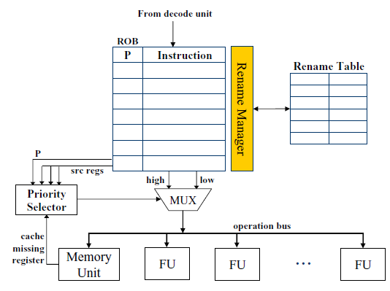
Architecture
Rename manager : insts in ROB renamed dynamically suing info from table
P : 1 bit priority indicator
Rename table : mapping info from real reg -> rename reg
Architecturally similar to Out of order execution with compiler support.
Requires full reg renaming capability.
Priority selector : decides exec mode of processory

Slide 12
Experimental setup
Use Intel Xscale microarchitecture:
Single fetch, single decode, single issue
7 stage out of order pipelined processor
32K 32 way Icache & Dcache
Experiments done on, innermost loops of several multimedia apps.
Specifically, 4 multimedia apps
H.264 decoder from MediaBench
2 checksum benchmarks from MiBench
3 kernels for swim from SPEC2000
3 benchmarks from DSPstone
Why were these benchmarks chosen ?
Important kernels of multimedia apps
Have non-negligible cache miss penalty due to data intensive calcs

Slide 13
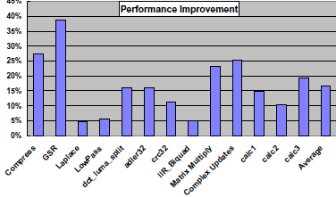
Effectiveness of priority based execution
ROB = 100 entries
GSR shows most improvement
17% avg reduction in exec time

Slide 14
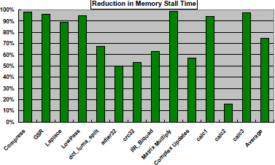
Reduction in memory stall time
Laplace benchmark interesting
So even if there is not much scope for improvement, this method can hide significant portions of memory latency.

Slide 15
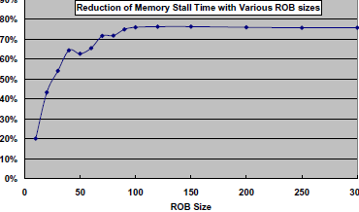
Varying ROB size
Saturates after ROB size = 100.
Because Intel Xscale avg mem latency = 75 cycles.

Slide 16
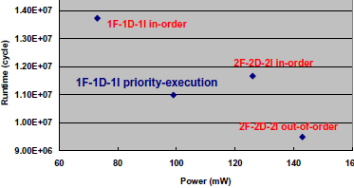
Power & performance tradeoffs
Performance better than 1F1D1I
Performance better than 2F2D2I
Worse than 2F2D2I out order, but lot smaller power consumption

Slide 17
Future work
Measuring effectiveness of this technique on high issue processors.
Questions ?

