Slide 1
Designing VM Schedulers for Embedded Real-Time Applications
Alejandro Masrur, Thomas Pfeuffer, Martin Geier, Sebastian Drössler and Samarjit Chakraborty
Institute for Real-Time Computer Systems, TU Munich, Germany
Realia Tec GmbH, Garching, Germany
Presented by Steven Fingulin

Slide 2
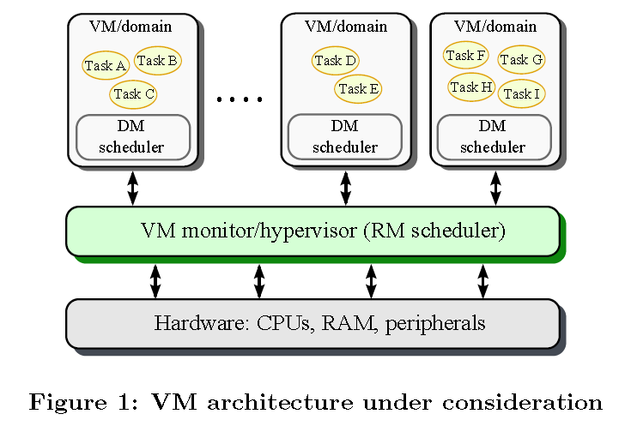
Introduction
In embedded systems, many applications may exist in the same system
In automotive industry, many Electronic Control Units (ECUs) to control each application
Increases cost and may have redundant hardware that is underutilized
Virtual machines provide isolation between separate applications
If one program crashes, it won’t affect others
More critical applications such as airbag deployment and anti-lock brakes can be separated from radio or A/C systems
Every operation must go through the VMM or hypervisor before executing on hardware

Slide 3
Introduction
Scheduling on VM requires hierarchical scheduling
VMs must be scheduled onto processors at VMM level
Tasks must be scheduled inside of each VM
Deadline-monotonic (DM) scheduling – tasks are assigned priorities based on their deadlines
Rate-monotonic (RM) scheduling – shorter jobs have higher priority
Tasks on VMs are scheduled with DM
VMs on the VMM are scheduled with RM

Slide 4
Related Work
Analysis of hierarchical scheduling by Deng and Liu using Earliest Deadline First (EDF)
Kuo and Li performed similar analysis with RM and EDF
Stricter assumption of periods equal to deadlines
PShED framework allows servers to update their priority according to deadline of current task
Shin and Lee present VM scheduling with periodic fixed CPU times for each VM
VM literature mainly analyzes performance and fairness of scheduling

Slide 5
Models and Notation
T denotes a set of sporadic independent tasks
Task T_{i} has deadline d_{i}, worst case execution time e_{i} and minimum inter-release time p_{i}
V denotes the set of all VMs V_{l} in the system
Each VM has a time slice s_{l} and a period p_{l}
Tasks and VMs are sorted by priority(T_{i} has higher priority than T_{i+1})

Slide 6
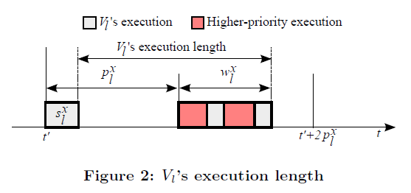
Requirements for a VM
Execution length – largest time interval that it takes a VM to execute a single time slice
Assume that scheduling all VMs is feasible
V_{l} can first finish executing sl time units as early as possible
All higher priority VMs are then released together with the next execution of V_{l}
These assumptions follow that the VM’s schedule time s_{l} must be greater than the worst case execution time of the task associated with the smallest deadline: s_{l} ≥ e_{l,min}
Worst-case response time for V_{l}
V_{l}’s execution length

Slide 7
Scheduling on a VM
Each application (composed of several real-time tasks) should run on its own VM
All of the tasks in a VM can run on the same processor
If only one VM allocated to a processor, then the tasks can be scheduled if s_{l} ≤ p_{l}
If w_{i} ≤ d_{i}, then the tasks are able to be scheduled and will meet deadlines
Worst-case execution demand of a task

Slide 8
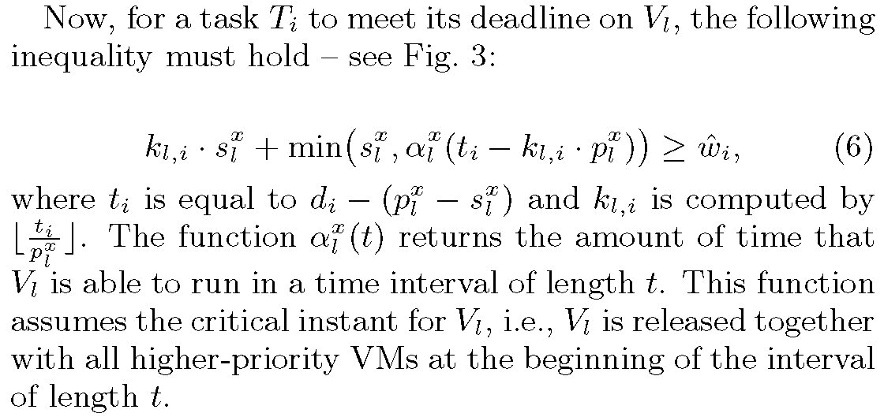
Guarantee of Task Meeting Worst-Case Deadline
w_{i}
k_{l,i} is number of complete periods that pass between when a task can start and its deadline
min(s₁, α(t_{i}-k_{l,i}*p_{l}) function is time in last period of deadline

Slide 9
Design of Highest-Priority VM Scheduler
VMs are scheduled under RM, so period determines priority of each VM
Highest priority VM is V₁ with minimum deadline d₁=p₁ and worst case response s₁
Eq 9 is used to find s₁ that enables scheduling of V₁
Eq 10 is derived by setting min(s₁,t₁-k_{1,i}*p₁) to 0 and substituting d_{i}-(p₁-s₁)/p₁ for t_{i}
s₁ must be smaller than p₁

Slide 10
VMs with Lower Priority
Shortest deadline of any task in V_{l} determines priority of V_{l}
p_{l} = d_{l,min} + s_{l} –w_{l} : derived from combining equations 2 and 1
Same equation as highest priority can be employed to solve for sl
By approximating α(t), a faster method can be used that requires less iterations to solve (appendix slide)
The complexity of calculating slice times is pseudo-polynomial

Slide 11
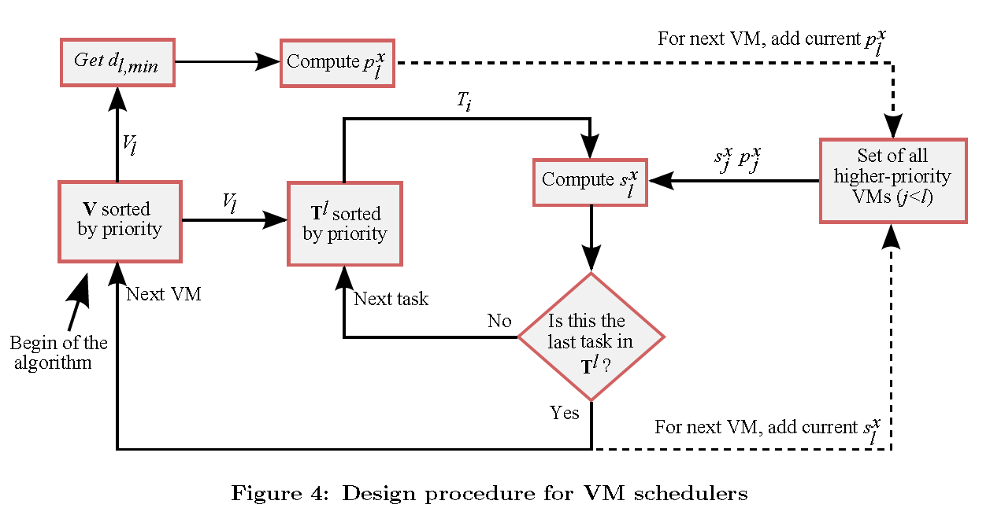
VM Scheduler

Slide 12
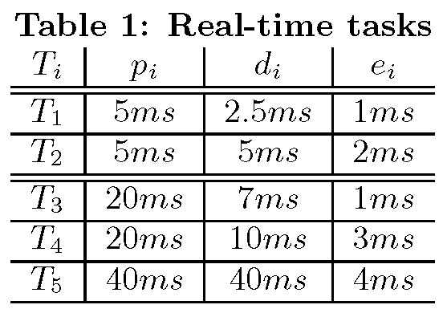
Case Study
Electronic Stability Control (ESC)
Improves steering by minimizing skidding and blocking
Two real-time tasks: T1 and T2
Engine Management (EM)
Computes best ignition point after each revolution in the engine
Three real-time tasks: T3, T4, T5
Xen hypervisor used for scheduling
Intel Core 2 Duo @ 2.16 GHz

Slide 13
Case Study
Network Interface Controller (NIC) assigned to an unprivileged domain in Xen to interface VMs to communication network
Sensors are connected to a bus with an Ethernet network listening via a gateway
Design cases analyzed:
Each real-time task has its own VM
Inefficient due to memory overhead
Higher utilization (more control over slice and period)
Each application is run on a VM

Slide 14
Network Domain
Network domain exists between VMs and bus so it must be highest priority
Has its own time slice and period, s_{N} and p_{N}
Number of packets limited by speed at which they are sent and number of tasks that can send them
s_{N} ≥ n * e_{N} : e_{N} is worst-case processing time of a packet
n=5 and e_{N}=0.06ms therefore s_{N}=0.3ms

Slide 15
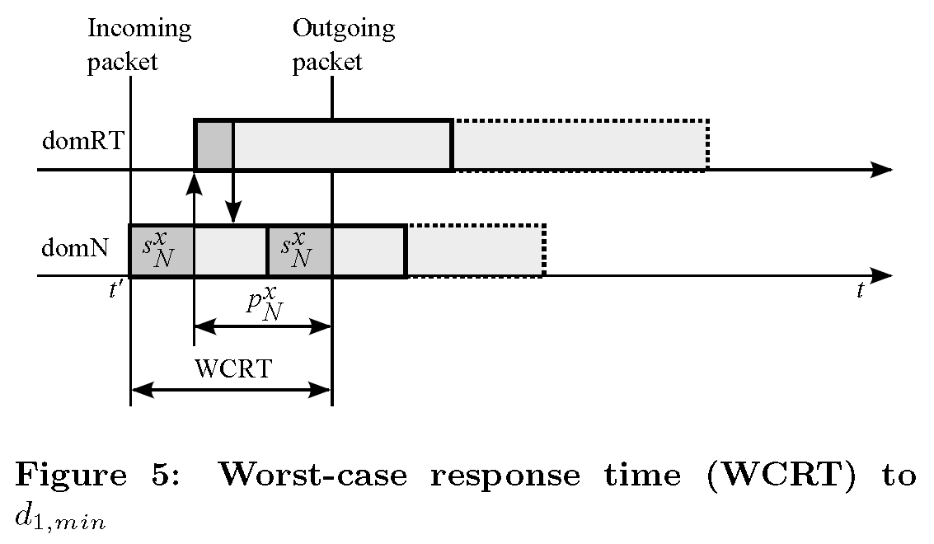
Network Domain
Worst-case response time used to determine p_{N}
domN receives message and uses up its time slice
Relays message to V₁ and must wait for response
p_{N} must be large enough that all tasks can process a packet
p_{N} = d_{1,min}-s_{N} : since d_{1,min}=2.5, p_{N}=2.2ms

Slide 16
Design Cases
Case A (Task Domains):
DM policy sets T1 as highest priority and T5 as lowest
Period set to period of the task
Slice set to execution time of the task
System and schedule are feasible
Case B (Application Domains):
ESC tasks: T1 and T2 on one domain
EM tasks: T3, T4, and T5 on separate domain
Network and EM share one core, ESC gets the other

Slide 17
Design Case B
Electronic Stability Control
Period of ESC: p_{ESC} = d1 = 2.5ms
Time slice of ESC: s_{ESC} ≥ e1 = 1ms
Equation 5 and 10 applied to calculate s_{ESC} so that it accounts for execution of T2
s_{ESC} = 1.5ms
Engine Management
Must share time with network VM so it is lower priority
s_{EM} = 3.85ms and p_{EM} = 6.7ms

Slide 18
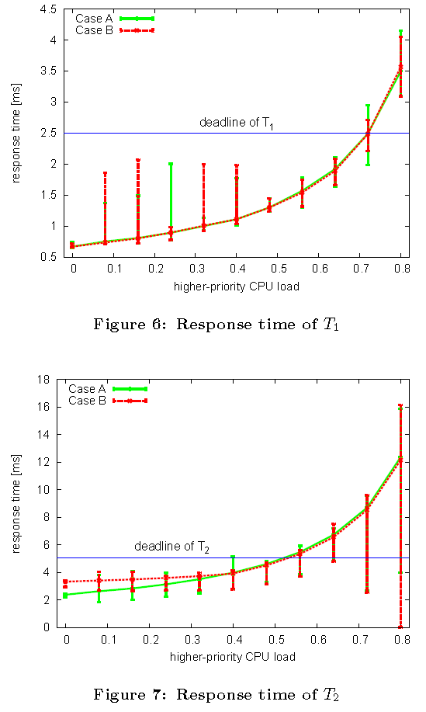
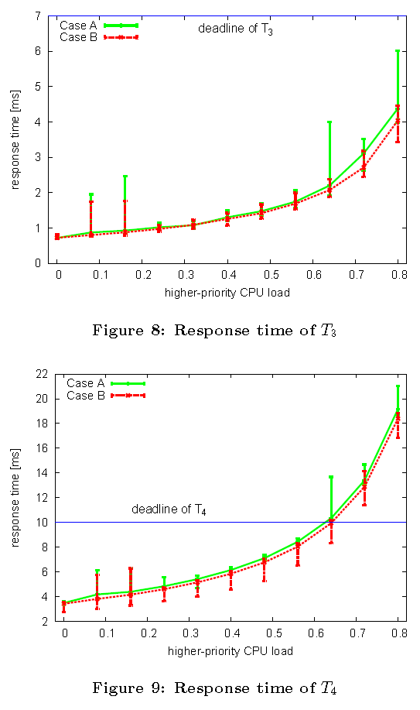
Results
Remote PC simulates input
20k packets sent for each point on curve

Slide 19
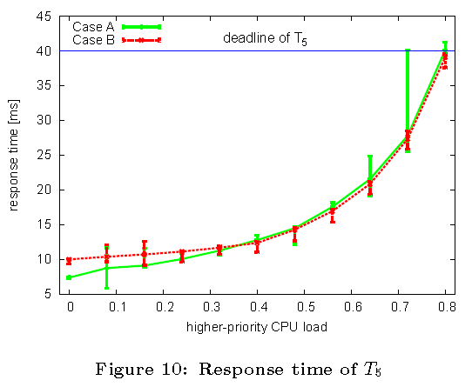
Results and Conclusion
For ESC tasks T1 and T2, no real difference between design A or B
Can meet deadline up to 70 and 50% respectively
EM task T3 always makes deadline
EM task T4 makes deadline up to 65% higher priority tasks
EM task T5 meets deadline up to 80%
Design A is better for below 35%
Presented method for real-time scheduler in VM systems
Compared case of task-dedicated VMs vs. application-dedicated

Slide 20
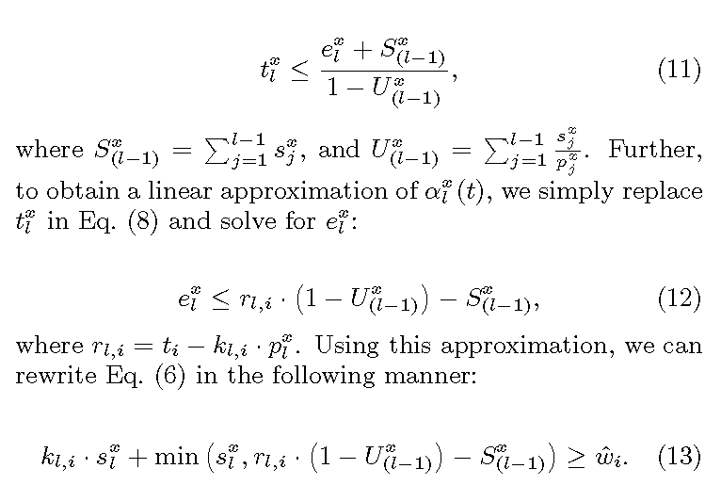
Appendix

