Slide 1

CubeSat Research
with Scott Arnold & Ryan Nuzzaci
Topic VIII (short) – General Low Power/Energy Optimization Techniques
Power Optimization for Embedded System Idle Time In The Presence of Periodic Interrupt Services
Gang Zeng, Hiroyuki Tomiyama, and Hiroaki Takada

Slide 2
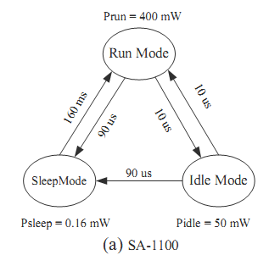
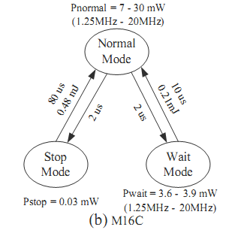
Idle State Power
Dependability
  Processor utilization is not 100% efficient, even at worst case execution time (WCET)
  During idle states real-time OS maintain a periodic interrupt to synchronize system
  eg) uc/OS-II, eCOS, and Linux all require 10ms clock to generate system clock
Reduce power usage
  Processors switch to low-power modes to save energy
  Many processors provide multiple power saving modes.
  Dynamic Power Management (DPM) tries to apply optimal low power mode
  Optimal low power mode is determined by the duration of the system idle state

Slide 3
Power Usage Modes
SA-1100 (high-performance, low power) Operational Modes
  Run mode : Normal operations, full functionalities and high power usage
  Idle mode : Stopped CPU clock, peripherals clock still enabled
  Sleep mode : Stopped CPU and peripheral clocks
M16C (low-end, low-power)
  Same modes, different names
  Lower power and time for transition between modes
SA-1100 not suitable for this application considered this paper
  Despite lower power sleep mode than M16C
  Too large a transition time for returning to run-mode, not efficient for short interrupt times
  Normal interrupt service requests related to on-chip interrupts don’t work in sleep mode

Slide 4
Power reduction methods
Dynamic voltage/frequency scaling (DVFS)
  Reduces voltage and frequency while still meeting the deadline time constraint
  Commonly accomplished with DC-DC converters and phase-locked loop (PLL)
M16C unique for it’s DVFS capability among low-end processors
  Small time overhead for frequency change
  By contrast, high-performance processor typically require transition time ranging 189µs to 3.3ms
Higher frequency corresponds to higher power in idle mode.
Lower frequency has disadvantages
  Longer execution times for interrupt service routines (ISR)
  May result in higher total energy usage
We need to find the Optimal low-power frequency to save on energy

Slide 5
Related Work
Most DPM schemes focus on stochastic to predictive schemes.
  Assume fixed power
  Objective to determine at which power mode the system should remain in
Predictive approach
  On-chip timer interrupt commonly employed in embedded systems to reactivate normal operation
  On chip clock cannot be disabled in this case
DPM vs. DVFS
  DPM saves power in the long idle times
  DVFS saves power in the short slack time
  DVFS assumes periodic tasks with known WCET
  Slack time cannot be reclaimed completely

Slide 6
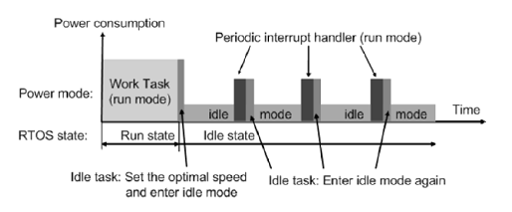
Power Model and Approaches
Assumptions of Case Studies
  Alterable voltage
  Multiple low power modes
  Modifiable clock frequency
  Real time operating system
  (RTOS)
To simplify calculation we
assume
  Static mode transition power
  Fixed voltage/frequency transitions
Two different case studies
  The periodic interrupt cannot be disabled
  The periodic interrupt can be disabled for a specific duration

Slide 7





Power and Current Calculations

Slide 8
Interrupt cannot be disabled
Large DVFS time overhead
  Static approach adopted (set only once at the beginning of idle)
  Upon first power saving mode goes to lowest possible state frequency
  Use equation 1 to calculate power usage
Negligible DVFS time overhead
  Dynamic approach is adopted(two DVFS modes)
  Full speed is assumed at the beginning of each ISR
  Slacks off to slow speed before entering each power mode
  Use equation 3 to calculate power usage
Because I_{idle} is linearly related M(speed) a limited number of speeds are applicable in this way

Slide 9
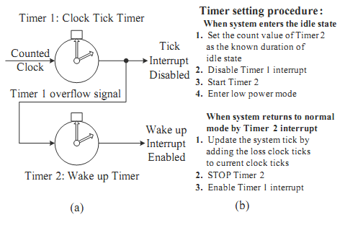
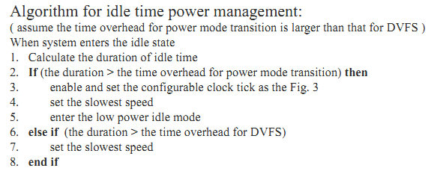
Interrupt can be disabled
Assuming Known WCET
  Idle state duration is a known in this case
  Thus disable clock for this interval
Problems
  Tracing original clock signal to keep synchronization time
  Additional tick-timer keeps track without power the peripherals
  This approach is hardware dependent

Slide 10
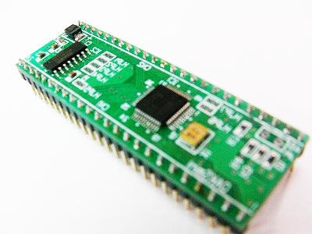
Experiment Setup
Platform
  OAKS 16-mini with Renesas M16C/26 processor
    20MHz max, adjustable with divider
    64K ROM, 2K RAM
    Custom ISA, 106 instructions, 39/106 single cycle
  Power Stats (from datasheet)
    16mA @ 3.3V, 20MHz
    1.8uA in wait mode
    .7uA in stop mode (static)
    Cannot change supply voltage

Slide 11
Experiment Setup
Software
  RTOS – TOPPERS/JSP kernel
    Consistent with uITRON4.0 standard
    Easy to read and reconstructible source code
    Easily port to other targets
    Low RAM usage
    Simulation environment in Windows or Linux
    Free
Testing
  DMM for current measurement
  O-scope for voltage waveform
  Voltage and current acquired separately
  Configurable clock tick set to the default 1ms period with an execution time of 12us @20MHz

Slide 12
Evaluation – w/ Periodic Interrupts
Normal and wait mode avg. current
Avg. current VS Exec. time with 1ms ISR period
Notes:
When periodic interrupts can not be disabled

Slide 13
Evaluation – w/ Periodic Interrupts
ISR Period = 1ms
ISR Exec. Time = 12us
ISR Period = 1ms
ISR Exec. Time = 7us
ISR Period = 10ms
ISR Exec. Time = 12us

Slide 14
Evaluation – w/ Periodic Interrupts
Periodic interrupt results overview
Dynamic approach
  DVFS overhead negligible with M16C
  Increase speed at the beginning of the ISR
  Decrease speed on exit to idle state
ISR Period | ISR Exec. Time | Optimal Speed
1ms | 12us | 10MHz (1/2)
1ms | 7us | 5MHz (1/4)
10ms | 12us | 1.25MHz (1/16)
100ms | 12us | 1.25MHz (1/16)

Slide 15
Evaluation – w/ Periodic Interrupts
  Static VS Dynamic Approach (1ms ISR period)

Slide 16
Evaluation – w/o Periodic Interrupts
The periodic clock tick interrupt is disabled when in idle mode
Idle mode can last up to 3000ms compared to 1-10ms
ISR execution time increases because there is now more overhead for clock syncing
Notes:
When periodic interrupts CAN be disabled

Slide 17
Evaluation – w/o Periodic Interrupts
Power Results DVFS and Idle State Power Management
Notes:
When periodic interrupts CAN be disabled

Slide 18
Conclusion
In case the periodic interrupt cannot be disabled, they proposed static and dynamic methods to achieve minimal power consumption
  The dynamic approach can reduce the average power by 4.3%-11% as compared to the static approach for systems with the clock tick interrupts that can not be disabled
In case the periodic interrupt can be disabled they proposed a configurable clock tick to save power by keeping the processor in low power mode for longer time
  A power reduction of 23% can be achieved for systems with configurable clock tick interrupts

Slide 19
Beef
Trivial experiments
Graphs difficult to read (could have used color)
Inaccurate measurement tools
Could have expanded to test other ISAs, OSs, architectures, platforms, etc.
Could include a cost/benefit analysis

Slide 20

Questions?

