Slide 1
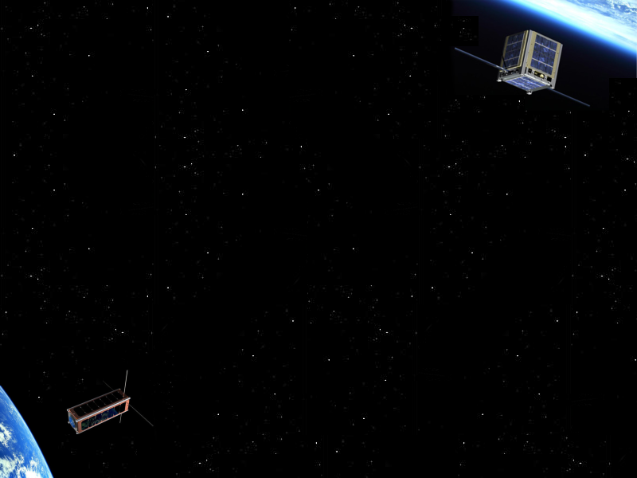
CubeSat Research
with Scott Arnold & Ryan Nuzzaci
Topic V (short) – Reconfigurable Computing
An Adaptive Fault-Tolerant Memory System for FPGA-based Architectures in the Space Environment
Dan Fay, Alex Shye, Sayantan Bhattacharya, and Daniel A. Connors

Slide 2
FPGAs in Space – Benefits
Reconfigurability
  Rapidly adapt to changing mission conditions and requirements
  Multiple applications
Speed
  High-performance, application specific computing power
  Accomplish more data collection and experimentation in short-life satellites
Cost and availability
  Commercially available (COTS) FPGAs can be used
  Affordable since non-RADhard components can be used
Notes:
Speed – able to exploit parallelism, especially with data intensive applications

Slide 3
FPGAs in Space – Challenges
Radiation
  Short term damage
    Single Event Upsets (SEUs) – Occurs when an energetic particle leaves behind a charge in the silicon lattice
    May cause faults that affect application execution or result data
  Permanent damage
    Extensive radiation exposure can render all or part of a device unusable
    May severely limit lifetime of device in certain orbits
SRAM vs. EEPROM
  Modern FPGAs use an SRAM-based memory to store the configuration
  EEPROM memory is less susceptible to radiation upsets, but is no longer used in FPGAs for the configuration space
Notes:
-FPGAs have a higher susceptibility to faults caused by ionizing radiation
-SRAM memory is faster, more dense, and consumes less power than EEPROMs

Slide 4
The Need for Adaptability
Adaptable fault tolerance
  Fault tolerance schemes incur significant penalties in logic utilization, memory utilization, power consumption, and heat dissipation
  Adapt to varying radiation conditions
    High radiation – Remove non-essential logic and increase fault tolerance logic for more critical logic
    Low radiation – Decrease fault tolerant logic and increase processing logic
Partial reconfiguration (PR)
  Part of an FPGA to be reconfigured without interrupting the rest of the logic
  Benefits
    Reconfigure only the logic where errors have been detected
    Relocate functionality of permanent radiation damaged logic
Notes:
2

Slide 5
Improving the Reliability
Triple3 Redundant Spacecraft Systems (T3RSS)
  Provides whole-system redundancy
  Requires three FPGAs each with their own local memory
  FPGAs are interconnected using dedicated, point-to-point links
  Adapts system to different failure modes
    Partial failure of one or more FPGAs
    Complete failure of one or more FPGAs
    Complete failure of one or more memories
  Triple Modular Redundancy (TMR) is used to triplicate all logic
  PR is used to relocate functionality around hard errors and scrub areas where soft SEU errors occur
Notes:
2

Slide 6
Improving the Reliability (cont)
T3RSS System Design
Notes:
2

Slide 7
Memory System Design
Challenges
  Remote redundant memory requires high off-chip bandwidth
  Must increase memory width or FPGA interconnect clock speed
    Difficult due to FPGA’s resource limitations
    Increasing memory width will dramatically increase I/O pin use
    Faster memory technologies (e.g. PCI-X, PCI Express, RapidIO and HyperTransport) require too much extra logic
Possible solution
  Bandwidth reduction with strategies like distributed error checking, posted writes, caching, and shadow fault detection
Notes:
1

Slide 8
Memory System Design (cont)
Implementing fault tolerance
  Error detection/correction
    Single bit error detection can be accomplished with simple parity checking
    CRC or MD5 checksumming techniques can be used for more sophisticated error detection
    EEC can be used for error correcting
  Redundancy
    Redundant Array of Independent Disks (RAID) techniques can be applies to external memory or FPGA internal BRAMs
  Both redundancy and error detection/correction can be used simultaneously
Notes:
1

Slide 9
Memory System Design (cont)
Applying memory system fault tolerance
  Configure fault tolerance based on application’s requirements
  Parts of the memory system may be more critical than others
Fault effects
  Benign Fault – A transient fault which does not propagate to affect the correctness of an application
  Silent Data Corruption (SDC) – A transient fault which goes undetected and propagates to corrupt program output
  Detected Unrecoverable Error (DUE) – A transient fault which is detected without possibility of recovery
Notes:
some applications must function without errors for months or years, while other applications can safely suffer periodic faults
For example, control system output data is more critical than temporary and read-only variables
Benign – example: a fault to unused data or a fault to dead (unreachable) code.
SDC – example: single bit flip in image data would appear as noise
DUE – example: obviously incorrect execution or cause the FPGA to reset

Slide 10
Experimental Methodology
Four different campaigns for injection of SEUs
  Registers – Source and destination of instructions
  BSS segment – Area for uninitialized global and static variables
  DATA segment – Area for initialized global and static variables
  STACK segment – where the stack is stored
1000 iterations for each benchmark
Intel Pin dynamic binary instrumentation tool for fault injection
Fault-injection results categorized as:
  Correct – Valid correct output data and valid return code, Benign fault
  Failed – Illegal operation performed, results in DUE
  Abort – Invalid return code, results in DUE
  Timeout – Program hangs, time-out circuitry resets causing DUE
  Incorrect – Valid return code incorrect output data, results in SDC
Incorrect result is worst possible outcome
Notes:
2

Slide 11
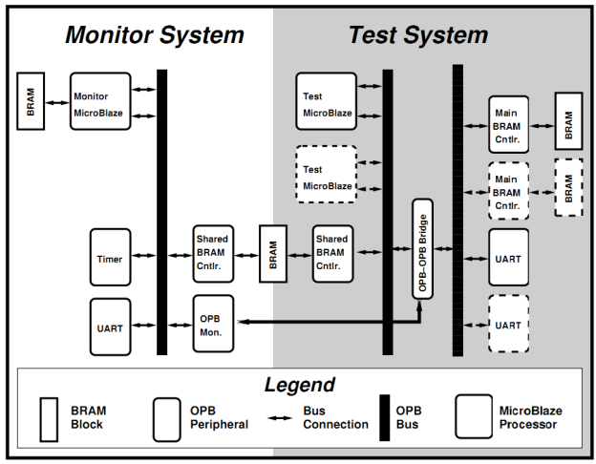

Memory Access Patterns
OPB – On-chip Peripheral Bus
Implemented on a Virtex-II pro
OPB-OPB bridge
  Snoop info to monitor
  Other side connects to Memory and UART
OPB Monitor
  Logs OPB bridge traffic
  Counts accesses to memory range
Microblazes
  Shared memory
  Between 2 and 3 used
Y

Slide 12
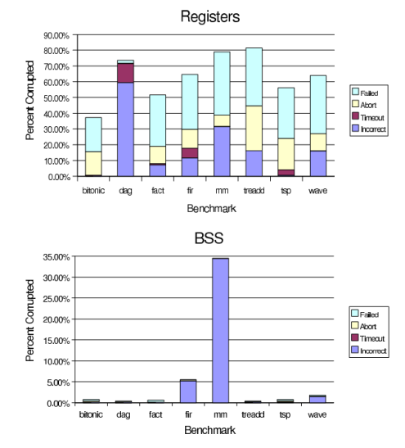
Register and BSS Results
Register vulnerability
  Particularly high compared to memory
  Frequent usage
  Use in multiple computations
BSS errors
  Typically Seldom do faults propagate to errors
  Notable exception in mm due to the large data structures
Notes:
3

Slide 13
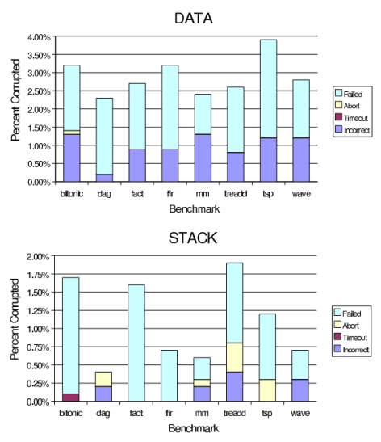
Data and Stack Results
Data memory section has almost uniform distribution
Stack memory shows selected applications have higher vulnerability
What does this all mean?
  Motivates the use of an adaptive memory system
  Customizable to the native characteristics and diverse workload

Slide 14
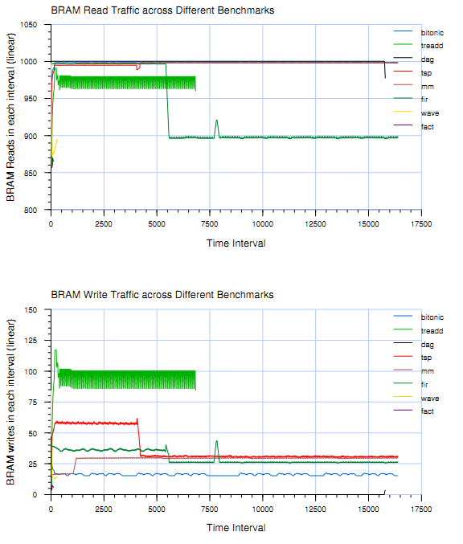
Memory Traffic Analysis
Large variations
  Read and write traffic
  Overtime in for each benchmark
Shows problem with providing
  Low-latency Memory
  fault- tolerant redundancy
Possible to not meet real time constraints, while providing FT

Slide 15
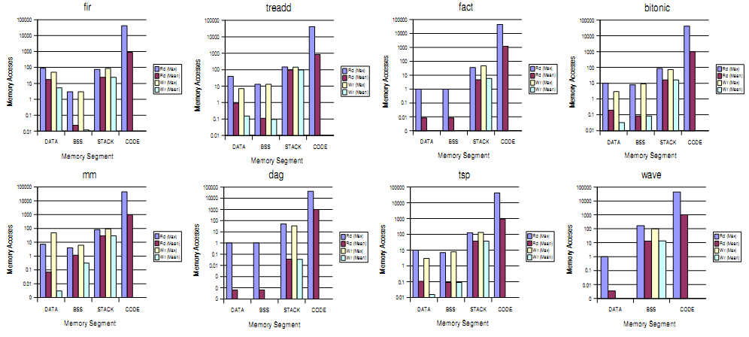
Memory Traffic by region

Slide 16
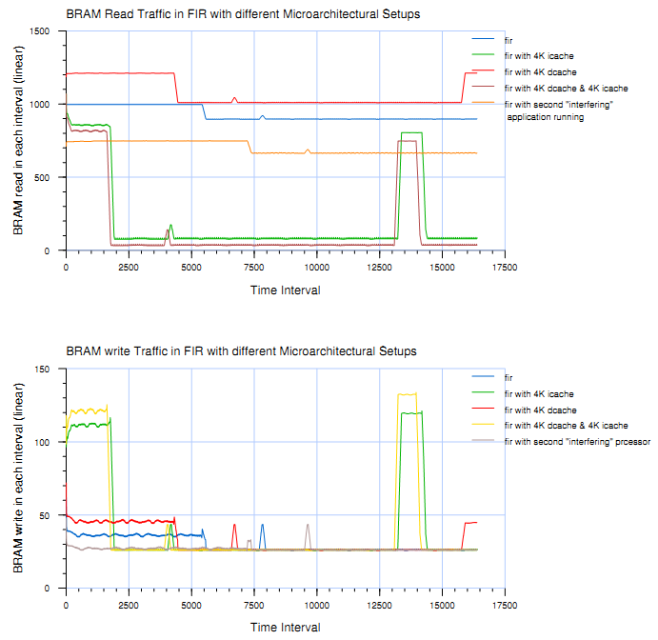
System w/Cache Analysis
Effects of 4KB I-cache
  Extremely effective in reducing read BRAM traffic
  Increased write traffic
  FIR filters shows significant speed increase
4KB D-cache
  Positive effect of FIR
  Increases amount memory accesses
Both
  Increases through-put of generated data
Application of third Microblaze
  Increases reads by 25%
  Decrease in overall system performance

Slide 17
Conclusions, FW, and Review
Conclusions
  Presented the T3RSS space hardware system
  Provided motivation for a needed Adaptive distributed memory FT strategy
  Emphasized the importance of reducing off-chip traffic
  Porting fault susceptable segments off chip it reduces the off-chip traffic
Future Work
  Implementing and testing new FT memory systems
  Overall performance of off-chip and on-chip FT techniques
  Study changes in wake of modified environmental conditions
Review
  Scott: Not a great paper, More explanation needed in results to back conclusions, poorly defined terminology through-out.
Notes:
1

