Slide 1
Topic 1: Sensor Networks (Long Lecture)
Jorge J. Gómez

Slide 2
Trickle: A Self-Regulating Algorithm for Code Propagation and Maintenance in Wireless Sensor Networks
Philip Levis, Neil Patel, Scott Shenker, and David Culler University of California, Berkeley Published in 2004 USENIX/ACM Symposium on Networked System Design and Implementation

Slide 3
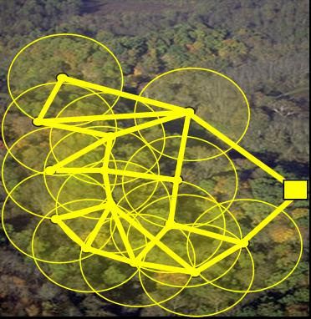
Introduction
Sensor networks
Made up of large numbers of small, resource-constrained nodes called motes
Operate unattended for long periods of time
Sensor networks need to evolve
Code can be changed during the lifetime of the network
New code must be propagated to all the nodes
Networking is expensive
High energy transmitters drain the battery of the mote
Constant communication means lower lifetime of a network
Two conflicting goals
Changes to running code need to disseminate quickly
Maintaining consistent code should have close to zero cost
Notes:
Unattended in buried an active burrow or implanted in a tag on an animal
Networking hardware is generally simple, 10s of Kbps. Single packet sent uses the same power as executing a thousand instructions

Slide 4
Introduction cont.
Authors present Trickle: an algorithm for code propagation and maintenance
Draws on two major areas of research
Controlled, density-aware flooding research for wireless and multicast networks
Epidemic and gossiping algorithms for maintaining data consistency in wired, distributed systems
It has been observed that transmitted code is generally very small
Verbose code needs demands concise representations
Basic overview of Trickle
Uses polite gossip: if a node hears gossip with the same metadata as its own, it will not gossip and if it hears old gossip it will broadcast new code
Nodes dynamically adjust gossiping attention spans in order to reduce overhead

Slide 5
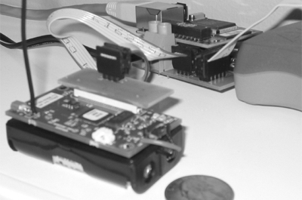
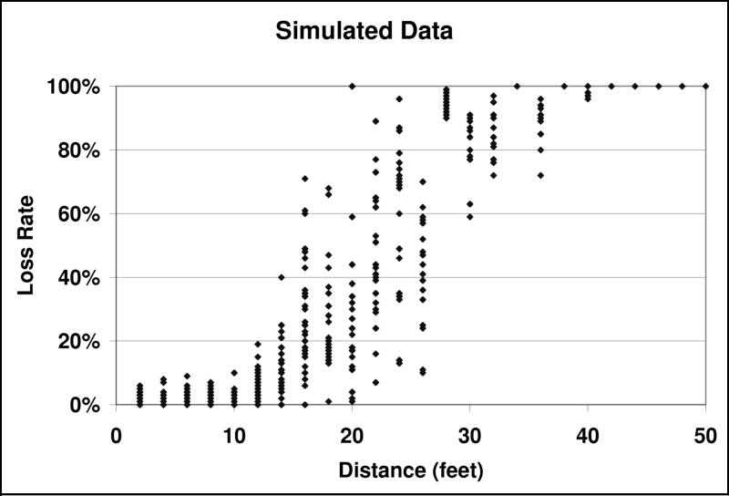
Methodology
Three platforms to investigate the Trickle algorithm
High-level, abstract simulation
TOSSIM, a bit-level simulator for TinyOS
Actual TinyOS mica2 nodes deployed in a lab
900 MHz radio, 128KB D+I memory, 4KB of RAM, 7MHz, 8 bit μC
Effective bandwidth is 40, 36-byte, packets per second
Abstract simulation
Quickly evaluates changes in the algorithm and its parameters
Just an event queue that outputs transmission amount and has various input parameters
Run duration
Boot time
Uniform packet loss rate
TOSSIM
Compiles from TinyOS code, simulating complete programs
Includes a CSMA MAC protocol
Model a network as a directed graph
Can simulate bit errors and hidden terminal problem
Uses a statistical packet loss rate as shown here

Slide 6
Trickle Overview
Two goals: propagation and maintenance
Propagation should be quick
Maintenance should cost very little
Cannot be free because you must communicate in order to tell if code is stale
Assumes reprogramming events are uncommon
O(minutes)
Assumes nodes can succinctly describe their code
Can tell if stale with metadata contained in a single packet
Two states for a cell (neighborhood): everyone is up to date, or the need for an update is detected
Detection can occur if a node broadcasts old data or if a node receives newer data
Communication can be either transmission on reception
Allows to scale
Communication rate can be kept independent of node density
Amount of bandwidth used in a cell is independent of cell size
Conserves bandwidth and power

Slide 7
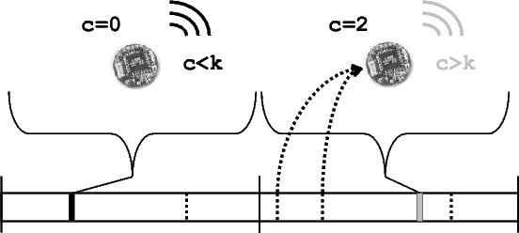
Maintenance
Each node maintains a counter, $c$, a threshold, $k$, and a timer, $t$, in the interval $[0, τ]$
$k$ is a small, fixed integer
$t$ is uniformly distributed in its range and $τ$ can be varied
When a node hears identical gossip, it increments$c$
At time $t$, if $c<k$, the node will broadcast its code
When the interval of size $τ$ completes, $t$ and $c$ are reset
If a node with code $∅_{x}$ hears a gossip of $∅_{x −y}$, it broadcasts a code update to that node
If a node with code $∅_{x −y}$ hears code $∅_{x}$, it broadcasts its code in order to receive an update
Performance
Each node broadcasts at most once per period
In perfect conditions (lossless, non-interfering motes) there will be $k$ transmissions per cycle
If there are multiple cells, $m$, each with $n$ nodes, this will go up to $km$ transmissions -- regardless of $n$
Random selection of $t$ ensures even distribution
Expected latency for detection is $\frac{τ}{n+1}$
Assumptions!!!

Slide 8
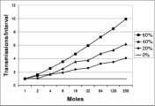
Maintenance cont.
Maintenance in the presence of loss
Packet loss is common
For a given loss rate, number of transmissions grows with $O\left(\log\left(n\right)\right)$
This logarithmic scaling is impossible to escape
Increase represents the worst case, expected case must transmit more to meet requirements
Some nodes miss an update and need it to be repeated
Maintenance without clock synchronization
Clock sync is a network intensive, expensive ordeal
Causes a short-listen problem
A subset of nodes have small $t$
With sync’d clocks the shortest of the set will quiet the rest
Short listen problem causes transmissions to go up with $O(\sqrt{n})$ all of which are redundant
Solution is a listen-only period, reducing the redundancy significantly
$t$ is now selected in the interval $[\frac{τ}{2}, τ]$
Notes:
Why not have a longer listen-only period: breaks down in the nominal case

Slide 9
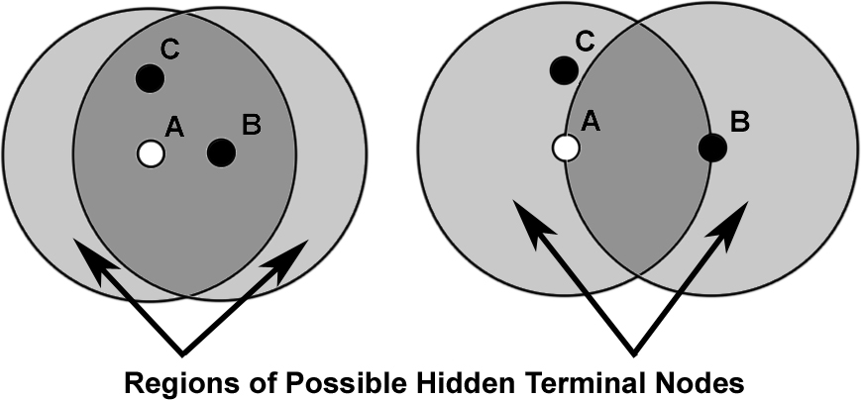
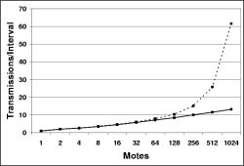
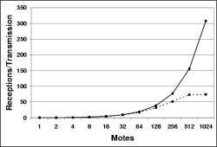
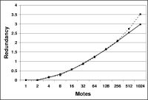
Maintenance cont.
Multiple Cells
TOSSIM used to simulate larger systems
Hidden node problem accounted for
Scales as expected when hidden node problem ignored
Scales poorly with high density systems if not ignored
Result of limitation of the CSMA protocol

Slide 10
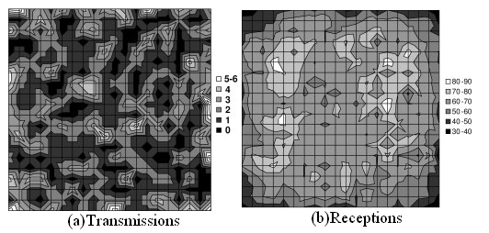
Load Distribution
Shown that Trickle imposes low system overhead
But is the overhead spread evenly
Results of a TOSSIM simulation show that load is correctly distributed
Simulation of 400 mote network in a 20x20 grid with 5 ft spacing
Transmissions per interval are uniformly distributed
Any non-uniformity can be attributed to statistical variation
Receptions are evenly distributed everywhere except in the edge of the grid
Edges have less multi-cell interference
Motes in center has 4x the neighbors and multiple cells it can hear
Motes in edges can hear very few cells

Slide 11
Propagation
Trickle can use the maintenance system to rapidly propagate code
Large $τ$ was shown to reduce maintenance cost
However for fast code propagation, a low $τ$ is desired
Trickle dynamically varies $τ$ in order to reduce overhead while still maintaining consistent code
$τ$ has a lower bound $τ_{l}$ and upper bound $τ_{h}$
Whenever $τ$ expires without an update, it doubles until it reaches $τ_{h}$
When a node installs an update, $τ$ is reset to$τ_{l}$
Nodes gossip more frequently when a change occurs
New information is dissemenated quickly
Once code is installed in most nodes, gossiping dies down

Slide 12
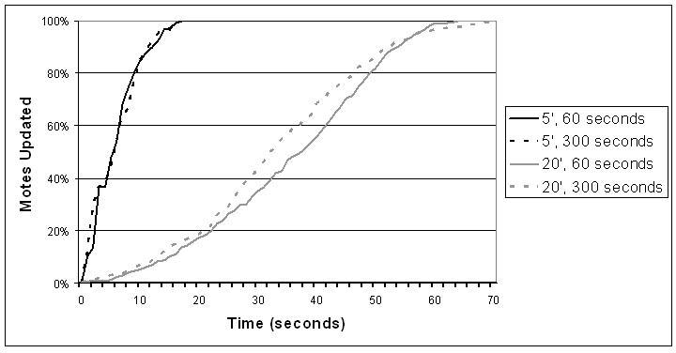
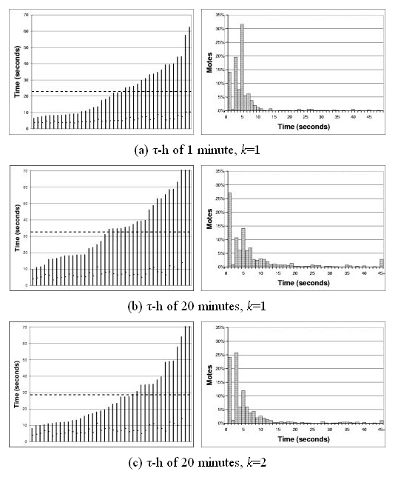
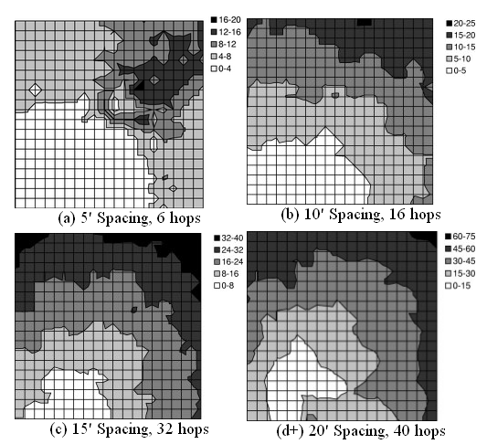
Propagation Results
Notes:
TL: Simulation of 400 mote network in a 20x20 grid with 5 ft spacing (spacing, Th) no real consistent tradeoff b/w th and effectiveness
BL: (a) shows hidden node effect
R: Nineteen nodes actually deployed tl=1s th=60s. RC is 40 experiments, avg is dotted. LC is distribution, long tail b/c of loss and exp scaling of tau, ramp up due to granularity of timers, could actually be artifact

Slide 13
Discussion
Trickle is small
70B of RAM, 2.5KB of machine code which can be optimized by 30%, low duty cycle
Assumes nodes are always on
Not true of energy conserving motes that power cycle
TDMA schemes can be used to schedule Trickle times
Trickle could be used to disseminate any kind of data
Designed for code propagation but only assumptions were low frequency and small size
Could limit propagation scope by adding predicates to broadcast data
Good for data replication among only a cell

Slide 14
Conclusions
Using dynamic $τ$ and listen-periods, Trickle effectively balances the need of quick propagation and low maintenance overhead
Simple mechanism means low resource overhead
In one empirical experiment, Trickle imposed an overhead of 3 packets per hour but reprograms the system in less than 30 seconds with no intervention from the user

Slide 15
A Key-Management Scheme For Distributed Sensor Networks
Laurent Eschenauer and Virgil D. Gilgor University of Maryland Published in 2002 Proceedings of the 9th ACM Conference on Computer and Communications Security

Slide 16
Introduction
Distributed Sensor Networks (DSNs)
Battery powered, resource constrained
Limited mobility after deployment
Large scale (tens of thousands of nodes)
May be deployed in hostile environments
Networks are self healing; they allow nodes to join and leave freely
Subject to capture or manipulation by adversaries
Communication security constraints
Typical sensor nodes lack computational power
Typical asymmetric cryptosystems are impractical due to high computation
Energy required to complete a 1024-bit RSA is 2 orders of magnitude greater that a 1024-bit AES
Symmetric-key ciphers, low-energy authenticated modes, and hash functions become the tool of choice for protecting communications
Key Management constraints
Traditional, internet-style key exchange based on a trusted third party is impractical due to limited communication range
Key pre-distribution
Single mission key would mean a compromised system if one node was captured
Pair-wise private keys would require (n-1) keys stored per node, n(n-1)/2 keys in the DSN

Slide 17
Overview of the Basic Scheme
Key distribution
Pre distribution
Generate a large pool of keys (100K-1M)
Draw k keys out of the pool without replacement for each node’s key ring
Load key ring on to memory of each sensor
Save a key identifier for each key ring on a trusted controller
Shared-key discovery
Every node discovers its neighbors and with which neighbors it shares keys
Key identifiers can be broadcast in plaintext
Or broadcast the identifiers k times, each encrypted with a certain key
This phase establishes the topology as seen by the DSN where a link is made only if the two nodes are in range and share a key
Path-key establishment
Assigns a path-key to pairs of sensor nodes in range of each other that do not share a key but are connected through other nodes
Uses left over keys in key ring
Key ring is statistically over provisioned
k chosen to allow for extra keys for revocation, node joins, and path-key establishment

Slide 18
Basic Scheme cont.
Revocation
When a node is compromised assume the key ring is compromised
Controller node broadcasts a revocation message containing a signed list of keys compromised
Signed with key generated in pre-distribution for node-controller communication
Nodes verify list, remove keys
Links may disappear so shared-key discovery and path establishment need to be restarted
Revocation only affects a small set of the global key space but all links of the compromised node
Re-keying
If keys in a node expire, nodes self revoke their keys
Very inexpensive, can just message affected nodes
Not very common as key lifetime usual exceeds node lifetime
Sensor node capture
Two levels of attack: data manipulation and physical control
Sensor data manipulation is hard to detect without off-line, computationally-intensive algorithms and can only be solved with redundancy
Physical control of a device can lead to sleep-deprivation attacks and could give away the key ring
Shielding of nodes can be used to detect tampering and trigger key ring erasure
Even if node lacks shielding, key-ring algorithm will only give away k keys where $k≪n$
Mission key scheme gives away all nodes
Pair wise key scheme results in n – 1 keys compromised

Slide 19
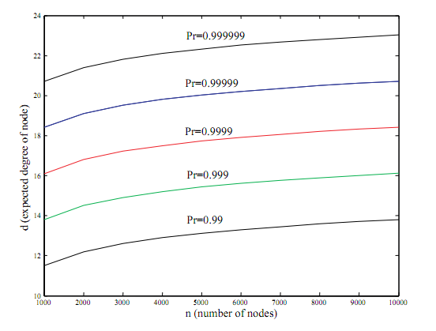
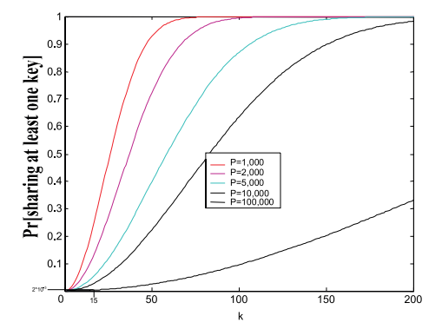
Analysis
Using graph theory we can determine what p, the probability two nodes share a key, needs to be in order to have the system be connected
Degree of a node, d, is the number of edges a node has $d=p∗\left(n−1\right)$
When p is zero, the graph does not have any edges
When p is one the graph is fully connected
Using results from graph theory we can find p as shown here
To increase probability by an order we need an increase of 2 in node degree
How to choose k and P, the key ring size and key pool?
p limited by wireless effects (cell size)
Deterministic equation can be derived for p given P and k as shown

Slide 20
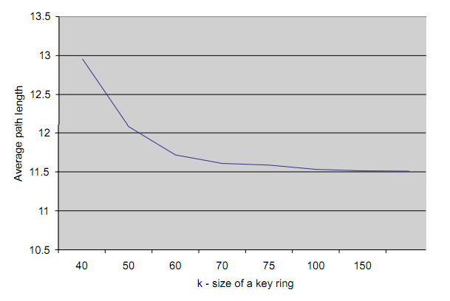
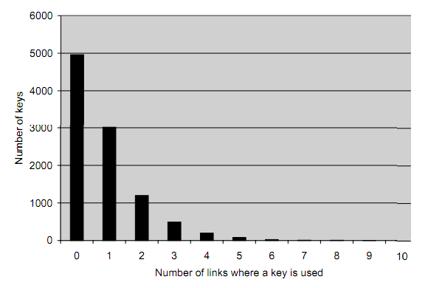
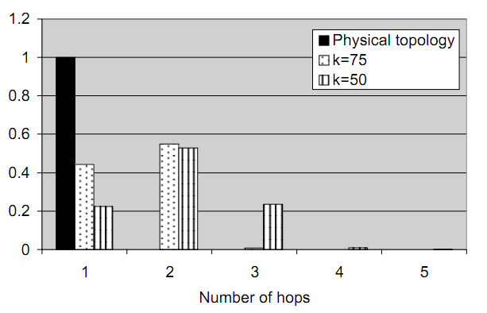
Simulations
Network of 1k nodes simulated
Average density of 40 nodes per cell
Average path length affected by k
Small k means two nodes may miss to share a key and therefor need to find an alternate, longer path
These long paths are only used once
Number of hops is to reach a neighbor is very small for large enough k
We can also see that only 50% of keys are used to secure links, 30% protect only one link, 10% two, etc.
Compromise of one key ring leads to compromise of a link with those probabilities

Slide 21
Conclusions
Presented a novel key-management scheme for large DSNs
Approach is simple to avoid computational overhead while deployed
Technique is scalable and flexible
Tradeoffs can be made between memory overhead and connectivity
Security is better than traditional schemes

