Slide 1
On-Chip Communication Buffer Architecture Optimization Considering Bus Width
Communication Architecture Optimization
Lochana Narayanan Suchitra Chandran
1

Slide 2
On-Chip Communication Buffer Architecture Optimization Considering Bus Width
Need for Communication Centric Design Flow
2

Slide 3
On-Chip Communication Buffer Architecture Optimization Considering Bus Width
COMMUNICATION CENTRIC DESIGN FLOW
System Performance
On-Chip Power
Increase in system cost
Increase in design cycle time
3
Notes:
Communication is THE most critical aspect affecting system performance
Communication architecture consumes upto 50% of total on-chip power
Ever increasing number of wires, repeaters, bus components (arbiters, bridges, decoders etc.) increases system cost
Communication architecture design, customization, exploration, verification and implementation takes up the largest chunk of a design cycle
Communication Architectures in today’s complex systems significantly affect performance, power, cost and time-to-market

Slide 4
On-Chip Communication Buffer Architecture Optimization Considering Bus Width
On-Chip Communication Buffer Architecture Optimization Considering Bus Width
4

Slide 5
On-Chip Communication Buffer Architecture Optimization Considering Bus Width
OUTLINE
1
2
3
4
5
Increase in data communication lead to buffer architecture optimization
Proposed SRAM optimization method to construct buffer architecture candidates
Design quality of each architecture candidate was evaluated
Experimented on a JPEG encoder system
Explore architecture with trade off between area and transfer time
5
Notes:
With multi core system the amount data involved in comunicaton has increased tremndously and hence optimi buffer arch have become critical
Pfropsed exploration method can explore archietecture with trade off between area and transfer time.

Slide 6
On-Chip Communication Buffer Architecture Optimization Considering Bus Width
INTELLECTUAL PROPERTY BASED DESIGN
Reuse previously designed modules on a standard bus architecture
Data transfers between IPs
6
Notes:
Using previously deisgned modules called Ips on a std bus architecture
Not only the data processing happeing in Ips but also de data commn between the IPS should operate correctly for the system to perform at its best.
So with incresing data processing in the IP cores the commn arch shud be able to handle it ..so choose ur parameters of the commn archie taking into accnnt so dat system achieves max perofmrnace

Slide 7
On-Chip Communication Buffer Architecture Optimization Considering Bus Width
COMMUNICATION BUFFER
Role
Compensates operational frequency difference between the IPs and bus.
Implementation
Stores data transferred between IPs
SRAM : faster, compact & no refreshing circuitry
7
Notes:
Using previously deisgned modules called Ips on a std bus architecture
Not only the data processing happeing in Ips but also de data commn between the IPS should operate correctly for the system to perform at its best.
So with incresing data processing in the IP cores the commn arch shud be able to handle it ..so choose ur parameters of the commn archie taking into accnnt so dat system achieves max perofmrnace

Slide 8
On-Chip Communication Buffer Architecture Optimization Considering Bus Width
BUFFER SIZE
Amount of data transfer
Number of bits per word, number of words & number of SRAMs
8
Notes:
Using previously deisgned modules called Ips on a std bus architecture
Therefore buffer archietecture suitable for every design should be chosen according to the amount of data and width of data in each data transfer

Slide 9
On-Chip Communication Buffer Architecture Optimization Considering Bus Width
PRIOR WORK
Buffer optimization for NoC
Analyzed the communication flow on chip.
Traffic in the interconnect .
Approach of Paper
Optimizes buffer for not only size but also for physical dimensions of the SRAM
9
Notes:
Analysing data flow for commn archietecture and minmising buffer for only that capacity.

Slide 10
On-Chip Communication Buffer Architecture Optimization Considering Bus Width
PRIOR WORK
Target Architecture
System Level Model (SLM)
Architecture Level Model (ALM).
10
Notes:
Exploring the archietecture based on system level profiling
Analysing data flow for commn archietecture and minmising buffer for only that capacity.

Slide 11
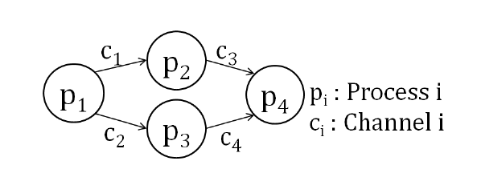
On-Chip Communication Buffer Architecture Optimization Considering Bus Width
PRIOR WORK
Target Architecture
System Level Model (SLM)
11
Notes:
Corresponds only to data processing mapped to a process and data transfer is mapped to a channel

Slide 12
On-Chip Communication Buffer Architecture Optimization Considering Bus Width
PRIOR WORK
Target Architecture
Architecture Level Model (ALM).
12
Notes:
ALM represents archietecture of the system. FB are registered in IP databases. Provides info about the archietecture which are proess to FB mapping, execution freq, bus width etc
Every proces in SLM mapped to FB and every channel is mapped to a bus. There exists a buffer in every channel betwenn fb and bus

Slide 13
On-Chip Communication Buffer Architecture Optimization Considering Bus Width
ARCHITECTURE EXPLORATION
Parameter set search tree traversal
Nodes: process mapping, channel mapping, execution freq. of FB, execution freq. buses, bus width and number of buffers.
Path from root to leaf corresponds to one ALM
13
Notes:
The design space is explored by

Slide 14
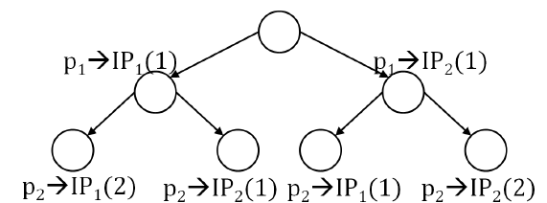
On-Chip Communication Buffer Architecture Optimization Considering Bus Width
Process i is mapped to instance k
of IPj
Process Mapping Search Tree
14
Notes:
Every process mapped to FB of IP in IP registered database
Each channel mapped to a bus
3
Execution freq. of FB mapped to freq. candidates of corresponding IP.
4
Execution freq. of bus & bus width selected from bus freq candidates & bus width input by designer

Slide 15
On-Chip Communication Buffer Architecture Optimization Considering Bus Width
Execution order of the process & data transferred between the processes
System level execution order graph (SL-EOG)
Architecture level execution dependency graph ( AL-EDG)
15
Notes:
Performanceof application estimated by
Execution order used to construct

Slide 16
On-Chip Communication Buffer Architecture Optimization Considering Bus Width
System level execution order graph (SL-EOG)
R/E order : execution of data processing begins when all data received.
E/S order : data transmission starts after data processing is complete
Architecture level execution dependency graph ( AL-EDG)
E/R dependency : next data can be received after data in buffer executed
S/E dependency : next data processing can be executed after data in buffer sent to other processes
16
Notes:
Two types of exec order exist between data processing & data transfer
ALEDG constructed from SLEOG by adding 2 dependancies to ALM

Slide 17
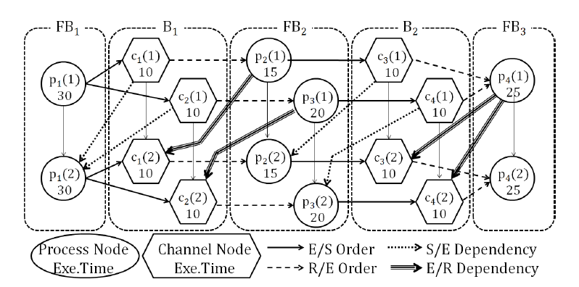
On-Chip Communication Buffer Architecture Optimization Considering Bus Width
Architecture level execution dependency graph ( AL-EDG)
17
Notes:
Each vertex pi represents either a data processing or a data transfer..each edge ci represnts the exceeution order in SLM & dependancy between data procees and data transfer acc to ALM

Slide 18
On-Chip Communication Buffer Architecture Optimization Considering Bus Width
BUFFER ARCHIETECTURE REALIZATION
Conventional Implementation
Only size considered and not physical access behavior & implementation
Buffer Arch. Optimization
Bus width & data size
18
Notes:
Bufferes were realised as temporary storage where Ips &buses cud acces them frojm thrie own perspective. Example IP can access and 512 byte buffer as 8 bit storage while the 16 bit bus can access it as 16 bit storage.
So only one buffer archi ALLOws one to explore in aprameter detail based on

Slide 19
On-Chip Communication Buffer Architecture Optimization Considering Bus Width
BUFFER ARCHIETECTURE OPTIMIZATION
SRAM towards design Quality
Choose SRAM suitable to each data communication on the system
Choice based on bus width, data width, area and energy consumption
19
Notes:
Section ahead describes the effect of buffer on on cjhip commn quality, optimized target buffer archiet and buffer arch exploraiton methd.Among several archi avaliable each arch holds trade off between area and exe tym

Slide 20
On-Chip Communication Buffer Architecture Optimization Considering Bus Width
SRAM towards design Quality
8 bit data between two IPs on a 16 bit bus
16 bit bus can transfer 2 pieces of data
8 bit SRAM would require 2 clocks to transfer 2 pieces of data
Utilization not exploited fully
16 bit SRAM or two 8-bit SRAMs
Transfer time is halved
Increase in size of SRAM
20
Notes:
Among several archi avaliable each arch holds trade off between area and exe tym

Slide 21
On-Chip Communication Buffer Architecture Optimization Considering Bus Width
SRAM towards design Quality
Row & Column of SRAM varies according to size of the column mux
21
Notes:
Communication thru measures the bus utilization
Numebr of row & colmn of SRAM varies acc to the size of the colmn mux

Slide 22
On-Chip Communication Buffer Architecture Optimization Considering Bus Width
System Assumption
Single port SRAM used
At least one receive buffer and one transmit buffer in the architecture
Based on shared bus model and data transfer can use the entire bus
22
Notes:
Among several archi avaliable each arch holds trade off between area and exe tym
thus you can read/write only one memory cell during each clock cycl

Slide 23
On-Chip Communication Buffer Architecture Optimization Considering Bus Width
Target Buffer Architecture
Bus Width
All data bits in bus stored within 1 clock cycle in 1 word
Bus greater than data width
Data width greater than bus width
Data Size
One data stored in 1 word.
At most one data stored in one clock cycle.
23
Notes:
Among several archi avaliable each arch holds trade off between area and exe tym

Slide 24
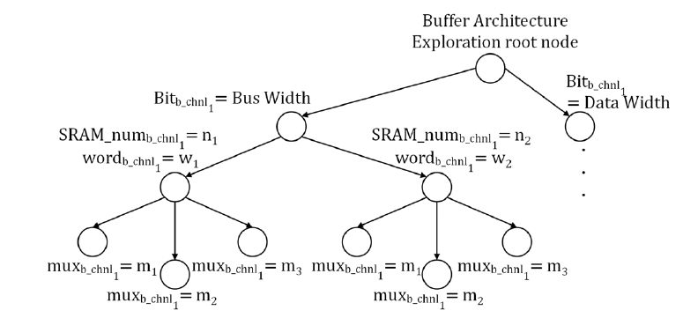
On-Chip Communication Buffer Architecture Optimization Considering Bus Width
Buffer Architecture Exploration
Bit Ci : no. of bits per word of SRAM comprising channel I
SRAM_numCj : no. of bits SRAM comprising buffer channel j
WordCk : no. of words per one SRAM of channel k
24
Notes:
Among several archi avaliable each arch holds trade off between area and exe tym

Slide 25
On-Chip Communication Buffer Architecture Optimization Considering Bus Width
Buffer Architecture Exploration
1
Number of bits per word
2
Number of component SRAM comprising the buffer
25
Notes:
No of words per SRAM :
Max data transferred in the channel is bits per word associated with data width

Slide 26
On-Chip Communication Buffer Architecture Optimization Considering Bus Width
Buffer Architecture Exploration
1
Number of bits per word
2
3
Number of component SRAM comprising the buffer
Size of the multiplexer
4
Pruning
If one or both lower bound of execution time & hardware area exceeds design constraints
If both lower bound of execution time and area exceeds explored optimal architecture
26
Notes:
Size of the mux chosen that yields the smallest SRAM to continue further exploration
Exploration might take a long time so prune the parameter search tree by considering execution tyma dn hardware area.

Slide 27
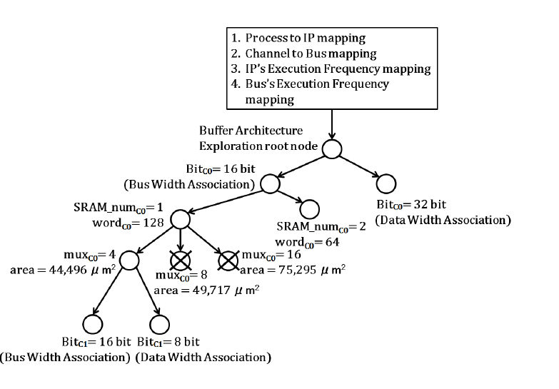
On-Chip Communication Buffer Architecture Optimization Considering Bus Width
Buffer Architecture Exploration
27
Notes:
Node aftre process to IP mapping, channel to bus mapping, execution freq ma[ping becomes the root node for the exploratoin.
From root paramters fo buffer arch for each channel are explored and search is done in DF search amnner.

Slide 28
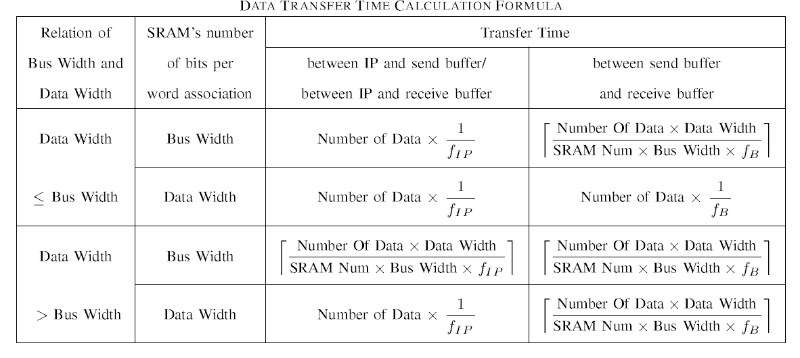
On-Chip Communication Buffer Architecture Optimization Considering Bus Width
Performance Estimation
Estimated using AL-EDG
28
Notes:
Fip: execution freq of IP
Fb execu freq of the bus
Transfer time : time spent for data commn between 2 ips: transfer tym bw IP & send buffer, send & recv buffer & rcv buffer & IP

Slide 29
On-Chip Communication Buffer Architecture Optimization Considering Bus Width
Area Estimation
Area of Buffer = Area of SRAM X number of SRAM
29
Notes:
Area of SRAM obtained thru logic syntesis using 0.18um process

Slide 30
On-Chip Communication Buffer Architecture Optimization Considering Bus Width
Energy Consumption Estimation
Transmit Buffer =
Word access counts =
Receive
Buffer =
SRAM write energy consumption X word access counts
SRAM read energy consumption X word access counts
transfer cycle (no. of bits => bus width)
number of transferred data (no. of bits => data width)
30
Notes:
Dynamic energy consumption of

Slide 31
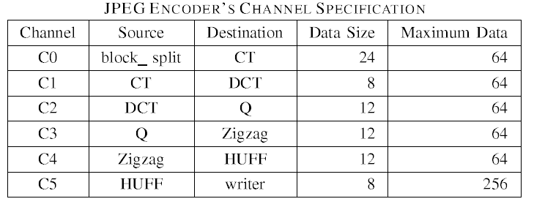
On-Chip Communication Buffer Architecture Optimization Considering Bus Width
Experiment & Results
31
Notes:
Proposed method was aplied to JPEG encoder system consisted of 7 process and 6 channels

Slide 32
On-Chip Communication Buffer Architecture Optimization Considering Bus Width
Experiment & Results
Global exploration conducted with following parameters
32
Notes:
Proposed method was aplied to JPEG encoder system consisted of 7 process and 6 channels

Slide 33
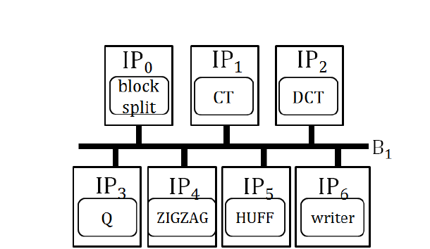
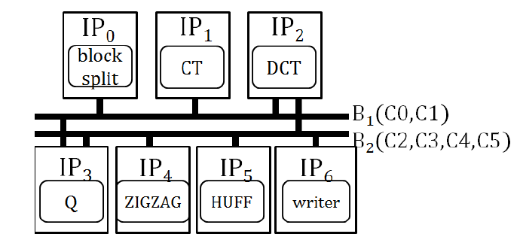
On-Chip Communication Buffer Architecture Optimization Considering Bus Width
Experiment & Results
SYSTEM LEVEL MODEL
33
Notes:
Proposed method was aplied to JPEG encoder system consisted of 7 process and 6 channels

Slide 34
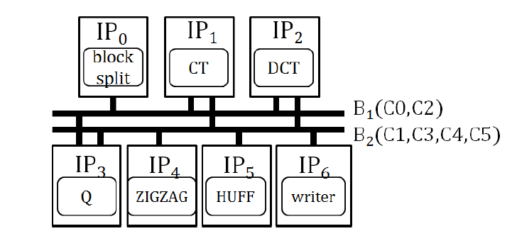
On-Chip Communication Buffer Architecture Optimization Considering Bus Width
Experiment & Results
SYSTEM LEVEL MODEL
34
Notes:
Proposed method was aplied to JPEG encoder system consisted of 7 process and 6 channels

Slide 35
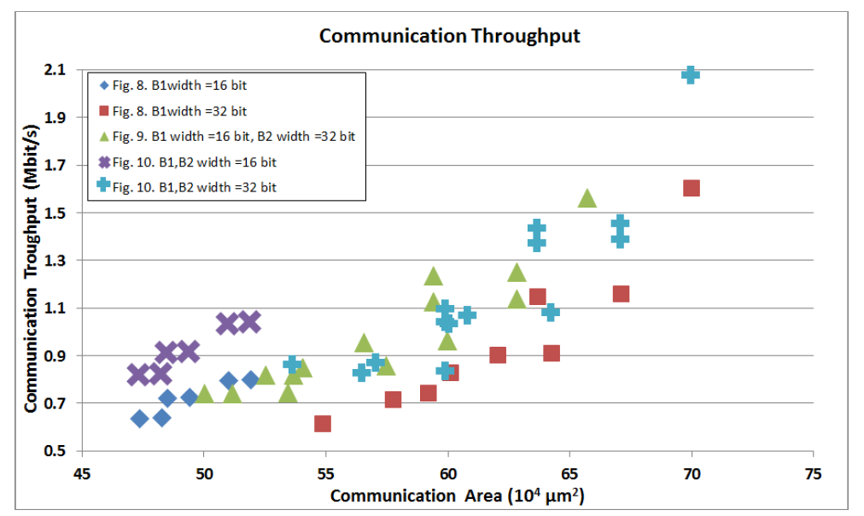
On-Chip Communication Buffer Architecture Optimization Considering Bus Width
Experiment & Results
35
Notes:
Proposed method was aplied to JPEG encoder system consisted of 7 process and 6 channels

Slide 36
On-Chip Communication Buffer Architecture Optimization Considering Bus Width
Experiment & Results
36
Notes:
Proposed method was aplied to JPEG encoder system consisted of 7 process and 6 channels

Slide 37
On-Chip Communication Buffer Architecture Optimization Considering Bus Width
Conclusion & Future Work
Conclusion
Buffer architecture optimized considering parameters of SRAM
Future Work
Does not specify the bus protocol
Implementation on multi layer bus
37
Notes:
Proposed method was aplied to JPEG encoder system consisted of 7 process and 6 channels

Slide 38
Architectural Optimizations
Lochana Narayanan Suchitra Chandran
₃₈

Slide 39
Communication Architecture Optimization: Making the Shortest Path Shorter in Regular Networks-on-Chip
Umit Y. Ogras, Radu Marculescu Hyung Gyu Lee, Naehyuck Chang
Department of Electrical and School of Computer Science and Engineering Computer Engineering Seoul National University, Korea
Carnegie Mellon University, USA {hglee,naehyuck}@cselab.snu.ac.kr
{uogras,radum}@ece.cmu.edu
₃₉

Slide 40
The Problem
Complex on-chip communication.
Adding more functionality to future SoCs depends critically on finding truly scalable on-chip communication architectures.
₄₀

Slide 41
The Potential Solution
Network-on-Chip (NoC) paradigm has been recently put forth as a potential solution to on-chip communication problems.
Key Features :
regular structure, mesh-like NoC architectures
Disadvantages :
poor topological properties such as long inter-node distances.
41

Slide 42
Introduction
Interconnect networks are abstracted as graphs that effect the communication capabilities.
Until recently, only fixed (deterministic) or completely random graphs were thoroughly studied.
E.g. : real networks such as WWW, internet, US power grid, collaboration networks etc. revealed that many real networks are neither completely regular, nor completely random.
Instead, they cover a sizeable design space in between these two extremes and are known as small-world networks.
42

Slide 43
Large inter-node distances increase :
the messages latency.
link blocking probability.
Fully customized topologies :
achieve short internode distances - expense of a complicated communication structure.
Possible to find a sweet spot between these two extremes in the design space – Small World Networks!
43

Slide 44
Small world networks
Features :
Small inter-node distances
Large clustering coefficients.
Small-world phenomenon (popularly known as six degrees of separation) implies that all nodes are connected to each other by a short chain of intermediate nodes.
Similar to network research, initial studies in the NoC area considered either completely structured (grid-like) or fully customized networks.
Mesh network lacks both high clustering and short paths between remotely situated nodes.
44

Slide 45
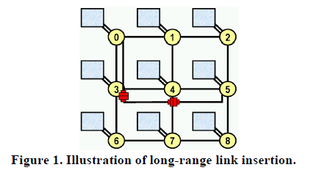
Structured Network with long range links
m × n 2D mesh network (N) with :
Vij – communication volume between i and j.
Wij – Required bandwidth.
Long range links are broken into regular links but are connected with repeaters.
Repeaters help with buffering which guarantees latency intensive operation.
2 ports – accept the incoming flit, store in FIFO and forward to output port.
45

Slide 46
The Working
Main goal :
Minimize the average packet delay w.r.t bandwidth and available resources.
- Given
Communication Volumes Vij
Corresponding bandwidth Wij
Routing strategy of mesh network
Amount of available resources S
Determine
Set of long range links Ls to be inserted
Deadlock free routing strategy for newly added long – range links
Such that
Links satisfy the Wij
Critical load λc is maximized max(λc) subject to Σ_{l ∈ LS} s(l)< S
Computes critical load for the initial mesh network – computes the improvement in the average inter node distance - most beneficial link is inserted permanently – amount of utilized resources is updated – algorithm computes till all the resources are used up – finally routing strategy is produced.
46

Slide 47
What this paper deals with
Static Properties –
Degree Distribution
Diameter and Cost Factor
Clustering Coefficient
Dynamic Properties –
Average inter – node distance
Link utilization
47

Slide 48
STATIC PROPERTIES
48

Slide 49
1. Degree Distribution
The degree of a node, di , is given by the number of links incident to that node.
3 main flavors of degree distribution :
Maximum degree d_{max} = max {di}
Range of degrees d_{span} = dmax – dmin
Sum of all degrees d_{T} = Σ_{i} di
Maximum degree determines the largest router needed in the network.
Range is a measure of different heterogeneities.
Sum of all degrees gives the total number of uni-directional links in the network.
49

Slide 50
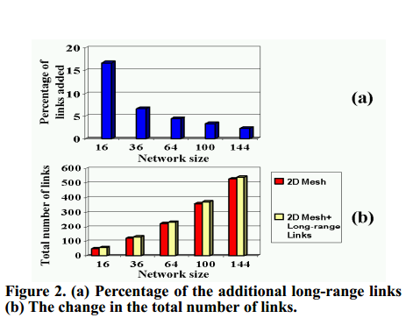
Impact of long-range links in degree distribution
Maximum degree of a standard mesh network is 4.
Increased to 5 – 1 extra link is attached to each tile.
--The total number of links
increases slightly.
--As network size scales up, % of
additional links drops.
50

Slide 51
2. Diameter and Cost factor
Diameter – longest path between any two nodes of a network.
Variation in D , as network size increases provides a measure of scalability.
Comparing only the diameters doesn’t provide a fair comparison as higher node degrees results in smaller diameter but this may incur an extra cost.
Hence use D*d_{m} which is the cost factor for quality measure.
51

Slide 52
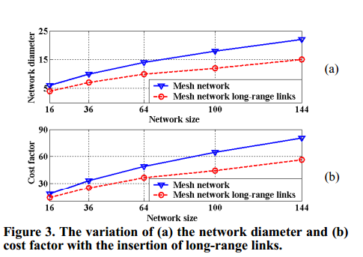
Impact of long – range links on the diameter and cost factor
There is 30 % reduction in the diameter of the networks in study.
-- Similar reduction is obtained for the
cost factor.
-- As network scales up, the gain in the cost factor increases as the change in average node degree becomes smaller.
52

Slide 53
3. Clustering Coefficient
53

Slide 54
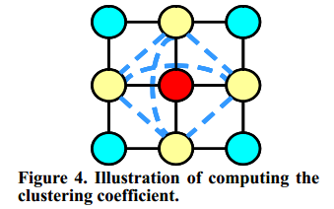
Impact of long-range links on clustering coefficient
C_{i} = 0 for all nodes in a mesh network as none of these 6 connections actually exist in a 2D network.
None of the immediate neighbors of a given node are directly connected to each other.
Long-range links of length 2 increase the C_{N.}
Adding any of the dashed lines increases C_{N} from 0 to 0.2.
54

Slide 55
DYNAMIC PROPERTIES
55

Slide 56
Dynamic Properties
Determined by :
Traffic flow
Routing strategy
Network topology
2 benchmarks were used :
hotspot
Transpose - each node send packets to the nodes located symmetrically to the first diagonal.
56

Slide 57
1. Average inter-node distance(µ)
Determines :
Packet delay in absence of contention
Effect on traffic congestion – Little’s theorem which states that the number of packets in the network is proportional to the average time the packets spend in the network.
µ is inversely proportional to λc, the critical traffic load.
57

Slide 58
Impact of long-range links on the avg. inter-node distance
58

Slide 59
2. Link Utilization (ρ)
Should be uniform across the network such that the traffic load is uniformly distributed and none of the routers become a performance bottleneck.
Maximum link utilization is defined as –
ρ_{max} = max {ρ_{i}}
Maximum performance link -> bottleneck, smaller ρ implies higher critical load traffic.
59

Slide 60
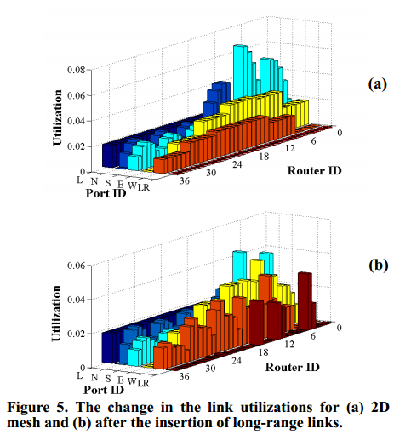
Impact on link utilization

Slide 61
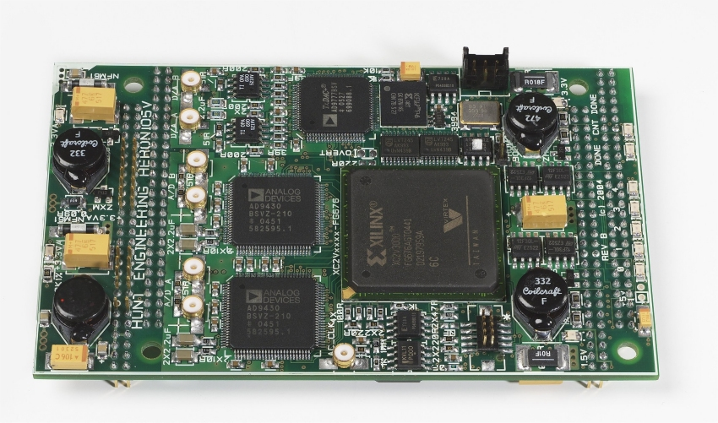
Experiments using an FPGA prototype
Xilinx Virtex-2 based FPGA.
4x4 mesh network with 16 routers
Router has I/O ports (3-6 no., 16 bit wide), decision logic, switch fabric and output controller.
Besides performance and area comparisons, energy comparison impact is also evaluated.
61

Slide 62
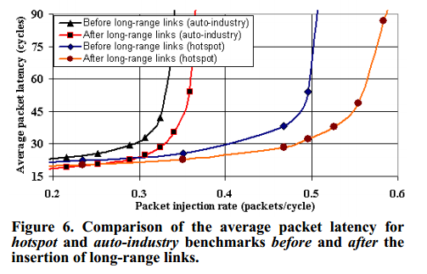
Performance Comparison
12 links – inserted in the mesh network.
Low injection rates
20% reduction in the packet latency
Higher injection rates
Reduction in latency goes over 50%
Throughput increases by 11%.
62

Slide 63
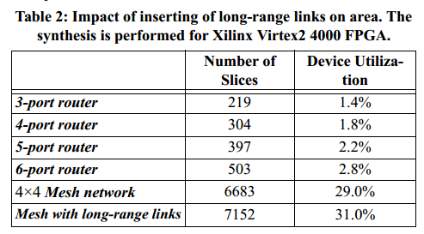
Area Comparison
More resources – more area
Increases the number of ports.
Increase in utilization by 85, 93 and 106 slices
63

Slide 64
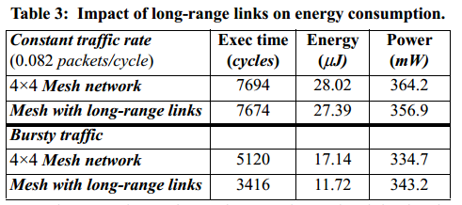
Energy comparison
As repeaters are present, not much change in link and buffer energy consumption.
Cycle accurate energy measurement tool.
2.2% reduction in energy.
64

Slide 65
Conclusion and Future Work
Explored the potential of inserting application specific long-range links to 2D mesh networks.
Small number of long-range links improve both static and dynamic properties of the network.
Future work
Experiments should be implemented on higher node networks.
65

Slide 66
Questions
Notes:
compares the costs of different
approaches using for Hybrid BIST cost calculation an
equation 1 with the parameters
a
= 1, and
ß
= B where B is
the number of bytes of the input test vector to be applied on
the CUT. As pseudorandom test is usually the most
expensive method, it has been selected as a reference and
given value 100%. The other methods give considerable
reduction in terms of cost and as it can be seen, hybrid BIST
approach has significant advantage compare to the pure
pseudorandom or stored test approach in most of the cases.

