Slide 1
Tyler Lovelly, Donavon Bryan, Andrew Milluzzi EEL6935 - Embedded Systems Seminar Spring 2013
Topic: Aerospace Applications
02/07/13

Slide 2
Pulling the Pieces Together at AFRL
Wegner, Peter M.; Kiziah, Rex R.; "Pulling the Pieces Together at AFRL", 4th Responsive Space Conference, April 24–27, 2006, Los Angeles, CA

Slide 3
Introduction
AFRL Space Vehicles Directorate pushing technology to enable rapid satellite development and launch
Minimal cost and response time emphasized
Lead to heavy investment in new technologies for rapid spacecraft design and integration
Experiments to demonstrate capabilities
TacSat Missions
Test beds and simulations

Slide 4
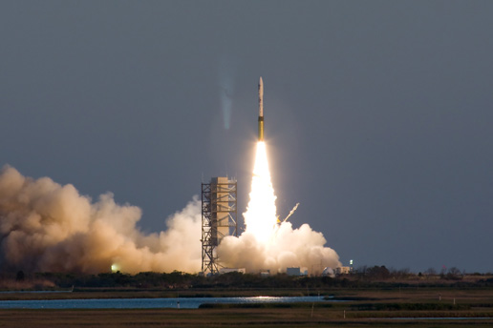
Operationally Responsive Space
Joint effort between several DoD agencies to provide cheap and rapidly deployable space capabilities
Plans laid out in Space Science and Technology Vector-2
Total mission cost <$30M
Less than one year development time
Launch in 6 days from call-up
Rapid integration with new technologies with new plug-n-play standards
Small operator crews (<4 people)

Slide 5
Filling the Gaps
Few options considered for Responsive Space
On-orbit storage of spacecraft
Deemed prohibitively expensive
Ground storage of spacecraft
Adopted cost effective solution
Technological advancements often outpace the rate of spacecraft development
Need way to rapidly develop spacecraft and integrate new technology
RSATS- Responsive Space Advanced Technology Study
Investigated technologies to develop these capabilities
Proposed plug and play architectures utilizing “internet-like” data-bus architectures
Identified key technologies to be developed
Communications for tactical tasking and data dissemination
Miniaturized spacecraft components and payloads
Rapid deployment tools
Modular plug and play spacecraft architectures and components

Slide 6
Spacecraft Plug-n-Play Avionics
Responsive capability through network structure
Similar to the internet
Plug-n-Play structure
Standard Interfaces
Modular components
Low-data-rate systems
SPA-U – similar to USB 1.1
High-data-rate systems
SPA-S – similar to European Spacewire
Notes:
SPA = Spacecraft Plug-n-Play Avionics

Slide 7
Spacecraft Plug-n-Play Avionics
Support for:
Data transport
Power delivery
Synchronization
Single point ground connection
Self descriptive ‘hooks’
Features added to existing standards
28 V power
Synchronization pulse (1 per second)
Test interface

Slide 8
Satellite Data Model
Components can share resources and data without needing to be programmed
XML Transducer Electronic Data Sheet (xTEDS)
Identifies device
Identifies resources for device
Devices can post data to network, SDM will route it, using xTEDS to other parts of the network

Slide 9
Responsive Space Test-bed
Responsive Satellite Cell
Mock of system to demo real-time operation
Hardware-in-the-loop simulation
Satellite Design Tool
Design satellite based on mission characteristics
‘Wizard’ approach
Ground Control Station and 6-DoF Simulator

Slide 10
Extending Plug-n-Play
Moving from avionics to structural elements
Leveraging SBIR grants to get additional systems for SPA
Generate a ‘PnP Catalog’
Increase autonomous operation of satellites
Fault detection
Reconfiguration based on goals
Collaborative decision making between satellites
Notes:
SBIR = Small Business Innovative Research

Slide 11
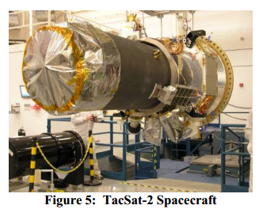
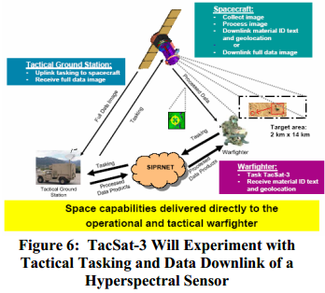
Operational Experimentation
TacSat-2
Low Earth Orbit (LEO)
Specific Emitter Identification (SEI)
Downlink in same orbit pass
Common Data Link (CDL)
On-Orbit Checkout Experiment (OOCE)
Autonomous Tasking Experiment (ATE)
TacSat-3
Low-cost Hyperspectral Imager (HSI)
HSI analysis of a given region for specific objects
Returns tagged image
2nd generation CDL radio
Notes:
SBIR = Small Business Innovative Research

Slide 12
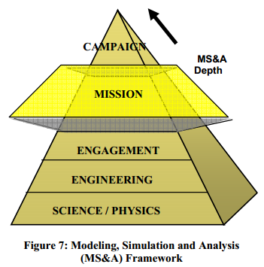
Modeling Simulation & Analysis
On-orbit experimentation is critical step
Tech. must provide cost-effective military benefit
Modeling Simulation and Analysis (MS&A)
Provides initial military benefit analysis
TacSat-2/TacSat-3 analyzed with MS&A
Provide useful/timely info to warfighters
Unpredictable overflight time & innovative
sensors counter enemy CC&D measures
Gives field commanders significant advantage
Notes:
SBIR = Small Business Innovative Research

Slide 13
Conclusions / Future Research
AFRL chartered to develop new tech for future national security needs
New series of tech & experiments on space-craft
Provides tactical warfighter real-time info
Can be rapidly tailored for new technologies
Fast time to place into orbit
Tasked directly from tactical theater, returns valuable info
AFRL pursuing Responsive Space tech & space-craft
Robust Plug-n-Play hardware & software
Small, lightweight, low-cost components
Ground-based & space-based experiments, test beds, analysis
Operational experimentation with TacSat-2/TacSat-3
Notes:
SBIR = Small Business Innovative Research

Slide 14
Development of the Malleable Signal Processor (MSP) for the Roadrunner On-Board Processing Experiment (ROPE) on the Tacsat-2 Spacecraft
R.L. Coxe, et al; "Development of the Malleable Signal Processor (MSP) for the Roadrunner On-Board Processing Experiment (ROPE) on the Tacsat-2 Spacecraft", 2005 MAPLD International Conference, September 7-9, 2005, Washington D.C.

Slide 15
Introduction
Malleable Signal Processor (MSP)
Reconfigurable computing engine.
Five radiation-tolerant Virtex-II FPGAs
Roadrunner On-Board Processing Exp. (ROPE)
Multispectral Imaging (MSI) payload
AFRL TacSat-2 satellite
DoD Responsive Space Initiative

Slide 16
Development Plan
Air Force Research Lab: Space Vehicles
Phase I Small Business Innovation Research (SBIR)
Physical Sciences Inc. (PSI)
MSP requirements
Pipelined radiometric calibration
JPEG image compression
Anomaly detection on multispectral imagery
Rapid prototyping
On-demand functional upgrades

Slide 17
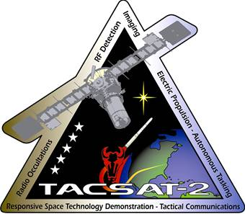
Responsive Space
Air Force Responsive Space Initiative
Demonstrated in TacSat missions
6-12 months development time
<3 years lifetime
Stored to orbit in <1 week
Modular design methodologies, standard interfaces
Collection/downlink of mission data in single pass
Dynamic re-tasking
“faster-cheaper”

Slide 18
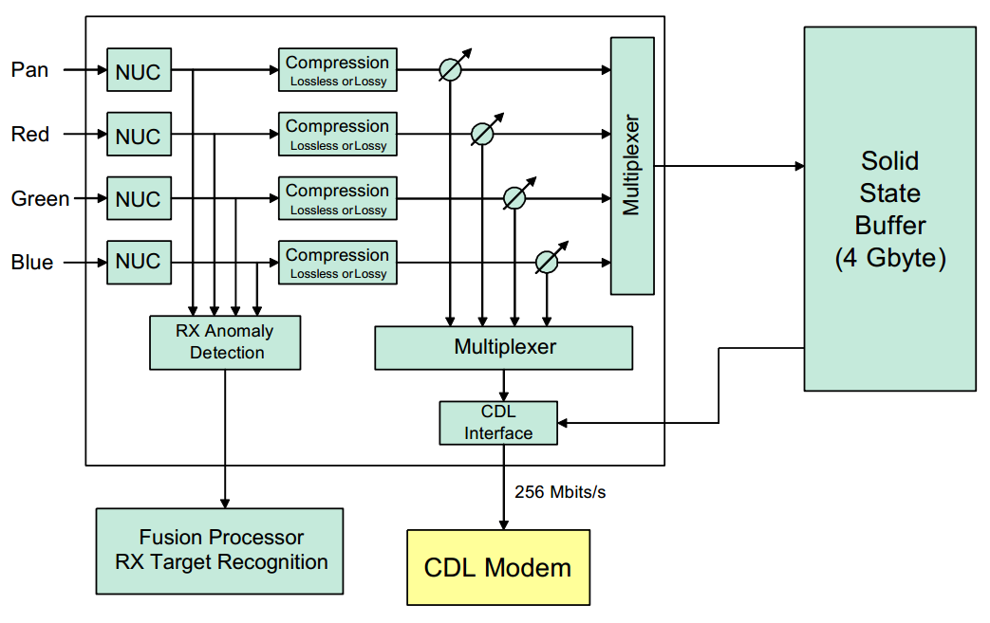
ROPE Payload
Roadrunner On-Board Processing Exp. (ROPE)
Real-time, MSI processing system
Major components
Wide-field MSI unit
MSP
Fusion Processor (FP)
8GB solid-state buffer

Slide 19
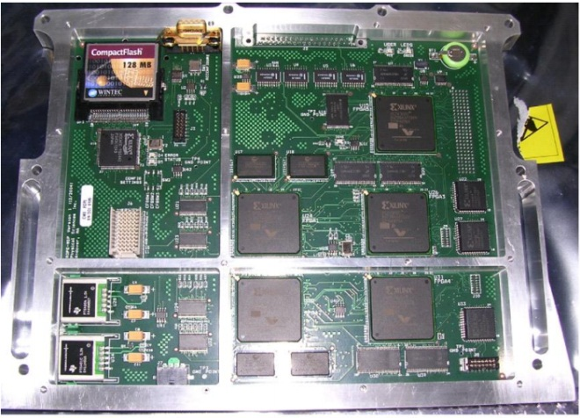
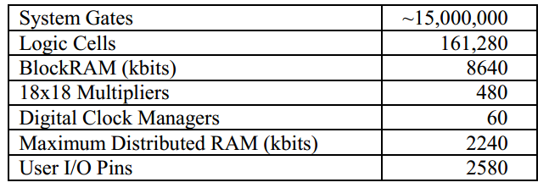
Malleable Signal Processor (MSP)
Five radiation-tolerant Virtex-II FPGAs
Military/industrial temperature grade COTS
MicroBlaze soft processor in Service FPGA
Software adjustable parameters
Radiation-tolerant configuration PROMs
MSP FPGA logic resources
MSP Flight Eng. Model

Slide 20
Malleable Signal Processor (MSP)
Operational modes or “personalities”
Personality #1: 16:1 Lossy JPEG
Personality #2 : 4:1 Lossy JPEG
Personality #3: Calibration
Personality updates possible from ground
Single-Event Upsets (SEUs)
SRAM-based FPGAs vulnerable
Data errors, functional failures
MSP/ROPE has no TMR, bitstream scubbing
FP reconfigs/power-cycles MSP after 100ms timeout

Slide 21
System Development Issues
Responsive Space is “wave of the future”
TacSat-2 one of the first missions
Integration of hardware was major hurdle
Third-party IP cores used
Xilinx: COREGEN & MicroBlaze
No major problems, new Xilinx ISE release solved issues
Amphion Semiconductor: Lossy JPEG core
Required much time/effort, ambiguous docs & timing data
Birger Engineering: Lossless JPEG core
Never met timing, removed from project

Slide 22
Conclusions
Malleable Signal Processor (MSP)
Five radiation-tolerant Virtex-II FPGAs
Roadrunner On-board Processing Exp. (ROPE)
Multispectral Imaging (MSI) payload
TacSat-2 mission for AFRL Space Vehicles
Air Force Responsive Space Initiative
“faster, cheaper, and good enough”

Slide 23
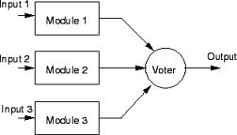
Further Research
MSP supports rapid-prototyping of reconfig. computing apps without hardware modification
Sonar beamforming
Other pipelined FFT processing applications
Real-time Hyperspectral Imaging (HSI)
More sophisticated anomaly and edge detection
Neural computation engines
Further fault-tolerance for SEU mitigation
Triple Modular Redundancy (TMR)
FPGA bitstream scrubbing

Slide 24
Achieving Multipurpose Space Imaging with the ARTEMIS Reconfigurable Payload Processor
Troxel, I.A.; Fehringer, M.; Chenoweth, M.T.; , "Achieving Multipurpose Space Imaging with the ARTEMIS Reconfigurable Payload Processor," Aerospace Conference, 2008 IEEE, vol., no., pp.1-8, 1-8 March 2008

Slide 25
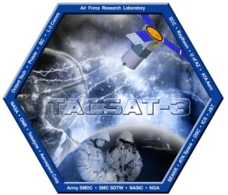
Introduction
ARTEMIS: Advanced Responsive Tactically Effective Military Imaging Spectrometer
Payload for the TacSat-3 mission
Features hybrid processing power, general purpose processor board and FPGAs
Design focused on flexibility, reusability, fault tolerance

Slide 26
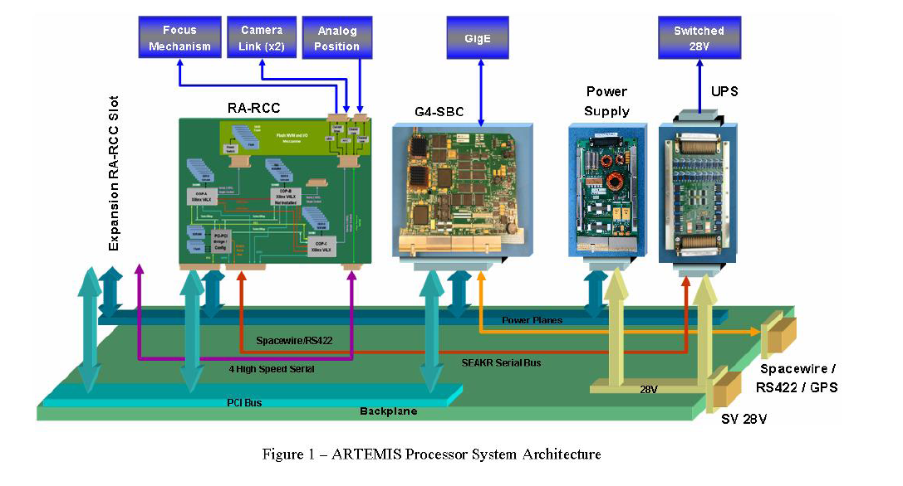
ARTEMIS Processor Architecture
Four types of boards constitute ARTEMIS
Power Supply
Receives 28V from spacecraft, regulates and distributes to other boards
Universal Power Switch
Relays commands for sensor power management
G4-based single-board computer (G4-SBC)
Responsive Avionics Reconfigurable Computer (RA-RCC)

Slide 27
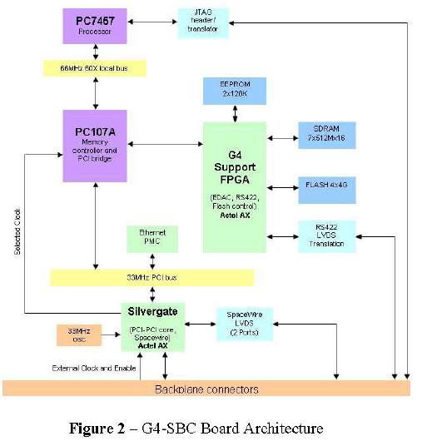
G4-SBC
Includes MPC7457 processor, memory controller, and support FPGA
Support FPGA provides fault tolerant memory interfaces, and external bus communication
External interfaces
RS422 LVDS
cPCI
SpaceWire
GigE
Primary payload controller
Controls external spacecraft interfaces
Manages data up/down links
Orchestrates data processing

Slide 28
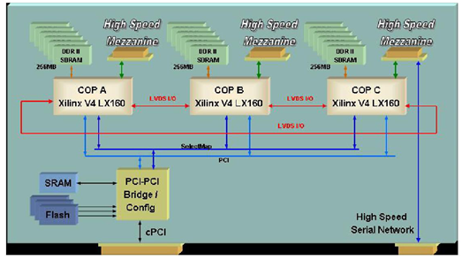
RA-RCC
Controls sensor functionality, mass data storage, performs on-board processing of sensor data
4 total FPGAs
Actel RTAX2000
Provides PCI interface to backplane and between other FPGAs
Controls FPGA scrubbing
Controls storage devices and UPS serial interface
3 Xilinx V4 LX160
adaptable high-speed mezzanine interface
Highly customizable interconnects to sensors, mission flexibility
Flexibility designed for fault tolerance and reusability

Slide 29
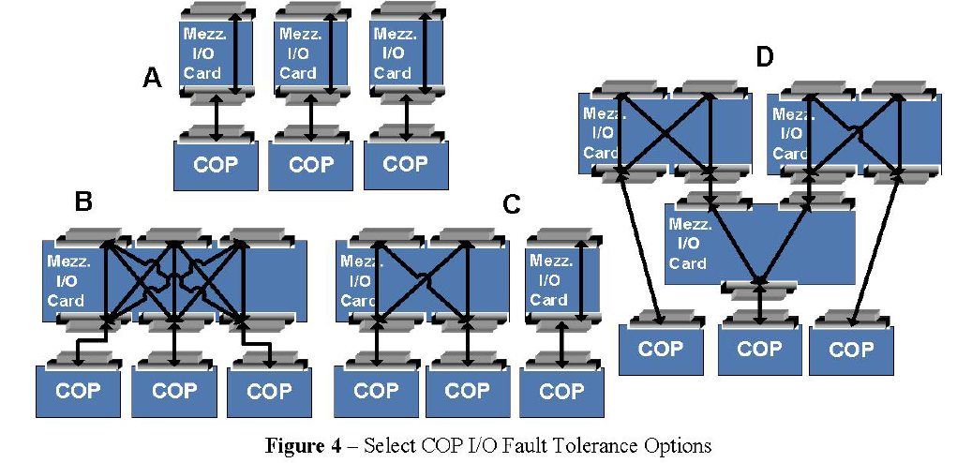
Reconfigurability for Fault Tolerance
Mezzanine I/O cards provide redundancy in sensor communications
Varying degrees of redundant links can be established

Slide 30
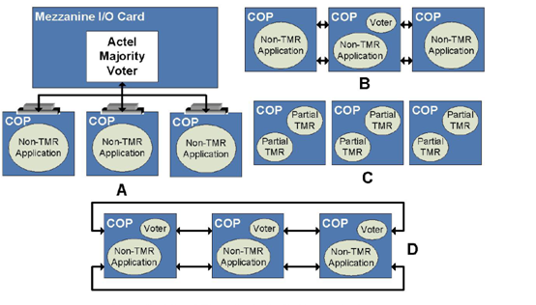
Fault Tolerance
Scrubbing configuration memory
Handled by Rad-hard controller
Many options for triple modular redundancy in the RA-RCC
Mezzanine cards can interface to external rad-hard voter
Distributed voting
Dedicated voter unit on COP
Selective TMR

Slide 31
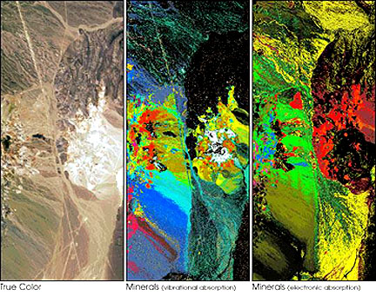
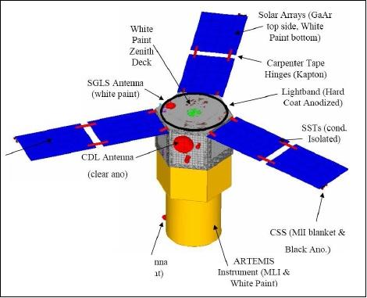
TacSat-3 Mission
Operational from May 19 2009- Feb. 15 2012
Joint AFRL and NRL effort
Primary focus was autonomous HIS processing
Handed over to Air Force in 2010
First satellite to provide recon within 10 minutes of passing

Slide 32
Conclusions/ Future Work
Mezzanine interface decouples sensors and processors
Allows for reuse in future generations
Fault tolerant architecture achieved with commercial components
Upgrades and future missions with ARTEMIS planned

Slide 33
Tactical Satellite 3 CDL Communications, a Communications Link for Mission Utility
Galindez, Richard; Davis, Thom; , "Tactical Satellite 3 CDL Communications, a Communications Link for Mission Utility," Military Communications Conference, 2007. MILCOM 2007. IEEE , vol., no., pp.1-6, 29-31 Oct. 2007

Slide 34
Introduction
Common Data Link
Wideband communications waveform
Launched in December 2006 with TacSat-2
274 Mbs down
200 Kbs up
12” parabolic antenna for ground communication
Horn antenna for rover communication
MMA originally for F-16
Not suited for LEO
Notes:
Microwave Modem Assembly

Slide 35
Background on CDL
Common Data Link (CDL)
History
Started in 1979 with Interoperable Data Link (IDL)
In 1988 the Assistant Secretary of Defense ordered development of common communication architecture for all DoD services
Decision based on success of IDL
Full duplex, jam resistant spread spectrum signal
Digital microwave system

Slide 36
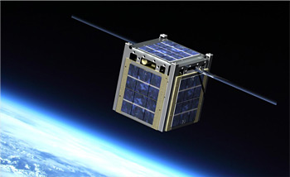
The Difference of Space
Space is much harsher environment than Earth
Temperature swings
Limited power
Separate power for Tx/Rx
Size and weight restrictions
The bigger an object and the heavier, the more it costs to launch
No gases/liquids for heating/cooling
Not likely to be fixed
Fault-tolerance
Electronic failure
Radiation
Notes:
Photo from NASA: http://www.nasa.gov/images/content/429961main_cubesat_1.jpg

Slide 37
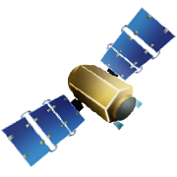
Operational Responsive Space
Tactical Satellites (TacSats)
Low cost
Small
Rapid response
Not a perfect system
Learning platform
2 years to launch vs. 5+ years for conventional

Slide 38
Need for CDL in Space
Existing Infrastructure
CDL is military standard
Existing ground stations
Multiplex with airborne systems
Reduced Lifetime Costs
No need to purchase new system for communication
Only one system to support
Parts can be reused between systems

Slide 39
Example
Ground uplinks collection task
TacSat-3 Moves to target position and collects data
Data is processed and sent back to earth
TacSat-3 waits for new task
Raw data is sent down when it has next opportunity

Slide 40
TacSat-3 Part Analysis
Radio Frequency Assembly
Parabolic Antenna
Special modifications required to ensure stability in temperature swing
Horn Antenna
Microwave Modem Assembly
More than 12,000 parts
1,000 active parts
350 unique parts
Limits on Tin, Zinc, and Cadmium
Some connectors had to be modified to get around Cadmium restriction

Slide 41
Radiation
Total Ionizing Dose is less than 70 rad
Not considered a significant risk to electronics
Single Events harder to estimate
Figure 4. shows lower high energy particle interference with 41⁰ vs. 60⁰
System only on for 45 minutes per day
System also powers down over South Atlantic Anomaly

Slide 42
Summary and Conclusion
TacSat-3 is an agile development approach to satellites
Validated solutions to many of the problems that come with using terrestrial systems in space
System leverages hardware reuse while still ensuring operation in space
Paper does not go into exact details of success
No discussion on tests performed and observed performance

