Slide 1
Andrew Milluzzi, Tyler Lovelly, Donavon Bryan
EEL6935 - Embedded Systems Seminar
Spring 2013
Topic: Sensor Networks
01/24/13

Slide 2
Assessing Performance Tradeoffs in Undersea Distributed Sensor Networks
Thomas A. Wettergren, Russell Costa, John G. Baylog, and Sandie P. Grage
Naval Undersea Warfare Center
Published in OCEANS in September 2006

Slide 3
Introduction
Large scale distributed networks
  Cost becomes important factor
Cheaper sensors prone to false alarms
  Tradeoff between sensitivity and false positives
Detection requires data from multiple sensors
  Triangulate data to ensure it comes from same target
  Ensure data is synchronized and readings are current

Slide 4
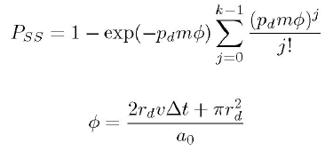
Performance Models
Even when an object is in sensing field, there is still a chance the network will miss it
  P_{SS} (successful search prob.)
  leverages Poisson process
  to model detections by nodes
  P_{FS} (false search prob.) based on false alarms from sensors
    Not a mixture of good and
    bad data, only concerned
    with false cases where we do not get useful data
Notes:
M is number of sensors
Rd is range of detection
A0 is search area
Pd is probability of detection
V is velocity

Slide 5
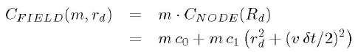
Issue of Cost
Many cheap sensors vs. fewer expensive sensors
Cost function of field is based on size of field and number of sensors
  Same factors as P_{SS} and P_{FS}
  Allows for system optimization

Slide 6
Pareto Optimization
Optimization based a set of parameters that shows tradeoffs
  Allows for a decision to be made without the need to explore the full range of every parameter
  Approaches
    Gradient Based
      Useful for various combinations of objectives
    Evolutionary
      Iterate to create a group of better designs
Notes:
Background info on Pareto Efficiency can be found at http://en.wikipedia.org/wiki/Pareto_optimum

Slide 7
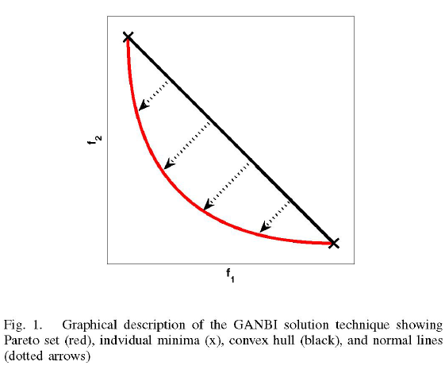
GANBI
Genetic Algorithm-based Normal Boundary Intersection
  Uses both approaches
  to combine objectives
  and iterates to find
  optimal design
  ‘Convex hull’ is
  combination of
  objective optimizations
Notes:
Image from paper

Slide 8
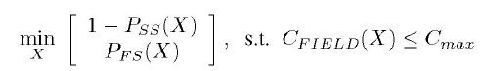
Experiment and Results
Optimization Goals:
  Max P_{SS}
  Min P_{FS}
  Min C_{FIELD}
Experiment:
  Run GAMBI for 200 iterations with 4 normals with 100 designs at each iteration
  Small sample
Hard to get specific values at given points in Pareto set

Slide 9
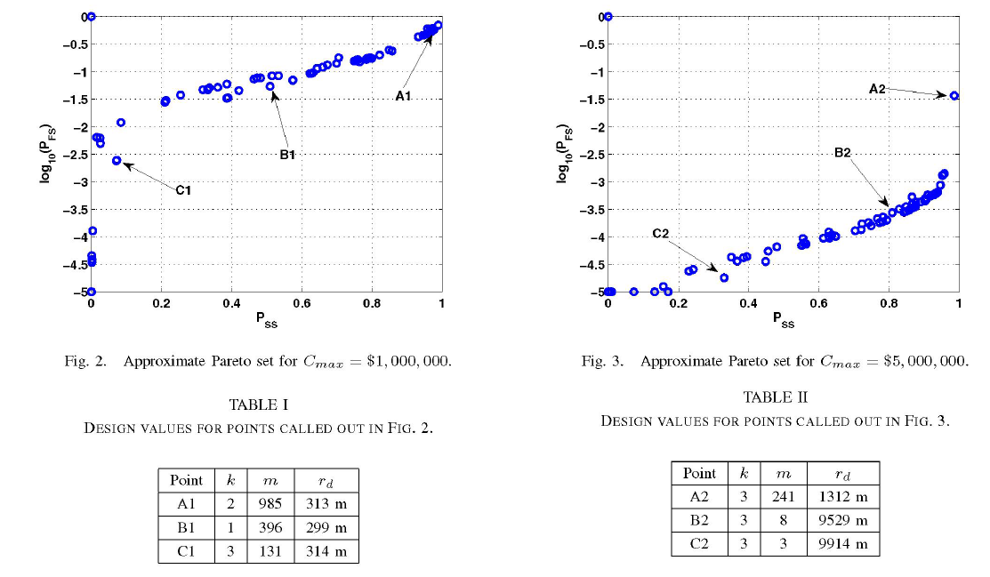
Result Graphs
Larger sensor range = fewer sensors
Large number of short sensors = high P_{SS} and high P_{FS}
Small number of long sensors = low P_{SS} and low P_{FS}
If cost is large constraint, best results come from varying number of sensors (Fig. 3)
Notes:
Images from paper

Slide 10
Conclusion and Future Work
When working with large scale sensor networks, cost becomes a concern
Using a Pareto Optimal Surface, we can balance cost, sensor quality and quantity of sensors
Future work would add in new parameters to the sensing model to account for non-uniform distribution/environments

Slide 11
Space-Based Wireless Sensor Networks: Design Issues
Vladimirova, T.; Bridges, C.P.; Paul, J.R.; Malik, S.A.; Sweeting, M.N.; , "Space-based wireless sensor networks: Design issues," Aerospace Conference, 2010 IEEE , vol., no., pp.1-14, 6-13 March 2010
VLSI Design and Embedded Systems research group, Surrey Space Centre, Department of Electronic Engineering, University of Surrey

Slide 12
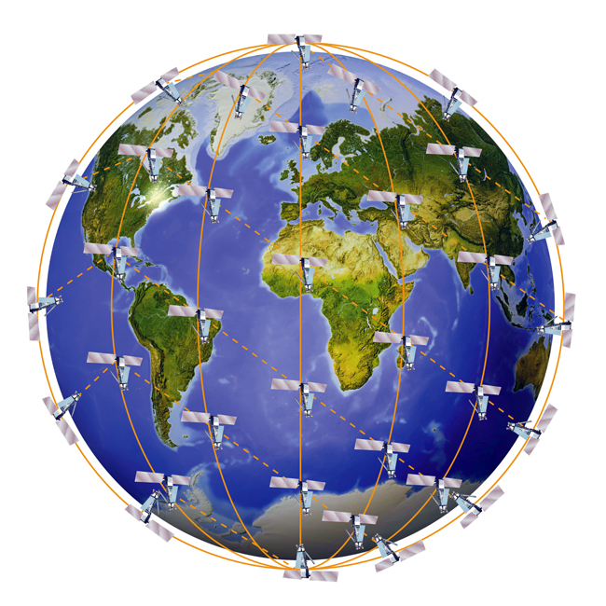
Introduction
Satellite sensor networks apply concepts of terrestrial sensor networks to space
Replacing group of sensing satellites by distributed networked satellites increases science return per dollar
Research from Surrey Space Center aimed at space weather missions in Low Earth Orbit (LEO)
  Space weather associated with anomalies detected on spacecraft
  Spacecraft in LEO vulnerable when passing poles or South Atlantic Anomaly (SAA)
  Distributed, networked small satellite missions can study impact of space weather phenomena (e.g. solar storms) on Earth atmosphere and spacecraft
Figure 1: Iridium LEO network
Space-Based Wireless Sensor Networks: Design Issues
  Distributed satellite system constellation scenario based on Flower constellation
  Space based wireless networking based on Open Systems Interconnection (OSI) stack
  System-on-a-chip (SoC) platform and agent middleware for distributed processing
  Configurable inter-satellite link communications module for pico-satellites
  Future applications and research for space-based wireless sensor networks

Slide 13
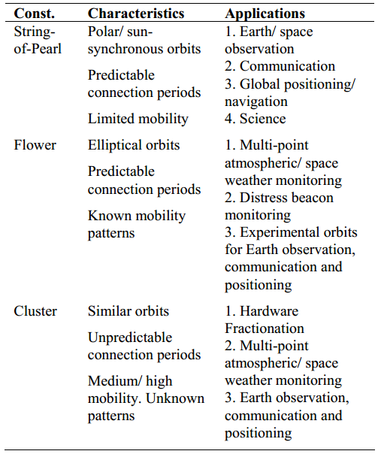
Mission Constellation
Space-based wireless sensor networks consist of small satellite nodes flying in close formations
Single large expensive satellite not needed
Large number of small satellite nodes used instead
  Inexpensive, mass producible
Perturbations reduce lifetime of satellite clusters
  Pico-satellite constellations drift in and out of inter-satellite link (ISL) length
  Creates dynamic and often “disconnected” environment
Ad-hoc, autonomous distributed computing system needed for collaboration
Flower constellation used
  Geometric shapes formed to produce ‘flower’s with the ‘petals’ giving angular requirements of satellite positions
  Low Earth Orbit (LEO) distributed mission feasible
Figure 2: Constellation Orbital Characteristics and Applications

Slide 14
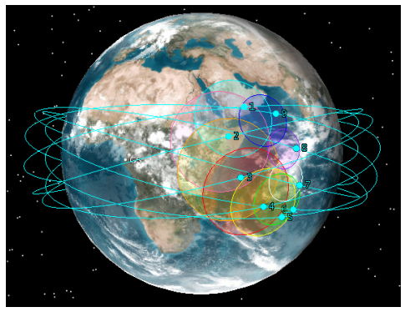
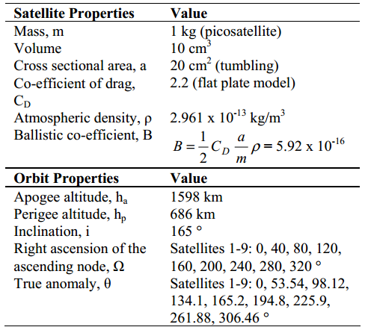
Mission Constellation
Flower constellation
  Stable orbit configurations for micro- and nano-satellites
  Applications: GPS missions, reconnaissance, two-way orbits, science missions, planetary exploration
  Axis of symmetry coincides with spin axis of Earth
  All satellites have same orbit shape
  Satellites equally displaced along equatorial plane
Figure 4: Flower Constellation
Research on Flower constellation in LEO
  9 pico-satellites, ranges from 100-400km between nodes
  Satellites drift together along equator, staying in formation without maintenance
  Promising for pico- (mass<1kg) and nano-satellites (mass<10kg)
Simulations using AGI’s High Precision Orbital Propagator (HPOP) in Satellite Toolkit (STK)
Figure 3: Satellite and Orbital Properties for Flower Constellation

Slide 15
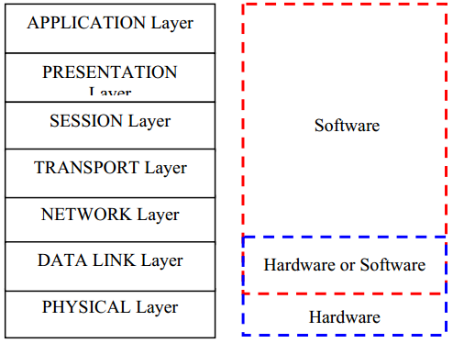
Network Design
Spacecraft communications affected by orbital dynamics
  Causes variable inter-satellite ranges, speeds, access
  Investigated using Open Systems Interconnection (OSI) networking scheme
  Functionality implemented in hardware/software
Physical Layer
  Radiation is inherent environmental hazard
  Ground communications for pico-satellites in VHF and UHF bands
  During intense solar cycles, VHF signals can be reflected back
  GPS essential for orbit determination and navigation; solar storms cause synchronization errors
  Models used to predict ionospheric propagation
Figure 5: OSI Layers and Implementation Methods

Slide 16
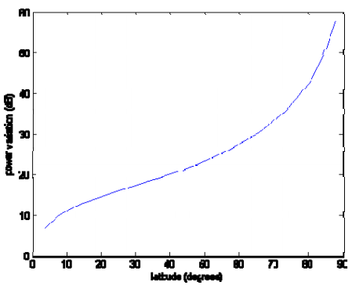
Network Design
Power resources limited aboard pico-satellites
Adaptive techniques used to optimize power utilization
Power variation modeled for receiving antenna for inter-satellite communication in LEO circular polar orbits
  Minimum at equator, maximum at poles
Data Link Layer
  Multiple-access schemes used for communications bandwidth sharing
  Medium Access Control (MAC) used to manage communication links
  Long propagation delays, appropriate data rates, forward error correction needed for reliable space communications
  Terrestrial IEEE 802.11 wireless standard adopted for inter-satellite link design
  IEEE 802.11 could be scaled from few hundred meters to few hundred kilometers in space
Figure 6: Power Variation with Respect to Latitude in Southern Hemisphere

Slide 17
Network Design
Network Layer
  Proactive and reactive topology schemes, must be capable of reconfiguration
  Ad-hoc inter-satellite networking capability
  Adaptable and redundant ground-link communication
  Middleware tolerant to extreme mobility, intermittent connectivity, node loss
Application Layer
  Mission and payload dependent
  High data-rate: client/server model
  Low data-rate: peer-2-peer model
  Consider future applications for distributed operations, autonomy and artificial intelligence
  Data transmissions should be minimized to reduce power overhead for communications
Figure 5: OSI Layers and Implementation Methods

Slide 18
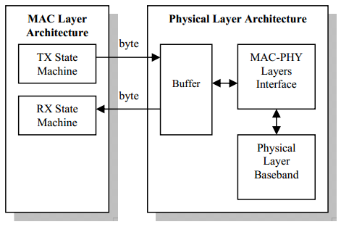
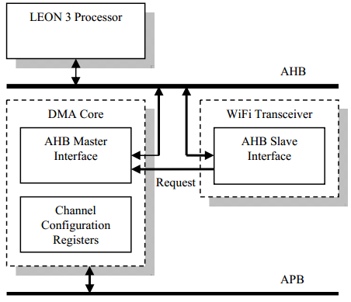
Distributed Computing Platform
Wireless transceiver operates in mobile environment
Hybrid software/hardware approach
  IEEE 802.11 MAC layer time-critical functionality in hardware with VHDL due to timing constraints, CRC coding used
  For ease of reconfiguration, communication range prediction done in software with LEON3 processor
Figure 8: MAC Layer Interface with Physical Layer
Direct Memory Access (DMA) core used for data transfer between memory and wireless transceiver
MAC-Physical Interface
  Appends info to packets: data type, modulation type, duration
  Data rate of 6Mbps
  Requires minimum DMA latency of 1.6us, achievable even in heavy-loaded processing platform
  Handshake mechanism required for synchronization between DMA and MAC layer operation
Figure 7: Wireless Transceiver Core Architecture

Slide 19
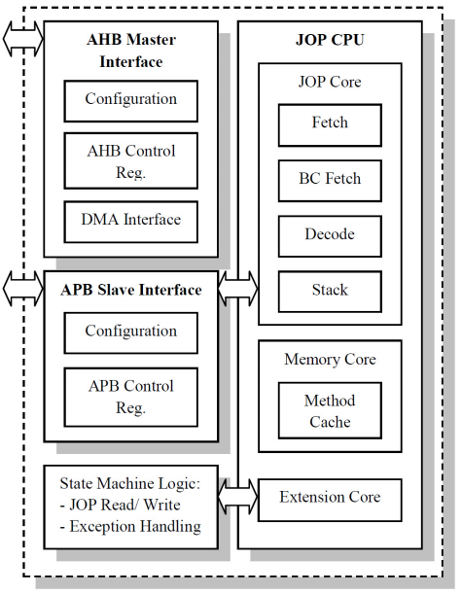
Distributed Computing Platform
Java Co-Processor enables future distributed computing and IP based networking capabilities
  Accesses external RAM via AMBA2 bus
  Multiple Instruction Multiple Data (MIMD) architecture which fetches own instructions
  Operates thread-level parallelism
Java Co-Processor pipeline stages
  microcode fetch, decode, execute, additional translation stage bytecode fetch
Hardware Exceptions
  Stack overflow, null pointer, array out of bounds
  Caused by processor overload or corrupt software
  Stall processor, hard reset needed
Software Exceptions
  Network exceptions, Application-specific exceptions
  Caused by poor connectivity or programming errors
Figure 9: Java Co-Processor IP Core Wrapper

Slide 20
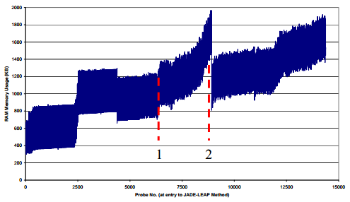
Distributed Computing Platform
Agent-Based Middleware with Instance Management for distributed operations
  Code migration, parallel behaviors and data distribution services supported
  Communications use TCP for High-Priority Data and UDP for Low-Priority Data
  ProGuard, open source Java tool, used for shrinking, optimization, and obfuscation
  Autonomous recovery from exceptions, expected (e.g. low-power) & unexpected (e.g. Single-Event Effects)
Soft Reset Analysis
  Topology reconfiguration tested with unexpected connections/disconnections
  Memory consumption increased with number of networked nodes
  Upon reconfiguration, instance is destroyed and restarted under new conditions
  Method calls needed for additional instance increase, leading to higher memory usage
  Agent instance information cost of 200KB per node, plus 600KB for original instance
Figure 10: Instance Manager Thread Performing Soft Resets

Slide 21
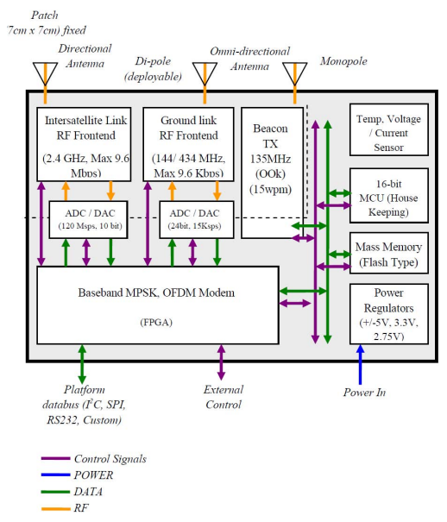
Configurable Inter-satellite Comm. Module
Configurable communications module
  Needed due to dynamic mobility and communications channels
  Commercial-of-the-shelf (COTS) components
  Industrial Scientific and Medical (ISM) frequencies employed
  Software-Defined Radio (SDR) architecture
Key Requirements
  Adhere to CubeSat design specifications
  Support IEEE 802.11 specifications
  Provide communications at variable data rates and configurable waveforms
  Provide link for ground communications
  Provide independent beacon signal generator
  Gather localization information for distance and bearing angles
Figure 11: Inter-satellite Communications Module Functional Block Diagram

Slide 22
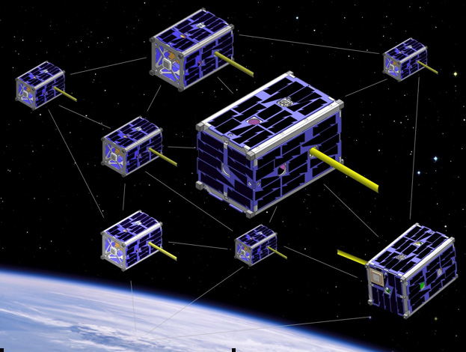
Conclusions
Space-based wireless sensor networks becoming more practical and advantageous
Surrey Space Center research presents design overview
  Target LEO missions to monitor space weather phenomena
  Flower constellation strategic for satellite networks
    All satellites have same orbit, 100-400km between nodes
    Drift together along equator, stay in formation without maintenance
  Orbital and network issues based on OSI layer stack
    Vulnerable to radiation in space environment
    Uses terrestrial IEEE 802.11 wireless standard scaled to space
    Proactive and reactive topology schemes, capable of reconfiguration
    Application layer mission- and payload-dependent
  Distributed computing platform employed in SoC design
    Hardware-accelerated wireless transceiver operates in mobile environment
    Java Co-Processor for future fault-tolerance capabilities
  Agent-based middleware for fault-tolerant networking design
    Instance management for distributed operation, autonomous exception recovery
  Configurable inter-satellite communications module
    Needed due to dynamic mobility of communications channels
    Meets key requirements for networking and data transmission, low cost and power
Figure 12: EDSN CubeSat Swarm - NASA

Slide 23
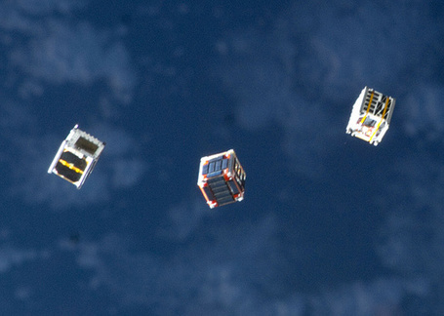
Further Questions & Research
Future distributed spacecraft envisioned as autonomous, small-sized, intelligent
Concept of satellite space sensor networks can be applied to many missions
  Realizing co-orbiting assistants
  Continuous Earth coverage for remote sensing
  Low-cost LEO communications
  Continuous communications for remote low-powered surface vehicles
Figure 13: Cubesat Deployment From ISS - SpaceRef
Future Research Topics
  Flower constellation scale to various small satellite platforms and sizes
  Alternative small satellite constellation scenarios
  Terrestrial network communication issues adapting to space environment
  Topology reconfig. overhead for various constellation and networking scenarios
  Inter-satellite comm. tradeoffs between low-cost, low-power vs. performance

Slide 24
ESPACENET: A Framework of Evolvable and Reconfigurable Sensor
Networks for Aerospace–Based Monitoring and Diagnostics
Proceedings of the First NASA/ESA Conference on Adaptive Hardware and Systems (AHS'06)
T.Arslan, N.Haridas, E.Yang, A.T.Erdogan, N.Barton, A.J.Walton, J.S.Thompson,
A.Stoica, T.Vladimirova, K.D. McDonald-Maier, W.G.J. Howells

Slide 25
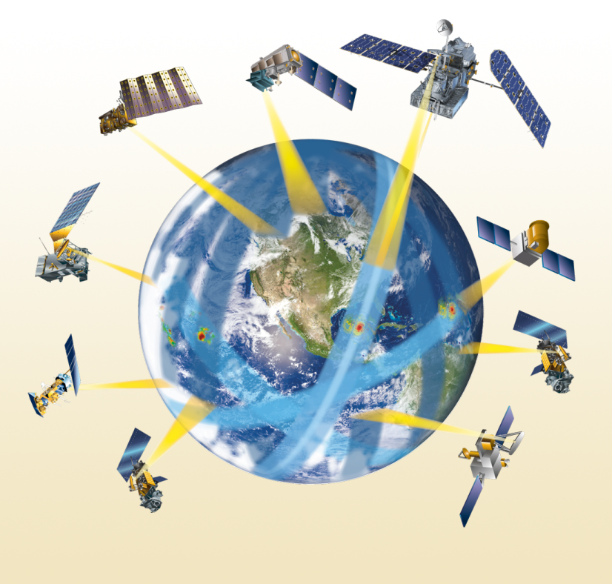
What is it?
ESPACENET is a proposed framework for a satellite constellation
Aspires to be flexible and intelligent, viable alternative to larger spacecraft
Motivations
  Cost- many smaller satellites vs. a single large spacecraft
  Flexibility- multiple coordinated nodes can react and adapt to changing missions

Slide 26
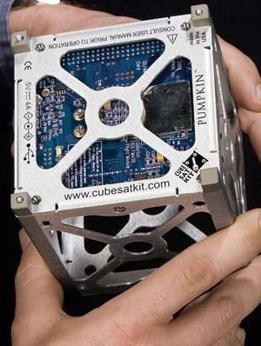
Previous Work
Pico Beacons at Berkeley
  Low power wireless transceivers
  Can be organized into small networks
CubeSat platform developed by Stanford and California Polytech
  Standardized small satellite platform
  Hardware and software platform readily
  integrated with user instruments/payload

Slide 27
3 Parts of the ESPACENET Framework
Network Architecture
  How nodes are connected and communicate with each other and outside the network
Hardware Architecture
  “guts” of the satellites, sensors and processing elements
Evolvable multi-objective algorithm controlling the network
  Algorithms for optimizing the network and
  adapting to changing mission parameters

Slide 28
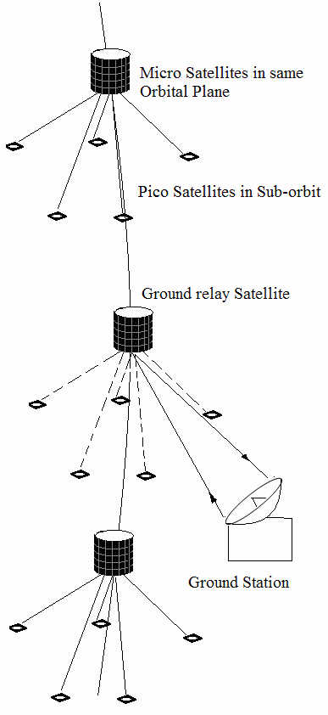
Network Architecture
3 level hierarchy
  Pico satellites
    Limited to 1kg
    Carry sensors and instruments for the mission
    Coordinate with the mother satellite to accomplish mission goals
  Micro satellites (Mother Satellites)
    Higher performance
    Coordinate actions of the pico satellites in its sub-orbit
    Process and relay received sensor data
  Ground Relay Satellites
    Reconfigured mother satellite
    Relinquishes control of pico satellites to transmit to the nearest ground station

Slide 29
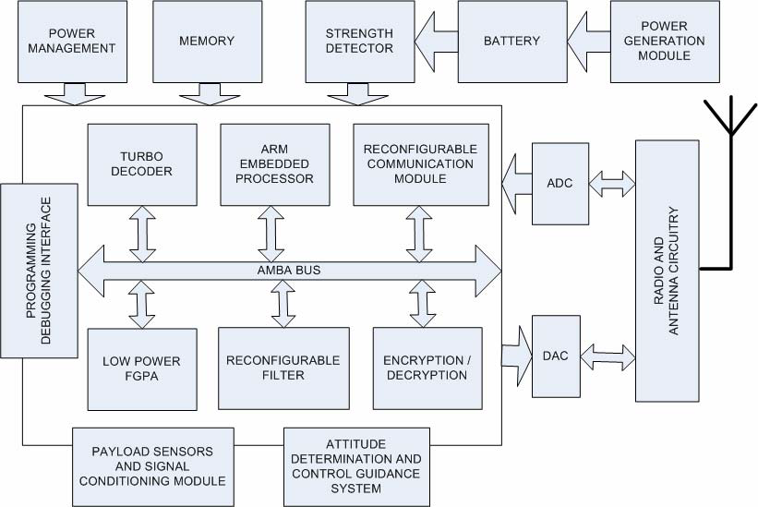
Hardware Architecture
Main goal is to have node level reconfiguration within the network
  nodes can adapt and optimize in response to power consumption, latency, sensors, ect
Pushing for System on Chip design
  Higher integration, smaller chip size
  Lower power
  Reduce latency between subsystems
Architecture centers around reconfigurable modules connected via AMBA bus
  Filters
  FPGA fabric
  Communication modules
Overall function determined by payload

Slide 30
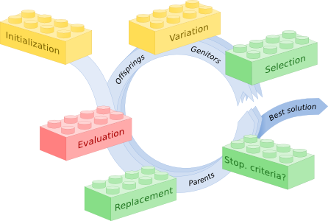
Evolving Control Algorithm
Multi-objective evolutionary algorithms (MOEAs)
  System will autonomously optimize the system
  Balanced between sensor, cluster, and overall network optimizations
  Criterion include power, reliability, security, ect
Modeled after process of evolution

Slide 31
Conclusions/ Future Work
Fault tolerance?
Lifetime of a ESPACENET system
Determining Ideal network size
Availability of system outside of Evolutionary algorithms
It is a proposed framework and so case studies of missions using it will be interesting

Slide 32
Development of a Satellite Sensor Network for Future Space Missions
Vladimirova, T.; Xiaofeng Wu; Bridges, C.P.; , "Development of a Satellite Sensor Network for Future Space Missions," Aerospace Conference, 2008 IEEE , vol., no., pp.1-10, 1-8 March 2008
VLSI Design & Embedded Systems research group, Surrey Space Centre, Department of Electronic Engineering, University of Surrey

Slide 33
Introduction
Principles developed from the ESPACENET framework are applied at University of Surrey
  Development of a robust satellite system with many sensor nodes
Test missions planned
    Aiming to test many new technologies for space networking and distributed computing
Adapts CubeSat as a platform to test a novel pico satellite architecture

Slide 34
Space Mission
Targeting one of two launch opportunities
  CubeSat Program
  Surrey Satellite Technology Limited
Undertaken to test technologies
  Adapting IEEE 802.11 for inter satellite communication
  Distributed computing via 3 satellites
    Collaborative image processing
    EM measurements
    Running MOEA to route signals
  Secure processing for nodes/ network
  SoC design with FPGA implemented controller

Slide 35
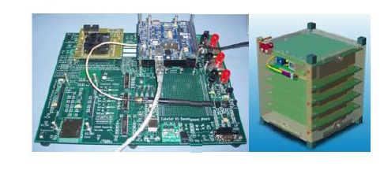
Pico satellite Design
System is designed as a payload to a cubesat
  Compartmentalizing the design increases reliability
Main satellite controller is a commercial off the shelf (COTS) MSP430
Leveraging the CubeSat kit allows for a focus on pico satellite design
CubeSat development kit and pico satellite prototype

Slide 36
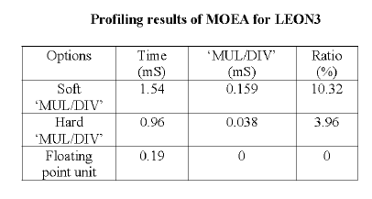
Pico Satellite Payload
Includes 3 hardware modules
  Camera System
  MEMS Antenna & GPS system
  LEON3-based FPGA System
    Image compression cores
    Wireless MAC/PHY
    Image encryption
Payload Computer
  LEON3 Processor- SPARC V8 RISC architecture
  Allows for algorithmic optimizations
    MULT/DIV results

Slide 37
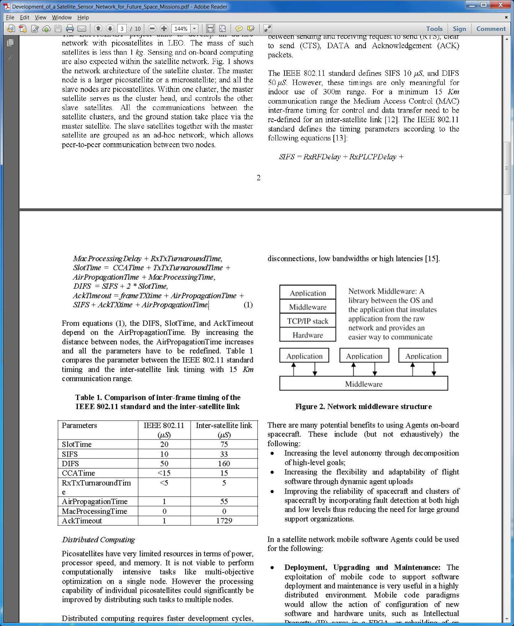
Satellite Sensor Network
Inter-satellite Links
  Based on IEEE 802.11
  standard
    Modified for range of more
    than 1 kilometer
  Need to modify timing in
  order make system work
    Current timing constraints are for 300 meter maximum
SIFS = RxRFDelay + RxPLCPDelay + MacProcessingDelay + RxTxTurnaroundTime
SlotTime = CCATime + TxTxTurnaroundTime + AirPropagationTime + MacProcessingTime
DIFS = SIFS + 2 * SlotTime
AckTimeout =frameTXtime + AirPropagationTime + SIFS + AckTXtime + AirPropagationTime

Slide 38
Distributed Computing
Limited power and
processing constraints
keep from having on
master computation
satellite
Leverage a middleware
to manage computing
and distribute computing
load
  Middleware abstracts out network and process management
  Leverage concept of ‘Agent’ to abstract out roles

Slide 39
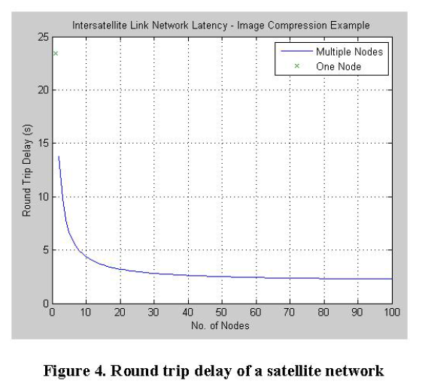
Simulation Results
Round trip delay parameters
  Worst-case hardware switching
  delay = 1.258 ns
  No. of nodes = 3
  MAC access delay = 2.049 ms
  Service delay = 1 ns to 1 s
  Propagation through free space of
  3.33x10 5s c 2.99792458x108
  WiFi (IEEE 802.1 lb) Variables:
    No. of transmissions = 3
    Packet sizes = 1500 of 2346 bits, Channels = 14
  Image Size: 7507 x 6399 pixels, File size: 50.826 to 6.386 MB
Notes:
Parameters taken directly from paper

Slide 40
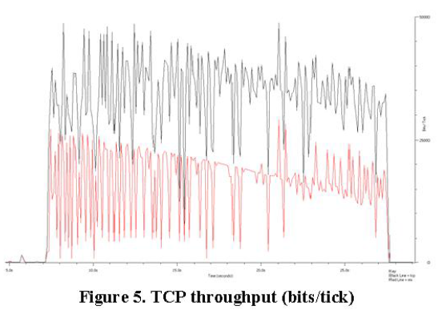
Simulation Results
Network Throughput
  Vary Agent size from 12 KB to 2.7 KB
  Black is TCP
  Red is RMI*
Not UDP
transport
*RMI = Remote Method Invocation

Slide 41
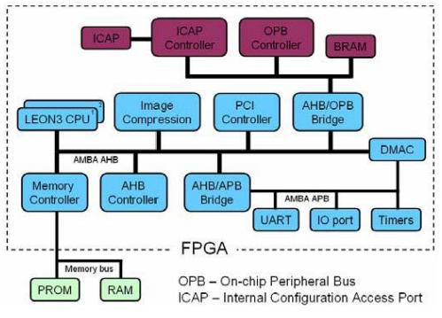
Partial Run-Time Reconfiguration on FPGA
Payload computer implemented on SRAM-based
Field-Programmable Gate Array (FPGA)
  FPGAs suitable for on-board small satellite systems
  Shorter time to market, lower cost, reconfigurability
  Partial run-time reconfiguration makes run-time changes
  to select regions on chip; supported by Xilinx devices
Radiation in space disruptive to FPGA operation
  Heavy ions from cosmic rays can deposit enough charge
  to cause Single-Event Upsets (SEUs)
  Upsets to SRAM configuration of FPGA can cause errors in routing and functionality of design
  Partial run-time reconfiguration can mitigate SEUs by repairing areas affected by soft errors
Many FPGAs use hard cores such as BRAMs and multipliers, not only soft cores
Application-specific IP cores in development to serve satellite missions
Configuration bitstream of each SoC component stored on-board in Flash mem.
Reconfigurable SoC architecture of payload computer

Slide 42
Conclusions & Future Work
Distributed image processing is a core application of the satellite cluster
Network performance is optimized by a multi-objective optimization algorithm
Use of an FPGA allows high performance data processing that can be combined with distributed computing techniques
  Partial run-time reconfiguration helps mitigate SEUs
Novel adaptations to IEEE 802.11 for usage between satellites in space
High-performance FPGA device could enable fast on-board processing results rather than send raw data to Earth
  Can provide low-cost approach with distributed computing to implement emergency response systems for detection and monitoring from space

