Slide 1
Energy Optimization Techniques: FPGA Glitch Reduction
Patrick Cooke and Elizabeth Graham

Slide 2
Field-Programmable Gate Arrays
Used to implement digital systems
Pros
Flexible
Low time-to-market
Cons
Consumes up to 10x more power than equivalent ASIC design
Barrier for power-sensitive applications

Slide 3
FPGA Architecture
Island-style
Logic blocks connected by programmable routing network
Look-up-tables (LUTs)
k-input LUT supports k variable logic functions and requires 2^{k} configuration bits
Hardware implementation of truth table

Slide 4
Power in FPGAs
Static power
Current leakage in transistors
Dynamic power
Signal transition between logic-0 and logic-1
Functional transition
Necessary for correct operation of circuit
Glitch
LUT output transition due to unbalanced delays at inputs
4-73% of total dynamic power
Average of 22.6%

Slide 5
Glitch Example
Unbalanced Delays
Balanced Delays

Slide 6
Glitch Reduction Techniques
Algorithms that balance delays
Technology mapping stage
Mapping based on glitch-aware switching activities
Routing stage
Faster arriving inputs delayed by extending path
Architectural level
Programmable delay elements
All incur area or performance overhead
Flip-flop insertion/pipelining
Fewer logic levels reduces opportunity for imbalanced delays
Logic manipulation algorithms
Change don’t-care values to reduce glitching

Slide 7
FPGA Glitch Power Analysis and Reduction
Warren Shum and Jason H. Anderson
University of Toronto
Department of Electrical and Computer Engineering
Published in ISLPED 2011

Slide 8
Proposed Solution
Glitch reduction optimization algorithm based on don’t-cares
Selects don’t-care output values of LUTs in such a way that reduces glitching
Performed after placement and routing
Uses timing simulation data for guidance
No area or performance overhead
Inspired by hazard-free logic synthesis techniques for asynchronous circutis

Slide 9
Don’t-cares
Entries in truth table where output can be set as either logic-0 or logic-1 without affecting correctness of circuit
Two categories
Satisfiability don’t-cares (SDCs)
Particular input pattern can never occur on inputs
Observability don’t-cares (ODCs)
Output cannot propagate to circuit’s primary outputs
SDC
ODC

Slide 10
Dynamic Power Model
Variables
n : number of nets in circuit
S_{i} : switching activity of net i
C_{i} : capacitance of net i
f : frequency of circuit
V_{dd} : supply voltage
Algorithm focuses on switching activity
$$P_{dyn}=\frac{1}{2}\sum_{i=1}^{n}{S_{i}C_{i}fV_{dd}^{2}}$$

Slide 11
Removable Glitch
$t=0$ $1$ $2$ $3$
0

Slide 12
Don’t-care Analysis
ABC logic synthesis network
Developed at UC Berkeley
Boolean satisfiability (SAT)-based complete don’t-care analysis
Determines don’t-care minterms
Utilizes miter circuit to find don’t-cares
If C(x) = 0, y is don’t care minterm of LUT f

Slide 13
Motivational Experiments
Examined amount of glitch power dissipated by 20 MCNC benchmark designs
Experimental setup
Altera Quartus 10.1
65nm Stratix III family
ModelSim 6.3e used for functional and timing simulation
5000 random input vectors
Dynamic power computed using Quartus PowerPlay
Glitch power = dynamic power(timing) – dynamic power(functional)

Slide 14
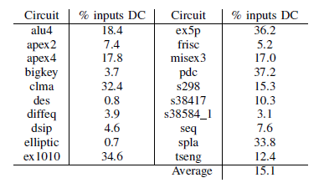
Motivational Results
Percentage of dynamic power from glitches
Range: 5.8-45.4%
Average : 26.0%
Percentage of LUT input states that are don’t-cares
Range: 0.8-37.2%
Average: 15.1%

Slide 15
Glitch Reduction Algorithm
Inputs
Placed and routed netlist
Value change dump (VCD) file
Results of timing simulation
Algorithm progresses from shallower levels of LUTs to deeper ones
In each level, LUTs examined in descending order of power consumption

Slide 16
Glitch Reduction Algorithm
For each LUT in netlist
Compute don’t-cares of LUT
ABC SAT-based don’t-care analysis
Scan input vectors
Voting mechanism
Details on next slide
Set values of don’t-cares and update netlist
Majority vote decides don’t-care value
Netlist updated to guarantee equivalent functionality

Slide 17
Input Vector Scan
Sequence of local input vectors to LUT extracted from VCD file and examined in order
When don’t-care input vector is reached
Find value of closest care state before and after don’t-care input vector
If these values are identical, vote for that value
Otherwise, no vote is cast
Each don’t-care in LUT has separate tally of votes

Slide 18
Algorithm Walkthrough
$t=0$ $1$ $2$ $3$
0
0

Slide 19
Iterative Flow
To verify modified don’t-care values, algorithm iterates until convergence
Placement and routing are not run again
Runtime on order of minutes
No modifications to timing characteristics

Slide 20
Experimental Study
Same experimental setup as motivational experiments
20 MCNC benchmark circuits
Altera Quartus 10.1
65nm Stratix III family
ModelSim 6.3e
Combinational equivalence checking used to ensure circuit functionality unchanged
Three passes of optimization loop
Negligible change after three passes
Worst-case sets don’t-cares to the opposite value of that obtained by algorithm

Slide 21
Experimental Results
Dynamic power reduction
Average: 4.0%
Peak : 12.5%
Glitch power reduction
Average: 13.7%
Peak: 49.0%
Optimized vs. worst-case dynamic power reduction
Average: 9.8%
Peak: 30.8%

Slide 22
Power & Don’t-care Ratio vs. Fanout
Average signal power increases with fanout due to increase in capacitance
Average don’t-care ratio shows decreasing trend with respect to fanout
Signals consuming most power are poor targets for glitch reducing algorithm based on don’t-cares

Slide 23
Average Vote Bias
Vote bias is percentage of votes that were cast for the more popular setting
For all circuits tested, highly preferable setting existed for all don’t-cares
Suggests don’t-care values can be picked with high degree of confidence

Slide 24
Conclusion
Future Work
Integrate algorithm into power-aware FPGA CAD flow
Investigate whether other stages of CAD flow could improve algorithm effectiveness
Reduce runtime by integrating algorithm with incremental timing simulation
Shortcomings
Algorithm seems to only address satisfiability don’t-cares (SDC)

Slide 25
GlitchLess: Dynamic Power Minimization in FPGAs through Edge Alignment and Glitch Filtering
Julien Lamoureux, Guy G. Lemieux, Steven J.E. Wilton
University of British Columbia
Department of Electrical and Computer Engineering
Published in TVLSI 2008

Slide 26
GlitchLess Overview
Adds programmable delay elements
To align arrival times
Act as filter to eliminate off-chip glitches
Applied after routing
Can be combined with other power-saving methods
Original circuit with glitch
Glitch removed by delaying input c

Slide 27
Trade-Offs
Save glitch power
Delay elements
Area overhead (modest increase)
Speed overhead (very minimal since only early-arriving signals are delayed)
Power overhead for driving additional circuit elements

Slide 28
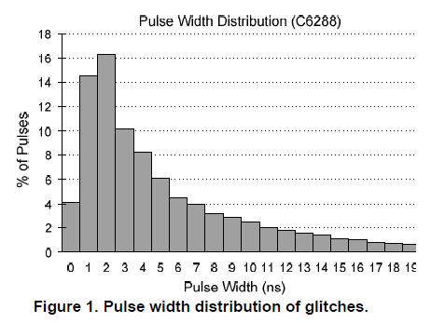
How Long Can Delays Be?
Actual range varies between benchmarks, but they all have similar shape
Most pulse widths < 10ns

Slide 29
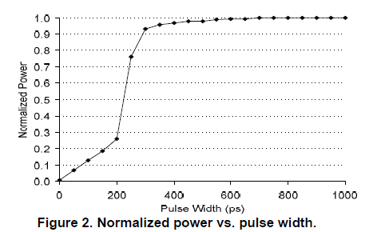
How Small Can Delays Be?
Longer pulse widths (over 200ps) are the ones that need to be aligned

Slide 30
Potential Power Savings

Slide 31
Programmable Delay Elements
Minimum delay
Small: Align edges more precisely
Large: Less overhead
Maximum delay
Small: Less overhead
Large: Able to suppress glitch from longer pulse
Number of delay elements (on input vector)
Small: Less adaptable
Large: More overhead
2

Slide 32
Programmable Delay Elements
Each delay stage has slow and fast mode
Mode controlled by value in SRAM
Bypass stages for very small delay
Number of stages determined by delay element parameters
Stage
Notes:
Configuration of each delay element determined after placement and routing (when accurate timing is available)

Slide 33
Placement of Delay Elements
Original
Scheme 1: LUT Inputs
BLE – Lookup Table and Flip-flop pair

Slide 34
Scheme 1: LUT Inputs
Each input delayed individually
Independently determine delay
Delay element optional for each input
Same minimum and maximum delay for all elements
Overhead increases exponentially with Number of delay elements

Slide 35
Placement of Delay Elements
Original
Scheme 2: Gradual LUT Inputs
BLE – Lookup Table and Flip-flop pair

Slide 36
Scheme 2: Gradual LUT Inputs
Delay elements in same location as Scheme 1
Maximum delay decreases by 50% for each input of an input vector
Works due to variation of input arrival times
Reduces area overhead for large Number of delay elements without loss of effectiveness

Slide 37
Placement of Delay Elements
Original
Scheme 3: LUT Inputs + Outputs
BLE – Lookup Table and Flip-flop pair

Slide 38
Scheme 3: LUT Inputs + Outputs
Scheme 1, add delay elements to BLE output
Output delay elements ignore parameter for Number of delay elements
1 output delay element eliminates multiple input delay elements
Reduces overhead

Slide 39
Placement of Delay Elements
Original
Scheme 4: CLB and LUT Inputs
BLE – Lookup Table and Flip-flop pair

Slide 40
Scheme 4: CLB and LUT Inputs
Same concept from Scheme 3
Delay elements closer to CLB input (than to output of LUT)
Every CLB input has a delay element

Slide 41
Placement of Delay Elements
Original
Scheme 5: LUT Inputs + Bank
BLE – Lookup Table and Flip-flop pair

Slide 42
Scheme 5: LUT Inputs + Bank
Scheme 1, add bank of delay elements
Any signal can use bank
Reduce number, size of input delay elements
Long delays use bank
Short delays use small input delay elements
Minimum bank delay = maximum input delay

Slide 43
Experimental Setup
Area, power, and delay estimations
VPR (Versatile Place and Route) simulations
Models original FPGA circuit
Inertial Delay Model
HSPICE simulations
Models delay elements
10 largest benchmarks each from MCNC, ISCAS89 benchmark suites
Manually set delay element parameters
Notes:
Inertial Delay Model
Mimics filtering effect of FPGA elements
Manually determine suitable values for the delay element parameters for each scheme (5 combinations)
Scheme 1/2 mimumum delay time = .25 ns (lower pulse widths are filtered out by other circuitry)
Scheme 1/2 maximum delay time = 8 ns (90% of pulse widths are less than that)
Scheme 1/2 number of delay elements = K – 1 (obviously the slowest path doesn’t need a delay element)

Slide 44
Delay Element Overhead

Slide 45
Select Results
Table 10: Overall power savings. (Abbreviated)
Notes:
LUT size = 4
Results for 5 and 6 were similar to 4 (so not shown/given in paper)

Slide 46
Conclusions and Future Work
Scheme 1 saves 18.2% of power
Scheme 2 saves 16.8% with less area and power overhead
Investigate newer technology
Tend to have higher leakage power
Circuit-level implementation
Reduce area overhead, increased PVT tolerance
Notes:
PVT variation = Process, voltage, temperature

Slide 47
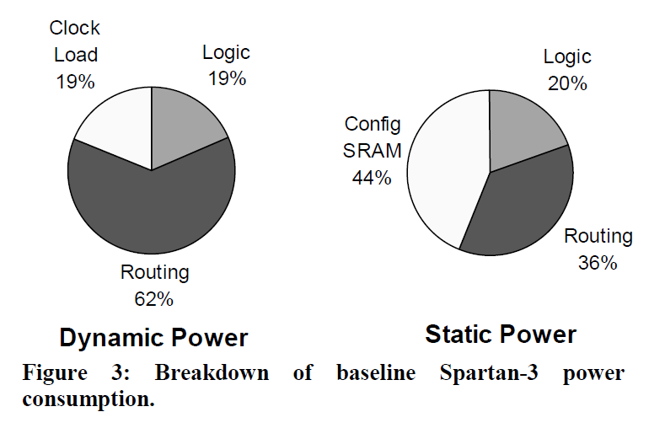
Shortcomings
No physical experiments (all simulation-based)
Misuse of data cited from another paper
“dynamic power still accounts for 62% of total power”
Tuan, Tim, et al. "A 90nm low-power FPGA for battery-powered applications."Proceedings of the 2006 ACM/SIGDA 14th international symposium on Field programmable gate arrays. ACM, 2006.
Notes:
Paper from Xilinx

Slide 48
Questions?

