Slide 1
Hardware software partitioning and co-design principles
MADHUMITA RAMESH BABU
SUDHI PROCH
1/37

Slide 2
Automated Derivation of Application-Aware
Error Detectors Using Static Analysis:
The Trusted Illiac Approach
Karthik Pattabiraman, Member, IEEE, Zbigniew T. Kalbarczyk, Member, IEEE, and Ravishankar K. Iyer, Fellow, IEEE
2/37

Slide 3
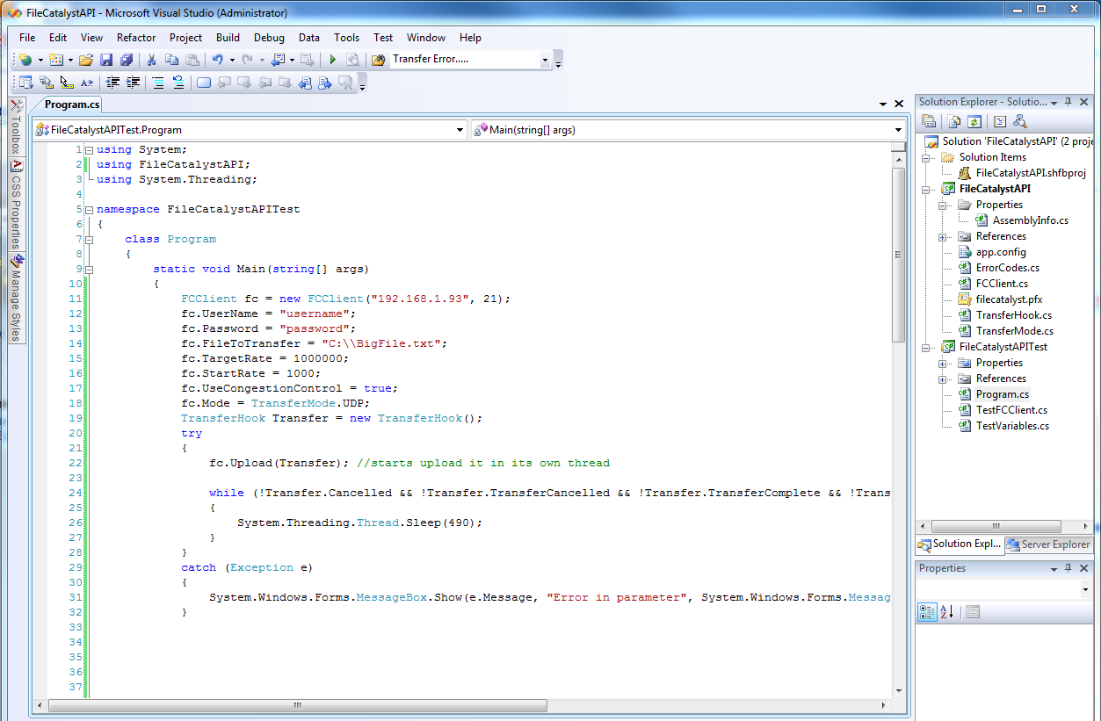


INTRODUCTION
3/37

Slide 4
OVERVIEW
A data error is defined as a divergence in the data values used in a program from an error-free run of the program for the same input.
Describes an approach to derive runtime error detectors using static analysis of application.
The detectors can be implemented in hardware or software.
This paper focuses on software implementation, but hardware in employed in Reliability and Security engine.
4/37

Slide 5
TERMS USED IN PAPER
Backward Program Slice
-- that can affect value of variable at program location.
Critical variable
-- highly sensitive to random data errors.
Checking expression
-- computed from backward slice of critical variable.
Detector
-- set of all checking expressions for a critical variable.
5/37

Slide 6
STEPS IN DETECTOR DERIVATION
IDENTIFICATION OF CRITICAL VARIABLE
Having highest dynamic fan-outs.
Each function is considered separately to identify variables.
Backward traversal of program till computation of variable.
All possible dependences are considered.
CHECK DERIVATION, INSERTION, INSTRUMENTATION
Backtracked, inserted just after computation of critical variable.
Track control paths at runtime.
COMPUTATION OF BACKWARD SLICE OF CRITICAL VARIABLES.
RUNTIME CHECKING IN HARDWARE AND SOFTWARE
Path Tracking is implemented in hardware.
Checking is also moved to hardware.
6/37

Slide 7
EXAMPLE CODE FRAGMENT WITH DETECTORS.
if (a==0)
if (path==1)
then
else
then
else
b=a+c;
d=b-e;
f=d+b;
c=a-d;
b=d+e;
f=b+c;
f2= 2*c – e
if (a==0)
f2=a+e
If (a!=0)
then
then
Path 1
Path 2
If (f2==f)
else
else
else
Use f;
then
Declare error in f along path and exit
Rest of code
7/37

Slide 8
SOFTWARE ERRORS COVERED
MEMORY CORRUPTION ERRORS:
Can write to heap or stack.
Static analysis assumes objects are infinitely apart in memory
Thus, backtracking examines all dependeces for the critical variable
RACE CONDITIONS AND SYNCHRONIZATION ERRORS:
Concurrent programs due to lack of synchronized accesses.
Static analysis does not account asynchronous modifications.
Thus, backward slice contains values of shared variables under synchronous conditions.
8/37

Slide 9
SOFTWARE ERRORS COVERED
MEMORY CORRUPTION ERRORS:
int foo (int buf[])
{ int sum [buflen];
int max = 0; int maxIndex=0;
Sum[0]=0;
for (int i=0; i<buflen;i++)
{ sum[i+1]=sum[i]+buf[i];
if (max<buf[i])
{ max= buf[i];
maxindex=I;
}
}
if (max>threshold) return sum[maxindex];
return sum[buflen];
}
Memory overflow
9/37

Slide 10
SOFTWARE ERRORS COVERED
RACE CONDITIONS AND SYNCHRONIZATION ERRORS:
void foo (int *a, mutex*alock, int n, int c)
{
int i= 0;
int sum =0;
for (i=0;i<n;i++)
{
acquire_mutex (alock[i]);
old_a= a[i];
a[i]=a[i]+c;
check (a[i]==old_a+c)
release_mutex(alock[i]);
}
}
Thread modifying contents of a may be in another module
CHECK
Precise analysis required, is unscalable
10/37

Slide 11
HARDWARE ERRORS COVERED
Hardware transient errors that result in corruption of architectural state are considered in the fault model.
INSTRUCTION FETCH AND DECODE ERRORS
EXECUTE AND MEMORY UNIT ERRORS
CACHE/MEMORY/REGISTER FILE ERRORS.
11/37

Slide 12
STATIC ANALYSIS
A new compiler pass VALUE RECOMPUTATION PASS (VRP) is introduced in the LLVM architecture.
Static Single Assignment (SSA) form is used as intermediate code representation.
each variable defined once and given an unique name.
a special static construct “phi” instruction whenever there is a merge.
12/37

Slide 13
PATH SPECIFIC SLICING ALGORITHM
The backward traversal starts from the critical instruction and terminates whenever one of these conditions is met:
Beginning of current function is reached:
  void bubble ( int srtElements, int *sortList)
  A basic block is revisited in a loop:
if data dependence is in a loop, one detector on critical variable, another on value after critical variable in the loop
A dependence across loop iterations is encountered:
Split detectors.
A memory operand is encountered:
Usually, virtual registers store variables, but cases like pointer references, duplicates memory loads.
13/37

Slide 14
ALGORITHM
Function computeslices (critical Instruction):
---- return PathList,SliceList
Function visit (seedInstruction,pathID,parent):
-----return Terminal;
Only terminal paths are added to the final list of paths.
Certain instructions like mallocs, frees cannot be computed but do not have nay impact on performance.
Critical instruction
Backward slice
Starting instruction with ID
Corresponding flowpath
Index of parent path
Visits each operand adding to slicelist
14/37

Slide 15
SCALABILITY AND COVERAGE
Number of control paths
Size of checking expression
Number of detectors
15/37

Slide 16
STATE MACHINE GENERATION
START
D
C
(LOOPENTRY, LOOPEXIT)
LOOPENTRY
START
A
E
NO_EXIT
(ENDIF,NO_EXIT)
THEN
(THEN, ENDIF)
(LOOPENTRY,NO_EXIT)
F
ENDIF
B
LOOPEXIT
(NO_EXIT, ENDIF)
G
16/37

Slide 17
EXPERIMENTAL RESULTS
PERFORMANCE OVERHEADS
  Checking overhead of VRP is 25%, code modification by 8%.
  DETECTION COVERAGE
17/37

Slide 18
DISCUSSIONS AND FUTURE WORK
77% coverage for errors that propagate and cause crashes.
FDV can provide 100% coverage, albeit extremely expensive.
If we neglect redundant detections, 90% of errors are detected.
============================================
Deriving detectors at lower levels of compilation.
Migration of checking functionality to reconfigurable hardware.
18/37

Slide 19
Hardware/Software Optimization of Error Detection Implementation for Real time Embedded systems
Adrian Lifa, Petru Eles, Zebo Peng, Viacheslav Izosimov
International Conference on Hardware/Software Codesign and System Synthesis, 2010
19/37

Slide 20
Agenda
Motivation and Background
Example Of Error Detection Implementation (EDI)
Optimization Challenge – with examples
EDI Algorithm for Static and PDR FPGA H/W
Experimental results
Conclusion and Improvements
20/37

Slide 21
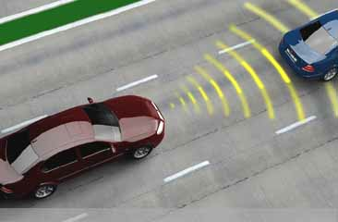

Motivation and Background
Reliable system operation for safety Critical systems
Error detection and recovery is very important
Adaptive Cruise Control
Implementation involves cost – time overhead
Early Optimization of scheme is most beneficial
21/37
Nuclear Power Plant

Slide 22
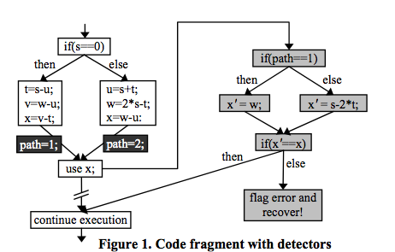
EDI - Example
Error Detection and recovery code
2 Main sources of performance overhead
  Path Tracking
  Variable Checking
22/37

Slide 23
Optimization Challenge
SW only approach – Overhead as high as 400%
HW only implementation – Increased cost (logic area)
Other Choice – Mixed H/W and S/W approach
Optimization Variables
  Time criticality of tasks
  Amount and cost of H/W
  Nature Of H/W (static or Partial reconfigurable)
23/37

Slide 24
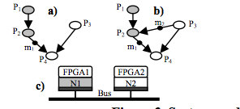
Optimization Challenge
Processes modeled as acyclic graphs – Connections show dependence
24/37

Slide 25
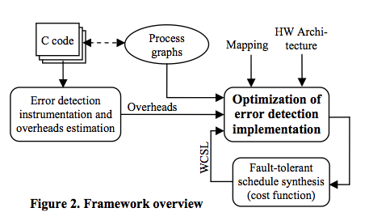
Optimization Challenge
“Re-execution of task on fault” model used for recovery
Optimization Objective – Optimal fault tolerant worst case schedule length (WCSL), given overheads and mapping of tasks
25/37

Slide 26
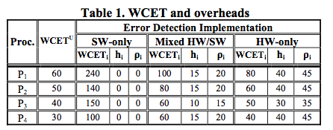
Optimization Challenge - Example
WCET^{U} – Baseline worst case execution time
WCET_{i} – worst case execution for an implementation
h_{i} – H/W cost/area for a particular process
P_{i} – Reconfiguration time for a particular task
26/37

Slide 27
Optimization Challenge - Example
Implementation Options Considered:
  S/W Only – Path tracking and variable checking in SW – interleaved code.
  Mixed HW/SW - Path Tracking in H/W. Variable Checking in SW
  HW Only – Path tracking and variable checking in HW
27/37

Slide 28
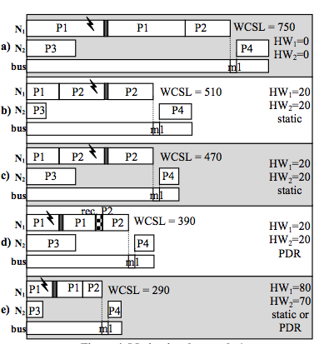
Optimization Challenge - Example
SW Only implementation
P1 – Mixed; P2 – SW
P3 – Mixed; P4 - SW
P1 – Mixed; P2 – SW
P3 – SW; P4 - Mixed
P1 – Mixed; P2 – Mixed PDR
P3 – SW; P4 – Mixed
HW Only implementation – Unconstraint area
28/37

Slide 29
EDI Algorithm
Combined mapping and scheduling problem
Optimal Sol possible only for very small set of tasks and nodes – NP complete otherwise
Use Heuristics – Tabu Search Algorithm
29/37

Slide 30
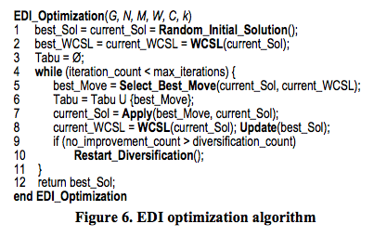
EDI Algorithm – Static FPGA
30/37

Slide 31
EDI Algorithm – Static FPGA
Important aspects –
  Start from a random start solution
  Search neighborhood – Perform Moves
    Simple Moves and Swap moves
    Swap moves – replace tasks on one resource
Avoid Local Minima -
  Accept non improving moves
  Tabu moves used to avoid cycling to local minima
  Diversification used to broaden search – Wait counters for processes. Use long waiting processes.
Restrict search to critical path moves – constraint
31/37

Slide 32
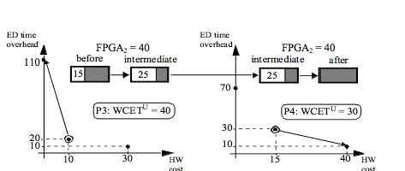
EDI Algorithm – PDR FPGA
Additional Complexities–
  Calculate reconfiguration schedule for EDI
  Function of Earliest Start time, Worst case execution time, HW area and critical path dependency.
Moves Exploration for a Process
32/37

Slide 33
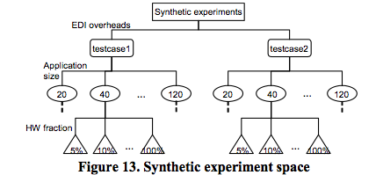
Experimental Results
Types of random data = 2
Process Graphs : 6 types with 15 graphs each
FPGA HW variation – 12 types (as % of max area)
Total Evaluation settings = 2 * 6 * 15 * 12 = 2160
33/37

Slide 34
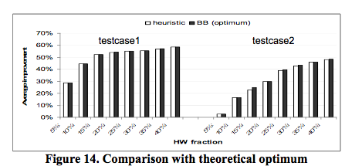
Experimental Results
Possible only for 20 process graphs and up to 40% HW area
Error – 1% max (testcase1) 2.5% max (testcase2)
34/37

Slide 35
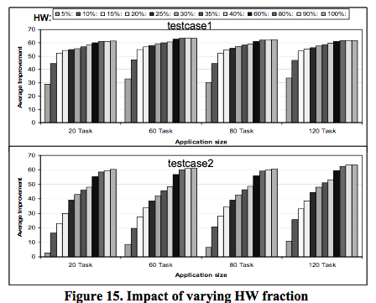
Experimental Results – Static FPGA
15% HW area gives >50% improvement – testcase1
40% HW area gives >50% improvement – testcase2
Improvement Saturates after a point
35/37

Slide 36
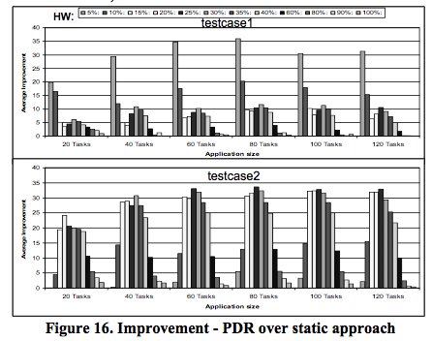
Experimental Results – PDR FPGA
5% HW area gives >36% improvement – testcase1
25% HW area gives >34% improvement – testcase2
Improvements are over and beyond Static HW case
36/37

Slide 37
Conclusion and Improvements
Conclusions -
Optimization scheme for EDI was presented
Fault tolerance and Real time constraints make life challenging
Heuristic based algorithm (Tabu search) was used
PDR HW option gives best results
Improvements -
Assumes a fixed mapping of tasks to each of the computational nodes
Could have compared with some other heuristic algorithm – simulated annealing
37/37

