Slide 1
Hardware-Software Partitioning

Slide 2
Hardware Software Definition
Definition: Given an application, hw/sw partitioning maps each region of the application onto
either a hardware (custom circuits)
or a software (microprocessors),
_{but not both}
A partition is a mapping of each region to either HW or SW
Mapping is done to meet certain Design Goals with Constraints

Slide 3
Design Constraints & Goals
Performance
Power
Space → Area
Schedule
Cost
Yield

Slide 4
You cannot get away with Everything !

Slide 5
Challenges
Exploration Space α $\exp^{\# of Components}$
E.g. Configurations possible for 30 software components in an application which may be implemented as hardware = 2³⁰ = 1Billion
Each component for different tradeoffs may have
Multiple software implementation
Multiple hardware implementation

Slide 6
Application with the Multiple Hardware Software Options
Process
FIR()
ACCUM()
SEARCH()
Hardware Implementation Options : Area and Execution Time
25s
10s
15s
12s
10s
5s
8s
5s
Sw Time: 50s
Sw Time: 30s
Sw Time: 20s
Consider all “middle” implementations
Use fastest implementations
Use smallest implementations
Possible Solutions:
25s
15s
15s
Area Budget
5s
10s
10s
Best Partition
Performance:
5+30+20=55s
25+15+10=50s
10+15+20=45s
Acknowledgement: Modified from G. Stitt’s slides in EEL5721

Slide 7
Mathematical Modeling to arrive at the Optimum H/W-S/W Partition
$b_{i}= \left( Whether component i impl in HW?1:0\right)$
$c_{i}= \left( Whether component i impl in SW?1:0\right)$
${het}_{i}$ = Hardware execution time of ith component
${set}_{i}$= Software Execution Time of the ith component
${hp}_{i}$= Hardware Power of the ith component
${sp}_{i}$= Software Power of the ith component
$a_{i }=Area of the component if implemented in Hardware$
$Total Execution Time =\sum_{i=1}^{n}{[ \left(b_{i}∗{het}_{i}\right)+\left(1−b_{i}\right) ∗\left({set}_{i}\right)]}$ $≤Design Constraint$
$Total Execution Power=\sum_{i=1}^{n}{[ \left(b_{i}∗{hp}_{i}\right)+\left(1−b_{i}\right) ∗\left({sp}_{i}\right)]}$ $≤Design Constraint$
Any component is either implemented in Hardware of Software but not in both
$$\bigvee_{i=1}^{n}{(b_{i}+c_{i})}=1$$

Slide 8
Granularity

Slide 9
Dynamic Hardware-Software Partitioning: A First Approach
Greg Stitt, Roman Lysecky, Frank Vahid,
University of California, Riverside
DAC 2003, June 2-6,2003, Anaheim, California, USA

Slide 10
Dynamic Hardware-Software Partitioning
Dynamically
identify and re-implement
critical software kernels, loops etc. to configurable fabric
in order to achieve better performance, lower energy or meet other design goals

Slide 11
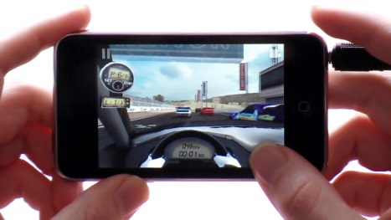
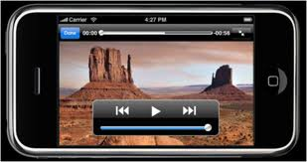
Multiple Applications an Illustration

Slide 12
Application Usage Profile: An Illustration
EEL5935
Different users have different usage profiles
User
While designing a product usage profile needs to be assumed to give best user experience. However
Usage Profile (Application usage) may be User/code dependent
E.g. MP3, Camera, Video Playback, Call etc.
Usage profile may change over-time
Generic product assuming a certain profile
is optimum for the “assumed” profile but sub-optimal in terms of area or performance for other usage profiles
Profiling in real time is key
usage profile may identify critical kernels
Critical components may be pushed to configurable area
To boost the performance and reduce energy
Mr. Jazz
Mr. Luigi
Mr. MTB
Music
Games
SMS
Calls
GPS
Data Access

Slide 13
Dynamic HW/SW Partitioner Requirements
Detect critical code regions
Decompile and synthesize them to hardware
Place and Route the Hardware onto on-chip configurable logic
Update binary to communicate with the logic
All of the above with on-chip implementable, very lean algorithms
Wait ! Did you say on-chip PnR ? You got to be kidding ! Right ?

Slide 14
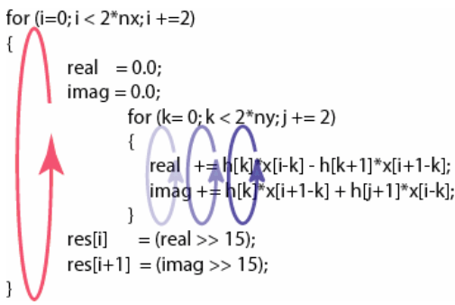
Binary Level Partitioning and Advantage
Partitioning at the binary level
offline or online
Steps
identify critical code sections, high loop sections
Consider assembly code and object code as HW candidates
Push these to configurable hardware
Advantage
Works with any
software compiler
High level language
The Paper uses Binary Level partitioning approach.
Critical Loops identified and implemented in the Configurable logic

Slide 15
Why Binary Level Partitioning instead of higher level optimizations ?
Dynamic Partitioning
Needs to run on a small on-chip partitioning system
Needs to be lean to be able to perform Place and Route etc. on-chip
Higher Level Partitioning Methodologies may be good for offline analysis, but very difficult to implement due to the compute constrain.

Slide 16
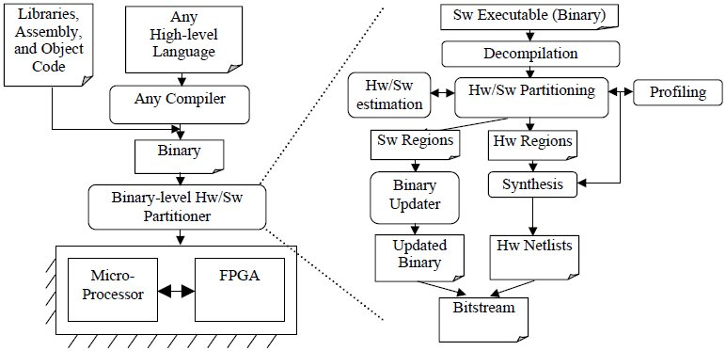
HW/SW Partitioning of Software Binary
Acknowledgement: Figure taken from G. Stitt, F. Vahid HW/SW Partitioning of Software Binaries ICCAD Nov 2002

Slide 17
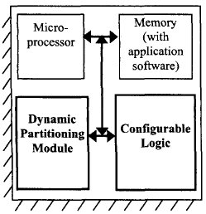
System Architecture (Top)
Microprocessor and Memory for normal Software application
1. Detects Most Frequently Executed Software region 2. Re-implements (1) in the configurable logic
Architecture Based on Triscend A7 (60MHz)
On chip configurable module

Slide 18
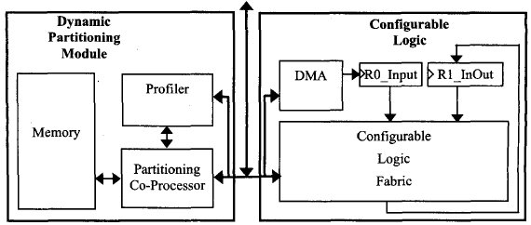
System Architecture (Sub Blocks)
Detects Most Frequently executed application-software loops
Direct Memory Access
Controller to access memory
Output
Decompiles and synthesized selected binary regions for HW implementation
32-bit i/p – o/p register
Input
Partitioning Co-Processor Overhead:
Not much : Very Lean compared to Main Processor
Platform with multiple Main Processors may share single Partitioning co-processor, reducing the overhead further

Slide 19
Simplified Configurable Logic Fabric
Simplified Fabric to just support inner loop implementation designed
Mapping, placing and routing a design to a general configurable logic fabric is time consuming

Slide 20
Architecture Limitations
No sequential Logic support in the Configurable logic (in the platform chosen)
Constraint:
Loops to be implemented must have single cycle implementable body
Number of loop iterations must be determined before the loop executes, in order to specify the DMA block size request.
Number of iterations may be determined :
Statically in case of constant bounds
Dynamically → requires extra instructions to configure the size of the DMA block request before HW execution starts
United States Patent 5,440,245 : Galbraith , et al. August 8, 1995 Logic module with configurable combinational and sequential blocks

Slide 21
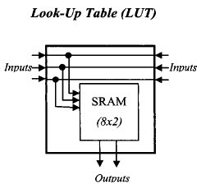
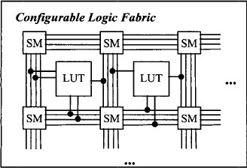
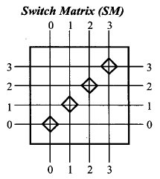
CLF Architecture
Either side connect-ability
(only at bottom)
4 channel:
Given Channel to Given Channel

Slide 22
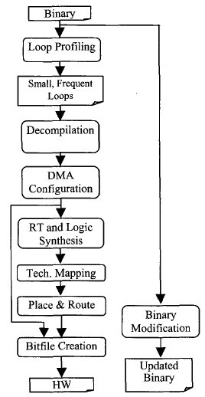
Tool Flow : Loop Profiler
Detects critical SW regions that should be implemented in HW
Is Non intrusive
Monitors instruction addresses on the memory bus
Increments branch frequency in the cache for a given backward branch
Small cache with a dozen entries
Need to save area and power
Reference: Ann Gordon-Ross et. al Frequent Loop Detection Using Efficient Nonintrusive On-Chip Hardware
IEEE TRANSACTIONS ON COMPUTERS, VOL. 54, NO. 10, OCTOBER 2005

Slide 23
Decompilation
Converts Software loops into higher level abstraction more suitable for synthesis
Step 1 : Converts each assembly instruction to register transfer
Step 2: Using Register Transfers Builds:
CFG (Control Flow Graph) for software region
DFG(Data Flow Graph) by parsing the Register transfers
Step 3: Applies compiler optimizations to remove overhead due to assembly code and instruction set

Slide 24
DMA Configuration Tool
Function: Maps the memory access of the decompiled loop onto the DMA Architecture
Involves detection of
Reads/ writes
Increment and decrement address updates
Single and block request modes
Remove following from Decompiled loop
Loop counters and exit conditions
Address calculations: As only sequential locations accessed
DMA functioning:
DMA transfers data needed before the loop starts
After HW initialization, HW starts a block request that fetches 1 memory location per cycle in case of a read or write

Slide 25
Register Transfer Synthesis
Converts each o/p bit into Boolean expression
By traversing the dataflow graphs of the software region
Limitation:
Single cycle executable loop-bodies only
Multi cycle would need behavioral synthesis to schedule loop operations

Slide 26
Logic Synthesis → Tech Mapping → P&R
Converts Boolean equations into a netlist
Boolean equations transformed into DAG (directed acyclic Graph) of the Boolean Logic network
Internal Nodes of DAG correspond to simple logic gates (AND/OR/INV, XOR)
Logic minimization
Light weight suited for on-chip execution
Applied at each node starting with the input nodes, while traversing through the network
Uses single expand phase to achieve good optimization
Tech Mapping
Traverses DAG starting from output nodes
Combines nodes that may create 3 i/p 1 o/p LUT
Further combine nodes (where possible ) to form 3 i/p 2 o/p LUTs

Slide 27
LUT Placement Steps
Step 1: Determine relative placement of LUTs to one another
by determining the critical path, and placing it on a horizontal row
Step 2 : For remaining non-placed nodes place as per dependency (i/p or o/p) w.r.t. placed
Place above for inputs to Placed nodes
Place below for outputs from Placed nodes
Step 3: Place in the Configurable Logic

Slide 28
Routing
Simple Greedy algorithm
Routes wires in most direct fashion
Route the wires between input nodes and LUTs
Route wires from LUTs to outputs
Route wires connecting LUTs together
Routing decisions at Switch Matrices for within conifugrable logic fabric

Slide 29
Bitfile Creation
Combines
the Placed and routed hardware description with the DMA configuration information into a single bit file
Bitfile can be used to initialize the configurable logic

Slide 30
Bitfile modification
Update software binaries to utilize HW for loops
Replace original software instruction for loop to a jump to HW initializing code
Initializing code sends HW enable signal through Memory mapped register
Code followed up with microprocessor power down trigger
Upon finishing HW asserts completion signal causing a software interrupt
Software interrupt wakes the microprocessor
Jump instruction at the end of the hardware initialization code to the end of the original software loop
Notes:
Draw cartoon for Second

Slide 31
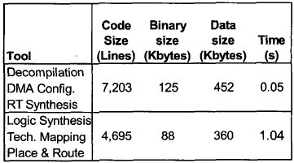
Tool : Performance and Area overhead
Typical tools for De-compilation, synthesis, and Place and Route need huge LSF machines
Designed tool very light weight and geared towards partitioning co-processor
Data Size: Memory required for the tool execution
Time : Execution time of each tool considering 60MHz clock and 1.5 cycle/Instruction

Slide 32
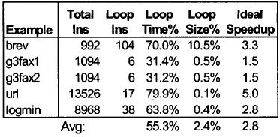
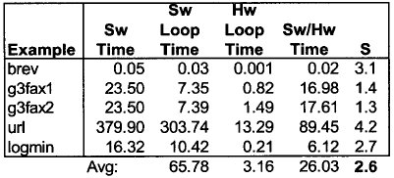
Results
Definitions:
Loop Time Perc: Percentage of total software time, spent in the implemented loops
Loop Size Perc: Percentage of the total instructions that the loop required
Ideal Speedup: Speedup assuming HW implemented loops are executing in Zero time.
Sw Loop Time: Time required by the loop if completely in software
HW Loop Time: Time when loop implemented in HW
Notes:
Where is the partitioning time ?
Partitioning is a one time even and would not be done often. Thus the partitioning time may not be considered

Slide 33
Conclusion
Dynamic HW/SW Partitioning offers advantages over traditional approach:
Transparent i.e. Benefits of partitioning even with regular software flows
Can adapt as per actual usage profile
Upto 2.6 average speedup

Slide 34
Areas of Improvement of Future Work
Power required by the partitioning module and the HW running specified as 10-20% of total power
Power data for individual modules not presented
Realistic loops have sequential logic and may not be always single cycle
Extend implementation on sequential logic compatible CLF
Extend to include mutli cycle loops
Applications seem too biased especially “url”, with 80% loop time with just 0.1% loop area overhead
Place and Route, synthesis would have been difficult to do on single partitioning chip:
Today as on 2013 it should be possible to interface the modules with the cloud computing. I would rather have a complex algorithm run to get best suited partition profile, on a cloud network than to try small tricks with the lean co-processors
This would be application dependent

Slide 35
A Study of the Speedups and Competitiveness of FPGA Soft Processor Cores using Dynamic Hardware/Software Partitioning
Roman Lysecky, Frank Vahid,
University of California, Riverside
Design, Automation and Test in Europe Conference and Exhibition (DATE’05)

Slide 36
Motivation (1/2)
Hard-Processor
Pros: Performance
Cons: Flexibility
Soft-processors
Pros: Flexibility
Cons: Degraded Performance and Energy Consumption
Can we leverage benefits of both using Warp Processing ?

Slide 37
Motivation (2/2)
Warp Processing : Technique for
optimizing a software application
by dynamically and transparently re-implementing “critical software kernels” as custom circuits in on-chip configurable logic
Study MicroBlaze based Warp processing System to
Eliminate the performance and energy overhead of a soft-processor compared to a hard-processor

Slide 38
FPGA single-chip Systems: Hard-core Vs Soft-core
Hard-core
Excellent Packaging and communication with the FPGA
Lower Power and Higher Performance than Soft-core
E.g. : Triscend, Atmel, Altera’s Excalibur, Virtex* with PowerPCs
Soft-core
Lower Part cost
Extreme Flexibility during design process
Adding custom instructions or including/ excluding particular data-path coprocessors
Quickly integrate the processor within a FPGA
Varying number of processors as per need
E.g. NIOS, NIOS II …, Picoblaze, Microblaze
Use Hardware / Software Partitioning Techniques to alleviate Power and Performance overhead of Soft Processors

Slide 39
MicroBlaze Soft Processor Core
Specify system Architecture and configure MicroBlaze
Xilinx Platform Studio Tools
Synthesizes
design
Bitstream
Software Libraries
MicroBlaze – 32bit softcore by Xilinx
LMB – Local Memory Bus
BRAM – Block RAM : User Defined Size
OPB – On-Chip Peripheral Bus
Application
Compile
Final
System
Bitstream

Slide 40
Key features of MicroBlaze
User Configurable options
Tailor processor’s functionality as per the design need
Configurable Instructions and data caches
Incorporate additional hardware:
Hardware multiplier ( mul instructions)
Hardware Divider ( div instructions )
Barrel Shifter (bs and bsi instructions)
Hardware bit manipulations and absolute plus

Slide 41
Peripheral Hardware available @ Present
Xilinx LogiCORE IP Floating-Point Operator v5.0 (Mar ‘11)
Available for
Kintex™-7, Virtex®-7, Virtex-6,Virtex-5, Virtex-4, Spartan®-6, Spartan-3/XA,Spartan-3E/XA, Spartan-3A/AN/3A DSP/XA FPGAs
Supported operators:
multiply
add/subtract
divide
square-root
comparison
conversion from floating-point to fixed-point
conversion from fixed-point to floating-point
conversion between floating-point types
Parameterized fraction and exponent word lengths

Slide 42
Applications analyzed
brev (Powerstone benchmark suite)
Critical kernel performs bit reversal heavily relying on shift operations
Software only Implementation (without mul or barrel shift)
N-bit shift by using n-successive add operations
Configurable Hardware implementation
2.1X speed up
“matmul”
Critical Region : Matrix multiplication
Hardware Multiplier provides 1.3X speedup

Slide 43
MicroBlaze-based Warp Processor
Implement critical Kernels in WCLA as cutom HW
Identify Critical Kernels in execution time
WCLA – Warp Configurable Logic Architecture

Slide 44
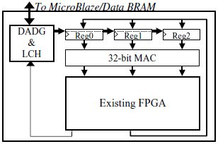
Warp Configerable Logic Architecture for Dynamic HW/ SW Partitioning
DADG: Data Address Generator
Used for any memory accesses to/for Configurable logic
LCH: Loop Control Hardware
Handles loops and controls executions
Reg 0, Reg 1 Reg 2:
i/p to CLF /or MAC (as per mapping)
Outputs from the configurable logic stored in Registers

Slide 45
MicroBlaze Multi-processor warp processing system
Mutliple Soft-cores may be incorporated within a single FPGA
Limited only by the FPGA Size
Multi-processor Warp Processing system may share a common DPM and WLCA and HW/SW partitioning may be done in round robin manner
No Overhead due to additional DPMs
Partitioning tools may be implemented as software tasks running in one of the cores

Slide 46
Experimental Setup
Execution Time and Power studied
Embedded systems applications chosen from Powerstone and EEMBC benchmark suites studies
MicroBlaze processor core implemented on Spartan3 FPGA
Barrel Shifter and Multiplier configured in Hardware
Note: MicroBlaze max frequency 85MHz; However FPGA circuits may run upto 250MHz

Slide 47
Profiling Simulation
Soft App 2
Soft App 1
Soft App n
MicroBlaze
Xilinx Microprocessor Debug Engine
Inst Trace 1
Inst Trace n
Inst Trace 2
Simulate On-chip Profiler Behavior
Critical Region

Slide 48
Energy Equations
Total Energy Consumed = $E_{total}$
Energy Consumed by HW in Configurable Logic = $E_{HW}$
Energy Consumed by Microblaze = $E_{MB}$

Slide 49
Performance / Power Simulation
MicroBlaze and system Component
(excluding WCLA)
Execution Traces of critical regions
Critical Regions
Execute HW Circuits (VHDL model for WCLA) for each partitioned Critical Region
Xilinx XPower
VHDL
Synopsys Design Compiler
UMC 0.18um
Library
Determine final application performance
Dynamic Power
Static Power
Synthesis
Configurable HW Power
MicroBlaze Power

Slide 50
Results
ARM execution determined using Simple Scalar

Slide 51
Conclusion
Warp processors (with soft-core), by pushing critical software kernels to the CFG can provide
Flexibility of the Soft-core
Due to soft-core implementation
Competitiveness of a Hard-core processors (as ARM)
Performance of the order of the Hard-core
By leveraging special Configured HW
5.8X (average) improvement (with MicroBlaze)
Eliminates Energy Overhead
By faster execution due to dedicated hardware and trimming down the soft-processor to perfectly fit design needs
Average Energy reduction ~ 57%
Opened Avenues for Soft-core processors which would not have been feasible previously due to energy/performance

Slide 52
Areas of Improvement & Future Work
Real processing systems do not just do a execute just a single application at a time
For realistic data, multiple applications should be run simultaneously
Explore Parallel Processing architecture further
Power Estimation Data
Estimation is good
It would be good to see real data as well
Online Profiler has a dozen entries
Number of entries should be configurable to avoid local maxima
Instead of simplified configurable logic fabric, how about using underlying FPGA physical fabric
Algorithm to come up with re-partitioning time interval should be worked up

Slide 53
Questions

Slide 54
Design Goals

