Slide 1
Low Power and Energy Optimization Techniques
Zack Smaridge
Everett Salley
1/42

Slide 2
Energy-Efficient Scheduling on Heterogenous Multicore Architectures
J. Cong, B. Yuan
University of California
International Symposium on Low Power Electronics and Design, 2012
2/42

Slide 3
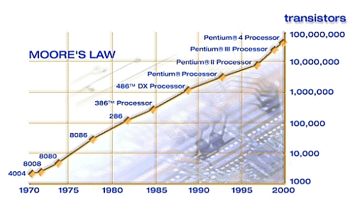
Introduction
Increase of transistors guided by Moore's Law has lead to more and more cores on a chip
On-chip power is becoming a critical issue
Intelligent scheduling may taken advantage of tradeoffs to reduce power consumption
Paper examines phase-based scheduling
Increasing use of heterogeneous multi-core architectures over homogeneous multi-core systems
Heterogeneous cores provide different power/performance trade offs
3/42

Slide 4
Heterogeneous Scheduling Approaches
Schemes addressing power
Sampling-based dynamic switching heuristics
Statically map program cores based on resource demands for the entire execution
Identify program phases by tracking program counters with history table
Proposed approach uses combination of static analysis and runtime scheduling
Reduces sampling overhead
Does not require large hardware additions
4/42

Slide 5
Energy Efficient Scheduling
Scheduling Steps
Static analysis and instrumentation
Takes sources code as input
Analyze code to identify loops/loop boundaries
Calculates invocation times, number of instructions, caller-callee sites and tracks relationships
Profile program to construct call graph
Each node is a function call or loop
Infers average number of executed instructions per loop
5/42

Slide 6
Scheduling Steps Continued
Identify major program phases
Call graph identifies loops that qualify
Must meet minimum thresholds for instruction and invocation counts to offset overhead
Instrumentation functions inserted at the edges of identified phases
Runtime Scheduling
During each invocation two pieces of hardware data are collected
Use regression model to estimate energy consumption
Predicts EDP to make scheduling decisions
6/42

Slide 7
Complexity and Scalability
Complexity: O(PxN)
P – Number of major program phases
N – Number of different types of processors
Scalability becomes an issue as the number of cores increases
Use hierarchically sampling to reduce overhead
Cluster processors in to categories based on characteristics
Scheduling first determines appropriate category then maps to specific processor
7/42

Slide 8
Heterogeneous Multi-core Architectures
Intel QuickIA platform
Employs two asymmetric processors in terms of performance and power
Excellent platform for evaluation of heterogeneous scheduling
Intel Atom Processor 330
Low-power microarchitecture targeted for mobil devices
Intel Xeon Processor E5450
High performance server-class microarchitecture
8/42

Slide 9
Energy Efficiencies
Energy Delay Product (EDP) – measurement of power consumption per switching period
Figure 1 shows EDP for Atom vs. Xeon
SPEC Benchmark 473.astar
Each interval contains 50 million instructions
Differences in EDP for each processor depending on program phase
Potential to reduce EDP by adaptively mapping the program to the most appropriate core
9/42

Slide 10
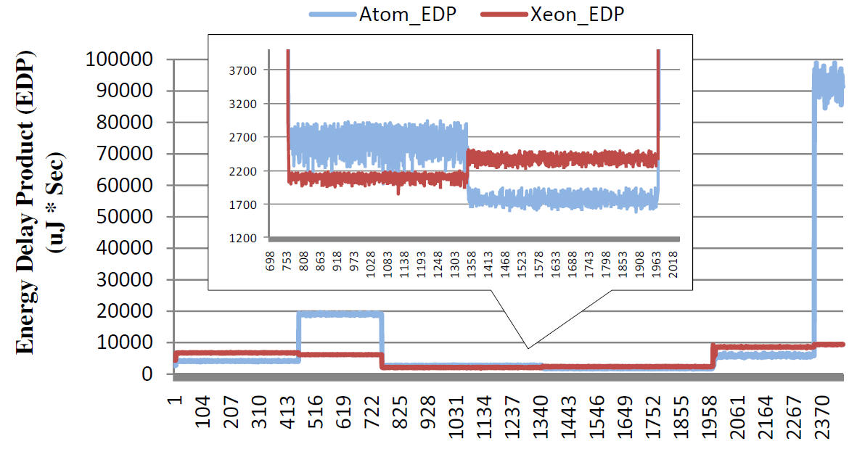
EDP Measurements
Figure 1: EDP on Xeon and Atom processors vs. instruction intervals for the SPEC CPU2006 Benchmark
10/42

Slide 11
Regression Modeling for Energy
Predicts energy usage based on training data
Data based on 4 benchmarks from SPEC CPU2006: astar, bzip2, h264ref and hmmer
Collected 15 pieces of hardware performance data for each
Data entered into McPAT to calculate energy consumption for each instruction interval
McPAT – integrated power, area and timing modeling framework that supports multicore configurations
Obtained 2000 training data samples
11/42

Slide 12
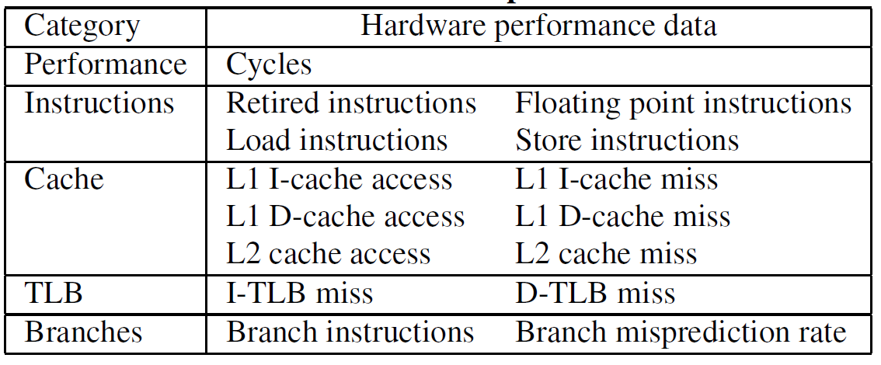
Hardware Performance Data
Use variable clustering and correlation analysis to identify 4 key parameters:
Table 1: Collected Hardware Performance Data
12/42

Slide 13
Predicting Energy Consumption
Linear regression model created from 4 key parameters:
Regression coefficients B determined from training data using ordinary least-squares method
Average model error:
Atom: 2.25%
Xeon: 2.6%
13/42

Slide 14
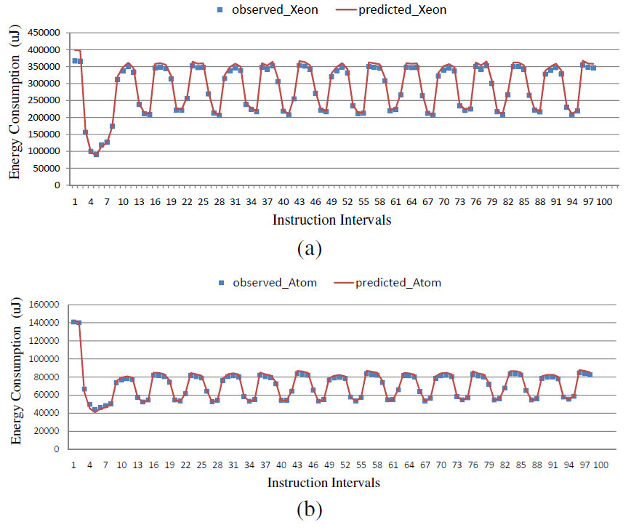
Regression Model Results
Figure 2: Regression model can accurately predict energy consumption in a) Xeon and
b) Atom processors
14/42

Slide 15
Evaluation Methodology
Benchmarks
SPU2006: astar, bzip2, h264ref, hmmer, lbm, libquantum and named
Medical imaging domain: denoise, deblure, registration(reg) and segmentation(seg)
Scheduling comparisons
Statical mapping approach (SMap) – statically maps programs to cores based on programs inherent characteristics. Does not switch during execution.
Periodic sampling approach (PS) – samples cores at set intervals and schedules. Modified approach is based upon pre-collected hardware performance data.
15/42

Slide 16
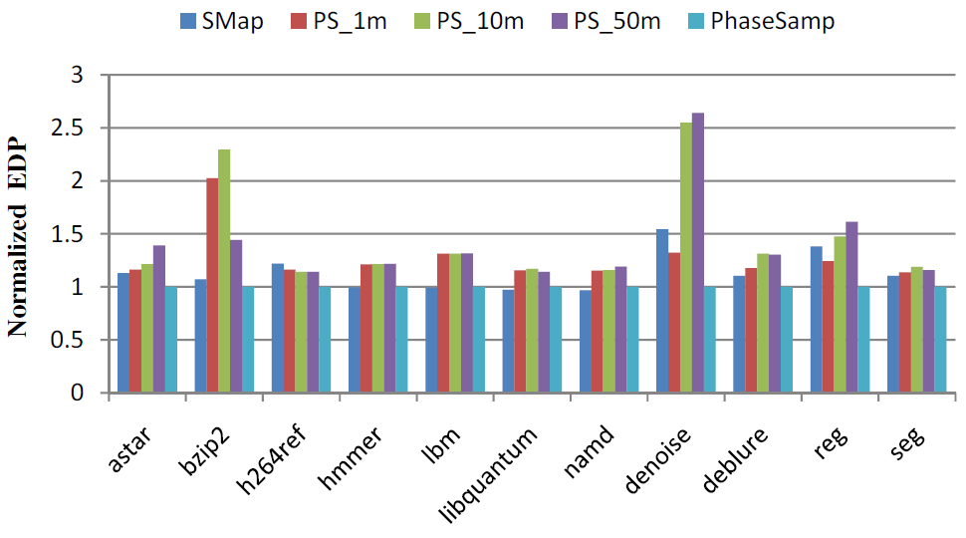
Results of Scheduling Comparison
Figure 2: Normalized results of scheduling results with interval lengths of 1, 10 and 50 million instructions
16/42

Slide 17
Conclusion
Compared against statistical mapping
Average 10.20% reduction up to 35.25%
Did worse in 4 benchmarks: hmmer, lbm, libquantum and namd
Worse results attributed to switching overhead and application always running more efficiently on one particular core
Compared against periodic sampling
Average 19.81% reduction at 1 million instructions
Average 26.25% reduction at 10 million instructions
Average 25.31% reduction at 50 million instructions
17/42

Slide 18
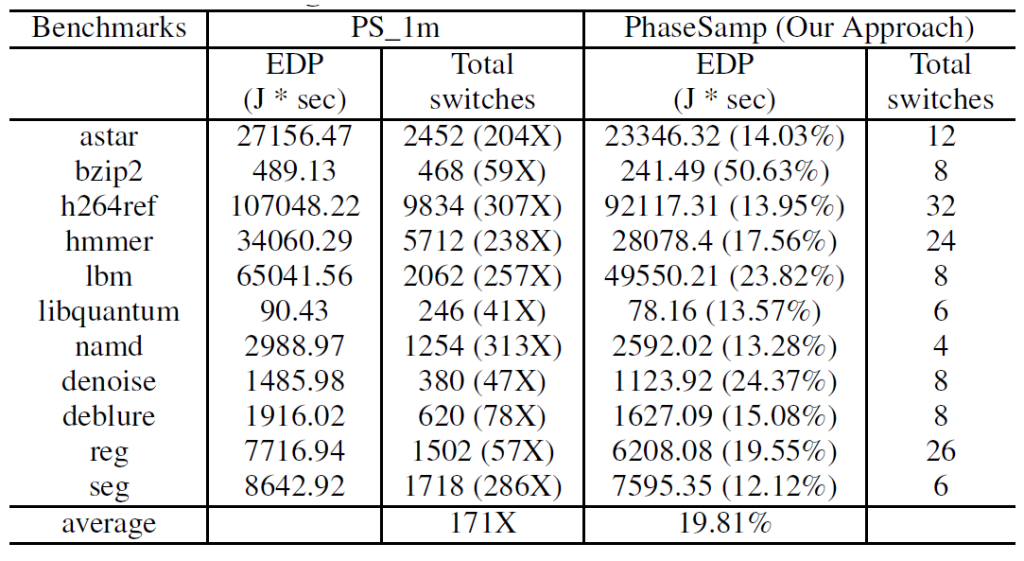
Comparing PhaseSamp Against PS
Table 2: Comparison of EDP and core switching over benchmark sets
18/42

Slide 19
Future Improvements
Regression model based on only 4 benchmarks and checked against only 1 benchmark
Run time scheduling is only capable of measuring 2 pieces of hardware data at each invocation
Error rate increases sharply for less than 4 pieces of hardware performance data
19/42

Slide 20
Energy-Efficient Signal Processing in Wearable Embedded Systems – An Optimal Feature Selection Approach
H. Ghasemzadeh, N Amini, M. Sarrafzadeh
University California
International Symposium on Low Power Electronics and Design, 2012
20/42

Slide 21
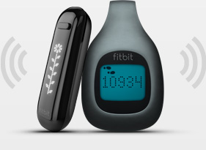
Wearable Embedded Systems
Wearable Electronics are computational elements that are tightly coupled with the human body
Examples include: Medical bands Personal Health trackers Smartgloves Google Glass | Application Domains: Remote Patient Monitoring Personalized Healthcare Gaming Sports
21/42

Slide 22
Scope of the Paper
Classification Applications - Map physiological sensor data to specific user states
Typically achieved by extracting features from the sensor signals then applying machine learning and pattern classification algorithms
22/42

Slide 23
Scope of the Paper
Classification Applications - Map physiological sensor data to specific user states
Typically achieved by extracting features from the sensor signals then applying machine learning and pattern classification algorithms
23/42

Slide 24
Scope of the Paper
Problem – Feature extraction consumes both time and energy. Performing feature extraction on an extensive set of signals may rapidly deplete battery.
Observation – Many features may be redundant or unnecessary. Some features may be more computationally intensive to extract.
Solution – Determine the optimal set of features which minimizes power cost while still accurately classifying the data.
Introduce a new feature selection algorithm which considers the computational complexity of extracting each feature
24/42

Slide 25
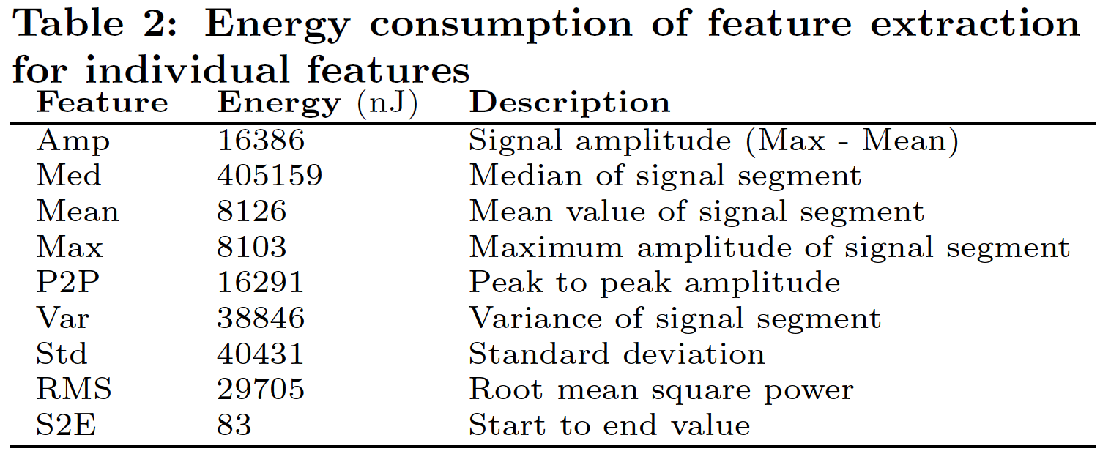
Examples of features
25/42

Slide 26
Example System
Sensors
Sensor Node
Gateway
(Smartphone)
Internet
Sensors
Sensor Node
Sensors
Sensor Node
Data
Center
26/42
Notes:
Feature selection only present when learning. Classification may take place on the gateway

Slide 27
Feature Selection Process
Only performed in the training phase
Construct on exhaustive set of initial features
Discard unnecessary features based on relevance and redundancy
Relevance
A feature is irrelevant if it is not useful to a specific classification application
Redundancy
A feature is redundant if it strongly correlates with other features
27/42

Slide 28
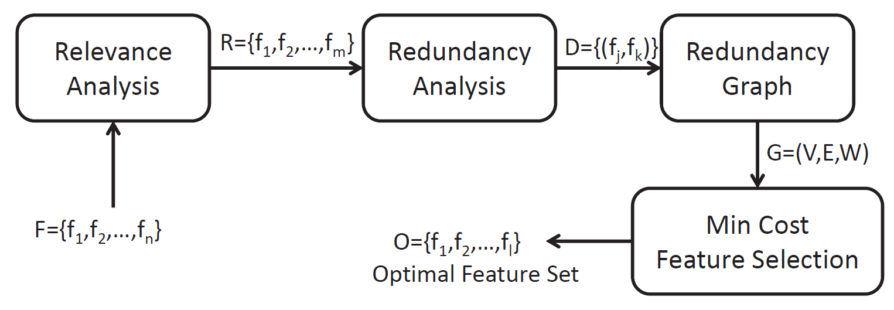
Proposed Selection Process
New Feature Selection Process
Construct exhaustive feature set
Eliminate all irrelevant features
Perform redundancy analysis and construct a redundancy graph. Include computational complexity.
Use the graph model so solve an optimization problem
28/42

Slide 29
Symmetric Uncertainty
U(X,Y):= Symmetric Uncertainty
H(X) := Entropy of RV X
I(X,Y) := Information Gain between RV X and Y
$$U\left(X,Y\right)=\frac{2I\left(X,Y\right)}{H\left(X\right)+H\left(Y\right)}$$
$$I\left(X,Y\right)=\left(X\right)−\left(X|Y\right)$$
Symmetric Uncertainty is the normalized information gain and has value between 0 and 1
U = 0 → Both RVs are completely independent
U = 1 → Knowing value of 1 RV allows you to completely predict the value of the other RV
Basically a measure of correlation between two RVs, but it also captures non-linear correlations
29/42

Slide 30
Relevance and Redundancy
30/42

Slide 31
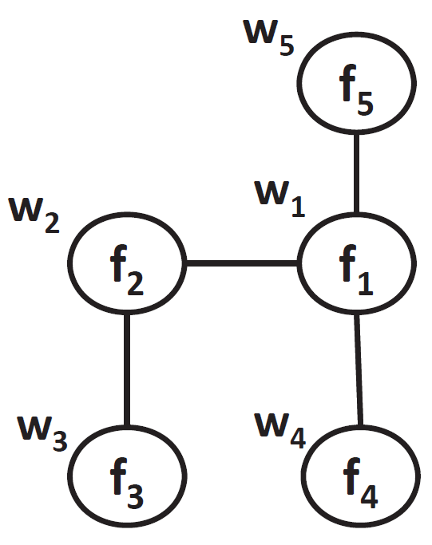
Redundancy Graph
Vertices connected by edges indicates a strong correlation between the pair of features
$F=\left\{f_{1},f_{2},f_{3},f_{4},f_{5}\right\}$ indicates the relevant features
W$=\left\{w_{1},w_{2},w_{3},w_{4},w_{5}\right\}$ represents the computing cost associated with the given feature
31/42

Slide 32
Minimum Cost Feature Selection
Goal: Find a subset of vertices in the redundancy graph that are not dominated by any other vertex (ie no redundancy) while minimizing the total cost
MCFS problem is equivalent to the Minimum Cost Dominating Set (MCDS) problem which is NP-Hard
Authors formulate the problem using ILP and propose a solution using Greedy Algorithms
32/42

Slide 33
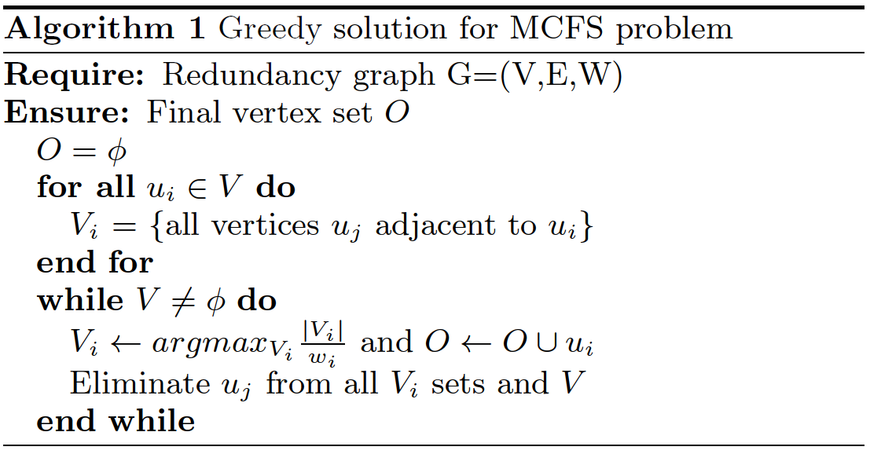
Greedy Approach
33/42

Slide 34
Feature Selection Example
1
1
1
1
1
10
1
1
1
1
Total Cost = 2
Total Cost = 3
34/42

Slide 35
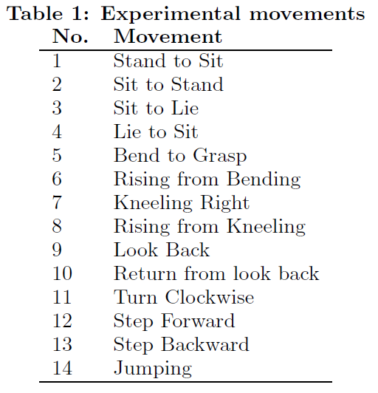
Experimental Set-up
Wearable sensor with an Accelerometer and Gyroscope attached to TI MSP430 microprocessor
3 human test subjects instructed to perform 14 transitional movements
Collected data was partitioned into two disjoint groups for training and testing
35/42

Slide 36
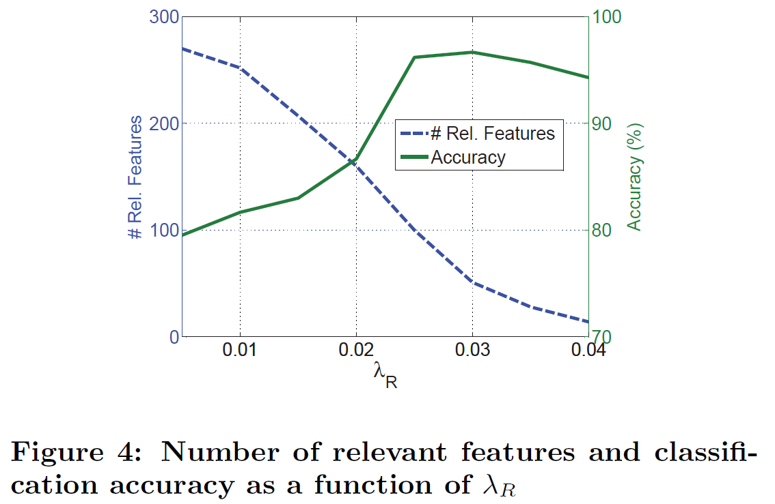
Results
270
51
36/42
Notes:
Relevance Threshold

Slide 37
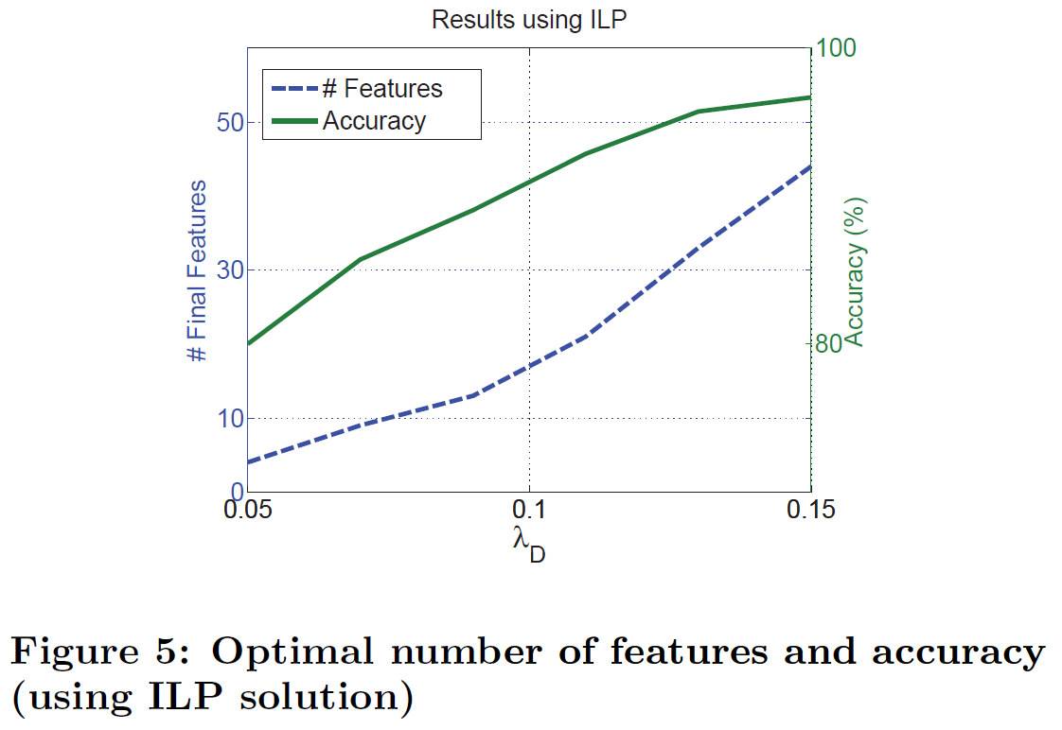
Results
44
4
37/42
Notes:
As lambda increases, results in less edges connecting correlated features

Slide 38
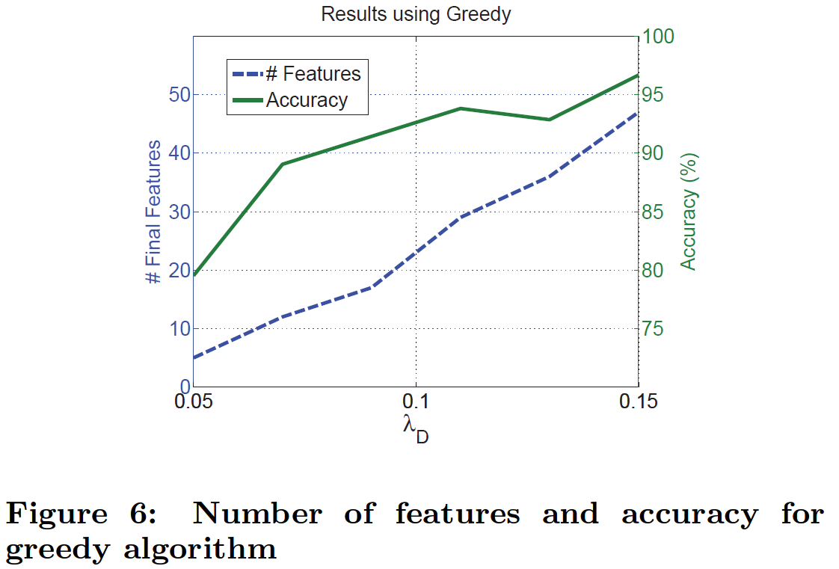
Results
47
5
38/42

Slide 39
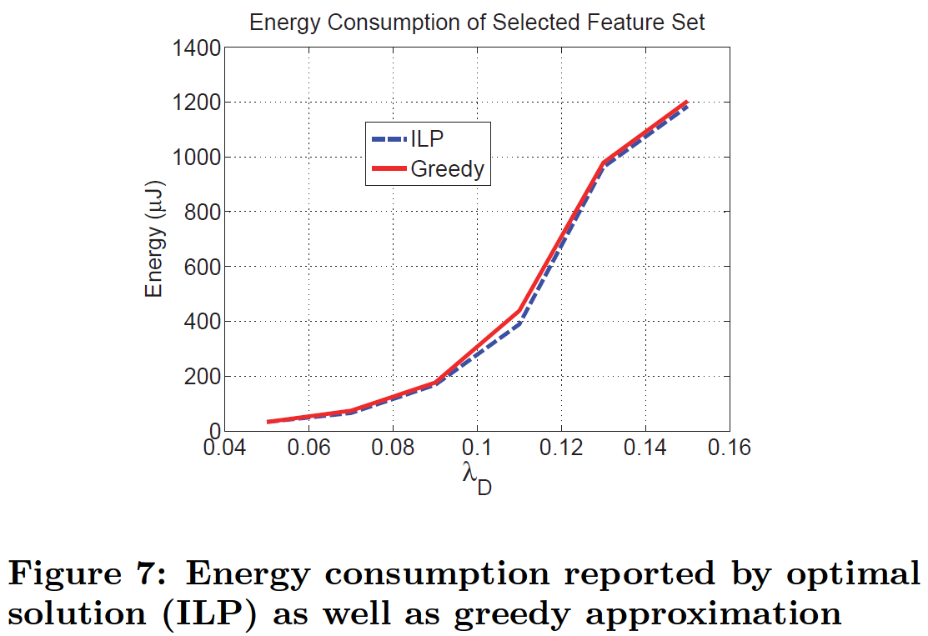
Results
39/42

Slide 40
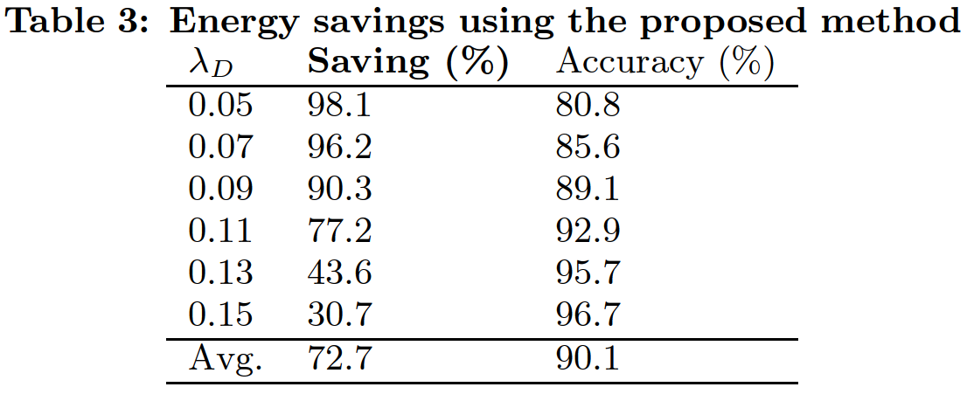
Conclusion
ILP and Greedy approach yield very similar results
Tradeoff between classification accuracy and total power savings
40/42

Slide 41
Future Improvements/Criticisms
Dynamic feature selection – contextual info such as location or time to be used in real-time to eliminate features and deactivate unused sensor nodes
No comparison to any previous works
Never specify how energy savings are determined (ie 72.7% average power savings with respect to what?)
41/42

Slide 42
Questions?
42/42

