Slide 1
Course-Grained Reconfigurable Architectures
Patrick Cooke and Elizabeth Graham

Slide 2
Introduction
FPGA Benefits
Better performance than software
Rapid prototyping
Lower NRE costs
Field-upgradable
FPGA Disadvantages
Learning curve
Lengthy compilation times
Lack of portability

Slide 3
Solution: CGRA
Learning curve
High-level synthesis
Simpler basic building blocks
Lengthy compilation times
Separate virtual hardware and application compilation
Shorter application compilation time
Lack of portability
Hardware abstraction
New FPGA, same application

Slide 4
Intermediate Fabrics: Virtual Architectures for Circuit Portability and Fast Placement and Routing
James Coole, Dr. Greg Stitt
University of Florida
Department of Electrical & Computer Engineering
Published in CODES + ISSS 2010

Slide 5
Intermediate Fabrics (IFs)
Specialized virtual reconfigurable architectures
Configure FPGA with a specialized, higher-level FPGA

Slide 6
IF Architecture
Data plane
Functional units
Tracks and switches
Connections
Control plane
State register
State machine LUT
Stream plane
Inputs and outputs

Slide 7
Data Plane
Performs application calculations
Island-Style Topology
Grid of CUs
E.g., ALUs, multipliers, adders
Routing resources in between CUs
Tracks connect CUs
Switch boxes connect tracks
Connection boxes connect I/O from CUs to tracks

Slide 8
Control Plane
Provides primitives for state machines and control logic
State register
Next state logic
State-dependent output logic
State-independent output logic
Limitation: Scalability
Not scalable to many inputs or large state machines
Data-parallel circuits require < 1% resources for control

Slide 9
Stream Plane
Transfers data to and from external memories
Saves data plane resources for computations
Components
Counter
Basic control
Memory controller
Optional specialized buffers
E.g., smart buffers
Improve memory bandwidth

Slide 10
IF Overhead
High usage of MUXs for routing
Reduction techniques
Decrease track density
Long tracks
Jump tracks
Wide channels
Connection box flexibility

Slide 11
Experiments
Metrics
Routability – % of random netlists routed successfully
PAR time – Time to complete PAR on the IF
Clock overhead – % clock frequency lowered to accommodate additional circuit complexity
Sample case studies (12 cases; 21 variations)
Matrix Multiply – Inner product of two vectors
Accum – Monitors an input stream, increments when value below threshold
Max Filter – Image filter, selects max of 3x3 window

Slide 12
Select Results
 | PAR Time Speedup | IF Area Overhead | IF Area Overhead Savings* | IF Clock Overhead
Matrix Multiply FXD | 112× | 16% | 63% | 16%
Matrix Multiply FLT | 602× | 31% | 58% | -11%
Accum FXD | 280× | 4% | 50% | 41%
Accum FLT | 323× | 14% | 29% | 25%
Max Filter | 444× | 9% | 56% | 23%
Average FXD | 275× | 16% | 48% | 18%
Average FLT | 1112× | 23% | 39% | 19%
Average | 554× | 18% | 45% | 18%
* Savings of IF area overhead versus using IF area overhead reduction techniques

Slide 13
Routability vs Overhead
 | Routability | Overhead
2 Tracks per Channel | 89% | 15%
3 Tracks per Channel | 99% | 23%
4 Tracks per Channel | 100% | 28%
5 Tracks per Channel | 100% | 37%
Values averaged over different fabric sizes
3×3, 4×4, 5×5, 6×6, 7×7, 8×8, 9×9, 12×8
CUs are DSP48

Slide 14
Conclusions
Average 554× PAR speedup
IF area overhead can be substantial, but routability remains relatively high
Overhead reduction techniques on average reduce overhead by 45%
IF clock overhead negligible to other system bottlenecks

Slide 15
Future Work
Directly map IF routing resources to reduce overhead
Evaluate performance of multiple smaller IFs with respect to one large IF
Create library of IFs
Develop algorithms for automatically selecting most appropriate IF
IF synthesis (done manually in this paper)

Slide 16
Shortcomings
IFs do not scale well
IF synthesis done by hand, so examples were overly simple
Besides random netlist generator, no tools developed for experiment or paper

Slide 17
An FPGA-based Heterogeneous Coarse-Grained Dynamically Reconfigurable Architecture
Ricardo Ferreira, Julio Goldner Vendramini, Lucas Mucida Departamento de Informatica
Universidade Federal de Vicosa
Monica Magalhaes Pereira, Luigi Carro
Instituto de Informatica-PPGC
Universidade Federal do Rio
Grande do Sul
Published in CASES 2011.

Slide 18
FPGA-based Coarse-Grained Reconfigurable Architecture (CGRA)
Virtual device implemented on any commercial off-the-shelf FPGA
Simple configuration algorithm enables fast prototyping
Algorithm maps dataflow graphs (DFGs) onto word level reconfigurable architecture
Proposed CGRA is 10-100x faster compared to previous CGRA work

Slide 19
CGRA Architecture
Three components
Registers
Normal and bypass
Functional units (FUs)
Heterogeneous or Homogeneous FUs
Heterogeneous reduces cost, power, and complexity
Homogeneous simplify scheduling, placement and routing
Global interconnection network
Single cycle latency between FUs
Structured & Unstructured Communication Patterns

Slide 20
Dynamic Interconnection Network
Multistage Interconnection Network (MIN)
Given n inputs, n outputs and switch radix r, log_{r} n stages with n/r switches each
Two parallel Omega networks
Blocking networks
Switch radix 4
Works well on 6 input LUTs
Half the cost of radix 2 network
Each extra stage doubles number of paths connecting each input/output pair

Slide 21
MIN Routing
Upper network routes first operand of each FU, lower network routes second operand
Commutative operators allow network to avoid conflicts by switching order of operands
Switches support multicast connections

Slide 22
Scheduling, Placement and Routing (SPR)
SPR all performed at same time
Modulo scheduling
Repeat schedule of configurations in loop
Greedy heuristic
Polynomial complexity
Placement and Routing
Greedy heuristic

Slide 23
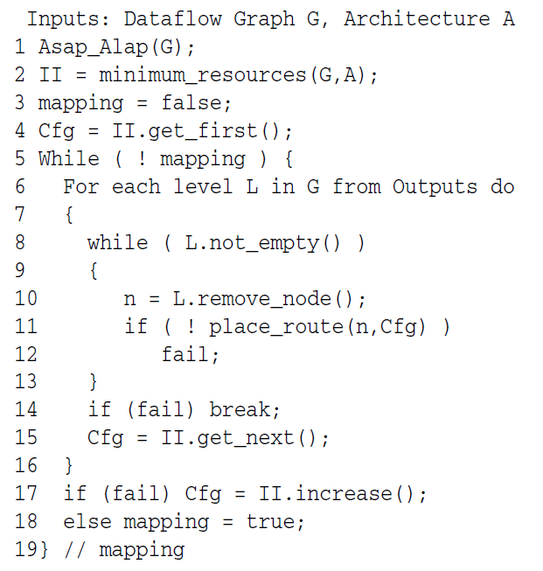
SPR Algorithm
As Soon As Possible (ASAP) & As Late As Posssible (ALAP) scheduling to find slack
Initiation Interval (II)
Number of network configurations
Initialized based on DFG and architecture configuration
Starting from output, attempt place and route for each node from current level in current configuration
If success, proceed to next level and next configuration until end of DFG
If fail, increment II and restart

Slide 24
Placement Algorithm
Request FU for node placement
If no available FU, request bypass register
If no available register, placement fails
Otherwise, reschedule node one level up
Placed nodes are immediately routed

Slide 25
Routing Algorithm
Attempt to route placed node’s FU to destination FU
If routing fails, request bypass register
If no available register, routing fails
Otherwise, reschedule node one level up and attempt to route to register
Algorithm returns success or fail of routing attempt

Slide 26
SPR Walkthrough
5 node DFG
2 FUs
1 bypass register
Initiation Interval starts at ceiling(5/2) = 3
Algorithm begins at node E
Assume node A is chosen for rescheduling

Slide 27
Experiments
Setup
Results
12 DFGs of digital signal processing benchmarks
6 architecture configurations
3 medium configurations (64 I/O MINs)
3 large configurations (256 I/O MINs)
Each configuration had unique combination of heterogeneous FUs
Medium configurations
Instructions per cycle (IPC) range = 19-26
20% overhead on minimum Initiation Interval
Average CPU time = 40 ms
Large configurations
Instructions per cycle (IPC) range = 37-104
40% overhead on minimum Initiation Interval
Average CPU time = 130 ms

Slide 28
Resource Utilization
Xilinx Virtex6 configured using ISE 12.4
Medium architectures (64 I/O MINs)
1% of FPGA register resources
15% of LUT resources
4% of DSP resources
Large architectures (256 I/O MINs)
6% of FPGA register resources
82% of LUT resources
16-25% of DSP resources

Slide 29
Conclusions/Future Work
Dynamic CGRA and SPR algorithm achieve on average 50% resource utilization per cycle and CPU time between 10-300 ms
Add local register file to FUs to reduce number of configurations in SPR algorithm
Integrate SPR tool into compiler tools for softcore FPGA processors
Significantly increase performance of data intensive applications

Slide 30
Shortcomings
No in-depth comparison of results with previous work
No comparison of CGRA circuits with equivalent FPGA circuits to evaluate quality of circuits mapped to CGRA

