Slide 1
Reconfigurable Computing
Zack Smaridge
Everett Salley
1/54

Slide 2
Application-Specific Customization and Scalability of Soft Multiprocessors
D. Unnikrishnan, J. Zhao, R. Tessier
University of Massachusetts
Field-Programmable Custom Computing Machines
April 5-7 2009, Napa, CA
2/54

Slide 3
Soft Processors
Soft Processor – a microprocessor that is implemented entirely on an FPGA or Reconfigurabe Fabric
More than 16% of FPGA designs incorporate soft processors
Examples include Altera Nios 2 and Xilinx MicroBlaze
Advantages
Fast and flexible way to develop applications. Allows developers to use familiar high-level languages.
Reconfigurability allows for optimization towards specific applications
Disadvantages
Cannot match performance, power, and area of hard processors
Does not utilize the underlying reconfigurable fabric to its fullest potential
3/54

Slide 4
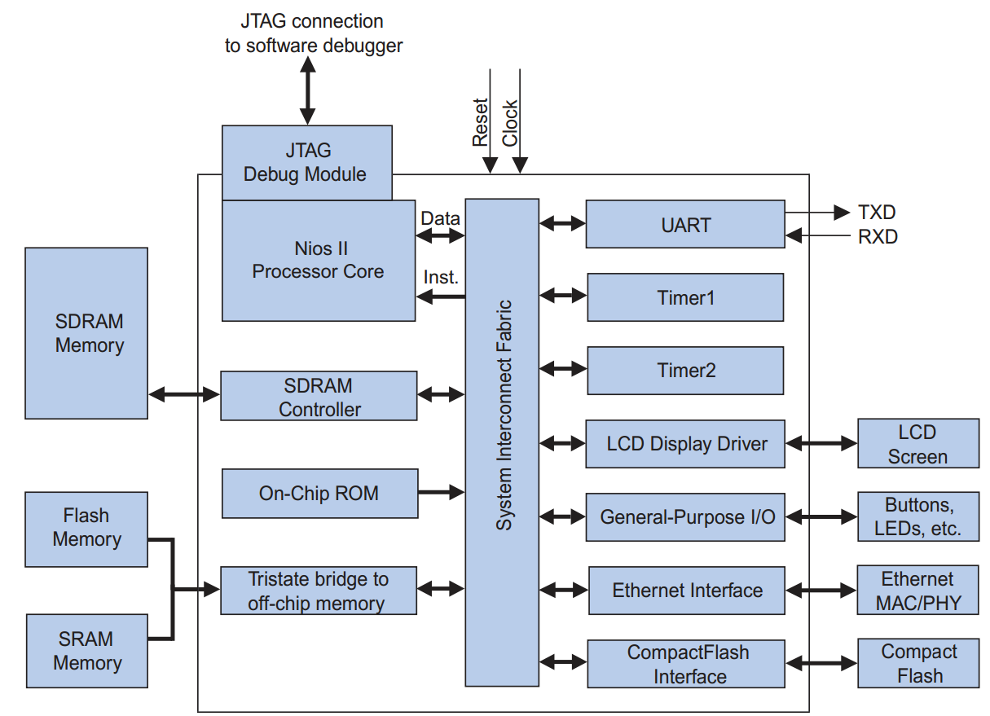
Example Soft Processor System
4/54

Slide 5
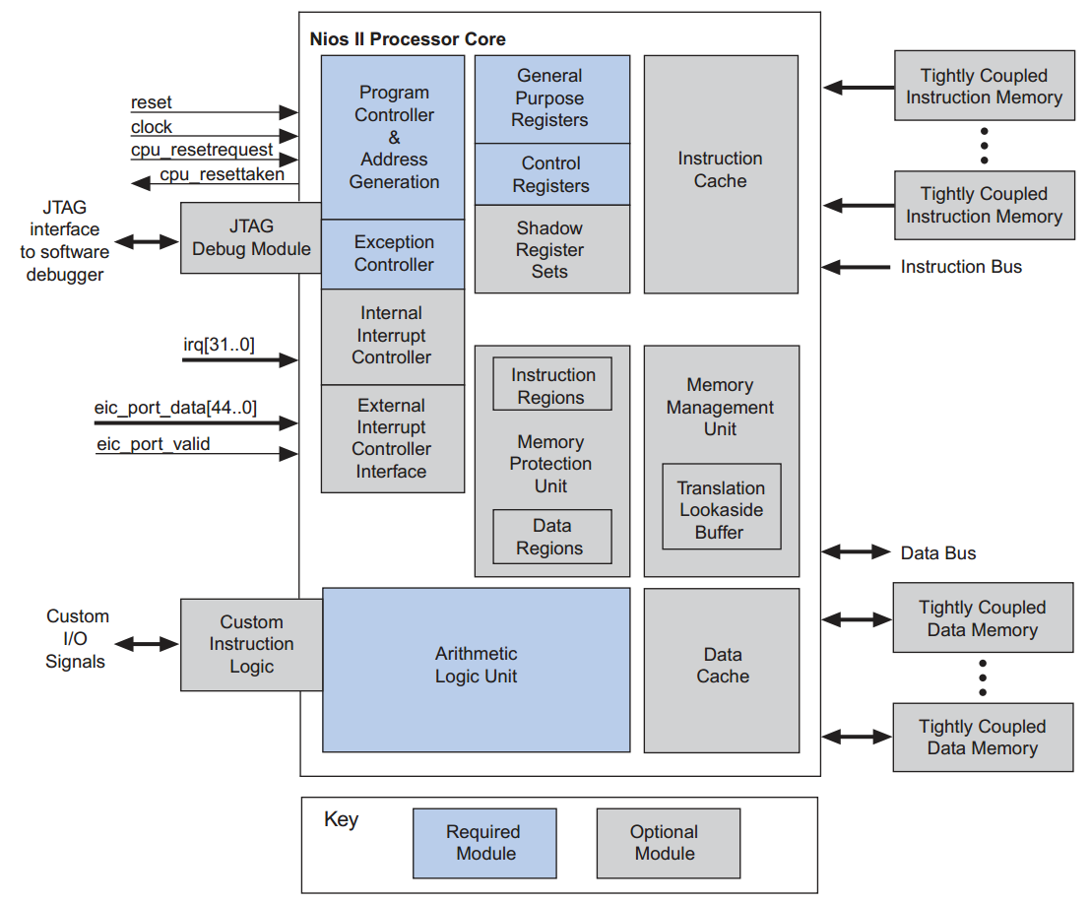
Example Soft Processor Core
5/54

Slide 6
Purpose
Create an environment that automatically generates a customized soft multiprocessor, given a set of architectural specifications
Pipeline depth
Unused instruction removal
Interconnection network topology
Inter-processor communication buffer sizing
Investigate the effects of architectural optimizations on performance, area, and energy consumption across 8 stream-based computing benchmarks
6/54

Slide 7
Soft Processor Architecture
32-bit RISC architecture which implements a subset of MIPS instruction set architecture (ISA)
Does not support:
Caches
Off-chip memory
Branch prediction
Exceptions
Floating Point
7/54

Slide 8
SPREE
Soft Processor Rapid Exploration Environment (SPREE)
Used to generate individual soft processors within the system
Generates synthesizable RTL from high-level architectural descriptions
Configurable Pipeline Depth
Appropriate datapath/control for given ISA subset
Includes communication FIFOs and interface logic
Provides modified MIPS gcc compiler for generating binaries targeted for the customized processor
8/54

Slide 9
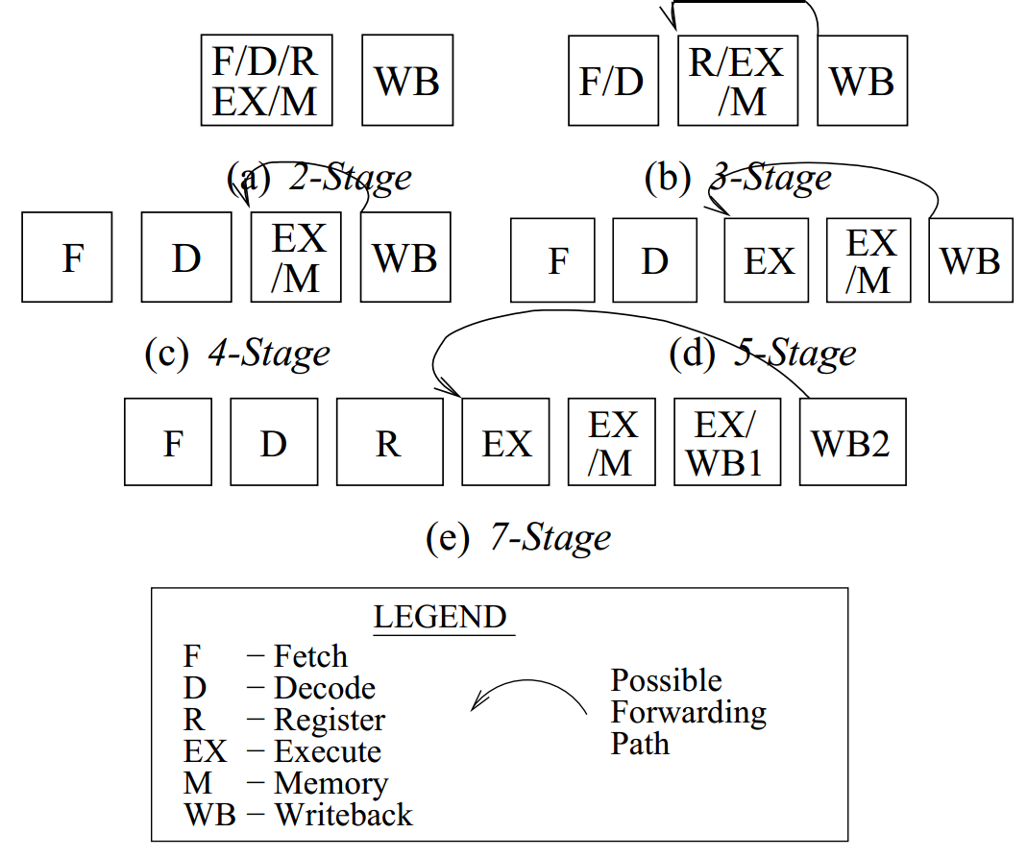
Pipeline Depth Variation
9/54

Slide 10
Instruction Subsetting
Most applications use less than 50% of instruction set
10/54

Slide 11
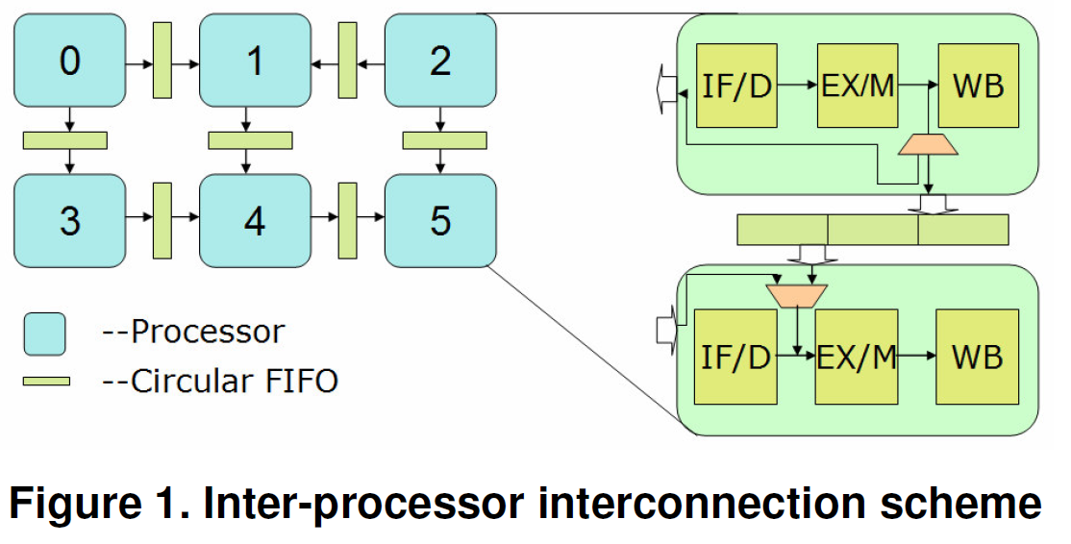
Interprocessor Communication
Processors are connected using unidirectional FIFO buffers
FIFOs tightly integrated into bypass path of processor pipeline using memory mapped I/O ports
FIFO buffer depth will affect application performance
11/54

Slide 12
Mesh vs. Point-to-Point Topologies
Mesh Topology
Adjacent processors communicate directly with one another through FIFO buffer interface
Non-Adjacent processor communication is achieved through a series of inter-processor hops
Any given processor will use at most 8 unidirectional FIFOs (4 directions with separate FIFOs for read and write)
Point-to-Point Topology
Source and destination processors communicate directly with one another
Some processors may have multiple input FIFOs while other may have none
12/54

Slide 13
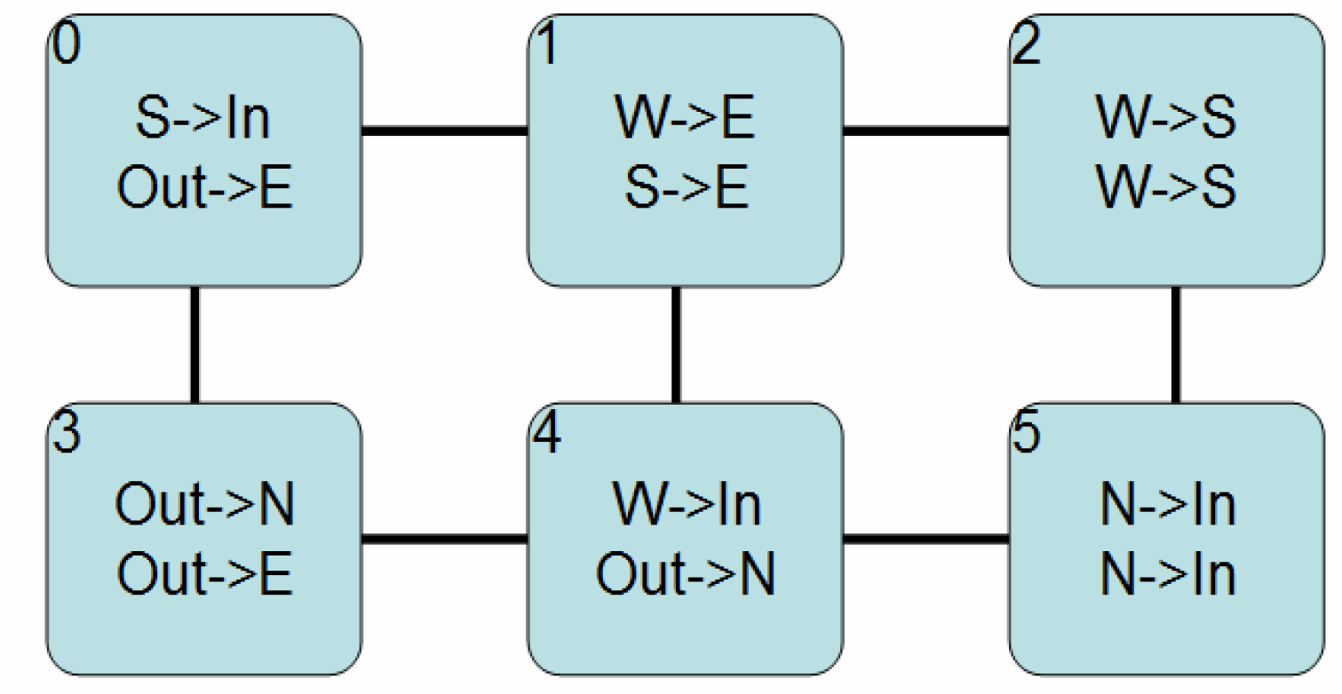
Mesh Topology
13/54

Slide 14
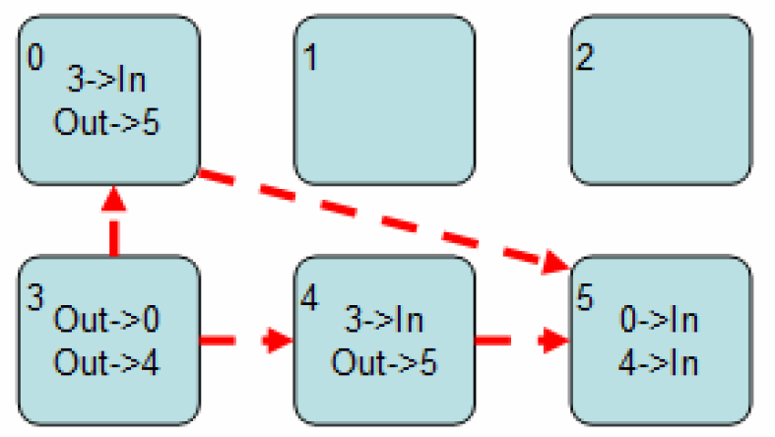
Point-to-Point Topology
14/54

Slide 15
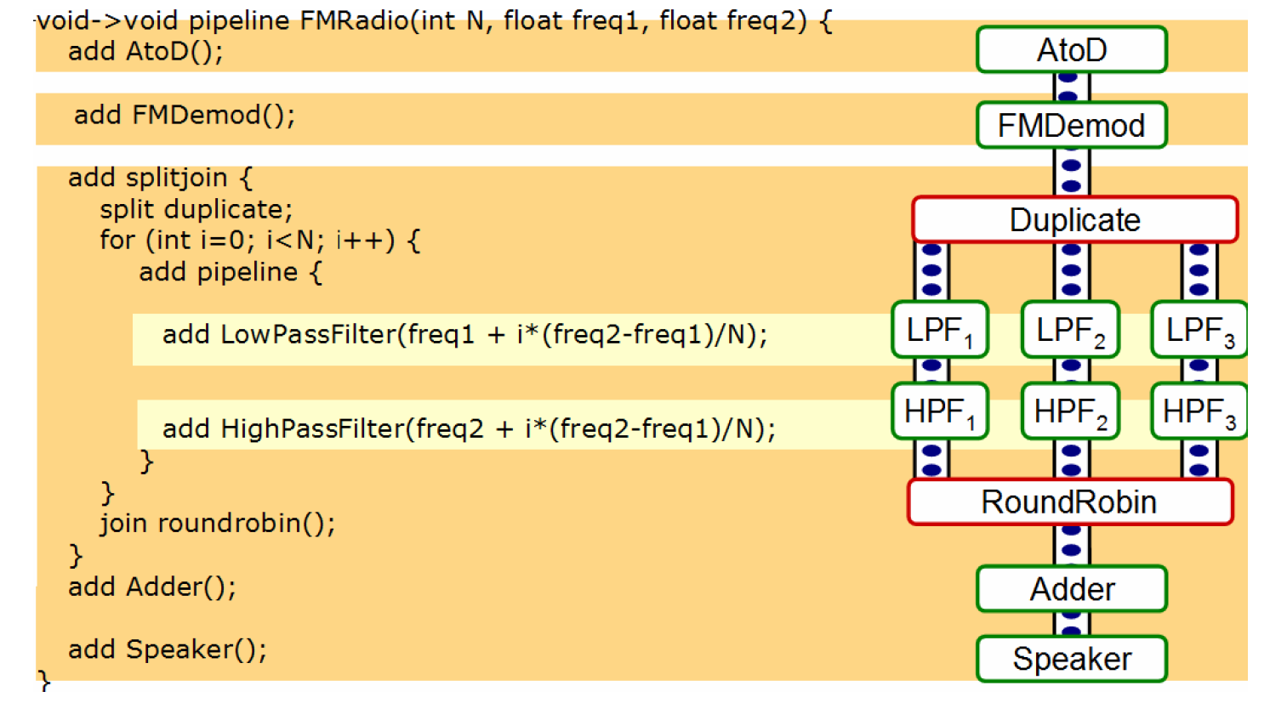
StreamIt
Application Language
StreamIt – High-Level language targeted towards stream-based applications
StreamIt Compiler – Optimized StreamIt compilation for parallel execution across multiple processors
15/54

Slide 16
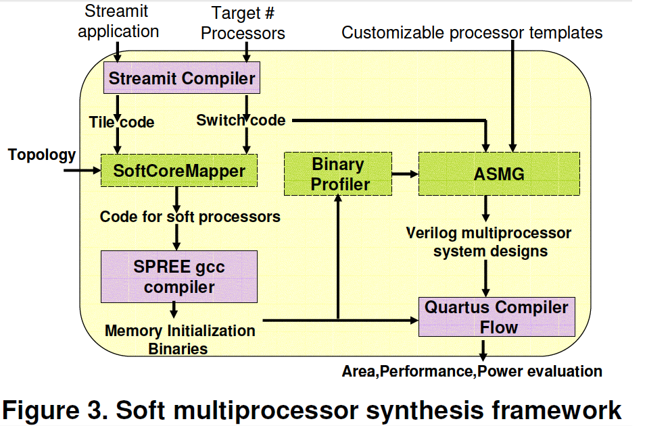
Synthesis Flow
16/54

Slide 17
Results - Pipeline Depth
Optimal: 4-stage pipeline
22% performance increase from 3-stages with 9.6% increase in area
Average design frequency increases 26% from 118 to 149 MHz
Performance and design frequency unchanged from 4 to 5 stages
Reasoning
3-stage critical path between register file and write-back through the branch predictor
4,5-stage critical path through integer multiplier
17/54

Slide 18
Speedup vs. Pipeline Depth
18/54

Slide 19
Results - Interconnection Topology
Optimal - Point-to-point topologies
Outperforms mesh topologies by 1.1x to 2x
Consume 28.6% less cycles
Slightly better design frequency 2%
Key concern - routing
Reasoning
Reduced synchronization overhead from elimination of network hops
Number of links scales linearly with process count
19/54

Slide 20
Results - Buffer Depth
Large applications
Cycle reduction (throughput) increased once a critical size threshold is passed
Small applications
Little benefit from increased buffer size
Due limited inter-process communication
FIFOs superior to communication controllers
Communication Controller - 468 LUTs, 128 flip flops
FIFO - 11 LUTs, 72 registers, 128 memory bits
20/54

Slide 21
Speedup vs. Buffer Size
21/54

Slide 22
Results - ISA Subsetting
Yielded 27% average improvement in area
Mostly from decode logic and control circuitry
Modest 4.2% improvement in maximum design frquency
Power consumption decreased by 30%
Consistent for multiprocessors with 6, 9 and 16 processors
22/54

Slide 23
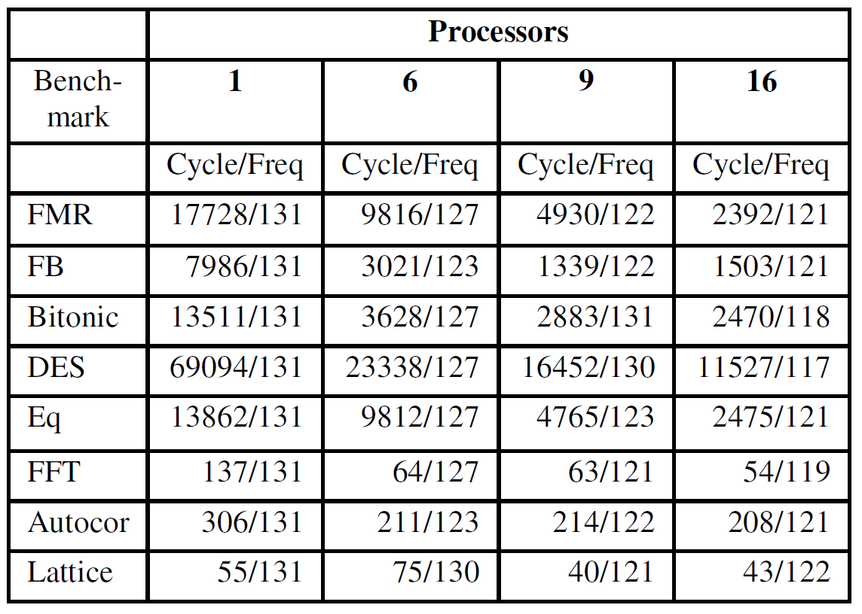
Results - Scalability
Larger applications optimal 5x speedup
Due to inherent application parallelism
Smaller applications degraded by communication overhead
Average 11% frequency degradation
23/54

Slide 24
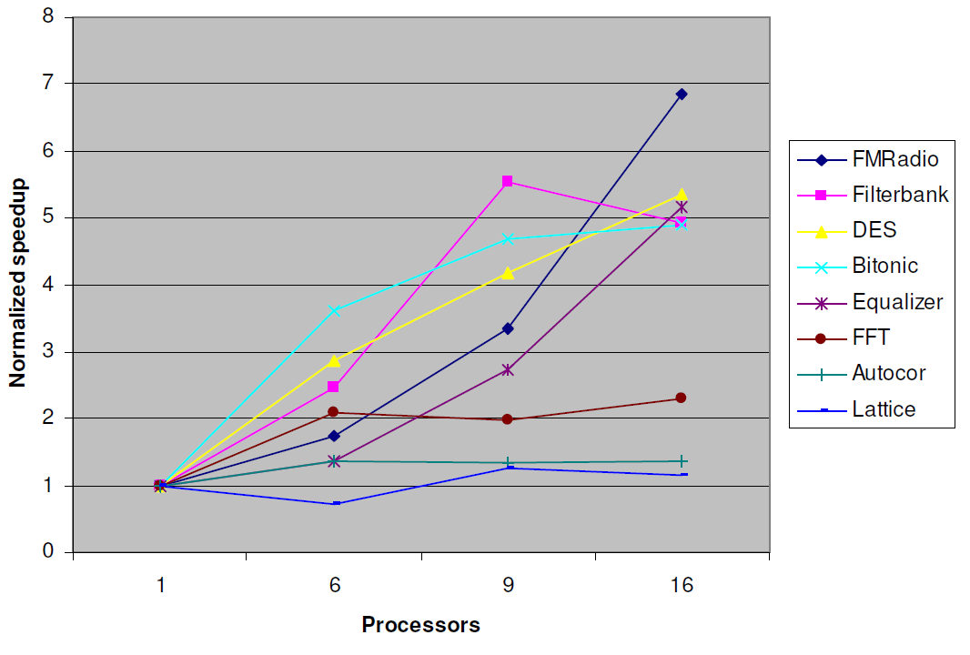
Speedup vs. Number of Processors
24/54

Slide 25
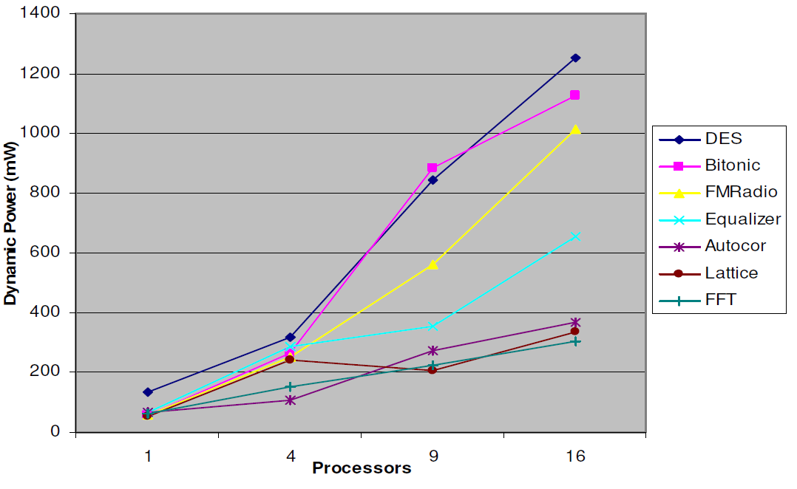
Power vs. Number of Processors
25/54

Slide 26
Results - Combined
Average 2.1x performance improvement
Primary factors
Pipeline depth: 4 stages optimal
Interconnect topology: point-to-point instead of mesh
Instruction sub setting saves area but contributes little to application speedup
26/54

Slide 27
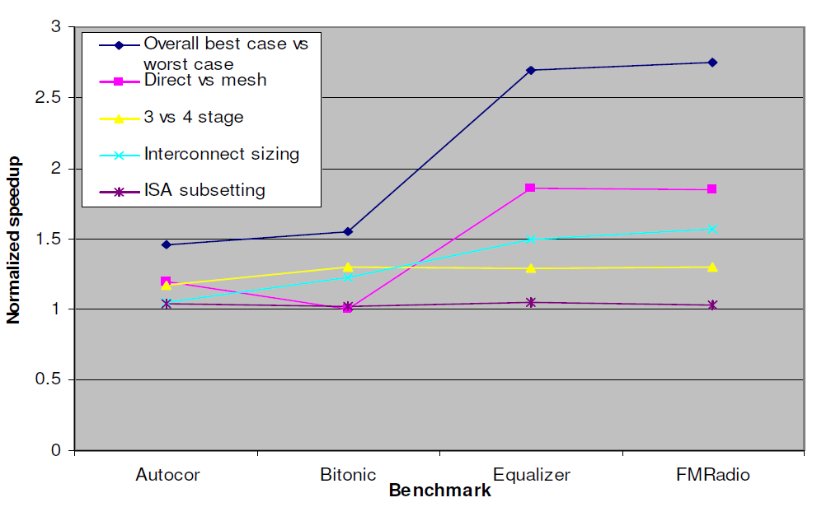
Combined Speed Up
27/54

Slide 28
Future Improvements
Use more complex processors
Soft processor implementations are fairly rudimentary
Does not support common memory interfaces
Smarter pipeline design
Advancing from 4 to 5 stages does not alter the critical path
Research built around specialized tools
Not very portable
28/54

Slide 29
PATS: A Performance Aware Task Scheduler for Runtime Reconfigurable Processors
L. Bauer, A. Grudnitsky, M. Shafique, J. Henkel
Karlsruhe Institute of Technology
Field-Programmable Custom Computing Machines
April 29-May 1 2012, Toronto, ON
29/54

Slide 30
Real Time Operating Systems
Valued based upon response time and predictability rather than throughput
System must adhere to strict deadlines
OS may support either hard or soft deadlines
Our system only supports soft deadlines in which it is acceptable to be fashionably late
Task scheduler responsible for balancing work load while making sure deadlines are met
30/54

Slide 31
Introduction
Multi-tasking is an important attribute for complex embedded systems
Increases resource utilization
Increases system efficiency
Often achieved by incorporating fine-grained reconfigurable fabrics
Coupled with general-purpose processor
Fabric implements Special Instructions (SI)
May reconfigure different SIs during run-time
31/54

Slide 32
Special Instructions
Implemented using accelerators
Accelerators – hardware implementation of task using partial reconfiguration (PR)
May use single or multiple accelerators per SI
Leads to different performance levels
Executed in software when no accelerators available
32/54

Slide 33
Implementation
PATS – Performance Aware Task Scheduler
Goal is to maximize performance during run-time
Monitors tasks based on number of accelerators
Still considers task deadlines
Aims to maximize the number accelerators given to tasks
Wait until accelerators are available or deadline is imminent
33/54

Slide 34
System Overview
Execution of SI
Small look up table (LUT) keeps track of which SIs are configured
During decode stage processor checks LUT
If unavailable – invoke “unimplemented trap” and execute in software
If available – execute SI in hardware and stall pipeline
Accelerators have access to memory hierarchy
Ability to obtain input data and store results
34/54

Slide 35
Managing Reconfigurable Fabric
Prototype utilizes Xilinx Virtex-4
Non-negligible reconfiguration time: 0.6-0.7 ms
Single internal configuration access port (ICAP) means multiple reconfigurations must be done sequentially
Operating system manages reconfiguration
During PR all other accelerators and processor remain operational
Reconfiguration sequence determined using weighted round robin approach
Supports sporadic tasks and periodic tasks without focusing on inter-task dependencies
35/54

Slide 36
PATS vs. EDF
Earliest Deadline First (EDF)
Optimal scheduler for non-reconfigurable systems
Doesn’t consider performance levels at run-time
Scenario
Two periodic tasks T1 and T2 with periods 10ms and 8ms respectively
T1 has two subsequently executing kernels K1 and K2
T1 benefits from accelerators
Both tasks start executing at t = 0ms
36/54

Slide 37
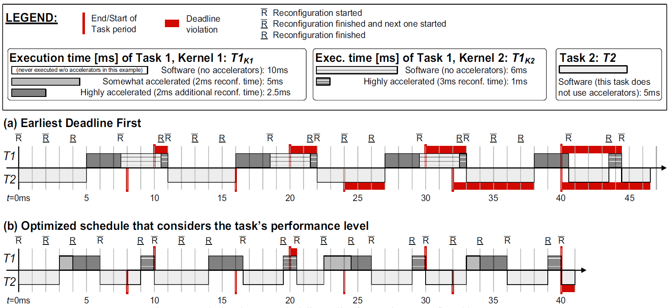
Example
37/54

Slide 38
Example
38/54

Slide 39
Example
39/54

Slide 40
Recap
EDF Results:
System tardiness = 26 ms
7 deadline misses
PATS Results:
System tardiness = 1.5 ms
2 deadline misses
Reasoning:
EDF doesn’t use exploit performance gains (accelerators left idle)
40/54

Slide 41
Scheduling Metrics
Makespan – time when all tasks have completed all of their jobs
Task slack – remaining cycles task is expected to execute until end of its period
Negative slack denotes task that cannot meet deadline
Tardiness – amount of time a job takes to finish after it’s deadline
System tardiness – Sum of tardiness for all jobs
41/54

Slide 42
Task Efficiency Metric
$$Task Efficiency=\left\{\frac{\sum_{SIs invoked in Kernel }{\frac{requested accelerators}{accelerators attained}}}{\left|SIs invoked in Kernel\right|}\right\}$$
Highest efficiency possible is 1
Either all requested accelerators are attained
Or no accelerators were requested (cannot improve)
Lower efficiencies signify lack of resources for optimal solution
42/54

Slide 43
Managing Tasks
Uses 3 queues:
Not Released Queue (NRQ) – cannot be scheduled, waiting on another job
Low Efficiency Queue (LEQ) – can be scheduled but few accelerators are available
Full Efficiency Queue (FEQ) – can be scheduled with all requested accelerators
Executing jobs are not placed into queue
Preemption – executing task interrupt after given time slice to re-evaluate which task should run next
Not supported for SIs executing in hardware
43/54

Slide 44
Using PATS
Input: currently executing task
Output: next task to be scheduled
Calling the scheduler
Time Slice finished
Task finished its period
Task requests a different set of accelerators
New job released from one task
44/54

Slide 45
PATS Algorithm
Insert currently executing task into appropriate queue.
Identify candidate tasks
If no FEQ tasks, consider all LEQ
Else consider all FEQ and LEQ with negative slack
Select one candidate from group
Calculate efficiency for each task
Adjust scores based on the relative slack
Choose the task with the best score
Remove selected task from queue
45/54

Slide 46
Experimental Setup
Test on cycle-accurate SystemC simulator
Important parameters measured from Virtex-4 LX 160 (e.g. reconfiguration time, context switching time, etc.)
Compared against 3 other schedulers
Earliest Deadline First (EDF) – focus on completion time
Rate Monotonic Scheduling (RMS) – focus on priorities
Round Robin (RR) – focus on fairness
46/54

Slide 47
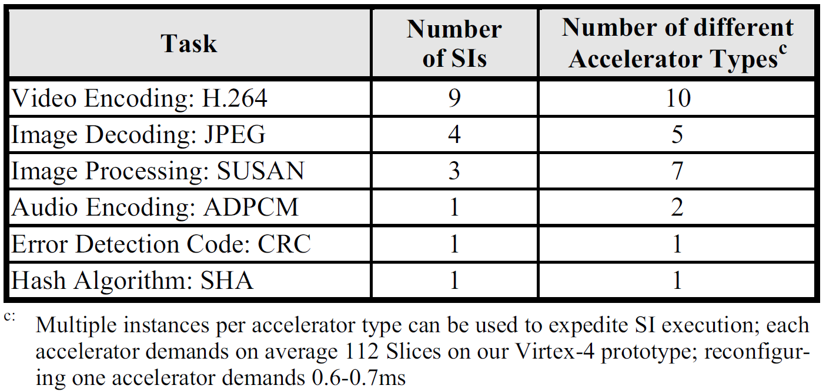
Experimental Tasks
10 different multitasking scenarios
Between 2-6 SI-accelerated periodic tasks
Each task has an individual deadline
Relaxed, normal or tight
47/54

Slide 48
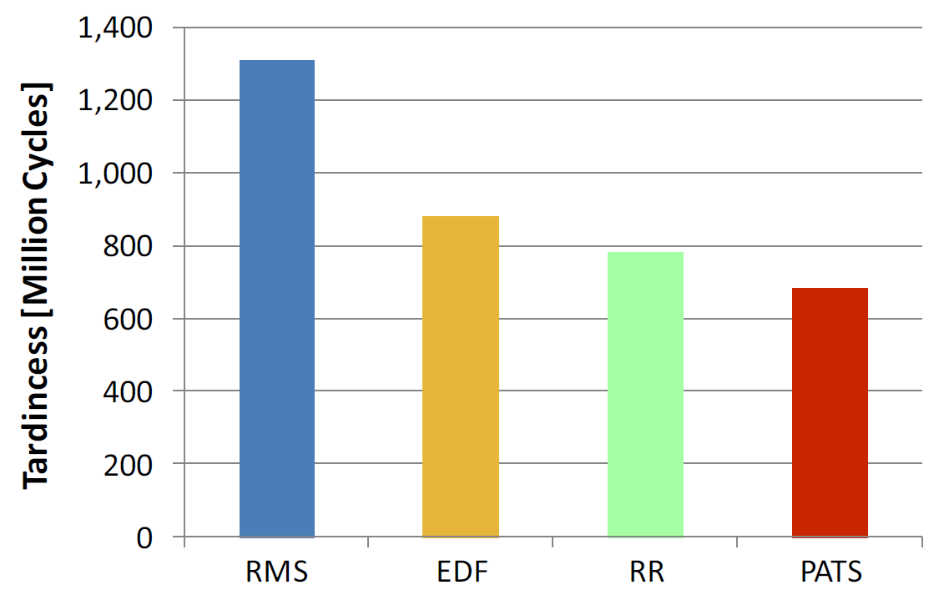
Results – Average Tardiness
System tardiness averaged over all 360 simulations
48/54

Slide 49
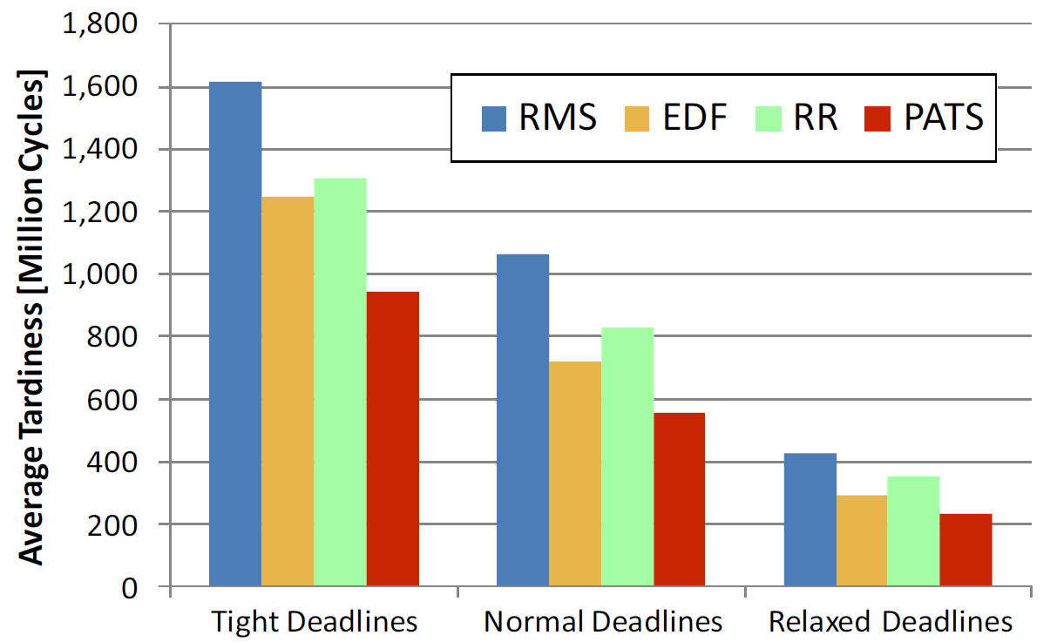
Results – Tardiness by Deadline
49/54

Slide 50
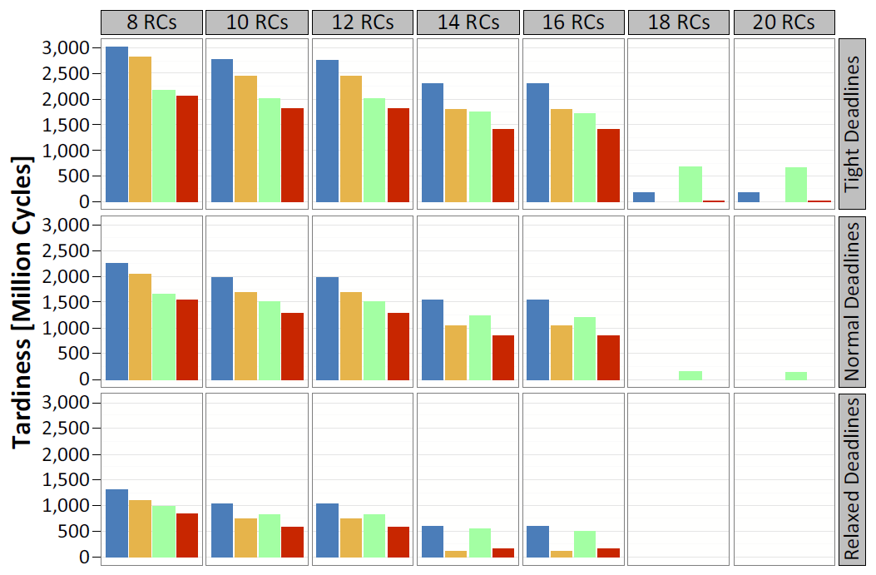
Results – Tardiness based on Reconfiguration Size
50/54

Slide 51
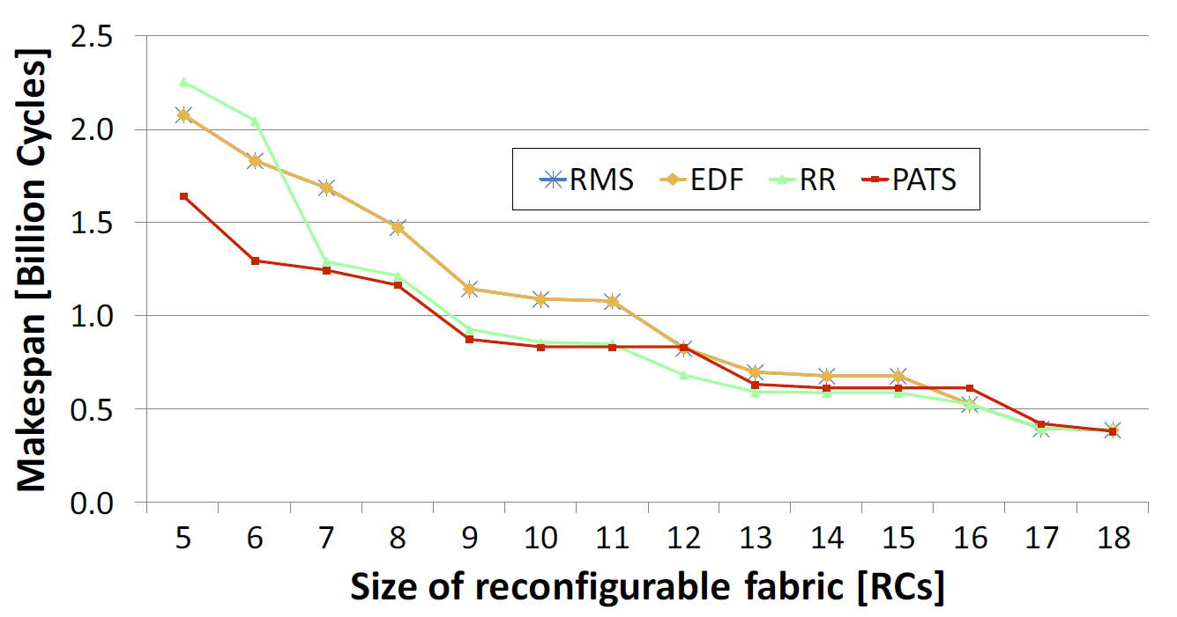
Results - Makespan
51/54

Slide 52
Conclusion
Consistently achieves better system tardiness
1.29x better than EDF
1.92x better than RMS
1.14x better than RR
1.45x better overall
May reduce makespan by up to 1.58x
Better for challenging multi-tasking scenarios with tight deadlines
Especially good for smaller reconfiguration fabrics
52/54

Slide 53
Future Improvements
Cost function for determining task scores could be made to adapt at run-time instead of using a constant weight for α
Allows for tradeoffs between increased performance and meeting deadlines
Interested to see results using other reconfigurable fabrics
How much does hardware characteristics affect the reliability of PATS
Stratix V
53/54

Slide 54
Questions?
54/54

