Slide 1
Real Time Systems
Madhumita Ramesh Babu
Sudhi Proch
0/41

Slide 2
REAL-TIME SCHEDULING WITH REGENERATIVE ENERGY
1/41

Slide 3
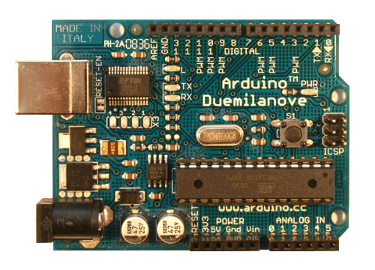



REAL TIME SYSTEMS
Real-time systems are those systems in which the correctness of the system depends not only on the logical results of computation but also on the time at which the results are produced [Stan- kovic 1988].
They span a broad spectrum of complexity from very simple microcontrollers in embedded systems (a microprocessor controlling a robot) to highly sophisticated, complex, and distributed systems (air traffic control).
2/41

Slide 4
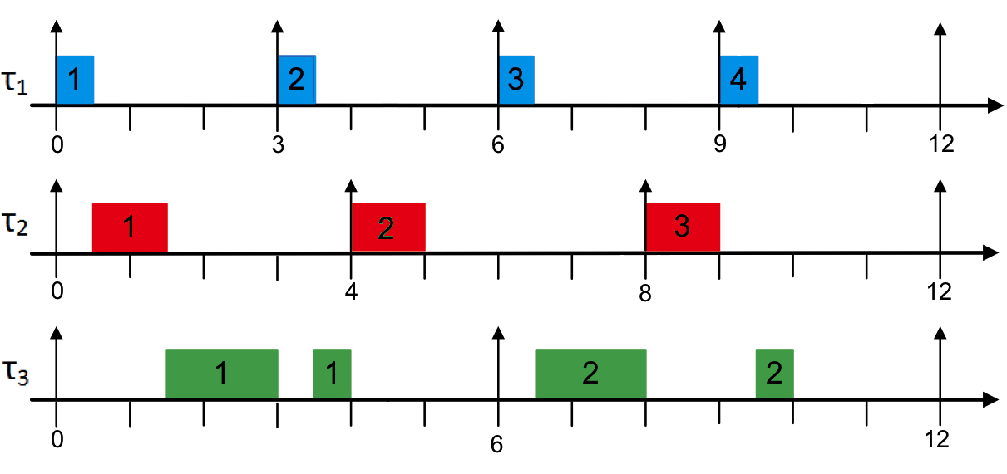
REAL TIME SCHEDULING
Assume that we have a task graph G=(V,T).
If V be the task sets to be done with the time domain T, then V  T would be mapped in G.
Schedules have to respect a set of constraints, such as resource, dependency, and deadlines.
  Scheduling is the process of finding such a mapping.
During the design of embedded systems, scheduling has to be performed several times
3/41

Slide 5
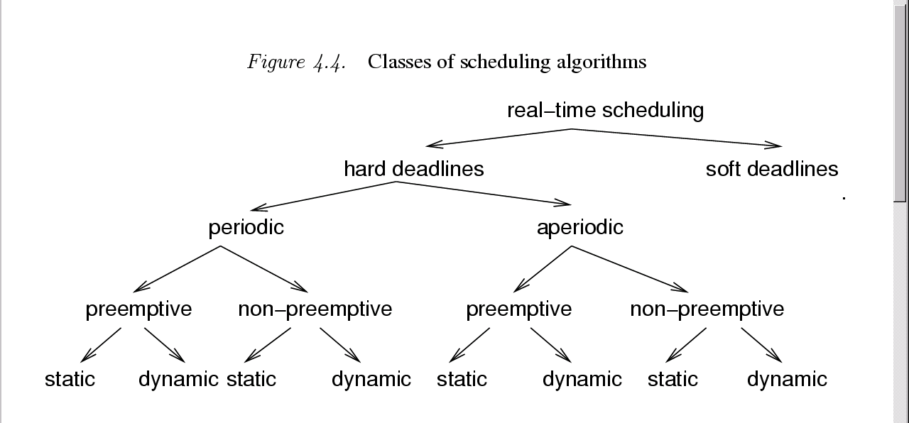
CLASSES OF ALGORITHMS
4/41
Ref: Class lectures- CDA5636 prof.P.Mishra
Notes:
Soft deadlines are the ones where a miss of deadline is accepted some of the times. The threshold is lower and comes with a minimum quality of service guarantee.
Preemptive tasks are the ones that can be dropped in between. Non –Preemptive tasks are the highest priority tasks. Non preemptive tasks are very rare in life but can be found easily in systems that have a concept of priority (Non Premptive tasks are the highest priority task in a system).
Static – is preprogrammed scheduling of the tasks. Dynamic one is controlled by OS at run time
Dynamic scheduling consumes time which takes time out of Real time deadlines. In terms of complexities (instantaneous) dynamic is less because it is looking at less number of tasks at any point of time

Slide 6
SCHEDULABILITY AND COST FUNCTIONS
To examine whether the task has been scheduled in a particular time period, we can carry out:
Exact tests - mostly NP-hard.
Sufficient tests – enough conditions to test a schedule, small chance of negative results.
Necessary tests – checking just the bare minimum conditions. Can be used to show if no schedule exists in some cases.
The cost functions for the tasks are different in different algorithms employed in scheduling, with one aiming for maximum lateness, one on early deadlines and more.
5/41

Slide 7
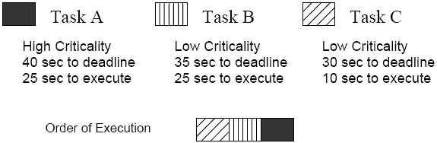
EDF- DEFINITION
Theorem [Horn74]: Given a set of n independent tasks with arbitrary arrival times, any algorithm that at any instant executes the task with the earliest absolute deadline among all the ready tasks is optimal with respect to minimizing the maximum lateness.
Earliest deadline first (EDF): each time a new ready task arrives, it is inserted into a queue of ready tasks, sorted by their deadlines. If a newly arrived task is inserted at the head of the queue, the currently executing task is preempted.
6/41

Slide 8
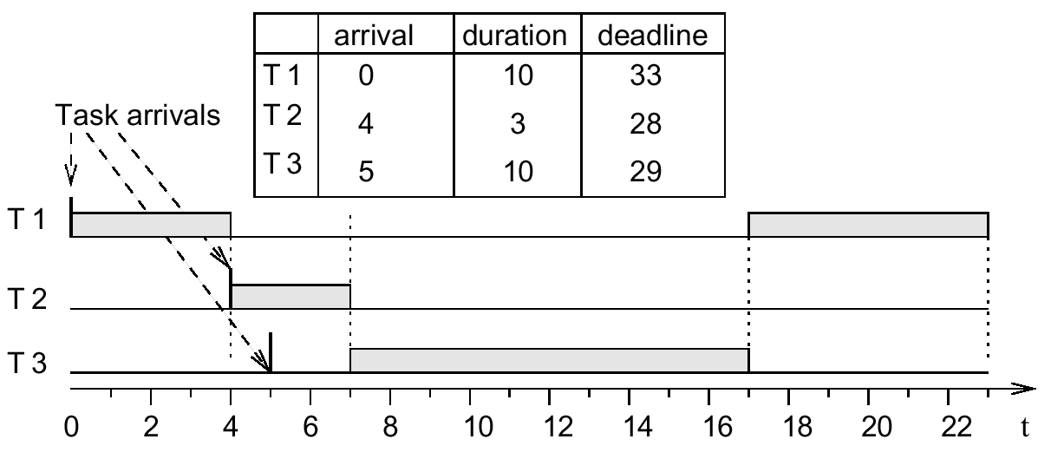
EDF EXAMPLE
Earlier deadline
☞ preemption
Later deadline
☞ no preemption
7/41
Ref: Class lectures- CDA5636 prof.P.Mishra

Slide 9
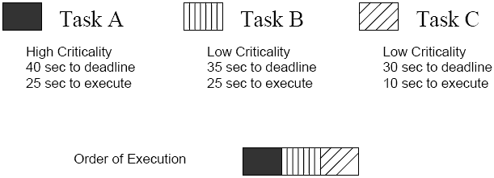
LATEST DEADLINE FIRST
Among tasks without successors select the task with the latest deadline
Remove this task from the precedence graph and put it into a stack
Repeat until all tasks are in the stack
The stack represents the order in which tasks should be scheduled
LDF is optimal.
8/41

Slide 10
REAL-TIME SCHEDULING WITH REGENERATIVE ENERGY
Investigation of real time scheduling in system where replenishment of energy is done by an environmental source.
A task can be completed only if energy requirements are satisfied.
Thus, things to be taken into account include:
  Energy source
  Capacity of the energy storage
  Power dissipation of single tasks
9/41

Slide 11
WHY EDF NOT SUITABLE IN THIS CASE
10/41
Notes:
Let us consider a node with an energy harvesting unit that replenishes a battery with constant power. Now, this node has to perform an arriving task ”1” that has to be fin- ished until a certain deadline. Meanwhile, a second task ”2” has to be executed within a shorter time interval that is again given by an arrival time and a deadline. In Figure 1, the ar- rival times and deadlines of these tasks are indicated by up and down arrows respectively. As depicted in the top di- agrams, a greedy scheduling of task ”2” since it dispenses overhasty the stored energy by driving task ”1”. When the energy is required to exe- cute the second task, the battery level is not sufficient to meet the deadline. In this example, however, a scheduling strategy that hesitates to spend energy on task ”1” meets both deadlines. The bottom plots illustrate how the Lazy Scheduling paradigm described in this paper outperforms a naive, greedy approach like EDF in the described situation.
strategy violates the deadline

Slide 12
WHAT PAPER TALKS ABOUT
Thus, scheduling algorithm which is not only energy-aware but truly energy-driven.
Energy, contrary to time, can be stored as a resource.
Previous work involved switching of active and sleep modes, offline scheduling, and Dynamic Voltage scaling mechanisms.
In this paper, we shall consider sensor nodes, which are energy constrained and energy demand is fixed. (no DVS). ( if harvested power is sufficient for continuous operations)
11/41

Slide 13
NOTATIONS USED
Notations that would be followed from here:
Harvested energy converted into electrical power PS (t).
Device’s capacity C.
The stored energy, EC < C.
Power drained from storage, PD(t) .
Tasks with arrival time ai, energy demand ei and deadline di.
12/41

Slide 14
PICTORIAL DEFINITION
13/41

Slide 15
CALCULATION OF VALUES
The respective energy ES in the time interval [t1, t2] is given as :
energy variability characterization curves (EVCC) that bound the energy harvested in a certain inter- val ∆: The EVCCs εl(∆) and εu(∆)with ∆ ≥ 0 bound the range of possible energy values ES as follows:
14/41

Slide 16
FINISHING TIME VALUE
If the node decides to assign power Pi(t) to the execution of task Ji during the interval [t1 , t2 ], we denote the corresponding energy Ei (t1 , t2 ). The effective starting time si and finishing time fi of task i are dependent on the scheduling strategy used: A task starting at time si will finish as soon as the required amount of energy ei has been consumed by it. We can write
15/41
Notes:
We see that the actual running time (fi − si) of a task i
is strongly dependent on the amount of power Pi(t) which
is driving the task during si ≤ t ≤ fi. In the best case,
energy source S P (t) SS
energy storage C computing device D
E (t)
l ε(∆i)
PS(t)
C C
it is processed without interrupts and with the maximum power Pmax

Slide 17
LSA-I for unlimited power Pmax
16/41
Notes:
Note that the LSA degenerates to an earliest deadline first (EDF) policy, if C = 0. On the other hand, we find an as late as possible (ALAP) policy for the case of C = +∞.

Slide 18
LSA II
In summary, LSA-II can be classified as an energy- clairvoyant adaptation of the Earliest Deadline First Algorithm.
It changes its behaviour according to the amount of available energy, the capacity C as well as the maximum power consumption Pmax of the device.
For example, the lower the power Pmax gets, the greedier LSA-II gets.
On the other hand, high values of Pmax force LSA-II to hesitate and postpone the starting time s.
For Pmax = ∞, all starting times collapse to the respective deadlines, and we identify LSA-I as a special case of LSA-II.
17/41

Slide 19
LSA-II for limited power Pmax
18/41

Slide 20
Optimality proof for LSA I+II
A deadline cannot be respected since the time is not sufficient to execute available energy with power Pmax. At the deadline, unprocessed energy re- mains in the storage and we have EC (d) > 0. We call this the time limited case.
A deadline violation occurs because the required en- ergy is simply not available at the deadline. At the deadline, the battery is exhausted (i.e., EC(d) = 0). We denote the latter case energy limited.
19/41

Slide 21
THEOREM 1
20/41

Slide 22
THEOREM 2
21/41

Slide 23
SIMULATION RESULTS
Figure 7 depicts the value of power used in the studies and
Figure 8 determines the value of successful tasks over the capacity C.
22/41

Slide 24
PERFORMANCE RESULTS
23/41

Slide 25
CONCLUSIONS AND IMPROVEMENTS
Thus, optimality proved on basis of lazy algorithms.
Determines amount of energy required to be stored to maintain perpetual operation.
Appropriate characterization of the energy source approximates future produced energy.
But slack period is not utilized.
DVFS mechanisms can be employed to improve energy utilization.
24/41

Slide 26
Harvesting Aware Power management for real time systems with renewable energy
Shaobo Liu,Jun Lu, Qing Wu and Qinru Qiu
IEEE Transactions on Very Large Scale Integration, TVLSI, 2012
25/41

Slide 27
Introduction
Motivation – Low power is good
Power management for Real time (RT) system - Challenges
Power management in Harvesting Aware RT (HA-RT) system – What is different?
HA-DVFS – overview
  HA-DVFS – individual steps in detail
Experimental results
Conclusion and Improvements
26/41

Slide 28


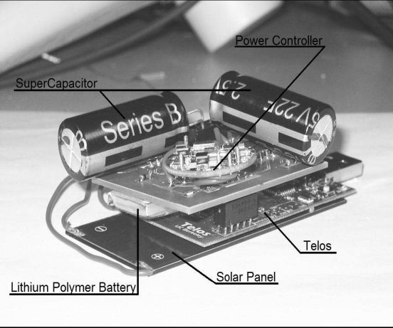
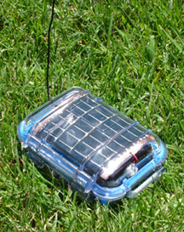
Low power is good
Especially true for portable devices - Limited power budget and longer single charge operation
More critical for devices that are difficult to recharge, like remote sensors
  Mission Critical deployment
  Need to run for far greater periods than conventional portable devices.
  Deployed in difficult terrain
One of the solutions is to use energy harvesting unit
27/41

Slide 29
Power Management(PM) for RT systems
Meeting task deadlines is critical performance parameter (Primary Objective)
Low power operation is desirable to maximize operating life/single charge operation – Limited energy source RT system
Challenge – Balance tradeoff between performance(task deadlines) and low power operation (DVFS and DPM)
  E(dyn) α V² and Freq α V
  Power mode switch incurs penalty overhead
  Solve for both time and energy constraints
Common to use low power modes after ensuring time constraints are met – Slack reclamation using EDF/RM scheduling
  How to distribute the slack across tasks is an important area of study
28/41

Slide 30
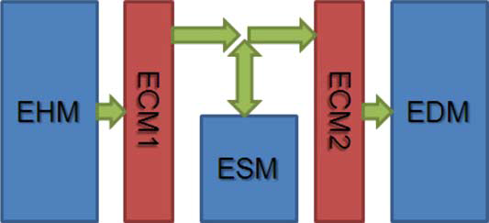
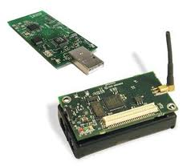


Power Management for HA-RT system
Real time systems with Energy Harvesting unit
Energy Harvesting Module
Energy Storage Module
Energy dicharging Module
29/41

Slide 31
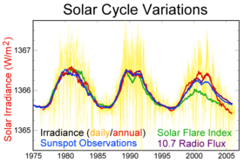
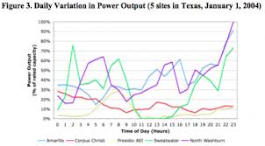
PM for HA-RT system - Challenges
Harvesting unit energy output is not constant due to variation in energy source
Limited storage capacity
  Size and form factor limitations
  Limits on recharge capability make it challenging
Unlike normal battery operated system, available energy is unknown
  System can be energy rich or deficient depending on tasks and harvesting unit status
  Accurate Forecasting is a challenge due to the nature of energy source.
30/41

Slide 32
PM for HA-RT system – Objectives
Good energy forecasting model
  Regression analysis
  Moving Average based on defined window
  Exponential smoothing – more biased towards recent data
Scheduler that meets time deadlines with the lowest energy of operation – Maximize service guarantee
  Solve for time and energy simultaneously – Complex
  Solve for time constraints first and then optimize for energy – simpler approach
  Must combine stored energy with future energy availability prediction
Two choices when excess energy is available :
  Do nothing OR
  Take advantage by speeding up the tasks
  Transfer slack to future tasks – maximize opportunity for low power operation
Harvesting Aware Dynamic Voltage and frequency scaling algorithm
Or HA-DVFS
31/41

Slide 33
HA-DVFS : Terminology
E_{H}(t₁,t₂) – Harvested Energy between time t₁ and t₂
E_{cap} – Energy capacity of the Energy storage unit
E_{th-low} – lower threshold of sufficient energy level
E_{c}(t) – Stored energy at a particular time
  For Normal operating mode E_{th-low} ≤ E_{c}(t) ≤ E_{cap}
E_{D}(t1,t2) – Energy drained by the system between time t1 and t2
Slowdown factor : S_{n} = F_{n}/F_{max}
  F_{n} – Frequency of the task
  F_{max} – Max operating frequency (highest Dynamic Power level)
32/41

Slide 34
HA-DVFS Step1 – Initial schedule
Tn (arrival time, deadline, worst case execution time)
T1
(0,8,2)
T2
(0,10,4)
T3
(0,3,1)
T4
(0,5,2)
Sort with EDF
EDF + Lazy scheduling guarantee timing constraints are met
T1
2
T2
4
T3
1
T4
2
Lazy Scheduling –
Last to first
All tasks scheduled for full speed(max power mode)
Last deadline
Energy
delay
T3
1
T4
2
T1
2
T2
4
0
1
2
4
6
10
Time
33/41

Slide 35
HA-DVFS Step2 – Workload balancing
Iterative search for the lowest power mode that meets deadlines
T1(0,11,2), T2(0,20,4), T3(0,3,1), T4(0,5,2)
Step -1
Energy
delay
T3
1
T4
2
T1
2
T2
4
0
1
2
3
5
8
10
16
20
Time
Step -2A – Power mode 1
F1 = Fmax/2
T4
2
Energy
T3
2
T4
4
T1
4
T2
8
0
1
2
4
6
8
16
20
Time
Step -2B – Power mode 2
F1 = Fmax/2.5
T4
2
Energy
T3
2.5
T1
5
T2
10
T4
5
0
1
2.5
4.5
7.5
9.5
19.5
20
Time
34/41

Slide 36
HA-DVFS Step3 : Check available Energy
Run time dynamic adjustment of task schedule based on available energy.
Energy sufficiency condition for a task (low threshold = 0) -
E_{C}(st_{m}) + E_{H}(st_{m}, ft_{m}) < E_{D}(st_{m}, ft_{m})
st_{m}: Start time for task
ft_{m}: Finish time for the task;
Objective - Calculate dl_{m} – Time duration for delay of a energy deficient task
35/41

Slide 37
HA-DVFS Step3 : Check available Energy – cont.
E_{d} @ 0.8
Shortfall = 0.8
Duration
T1 = T2 = 6
St1 = 50
St2 = 56
4
Deadline T1
Deadline T2
E_{h} @ 0.5
Energy
2
1
Task failure
50
52
54
56
58
60
62
64
68
Task time adjustment as per Algorithm
Surplus = 0.2
St1 = 52
St2 = 58
4
Deadline T1
Deadline T2
E_{h}@0.5
Energy
2
E_{d}@0.8
50
52
54
56
58
60
62
64
68
36/41

Slide 38
HA-DVFS Step4 : Avoid wastage – transfer slack
Useful Overflow vs Not useful overflow
Definition : Energy overflow must occur at a point where speedup of current task with increased energy consumption results in a benefit transfer to future tasks
Energy Overflow predicted
T2
T2
T1
T1
T1
T2
Energy
T1
T2
st_{m}
ft_{m}’
ft_{m}
St_{m+1}
ft_{m+1}
st_{m}
ft_{m}’
ft_{m} =St_{m+1}
ft_{m+1}
Speedup Tm
Energy Overflow predicted
Speedup Tm
Transferred slack
Slack transfer does not reduce energy available for future tasks
37/41

Slide 39
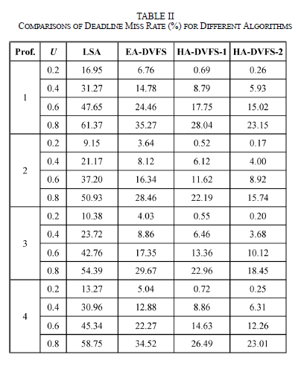
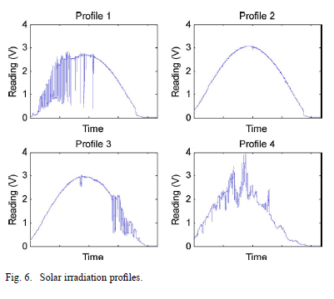
Experimental results
Uses Synthetic task set used in other related work
Run for different solar profiles
Data collected for different processor utilizations
38/41

Slide 40
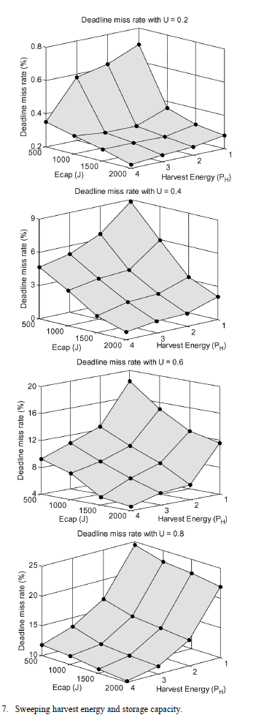
Experimental results - cont
Effect of sweeping harvest energy availability and storage capacity
Obvious that lowest deadline misses occur when harvest energy is high and storage capacity is high.
Processor utilization increase increases deadline misses relatively (less available slack to manipulate at high operating power mode)
Storage capacity for zero deadline miss
  6% of LSA and 12% of EA at low util
  70-75% of LSA at higher Util
39/41

Slide 41
Conclusion
Harvesting aware scheduling algorithm was presented that utilizes voltage and frequency scaling (DVFS) to achieve energy efficient operation
Algorithm has four major steps
  Initial scheduling – Lazy like algorithm that ensures time deadlines are met
  Workload balance – Use DVFS to exploit task slacks for lower energy operation
  Reschedule tasks based on energy availability. Delay if energy targets can be met along with deadlines.
  Exploit Excess energy (overflow) to speed up tasks and transfer slack to future tasks.
Scheduler solves for time and energy constraints separately – simpler approach
Improvement over pure Lazy algorithm and Energy Aware scheduler
40/41

Slide 42
Improvements
Does not take in to consideration any overheads due to power mode switches.
  Might not be beneficial if mode switch energy offsets the benefit
Distributes slack from overflow evenly among future tasks.
  Might not be most efficient.
  More energy demanding tasks might require more slack
Assumes fixed energy cost of tasks
  Model should be enhanced to model energy use of tasks as a dynamic function of both time and temperature
  Might not be beneficial to always run tasks at maximum power level to exploit energy overflow (thermal effect causing increased energy for future tasks). Decision should be based on energy weight of tasks
41/41

