Slide 1
Bulbul Rath EEL 6935- Embedded System Seminar
Memory/Cache Optimization Techniques
04/02/2013
1

Slide 2
An Integrated Approach to Reducing Power Dissipation in Memory Hierarchies
Jayaprakash Pisharath
Department of Electrical & Computer Engineering
Northwestern University
Evanston IL 60208
Phone: 1–847–467–2299
jay@ece.northwestern.edu
Alok Choudhary
Department of Electrical & Computer Engineering
Northwestern University
Evanston IL 60208
Phone: 1–847–467–4159
choudhar@ece.northwestern.edu
2

Slide 3
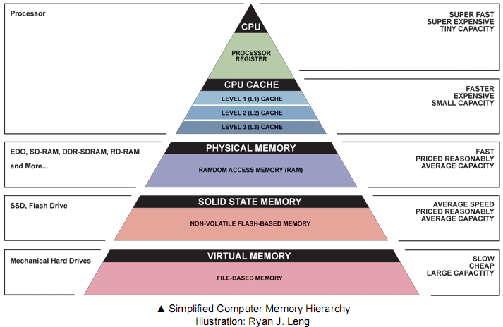
Introduction
Immense power requirements of integrated circuits.
Memory-Common candidate for low power design.
Deployment of different power modes based on the idleness of processors – effective to reduce energy consumption
Drawback: Resynchronization overhead ( Hardware goes from idle to active state).
3

Slide 4
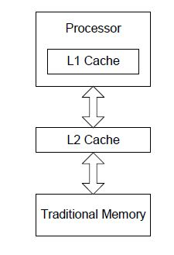
Previous Work:-
Reduce leakage energy in instruction cache.
Compiler and hardware based approaches to reduce cache misses.
And so on.
Present Objective- to integrate all the aspects of power reduction and reach at an optimal solution.
Basis for this paper’s work:-
the different operating modes of RDRAM are exploited to improve the energy-delay product.
Wattch method – power evaluation methodology within the portable and familiar SimpleScalar [2, 9] framework. (D. Brooks, V. Tiwari, and M. Martonosi. Wattch: A Framework for Architecture-Level Power Analysis and Optimizations, in Proceedings of the International Symposium on Computer Architecture (Vancouver, Canada,2000), ACM Press, pp. 83-94.)
Fig1.
Traditional memory
4

Slide 5
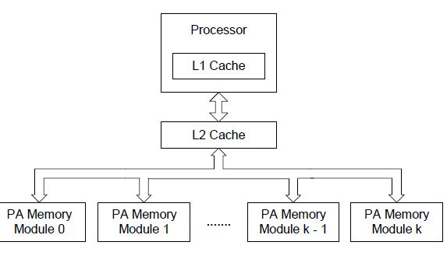
POWER-AWARE PAGE ALLOCATION(Base Model)
Power-Aware DRAM model (PADRAM):-
Memory modules can exist in different power modes.
RDRAM functions in one of the four power modes,
>active- consumes maximum energy.
>standby
>nap
>power-down-consumes minimum energy.
A memory module will gradually go down to a lower-power state based on the number of cycles it remains inactive.
A memory module in a low-power state is reactivated on a read or write operation.
5

Slide 6
Fig a.Traditional memory without any power-aware schemes
Fig b.Equivalent power-aware (PA)DRAM implementation with power-aware memory modules. Traditional cache with all sets active.
6

Slide 7
PADRAM Page Allocation
Sequential first touch page placement policy:
Allocates pages sequentially in a single memory module until it gets completely filled.
All the pages restrict themselves to
fewer memory modules than is the case for random placement, where pages are spread across all memory modules.
Disadvantage: Although power saving, PADRAM scheme incurs a sizeable delay and an additional power dissipation during resynchronization of the memory modules.
7

Slide 8
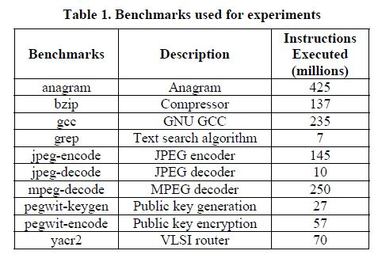
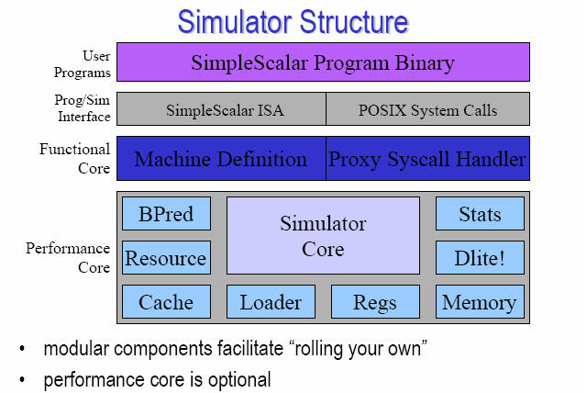
Experimental Setup
SimpleScalar/Arm architecture simulator modified to incorporate a detailed power model.
Benchmarks - binaries of applications from the SPECint2000 suite, Mediabench suite and some other custom applications.(Table1 gives a list )
8

Slide 9
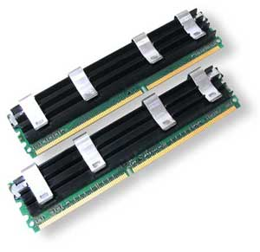
Comparative study
Comparison is made with respect to a traditional memory hierarchy.
The memory delay due to the introduction of new schemes is measured using their corresponding access times.
For instance :
the access time for traditional traditional memory hierarchy
(as seen from the L1 cache) is given by:
tTM = hL1 ⋅ tL1 + mL1 ⋅ ( hL2 ⋅ tL2 + mL2 ⋅ tMEM )
hL1 and hL2 -> hit ratios of L1 and L2 caches,
mL1 and mL2 -> miss ratios of L1 and L2 caches,
tL1, tL2 and tMEM -> times taken to access L1, L2 caches and memory respectively.
Power model is based on the Wattch [8] model. This has been incorporated within the existing framework of SimpleScalar and modified for the purpose of introducing new schemes.
9

Slide 10
Performance of Power-Aware memory scheme
Measured the energy and access times for each of the selected benchmarks.
Evaluated the energy-delay product of the entire memory hierarchy for each of the proposed schemes.
Measured relative performances of the new schemes are using simple ratios, with the energy consumed by additional buffers being calculated explicitly.
Performance tests:-
Test cases varied in the threshold for memory state transitions (the number
instructions for which the memory remains in a particular energy state.)
The results of memory delay,energy and energy delay product ratios are plotted.
Some notations are explained below:
FFnap and FFstdby - memory modules go directly to nap and stand-by states.
FF100 and FF1000 - sequential first touch policy (with 100 and 1000 instructions
as the threshold for transition to the next power state) is used for replacement.
RND100 and RND1000 - random page replacement policies.
10

Slide 11
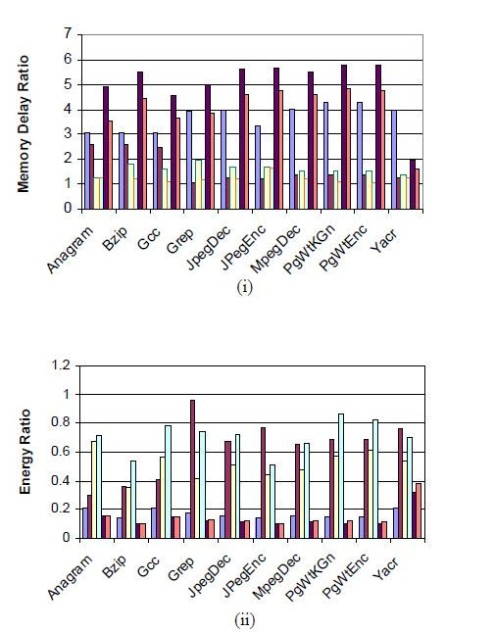
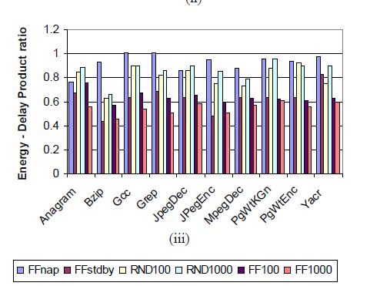
Memory delay (i), energy (ii) and energy-delay
product ratios (iii) for a 512MB PADRAM scheme with
sixteen 32MB modules
11

Slide 12
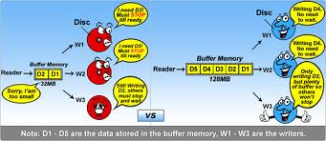
ON-CHIP ENERGY SAVER BUFFERS(ESB)
Addresses the resynchronization delay and additional power dissipation issue of PADRAM.ESB reduces the frequency of memory module reactivations.
ESB is an onchip memory module. Implemented as logically separated buffers within a single chip along with the L2 cache (owing to their small size). The cache controller is responsible for a harmonious communication between the two.
The L2 cache has exclusive read/write access to ESBs.For read/write operations directed to the memory, the bus is accessed.
Existing hardware technologies can be used for implementing the new power aware memory hierarchy and hence, addition of ESB is an economic solution.
12

Slide 13
ESB protocol
If a memory read is initiated, before going to the memory module (which might be in a low-power state) the ESB of the corresponding module is searched for the word line. If the data is found, the delay and the power associated with the read operation are reduced since the ESB is located near the L2 cache.
If the word-line is not found in the ESB, the corresponding memory module is activated for a read. All the “dirty” lines in the ESB are first written back to the memory module. All lines of the ESB are invalidated. The data is read from the corresponding memory module to L2 cache.
If a memory write is initiated and if the L2 cache is full, “dirty” data is written back to the ESB of the corresponding memory module and not to the memory module itself.
If an ESB is full, the corresponding memory module is activated, the entire content of the ESB is flushed, and the ESB lines are invalidated.
13

Slide 14
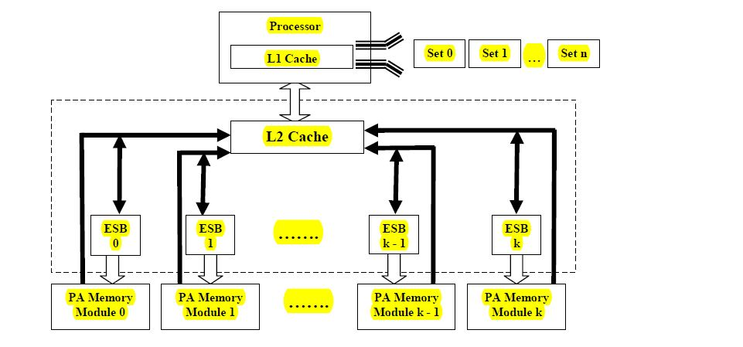
Schematic showing the addition of on-chip Energy-Saver Buffers to a power-aware memory hierarchy. Dotted line shows the chip boundary. Energy-Saver Buffers reside in the same chip as L2 cache. These buffers reduce the number of
times the PA memory modules get reactivated.
14

Slide 15
Dynamic Cache
Power aware caching scheme.
Allocates cache sets depending on program needs.
The memory and hence the cache access patterns are carefully studied and then the number of active cache sets are dynamically enabled or disabled.
The next figure slides describe the detailed algorithm of the dynamic cache system.
The plot following the flowchart depicts the memory delay, energy, energy delay product ratios of the memory hierarchy comprising of dynamic cache and PADRAM without any ESB.
15

Slide 16
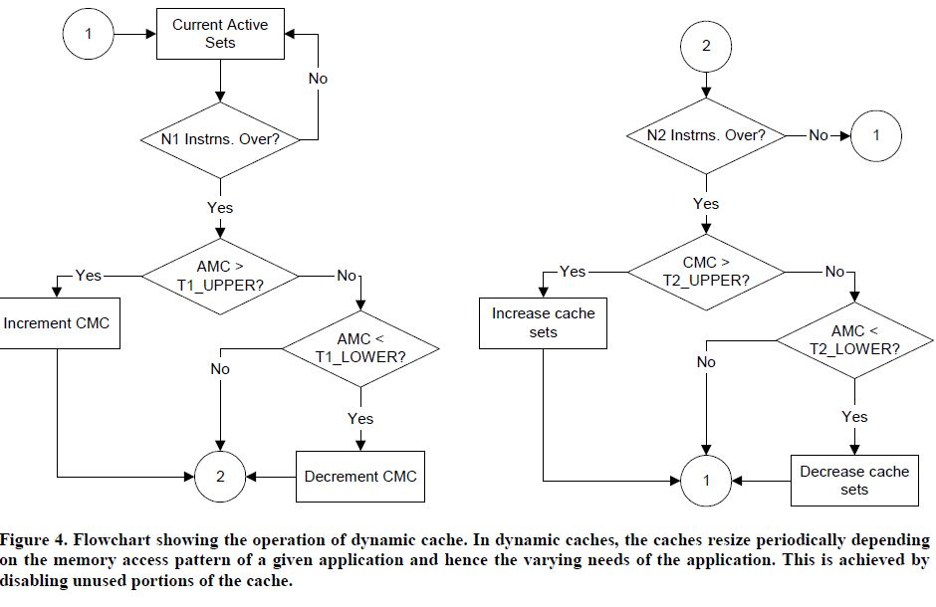
Dynamic Cache Flowchart
16

Slide 17
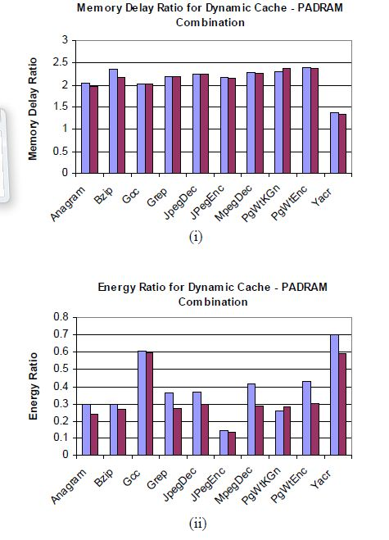
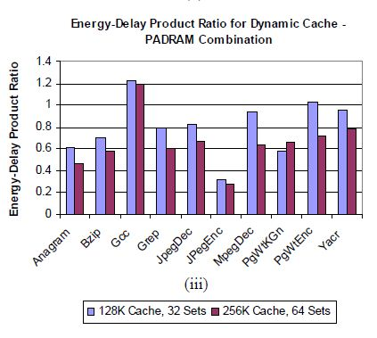
The AMC
and CMC thresholds (lower, upper) are (20, 50) and (4, 8).
The instruction threshold is(100, 1000)..
Memory delay ratio (i), energy ratio (ii) and energy-
delay product ratio (iii) for dynamic cache and
PADRAM combination (no ESB).
17

Slide 18
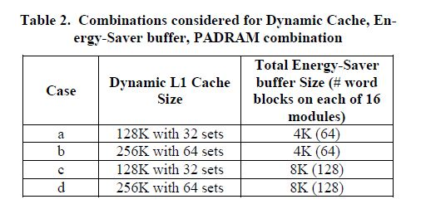
Integrated approach
Configurations considered for analysis of integrated approach are mentioned in Table2.
Configurations selected for comparison with designs without ESB are:
Directmapped L1 cache , one of size 128K with 32 sets and one of size 256K with 64 sets (these performed well in terms of energy-delay product when used in conjunction with a 512 MB PADRAM and the FF1000 page replacement scheme ).
In dynamic cache coupled with PADRAM and
without ESB’s as seen from the energy,delay and
energy-delay plots:
The average energy-delay product is 73% of
traditional memory hierarchy. The energy
consumed is just 35% of the traditional
hierarchy.
Note: L2 cache configuration considered is a unified 2-way 1M cache.
18

Slide 19
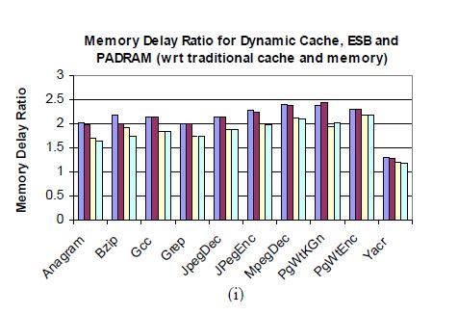
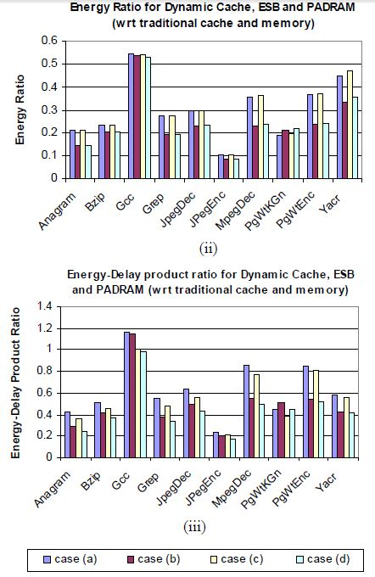
Results:-
Memory delay ratio (i), energy ratio (ii) and
energy-delay product ratio (iii) for dynamic cache,
ESB and PADRAM Combination
19

Slide 20
ESB’s with PADRAM vs Traditional Memory Hierachy
Large savings in energy consumption that is offset by an increase in memory(delay can be attributed to the dynamic caches, as when the number of cache sets used during a program’s execution is reduced, there is an increased likelihood that data would be accessed directly from the memory)
Coupled with dynamic caches average energy consumption is 27% of the traditional model.
Overall improvement in energy consumption, memory delay, and energy-delay product
An optimal value of the buffer size has the potential to reduce the delay significantly. Also, the average energy consumption reduces by 25%
20

Slide 21
Conclusions
A hierarchy with only dynamic cache increases the energy-delay product by 50%.
Hierarchy with dynamic cache and PADRAM decreases the energy-delay product by 30% .
On-chip ESBs added in-between dynamic cache and established a 50% cutback in the energy-delay product, when compared to a traditional hierarchy.
Combination of a traditional cache, Energy-Saver Buffers, and the PADRAM memory performs the best in terms of energy-delay product, on average bearing a savings of 80% at the cost of a huge increase in delay.
Combination of dynamic cache, ESB, and PADRAM providing an optimal tradeoff between energy and delay.
21

Slide 22
Future Work
The dynamic cache used in the following can be replaced by better cache optimization techniques which would produce smaller energy delay products.
The ESB protocol does not consider the application’s processor clock cycle while performing the communication with processor and memory module.
The type of energy saving buffer introduced is to be customized as per application needs.
The design space can still be explored to aggregate results over a vast range of configurations to obtain an optimal tradeoff between performance and power.
22

Slide 23
HitME: Low Power Hit MEmory Buffer for Embedded Systems
Andhi Janapsatya, Sri Parameswaran† and Aleksandar Ignjatovi´c†
School of Computer Science & Engineering, University of New South
Wales, Sydney, NSW 2052, Australia
†NICTA, Sydney, NSW 2052, Australia
{andhij, ignjat, sridevan}@cse.unsw.edu.au
23

Slide 24
Introduction
Memory hierarchies inside an embedded processor contribute
as much as 50% of the total microprocessor power.
The performance gap between processor and the memory system necessitates the use of cache memory hierarchies to improve performance and reduce energy consumption.
HitME buffer - a small Hit-MEmory (tiny direct-mapped cache) buffer.
The HitME buffer is inserted in addition to the existing cache memory structure.
24

Slide 25
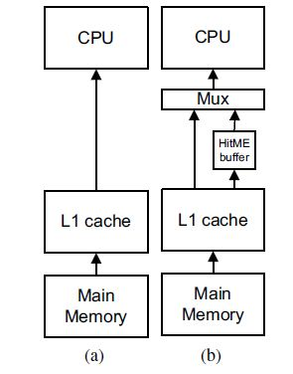
HitMe buffer
The content of the HitMe buffer is only updated whenever an L1 cache hit event occurs.
A multiplexer is inserted in the HitME buffer architecture (Figure (b)) to allow the CPU to select whether to fetch data from the L1 cache or the HitME buffer.This reduces HitMe buffer pollution.
The strategy is such that only memory elements that have been accessed more than once will be loaded into the HitMe buffer.
Motivation-90% of memory blocks are accessed only once. The probability of re-access increases as thenumber of accesses increase.
25

Slide 26
Improvements over previous work
The HitME buffer differs from the filter cache . Not all memory accesses are fetched from the HitME buffer, and only a selected memory contents are inserted into the HitME buffer.
Preloaded loop cache does not allow the modification of the content of the loop cache during run time. The content of the HitME buffer changes according to the memory access pattern of the application.
Dynamic loop cache needs custom compilers and expensive dynamic loop profilers which is not the case with HitME buffer. In addition, loop caches only target instruction memory, while HitME buffer can target both instruction and data memory.
26
Notes:
.

Slide 27
System Architecture
Direct-mapped cache and the number of sets of the HitME buffer is designed to be equal to the number of sets in the L1 cache memory.
Size of the HitME buffer is:
HitMEsize = L1Cachesets ∗L1Cacheblock
Each cache set in the L1 cache will map to exactly one set in the HitME buffer. Hence, the idea of HitME buffer is to provide each L1 cache set with a hit buffer.
27

Slide 28
Buffer strategy
When the memory hierarchy receives a memory request from the CPU, the HitME buffer is the first memory level to be searched.
If a HitME buffer hit occurs, the memory request will be serviced from the data inside the HitME buffer.
If a HitME buffer miss occurs, the L1 the L1 cache memory will be the next memory level to be searched.
If an L1 cache miss occurs memory request is sent to the main memory and the L1 cache memory is updated according to the L1 replacement policy. The CPU memory request will then be serviced from the L1 cache memory and no update is done to the HitME buffer.
When a HitME buffer miss occurs and an L1 cache hit occurs, the content of the HitME buffer is first updated with the data from the L1 cache memory. The HitME buffer will then service the CPU memory request. The decision to allow the HitME buffer to be updated prior to servicing the CPU memory request will ensure the validity of the content of the HitME buffer and allow a single read/write port L1 cache memory to be used with the HitME buffer.
28

Slide 29
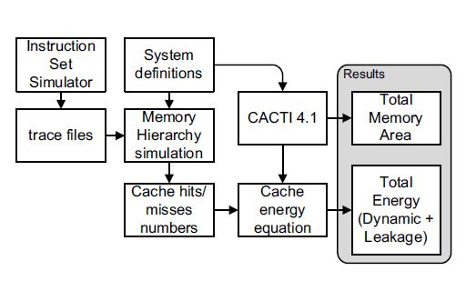
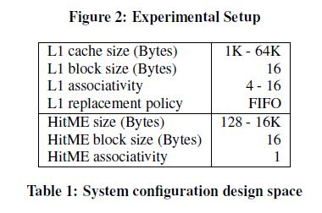
Experimental Setup
First step is trace generation using Tensilica Instruction Set Simulator.
System definition provide the cache configurations and the HitME buffer configurations as listed in Table1.
Traces are simulated for the different configurations.
Cache memory area, leakage power, cache access time and access energy numbers were obtained using CACTI4.1.
29

Slide 30
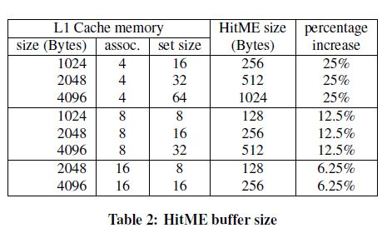
Results
Area Estimation :-
The addition of the HitME buffer will increase the on-chip area of the cache memory hierarchy.
The area increase only considers the size of the HitME buffer
The HitME buffers are direct-mapped caches with size equal to the L1 cache memory set size multiplied by the L1 cache block size.
Table 2 shows the theoretical increase in memory bytes on chip due to the addition of the HitME buffer.
30

Slide 31
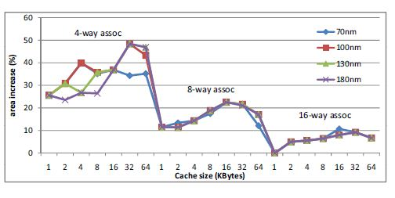
Results
Area Estimation :-
The on-chip area increase shown is the ratio of the area of the HitME buffer over the area of the L1 cache memory.
For smaller cache sizes (L1 size of 1K to 2K bytes compared to HitME buffer size of 128 to 512 bytes) the addition of HitME buffer increases the area by the theoretical size shown in Table 2.
For larger cache sizes (L1 cache size of 32K to 64K compared to HitME buffer size of 4K to 16K), it the HitME buffer increases the memory area by almost double the expected area increase.
To limit the area increase and for a fair comparison on the performance of HitME architecture with existing cache architecture, we reduce the L1 cache size by the size ofthe HitME buffer..
31

Slide 32
Performance Estimation
Comparison of the cache access time (L1 cache or HitME buffer) versus the processor cycle time shows that the processor clock cycle time is much slower compared to the cache access time.
Addition of the HitME buffer would not reduce performance as HitME buffer miss and L1 cache hit can be serviced within a processor clock cycle.
The only factor that can cause performance degradation is if there exist many more off-chip memory accesses.
Table 3 shows the area, clock frequency and power consumption for the ARM9E processor .
Table 4 shows the access time, for various cache memory configurations.
32

Slide 33
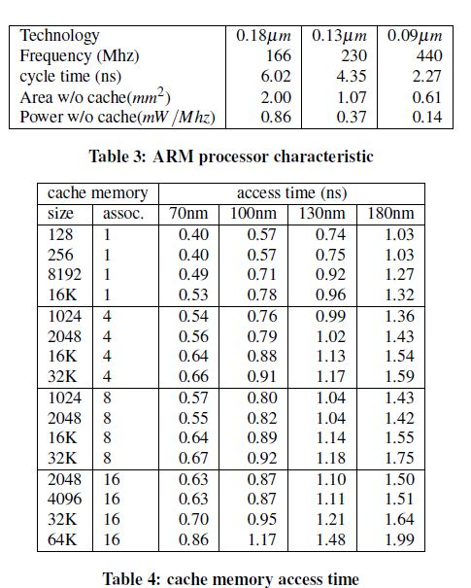
33

Slide 34
Energy Estimation
The memory hierarchy energy components are the only factors that differ between the traditional cache memory hierarchy and the HitME buffer memory hierarchy.
EnergyHitME = HitMEread ∗HitMEreadEnergy +
HitMEmiss ∗L1CachereadEnergy +
(HitMEwrite +L1Cachehit ) ∗HitMEwriteEnergy +
L1Cachemiss ∗L1CachewriteEnergy +
L1Cacheleakage +HitMEleakage
HitMEread -total number of HitME buffer read accesses,
HitMEwrite -total number of HitME write accesses
HitMEreadEnergy-HitME buffer read energy
HitMEmiss -total number of HitME buffer misses
HitMEwriteEnergy -HitME buffer write energy
HitMEleakage -total leakage energy of the HitME buffer.
34

Slide 35
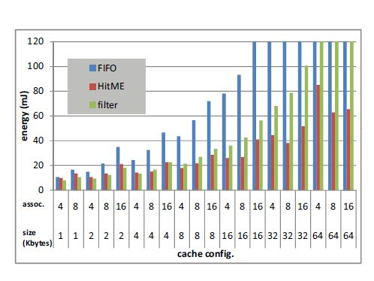
Analysis
Simulations were performed to compare traditional L1 cache memory with FIFO replacement policy, HitME buffer and filter cache architecture.
Figure below shows the energy comparison of the three memory systems for mpeg2decode application. The x-axis represents the cache configuration and the y-axis shows the total energy (dynamic + leakage) of each memory systems. The three bars shown are (in order) FIFO, HitME buffer and filter cache.
35

Slide 36
Analysis
The same experiments were performed for different cache technologies —100nm, 130nm and 180nm respectively.
It was observed that HitME system and filter cache system consume less memory energy compared to traditional L1 cache architecture.
For small cache sizes (1K and 2K caches), HitME architecture and filter cache consumes marginally smaller energy compared to traditional L1 cache architecture. This indicates that for small caches, the use of small filter cache or HitME buffer is not very beneficial.
In large caches, significant energy reduction are seen when comparing HitME buffer to traditional L1 cache architecture.
36

Slide 37
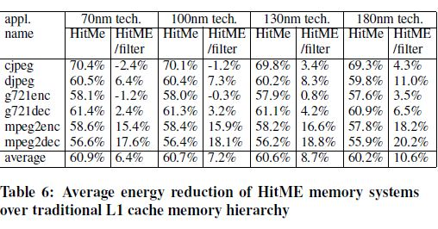
Analysis
Table 6 shows the average energy reduction of the HitME
memory system over traditional L1 cache memory architectur
e and the HitME memory system over filter cache memory
architecture for various cache technologies.
37

Slide 38
Conclusions
HitME buffer causes large reduction in L1 cache accesses with an average of 58.6% less energy compared to traditional cache hierarchy for mpeg2encode application with 70nm technology.
For very large L1 caches (32K and 64K L1 cache size energy reduction of up to 80% is observed. This can be explained by the fact that the energy costs are much higher to access a large 64K-16way associative cache compared to accessing a 4K direct-mapped cache (HitME buffer).
Comparing HitME architecture with traditional FIFO cache memory for the MediaBench applications, we observed an average energy reduction of 60.9% for 70nm technology.
Compared to filter cache architecture, HitME buffer reduces energy consumption by an average of 6.4% (70nm technology).
38

Slide 39
Future Work
The work here focuses exclusively on L1 cache hits/miss and does not consider several other aspects of cache interaction.
The comparisons have been limited to only filter cache and traditional cache .Since several new cache optimization techniques have now emerged its essential to make a generic comparison with varied other techniques to conclude on the efficiency of the results obtained.
Many assumptions like less leakage energy,less number of off chip accesses,ignoring the multiplexer area overhead and the like have been made in this work.These areas can be explored for a universal application.
39

