Slide 1
Bulbul Rath EEL 6935- Embedded System Seminar
Topic: Real Time Systems
02/14/2013
1

Slide 2
An MDE Methodology for the Development of High-Integrity Real-Time Systems
Silvia Mazzini, Stefano Puri
Intecs SpA, Pisa, Italy
Email: {silvia.mazzini, stefano.puri}@intecs.it
Tullio Vardanega
University of Padua, Italy
Email: tullio.vardanega@math.unipd.it
2

Slide 3
Introduction
Model Driven Engineering :-
Definition, composition and integration of complex software systems.
Model evolution through refinements, transformations and code generation, possibly automated by tool support.
A popular variant is the Model Driven Architecture (MDA), to achieve a cohesive set of model-driven technology specifications that use version 2 of the OMG general-purpose UML language and/or specific profiles of it.
3

Slide 4
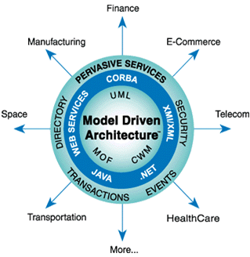
Model Driven Engineering Goals
separate business and application logic from the underlying execution platform technology.
focus developers on the production of models of the application and of the relevant business logic.
support the generation of platform-specific models and code by means of engineered, and possibly automated, transformations.
4

Slide 5
Hard Real-Time UML for the Ravenscar Computational Model (HRT-UML/RCM)
Object Management group(OMG) ‘s Unified Modeling Language (UML) - Specify, visualize, and document models of software systems.
HRT-UML/RCM- an integrated method and infrastructure for the development of embedded real-time software systems, was one of the major results of the ASSERT (Automated proof based System and Software Engineering for Real-Time Applications) project.
5

Slide 6
HRT-UML/RCM & MDA
Defines Platform Independent Models.
Platform-specific models are automatically produced from platform-independent specifications using proven model-to-model transformations.
Platform-specific models are submitted to static analysis .
Once the user model is committed, its platform-specific correspondent becomes input to automatic generation of source code for the target platform.
6

Slide 7
Architectural Framework
Functional View :-defines the sequential algorithmic behavior of the functional components of the system using UML class and state-chart diagrams.
Interface view :- specifies how functional components aggregate together and what interfaces they offer and require and the relations traced among them, by augmenting the specification of the corresponding functional signatures with attributes that specify the desired concurrency semantics.
Deployment view :-specifies the physical components of the system, in terms of nodes (processors, memory, devices), partitions, interconnects, protocols, capabilities and restrictions, and allocation relations with software components are submitted to static analysis .
Concurrency view:-defines the concurrent architecture of the system in terms of threads of control, communication and synchronization protocols and resources to “realize” the execution semantics specified in the interface view for the target platform specified in the deployment view, assuming an execution environment
that complies with the RCM.
.
7

Slide 8
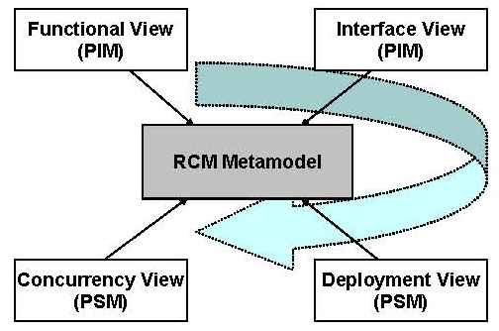
Architectural Views
functional and interface views operate in the platform-independent
modeling space.
concurrency view and the deployment views are platform specific.
8

Slide 9
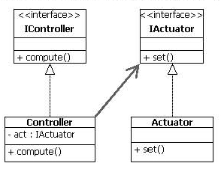
Functional View
Intentionally ignores all timing, concurrency and synchronization issues that are typical of real-time system design.
Structural information can be expressed with standard UML class diagrams, and thus by the definition of classes, operations and attributes.
The specification of behavioral information is an important step in the functional design process. It is used to feed model transformation and code generation.
Fig: functional view
of a simple controller actuator
9

Slide 10
Interface View
Components specified in the functional view are augmented with concurrency-related characteristics.
Class entity Application-level Container (APLC) populates this view Modeled first as types, they are instantiated and interconnected to form a precise and verifiable instance of the real-time software system under design.
An APLC is a stereotyped UML structured component; it can own parts that can be typed only with a (non-abstract) class defined in the functional view. Parts are the only features that the designer can create/delete for an APLC.
Designer creates the APLC, together with their parts, and then attaches semantic decorations to all elementary provided ports (EPP), to specify the concurrent behavior that shall occur on invocation of each wrapped operation.
10

Slide 11
Elementary Ports(EP)
Interfaces are automatically exposed by the APLC through stereotyped ports, called port clusters in HRT-UML/RCM
A port cluster is a special UML composite port which aggregates elementary interaction points, called elementary ports.
EP acts as wrapper of the associated operation to specify the kind of the synchronization protocol when the operation, implemented by the functional part, is invoked through the owner port.
Permits finer grained modeling of component interactions as compared to plain UML.
Attaching concurrency semantics to elementary ports and referring to functional entities via APLC parts facilitates the reuse of functional specifications across multiple execution scenarios.
11

Slide 12
Detailed View of Port Cluster
12

Slide 13
Deployment View Concurrency View
Designer specifies the physical architecture of the system and commands the way the logical architecture must map to it.
The model of Partition is used and each partition contains several APLC. APLC in each partition are isolated in space, time and communication from all other partitions.
permit finer grained modeling of component interactions as compared to plain UML.
Platform specific view.
describes the concurrent architecture of the system realized in compliance with the RCM for the target execution platform as specified in the deployment view.
Once functional and interface views are modeled and the target platform is specified, a fully automated model transformation process obtains concurrency view.
Best suited to feed feasibility and sensitivity analysis as well as code generation.
13

Slide 14
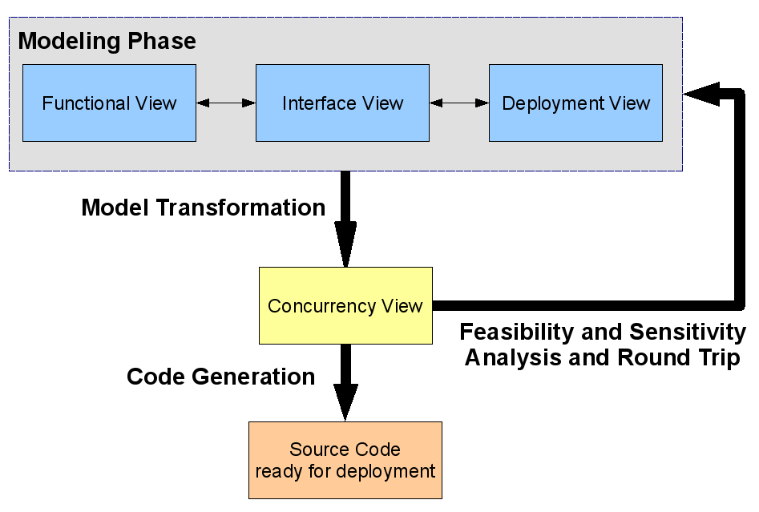
HRT-UML/RCM Process
Modeling Phase
Modeling Transformation
Feasibility and Sensitivity Analysis
Code Generation
14

Slide 15
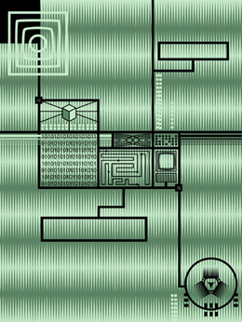
Industrial Evaluation Results
In the context of the ASSERT project a prototype tool
supporting the methodology was developed and submitted to
extensive industrial evaluation.
Favourable Results:-
Satisfactory integration level of all tools in the HRT-UML/RCM track
Guarantee of consistency across model spaces.
The declarative style of specification in the interface view was rated effective in permitting the user to abstract away from the complexity of the underlying implementation (captured by the concurrency view).
Ensures static analysis as functional dependency is determined by class members only.
15

Slide 16
Future Work
Provisions in interface view itself for making changes in APLC rather than tracing back to functional view every time.
Support for hierarchical functional decomposition.
Behavioral modeling with statecharts, to increase the rate of functional code generation.
Integration with complementary and/or domain specific languages and tools such as Matlab/Simulink, Scade, SDL.
Extensions to realtime attributes and concurrent semantics to the modeling of operation modes as well as of application-specific synchronization protocols.
16

Slide 17
An MDE-based approach for reconfigurable DRE systems
Fatma Krichen1,2, Amal Ghorbel2, Brahim Hamid1, and Bechir Zalila2
1IRIT, University of Toulouse, France
Email: Fatma.Krichen@irit.fr
2ReDCAD, University of Sfax, Tunisia
17

Slide 18
Introduction
Distributed Real-time Embedded(DRE) Systems:-
Constructing reconfigurable DRE systems requires considerable efforts and is error prone..
Most DRE systems are not fully autonomous and require the human intervention to respond to triggered events and to be reconfigured.
MDE based model to model (M2M) transformations to develop reconfigurable DRE systems.
M2M- At software level, model transformations until a final platform specific model is achieved.
18

Slide 19
MDE based approach
Metamode:-
Captures and characterizes a set of configurations
(modes) instead of defining each of them.
Described by structured components, connectors as well as non-functional and structural constraints.
Modes are specified by the set of instances of structured components and connectors defined by this MetaMode and satisfying its constraints.
MetaMode transition presents a set of reconfigurations between modes belonging to these MetaModes.
19

Slide 20
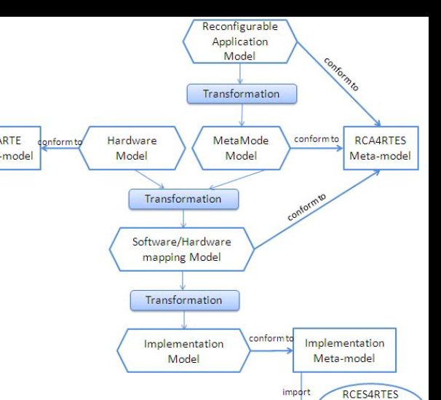
DRE- MDE based Development process
Reconfigurable Application model- Modeling of the dynamic reconfiguration using state machines.
MetaMode Model-Modeling of system MetaModes.
Hardware Model- modeling of the fixed hardware architecture in terms of hardware components such as processor.
Software/Hardware Mapping Model- Allocation of system MetaModes to the fixed hardware architecture.
Implementation Model- Generation of models which present
the system implementation.
20
Notes:
.

Slide 21
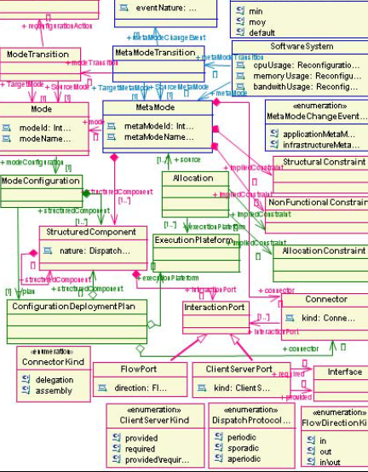
Reconfigurable Computing Architecture for Real Time Embedded Systems (RCA4RTES) Meta-model
Software System meta-class has a set of MetaModes and MetaMode transitions.
Mode transition involves an algorithm for switching from the current configuration to the target one.
MetaMode transition presents an abstraction of a set of mode transitions.
Mode configuration is a set of structured components, the connections between them, their configuration, and their allocation to physical nodes..
21

Slide 22
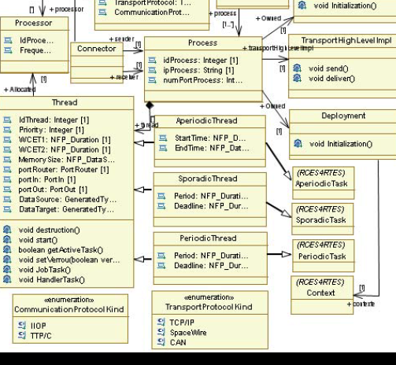
Implementation Meta-model
Has a set of processes defined by both System and Process meta-classes.
Connector metaclass describes communication between two processes (sender and receiver) through buses of Bus meta-class.
Each thread in a process is allocated to a processor as per design constraints.
Mode configuration is a set of structured components, the connections between them, their configuration, and their allocation to physical nodes..
22

Slide 23
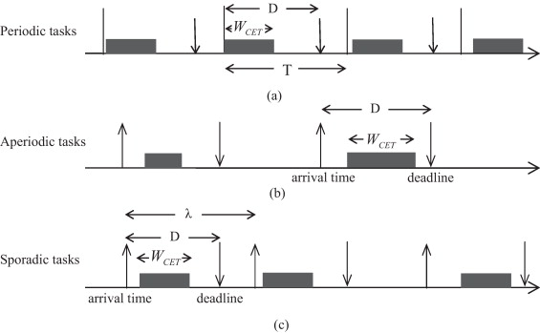
Thread MetaClass
Types of Threads:
-Periodic Thread
metaclass
- Aperiodic Thread
metaclass
- Sporadic Thread
Metaclass
23

Slide 24
Dynamic Reconfiguration Metaclasses
Deployment metaclass -Presents the deployment of the initial mode
TransportHighLevelImpl meta-class -Handles both sending and receiving data for each thread
Activity meta-class-Allows the starting of system threads and also the starting of the thread which ensures the dynamic reconfiguration of system (instance of ReconfigurationTrigger class of RCES4RTES middleware model).
24

Slide 25
Transformation Engine
Endogenous - source and target models are conform to the same meta-model :
Reconfiguration application model, MetaMode model and software/hardware mapping model are conform to the RCA4RTES meta-model.
Exogenous- different source and target meta-models
Software/hardware mapping model is conform to the RCA4RTES meta-model
Implementation model is conform to the implementation meta-model
25

Slide 26
RCA4RTES profile
SoftwareSystem stereotype – extends the StateMachine UML meta-class and presents the dynamic reconfigurations of DRE systems.
MetaModeTransition stereotype -extends the Transition UML meta-class and defines the events that handle the system state machine.
StructuredComponent stereotype- nature, deadline , period etc define thread characteristics in a process.
StructuralConstraint stereotype- extends the Constraint UML meta-class in order to specify architectural constraints.
FlowPort and ClientServerPort stereotypes - extend the Port UML meta-class.
Connector stereotype- extends the Connector UML meta-class.
26

Slide 27
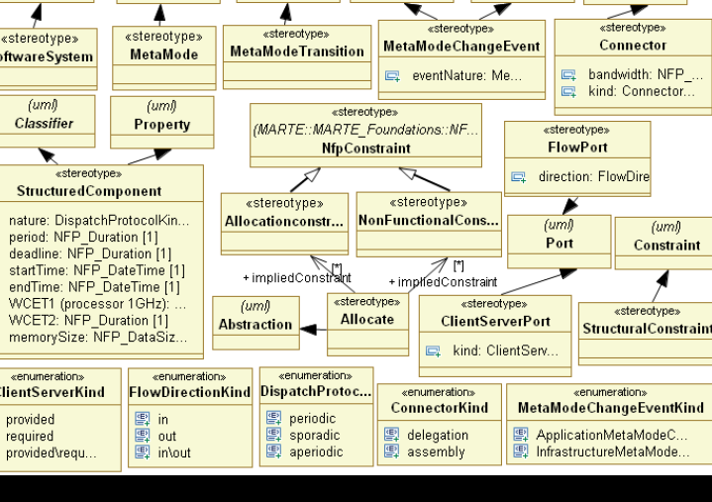
RCA4RTES profile description
27

Slide 28
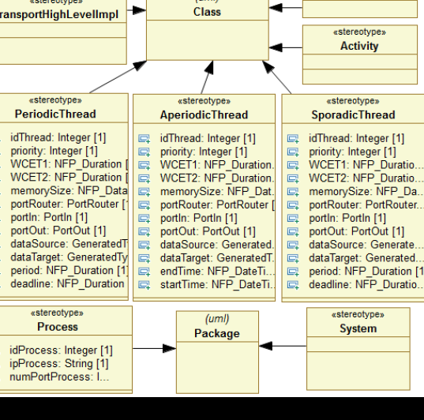
Implementation profile
PeriodicThread, SporadicThread and AperiodicThread streotype- each process is composed by a set of threads.
Deployment, TransportHighLevelImpl and Activity
stereotypes
28

Slide 29
MDE based approach-GPS
Step 1-Metamodes
Insecure GPS- with insecure functioning for a traditional use of a GPS
Secure GPS-with secure functioning for a restricted use of a GPS with some safety requirements.
Step 2- specify each MetaMode by a set of structured components,
connectors and non-functional and structural constraints
like position, encoder, decoder etc.
Step 3- specify the fixed hardware architecture followed by the
allocation of each MetaMode to the specified fixed hardware
architecture.
Fig: UML State Machine
29

Slide 30
Conclusions and Future Work
RCA4RTES and implementation meta-models:
-RCA4RTES meta-model allows to specify reconfiguration
application model, MetaMode model and software/hardware
mapping model.
- Implementation meta-model allows to specify implementation
model.
Development of ECLIPSE plug-in allowing the generation of code following the proposed process.
Enable validation and verification of reconfigurable DRE systems. Handle the state of components and connectors during reconfiguration at runtime.
30

