Slide 1
A Framework to Analyze Processor Architectures for Next-Generation On-Board Space Computing
Tyler M. Lovelly
Ph.D. student
University of Florida
Donavon Bryan
Kevin Cheng
M.S. students
University of Florida
Rachel Kreynin
B.S. student
University of Florida
Dr. Alan D. George
Professor of ECE
University of Florida
Dr. Ann Gordon-Ross
Assoc. Professor of ECE
University of Florida
Gabriel Mounce
Deputy Chief, Space Electronic Tech.
Air Force Research Laboratory

Slide 2
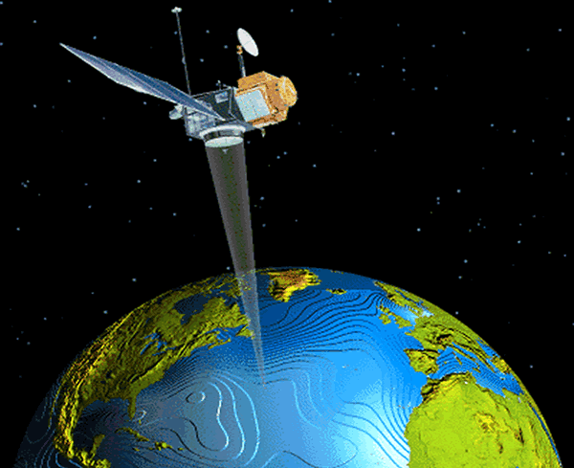
Introduction
Space computing presents unique challenges
  Harsh and inaccessible operating environment
  Stringent constraints on power, reliability, programmability
  Limitations for on-board performance and mission capabilities
Increasing need for high-performance on-board computing
  Demand for real-time sensor and autonomous processing
  Limited communication bandwidth to ground stations
  Existing rad-hard processors cannot meet performance requirements
    Typically several generations behind commercial processors
    Based on architectures not specifically designed for space computing
Framework created to analyze processor architectures for next-generation on-board space computing
  Study wide range of architectures based on performance and power
  Gain insights into architectural capabilities for key computations

Slide 3
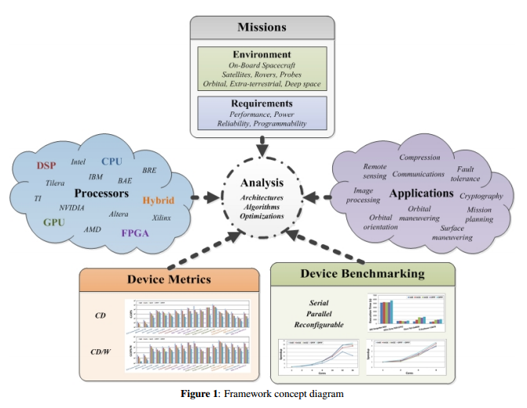
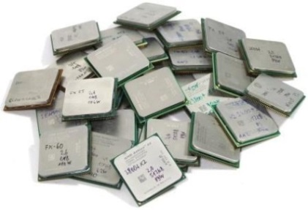
Framework
Space-computing taxonomy
  Broadly define and classify space-computing domain
  Simplify into key computations
Device metrics
  Analyze wide range of architectures
  Based on theoretical device capabilities
    Performance & power
Device benchmarking
  Further analyze promising architectures based on key computations
  Parallelization across processor cores and reconfigurable fabrics

Slide 4
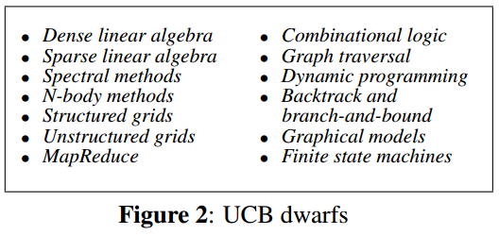
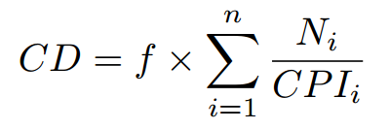
Background and Related Research
Computational dwarfs
  Defined by UCB as “an algorithmic method that captures a pattern of computation and communication” ^{[1]}
  Used to characterize applications based on key computational patterns
  Concept can be adapted and applied to any domain of computing
f = operating frequency
N = # of execution units
CPI = cycles per instruction
n = # of execution unit types
Device metrics
  Computational Density (CD) measures theoretical device performance; scaled by power for CD per Watt (CD/W) ^{[2]}
Device benchmarking
  Based on key computations for applications under consideration
  Provides greater insight into architectures, algorithms, optimizations
[1] K. Asanovic et al., "The Landscape of Parallel Computing Research: A View from Berkeley,” Technical Report No. UCB/EECS-2006-183, University of California, Berkeley, Dec 18 2006
[2] J. Richardson et al., “Comparative Analysis of HPC and Accelerator Devices: Computation, Memory, I/O, and Power,” Proc. of High-Performance Reconfigurable Computing Technology and Applications Workshop (HPRCTA), at SC’10, New Orleans, LA, Nov 14 2010

Slide 5
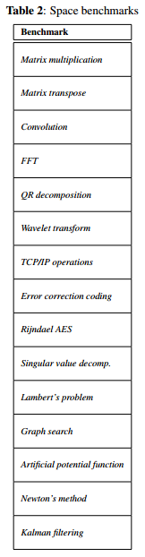
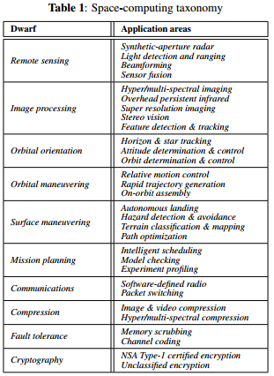
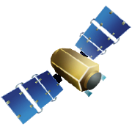
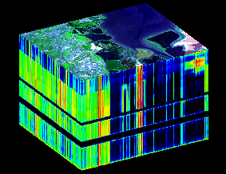
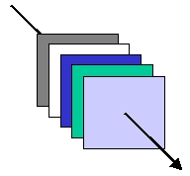
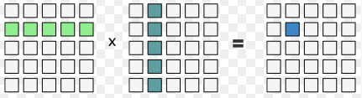
Space-Computing Taxonomy
Space dwarfs
  Studied common and critical space apps and missions
  Established computational dwarfs for space computing
Space benchmarks
  Key computations selected for space benchmark suite
  Example: satellite mission
    Critical application
      Hyper-spectral imaging
    Corresponding dwarf
      Image processing
    Key computations
      Matrix multiplication
      QR decomposition

Slide 6
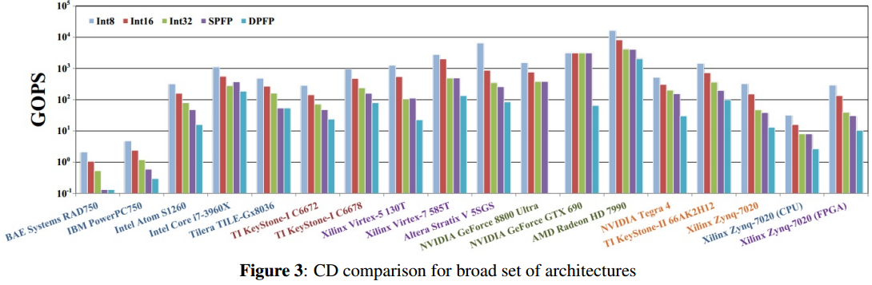
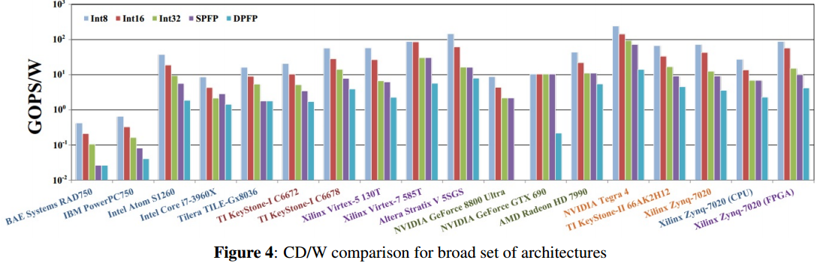
Device Metrics Analysis
Initial analysis on broad and diverse set of architectures
Closest comm. arch. to rad-hard Boeing MAESTRO
GPUs give high CD, but too high power for many space missions
Hybrid architectures analyzed in isolated or combined fashion
Existing rad-hard outperformed by comm. architectures
Commercial counterpart of rad-hard Virtex-5QV
No DPFP support for high-precision space apps
FPGA provides most CD & CD/W to hybrid device
Intel Atom S120 has power-efficient advantage for space

Slide 7
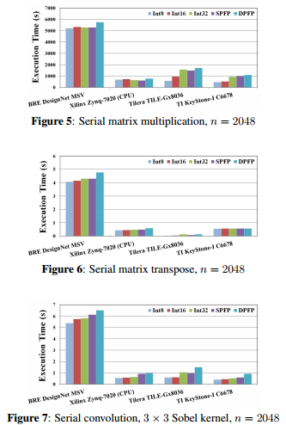
Device Benchmarking Analysis
Developed space benchmarks for several targeted architectures
  Rad-hard CPU
    Based on PowerPC750FX
    Similar arch to BAE Systems RAD750
  Commercial CPUs and DSP
Generated initial performance results based on serial operation
  Rad-hard technology outperformed by commercial architectures
    Even when commercial architectures are limited to single-core operation
    Supports device metrics data for rad-hard vs. commercial architectures
Execution time increases with data precision for compute-intensive benchmark
Data type & precision less important for memory-intensive benchmark
Best performing architecture varies based on benchmark, data type & precision

Slide 8
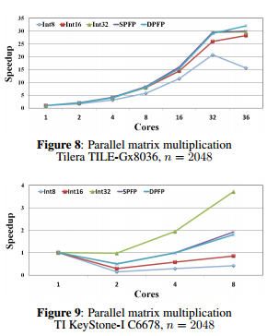
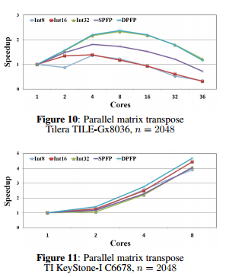

Device Benchmarking Analysis
Parallel benchmarking on multi/many-core architectures
  OpenMP shared-memory parallelization strategy
  Space benchmarks parallelizable across processor cores
  Eventual tipping points when overhead surpasses speedup
FPGA benchmarking
  Parallel-pipelined hardware datapath
  Alleviate performance bottlenecks for critical space applications
Optimal # cores based on benchmark, data type & precision, problem size
More optimization needed to achieve significant speedup
Not enough cores to reach tipping point in parallelization
FPGA resource usage grows with data precision
Significant resources not required, even for highest precision

Slide 9
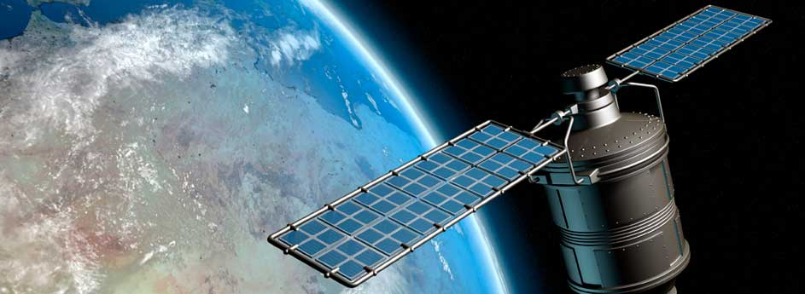
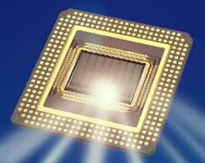

Conclusions and Future Research
Framework created to analyze processor architectures for next-generation on-board space computing
  Space-computing taxonomy
    Established set of computational dwarfs for space
    Key computations selected for space benchmarking
  Device metrics analysis
    Wide range of architectures analyzed with CD and CD/W metrics
    Initial insights into performance and power efficiency for various architectures
  Device benchmarking analysis
    Conducted serial, parallel, and reconfigurable benchmarking
    Further supports metrics data that rad-hard tech becoming outdated
    Space apps parallelizable across processor cores and reconfig. fabrics
Expand results with new devices and benchmarks
  Multi/many-core CPUs and DSPs; comm. and rad-hard
  Leverage established libraries and architecture-specific optimizations
Notes:
Slide 8: Justin
Requesting a minimum of 3 memberships, directly correlating to how many platforms and benchmarks we can do

