Slide 1
Improving Compression Ratios for High Bit-Depth Grayscale Video Formats
Dr. Alan D. George
Professor of ECE
University of Florida
Dr. Ann Gordon-Ross
Assoc. Professor of ECE
University of Florida
An Ho
Research Students
University of Florida

Slide 2
Outline
Motivations
Evaluation Metrics
Current Solutions
Proposed Solutions
Results Analysis
Conclusions

Slide 3
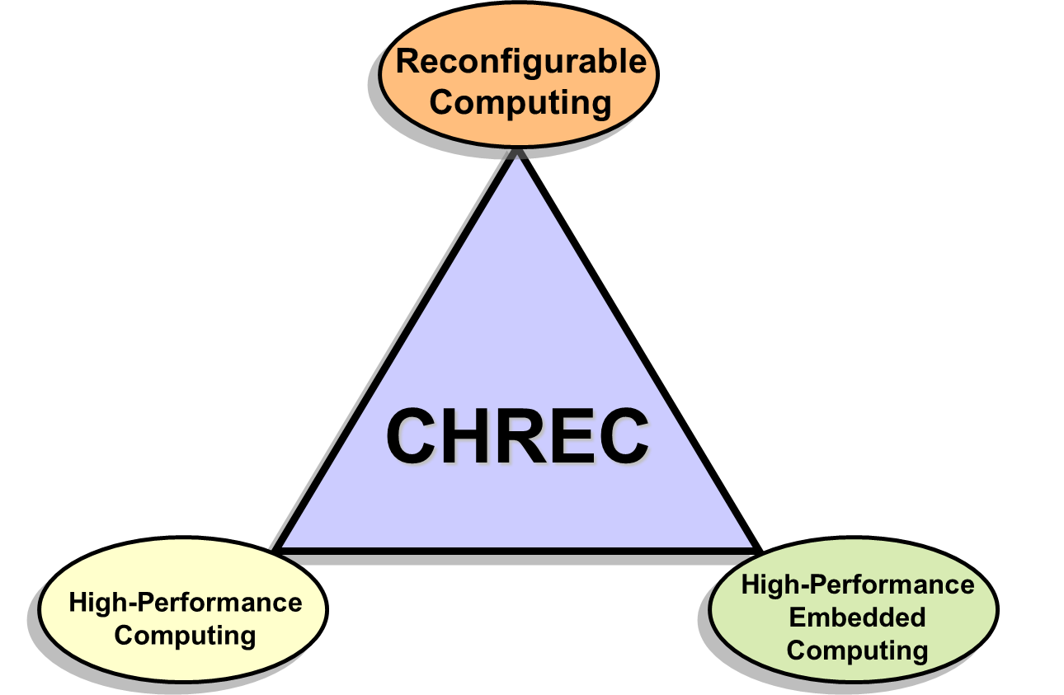
Acknowledgements
Research project at CHREC
NSF Center for High-Performance Reconfigurable Computing (CHREC)
Founded in 2007
Comprised of 4 university sites and over 30 industry and government partners
3 main research domains
I/UCRC Program at NSF
Industry/University Cooperative Research Center
CHREC is both National Research Center and Consortium
Basic and applied R&D in advanced computing in three major domains
Universities
Basic Research
CHREC
Applied R&D
Industry & Government
See www.chrec.org for more info

Slide 4
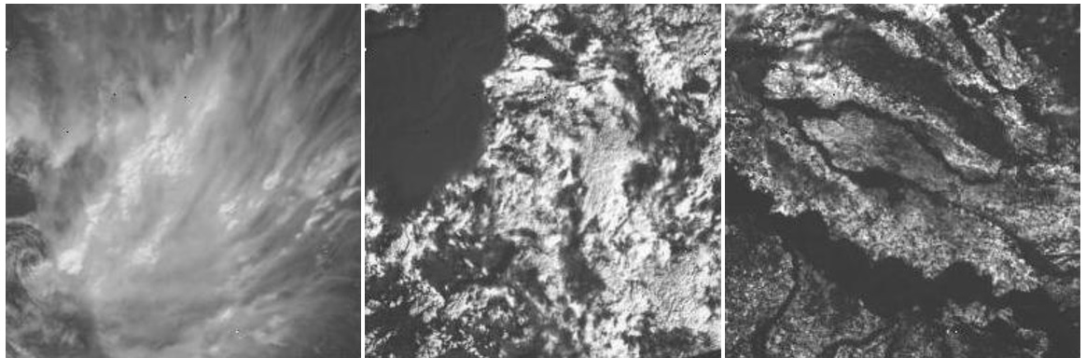
Motivations
High bit-depth video format
Use more than 8-bit per pixel
Double the memory requirement per pixel
Overhead Persistent Infrared (OPIR)
14-bit grayscale video
High frame rate, at 300 Hz
Video
Compression Algorithm
Compressed Video
16-bit supported encoder
8-bit supported encoder
Lossless and Lossy
Cloud001
Cloud002
NoCloud001
Evaluated Video Test Set provided by Air Force Research Laboratory Space Vehicles Directorate

Slide 5
Evaluation Metrics
Compression Ratio (CR)
Quantifies the reduction in data size
Higher CR values indicate smaller compressed file size
Root Mean Squared Error (RMSE)
Measure the quality of a video
Difference in pixel values in compressed file vs. raw, uncompressed file
Goal: 10 CR or more, 15 RMSE or less

Slide 6
Current Solutions
Using video encoders to compress raw data
Lossless mode: retain all original data
Lossy mode: some data is lost but can achieve higher CR
Typical video encoders only support 8-bit video formats
Few existing encoders support high bit-depth video
Video
Compression Algorithm
Compressed Video
16-bit supported encoder
8-bit supported encoder
Lossless and Lossy

Slide 7
Current Solutions
Using video encoders to compress raw data
Lossless mode: retain all original data
Lossy mode: some data is lost but can achieve higher CR
Typical video encoders only support 8-bit video formats
Few existing encoders support high bit-depth video
FFV1 used as baseline number for comparisons due to highest lossless CR (average of 1.62 CR)
Baseline CR for each video using existing 16-bit encoders for lossless compressions

Slide 8
Proposed Solutions
Add a preprocessing step before applying compression
Modify input data to be more amenable to existing encoders
Methods evaluated:
Filtering
Region of Interest
Factoring
SuperFrame
Bit-Stream Splitting
Video
Compression Algorithm
Compressed Video
Preprocessing Methods
OPIR Video Source
16-bit supported encoder
8-bit supported encoder
Lossless and Lossy
New
New
Filtering
Region of Interest
Factoring
SuperFrame
Bit-Stream Splitting

Slide 9
Filtering
Filtering: reducing noise in a video using image processing
Reducing noise would in turn reduce entropy of video
Evaluated using Gaussian, Median, Average, and Wiener
Results unimpressive:
FFV1 as the encoder
Gaussian shows lowest RMSE
1.04x CR with RMSE over 100
CR and RMSE for Filtering using different algorithm and kernel size

Slide 10
Region of Interest (ROI)
ROI: split video into multiple regions (e.g. quadrants)
Compress critical region using lossless compression
Compress non-critical region using lossy compression
Critical region
Non-critical region

Slide 11
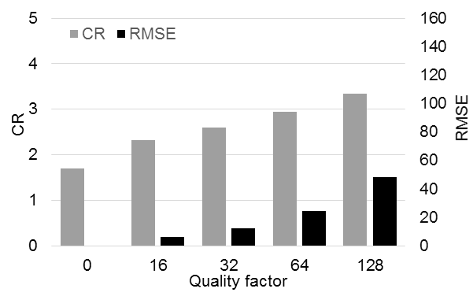
Region of Interest (ROI)
ROI: split video into multiple regions (e.g. quadrants)
Compress critical region using lossless compression
Compress non-critical region using lossy compression
FFV1 as the encoder
2.06x CR at RMSE of 50
Need automation in selecting ROI to be effective
CR and RMSE for ROI, averaged over the video test set using JPEG-LS, for varying quality factors

Slide 12
Factoring
Factoring: reduce the number of bits by dividing pixel value by a factor number 2^{n}
n represents number of bits reduced or removed
Achieved average CR of 3.40 on average at factor 64
2.10x increase
FFV1 as encoder
Factor number
Factoring results with the video test set for varying factor numbers in terms of CR

Slide 13
Factoring
Factoring: reduce the number of bits by dividing pixel value by a factor number 2^{n}
n represents number of bits reduced or removed
Achieved average CR of 3.40 on average at factor 64
2.10x increase
RMSE is similar across video
RMSE of 18.5 at factor 64
FFV1 as encoder
Factor number
Factoring results with the video test set for varying factor numbers in terms of RMSE

Slide 14
SuperFrame
SuperFrame: add redundancy by combining multiple frames into a single combined frame
256x256 video with 4224 frames
SuperFrame: 65536x4224 image
JPEG2000 is used as the SuperFrame encoder
Popular image-compression algorithm for space applications
Lossy or lossless mode
New
SuperFrame concept: Sequential video frames (a) are reorganized into a single SuperFrame (b) for frame-based compression

Slide 15
SuperFrame Results
SuperFrame method improved CR significantly
Lossless compression mode:
Average of 1.63x improvement
Lossy compression mode:
At CR of 20, RMSE less than 20 for all videos
Target CR and RMSE achievable
RMSE versus CR using the normal JPEG2000 image compression method
RMSE versus CR using a SuperFrame with JPEG2000

Slide 16
Bit-Stream Splitting
Bit-Stream Splitting (BSS): split high bit-depth video into two 8-bit videos
Allows use of 8-bit video encoders
Access to more commercially developed encoder (e.g. H.264)
Lossless compression on upper byte keeps overall RMSE low
New
BSS conceptual flow

Slide 17
Bit-Stream Splitting Results
Evaluated multiple 8-bit lossless encoders using BSS
x264 provided the best CR
3.40 for Cloud001
2.45 for Cloud002
2.60 for NoCloud001
Improve CR by 1.74x on average
Outperformed SuperFrame in lossless compression
CR from lossless compression with BSS

Slide 18
Combination: BSS and Factoring
Evaluate combination of best performing methods
BSS and factoring:
BSS using lossless x264
Same low RMSE as factoring alone
On average:
Increased CR by 22.4x at RMSE of 18.5
Better than using BSS or factoring alone
RMSE of 18.5
CR results when combining factoring and lossless BSS using x264 on the video test set with varying factor values

Slide 19
Combination: BSS and SuperFrame
Apply BSS and then SuperFrame
JPEG2000 as encoder
BSS & SuperFrame has higher RMSE
BSS & SuperFrame has lower RMSE
BSS & SuperFrame has lower RMSE

Slide 20
Combination: BSS and SuperFrame
Apply BSS and then SuperFrame
JPEG2000 as encoder
Closer look
BSS & SuperFrame has higher RMSE
BSS & SuperFrame has higher RMSE

Slide 21
Summary and Conclusions
Extra preprocessing step enhanced CR for both lossy and lossless
SuperFrame, BSS, factoring, and combinations of these methods
Tradeoff between large CR increase and loss of data quality
Enable system designers to select appropriate preprocessing method
Expand on range of available encoders using new BSS method
Use of 8-bit encoders on high bit-depth video format
Future works:
Research space processor architectures for best fit to implement preprocessing methods
Evaluate resource and overhead cost to run preprocessing methods

Slide 22
Questions

