Slide 1
Comparative Analysis of Parallel OPIR Compression on Space Processors
2017 IEEE Aerospace Conference
Eric Shea
M.S. Student
University of Pittsburgh
An Ho
M.S. Graduate, University of Florida
(now at Harris)
Dr. Alan D. George
Mickle Chair Professor of ECE
University of Pittsburgh
Dr. Ann Gordon-Ross
Assoc. Professor of ECE
University of Florida

Slide 2
Outline
Introduction
Video Preprocessing Methods
Compression Methods
Experimental Setup
Platforms Analyzed
16-Bit Encoder Analysis
8-Bit Encoder Analysis
16-Bit vs 8-Bit Encoder Analysis
Conclusions and Future Research

Slide 3
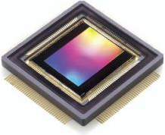
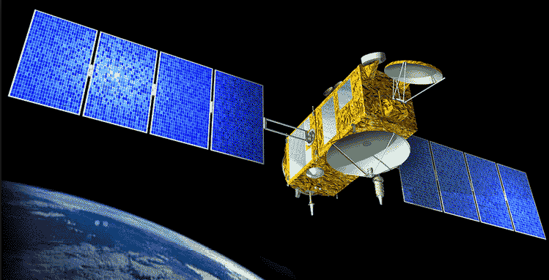
Introduction
Video compression on space processors
Increasing high bit-depth on next-generation image sensors presents unique challenges
Limited resources, such as memory and download bandwidth, requires more efficient preprocessing and compression methods
Existing methods use limited/incompatible proprietary data encoders lacking preprocessing for limited resource environments
Balance between video quality and data throughput
We present novel real-time processing on high bit-depth video for different processor architectures
Perform preprocessing and compression faster than transmitting raw data based on available bandwidth
Achieve better compression ratios with minimal effect on video quality and latency

Slide 4
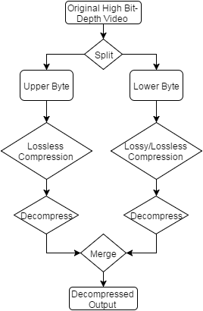
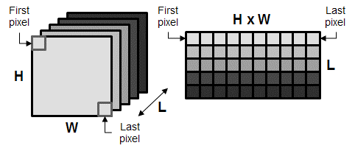
Video Preprocessing Methods
1) Bit-Stream Splitting (BSS) ^{[1]}
Splits high bit-depth video into separate upper and lower byte video files
Enables use of 8-bit encoders and parallelization
2) SuperFrame ^{[1]}
Consecutive frames placed in one massive SuperFrame to leverage image encoders
SuperFrame
Bit-Stream Splitting
[1] A. Ho, A. George, A. Gordon-Ross “Improving Compression Ratios for High Bit-Depth Grayscale Video Formats,” Proc. Of IEEE Aerospace Conference 2016

Slide 5
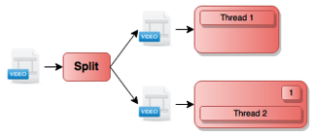
Compression Methods
1) Baseline method
Serially compresses each split file using a single thread
2) Parallelized method
Uses FFmpeg’s built-in multithreading capabilities to operate on both split files in parallel
3) Enhanced Parallelized method
Executes multiple encoder threads in parallel
Dynamically re-allocates threads to cores after thread completes execution
Performed with BSS and 8-bit encoders

Slide 6
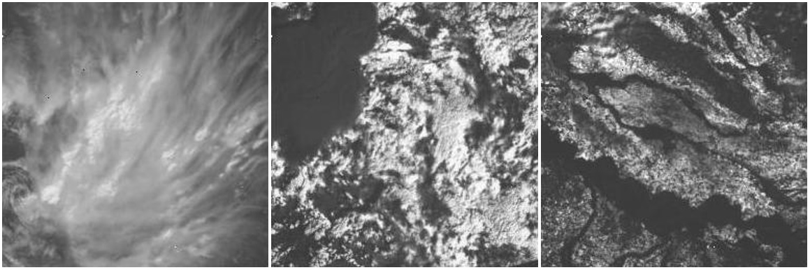
Experimental Setup
Using video data taken from 14-bit Overhead-Persistent InfraRed (OPIR) image sensor
Video files contain ~4000 frames of various cloud cover
Files provided by AFRL Space
Using open source FFmpeg compression library ^{[5]}
Encoders tested: PNG, FFV1, FFVhuff, JPEG-LS, FFV1 V3, x264
Performed lossless compression with 16-bit encoders, and lossless and lossy compression with 8-bit x264
[5] FFMPEG [Online]. Available: http//:www.ffmpeg.org

Slide 7
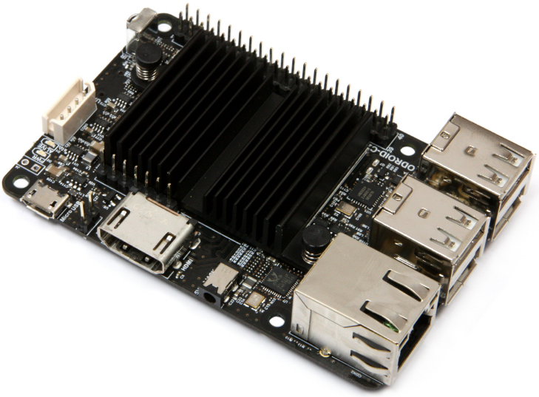
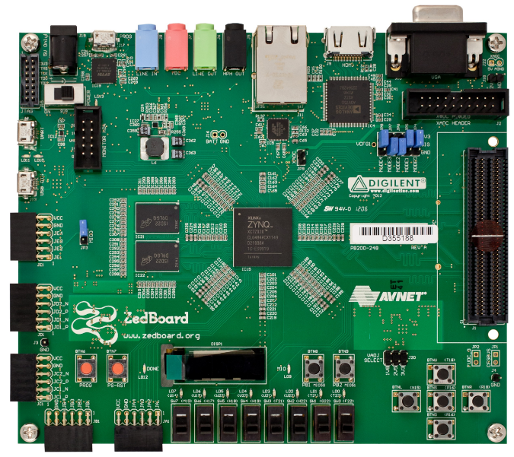
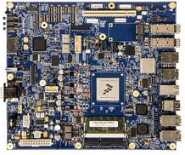
Platforms Analyzed
ODROID-C2
Amlogic S905 with quad-core ARM Cortex-A53 (akin to HPSC)
1.50 GHz clock frequency
Avnet Zedboard (akin to CSP)
Xilinx Zynq-7020 with dual-core ARM Cortex-A9
0.766 GHz clock frequency
NXP P5040 Evaluation Board
FreeScale P5040 with quad-core e5500
2.20 GHz clock frequency
BAE Systems RAD5545
Extrapolated results ^{[8]} using device metrics which revealed that RAD5545 achieves, on average, 21.8% of P5040 performance
0.466 GHz clock frequency
COTs equivalent and space-grade processors
[8] T. Lovelly, D. Bryan, K. Cheng, R. Kreynin, A. George, A. Gordon-Ross, and G. Mounce, “A Framework to Analyze Processor Architecture for Next-Generation On-Board Space Computing,” Proc. of IEEE Aerospace Conference 2014.

Slide 8
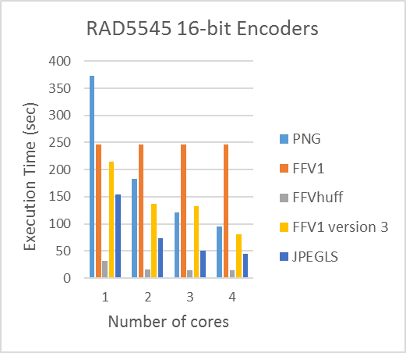
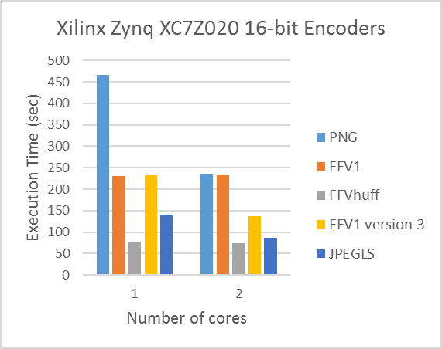
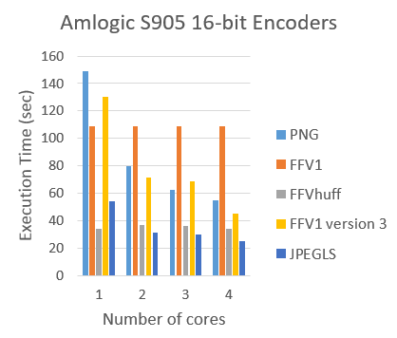
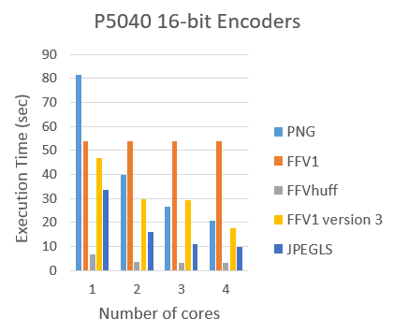
16-Bit Encoder Analysis
No BSS required
PNG and FFV1 version 3 offered significant improvement with increasing number of cores
Negligible improvement for FFV1 and FFVhuff
FFVhuff offered fastest execution time due to inefficient compression of OPIR video
P5040 and Amlogic S905 offered best 16-bit performance due to faster clock speeds
1.0x
1.0x
3.9x
2.6x
RAD5545 achieves 21.8% performance of P5040
1.0x
1.0x
1.0x
1.0x
Offers 4.7x average speedup over next fastest platform, S905
No improvement
No improvement
1.0x
2.0x
2.4x
1.0x
1.7x
2.9x
3.9x
2.6x
FFVhuff performed extremely well offering 4.2x speedup over PNG
FFVhuff performed extremely well offering 11.6x speedup over PNG

Slide 9
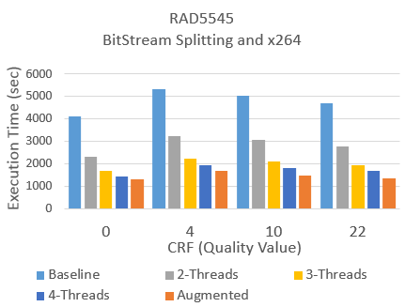
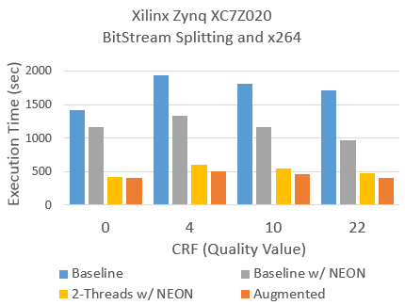
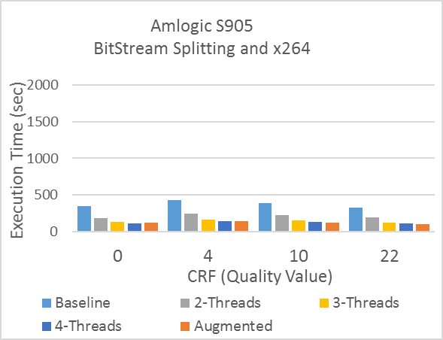
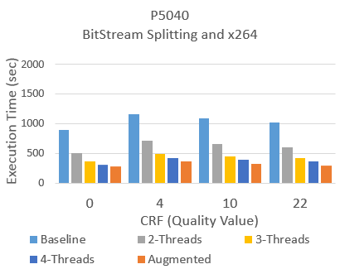
8-Bit Encoder Analysis
BSS required
x264 supports multithreading using pthreads
Execution time decreased by nearly 2x using two threads compared to single thread
Increases overall with increasing quality factor due to addition of quantization step
Augmented compression method performed extremely well with 3.4x average speedup over baseline method
Relative speedup between compression methods increases with increasing quality factor
1.0x
1.0x
1.9x
3.2x
3.5x
1.0x
S905 outperforms P5040 but was opposite for 16-bit encoders
RAD5545 achieves 21.8% performance of P5040
Best speedup between compression methods with increasing quality factor
Fastest due to efficient handling of threads
1.3x
1.2x
1.0x
1.0x
1.1x
1.0x
Offers 2.8x average speedup over next fastest platform, P5040
1.0x
1.0x
3.6x
4.2x
1.0x
1.0x
1.9x
3.5x
2.3x
2.9x
3.2x
3.2x
1.0x
3.6x
1.0x
1.0x

Slide 10
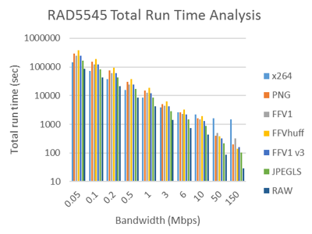
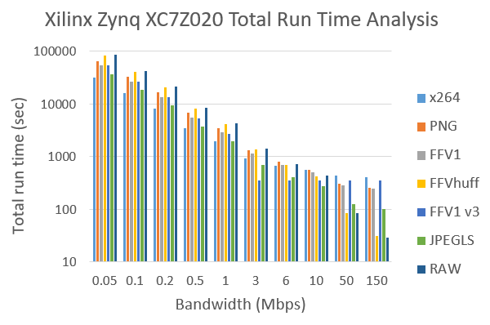
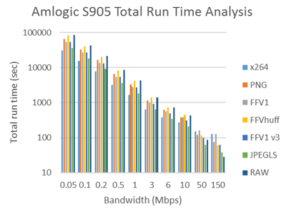
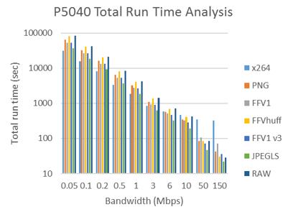
16-Bit vs 8-Bit Encoder Analysis
BSS with x264 compression results in fastest total run-time for bandwidths less than 3 Mbps
Provided highest compression ratio ^{[1]}
FFVhuff provided fastest 16-bit execution time but performed worst in total run-time
Does not compress OPIR video efficiently
Mix between RAW and JPEGLS being fastest at much higher bandwidths
Raw data fastest at all bandwidths
Total Run Time = Execution Time + Transfer Time
1.0x
FFVhuff averaged 2.6x slower than x264
1.0x
1.0x
2.7x
2.2x
2.7x
JPEGLS fastest at high bandwidths
2.7x
JPEGLS fastest at high bandwidths
1.0x
RAW fastest
RAW Fastest
[1] A. Ho, A. George, A. Gordon-Ross “Improving Compression Ratios for High Bit-Depth Grayscale Video Formats,” Proc. Of IEEE Aerospace Conference 2016

Slide 11
Conclusions and Future Research
Analysis of performance of 16-bit and 8-bit encoders on multiple space processors
Analyzed execution time using three different compression methods
PNG and FFV1 version 3 offered much improvement with increasing number of cores
16-bit encoders executed faster since BSS not needed
P5040 had 4.7x speedup over Amlogic S905
Analyzed total run-time
BSS and x264 combination was fastest at lower bandwidths while JPEGLS and RAW were fastest at higher bandwidths
Amlogic S905 and P5040 had best performance due to highest clock speeds
Expand analysis to new devices and SuperFrame method
Use SuperFrame method to leverage image encoders
Integrate encoder IP cores on FPGAs and analyze total run-time

