Slide 1



2017 IEEE Aerospace Conference, 10MAR17
Hybrid, Adaptive, and Reconfigurable Fault Tolerance
Investigators and Students
Christopher Wilson, Sebastian Sabogal, Alan D. George, Ann Gordon-Ross
Research Partners
University of Pittsburgh, University of Florida
Research highlighted in this presentation was supported by CHREC members and by the I/UCRC Centers Program
of the National Science Foundation under Grant Nos. EEC-0642422 and IIP-1161022.

Slide 2

Outline
Acknowledgements
Background
  Space Environment & Design Challenges
  CSP Concept & CSPv1 on ISS
  FPGAs & Partial Reconfiguration
  Asymmetric Multiprocessing
Approach
Conclusions & Future Work

Slide 3
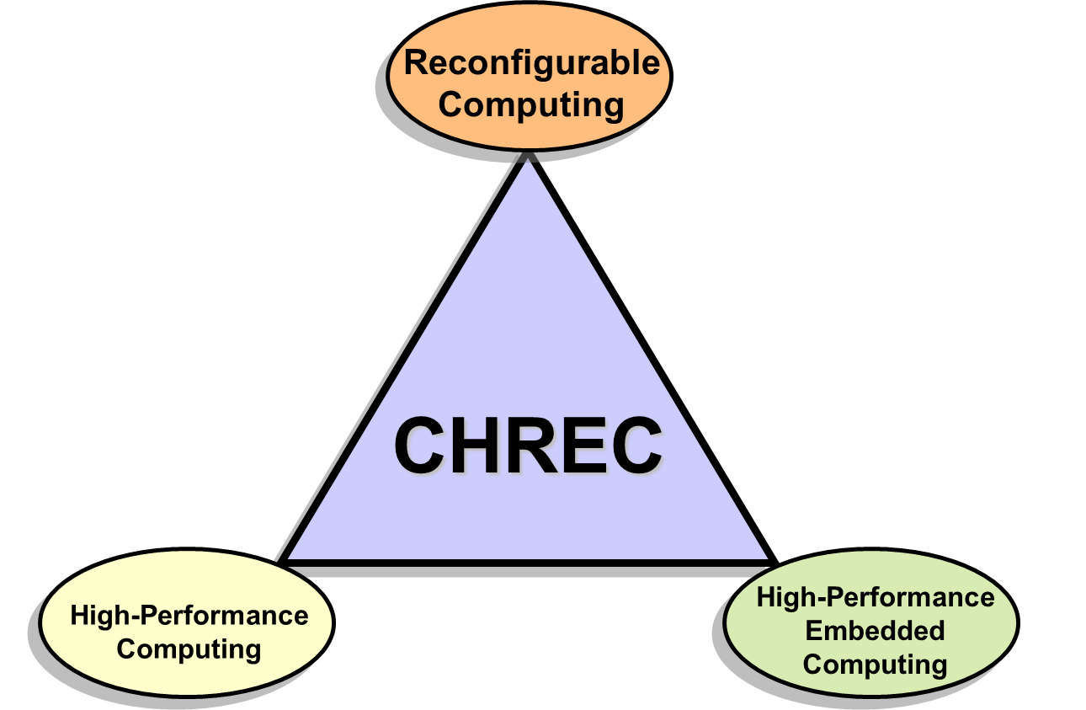

Acknowledgements
Universities
Research Project at CHREC
  NSF Center for High-Performance
  Reconfigurable Computing (CHREC)
    Founded in 2007
    Comprised of 4 university sites and
    30+ industry and government partners
    3 main research domains
I/UCRC Program at NSF
  Industry/University Cooperative
  Research Center
    CHREC is both National Research
    Center and Consortium
    Basic and applied R&D in advanced
    computing in three major domains
Basic Research
CHREC
Applied R&D
Industry & Government
See www.chrec.org for more info

Slide 4
Background

Slide 5
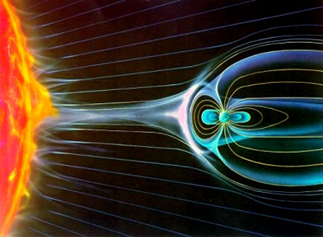
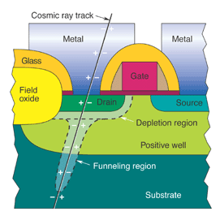
Harsh Space Environment
Challenging Environment
  Designers must consider hazards of
  radiation effects
Radiation Particles and Sources
  Solar flares & coronal mass ejections
  Galactic cosmic rays
  Trapped protons & high-energy ions
Radiation Effects
  Temporal effects
    Single Event Effects (SEE): Upset (SEU),
    Transient (SET), Latch-up (SEL), Burnout (SEB),
    Gate Rupture (SEGR),Functional Interrupt (SEFI)
  Cumulative effects
    Total Ionizing Dose Levels (TID)
    Enhanced low-dose-rate sensitivity (ELDRS)

Slide 6
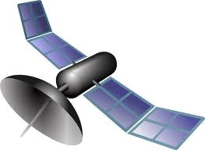
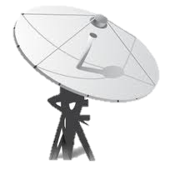







Design Challenges
Challenges
  Limited downlink bandwidth
  Escalating demands for high-performance on-board
  sensor-data and autonomous processing
Requirements
  Space environments have strict
  requirements and restrictions
  Performance (throughput and real-time)
  Size, Weight, Power, Cost (SWaP-C) & Reliability
Radiation Effects
  Radiation from space is harmful to electronic devices
  Radiation commonly manifests as SEEs
    Occurs when particle strikes device causing deposit or
    removal of energy which inverts transistor state
    Usually observed as bit-flip in memory cell and can
    result in several upset modes (i.e. reset of device, silent
    data error, system crash, system hang etc…) on general-purpose processor
Low Power
Depend-ability
Low Cost
Speed
Lifetime
0011
1000

Slide 7
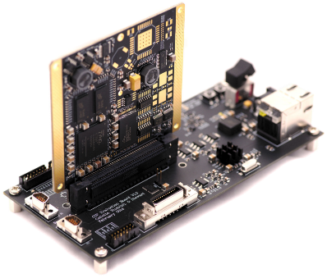
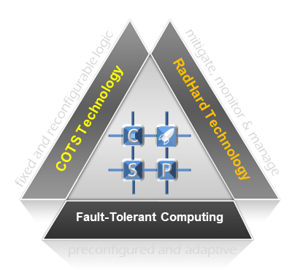
CHREC Space Processor (CSP)
Overview
Motivation
Create high-performance and reliable space computing platform to fulfill variety of demands in mission requirements
Multifaceted hybrid space computer
Hybrid system
(COTS + RadHard technology)
Hybrid processor (Xilinx Zynq-7020)
(Fixed + Reconfigurable logic subsystems)
Concept

Slide 8
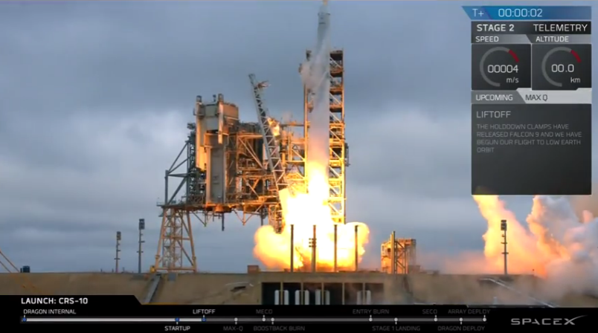
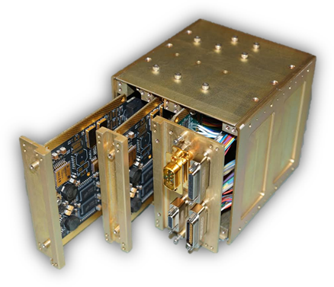

CSPv1 Onboard ISS on STP-H5
Successfully Installed on ISS with Space Test Program – Houston 5 (STP-H5) as part of ISS SpaceCube Experiment Mini (ISEM)
Features 2 CSPv1
Computing Cards
Launched in Feb
19 on SpaceX
CRS-10
Preliminary Functional Checkout Successful
SpaceX CRS-10 Launch
CSPv1 Flight Unit
STP-H5 Installation

Slide 9
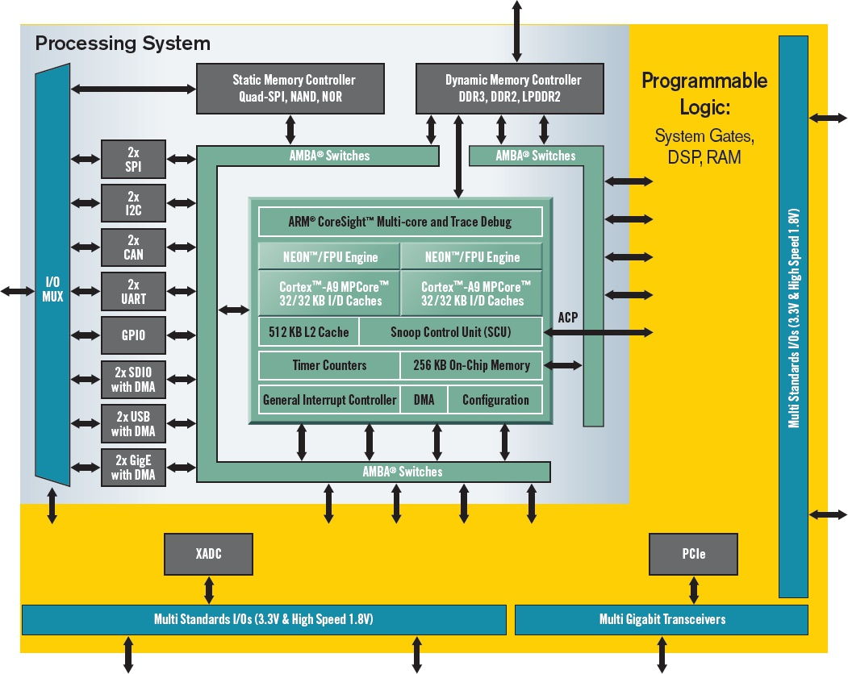
Zynq SoC Architecture
Fixed logic: dual-core
ARM® Cortex™-A9
Reconfigurable logic:
Artix®-7 FPGA

Slide 10
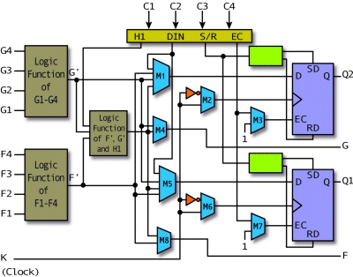
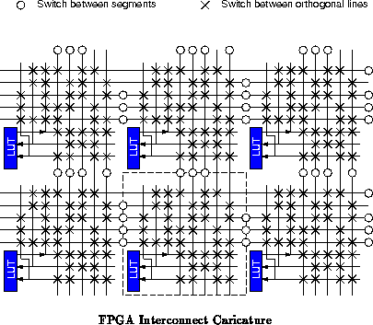
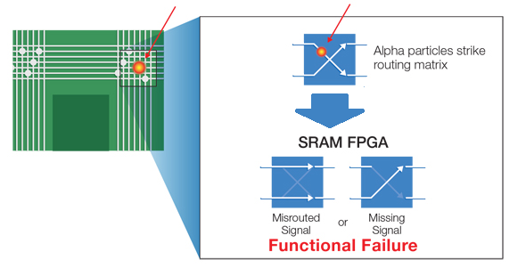
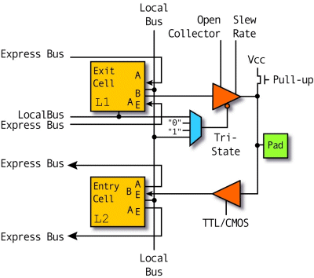
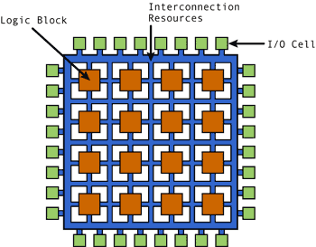

Effects of SEE on FPGAs
Field-Programmable Gate arrays (FPGAs) Provide
Large Amounts of Logic Resources Connected
with Complex, Configurable Routing Network
  Logic resources: LUTs & FFs
  Routing resources: switchboxes
  Specialized resources: BRAMs, DSPs, etc.
Configuration Memory Stores
FPGA Design
  Modification of configuration memories
  affects functionality of device
  SEE can cause bit-flips and other errors
Mitigation on FPGAs
  Accepted practice to run Triple Module
  Redundancy (TMR) on circuits and scrubbing
    TMR – triplicated circuit with voter for error masking
    Scrubbing – background config. memory checking for FPGAs

Slide 11

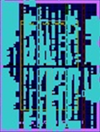

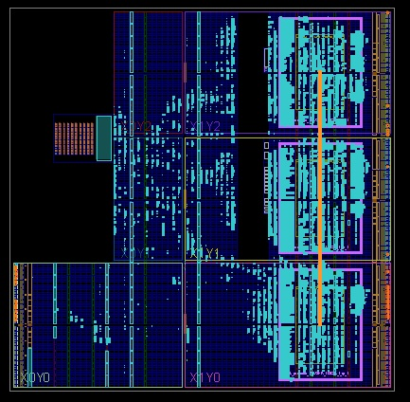
Intro. to Partial Reconfiguration
Partial Reconfiguration (PR): Process of Reconfiguring Sections of FPGA at Runtime
  Program PR module (PRM) without reconfiguring entire FPGA and without interrupting remainder of system
  Rotation of PRMs for large suite of available applications
Reduce Vulnerable Configuration
Area & Power Consumption
Extend Post-Mission Operation
and Capabilities
Dynamically Switch between Multiple Fault-Tolerance Techniques
Zynq-7020 FPGA floor plan
w/ purple-outlined PR regions

Slide 12

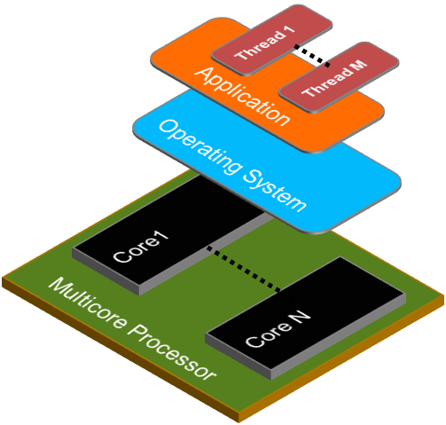
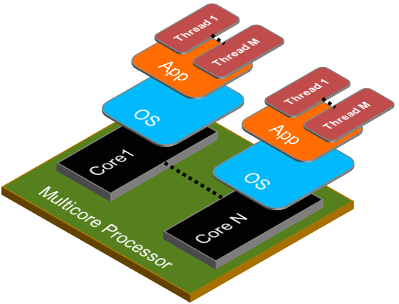
Introduction to AMP
What is AMP?
  Asymmetric multiprocessing (AMP) is mechanism
  that allows multi-core devices to have cores that
  run their own operating systems or bare-metal applications
Advantages of AMP
  Security
    Secure software zoning of secure
    applications
  Fault-tolerance
    Separate application and critical
    flight software
    Redundant processing
  Interactive and real-time processing
SMP
AMP

Slide 13
Approach

Slide 14



Introduction to Hybrid Adaptive Reconfigurable Fault Tolerance
PROBLEM
Hybrid SoCs present numerous architectural advantages, however, there are FT architectural disadvantages
Systems need to respond to changing environment
MOTIVATION
Find synergy of hybrid SoC subsystems for FT
Use adaptive systems to optimize system
configuration for current radiation environment
CHALLENGE
Realize flight-system proof-of-concept testbed
Involves understanding of integration of CPU
and FPGA subsystems

Slide 15
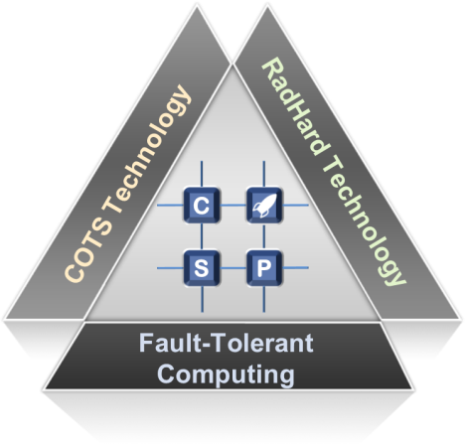
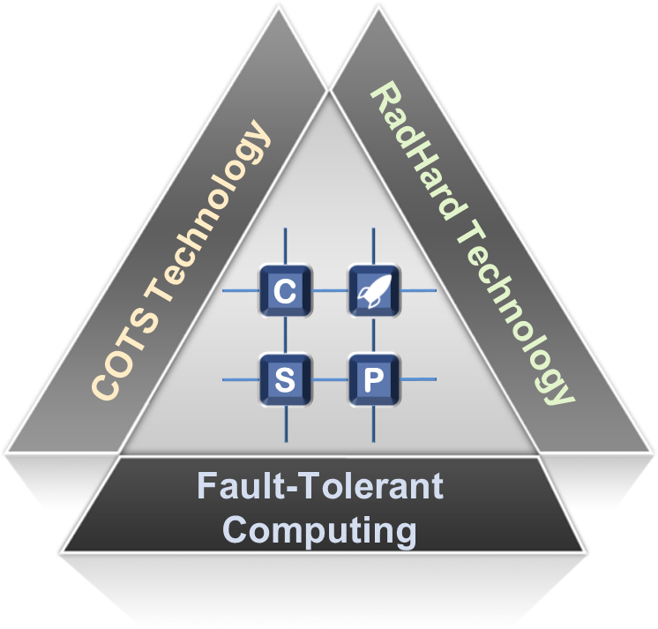



Fault-Tolerant Computing Facet
Fault-Tolerant Computing (FTC)
Research Focused on Improving Reliability of CSPv1 with FTC
Hybrid Capability
  Build FT strategy for hybrid SoC architecture by combining fixed and reconfigurable FT strategies
Reconfigurable Capability
  Environmentally aware configuration manager monitors FPGA configuration upsets while scrubbing to approximate current upset rate
  Adapt to changing upset rate by optimizing usage of resources in performance-reliability trade space
  FT modes in fixed-logic processor and reconfigurable-logic FPGA

Slide 16

HARFT Modes of Operation
Symmetric Multiprocessing (SMP)
Dual-core HPS operates using both cores together for maximum performance
Accelerated modes including OpenMP and distributed processes available
MODE
01
HARFT
Asymmetric Multiprocessing (AMP)
Cores run pseudo-independently for greater reliability in hard environments
Additional functionality possible with real-time operation on second core
MODE
3
02
MODES
Fault Tolerance
FPGA-Enhanced Fault Tolerance (FEFT)
    PRRs in SPS operate MicroBlaze in simplex, duplex, or triplex configurations for reliability
Hardware accelerators can take place of soft cores for additional app acceleration
MODE
03

Slide 17
HARFT Architecture Overview
High-Performance Hard Processing System (HPS)
[ARM Cores]
Redundant Soft Processing
System (SPS) [FPGA]
  Lockstepped MicroBlazes aggregated as one
Static Triplicated Configuration Manager (ConfigMan)
  Configuration memory scrubbing
  Manages system configuration
Partial Reconfiguration Modules
  MicroBlaze soft-core processors
  Auxiliary peripherals or accelerators
Programmable
Logic
Hard
Processing
System
M
Partial
Reconfiguration
Region 0
M
Interconnect
SPS
Static
Memory
M
M
· · ·
Configuration
Manager
ICAP
FRAME
ECC
M
Partial
Reconfiguration
Region N-1
I/O
Storage

Slide 18
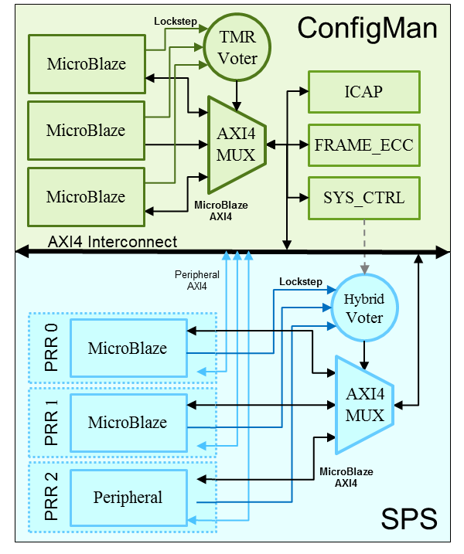
ConfigMan Features
Environmentally Aware
  Performs readback scrubbing to detect faults in configuration memory
  Aging-window algorithm for approximating SEU rate (i.e., number of faults for given period of time)
System Adaptation with Dynamic- Mode Switching
  Repurpose system resources for performance or for reliability based on current SEU rate
  Aggregate or decouple HPS cores
  Reconfigure PRMs
  Manual mode switching: User-implemented policy for reconfiguring system behavior in advance

Slide 19

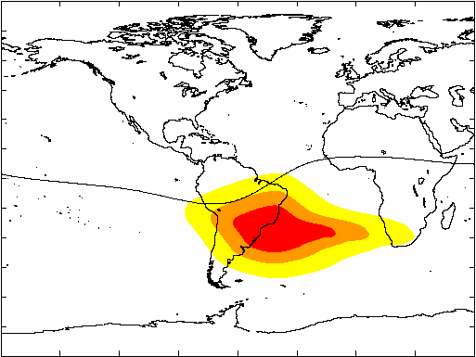

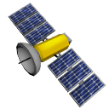
Concept of Operation
Reliability Mode 0
HPS in AMP mode
SPS in simplex operation
High-Performance Mode
HPS in SMP mode
SPS is not present
Reliability Mode 2
HPS in AMP mode
SPS in triplex operation
Reliability Mode 1
HPS in AMP mode
SPS in duplex operation
Programmable
Logic
Auxiliary
M
Soft Core
M
Interconnect
SPS
Static
Auxiliary
Memory
M
M
Soft Core
Configuration
Manager
Auxiliary
ICAP
FRAME
ECC
M
Soft Core
I/O
Storage

Slide 20
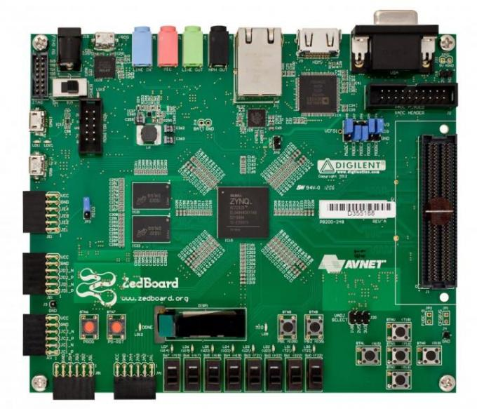
Prototype Description
Proof-of-Concept Prototype for HARFT was Developed
using Digilent ZedBoard containing Zynq-7020 (same
Device as CSPv1)
HARFT Concept Encompasses several
Degrees of Freedom in System
Configurations and User-Defined Policies
for Configuration Management
HARFT Prototype
  HPS configuration:
    SMP: CPU0 + CPU1 run Xilinx Linux
    AMP: CPU0 runs Xilinx Linux, CPU1 runs baremetal
    or RTOS application
  SPS configuration: 3 PRRs, mix of MicroBlazes and AXI4 peripherals
  ConfigMan configuration: Mode switching based on user-configurable upset thresholds
  Miscellaneous details: Prototype contains logic or software for development and debugging that would not be present in actual flight

Slide 21
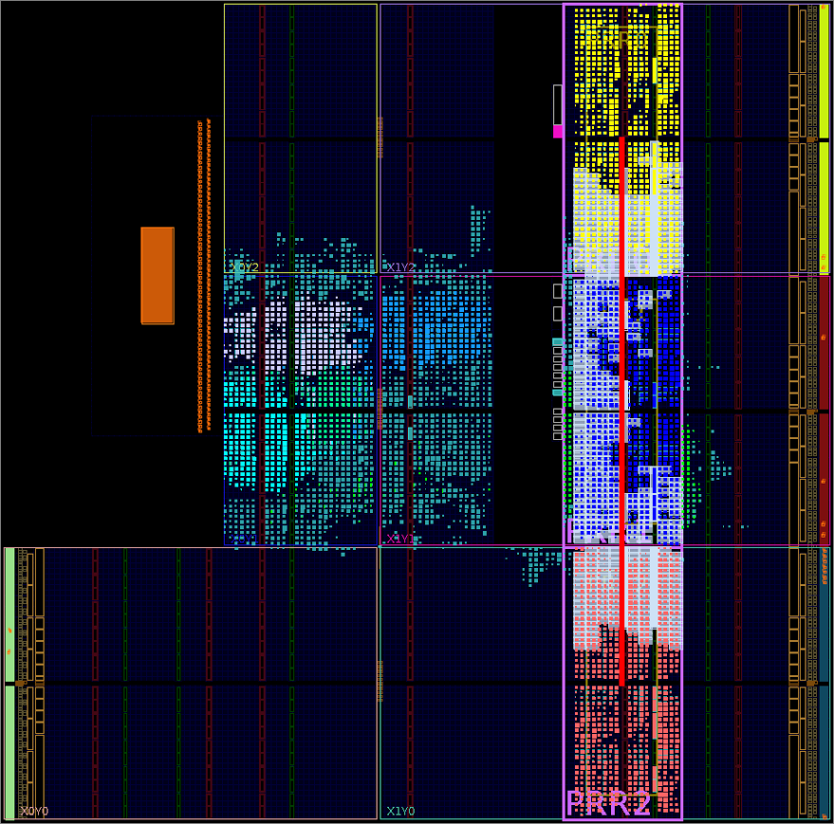
Resource Utilization
Prototype Total Resource Utilization
HARFT on Zynq SoC Floorplan
Resource | Used | Available | Util%
Slice-LUTS | 13931 | 53200 | 26.19
Slice-Registers | 11303 | 106400 | 10.62
BRAM Tile | 1 | 140 | 0.71
RAMB36 | 0 | 140 | 0.00
RAMB18 | 2 | 280 | 0.71
DSP48E1 | 18 | 220 | 8.18
PRR Resource Utilization
Resource | PRR0 | PRR1 | PRR2 | Total
Slice-LUTS | 2428 | 2433 | 2440 | 13931
Slice-Registers | 1884 | 1884 | 1884 | 11303
BRAM Tile | 0 | 0 | 0 | 1
RAMB36 | 0 | 0 | 0 | 0
RAMB18 | 0 | 0 | 0 | 2
DSP48E1 | 6 | 6 | 6 | 18
Color | Component
Cyan | ConfigMan
Purple | SPS-SL
Light Blue | Miscellaneous resources
Yellow, Red, Blue | MicroBlaze PRMs

Slide 22
Performance Modeling
Processor Performance
  Dual-core ARM > single-core ARM
  Single-core ARM > MicroBlaze core
  Benchmark may not be large enough to fully leverage L2 cache memory
Configuration Memory Scrubbing is Relatively Faster than Upset Rates in LEO
Computational Density Device Metrics
Processor | Computational Density (GOPS)
 | INT8 | INT16 | INT32
ARM Cortex-A9 Dual-Core | 32.02 | 16.01 | 8.00
ARM Cortex-A9 Single-Core | 16.01 | 8.00 | 4.00
MicroBlaze Processor | 0.125 | 0.125 | 0.125
FPGA Scrubbing Duration
CoreMark Benchmarking
Operation | Duration (sec)
Readback (Entire FPGA) | 14.5246
Readback (Frame) | 0.001888
Writeback (Entire FPGA) | 19.9478
Writeback (Frame) | 0.002593
Configuration | Iterations/sec
HPS (ARM) with Caches Single-Core | 1993.6778
HPS (ARM) w/o L2 Cache Single-Core | 1971.2254
SPS (MicroBlaze) | 9.5975

Slide 23

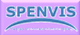




Reliability Modeling
Challenges
  Need for modeling from system, not component, perspective
  Clear and practical methodology for assessing design with COTS
Overview
  4-stage methodology for estimating
  reliability of computers for small
  satellites from system-level
  perspective due to radiation
  Reviewed with NASA GSFC
  radiation effects branch
Key Usage Features
  Gauge general board reliability to provide first-order estimates
  Help compare reliability of different boards designs
  See how each component effects affects overall design reliability
  Evaluate FTC mechanisms of within given design
  Relies on state-of-the-art tools (CRÈME, RHA, SECCA etc…)
Dynamic Fault Tree
ESTIMATE
Established Tools
Fault-Tree Construction
Radiation Literature
Database Survey
Mission Parameters, RTRP
Component Radiation
List Concerns
Radiation Data Collection
Component Analysis
C. Wilson, A. George, and B. Klamm “A Methodology
for Estimating Reliability of SmallSat Computers in
Radiation Environments,” 2016 IEEE Aerospace Conf.,
Big Sky, MT, Mar 5 - 12, 2016.

Slide 24
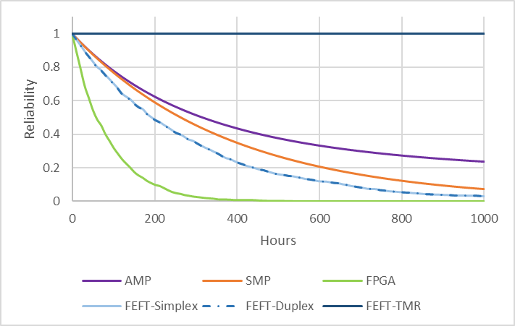
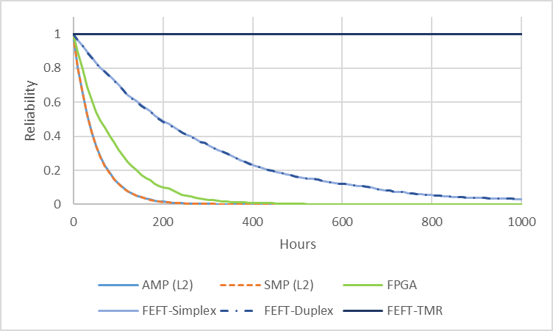
Reliability Over Time
“FPGA” – If every bit on FPGA
was essential for reference
FEFT-TMR reliability near 1 because scrubber
correction rate is higher than LEO upset rate
PS modes become worse with L2 cache enabled
AMP next best
HARFT Reliability with L2 Cache Disabled
HARFT Reliability with L2 Cache Enabled
Upset Rates Calculated for LEO
L2 Cache is Responsible for Majority of Upsets in Processing System

Slide 25
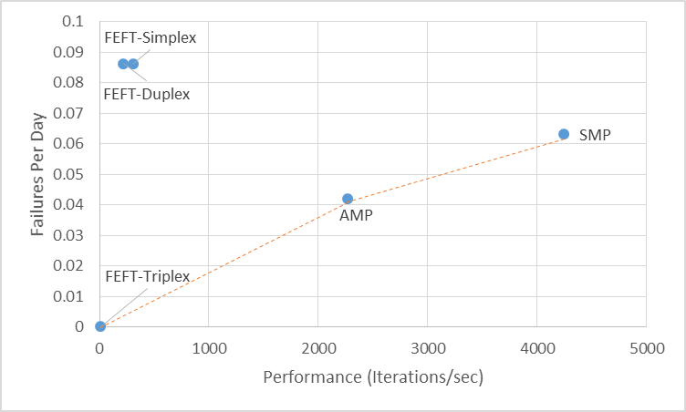
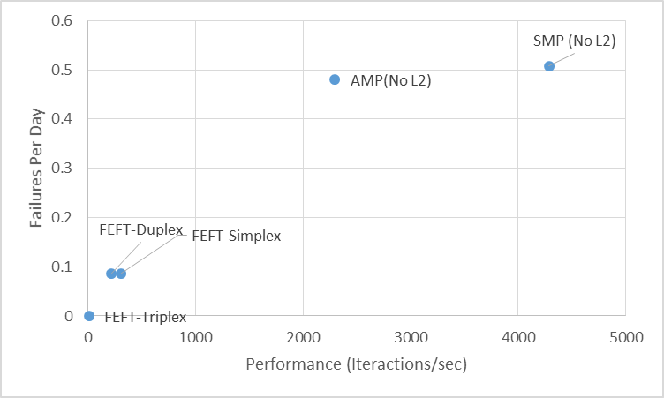
Performance vs Upsets Per Day
Only useful to switch between AMP, SMP,
and FEFT-Triplex when L2 cache is disabled
HPS shows drastically higher performance
but much more prone to upsets
FEFT-Duplex and FEFT-Simplex are viable options
Upsets Per Day vs. Performance
with L2 Cache Disabled
Upsets Per Day vs. Performance
with L2 Cache Enabled
Upset Rates Calculated for LEO
Calculations for SMP Estimated by Doubling Single-Core Results

Slide 26

Conclusions
Major Challenges Lie Ahead…
  Small missions are becoming more prevalent
    SoC and hybrid devices will become more common on spacecraft
  Radiation will have different effects on architectures and hybrid fault-tolerance techniques will be needed
Hybrid Adaptive Reconfigurable Fault Tolerance
  Novel, hybrid fault-tolerant framework (HARFT) designed to adapt to dual architecture needs of SoC device
  Prototype demonstrated 3 configurable modes
    (1) Symmetric Multiprocessing (SMP) + Accelerators
    (2) Asymmetric Multiprocessing (AMP) + Accelerators
    (3) FPGA Enhanced FT + Sub-configurations (TMR, duplex, etc…)

Slide 27






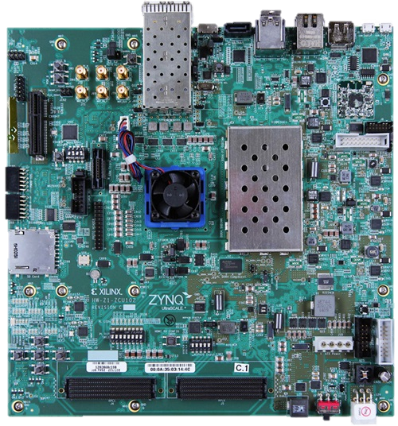
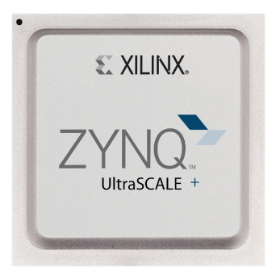
Future Plans
Redundant
Soft Core
Accelerator₀
Accelerator₁
Evolving HARFT
  Mature HARFT prototype into user-
  defined framework
  Extend experimentation and analysis with fault injection and radiation beam testing
  Map HARFT on Zynq UltraScale+ MPSoC
    FT modes for quad-core ARM Cortex-A53 (HPS)
    FT modes for UltraScale Architecture PL (SPS clusters + high-performance HW acceleration)
    Lockstepped ARM Cortex-R5 (ConfigMan)
HARFT in Flight
  Derivative of HARFT framework is planned for Space Supercomputing for Image and Video Processing (SSIVP) on STP-H6 mission (2018)
Redundant
Soft Core
Arbiter
Voter
Accelerator₂
Redundant
Soft Core
Performance
Power
Dependability

Slide 28
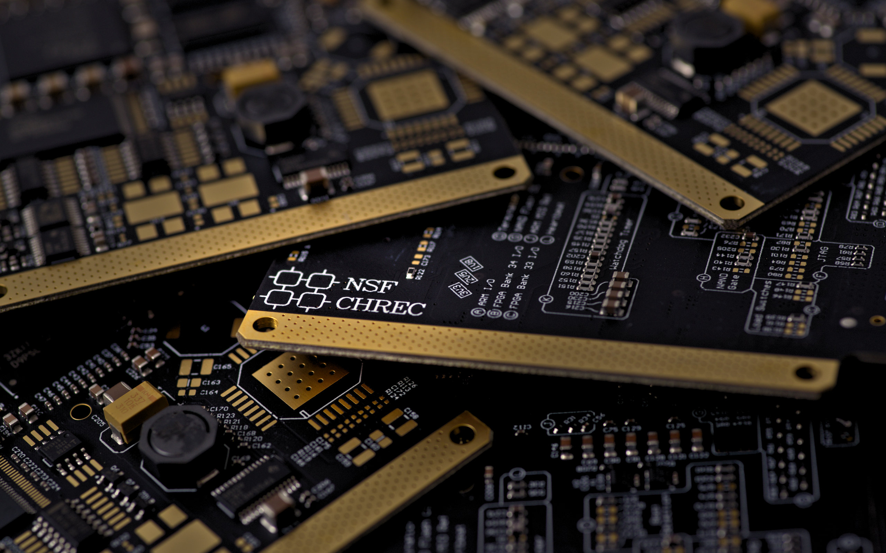
Questions?

