Slide 1
SCIPS: An Emulation Methodology for Fault Injection in Processor Caches
Nicholas Wulf
Grzegorz Cieslewski
Ann Gordon-Ross
Alan D. George
3/7/2011

Slide 2
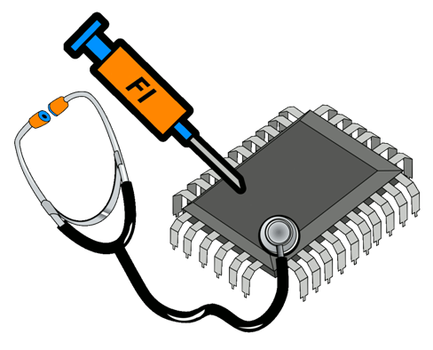
Fault Injector Background
Automated fault-injection tools
Validation of system design characteristics
Demonstration of system robustness in presence of certain faults
Fault injectors typically fall into 1 of 3 categories
Hardware-Based: Physical radiation of device
Complete test of all device components
Expensive and requires special testing platform
Simulation-Based: Modeling of faults and their effects in simulated environment
Full control over fault placement and observation
Requires simulation; May not consider all fault types
Software-Based: Modify software to simulate faults during runtime
Cheaper that hardware-based, more accurate/realistic than simulation-based
Restricts testing from certain important components such as processor cache

Slide 3
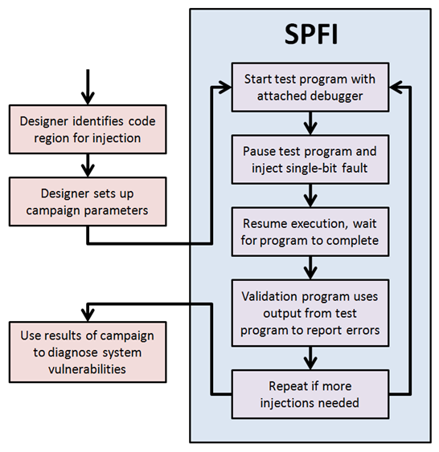
SPFI-TILE: SW-Based Injector
The Simple Portable Fault Injector (SPFI)
Represents group of fault-injectors, each targeting different systems
PowerPC, FPGA, Embedded PowerPC on FPGA
Software runs as normal, pauses at random point, corrupts single bit, and resumes execution
SPFI analyses output of test program
If output is incorrect, then error has occurred
SPFI-TILE: Injector for TILE64
Able to inject faults into several areas
Register file, main memory, instruction stream
Tests a single-bit upset during runtime
Able to target specific tile when test program parallelized on multiple tiles
Easily portable to MAESTRO device

Slide 4
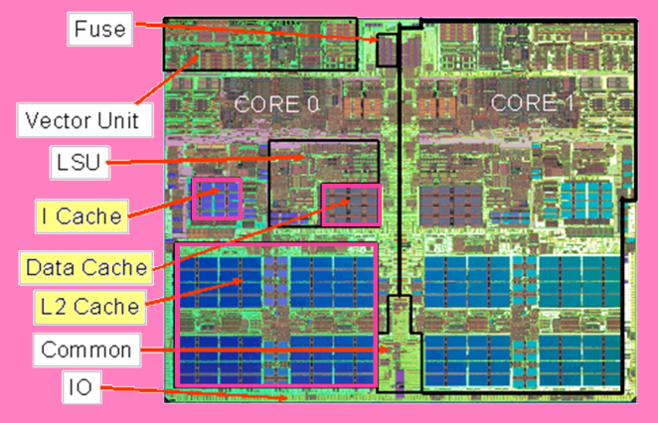
Adding Cache Injection
Testing cache for susceptibility to faults is critical to total system verification
Cache typically largest component on die
Larger physical size causes increased upset rate
Unfortunately, SW-based fault injectors can’t access cache directly
SPFI-TILE can leverage abilities to emulate cache injection
Lack of cache injection is major downside to SW-based fault injectors
Cache injection makes SW-based much more attractive approach
Faulty cache data must be loaded in order to cause errors
As usual, SPFI-TILE randomly pauses execution during test program
Steps through instructions until reaching the first load instruction (FLI)
Data being loaded from is corrupted before the load
Execution resumes with corrupted load data, emulating cache fault
IBM PowerPC 970MP

Slide 5
Drawback to FLI Method (FLIM)
No direct access to cache, no knowledge of its true behavior
Must assume all load instructions (LI) are equally likely to load faults
First Load Instruction Method (FLIM) favors certain LIs
Example code on right illustrates this unbalanced injection problem
Ex. Code loops continuously from 1st to 5th address due to jump instruction
SPFI-TILE stops randomly on any 1 of the 5 instructions, then looks for FLI
FLI for 2nd address is Load_2
FLI for all other address is Load_1
Load_1 receives 80% of injections
This unbalanced injection results in biased measurements
Unrelated to unequal fault-inducing prob. from hidden cache behavior
Simply an artifact of the instruction execution flow
Example of simple loop in a programs instruction stream
Address | Instruction
1st | Load_1
2nd | Load_2
3rd | Non-Load
4th | Non-Load
5th | Jump to 1st Address

Slide 6
Injection Balancing with SCIPS
SCIPS provides method to balance injection rates
Stands for Smooth Cache Injection Per Skipping
Modifies FLIM by randomly skipping LIs instead of always using FLI
Consider same sample code with 5-address loop
With SCIPS, there is a 50% chance that the FLI is skipped and the next LI is used for injection instead
What is chance of injecting into Load_2?
20% chance to stop on 2nd Address and 50% chance to use the FLI
80% chance to not stop on 2nd Address and 50% chance to skip to the next LI
(0.2)(0.5) + (0.8)(0.5) = 50%
Simply adding a single skip 50% of the time removes the unbalanced injection problem caused by FLIM
Example of simple loop in a programs instruction stream
Address | Instruction
1st | Load_1
2nd | Load_2
3rd | Non-Load
4th | Non-Load
5th | Jump to 1st Address

Slide 7
SCIPS and Convolution
How does previous example work with more complex code?
Assume that example loop executes 20 times (100 instructions total)
Probability of stopping on n^{th} LI is
The probability of SCIPS skipping n LIs is given by its PMF P_{skip}[n]
For previous 50-50 example,
Let P_{SCIPS}[n] equal the fault-injection probability of injecting into the n^{th} LI using SCIPS with a skipping PMF equal to P_{skip}[n]
Calculating P_{SCIPS}[n] for given n involves summing the following values
Probability of skipping 0 times when the n^{th} LI is the FLI
Probability of skipping 1 time when the (n-1)^{th} LI is the FLI
Probability of skipping 2 times when the (n-2)^{th} LI is the FLI
Continue this pattern until P_{skip}[n] reduces to zeros
This pattern is equivalent to
The problem of finding the right PMF for P_{skip}[n] is identical to finding an FIR filter to remove AC signals from the code!

Slide 8
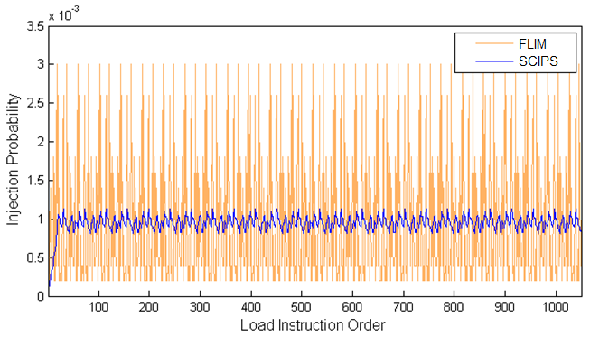
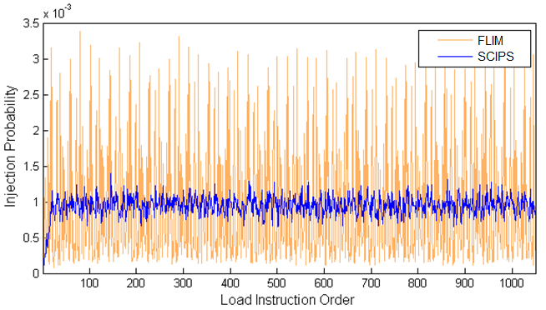
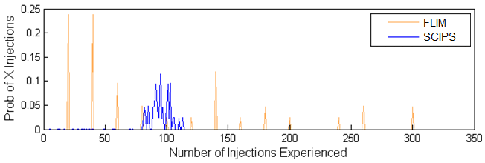
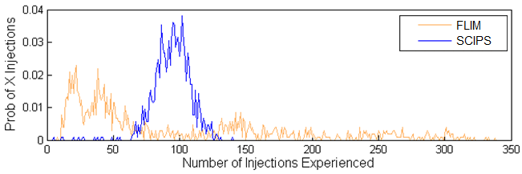
Simulation Results
MATLAB analysis used to test theory
Synthetic code generated to simulate injections
Created set of 200 instructions that loops 25 times
LIs randomly distributed throughout set (20% LIs)
Provides theoretical and simulated results
Theoretical results based on convolution analysis
Simulated results based on 100,000 test runs
Each consisted of randomly stopping within the code and randomly choosing a LI based on PMF
Results confirm SPIPS convolution theory
Results on right show injection prob. for each LI
About 1000 LIs, so an average of 0.1% is expected
SCIPS smoothes out unbalanced injection probabilities
Left results show inj. count PMF for a given LI
Based on 100,000 injections across 1000 LIs, the average number of injections for a given LI is 100
Theoretical prediction (top) and simulation (bottom) of fault-injection probabilities across all load instructions for synthetic code using FLIM (highly peaked line) and SCIPS (smoother line)
Theoretical (top) and simulated (bottom) injection count PFM for a given load instruction using FLIM (dispersed groups) and SCIPS (tight grouping)

Slide 9
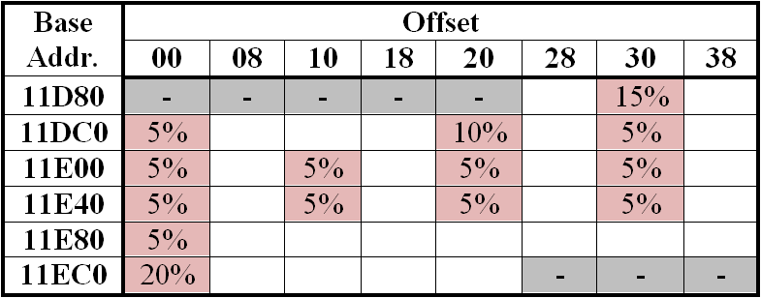
Testing on SPFI-TILE
Integrated SCIPS into SPFI-TILE to confirm effectiveness
Parallel (5 tiles) integer matrix multiply code used as test program
Calculates C matrix as product of A (550x600) and B (600x650) matrices
Innermost loop (in red on right) accounts for 99% of total calculation time
Recieves 99% of injections
Innermost loop of matrix multiply code is focus of the test
Bottom right shows the address range of innermost loop’s execution
Each box represents single instruction
40 total instructions (0x11DA8 – 0x11EE0)
Gray boxes not included in loop
Red boxes represent LIs
Predicted FLI probabilities shown
White boxes show non-load instructions
Addresses 0x11DB0 and 0x11EC0 receive ¹/₃ of injections with FLIM
for (int i=0; i<rowCount; i++) {
for (int j=0; j<dimWC; j++) {
int sum = 0;
for (int k=0; k<dimInner; k++) sum += matA[i][k] * matBtp[j][k];
matC[i][j] = sum;
}
}
Main loop for parallel matrix multiply test program (innermost loop highlighted in red)
Addresses for innermost loop (LIs highlighted in red with predicted FLI probabilities)

Slide 10
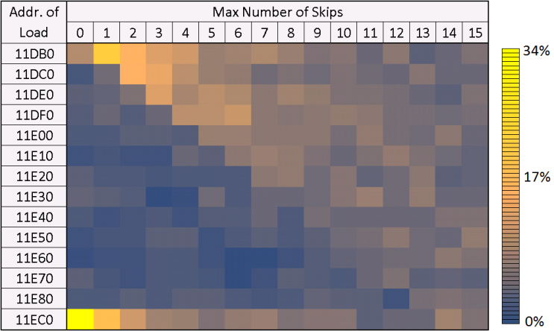
SPFI-TILE Results
Different skipping PMFs were applied to SCIPS during tests
Each column in figure represents injection distribution for unique PMF
PMFs are uniform from 0 to some max number of skips
Equivalent to using a moving average filter on FLIM distribution (1st column)
Results show SCIPS removes imbalance caused by FLIM
FLIM equivalent to skipping 0 times
0x11DB0 and 0x11EC0 most likely for injection
As skipping range increases, injection peak is stretched across subsequent LIs
Near uniform results when skipping range reaches 13 or more

Slide 11
Conclusions
SW-based fault injectors can emulate cache injection by monitoring instruction stream and modifying memory
This emulation strategy inherently leads to unbalanced injection rates that are uncharacteristic of the hidden cache behavior
SCIPS provides method to balance biased injection rates
MATLAB simulation shows 97% reduction in variance of inj. prob.
SPFI-TILE experiment showed near complete smoothing of injection rates with as low as 13 skips
SCIPS behavior is well defined and analogous to convolution
Acknowledgements
Special thanks to Marti Bancroft and the National Reconnaissance Office for their support in providing equipment and tools

