Slide 1
A Framework to Analyze, Compare, and Optimize High-Performance, On-Board Processing Systems
Nicholas Wulf
Alan D. George
Ann Gordon-Ross
3/5/2012

Slide 2
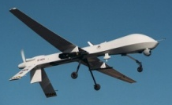
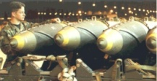
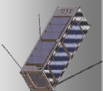
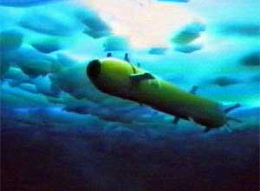
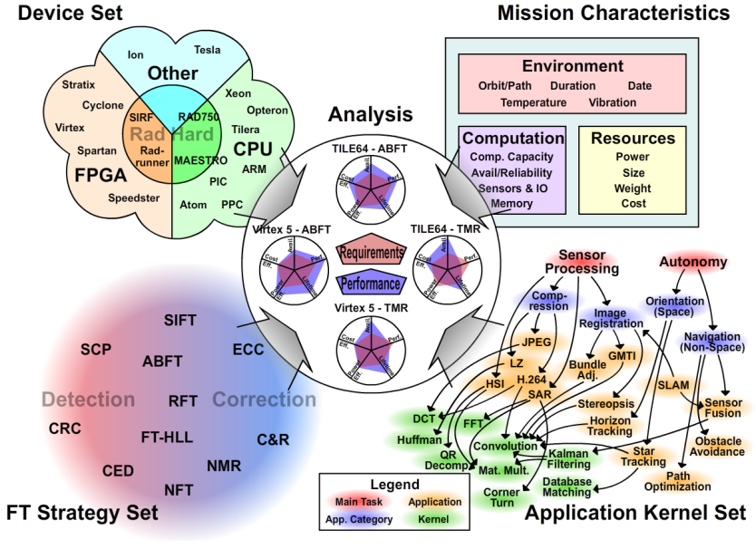
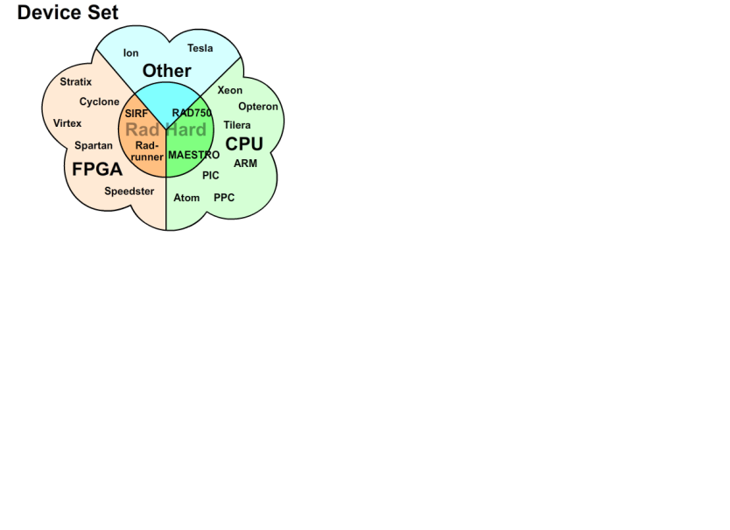
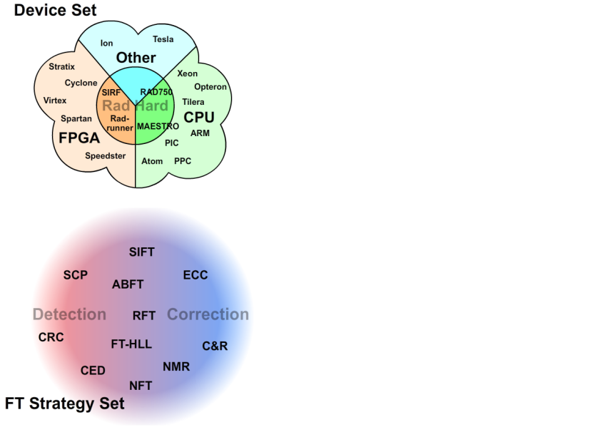
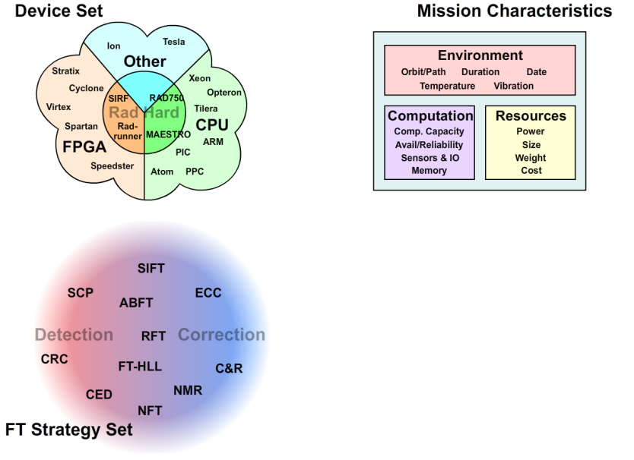
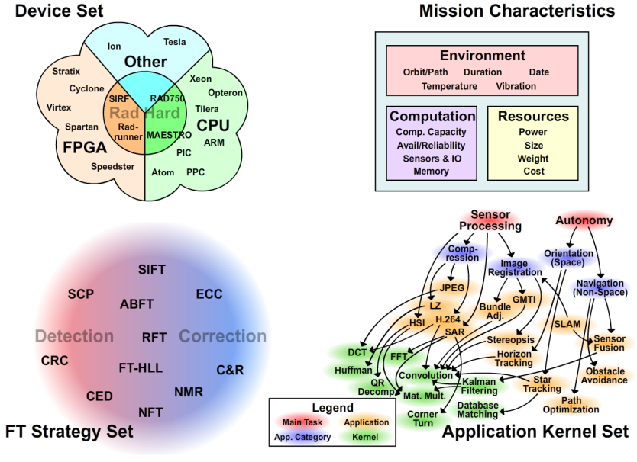
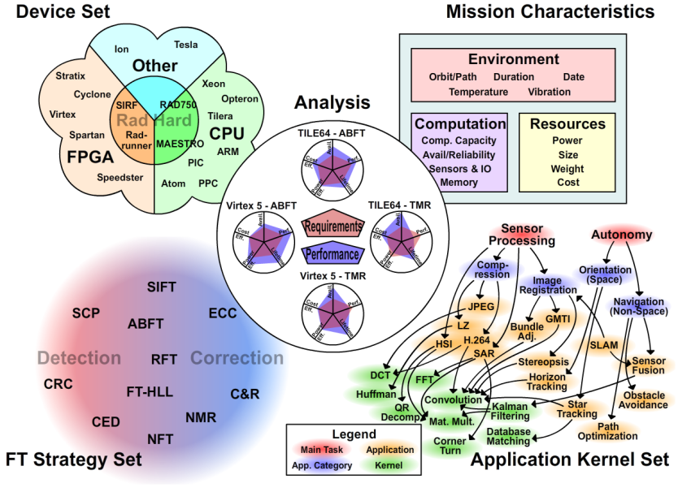
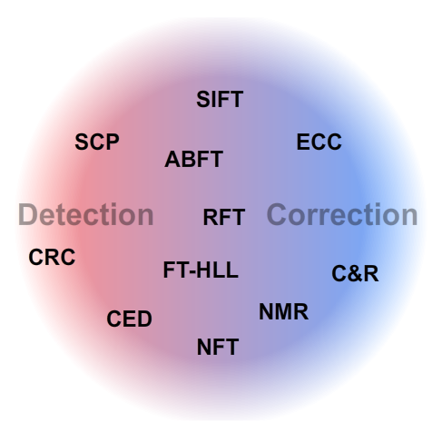
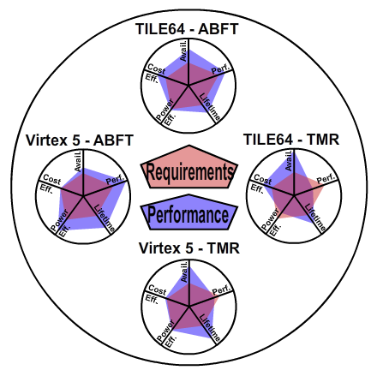
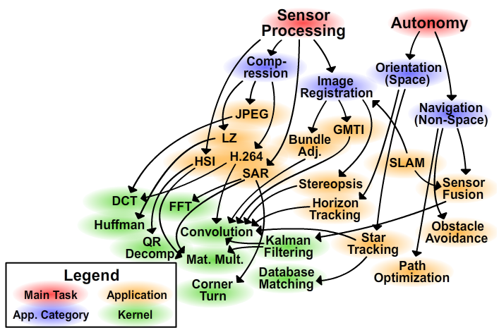
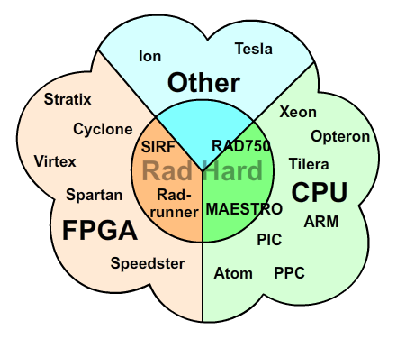
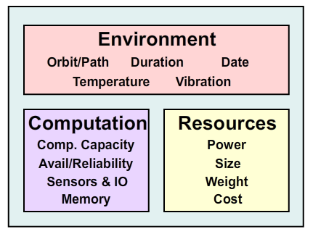
On-Board Proc. Framework
Goal: Provide theory for determining Pareto-optimal device & fault-tolerant (FT) strategy for on-board processing systems
Focus on small satellites, UAVs, smart munitions, AUVs
Generalized comparison framework deters ad hoc design methodology, leading to Pareto-optimal designs
Approach: Divide exploration space into its key components for study
Device Set – Includes CPUs, DSPs, FPGAs, GPUs, & any Rad-Hard versions
FT Strategies – Sacrifice resources for fault tolerance (may be app-specific)
Mission Characteristics – Defines system’s environmental conditions
Application Set – Includes most common kernels (e.g., space apps.)
Analysis – Design evaluation metrics calculated from other components
Is selected design acceptable?
How does it compare to others?
Application
Kernel Set
Mission Characteristics
Device Set
Analysis
FT Strategy Set

Slide 3
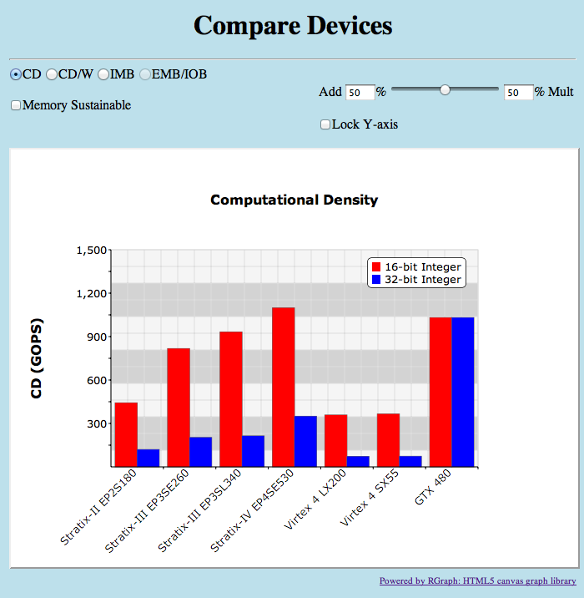
Calculating Computational Density
Computational Density (CD) used to analyze device performance
Developed within CHREC at the University of Florida
Applicable to wide range of architectures (e.g., CPU, DSP, GPU, FPGA, etc.)
Produces results in terms of operations per second
Different CD result for each type of precision (e.g., bit, 8-bit int., 64-bit double)
CD also depends on type of operation (e.g., add, multiply, divide)
Standard objective methodology for calculating CD on FPGAs
Generate and analyze compute core on FPGA
Perform twice for each core; one with and one without DSP resources
Core must match desired precision & operation
Collect data on resources used and max freq.
Use optimal packing algorithm to determine maximum number of cores on device
CD equals number of cores times worst clock rate from the list of cores used

Slide 4
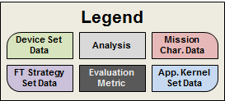
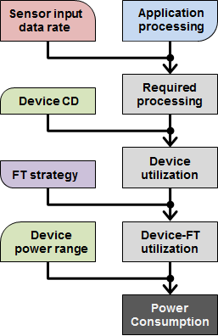
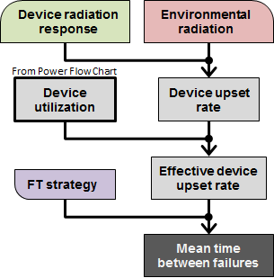
Framework Methodology
Designs evaluated according to two metrics
Power – power consumed by device
Sensor data rate & application determine amount and type of required processing
Device utilization is ratio of corresponding device CD to required processing
FT strategy overhead increases utilization
Linear interpolation between power range to find power consumption
Dependability – time between failures
Device radiation characteristics and environment determine device upset rate
Low utilization causes lower vulnerability
FT strategies help to mitigate upsets
Power
Sensor
Power
Sensor
Device
Device
TMR
Utilization: 72%
Utilization: 24%
Consumed
Max
Dependability
Dependability
Device Upset Rate:
Static
10 upsets/day
0%
50%
72%
100%
Device Cross-Section (SEE / Particle·m²)
Environmental Radiation (Particles / m²·ster·s)
Utilization
0
50
100
LET $\left(\frac{MeV}{mg∙{cm}^{2}}\right)$
Only 72% of device is vulnerable
TMR protects against 99% of upsets
0.14
MTBF:
13.89
0.10
days
MTBF = Mean Time Between Failures
TMR = Triple-Modular Redundancy
CD = Computational Density

Slide 5
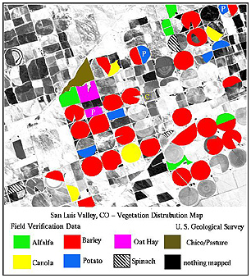
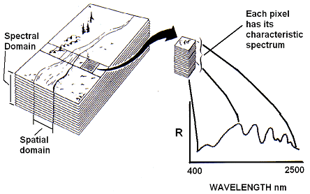
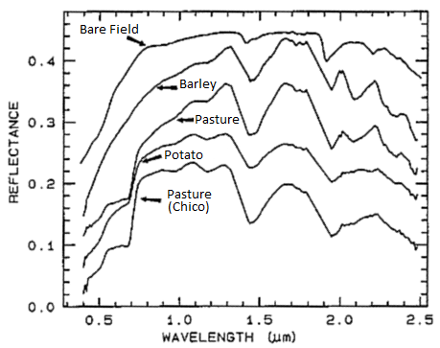
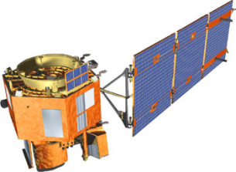
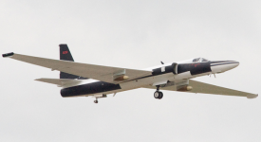
HSI Case Studies
Hyperspectral Imaging (HSI) enables detection of key materials within a scene
Detects intensities of hundreds of wavelengths for each pixel forming an image cube
Compares characteristic spectrum of pixels to spectral signatures of desired materials
Marks location of identified materials within the scene
Image cube too large for transfer to processing station due to limited bandwidth
Solution: perform computation in-situ and only transfer final results
Two HSI missions chosen as case studies for on-board processing
Hyperion on EO-1 satellite requiring 2.2×10⁹ 32-bit integer MAC/s
AVIRIS on ER-2 aircraft requiring 348×10⁶ 32-bit integer MAC/s
Identify
Detect
Compare
MAC = Multiply Accumulate

Slide 6
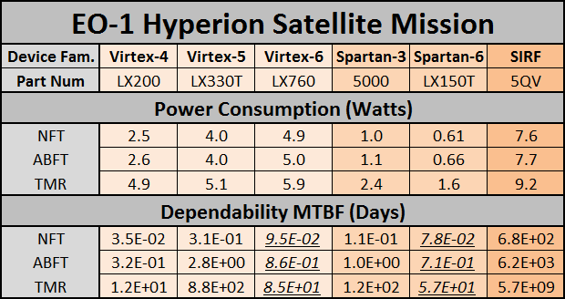
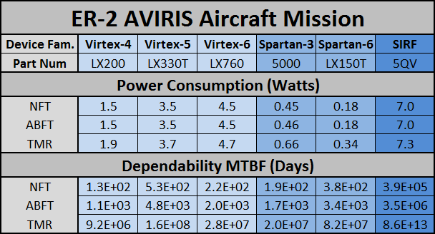
Raw Results
Studied design combinations of 6 FPGAs and 3 fault-tolerant strategies
Devices: 3 standard Virtexes, 2 low power Spartans, and 1 Rad-Hard SIRF
Fault-tolerant strategies:
No fault tolerance (NFT): 0% overhead and no added reliability
Algorithm-based FT (ABFT): 10% overhead and significant added reliability
Triple-modular redundancy (TMR): 200% overhead and strongest reliability
Power consumption and dependability metrics calculated for each design
Values predicted with linear regression on feature size in underlined italics
FPGA = Field-Programmable Gate Array

Slide 7
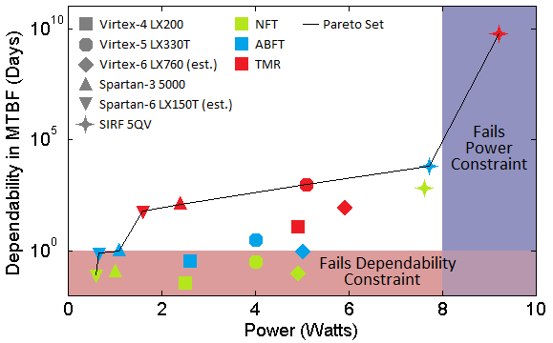
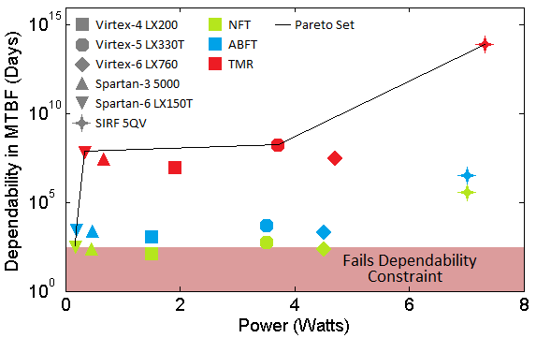
Optimal Design Selection
Framework determines Pareto-optimal designs based on metrics
Non-Pareto-optimal designs can be completely ignored
Constraints on metrics enforced to remove invalid designs
Removes unreliable and/or power-hungry designs based on mission
Out of 18 designs, only 5 designs selected as optimal for each mission
Designers decide which design is best based on desired tradeoffs
EO-1 Hyperion Satellite
ER-2 AVIRIS Aircraft

Slide 8
Conclusions and Future Research
Conclusions
The design of on-board processing systems can be complicated
Many constraints due to sparse and hostile environments
Many combinations of devices and FT-strategies to consider
Our framework simplifies exploration space and highlights most promising designs, allowing designers to choose best design for their needs
Future Research
Add CPUs to list of studied devices (from high performance to low power)
Consider memory devices in addition to processors
Integral to on-board processing systems
Affects performance, power, and dependability
Expand framework to include metrics such as lifetime (TID), cost, size/weight, maximum dose rate

