Slide 1

Online Algorithms for Wireless Sensor Networks Dynamic Optimization
Arslan Munir¹, Ann Gordon-Ross²⁺, Susan Lysecky³, and Roman Lysecky³
¹ Department of Electrical and Computer Engineering
University of Toronto, Toronto, Ontario, Canada
² Department of Electrical and Computer Engineering
University of Florida, Gainesville, Florida, USA
³ Department of Electrical and Computer Engineering
University of Arizona, Tucson, Arizona, USA
⁺ Also affiliated with NSF Center for High-Performance Reconfigurable Computing
This work was supported by National Science Foundation (NSF) grant CNS-0834080 and Natural Sciences and Engineering Research Council of Canada (NSERC)

Slide 2



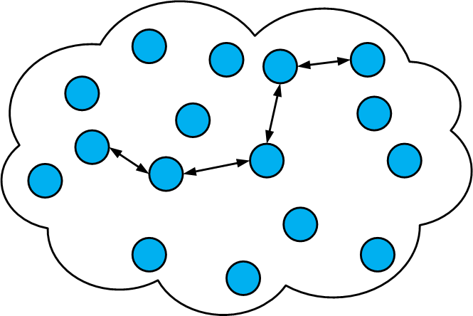


Introduction and Motivation
Wireless Sensor Network (WSN)
WSN
Applications
Importance
Network
Application manager
(WSN designer)
Ever
Increasing
Gateway node
Sensor nodes
Security and
Defense Systems
Sink node
Health Care
Sensor field
Ambient conditions Monitoring, e.g., forest fire detection

Slide 3

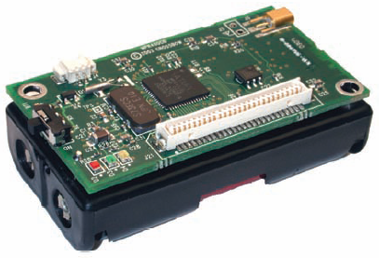
Introduction and Motivation
WSN
Design
Forest fire could spread
uncontrollably in the
case of a forest fire
detection application
Failure to meet
Challenges
Catastrophic
Consequences
Meeting application requirements
e.g., reliability, lifetime, throughput,
delay (responsiveness), etc.
Loss of life in the case
of health care application
Application requirements
and environmental conditions
(stimuli) change over time
Tunable Parameters
Processor Voltage
Processor Frequency
Commercial
off-the-shelf
sensor nodes
Radio Transmission Power
Characteristics
Generic Design
Not Application Specific
Few Tunable Parameters
Sensing Frequency

Slide 4
Introduction and Motivation
Determine appropriate
parameter values to meet
application requirements
Parameter
Tuning
(Optimization)
Challenges
Application managers
typically non-experts
e.g. agriculturist,
biologist, etc.
Types
Static
Optimization
Dynamic
Optimization
Cumbersome and
time consuming task
Challenges/
Disadvantage
Assign parameter values at deployment
Stay the same during sensor node lifetime
Assign parameter values at runtime
Reassign/change parameter values
in accordance with changing
application requirements and
environmental stimuli
Difficult to predict/simulate
environmental stimuli
Not suitable for applications with
changing application requirements
and environmental stimuli

Slide 5
Contributions
Dynamic Optimization
for WSNs
Dynamic Optimization
Methodology
Online Optimization
Algorithms
We propose an online
dynamic optimization
methodology that extends
static optimization
Our proposed methodology
is amenable to non-expert
application designers
We propose online algorithms
(greedy- and simulated annealing-based)
that enable dynamic optimizations to
meet application requirements
Greedy- and simulated annealing-
based algorithms enable relative
comparison of solution quality and
required computational resources
Our proposed online algorithms
consume minimum storage and
computational requirements that are
amenable for resource constrained
embedded sensor nodes
Our proposed online
algorithms quickly converge
to a near-optimal solution

Slide 6
Related Work
Dynamic optimizations
  Much research in dynamic optimizations: Brooks et al. [ACM Trans. on Computer Systems, 2000], Hamed et al. [IEEE JSAC, 2006], Hazelwood et al. [ACM TACO, 2006]
  Our work differs from the previous dynamic optimizations work
    Applies dynamic optimization to embedded sensor node parameter tuning
    Previous work focused on processor or memory (cache) in computer systems
Dynamic optimizations and algorithms for embedded sensor nodes
  Kogekar et al. [ACM IPSN, 2008] discussed dynamic software reconfiguration in WSNs
  Min et al. [IEEE WVLSI, 2000], Yuan et al. [IEEE ASAP, 2002] investigated DVFS for embedded sensor nodes
  Verma [MS Thesis, U of A, 2008] and Lysecky et al. [UbiComp, 2006] studied SA-based algorithms for parameter tuning
  Our work differs from previous embedded sensor nodes dynamic optimization work
    We explore extensive sensor node design space with many tunable parameters
    Previous work did not analyze execution time and memory requirements
Different design space (e.g., line size, associativity)

Slide 7

Dynamic Optimization Methodology for WSNs
Application metrics specify
application requirements
(e.g., lifetime, throughput)
Application Requirements
Application Metrics and Weight Factors
Per Sensor Node Dynamic Optimization Process
Weight factors specify the
importance of each application
metric with respect to each other
Sensor node
Optimal or
Near-Optimal
Operating
State
Dynamic
Optimization
Module
(Online
Optimization
Algorithm)
Dynamic
Optimization
Controller
WSN Designer
Profiling statistics
Wireless channel
condition
Number of
packets dropped
Radio trans-
mission power
Processed
Profiling
Statistics
Operation
in the
Determined
State
Sensor Node
Dynamic
Profiler
Module
Profiling
Statistics
Processing
Module
Operational Feedback

Slide 8


Dynamic Optimization Formulation –
State Space
State Space
  We define state space S as
  where
  = cartesian product
  S_{i} = state space for tunable parameter i
  Each tunable parameter S_{i} consists of n values

Slide 9



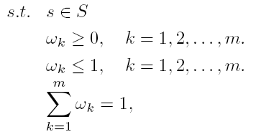
Dynamic Optimization Formulation –
Objective Function
Objective Function
  The dynamic optimization problem can be formulated as
  where
  = overall objective function
  = objective function for the k^{th} application metric
  = weight factor for the k^{th} application metric

Slide 10
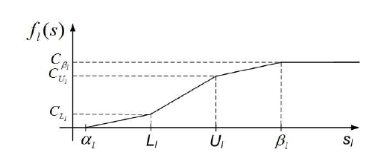
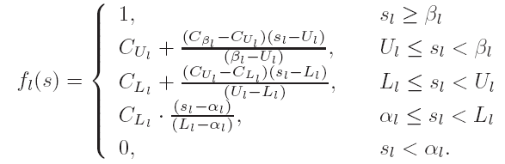
Dynamic Optimization Formulation –
Objective Function
Application Metrics’ Objective Functions
  We consider three application metrics
    Lifetime (with objective function f_{l}(s))
    Throughput (with objective function f_{t}(s))
    Reliability (with objective function f_{r}(s))
  We consider piecewise linear functions
    Piecewise linear functions enable
    specification of desired and acceptable
    values of application metrics, e.g.,
Desirable Range
Acceptable Range
L_{l} = minimum desirable lifetime
U_{l} = maximum desirable lifetime
α_{l} = minimum acceptable lifetime
β_{l} = maximum acceptable lifetime

Slide 11
Online Algorithms for Dynamic Optimization –
Greedy Optimization Algorithm
Initial tunable
parameter values
solution from state μ
Explore each sensor node
tunable parameter
in ascending order
current state
solution
Stop exploring the current
tunable parameter
current state
return ξ & BestSolution

Slide 12
Online Algorithms for Dynamic Optimization –
Simulated Annealing Optimization Algorithm
Initializations
number of trials c at a given temperature
number of temperature reductions t_{o}
initial values of all tunable parameters
set pseudo-randomly
current annealing temperature T_{q}
initialized to initial temperature T_{o}
solution from initial state μ
Explore neighboring states
pseudo-randomly
New neighboring
state solution
Stochastic hill climbing
based on Metropolis-Hastings
random-walk algorithm
current state
Decrease annealing
temperature exponentially
return ξ & BestSolution

Slide 13
Experimental Results
Sensor Node Platform
  Crossbow IRIS mote
    Two AA alkaline batteries
      battery capacity = 2000 mA-h
    Atmel ATmega1281 microcontroller
    MTS400 sensor board
      Sensirion SHT1x temperature and humidity sensors
    Atmel AT-86RF230 low power 2.4 GHz transceiver
Tunable Parameters
  Processor voltage
  Processor frequency
  Sensing frequency
  Packet size
  Packet transmission interval
  Transceiver transmission power
Crossbow Mica2 mote

Slide 14
Experimental Results
Design Space Cardinalities
  |S| = 729
    V_{p} = {2.7, 3.3, 4} (volts)
    F_{p} = {4, 6, 8} (MHz)
    F_{s} = {1, 2, 3} (samples per second)
    P_{s} = {41, 56, 64} (bytes)
    P_{ti} = {60, 300, 600} (seconds)
    P_{tx} = {-17, -3, 1} (dBm)
  |S| = 31,104
    V_{p} = {1.8, 2.7, 3.3, 4, 4.5, 5} (volts)
    F_{p} = {2, 4, 6, 8, 12, 16} (MHz)
    F_{s} = {0.2, 0.5, 1, 2, 3, 4} (samples per second)
    P_{s} = {32, 41, 56, 64, 100, 127} (bytes)
    P_{ti} = {10, 30, 60, 300, 600, 1200} (seconds)
    P_{tx} = {-17, -3, 1, 3} (dBm)
Crossbow Mica2 mote

Slide 15
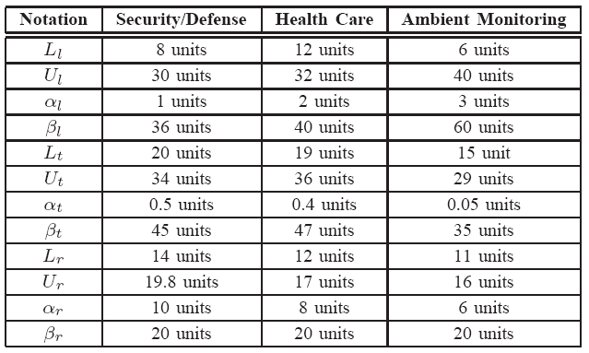
Experimental Results
WSN Applications
  Security/defense system
  Health care
  Ambient conditions monitoring application
Algorithms implemented in C++: Greedy (GD) and Simulated Annealing (SA)
TABLE: Desirable minimum L, desirable maximum U, acceptable minimum α, and acceptable maximum β, objective function parameter values. One lifetime unit = 5 days, one throughput unit = 20 kbps, one reliability unit = 0.05
E.g., for security/
defense system:
acceptable minimum lifetime α_{l} = 5 days
acceptable maximum lifetime β_{l} = 180 days
Lifetime
Throughput
Reliability

Slide 16
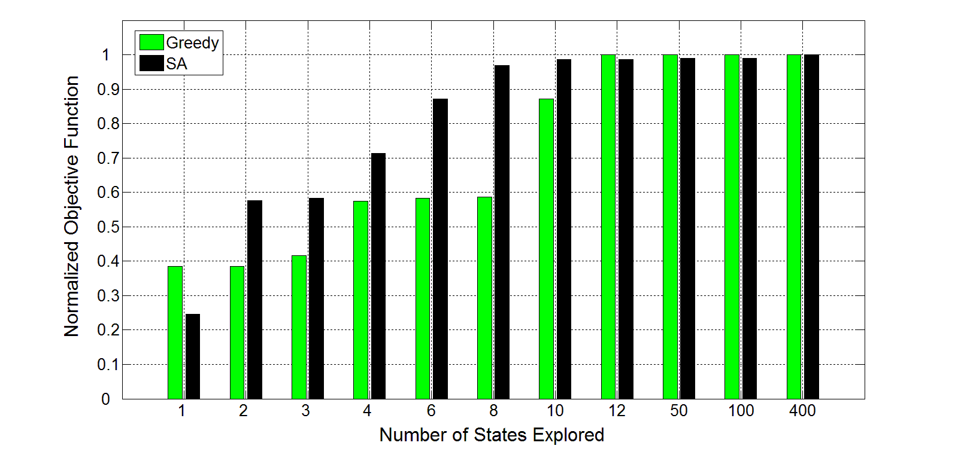
Results – Security/Defense System
Average growth rate for increasing solution quality was faster in initial iterations than later iterations both for GD and SA
GD converges quickly to optimal (or near-optimal) solution
Objective function value normalized to the optimal solution for a varying number of states explored for SA and the greedy algorithms for a security/defense system where ω_{l}=0.25, ω_{t}=0.35, ω_{r}=0.4, |S| = 729.

Slide 17
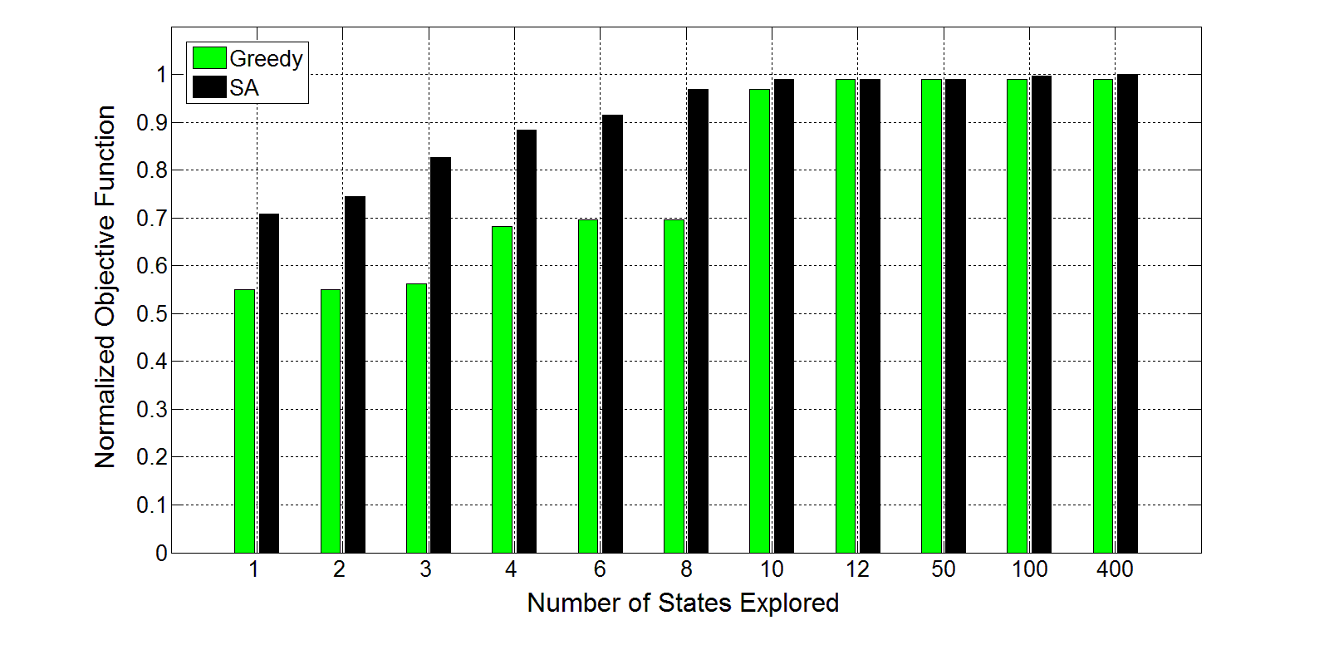
Results – Health Care
GD converges to the steady state after exploring 11 states (1.5% of the design space)
SA algorithm converges to the optimal solution after exploring 400 states (55% of the design space)
GD solution is within 0.03%
of the optimal solution
Objective function value normalized to the optimal solution for a varying number of states explored for SA and the greedy algorithms for a health care application where ω_{l}=0.25, ω_{t}=0.35, ω_{r}=0.4, |S| = 729.

Slide 18
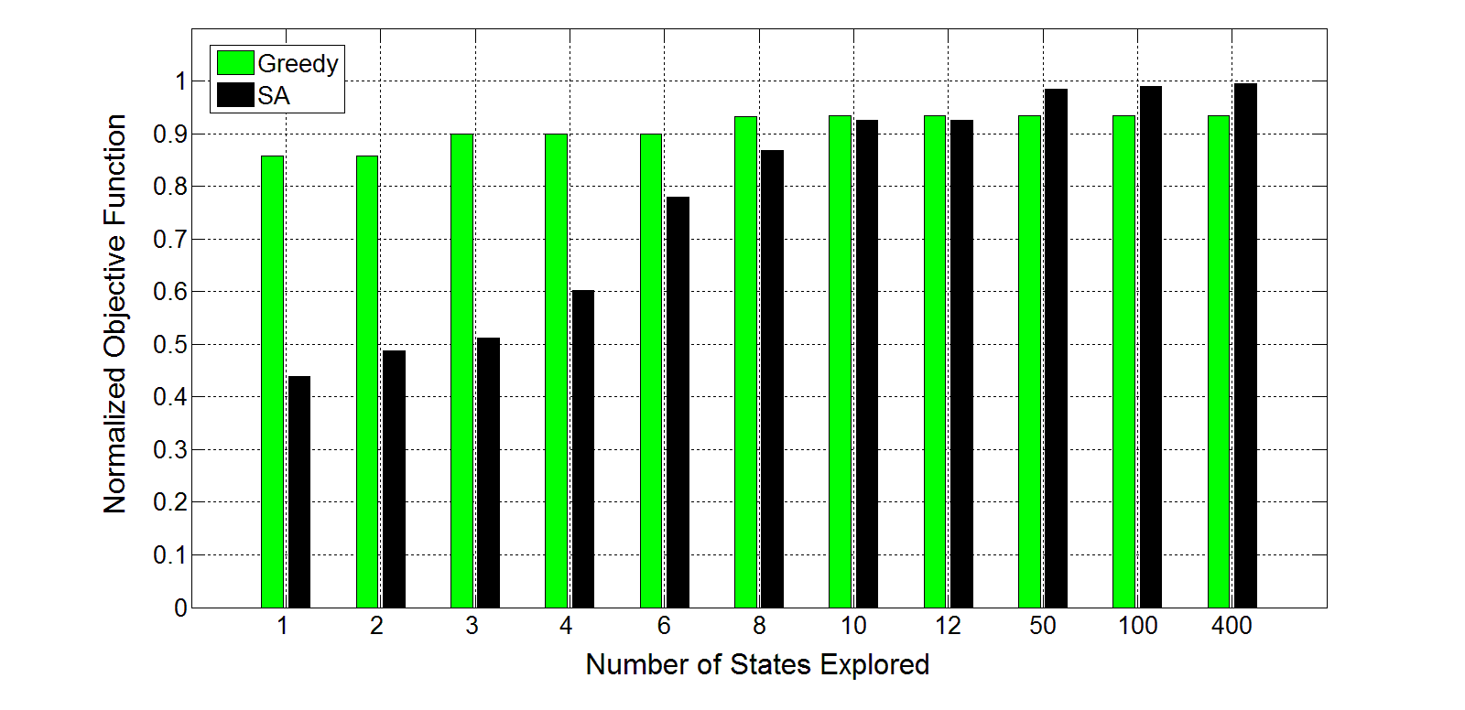
Results – Ambient Conditions Monitoring
Both GD and SA explore only a small percentage of design space even though design space cardinality
increases by 43x (from 729 to 31,104)
GD solution after
exploring 10 states
(0.03% of the design
space) is within 6.6%
of the optimal solution
SA solution after
exploring 400 states
(1.3% of the design
space) is within 0.5%
of the optimal solution
Objective function value normalized to the optimal solution for a varying number of states explored for SA and the greedy algorithms for an ambient conditions monitoring application where ω_{l}=0.6, ω_{t}=0.25, ω_{r}=0.15, |S| = 31,104.

Slide 19
Results – Execution Time, Energy, and Data Memory
Execution time for GD and SA
The greedy algorithm requires
34% less execution time on
average as compared to SA
(after exploring 10 states)
# of States | GD (ms) | SA (ms)
1 | 0.37 | 1.1
4 | 0.73 | 1.2
10 | 0.96 | 1.3
GD and SA require 2868x and 2132x less execution time as compared to exhaustive search for |S| = 31,104
Data memory requirements for GD and SA
Energy consumption for
GD and SA
|S| | GD (B) | SA (B)
8 | 452 | 508
81 | 520 | 574
729 | 562 | 612
46,656 | 874 | 924
# of States | GD (μJ) | SA (μJ)
1 | 5.2 | 15.7
4 | 10.5 | 17.1
10 | 13.8 | 18.6
Energy consumption is calculated using
E = V_{p}×I_{p}×T_{exe} at (Vp, Fp) = (2.7 V, 8 MHz)
for Atmel ATmega1281 microcontroller
where I_{p} = processor active mode current
SA has 9.4% larger data memory
requirements on average
as compared to GD

Slide 20
Conclusions
We propose a dynamic optimization methodology
  Dynamic optimization methodology leverages online optimization algorithms
    Greedy optimization algorithm
    Simulated annealing optimization algorithm
Our online algorithms considers an extensive sensor node design space
  Allows sensor nodes to more closely meet application requirements
Our online algorithms are lightweight requiring little memory, computational, and energy resources
  GD and SA require 2868x and 2132x less execution time as compared to exhaustive search
  Memory requirements are of the order of a few hundred bytes on average
  Energy consumption is of the order of tens of μJ on average
Online algorithms are amenable for implementation on resource-constrained sensor nodes
Online algorithms can perform in situ parameter tuning to adapt to changing environmental stimuli and/or changing application requirements

Slide 21

Questions?

Slide 22
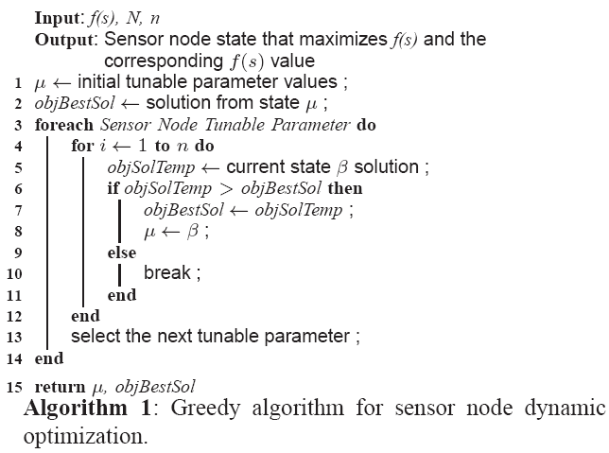
Online Algorithms for Dynamic Optimization –
Greedy Optimization Algorithm

Slide 23
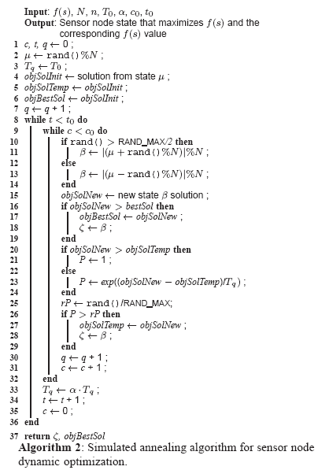
Online Algorithms for Dynamic Optimization –
Simulated Annealing Optimization Algorithm

