Slide 1

An MDP-based Application Oriented Optimal Policy for Wireless Sensor Networks
Arslan Munir and Ann Gordon-Ross⁺
Department of Electrical and Computer Engineering
University of Florida, Gainesville, Florida, USA
⁺ Also affiliated with NSF Center for High-Performance Reconfigurable Computing
This work was supported by National Science Foundation (NSF) grant CNS-0834080

Slide 2



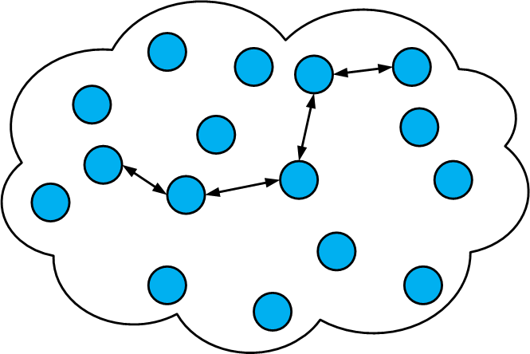

Introduction and Motivation
Wireless Sensor Network (WSN)
Network
Application manager
Sensor nodes
Gateway node
Sensor field
Sink node

Slide 3


Introduction and Motivation
WSN
Applications
Ever Increasing
Security and
Defense Systems
Industrial
Automation
Ambient conditions
monitoring e.g.
forest fire detection
Health Care
Logistics

Slide 4


Introduction and Motivation
WSN
Design
Forest fire could spread
uncontrollably in the
case of a forest fire
detection application
Failure to meet
Challenges
Catastrophic
Consequences
Meeting application requirements
e.g. reliability, lifetime, throughput,
delay (responsiveness), etc.
Loss of life losses in the case
of health care application
Application requirements
change over time
Major disasters in the
case of defense systems
Environmental conditions (stimuli)
change over time

Slide 5
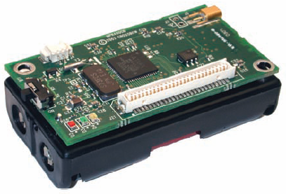
Introduction and Motivation
Commercial
off-the-shelf
sensor nodes
Characteristics
Generic Design
Not Application Specific
Few Tunable Parameters
Tunable Parameters
Processor Voltage
Processor Frequency
Radio Transmission Power
Sensing Frequency
Crossbow Mica2 mote

Slide 6
Introduction and Motivation
Parameter
Tuning
Determine appropriate
parameter values to meet
application requirements
Challenges
Application managers typically non-experts
e.g. agriculturist, biologist, etc.
Cumbersome and time consuming task
Optimal parameter value selection given a
large design exploration space

Slide 7
Introduction and Motivation
WSN
Design
Challenges
Dynamic
Optimization
What solutions
assist application
manager???
Processor
Frequency
Processor
Voltage
Processor
Frequency
Processor
Voltage
Sensing
Frequency
Sensing
Frequency
High Values
High Values
Low Values
Low Values
Dynamically tune/change sensor node parameter values
Adapts to application requirements and environmental stimuli
Tunable Parameters
Tunable Parameters
Application manager
Notes:
I have hide the next slide so that you can keep whichever looks better. In this one tortoise is a bit faster but the movement is very smooth. In the next one, the movement is not that smooth =( although it took me a long time to make that one.

Slide 8
Introduction and Motivation
WSN
Design
Challenges
Dynamic
Optimization
Solution to
Assist Application
Manager
???
Processor
Frequency
Processor
Voltage
Processor
Frequency
Processor
Voltage
Sensing
Frequency
Sensing
Frequency
High Values
High Values
Low Values
Low Values
Dynamically tune sensor node parameter values
Adapts to application requirements
and environmental stimuli
Tunable Parameters
Tunable Parameters
Application manager
Notes:
Hidden but complete, you can use either this one or previous one whichever looks good to u =)

Slide 9
Introduction and Motivation
Dynamic
Optimization
Processor Frequency
Processor Voltage
Radio Transmission
Power
Sensing Frequency
Challenges
Crossbow Mica2 mote
How to perform dynamic optimization?
Which optimization technique to select?
Formulate an optimization to
perform dynamic optimization
Optimal tunable parameter values
selected

Slide 10
Contributions
Dynamic Optimization
For WSNs
Models and solves
dynamic decision making problems
MDP – Markov Decision Process
MDP –based
Dynamic Optimization
Discrete Stochastic Dynamic Programming
Gives an optimal policy that performs
dynamic voltage, frequency, and sensing
frequency scaling (DVFS2)
Optimal in any situation
Adapts to changing application
requirements and environmental stimuli

Slide 11
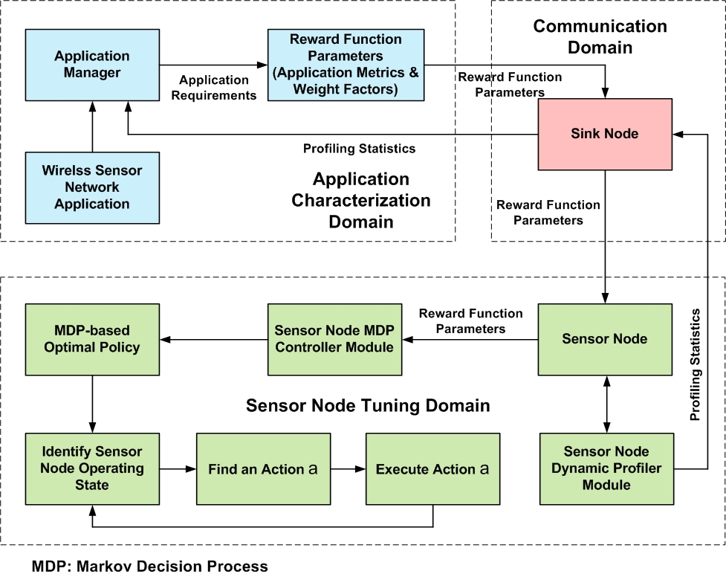
MDP-based Tuning Methodology for WSNs

Slide 12
Application Characterization Domain
Application Metrics
Tolerable power consumption
Tolerable throughput
Tolerable delay
Weight Factors
Signify the weight
or importance of each
application metric
Network
Application manager
Gateway node
Sensor nodes
Sensor field
MDP Reward
Function Parameters
(to Communication
Domain)
Profiling Statistics
(from Communication
Domain)
Sink node
Wireless Sensor
Network
Application
Application
Requirements
Application
Manager
Reward Function
Parameters
(Application Metrics &
Weight Factors)

Slide 13
Communication Domain
Network
MDP Reward
Function Parameters
(from Application
Characterization
Domain)
Application manager
Gateway node
Sensor nodes
Sensor field
Sink node
Sink Node
Profiling Statistics
(to Application
Characterization
Domain)
MDP Reward
Function Parameters
(to Sensor Node
Tuning Domain)
Profiling Statistics
(from Sensor Node
Tuning Domain)

Slide 14
Sensor Node Tuning Domain
MDP Reward Function Parameters
(from Communication Domain)
MDP-based
Optimal Policy
Sensor Node MDP
Controller Module
Sensor Node
MDP
Reward
Function
Parameters
Action a
Stay in same state
OR
Transition to some other state
Sensor node state
Processor voltage
Processor frequency
Sensing frequency
Sensor Node
Dynamic Profiler
Module
Profiles statistics
Radio transmission power
Packet loss
Remaining battery
Profiling
Statistics (to
Communication
Domain)
Identify Sensor
Node Operating
State
Find an Action a
Execute Action a

Slide 15
MDP-based Tuning Methodology for WSNs
Notes:
10 minutes.

Slide 16
MDP Overview With Respect to WSNs
Markov Decision Process
Markovian:
Transition probabilities and rewards
depend on the past only through the
current state
MDP
Basic Elements
Decision
Epochs
States
State Transition
Probabilities
Actions
Rewards

Slide 17
MDP Basic Elements
Decision epochs
  Points of time at which sensor nodes make decisions
  Discrete time divided into periods
  Decision epochs correspond to the beginning of a period
State
  Combination of sensor node parameter values
    Processor voltage V_{p}
    Processor frequency F_{p}
    Sensing frequency F_{s}
  Sensor node operates in a particular state at each decision epoch and period
Actions
  Allowable actions in each state
    Continue operating in the current state
    Switch to some other state

Slide 18
MDP Basic Elements
Transition probability
  Probability of being in a state given an action
Reward
  Reward (income or cost) received in given state at a given time
  Specified by reward function
    Captures application requirements
      application metrics
      weight factors
Policy
  Prescribes actions for all decision epochs
MDP optimization objective
  Determine optimal policy that maximizes reward sequence

Slide 19
Application Specific Tuning Formulation as an MDP – State Space
State Space
  We define state space as
  such that
  where
  = cartesian product
  = total number of available sensor node state tuples [V_{p}, F_{p}, F_{s} ]
  = power for state i
  = throughput for state i
  = delay for state i

Slide 20
MDP Formulation – Decision Epochs
Decision Epochs
  The sequence of decision epochs is
  such that
  where
  = random variable (related to sensor node lifetime)
    Assumption: geometrically distributed with parameter λ
    Geometric distribution mean =

Slide 21
MDP Formulation – Action Space
Action Space
  Determines the next state to transition to given the current state
  where
  = action taken at time t that causes transition to state j at time t+1 given
  current state is i
  action taken
  action not taken

Slide 22
MDP Formulation – State Dynamics
State dynamics
  We formulated our problem as deterministic dynamic program (DDD)
    Choice of an action determines next state with certainty
    Transfer function provides mapping useful in determining next state
  Transition probability function determines state dynamics
  where
  = probability that action a taken at time t dictates transitions to state j at time t+1 given current state is s

Slide 23
MDP Formulation – Policy and Performance Criterion
Policy and Performance Criterion
  Policy π that maximizes the expected total discounted reward performance criterion
  where
  = reward received at time t
  = discount factor (present value of one unit of reward received one unit in
  future)
  = expected total discounted reward value obtained using policy π

Slide 24
MDP Formulation – Reward Function
Reward Function
  Captures application metrics, weight factors, and sensor node characteristics
  We define reward function r(s,a) given current sensor node state s and sensor node selected action a as
  We define
  where
  = power reward function
  = throughput reward function
  = delay reward function
  = transition cost function
  = power weight factor
  = throughput weight factor
  = delay weight factor

Slide 25
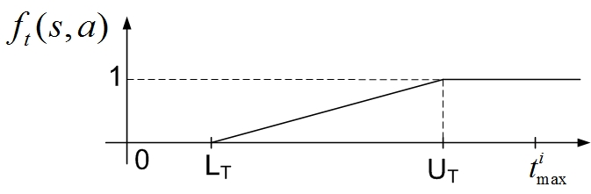
MDP Formulation – Reward Function
Example: Throughput Reward Function
  We define throughput reward function as
  where
  = throughput of the current state given action a taken at time t
  = minimum tolerated throughput
  = maximum tolerated throughput
  = maximum throughput in state i

Slide 26
MDP Formulation – Optimality Equations and Policy Iteration Algorithm
Optimality Equations
  Optimality equations or Bellman’s equations for expected total discounted reward criterion are
  where
  = maximum expected total discounted reward
Policy Iteration algorithm
  MDP iterative algorithm to solve optimality equations
  Solves optimality equations to give MDP-based optimal policy

Slide 27
Numerical Results
WSN Platform
  eXtreme Scale Motes (XSMs)
    Two AA alkaline batteries – average lifetime = 1000 hours
    Atmel ATmega128L microcontroller
    Chipcon CC1000 radio – operating frequency = 433 MHz
    Sensors
      Infra red
      Magnetic
      Acoustic
      Photo
      Temperature
WSN Application
  Security/defense system
  Verified for other applications
    Health care
    Ambient conditions monitoring

Slide 28
Numerical Results
Fixed heuristic policies for comparison with π^{MDP}
  π^{POW} = policy which always selects the state with lowest power consumption
  π^{THP} = policy which always selects the state with highest throughput
  π^{EQU} = policy which spends an equal amount of time in each of the available states
  π^{PRF} = policy which spends an unequal amount of time in each of the available
  states based on specified preference
        E.g. given a system with four states, it spends
        40% of time in first state,
        20% of time in second state,
        10% of time in third state, and
        30% of time in fourth state
i₂
20%
i₁
40%
i₃
10%
i₄
30%

Slide 29
Numerical Results – MDP Specifications
Parameters for sensor node states
  Parameter values are based on XSM motes
  We consider four sensor node states i.e. I = 4
    Each state tuple is given by
    V_{p} in volts, F_{p} in MHz, F_{s} in KHz
  Parameters specified as multiple of a base unit
    One power unit equal to 1 mW
    One throughput unit equal to 0.5 MIPS
    One delay unit equal to 50 ms
Parameter | i₁=[2.7,2,2] | i₂=[3,4,4] | i₃=[4,6,6] | i₄=[5.5,8,8]
p_{i} | 10 units | 15 units | 30 units | 55 units
t_{i} | 4 units | 8 units | 12 units | 16 units
d_{i} | 26 units | 14 units | 8 units | 6 units
  p_{i} = power consumption in state i
  t_{i} = throughput in state i
  d_{i} = delay in state i

Slide 30
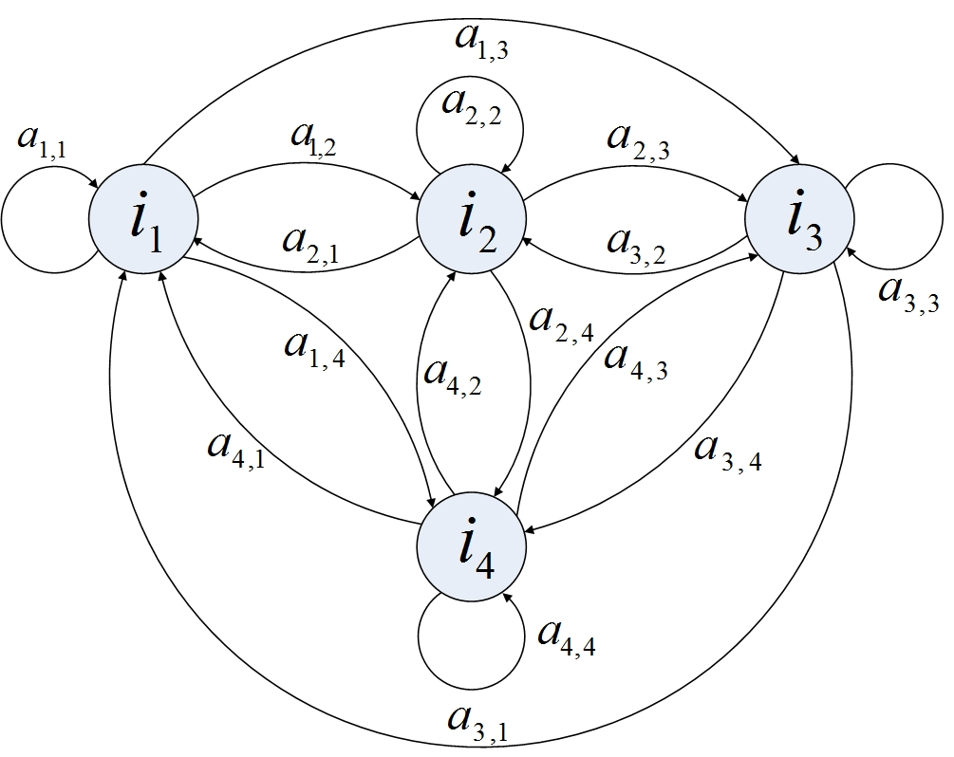
Numerical Results – MDP Specifications
Each sensor node state has allowable actions
  Stay in the same state
  Transition to any other state
Transition cost
  H_{i,j}=0.1 if i ≠ j
Sensor Node lifetime
  Mean lifetime = 1/(1-λ)
    E.g. when λ = 0.999
    Mean lifetime = 1/(1-0.999)=1000 hours ≈ 42 days

Slide 31
Numerical Results – MDP Specifications
Reward Function Parameters
  Minimum L and Maximum U reward function parameter values and application metric weight factors for a security/defense system
Notation | Parameter Description | Value
L_{P} | Minimum acceptable power consumption | 12 units
U_{P} | Maximum acceptable power consumption | 35 units
L_{T} | Minimum acceptable throughput | 6 units
U_{T} | Maximum acceptable throughput | 12 units
L_{D} | Minimum acceptable delay | 7 units
U_{D} | Maximum acceptable delay | 16 units
ω_{p} | Power weigh factor | 0.45
ω_{t} | Throughput weight factor | 0.2
ω_{d} | Delay weight factor | 0.35

Slide 32
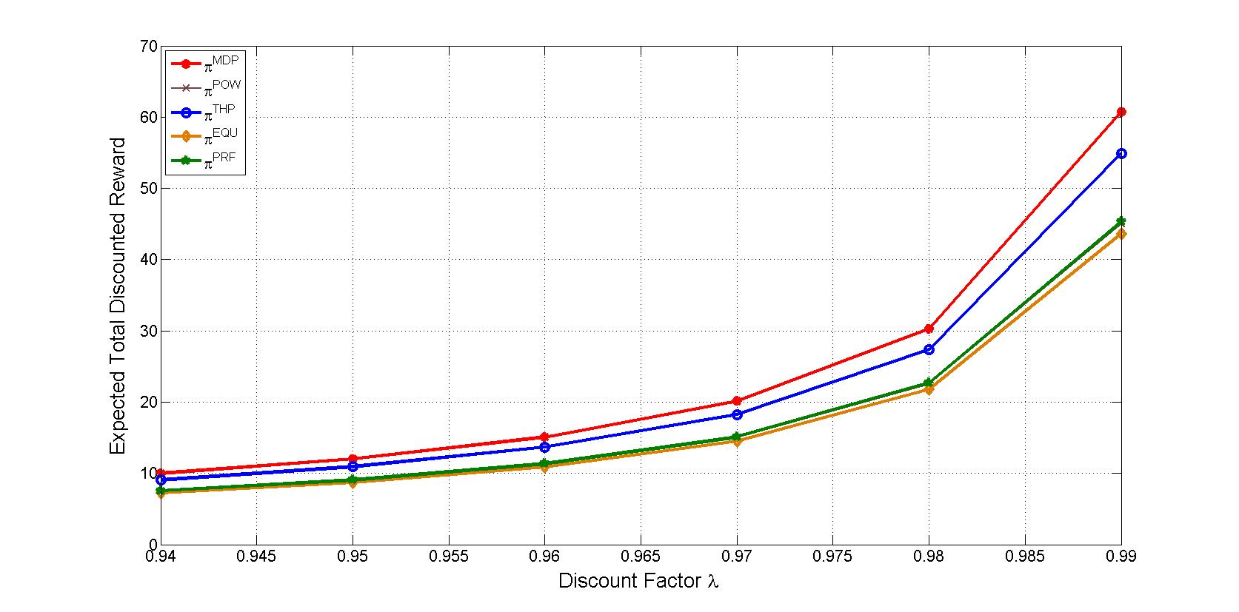
Results – Effects of Discount Factor
Magnitude Difference in expected total discounted reward provides relative comparison between policies
π^{MDP} results in highest expected total discounted reward
The effects of different discount factors on the expected total discounted reward for a security/defense system. H_{i,j}=0.1 if i ≠ j, ω_{p}=0.45, ω_{t}=0.2, ω_{d}=0.35.

Slide 33
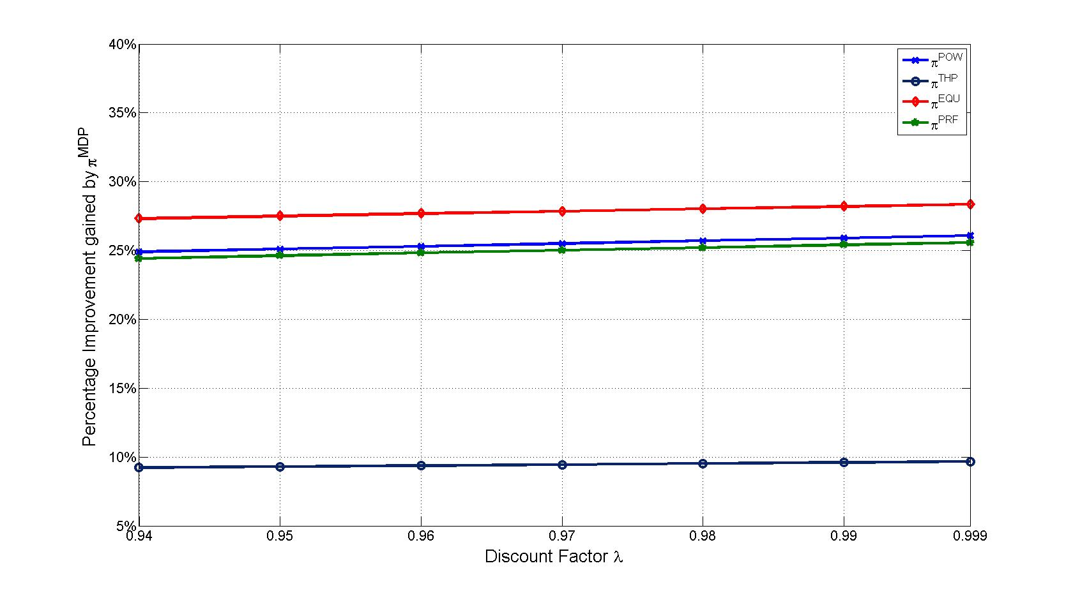
Results – Percentage Improvement Gained by π^{MDP}
π^{MDP} shows significant percentage improvement over all heuristic policies
Percentage improvement in expected total discounted reward for π^{MDP} for a security/defense system. H_{i,j}=0.1 if i ≠ j, ω_{p}=0.45, ω_{t}=0.2, ω_{d}=0.35.

Slide 34
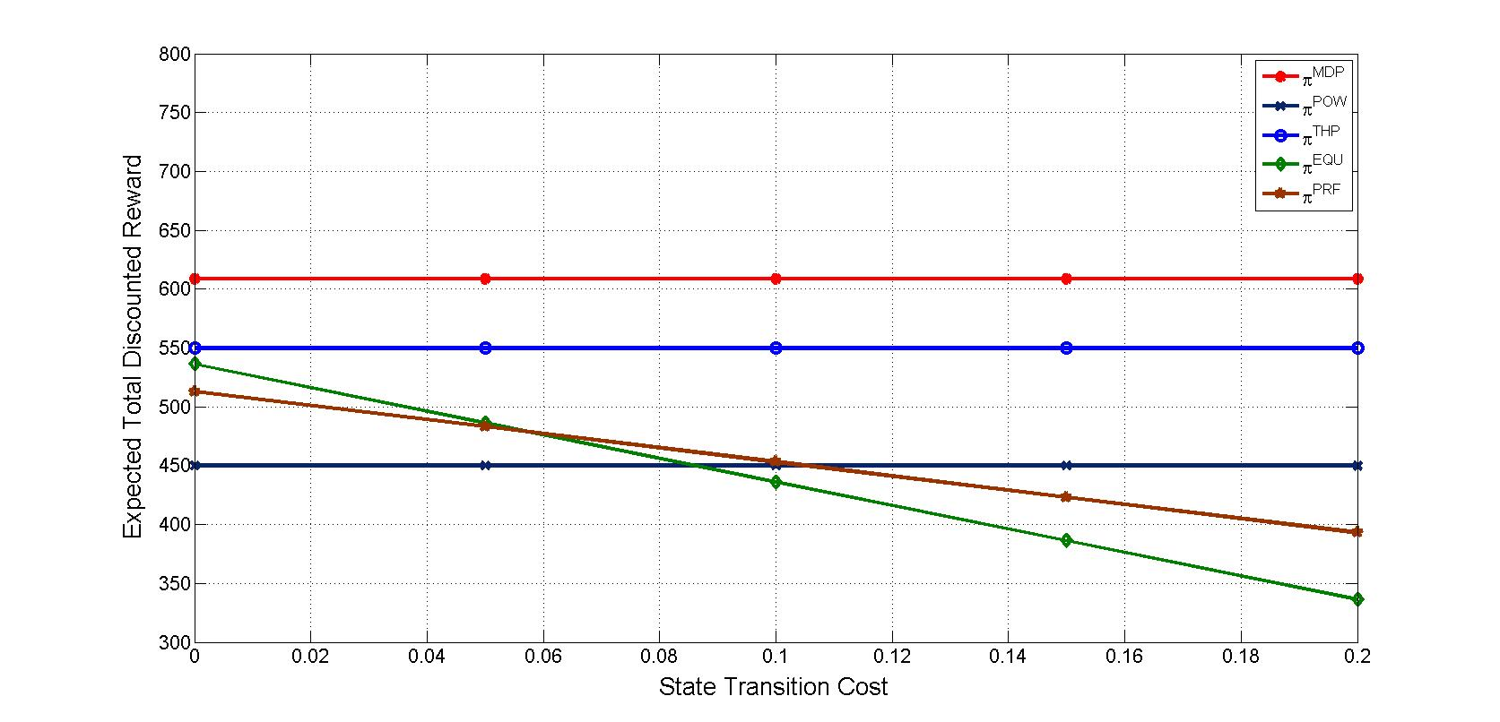
Results – Effects of State Transition Cost
π^{MDP} results in highest expected total discounted reward for all state transition costs
π^{EQU} mostly affected by state transition costs due to its high state transition rate
The effects of different state transition costs on the expected total discounted reward for a security/defense system. λ=0.999, ω_{p}=0.45, ω_{t}=0.2, ω_{d}=0.35.

Slide 35
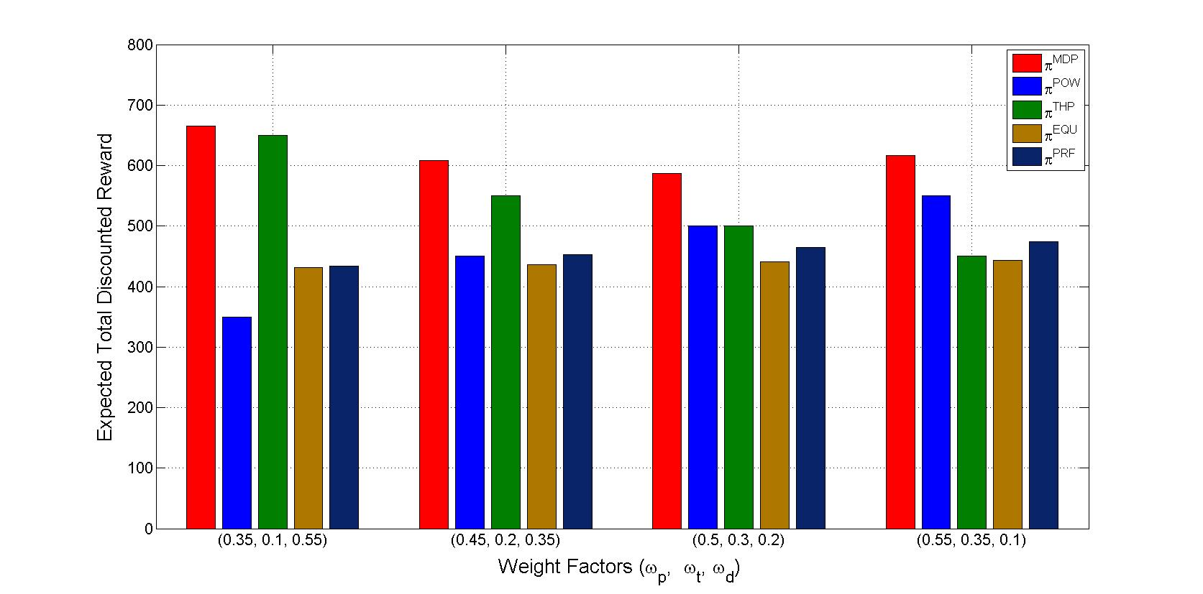
Results – Effects of Weight Factors
π^{MDP} results in highest expected total discounted reward for all weight factors
The effects of different reward function weight factors on the expected total discounted reward for a security/defense system. λ=0.999, H_{i,j}=0.1 if i ≠ j .

Slide 36
Conclusions
We propose an application-oriented dynamic tuning methodology based on MDPs
Our proposed methodology is adaptive
  Dynamically determines new MDP-based optimal policy when application requirements change in accordance with changing environmental stimuli
Our proposed methodology outperforms heuristic policies
  Discount factors (sensor node lifetimes)
  State transition costs
  Application metric weight factors

Slide 37
Future Work
Enhancement of our MDP model to incorporate additional high-level application metrics
  Reliability
  Scalability
  Security
  Accuracy
Incorporate additional sensor node tunable parameters
  Radio transmission power
  Radio sleep states
  Packet size
Enhancement of our dynamic tuning methodology
  Reaction to environmental stimuli without the need for application manger’s feedback
  Exploration of light-weight dynamic optimizations for WSNs

