Slide 1


VAPRES
A Virtual Architecture for Partially Reconfigurable Embedded Systems
Presented by Joseph Antoon
Abelardo Jara-Berrocal, Ann Gordon-Ross
NSF Center for High-Performance
Reconfigurable Computing (CHREC)
Department of Electrical and Computer Engineering
University of Florida

Slide 2




Adaptive Hardware Applications
Kalman filter used for target tracking
  Finds likely location from noisy measurements
  Optimized filter depends on target type
Slow Target
Low Power | Constant gain
Low Bandwidth | Kalman Filter
Fast Target
High Power | Constant gain
High Bandwidth | Kalman Filter
Airborne Target
High Power | Variable Gain
Low Bandwidth | Multi-scale Smoother
Noisy Target
High Power | Variable Gain
Low Bandwidth | Kalman Filter

Slide 3



Adaptive Hardware Applications
FPGAs often out-perform CPUs
  Parallel computing power
  Kalman filters scale well
Partial Reconfiguration (PR)
  Run-time HW adaptation
  Allows FPGA time-sharing
Communication Challenge
  Transfers between modules can lock up CPU
  Inter-module network alleviates resources
CPU
FPGAs
FPGA Device
Memory
CPU
Filter A
Filter B
Processor

Slide 4
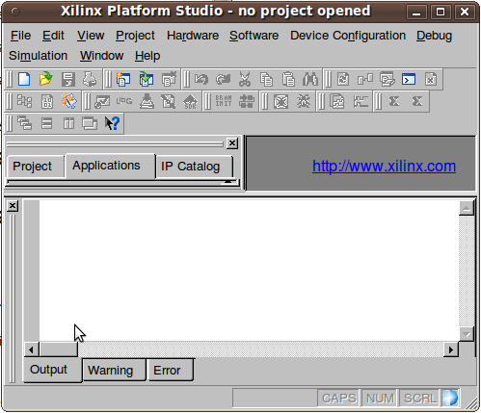
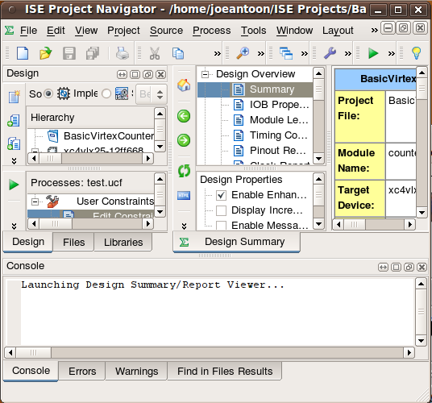


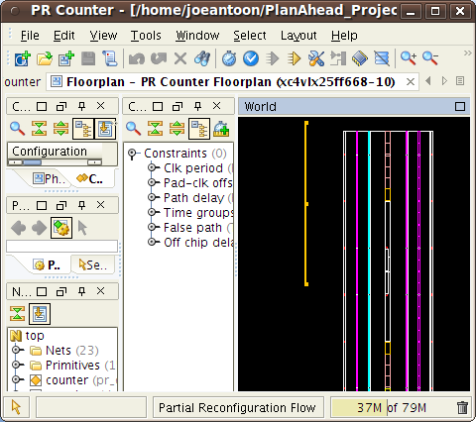

Using Partial Reconfiguration
System Specifications
1. Define system
2. Platform studio
3. Import into ISE
top
7. Synthesize!
11. Implement!
Could you make it just a bit different…
static
prr_a
prr_b
6. Code PR
region HDL
5. Set PRRs as black boxes
4. Divide project into mandated hierarchy
9. Map on to PlanAhead
10. Create “configurations”
8. Guess Estimate
a good floorplan
12. Write software

Slide 5

Identifying Issues With PR
Support
  Only supported by Xilinx
  Altera support announced
Lack of abstraction
  Manual partitioning
  Manual floor-planning
App-specific architectures
  Increased time-to-market
  Reduced flexibility
Frustrating
Design Flow!
In this work, we propose VAPRES
  A Virtual Architecture for PR Embedded Systems
  Abstracts base system from application
  Automates design flow and floor-planning
  Scalable, flexible features

Slide 6
VAPRES Architecture
  PR Regions (PRRs)
    Independent clocks
    FIFO-based I/O
    Online placement
    Created separately
  MACS
    Intermodule network
  Flexible, scalable
    PR Region Count
    PR Region Size
    MACS bandwidth
      Module channel width
      Left to right channel width
      Right to left channel width
    IO Module Count
PLB Bus
PLB Bus
DCR
Bridge
DCR
Bridge
MicroBlaze CPU
MicroBlaze CPU
PLB Bus
DCR
Bridge
MicroBlaze CPU
FSL
Fast
Simplex
Links
FSL
Fast
Simplex
Links
FSL
Fast
Simplex
Links
PR
Region 1
PR
Region 2
IO
Module
To IO
IO
Module
PR
Region 1
IO
Module
PR
Region 1
PR
Region 2
PR
Region 2
To IO
To IO
PR
Socket
PR
Socket
IF
IF
IF
IF
Switch 1
Switch 2
PR
Socket
PR
Socket
PR
Socket
PR
Socket
IF
IF
IF
IF
IF
IF
IF
IF
Switch 1
Switch 1
Switch 2
Switch 2

Slide 7

PR Region Connectivity
MicroBlaze
PR Socket
Device Control Register (DCR)
FSL
Fast Simplex
Links
Regional Clock Buffer
(BUFR)
Clock
Select
Slice Macros
Enable
Reset
PR
Region
Macro
Clock
PRR
FSL
Slice Macros
Fast Clock
Producer / Consumer
Queues
Slow Clock
Clock Multiplexer
(BUFGMUX)
MACS Switch

Slide 8
MACS – Intermodule Network
Minimal Adaptive-Routing Circuit Switched Network
Circuit based
  Uses streaming channels
  Circuit set by first word in channel
  Fast setup (<10 cycles)
Module 1
Module 2
Module 3
dst
end
IF
IF
IF
IF
Switch 2
Switch 2

Slide 9
Design Methodology
Two separate design flows
  Base System
  Application
Applications made independently
  Only base system specs needed
Base system specifications
Base Flow
App Flow
App Flow
App Flow

Slide 10
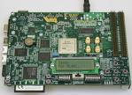
Base System Design Flow
User feeds specs to VAPRES
Base design created from specs
  Parametric templates used
System files generated
  Floorplan and Constraints
  Embedded Dev. Kit (EDK) Files
  HDL
Synthesis
Implementation
Bitstream generated
System downloaded to the board
Base system flow
System
Specs
Templates
Base Design
Floorplan
HDL
Synthesis
Implementation
Generate Bitstream

Slide 11
Application Design Flow
Partition App
  Hardware
  Software
Software flow
  Compile
  Link
Hardware Flow
  Synthesize
  Implement
  Bitstream gen
Download App
Application Flow
Application Decomposition
HDL
Source Code
API
System
Specs
Compile
Synthesis
Link
Implementation
Executable
Generate Bitstream

Slide 12




Revisiting Target Tracking
Filter
Storage
PLB Bus
Aerospace
Kalman
Filter
DCR
Bridge
MicroBlaze CPU
ICAP
Looks like a
spaceship
Aerospace
Kalman
Filter
Sensor
Blank
PR Region
IO
Module
PR
Socket
IF
IF
Switch 2

Slide 13

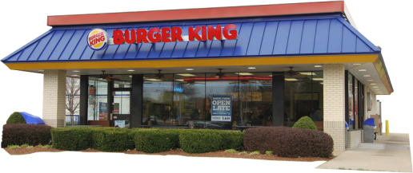
Seamless Filter Swapping
The target changed!
Filter tracks target
  Target slows down
  Filter swap needed
First load new filter
  Spare region used
  Old filter continues
Redirect traffic
  Downtime is now negligible
  Previously in seconds
MicroBlaze CPU
Blank
Module
High Power
Kalman
Filter
Blank
Module
Low Power
Kalman
Filter
IO
Module
Low Power
Kalman
Filter
Low Power
Kalman
Filter
Low Power
Kalman
Filter
IF
IF
IF
IF
SW2
SW2

Slide 14
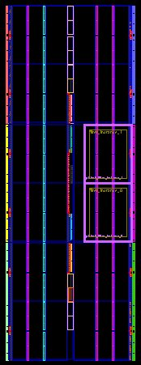

Experimental Setup - Resources
Implemented on ML401 board
  Virtex-4 LX25 FPGA
VAPRES
  Two PR Regions
  16x11 CLB region size
  Two IOMs
MACS
  Four switches
  32-bit channels
  Two channels left to right
  Two channels right to left
Base System View
Floor Plan
Post Place and Route

Slide 15
Results – Resource Usage
9721
LX25
1890
LX60
LX100

Slide 16
Experimental Setup – Timing
Two methods to reconfigure
  Implemented in software
  1) Write bitfile in one stage
  2) Write bitfile in two stages
One-stage method
  Load Flash sector to BRAM
  Write to ICAP
  Repeat until bitfile is loaded
Two-stage method
  Load bitfile into BRAM
  Write bitfile to ICAP
Less RAM
required
Flash
BRAM
ICAP
Flash
BRAM
ICAP
Load once,
write often
Board peripheral
FPGA structure

Slide 17
Results – Reconfiguration Time
ICAP write reduced to 71.94 ms
One-Stage
Time Breakdown
Two-Stage
Time Breakdown

Slide 18
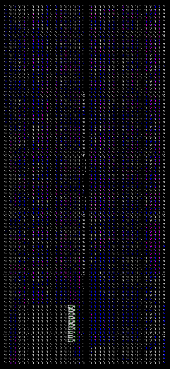
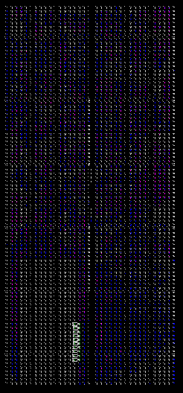
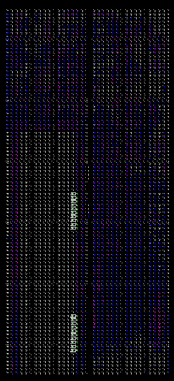
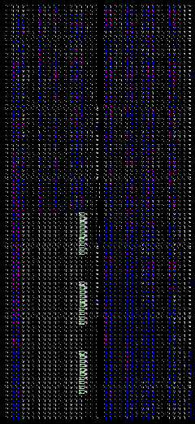
Experimental Setup - Scaling
Four VAPRES Systems Set Up
Small
PRRs: 1
Width: 10 CLB
Height: 1 row
MACS: No
Medium
PRRs: 1
Width: 10 CLB
Height: 2 rows
MACS: No
Large
PRRs: 2
Width: 16 CLB
Height: 2 rows
MACS: Yes
Populous
PRRs: 3
Width: 16 CLB
Height: 1 row
MACS: Yes

Slide 19
Results - Scalability
Added
PRR
Decreased
PRR Size
Increased
PRR Size

Slide 20
Results - Scalability
All designs
meet 100Mhz constraint

Slide 21
Conclusions
We developed VAPRES
  Virtual Architecture for Partially Reconfigurable Systems
Contributions
  Modular design methodology
  PR regions with independent, selectable clocks
  Highly parametric design
  Seamless filter swapping
Future work
  Algorithms for runtime module placement
  Tools to assist system design formulation
  Context save and restore for modules

Slide 22

Thank you for attending
Questions?

