Slide 1
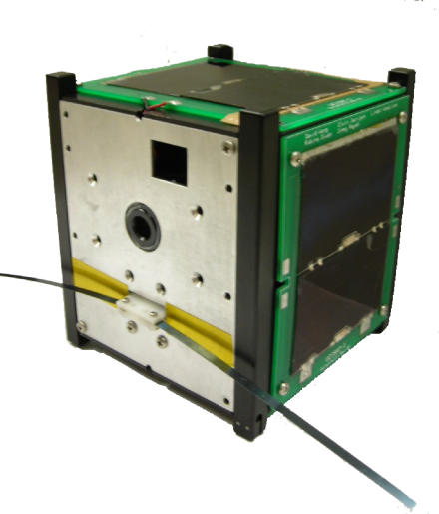
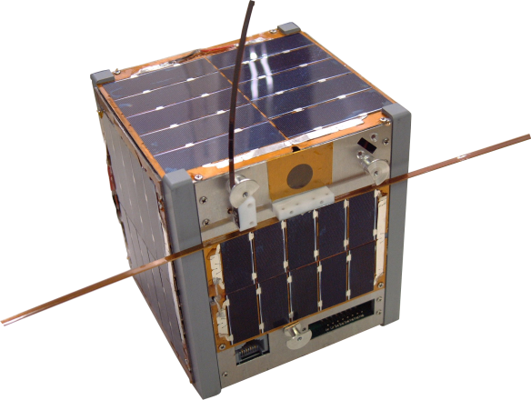
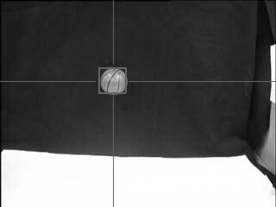
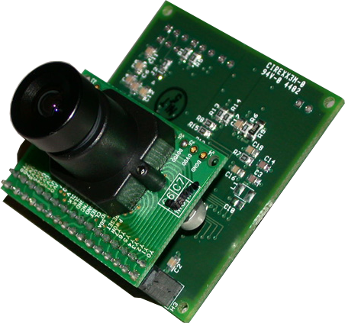
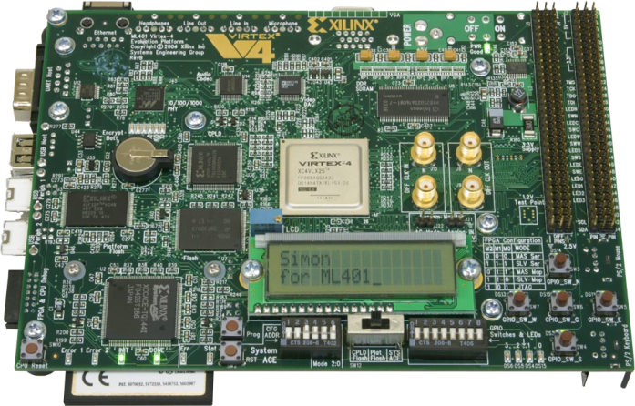
Seamless Hardware Module Swapping for Partially Reconfigurable Stream Processing Systems
EJSM
Abelardo Jara-Berrocal, Joseph Antoon, and Ann Gordon-Ross
Partial Reconfiguration and Adaptation
Systems in harsh, remote regions rely on adaptive behavior
Power management
Fault tolerance
Environmental changes
Partial reconfiguration helps enable this behavior in reconfigurable systems
Alters FPGA without interrupting service
Allows seamless filter swapping, where an old filter functions during reconfiguration
This prevent critical errors due to reconfiguration downtime
Virtual Architecture For Partially Reconfigurable Embedded Systems (VAPRES)
Architecture for creating partially reconfigurable embedded systems
Module communication
Processor – Fast Simplex Links (FSL)
Intermodule – MACS Network on Chip
Highly parametric
Number of PR regions
PR region size
Number of I/O modules
Independent region clocking
Module network parameters
Independent development flows
Applications (HW, SW)
Base system
API for run-time reconfiguration
Module loading
Seamless filter swapping
Bitstream relocation
Seamless Filter Swapping
CPU
CPU
CPU
PLB Bus
I/O
Module
Kalman
Filter A
Empty
Region
State data
End of stream
State data
Empty
Region
I/O
Module
Kalman
Filter A
Empty
Region
Kalman
Filter B
I/O
Module
Kalman
Filter A
Empty
Region
MicroBlaze™ CPU
Loading…
Loading…
Kalman
Filter B
Filter B
PR Socket
PR Socket
PR Region 1
PR Region 2
PR Region 2
PR Region 2
PR Region 1
PR Region 2
PR Region 2
PR Region 2
PR Region 1
PR Region 2
FSL
Target data
End stream
Target data
PR Region 2
Control
MACS
Target data
PR
Region 1
PR
Region 2
IO
Module
I/O
MACS
MACS
MACS
MACS
MACS
IF
IF
IF
IF
Stage 1 – Preload Filter
Kalman filter A in normal operation
CPU tests Kalman filter A gain
CPU begins loading Kilman filter B
Stage 2 –Simultaneous Operation
Filter B is loaded into empty region
End stream word is sent to filter A
Filter A sends state to CPU
Stage 3 – Operation Transfer
CPU initializes filter B
CPU waits for end stream from A
Filter B begins operation
MACS
Switch 1
Switch 2
Adaptive Target Tracking
Kalman Filters
Tracks target from noisy measurements
Highly parallel calculation ideal for FPGAs
Different Kalman filters match different targets
Proposed algorithm for adaptive target tracker
Tracker uses basic Kalman filter at start
Switches to constant-gain Kalman filter if filter gain does not change over time
Adaptive clock keeps throughput constant
Experimental Setup
This experiment demonstrates adaptive target tracking of a ball using a camera and near-seamless filter swapping
X
Equipment
Target Ball on cloth backdrop
C3188A Camera Module Omnivision OV7620 sensor 640x480 color 16-bit raw YUV interface
Xilinx ML401 FPGA Board Virtex-4 LX25 FPGA 64MB DDR SDRAM
VAPRES Setup
PR Regions: 2
Basic Kalman filter
Constant gain filter
IO Modules: 1
Camera interface and image recognition
MACS Setup 3 switches 1 channel left and right
MicroBlaze
Analysis | Basic | Constant-gain
Max Clock | 156.2 MHz | 71.4 MHz
Throughput | 26 cy / sample | 3 cy / sample
Power | 80.92 mW | 61.18 mW
Y
IO Module
Camera Interface Image
Decoder
PRR 1
Constant
Gain Kalman
Filter
PRR 2
Variable
Gain
Kalman
Filter
MACS Interconnect

