Slide 1

Dynamic Scheduling for Reduced Energy in
Configuration-Subsetted Heterogeneous Multicore Systems
Hammam Alsafrjalani and Ann Gordon-Ross⁺
Department of Electrical and Computer Engineering
University of Florida, Gainesville, Florida, USA
⁺ Also Affiliated with NSF Center for High-Performance Reconfigurable Computing
This work was supported by National Science Foundation (NSF) grant CNS-0953447

Slide 2

Introduction and Motivation
Reducing energy in computing devices is key goal
Application hardware requirements significantly impact energy consumption
  An application’s workload can thrash a cache with improper size/associativity
Hardware resources can be specialized for energy efficiency
  Voltage, clock frequency, cache size/associativity, etc.
Hardware resources can be specialized to meet application requirements
Application
Domain-similar applications have similar resource requirements
CPU Speed: 2 GHz
Cache: 512KB
CPU Speed: 1 GHz
Cache: 64KB
CPU Speed: 2+ GHz
Cache: 1024KB
Requirements

Slide 3
Introduction and Motivation
Heterogeneous multicore systems provide specializations
Limitations
  Fixed, limited number of heterogeneous options (e.g., number of cores)
  Only coarse grained specialization
    Different applications within same domain may need finer-grained specialization
      Different cache associativity of a same cache size
  Laborious: designer-expended effort to profile applications to determine application hardware requirements
    Profiling info: Cache miss rate, pipeline stalls, branch miss rate, etc.
  TI® OMAP3530 TM
  Intel® Atom TM E6x5C
  ARM® big.LITTLE
Intel Atom Processor
big
Cortex A8
Cortex M3
LITTLE
SGX530 GPU
C674x DSP
Altera® FPGA
Various hardware resources meet disparate application-domain requirements
Notes:
Ann – you will need a pic to define what theses systems are, and then you won't have room for your text, so this will either have to have lots of graphics or two slides. Also must make the other tradeoffs between static and dynamic more clear.
Hammam– I think graph here and another slide talking about profiling is a good way to split it.
Ann - yes

Slide 4


Profiling Challenges
Static Profiling
  Heterogeneous multi-core
Good optimization potential
Known
Applications
Requires a priori knowledge of applications
Profiling information dictates best core
Hardware
Does not react to runtime input, stimuli, environment, etc.
Profiling at design time
Scheduling to best core at run time
Dynamic Profiling
Unknown
Applications
Profile on base/default core
No a priori knowledge of applications
- Application’s best core known for next execution
Flexible: reacts to runtime input, stimuli, environment, etc.
- Scheduler uses profiling information during scheduling to select a core
Potentially less energy savings if improper cores
Incurs profiling overhead
Notes:
Hammam: For dynamic scheduling. There is a lot of prior work done here, should we mention all of it? For instance, there is work done in which only part of the application is profiled, other work

Slide 5
More Flexibility with Configurable Cores
Cores have configurable parameters
  Cache size, core frequency and/or voltage, etc.
Configurations must be tuned
  Evaluate application requirements
  Determine the best configuration with respect to design goals
Executing in base
configuration
Lowest energy
More flexible
  More configurations as compared to total number of cores
  Finer-grained specialization
Energy
Cache Size Tuning
Tuning incurs overhead
Execution time

Slide 6
Tuning Overhead
If EVERY core offers ALL configurations, significant tuning overhead
Reduce configurations to reduce tuning overhead
Tuning searches 2 configurations
Must first schedule to core with best configuration for application
Tuning searches 8 configurations regardless of core
Core A
Core B
Core A
Core A
Core B
Core A
Core B
Core A
Core B
Core A
Core B
Core A
Core B
Core A
Core B
Core A
Core B
Core B
Core C
Core D
Core C
Core D
Core C
Core D
Core C
Core D
Core C
Core C
Core D
Core C
Core D
Core C
Core D
Core C
Core D
Core C
Core D
Core D
Example: quad core system, each core has same 8 configurations
Example: quad core system, each core has 2 configurations
6

Slide 7
Summary
Application hardware requirements impact energy consumption
  Hardware must be specialized to meet application requirements
Heterogeneous multicore systems provide specializations
  Require profiling
  Limited number of heterogeneous options
Configurable cores provide specializations
  Greater optimization potential
  Must limit tuning overhead
  Can eliminate/subset configurations
Disparate application requirements, and thus configurations, must be distributed across cores
  Potential for core bottlenecks
Notes:
Hammam: I think we need a summary because we have so many variables introduced

Slide 8
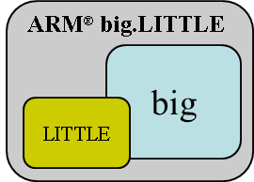
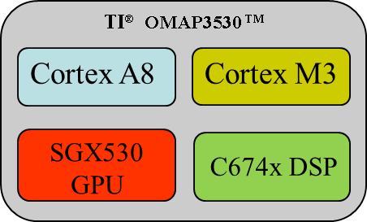
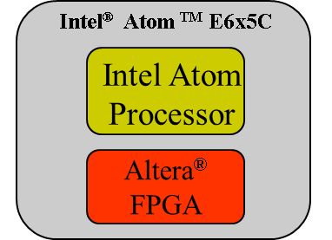
Problem Definition
Given:
  Disparate application requirements
  Vast hardware specialization options
Goal: Specialized cores for all application requirements while minimizing profiling effort and tuning overhead
More app.
Heterogeneous cores
Configurable cores

Slide 9
Prior Work
Heterogeneous multicore system
  Statically schedule applications to cores for reduced energy, Kumar et al.
  Statically schedule applications to cores with various cache configurations for reduced cache misses, Silva et al.
Configurable-core system
  Tune cores after scheduling for configurable issue width, clock rate, dynamic voltage, caches, etc.
Reduce core configurations to small subsets of configurations, Viana et al.
No work holistically considered heterogeneous, subsetted,
configurable cores
  Heterogeneous multi-core
  Configurable multi-core
Configuration design space

Slide 10
Our Solution
A heterogeneous and configurable multicore system architecture
  Domain-specific core configuration subsets
  Associated scheduling and tuning (SaT) algorithm
Core heterogeneity
  Distinct, unchangeable per-core configuration subsets that meet an application-domain hardware requirements
Core configurability
  Per-core configurable parameters and parameter values
SaT algorithm
  Dynamically profile application
  Based on designer goals (e.g., reduced energy)
    Determine core with needed hardware requirements
    Tune core’s configurable parameters

Slide 11
Example
Heterogeneous Configurable Quad-cores and SaT
Heterogeneous, configurable multicore platform
Scheduling and tuning algorithm (SaT)
512KB
Cache
512KB
Cache
512KB
Cache
512KB
Cache
512KB
Cache
512KB
Cache
64KB
Profile
Applications
64KB
64KB
128KB
128KB
128KB
Determine
HW req.
  1-way 32B Line Size
  2-way 32B Line Size
Schedule
to core
  2-way 16B Line Size
  Configurability defined by application-specific requirements (e.g., cache associativity and line size)
Tune core
  Heterogeneity defined by domain-specific requirements (e.g., size has most impact on energy, so cores with various cache sizes)

Slide 12
Determining Configuration Subsets
Prior work evaluated domain-similar applications
  Applications had execution/profiling similarity
  Applications had similar, but not necessarily the same, best configurations
Design space can be subsetted to domain-specific similar configurations
  Small fraction of the complete design space
  Still offer best, or near-best, configurations for each application
Accurate subset determination
  Profile several domain-similar applications
Three subsets are sufficient to
meet varying domain-specific requirements
Configuration design space

Slide 13
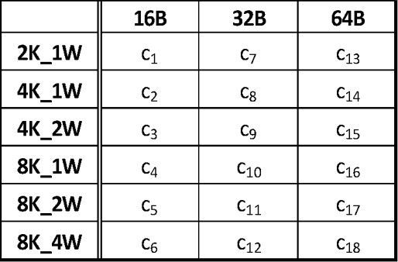
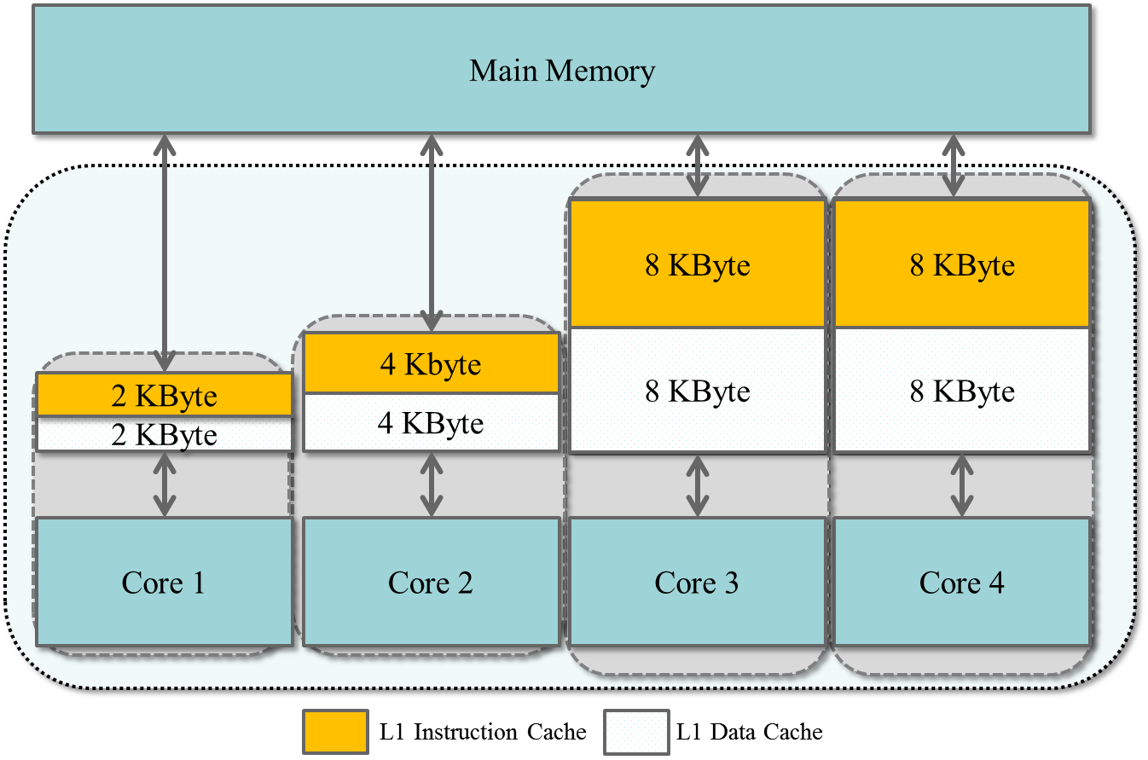
Configurable Cache Architecture
Complete cache design space
  18 configurations
Three domain-specific subsets
Quad-core heterogeneous, configurable multicore architecture
  One core for each domain
  Fourth core replicates core with largest cache size
    Additional profiling core
Subset configurations mapped to cores based on size
Tuning cores changes the cache line size and associativity

Slide 14
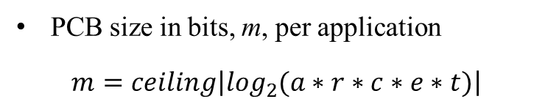
Software Support
SaT integrated into OS scheduler
Process control block (PCB)
  Used by typical OS scheduler for application execution status, etc.
PCB
Process State
Process Number
SaT’s PCB additions
  Necessary profiling information to make scheduling and tuning decision
Typical process information in PCB
Process Counter
Registers
. . .
Registers
PCB size in bits, m, per application
$$m=ceiling\left|\log_{2}{(a∗r∗c∗e∗t)}\right|$$
Profiling Info
Additional information used by SaT
Energy(core, config.)
Ex Time(core, config.)
. . .
applications
configurations
time
cores
energy

Slide 15
Scheduling and Tuning Algorithm (SaT)
Ready queue
SaT
Scheduling Stage
Applications waiting in ready queue
Yes
Best core
idle
Execute on best core
Application profiled
Yes
SaT profiles application first to determine best domain/core
  Profiling information saved in PCB
No
No
If application already profiled, SaT
attempts scheduling
Idle non-best cores
Leave application in queue
Yes
Profiling
cores
idle
First checks if best core is idle
If busy, check for idle non-best core
No
Leave application in ready queue
Energy-advantageous scheduling decision
Execute on
non-best core
Based on (1), SaT either schedules to non-best core or
leaves the application in the queue
Scheduling stage completes
Profile application
Leave application in queue
After scheduling, tuning stage begins
  If best configuration in PCB, SaT tunes the core to that configuration directly
Tuning Stage
  If not, SaT selects an unused configuration, and stores information in PCB
No
Yes
Best config known
Tune to unused config
Tune to best config
(1)
$$Th=E_{dyn}\left(a_{2},c_{1}\right)+E_{dyn}\left(a_{1},c_{1}\right)+E_{idl}\left(a_{2},c_{2}\right)> E_{dyn}\left(a_{1},c_{2}\right)$$
Notes:
Hammam: Is this boring to just list them like that? I couldn’t find a better way than iterating through the steps. Kept it high level

Slide 16
Experimental Setup
Software Setup
Diverse benchmark of 36 applications from EEMBC Automotive, MediaBench, and Motorola®’s Powerstone
Replicated persistent application behavior
  Random queue of 1,000 applications from benchmark applications
  Generated using discrete uniform distribution
Arrival times
  Normal distribution centered at the mean, one std. from ave. exe. time
Hardware Setup
E(total) = E(sta) + E(dyn) E(dyn) = cache_hits * E(hit) + cache_misses * E(miss) E(miss) = E(off_chip_access) + miss_cycles * E(CPU_stall) E(cache_fill) Miss Cycles = cache_misses * miss_latency + (cache_misses * (line_size/16)) * memory_band_width) E(sta) = total_cycles * E(static_per_cycle) E(static_per_cycle)) = E(per_Kbyte) * cache_size_in_Kbytes E(per_Kbyte) = (E(dyn_of_base_cache) * 10%) / (base_cache_size_in_Kbytes)
Quad-core platform
Private level-1 data/inst caches
Used SimpleScalar for cache statistics
CACTI and energy model to obtain energy values
Cache hierarchy energy model for the level one instruction and data caches

Slide 17


Evaluation Methodology
Evaluated a base system against three proposed systems
  Base system: quad-core, fixed configuration representing good, average configurations across all applications
  Three systems with similar core configurations but distinct scheduling algorithms
System 1-2:A priori profiling System 3: Dynamic profiling
System-1
System-2
System-3
Energy conservative
Performance centric system: maximizes throughput, core utilization
Uses SaT scheduling algorithm
Applications must wait for best core
Round robin scheduling algorithm
Uses energy and performance criteria to schedule applications (e.q., (1))
A
A
B
B
Provides insights to wasted idle energy
Serves as a near-optimal system for comparison purposes
Provides insights on tradeoffs on scheduling decisions
Provides insights on SaT and tradeoffs between performance and energy

Slide 18
Results: Base system vs. Systems-1, -2, -3
System 1: Energy Conservative
System 2: Performance Centric
System 3: SaT
Energy normalized to base cache for data cache
Energy normalized to base cache for instruction cache
System-1: Lower dynamic energy
System-1: Higher idle energy
System-1: Lower total energy
1) Wasted idle can overcome dynamic energy savings, in smaller technologies
2) Uncertain energy savings for performance-centric system
System-2: Lower idle energy
System-2: not guaranteed lower dynamic/total energy
3) System-3 saves total energy, despite increased idle energy.
System-3: Lower dynamic energy
System-3: Greater idle energy
System-3: Lower total energy

Slide 19


Results: System-3 vs. Systems-1, -2
System 1: Energy Conservative
System 2: Performance Centric
System 3: SaT
Energy normalized to base cache for data cache
Energy normalized to base cache for instruction cache
Lower total energy than system-1 and -2
Only 4.8% more total energy than system-1 and
lower energy than system-2
No a priori knowledge of applications is required

Slide 20
Profiling and Tuning Overhead Evaluation
Measured energy savings with and without a priori knowledge of application profiling information
  System 3-A with a priori knowledge of profiling information
  System 3-B without a priori knowledge of profiling information
Profiling energy overhead
  1.8% for data cache
  0.9% instruction cache
Overhead is amortized due to persistence nature of applications
Normalized energy
Energy consumption of system 3-B normalized to energy consumption of system 3-A
Notes:
Hammam: It looks too light… not much information here. What do you think?

Slide 21
Conclusions
Heterogeneous and configurable multicore systems
  Hardware specialization for disparate application requirement
Leveraged application domain specific configuration subsets
Associated scheduling and tuning (SaT) algorithm
  Dynamic application profiling
  Determined best core
  Tuned core configuration
Average energy savings of 31.6% and 17.0% for the data and instruction caches, respectively
  Only 1.8% and 0.9% profiling and tuning overhead

Slide 22

Questions

