Slide 1

Minimum Effort Design Space Subsetting for Configurable Caches
Hammam Alsafrjalani, Ann Gordon-Ross⁺, and Pablo Viana
Department of Electrical and Computer Engineering
University of Florida, Gainesville, Florida, USA
⁺ Also Affiliated with NSF Center for High-Performance Reconfigurable Computing
This work was supported by National Science Foundation (NSF) grant CNS-0953447

Slide 2
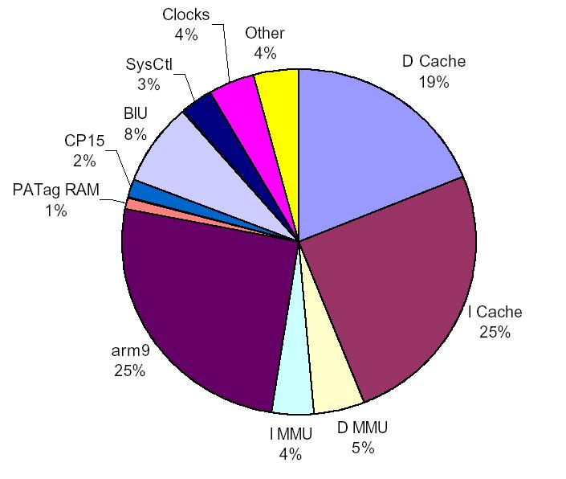
Introduction and Motivation
Reducing energy is a key goal in system design
Cache hierarchy accounts for large percentage of energy
  Cache hierarchy is good candidate for energy optimization
Cache energy varies based on application requirements
  Specialize/configure cache to application requirements for energy optimization
Viana ‘06
44%
Energy
Gaming
Video Streaming
Networking
Voice to text
Scanning
Applications
Viana, P., Gordon-Ross, A., Keogh, E., Barros, E., Vahid, F., "Configurable cache subsetting for fast cache tuning," Design Automation Conference, 2006

Slide 3
Introduction and Motivation
Configurable caches offer different configurations for application requirements
  Configurable parameters offer different values
    Cache size, associativity, line size, etc.
Cache tuning determines the best configuration for optimization goal
  Reduced energy, best performance, etc.
Configuration design space tradeoffs
  Large design space
    Closer adherence to application requirements
    Greater optimization potential
    Challenging design time exploration
    Greater runtime tuning overhead (e.g., energy, performance, etc.)
  Smaller/subsetted design space
    Alleviates above negatives
    Still good optimization potential if properly selected
Design Space
Exploration
Executing in base
configuration
Large Design Space
Lowest energy
Smaller Design Space
Energy
Energy
Energy
Cache Tuning
Cache Tuning
Cache Tuning
Execution time
Lowest energy
Near-Lowest energy

Slide 4
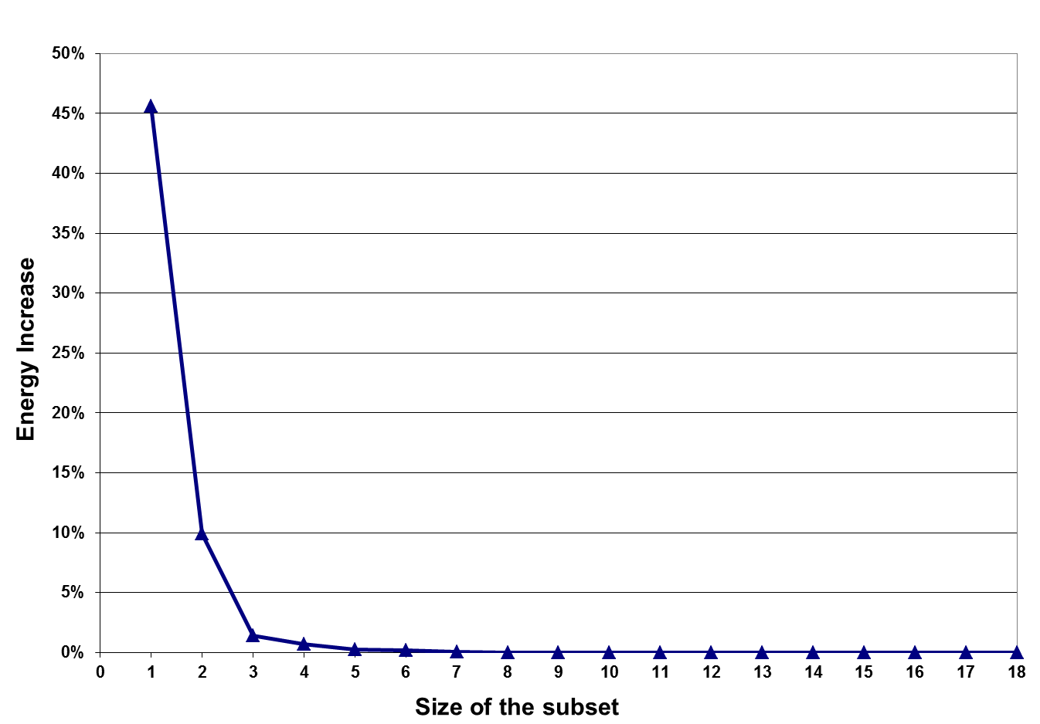
Challenges of Design Space Exploration
Prior work showed design space can be reduced
  Smaller, subsetted space contains
  near-best configurations
  Not all configurations are needed to obtain
  near-lowest energy savings
Largest subset contains entire design space
  Guarantees best configuration
Smallest subset contains one configuration
  Can be very far from best configuration
Finding best subset size and configurations is challenging
Near best
Smallest, bad subset
Viana ‘06
A subset contains near best configurations
Energy
Largest subset
Good subset-size, energy increase tradeoff
Best Configuration
Possible cache configurations

Slide 5
Methods for Determining Best Subset
A priori knowledge of all
application/configuration energies required!
Exhaustive search
  Prohibitive: for each subset size, each configuration subset, and for each application determine energy increase compared to complete design space
Data mining algorithms
  Example: SWAB algorithm used for color decimation
    Merge colors based on similarity between adjacent pixels, reduces number of colors
  Configurations in design space are similar to pixels
    Energy of each configuration is similar to color of each pixel
  SWAB can reduce number of configurations with small energy increases
36 colors
Merging and measuring error
8 colors
Still…a priori knowledge of all application/configuration energies but faster

Slide 6
SWAB Dynamics
Example: SWAB used to merge configurations in a design space
Example: design space of a configurable cache
c₁₃
c₁
c₇
c₁
c₂
c₇
Application
a_{i}
c_{j}
c_{k}
merging
e(c_{j},a_{i})
e(c_{k},a_{i})
Requires a priori knowledge of energy to run a_{i} on c_{j} and a_{i} on c_{k}
energy increase

Slide 7
Problem Definition
Given a large design space
  Determine smaller, high-quality subset offering near-lowest energy configurations
  Without a priori knowledge of all anticipated applications
Anticipated applications
Configuration design space

Slide 8
Our Contribution
Subsetting method based on SWAB
  Reduces design-time subset selection effort
  Eliminates SWABS requirement of a priori knowledge of all anticipated applications
Quantify the extent to which a priori knowledge
affects SWAB
  Train SWAB using random training-set applications to
  determine subsets
  Evaluate subsets’ qualities using testing-set applications
Improving subset quality with application domain knowledge
  Small training set with applications from the same general domain
    Domain classification based on cache statistics
SWAB for application-domain specific systems
Notes:
Hammam: I like the small, but impactful change. Now SWAB (old work) is presented and we can move on with our contribution about broadening SWAB’s applicability

Slide 9
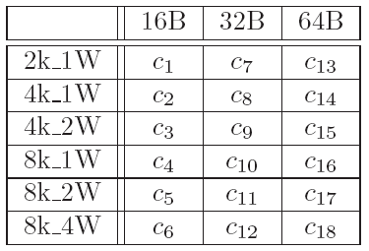
Evaluating SWAB: Random Training Sets
Given a set of anticipated applications
Randomly select n applications
  Training set T(n)
  Remaining are test set
Used SWAB to determine subsets
Evaluated subset quality based on energy increase
  Best in subset normalized to best in complete design space
  Best in subset normalized to default base configuration c₁₈
Repeat for all training set and subset sizes
SWAB

Slide 10
Our Subsetting Method:
Cache-Statistic Based Training Sets
Application domain classification based on cache miss rate
Using large set of diverse applications
  Split applications into equal-size miss-rate groups
Select three training applications from
each group
  Size based on results of random training sets
Used SWAB to determine subsets for
each group
Low
Mid-Range
High
SWAB
Evaluated subset quality based on energy increase
  Best in subset normalized to average energy of best in a same-sized subset created using random training applications

Slide 11
Experimental Set Up
Software Setup
Diverse benchmark set of 36 applications from EEMBC Automotive, MediaBench, and Motorola®’s Powerstone
Hardware Setup
Private level-1 cache
Energy model for level-1 cache
Used SimpleScalar for cache statistics
CACTI and model in (1) to obtain energy values
E(total) = E(sta) + E(dyn) E(dyn) = cache_hits * E(hit) + cache_misses * E(miss) E(miss) = E(off_chip_access) + miss_cycles * E(CPU_stall) E(cache_fill) Miss Cycles = cache_misses * miss_latency + (cache_misses * (line_size/16)) * memory_band_width) E(sta) = total_cycles * E(static_per_cycle) E(static_per_cycle)) = E(per_Kbyte) * cache_size_in_Kbytes E(per_Kbyte) = (E(dyn_of_base_cache) * 10%) / (base_cache_size_in_Kbytes)
Cache hierarchy energy model for the level one instruction and data caches

Slide 12
Random Training Set Applications
Higher quality
Lower quality
Lower value = higher quality subsets
Normalized Energy
Training set size
Training set size
Best configuration in subset normalized to best configuration in complete design space
Best configuration in subset normalized to base configuration
Larger training set sizes not
necessarily better
  T(3) provided higher quality subset, compared to T(6) for
  instruction cache
T(3) provided best savings with respect to designer effort
  29% and 31% energy savings, compared to base configuration, for instruction and data cache, respectively

Slide 13
Cache-Statistic Based Training Set Applications: Instruction Cache
Low
Mid-Range
High
Baseline
Energy using best configuration in a subset obtained from random T(3)
Normalized Energy
Sorted Applications
On average, for each group
  Cache-statistic based training sets subsets were higher quality than subsets obtained from random training applications
On average, for all applications
  Cache statistic training sets increased subset energy savings by 10%

Slide 14
Cache-Statistic Based Training Set Applications: Data Cache
Low
Mid-Range
High
Baseline
Energy using best configuration in a subset obtained from random T(3)
Normalized Energy
Sorted Applications
Data cache savings as compared to instruction cache savings
  Similar trends
Lower energy savings increase
  3% for data caches vs. 10% for instruction caches
For instruction and data caches, general knowledge of anticipated application domain is sufficient to increase subset quality as compared to random training set applications

Slide 15
Design-time Speedup Analysis
Exploring the design space using domain-specific training applications of size three is 4X faster, compared to using all anticipated applications
Baseline: Time to run SWAB with all anticipated applications

Slide 16
Conclusion
Reducing design space exploration efforts
  Used training set applications to evaluate design space subsetting, and evaluated the subsets' energy savings using disjoint testing applications
Subset quality
  Random training set applications provided quality configuration subsets, and domain-specific training application increased subset quality
4X reduction in design space exploration time using domain-specific training applications as compared to using all anticipated applications
Our training set methods enable designers to leverage configurable cache energy savings with less design effort

Slide 17
Questions

