Slide 1
Partially Reconfigurable System-on-Chips for Adaptive Fault Tolerance
Shaon Yousuf
Adam Jacobs
Ph.D. Students
NSF CHREC Center, University of Florida
Dr. Ann Gordon-Ross
Assistant Professor of ECE
NSF CHREC Center, University of Florida

Slide 2




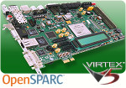
Introduction
Many space systems use remote sensing applications
  Gathers information about a target of interest from a distance
Gathered information requires processing
  Send data to ground station or other space systems using communication link
Modern remote sensing applications are complex
  Gathers a large amount of data
  Impractical to send all data through communication link
    System performance bottlenecked by limited communication bandwidth
  Solution: Pre-process data and transmit results
    On-board processing using system-on-chips (SoCs)
Limited Bandwidth
Preprocess Data
Notes:
Est time for slide: 0:45 min
Total = 0:45 min

Slide 3
SoCs for Space Applications
SoCs increase on-board data processing capabilities
  However, increases the system’s payload
  Optimized/customized SoCs for use in space (space SoCs) required
    Provide cost effective, high performance, and reliable data processing
  Traditionally space SoCs consist of radiation hardened (rad-hard) devices
Rad-hard devices
Specialized device enable
reliable on-board data processing
Specialized equals expensive
Fixed/static design provide all the application’s required functionality all of the time
Increased payload

Slide 4
SoCs for Space Applications
Is there a better choice?
  Sure, why not use commercial-off-the-shelf (COTS) SRAM-based FPGAs
    Cheaper than rad-hard devices
    Allows reprogrammability (time multiplex hardware resources to reduce payload)
Is it that simple?
  Well, no
    In space, cosmic radiation corrupts FPGA SRAM!
    These are called single event upsets (SEU)s
FPGA
10111011
FPGA
01101100
COTS FPGA devices
Fault tolerance (FT) techniques used for reliability (provide redundant copies of required functionality)
Payload still an issue
Efficient SoC design to ensure a particular functionality along with required FT is available when required
Increased design complexity

Slide 5
SoCs for Space Applications
So what do we do?
  Mitigate payload issues by adapting to varying levels of radiation in space
    Same degree of FT (reliability) not required all the time
    Reconfigure FPGA to provide adaptive fault tolerance (AFT)
  Mitigate design complexity by designing a AFT base platform
    Enable rapid design and deployment of space applications
High reliability required
High radiation Orbit
Low radiation orbit
High radiation Orbit
Low reliability will suffice
High radiation Orbit

Slide 6
AFT using FPGA Reconfiguration
FPGAs offer two reconfiguration (reprogrammability) methods
  Full reconfiguration (FR), which halts and reconfigures the entire FPGA
    Can impose significant performance overhead
  Partial reconfiguration (PR) halts and reconfigures a portion of the FPGA
    Mitigates FR performance issues by isolating reconfiguration to selected parts
Example with 2 PRRs
ICAP
Module A
Module:
A & B
Module B
PRR 1
Central
Controlling Agent
Module C
Mem controller
Static
modules
Static region
PRR 2
Modules:
C & D
Module D
Static modules
Reconfigurable Modules (PRMs)
FPGA Fabric
PRR – Partially reconfigurable regions

Slide 7

Contribution
In this work, we present an adaptive fault tolerant partially reconfigurable system-on-chip (AFT PR SoC)
  Leverages VAPRES*
    A Virtual Architecture for Partially Reconfigurable Embedded Systems
  Contains a data flow controller to manage data flow to and from PRRs
    Enables high SoC throughput by continuous data stream processing
  Contains a software-based AFT controller to vary the degree of FT
    Dynamically reconfigures the PRRs and changes the reliability mode according to the current orbital position
  The AFT PR SoC decrease payload and cost of space systems as compared to traditional static FT systems
  The AFT PR SoC can be leveraged
  as a base platform to deploy a multitude
  of different space applications
* A. Jara-Berrocal, A. Gordon-Ross, "VAPRES: A Virtual Architecture for Partially Reconfigurable Embedded Systems," Design, Automation & Test in Europe Conference & Exhibition (DATE), March 2010

Slide 8



Why VAPRES ?
Control functions
PLB Bus (other peripherals: SDRAM, UART)
PLB Bus (other peripherals: SDRAM, UART)
MicroBlaze CPU
GPIO Peripheral
MicroBlaze CPU
ICAP
GPIO Peripheral
ICAP
Independent clocks
FSL
Fast
Simplex
Links
FSL
Fast
Simplex
Links
Data
Reconfiguration
PR
Region 1
PR
Region 2
IO
Module
PR
Region 1
PR
Region 2
IO
Module
To IO
To IO
PR
Socket
PR
Socket
Streaming data channels
PR
Socket
PR
Socket
PR
Socket
PR
Socket
IF
IF
IF
IF
IF
IF
IF
IF
Slice macro
Switch 1
Switch 2
Switch 1
Switch 2
VAPRES is a multipurpose, scalable, flexible architecture
  Flexible, scalable
    PRR count
    PRR size
    Number of FSLs per PRR/IOM
    MACS bandwidth
  Good platform for developing complex reconfigurable applications
Regional clock buffer (BUFR)
Notes:
Changes: Left side, bullet 2.1

Slide 9
AFT PR SoC Design Consists of Two Steps
Data flow controller step
  Creates an HDL-based finite state machine to orchestrate the dataflow between the MicroBlaze and PRRs
Software-based AFT controller step
  Creates a C-based AFT controller module that allows the MicroBlaze to adaptively change the reliability mode

Slide 10
Data Flow Controller
If p_consumerfsl
and rfd and !done/
ce=1, start=1, p_consumer_en =1,
p_consumer_data (32) = input_data (32)
If !p_consumerfsl_rdy
If p_consumerfsl_rdy/
ce = 1, start = 1
Idle
Read_Data
If !p_producer_rdy /
ce= 0, start=0
If !data_valid/
ce = 0, start = 0
If !p_producer_rdy/
ce= 0, start=0
If !p_producer_rdy /
ce= 0, start=0
Stall
If p_consumerfsl and rfd and done/
ce=1, start=1
Write_Data
If p_producer_rdy/ ce= 1, start=1
If dv and p_producer_rdy/
p_producerfsl_en = 1
p_producerfsl_data(32) = output_data(32)
Read_Write_Data
If !p_producer_rdy and !rfd/
p_consumer_en=0
If p_consumerfsl and rfd
and dv and p_producer_rdy/
p_consumer_en =1,
p_consumer_data (32) = input_data (32),
p_producerfsl_en = 1,
p_producerfsl_data(32) = output_data(32)

Slide 11
Software-based AFT Controller
AFT controller brings efficient resource
management to traditional fault tolerant (FT) systems
  Required FT level varies to match current
  orbital position’s radiation level
  Offers four reliability modes (software-based switching)
    Reliability mode switching depends on thresholds
  Required FT level dictates hardware task (PRMs) loading/unloading into PRRs
    Unused PRRs turned off to save power (power saving mode)
  Software voter detects anomalies and refreshes PRRs (configuration scrubbing) when errors detected (refresh mode)
Reliability modes
  High reliability – TMR
  Medium reliability – SCP
  Low reliability – PRM loaded into single PRR
  Hybrid reliability
    Use low reliability mode for PRMs with ABFT
    Use medium/high reliability for PRMs without ABFT
PLB Bus (other peripherals: SDRAM, UART)
MicroBlaze CPU
ICAP
Voter+Controller
FSL
Fast
Simplex
Links
GPIO
Peripheral
Data
PR
Region 1
PR
Region 2
PR
Region 3
FFT
Matrix Multiply
PR
Region 4
FFT
Matrix Multiply
FFT
CORDIC
Matrix Multiply
PR Socket
PR Socket
PR Socket
PR Socket
PRM – Partially reconfigurable modules
TMR – Triple modular redundancy
SCP – Self-checking pairs
ABFT – Algorithm-based fault tolerance

Slide 12
Experimental Setup
Software
  Xilinx ISE design suite 12.4
  AFT VAPRES SoC compared
  to SoC without AFT
    Both SoCs have 4 PRRs
    PRRs reconfigured with 1k-point FFTs
    PRRs span 40 vertical and 21 horizontal configuration logic blocks (1,680 slices each)
  SoC without AFT always operates in
  TMR mode (worst-case condition)
  AFT SoC switches according to thresholds
    Low SEU rate threshold of 2.0 SEUs per day for switching between low to medium reliability
    High SEU rate threshold of 8.0 SEUs per day for switching between medium to high reliability
  Virtex-5 LX110T ISS orbit fault rates applied
Hardware
  XUPV5-LX110T board
Virtex-5 LX110T ISS orbit fault rates calculated using crème tool (https://creme.isde.vanderbilt.edu)
CRÈME96 ISS (ZARYA) Orbit Parameters*
Apogee (km) | 355
Perigee (km) | 352
Inclination (º) | 51.6472
Initial Longitude (º) | 339.10
Initial displacement from ascending node (º) | 217.9038
Displacement of perigee from ascending node (º) | 185.0581
CRÈME96 Virtex-5 Weibull parameters**
Onset (um) | 0.5
Width (w) | 30
Power (s) | 1.5
Limit (um²) | 1.13E-7
* http://celestrak.com/NORAD/elements/stations.txt
** Quinn, H.; Morgan, K.; Graham, P.; Krone, J.; Caffrey, M.; , "Static Proton and Heavy Ion Testing of the Xilinx Virtex-5 Device," Radiation Effects Data Workshop, 2007 IEEE , vol.0, no., pp.177-184, 23-27 July 2007 doi: 10.1109/REDW.2007.4342561 URL: http://ieeexplore.ieee.org/stamp/stamp.jsp?tp=&arnumber=4342561&isnumber=4342526
ISS – International space station
Notes:
Est time for slide: 0:20 min
Total = 10:50 min

Slide 13
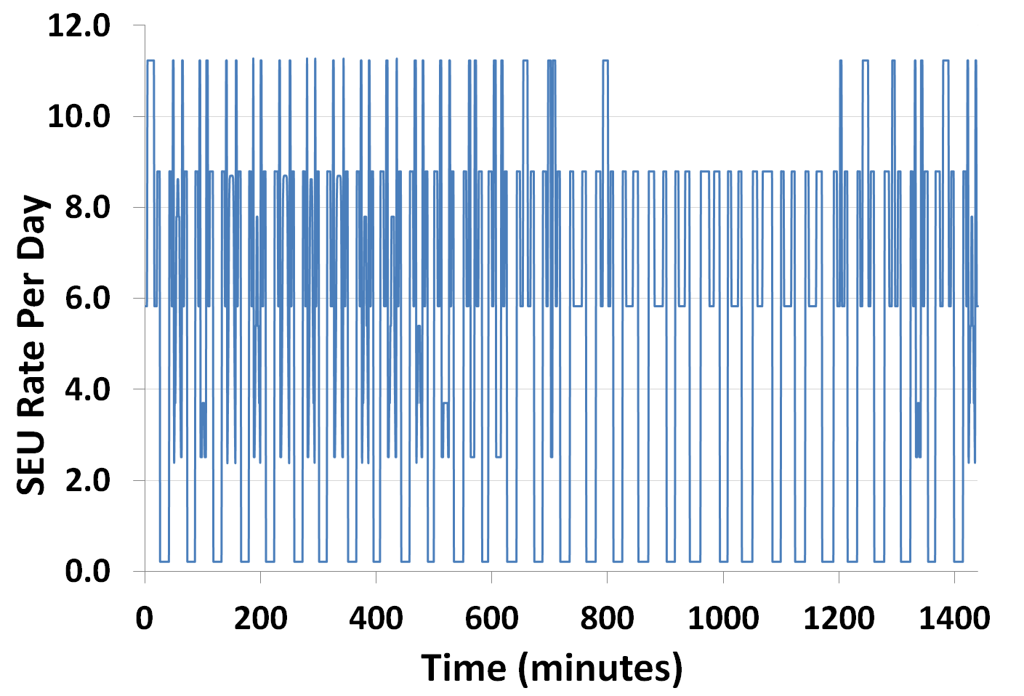
Virtex-5LX110T ISS orbit SEU rates
South Atlantic Anomaly (SAA)
Poles
Calculated using CRÈME 96 tool
Notes:
Dr. George: incomplete, needs much work
Dr. Ann: Not sure about the title here. It says increased productivity, but this slide is about AFT. Not entirely what that work was targeted for.

Slide 14
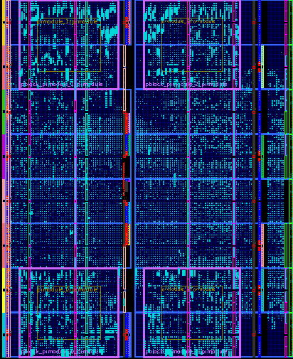

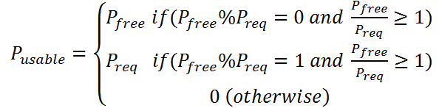

AFT PR SoC Resource Requirements and Analysis
SoC operates at 100MHz
  71% of total device slices used
Normalized PRR resource utilization calculation
Symbol | Definition
P_{nru} | Normalized resource utilization
P_{av} | Total PRRs available
P_{req} | Number of PRRs required per PRM
P_{used} | Number of PRRs used per PRM
P_{ex} | Number of extra PRRs used
P_{free} | Number of free PRRs
P_{usable} | Number of usable free PRRs
where, , ,
and
Resource Type | 1-K point FFT Core | AFT PR SoC
Slice | 1, 680 | 12,351
BRAM/FIFO | 10 | 50
Finally,
Notes:
Est time for slide: 0:20 min
Total = 10:50 min

Slide 15
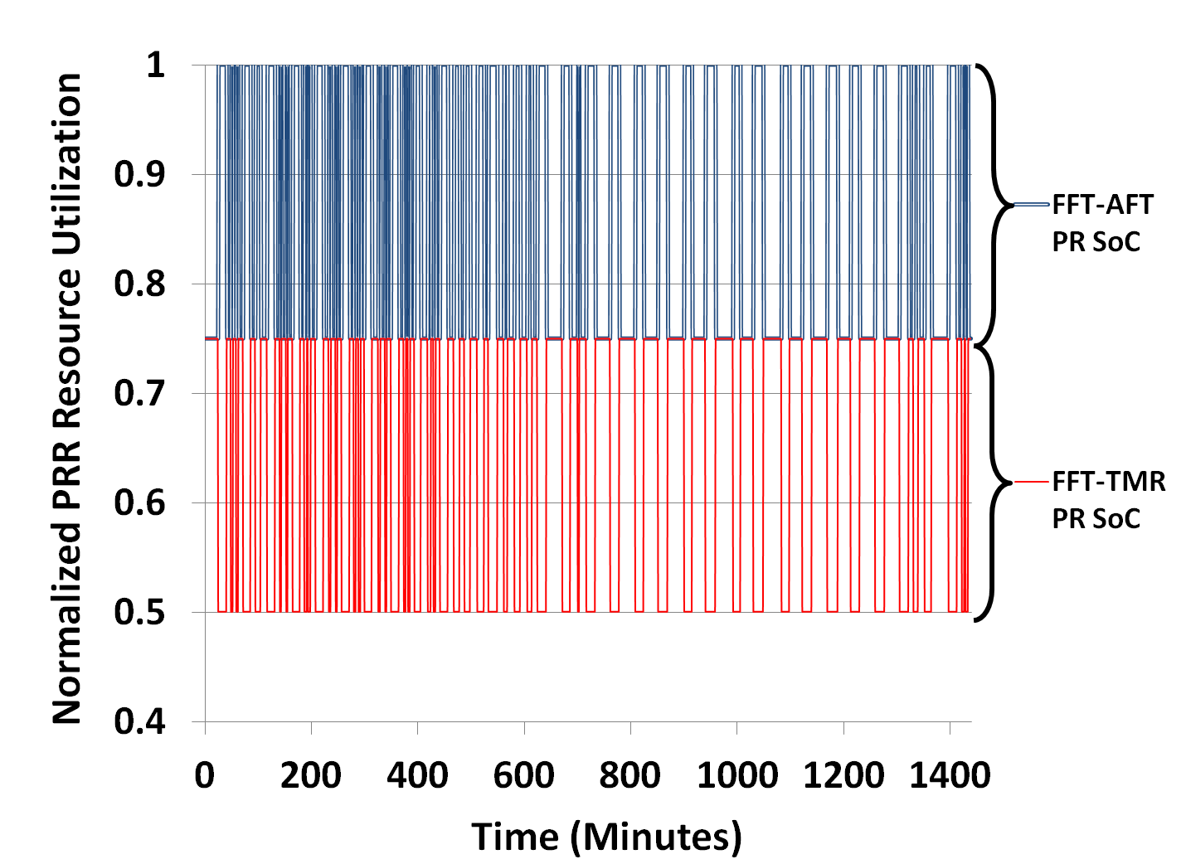
AFT PR SoC Resource Utilization
100% PRR utilization
Average 21% increase in PRR resource utilization over 24-hour period
50% PRR utilization
Notes:
Dr. George: incomplete, needs much work
Dr. Ann: Not sure about the title here. It says increased productivity, but this slide is about AFT. Not entirely what that work was targeted for.

Slide 16
Conclusions and Future Work
Conclusions
  We designed and implemented an adaptive fault tolerant partially reconfigurable system-on-chip (AFT PR SoC) leveraging VAPRES
    The Virtual Architecture for Partially Reconfigurable Embedded Systems
  A novel MicroBlaze-based software controller (AFT controller) adapts the AFT PR SoC’s fault tolerance to changing space radiation levels
    Achieves higher resource utilization in comparison to a traditional triple modular redundancy (TMR)-based fault tolerant (FT) PR SoC
    Our results indicate the AFT PR SoC can achieve an average of 22% higher resource utilization in the International Space Station (ISS) orbit compared to a traditional FT SoC
  The AFT PR SoC is an ideal platform for space SoCs
    System designers can implement a wide variety of applications using the AFT PR SoC’s PRRs
Future Work
  Integrating an operating system in our space SoC to allow parallel software processes to control voting and reliability mode switching
  Upgrading the AFT PR SoC’s MicroBlaze processor with a LEON3FT fault tolerant processor to provide additional system reliability
  Using fault injection techniques to test our space SoCs robustnes
Notes:
Est time for slide: 0:30 min
Total = 15:00 min

Slide 17

QUESTIONS?
This work was supported in part by the I/UCRC Program of the National Science Foundation under Grant No. EEC-0642422. We also gratefully acknowledge tools provided by Xilinx.

