Slide 1

Markov Modeling of Fault-Tolerant
Wireless Sensor Networks
Arslan Munir and Ann Gordon-Ross⁺
Department of Electrical and Computer Engineering
University of Florida, Gainesville, Florida, USA
⁺ Also affiliated with NSF Center for High-Performance Reconfigurable Computing
This work was supported by the Natural Sciences and Engineering Research Council of Canada (NSERC)

Slide 2


Wireless Sensor Networks (WSNs)
WSN
Applications
Ever Increasing
Security and
Defense Systems
Industrial
Automation
Ambient conditions
Monitoring, e.g. ,
forest fire detection
Health Care
Logistics

Slide 3


WSN Design Challenges
WSN
Design
Forest fire could spread
uncontrollably in the
case of a forest fire
detection application
Failure to meet
Challenges
Catastrophic
Consequences
Meeting application requirements
e.g., reliability, lifetime, throughput,
delay (responsiveness), etc.
Loss of life in the case
of health care application
Application requirements
change over time
Major disasters in the
case of defense systems
Environmental conditions (stimuli)
change over time

Slide 4



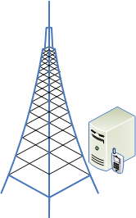
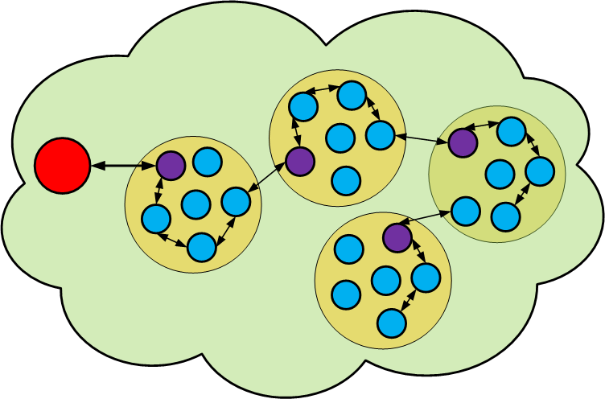

WSN Hierarchical View
Application
Requirements
Lifetime
Reliability
Computer
Network
MTTF
Average time to
WSN failure
WSN
Designer
Sensor
Nodes
Cluster
Head
WSN
Cluster
Gateway
Sink
Node
Sensor
Field
WSN

Slide 5

WSN Fault-Detection and Fault-Tolerance
WSN
Fault-detection &
Fault-tolerance
Fault-detection => Distributed fault-detection (DFD) algorithms
that identify faulty sensor readings to indicate sensor faults
DFD algorithm’s accuracy =>
Algorithm’s ability to accurately
identify faults
Fault-tolerance =>
Adding hardware/software
redundancy to the system
Necessity
Sensor nodes deployed in unattended and
hostile environments => susceptible to failures
Manual inspection of faulty sensor nodes
after deployment is impractical
Many WSN applications are mission critical
and require continuous operation

Slide 6
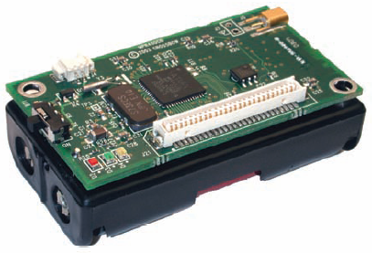
WSN Fault-Tolerance
WSN
Fault-tolerance
Fault-tolerance => Adding hardware/software
redundancy to the system
Sensors (e.g., temperature and
humidity sensors) have higher
failure rates than other components
(e.g., processors, transceivers, etc.)
Where to add redundancy?
Within a sensor node
Sensors are cheap =>
Adding spare sensors
contribute little to a
sensor node’s cost
Within a cluster => redundant sensor nodes
Within a WSN => redundant WSN clusters

Slide 7
Contributions
Fault-tolerance for
WSNs
Investigate synergy between
fault-detection and
fault-tolerance (FT) for WSNs
Proposed a duplex sensor node
model for fault-tolerance
Develop a Markov model for characterizing
WSN reliability and MTTF
A good DFD
algorithm is necessary
for robust FT
Provides an insight into the type of
sensor nodes (duplex or simplex)
feasible for an application to meet
the application’s requirements
Used a hierarchical approach =>
WSN Markov model leverages
WSN cluster model
which in turn leverages
sensor node model
Helps WSN designer in determining
the exact number of sensor nodes
required to meet the application’s
lifetime and reliability requirements

Slide 8
NFT and FT Sensor Node Markov Model
1 Non-Faulty
Sensor
1
0
Failed State
= Sensor failure rate
Non-fault-tolerant (NFT) Sensor Node Markov Model
2 Non-Faulty
Sensors
2
1
C = Coverage factor
Proposed
Duplex
Model
Probability that the faulty sensor
is correctly diagnosed, disconnected,
and replaced by a good inactive
spare sensor
0
Failed State
Fault-tolerant (FT) Sensor Node Markov Model

Slide 9



FT Sensor Node Markov Model –
Differential Equation Solutions
Reliability
  where
  P_{i} (t) = Probability that sensor node will be in state i at time t
MTTF
Average Failure Rate (or Failures in Time (FIT))
  where
  k denotes the average number of sensor node neighbors
  k is important as DFD algorithm’s accuracy depends upon k

Slide 10
FT WSN Cluster Model
Average number of
neighbor nodes per cluster
is k = n - 1
n
n-1
k_{min}+1
k_{min}
We consider a special case with n = k_{min}+2
Average number
of nodes in each
cluster is n
A cluster fails to
perform its assigned
application task if the
number of non-faulty
sensor nodes in the
cluster reduces to k_{min}
k_{min}+2
k_{min}+1
k_{min}

Slide 11
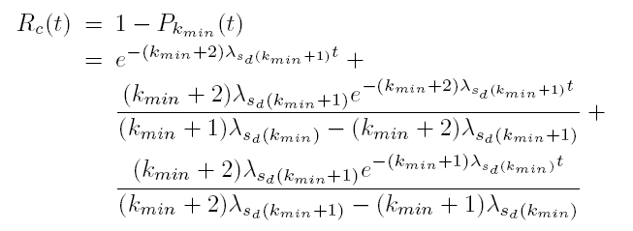
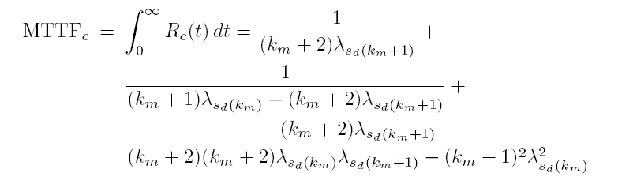
FT WSN Cluster Markov Model –
Differential Equation Solutions (n = k_{min}+2)
Reliability
MTTF

Slide 12

FT WSN Cluster Markov Model –
Differential Equation Solutions (n = k_{min}+2)
Average Failure Rate
  where
  MTTF_{c(n)} denotes the MTTF of a WSN cluster of n sensor nodes
Sensor
Nodes
Cluster
Head
WSN
Cluster
Sink
Node
Sensor
Field
WSN

Slide 13
FT WSN Model
λ_{c(n)} corresponds to
the failure rate of a WSN
cluster with n sensor nodes
N
N-1
N_{min}+1
N_{min}
A typical WSN consists of N = n_{s}/n clusters
  where
  n_{s} denotes the total number of sensor nodes in the WSN
  n denotes the average number of nodes in a cluster
WSN fails to perform
its assigned task when
the number of alive
clusters reduces to N_{min}

Slide 14
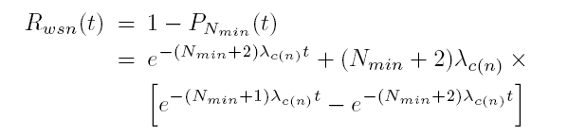
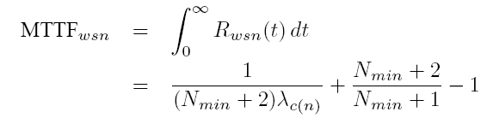
FT WSN Markov Model –
Differential Equation Solutions (N = N_{min}+2)
Reliability
MTTF

Slide 15
Experimental Results
SHARPE Software Package
  Markov model implementations
    NFT sensor node
    FT sensor node
    NFT WSN cluster
    FT WSN cluster
    NFT WSN
    FT WSN
Sensor Failure Probability
  Exponential distribution
  where
  p = sensor failure probability
  λ_{s} = sensor failure rate over period t_{s}
  t_{s} = time over which sensor failure probability/failure rate is specified
  We present results for t_{s} = 100 days
Sensor
Nodes
Cluster
Head
WSN
Cluster
Sink
Node
Sensor
Field
WSN
Our Markov models
are valid for any other
distribution as well

Slide 16
Results – MTTF FT & NFT Sensor Nodes
An FT sensor node has a remarkable difference in MTTF as compared to an NFT sensor node: approx 95% improvement!!
c = 1 for an ideal
DFD algorithm and
an ideal replacement of
faulty sensor with a
non-faulty sensor
c = coverage factor
k = number of neighbor
sensor nodes
c improves as the number of neighboring sensor nodes k increases (DFD specifics) and hence the MTTF for an FT sensor node increases
MTTF for both NFT and FT sensor node decreases as p increases
MTTF (days) for an FT and a non-FT (NFT) sensor node.

Slide 17
Results – Reliability FT & NFT Sensor Node
The percentage
improvement in
reliability attained
by an FT sensor node
with c = 1 increases
as p →1 because
because for an FT
sensor node with
c≠1, c decreases
as p →1
(DFD specifics)
Reliability for an NFT and an sensor node
p | NFT | FT (k=5, c≠1) | FT (k=10, c≠1) | FT (c=1)
0.05 | 0.94999 | 0.99770 | 0.99872 | 0.99872
0.1 | 0.89996 | 0.98135 | 0.99074 | 0.99482
0.2 | 0.80011 | 0.93481 | 0.95088 | 0.97853
0.3 | 0.69977 | 0.86265 | 0.88263 | 0.94959
0.4 | 0.59989 | 0.77094 | 0.79209 | 0.90643
0.5 | 0.5007 | 0.66086 | 0.68097 | 0.84662
0.6 | 0.40012 | 0.53610 | 0.55295 | 0.76663
0.7 | 0.30119 | 0.40167 | 0.41432 | 0.66262
0.8 | 0.19989 | 0.25943 | 0.26683 | 0.52171
0.9 | 0.10026 | 0.12148 | 0.12424 | 0.33086
0.99 | 0.01005 | 0.01048 | 0.01053 | 0.05628
The percentage
improvement
in reliability for an
FT sensor node with
c=1 over an NFT sensor
node and FT sensor node
with c≠1 and k = 5 and 10
is 230%, 172%, and
166%, respectively
for p=0.9
230%
172%
166%

Slide 18
Results – MTTF FT & NFT WSN Cluster
MTTF for FT WSN clusters with c=1 is always better than the FT WSN clusters with c≠1
The FT WSN cluster with n=k_{min}+5 has more redundant senor nodes as compared to the FT WSN cluster with n=k_{min}+2 and thus has a comparatively greater MTTF
MTTF for both NFT and FT WSN cluster decreases as p increases
MTTF (days) for the FT and non-FT (NFT) WSN clusters with k_{min} = 4.

Slide 19
Results – Reliability FT & NFT WSN Cluster
Reliability for an NFT and an FT WSN cluster when n = k_{min} + 2 (k_{min}= 4)
p | NFT | FT (c≠1) | FT (c=1)
0.05 | 0.96720 | 0.99058 | 0.99098
0.1 | 0.88562 | 0.95969 | 0.96552
0.2 | 0.65567 | 0.84304 | 0.87474
0.3 | 0.41968 | 0.66438 | 0.74422
0.4 | 0.23309 | 0.45925 | 0.59388
0.5 | 0.10942 | 0.26595 | 0.43653
0.6 | 0.04098 | 0.11837 | 0.28732
0.7 | 0.01114 | 0.03548 | 0.16279
0.8 | 0.0015957 | 0.0043470 | 0.06723
0.9 | 5.5702x10⁻⁵ | 1.4838x10⁻⁴ | 0.01772
0.99 | 6.1056x10⁻¹⁰ | 1.0057x10⁻⁹ | 5.5702x10⁻⁵
The percentage
improvement
in reliability for an
FT WSN cluster with
c=1 over an NFT WSN
cluster and FT WSN
cluster with c≠1
is 601% and 143%,
respectively for p=0.6
601%
143%

Slide 20
Results – MTTF FT & NFT WSN
MTTF percentage
improvement for FT WSN over NFT WSN
is 88% for p=0.1
Low failure
probability sensors
are required to build
a more reliable
FT WSN
MTTF for WSNs with N=N_{min}+5
is always greater than the MTTF for WSNs with N=N_{min}+2
(due to additional redundancy
in WSN with N=N_{min}+5)
MTTF percentage improvement
for FT WSN over NFT WSN
drops to 3.3% for p=0.99
MTTF (days) for the FT and non-FT (NFT) WSNs with N_{min} = 0.

Slide 21
Results – Reliability FT & NFT WSN
Reliability for an NFT and FT WSN when N = N_{min}+ 2 (N_{min} = 0)
p | NFT | FT (c≠1) | FT (c=1)
0.05 | 0.99557 | 0.99883 | 0.99885
0.1 | 0.98261 | 0.99474 | 0.99534
0.2 | 0.93321 | 0.97583 | 0.98084
0.3 | 0.85557 | 0.93775 | 0.95482
0.4 | 0.75408 | 0.87466 | 0.91611
0.5 | 0.63536 | 0.78202 | 0.86218
0.6 | 0.51166 | 0.65121 | 0.78948
0.7 | 0.36303 | 0.49093 | 0.69527
0.8 | 0.20933 | 0.30328 | 0.55494
0.9 | 0.08807 | 0.11792 | 0.39647
0.99 | 0.004054 | 0.004952 | 0.08807
An FT WSN can
deliver much better
reliability than an
NFT WSN even for
higher sensor failure
probability p
The percentage
improvement
in reliability for an
FT WSN with c=1
over an NFT WSN
and FT WSN with c≠1
is 350% and 236%,
respectively for p=0.9
350%
236%

Slide 22
Conclusions
We proposed an FT duplex sensor node model
  A novel concept for determining the coverage factor using sensor fault detection algorithm accuracy
We developed hierarchical Markov models for WSNs consisting of sensor node clusters to compare the MTTF and reliability for FT and NFT WSNs
  Aids design of WSNs with different lifetime and reliability requirements
Fault detection algorithm’s accuracy plays a critical role in FT WSNs
FT duplex sensor node provides improvement over an NFT sensor node
  100% MTTF improvement with a perfect fault detection algorithm (c = 1)
  MTTF improvement from 96% for current fault detection algorithms with low p
  (p < 0.3) - MTTF improvement reduces to 1.3% as p → 1
Percentage reliability improvement for an FT WSN with c = 1 over an NFT WSN with c≠1 is 350% and over an FT WSN with c≠1 is 236% for p=0.9
Redundancy in WSN plays an important role in improving MTTF
  Our models allow designers to determine the fault detection algorithm’s accuracy and required redundancy to meet application requirements

