Slide 1
A Queueing Theoretic Approach for
Performance Evaluation of Low-Power
Multi-core Embedded Systems
Arslan Munir, Ann Gordon-Ross⁺ , and Sanjay Ranka*
Department of Electrical and Computer Engineering
*Department of Computer and Information Science and Engineering
University of Florida, Gainesville, Florida, USA
⁺ Also affiliated with NSF Center for High-Performance Reconfigurable Computing
This work was supported by the Natural Sciences and Engineering Research Council of Canada (NSERC) and the National Science Foundation (NSF) (CNS-0953447 and CNS-0905308)

Slide 2
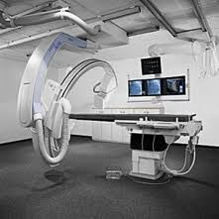
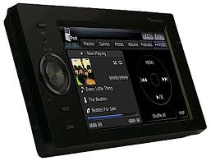
Introduction and Motivation
The word embedded
literally means “within”,
so embedded systems are
information processing systems
within (embedded into)
other systems
Embedded
Systems
Automotive
Applications
Space
Medical
Consumer
Electronics

Slide 3
Introduction and Motivation
Multi-core embedded systems
Moore’s law supplying billion of transistors on-chip
Increased computing demands from embedded system with constrained energy and power
A 3G mobile handset’s signal processing requires 35-40 GOPS
Constraints: power dissipation budget of 1W
Performance efficiency required: 25 mW/GOP or 25 pJ/operation
Multi-core embedded systems provide a promising solution
to meet these performance and power constraints
Multi-core embedded systems architecture
Processor cores
Caches: L1-I, L1-D, last-level caches (LLCs) L2 or L3
Memory controllers
Interconnection network
Focus of our work
Challenge: General consensus on
private L1-I and L1-D caches but no
dominant architectural paradigm for
private, shared, or
hybrid LLCs
LLC configuration (private, shared, hybrid)
can significantly impact an architecture’s
performance and power consumption

Slide 4
Introduction and Motivation
Run benchmarks on
real multi-core
platforms/architectures
to be evaluated
Run benchmarks on
a multi-core
simulator
Multi-core Architecture
Evaluation Approaches
Focus of our work
Benchmark-driven
simulative approach
Benchmark-driven
experimental approach
Analytical modeling
approach
Models multi-core
architectures
to be evaluated
Most accurate way of evaluating an architecture
Cannot be used for design tradeoffs evaluation
since only evaluates what an architecture offers
Much faster than simulative approach
Requires good and diverse benchmarks
Provides a good way of evaluating designs
Requires an accurate multi-core simulator
Requires good and diverse benchmarks
Can be very time consuming
Can be quickest amongst other approaches
Benchmarks not required
A good model development is a challenging endeavor
Compromises accuracy for faster evaluation

Slide 5
Introduction and Motivation
Modeling
A model is a simplification of another entity,
which can be a physical thing or another model
A system or subsystem’s mathematical model is a
mathematical structure consisting of sets, definitions,
functions, relations, logical predicates (true or
false statements), formulas, and/or graphs
The short
time-to-market
constraint of embedded
systems necessitates the
architectural modeling to
expedite target
applications to
architecture
mapping
Significance
An integral part of the embedded system design flow
Modeling is often used to characterize as well as optimize
embedded systems design metrics (e.g., energy/power consumption,
safety, reliability, cost, and weight)
Modeling facilitates designers to deduce errors and
quantitative aspects (e.g., reliability, lifetime) early in the design flow

Slide 6
Contributions
A Queueing Theory-based
Modeling Approach
Propose a queueing theory-based modeling
approach for evaluating multi-core
embedded systems
Quantifies performance
metrics (e.g., response time,
throughput)
Enables performance per watt and
performance per unit area
characterizations of multi-core
embedded architectures
Enables quick and inexpensive architectural
evaluation both in terms of design time and
resources as compared to developing and/or
using existing multi-core simulators and
running benchmarks on these simulators
Our queueing theoretic approach
quantifies performance metrics for
different workload/benchmark
characteristics and different cache
miss rates
Based on a preliminary evaluation using our
model, architecture designers can run targeted
benchmarks to further verify the performance
characteristics of selected multi-core
architectures, i.e., our model facilitates early
design space pruning
Our modeling approach enables
architectural evaluation for workloads
with any computing requirements
characterized probabilistically

Slide 7
Related Work
Queueing theory for performance analysis
Samari et al. [IEEE Trans. on Computers, 1980] used queueing theory for the analysis of distributed computer networks
Mainkar et al. [RELECTRONIC, 1991] used queueing theory-based models for performance evaluation of computer systems with a central processing unit (CPU) and disk drives
Our work differs from the previous work on queueing theory-based models for computer systems in that our work applies queuing theory for performance evaluation of multi-core embedded systems with different cache subsystems, which were not investigated before using queueing theory
Furthermore, our work introduces a novel way of representing workloads with different computing requirements probabilistically in a queueing theory-based model
Evaluation and modeling of multi-core embedded architectures
Savage et al. [ACM IFMT, 2008] proposed a unified memory hierarchy model for multi-core architectures that captured varying degrees of cache sharing at different cache levels. The model, however, only worked for straight-line computations that could be represented by directed acyclic graphs (DAGs)

Slide 8
Related Work
Our queueing theoretic models can work for virtually any type of workload with any computing requirements
Fedorova et al. [Communications of the ACM, 2010] studied contention-aware task scheduling for multi-core architectures with shared resources (caches, memory controllers). The authores modeled the contention-aware task scheduler and investigated the scheduler’s impact on application performance for multi-core architectures
Our queuing theoretic models permit a wide range of scheduling disciplines based on workload requirements (e.g., first-come-first-served (FCFS), priority, round robin, etc.)
Performance and energy evaluation for multi-core architectures
Kumar et al. [IEEE Computer, 2005] studied power, throughput, and response time metrics for heterogeneous chip multiprocessors (CMPs). The authors used a multi-core simulator for performance analysis, however, our queueing theoretic models can be used as a quick and inexpensive alternative for investigating performance aspects of heterogeneous CMPs

Slide 9
Related Work
Sabry et al. [IEEE/ACM GLSVLSI, 2010] investigated performance, energy, and area tradeoffs for private and shared L2 caches using a SystemC-based model. The model, however, required integration with other simulators such as MPARM to obtain performance results
Our queueing theoretic models do not require integration with other multi-core simulators to obtain performance results and serve as an independent comparative performance analysis approach for multi-core architecture evaluation
Benitez et al. [ACM EuroPar, 2007] proposed an adaptive L2 cache architecture that adapted to fit the code and data during runtime using partial cache array shut down. The proposed adaptive L2 cache resulted in energy savings.
Our work does not consider adaptive private caches but compares private, shared, and hybrid caches on an equal area basis to provide a fair comparison between different LLCs

Slide 10
Queueing Network Modeling Terminology
A queuing network is open if jobs
arrive from an external source,
spends time in the network,
and then departs
A queuing network is closed if
a fixed number of jobs circulate
among the service centers
Queueing Network
for Multi-core
Embedded Systems
In the product-form queueing network,
the joint probability of the queue sizes
in the network is a product of the
probabilities for the individual
service centers’ queue sizes
Jobs
Service
Centers
Open or
Closed
Chains
Product-form
Decomposed workloads
or tasks resulting from
parallelizing an
application or even
independent workloads
Jobs can be viewed as
customers in queueing
networks context
Serves jobs in the queueing network
Service center examples include processor
core, L1-I cache, L1-D cache, L2 cache,
and main memory (MM)
A service center consists of one or more
queues to hold jobs waiting for service
Arriving jobs enter the service center’s
queue and a scheduling discipline
(e.g., FCFS, priority) selects the next job
to be served when a service center
becomes idle
A queuing network is single-
chain if all jobs possess the
same characteristics
(e.g., arrival rates) and are
serviced by the same service
centers in the same order
If different jobs can belong
to different chains, the
network is a multi-chain
queueing network

Slide 11
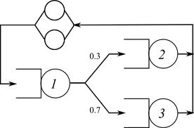
Queueing Network Modeling Terminology
Queueing Network
Performance Metrics
Response Time
Throughput
Utilization
The response time is
the amount of time a
job spends at the service
center including the
queueing delay (the
amount of time a job
waits in the queue)
and the service time
Throughput is defined as the number
of jobs served per unit of time
In multi-core embedded architecture
context, throughput measures the
number of instruction/data bits processed
by the architectural element
(e.g., processor, cache) per second
Utilization measures the
fraction of time a service
center is busy

Slide 12
Multi-core Embedded Architectures Studied
Table: Multi-core embedded architectures with varying processor cores and cache configurations (P denotes a processor core, L1ID denotes L1-I and L1-D caches, M denotes main memory, and the integer constants preceding P, L1ID, L2, and M denote the number of these architectural components in the embedded architecture).
Architecture | Description
2P-2L1ID-2L2-1M | Multi-core embedded architecture with 2 processor cores, private L1 I/D caches, private L2 caches, and a shared MM
2P-2L1ID-1L2-1M | Multi-core embedded architecture with 2 processor cores, private L1 I/D caches, a shared L2 caches, and a shared MM
4P-4L1ID-4L2-1M | Multi-core embedded architecture with 4 processor cores, private L1 I/D caches, private L2 caches, and a shared MM
4P-4L1ID-1L2-1M | Multi-core embedded architecture with 4 processor cores, private L1 I/D caches, a shared L2 cache, and a shared MM
4P-4L1ID-2L2-1M | Multi-core embedded architecture with 4 processor cores, private L1 I/D caches, 2 shared L2 caches, and a shared MM

Slide 13
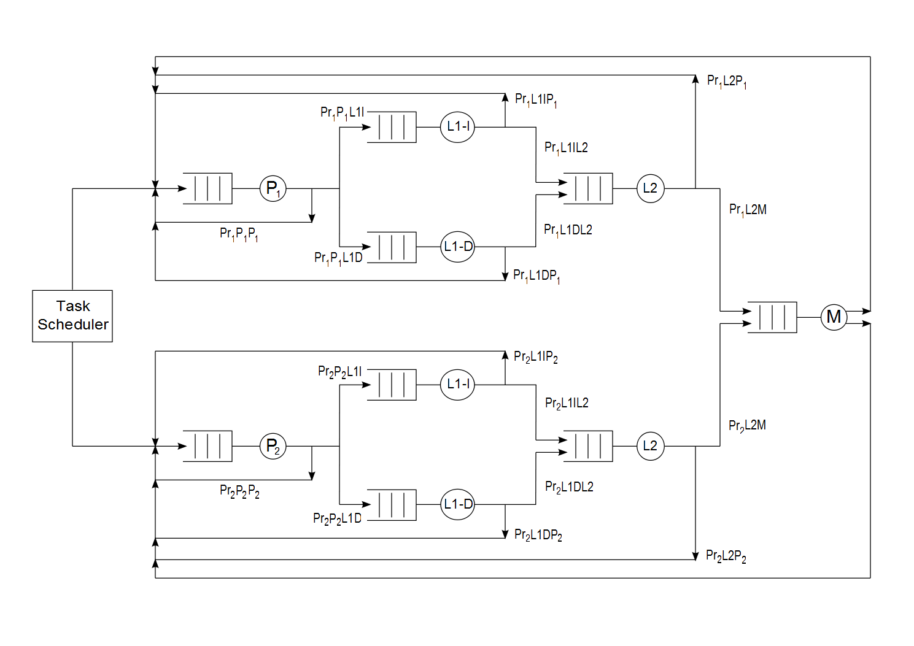
Queueing Network Model for 2P-2L1ID-2L2-1M
Probabilities assigned based on cache miss rates for a workload
Probabilities assigned based on workload characteristics
(i.e., processor-bound, memory-bound, or mixed)
Chain one
Chain two
Closed product-form multi-chain queueing network

Slide 14
Queueing Network Model for 2P-2L1ID-2L2-1M
For a memory-bound workload
Processor-to-processor probability, P_{pp} = 0.1
Processor-to-memory probability, P_{pm} = 0.9
For cache Miss Rates
L1-I = 0.25, L1-D = 0.5, L2 = 0.3
QueueingPr1P1P1 network model probabilities for 2P-2L1ID-2L2-1M
Pr₁P₁P₁ = 0.1
Pr₁P₁L1I = 0.45
Pr₁P₁L1D = 0.45
Pr₁L1IP₁ = 0.75
Pr₁L1DP₁ = 0.5
Pr₁L1IL2 = 0.25
Pr₁L1DL2 = 0.5
Pr₁L2P₁ = 0.7
Pr₁L2M = 0.3
Pr₁MP₁ = 1

Slide 15
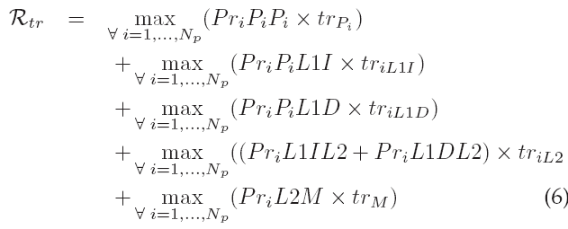
System-wide Performance Metrics
Our queueing theoretic models determine performance metrics at component-level of architectural elements (e.g., processor cores, L1-I, L1-D, etc.)
Our queuing theoretic models enable calculation of system-wide performance metrics
E.g., system-wide response time for a multi-core architecture can be given as:
where
N_{p} = total number of processor cores in the multi-core embedded architecture
tr_{x} = response time for architectural element x : x = {P_{i}, L1-I, L1-D, L2, M}
PriX1X2 = Probability of requests going from architectural element X1 to architectural element X2 for chain i where X1 = {P_{i}, L1-I, L1-D, L2} and X2 = {P_{i}, L1-I, L1-D, L2, M}

Slide 16
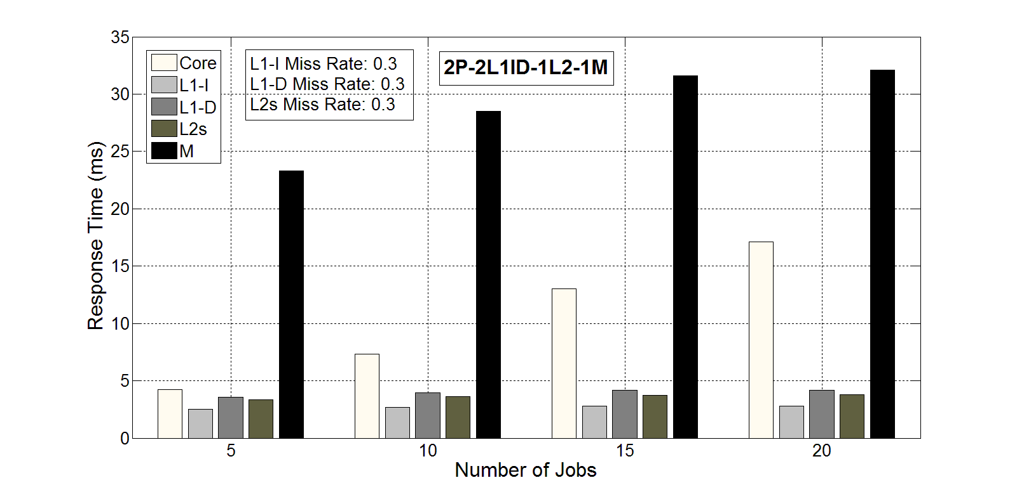
Queueing Network Models Validation
Results conform with expected queueing theoretic results
N has more impact on processor response time for small cache miss rates because most of the time jobs are serviced by the processor core
Response time
increases
as N increases
For large cache miss rates MM response time increases drastically with N
Response time (ms) for mixed workloads for
2P-2L1ID-1L2-1M for a varying number of jobs N

Slide 17
Queueing Network Models Validation
Execution time obtained from SESC and our queueing theoretic models for SPLASH-2 benchmarks for multi-core architectures (QT denotes our queueing theoretic model)
Results from SESC and our queueing theoretic models provide similar insights
The multi-core architectures with shared LLCs provide better performance than the architectures with private and hybrid LLCs for these benchmarks
Architectures with hybrid LLCs exhibit superior performance than the architectures with private LLCs
Our queueing theoretic models provide relative performance measures for different architectures and benchmarks by simulating a minimum number of instructions representative of a benchmark, which explains the difference in execution time obtained from SESC and our queueing theoretic models for these benchmarks

Slide 18
Queueing Network Models Validation
Execution time comparison of SPLASH-2 benchmarks on SESC versus our queueing theoretic models. T_{y}^{x-core} denotes the execution time for simulating an
x-core architecture using Y where Y ={SESC, QT} (QT denotes our queueing theoretic model)
Results verify that our queueing theoretic modeling approach provides a quick architectural evaluation as compared to running benchmarks on a multi-core simulator
Our queueing theoretic modeling approach can provide architectural evaluation results 482,995x faster as compared to executing benchmarks on SESC

Slide 19
Experimental Setup
We implement our queueing network models using SHARPE modeling tool
Architectural Elements
Processor core: ARM7TDMI 32-bit processor core
Main memory (MM): 32 MB
Cache parameters:
To provide a fair comparison between architectures, we ensure that the total L2 cache size for shared L2 cache architectures and private L2 cache architectures remain the same
Cache Parameter | L1-I | L1-D | L2
Cache size | 8 KB | 8 KB | 64 KB
Associativity | Direct-mapped | 2-way | 2-way
Block/line size | 64 B | 16 B | 64 B

Slide 20
Experimental Setup
Service rates for architectural elements
Processor core
15 MIPS @ 16.8 MHz
Cycle time = 59.524 ns
Service rate = 480 Mbps (for 32-bit instructions)
L1-I
Access latency = 2 cycles
Line size = 64 B
Transfer time for 64 B = 64/4 = 16 cycles (for 32-bit/4 B bus)
Total L1-I time = access time + transfer time = 2 + 16 = 18 cycles
Service rate = (64 x 8) / (18 x 59.524 ns) = 477.86 Mbps
L1-D
Service rate = 358.4 Mbps
L2
Service rate = 330.83 Mbps
MM
Service rate = 74.15 Mbps

Slide 21
Insights obtained from Queueing Theoretic Models ‒ Effects of Workload on Performance
Our queueing theoretic models provide insights into the effects of varying computing requirements of workloads
Computing requirements signify a workload’s demand for processor resources
Depends on the percentage of arithmetic, logic, and control instructions in the workload relative to load and store instructions
Computing requirements of workloads are captured by P_{pp} (processor-to-processor probability) and P_{pm} (processor-to-memory probability) in our model
As N increases, the response time for the processor core, L1-I, L1-D, L2, and MM increases for all value of P_{pp} and P_{pm}

Slide 22
Insights obtained from Queueing Theoretic Models ‒ Effects of Workload on Performance
As P_{pp} increases, the response time of the processor core increases whereas the response time of L1-I, L1-D, L2, and MM decreases slightly because of the processor-bound nature of the workload
E.g., processor response time increases by 19.8% as P_{pp} increases from 0.7 to 0.95
when N = 5
The response time of L1-I, L1-D, L2, and MM decreases by 10.8%, 14.2%, 2.2%, and 15.2%, respectively, as P_{pp} increases from 0.7 to 0.95 when N = 5
2P-2L1ID-1L2-1M provides a 25% improvement in L2 response time and 12.3% improvement in MM response time over 2P-2L1ID-2L2-1M when P_{pp} = 0.7 and N = 5
4P-4L1ID-2L2-1M provides 22% improvement in L2 response time and 13% improvement in MM response time over 4P-4L1ID-4L2-1M when P_{pp} = 0.7 and N = 5
4P-4L1ID-1L2-1M provides 7.4% improvement in L2 response time with 5.2% degradation in MM response time over 4P-4L1ID-2L2-1M when P_{pp} = 0.7 and N = 5
Results reveal that shared LLCs provide more improvement in L2 response time as compared to hybrid and private LLCs
Hybrid LLCs can provide better MM response time than shared LLCs and are more scalable than shared LLCs

Slide 23
Insights Obtained from Queueing Theoretic Models ‒ Performance per Watt
Our queueing theoretic models enables performance per watt calculations for different multi-core embedded architectures
The peak performance per watt for LLCs for two core architectures is attained when L1-1, L1-D, and L2 cache miss rates are equal to 0.3, P_{pm} = 0.9, and N = 20
LLC’s peak performance per watt for 2P-2L1ID-2L2-1M = 11.8 MFLOPS/W
LLC’s peak performance per watt for 2P-2L1ID-1L2-1M = 14.3 MFLOPS/W
The peak performance per watt for LLCs for four core architectures is attained when L1-1, L1-D, and L2 cache miss rates are equal to 0.2, P_{pm} = 0.9, and N = 20
LLC’s peak performance per watt for 4P-4L1ID-4L2-1M = 7.6 MFLOPS/W
LLC’s peak performance per watt for 4P-4L1ID-2L2-1M = 9.2 MFLOPS/W
LLC’s peak performance per watt for 4P-4L1ID-1L2-1M = 13.8 MFLOPS/W
The comparison of peak performance per watt results for LLCs for two core and four core architectures indicate that architectures with different number of cores and private or shared caches deliver peak performance per watt for different types of workloads with different cache miss rate characteristics

Slide 24
Insights Obtained from Queueing Theoretic Models ‒ Performance per Unit Area
Our queueing theoretic models enables performance per unit area calculations for different multi-core embedded architectures
The peak performance per unit area for LLCs for two core architectures is attained when L1-1, L1-D, and L2 cache miss rates are equal to 0.3, P_{pm} = 0.9, and N = 20
LLC’s peak performance per unit area for 2P-2L1ID-2L2-1M = 6.27 MFLOPS/mm²
LLC’s peak performance per unit area for 2P-2L1ID-1L2-1M = 7.14 MFLOPS/mm²
The peak performance per unit area for LLCs for four core architectures is attained when L1-1, L1-D, and L2 cache miss rates are equal to 0.2, P_{pm} = 0.9, and N = 20
LLC’s peak performance per watt for 4P-4L1ID-4L2-1M = 4.04 MFLOPS/mm²
LLC’s peak performance per watt for 4P-4L1ID-2L2-1M = 4.6 MFLOPS/mm²
LLC’s peak performance per watt for 4P-4L1ID-1L2-1M = 5.2 MFLOPS/mm²
The comparison of peak performance per unit area results reveal that architectures with shared LLCs provide the highest LLC performance per unit area followed by architectures with hybrid LLCs and private LLCs

Slide 25
Conclusions
We developed closed product-form queueing network models for performance evaluation of multi-core embedded architectures
The performance evaluation results indicate that the architectures with shared LLCs provide better LLCs performance and performance per watt than the architectures with private LLCs
Results revealed that architectures with shared LLCs are more likely to cause main memory response time bottleneck for large cache miss rates as compared to private LLCs
Main memory response time bottleneck created by shared LLCs can be mitigated by using hybrid LLCs (i.e., sharing LLCs by a fewer number of cores) though hybrid LLCs consume more power than shared LLCs and deliver comparatively less MFLOPS/W
The performance per watt and performance per unit area results revealed that the multi-core embedded architectures with shared LLCs become more area and power efficient as the number of processor cores in the architecture increases
The simulation results for the SPLASH-2 benchmarks executing on the SESC simulator verified the architectural evaluation insights obtained from our queueing theoretic models

